Slide 1
Core Modality 2: Peripheral Arterial Duplex
Louis Alexander BSc (Hons)., MSc

Slide 2
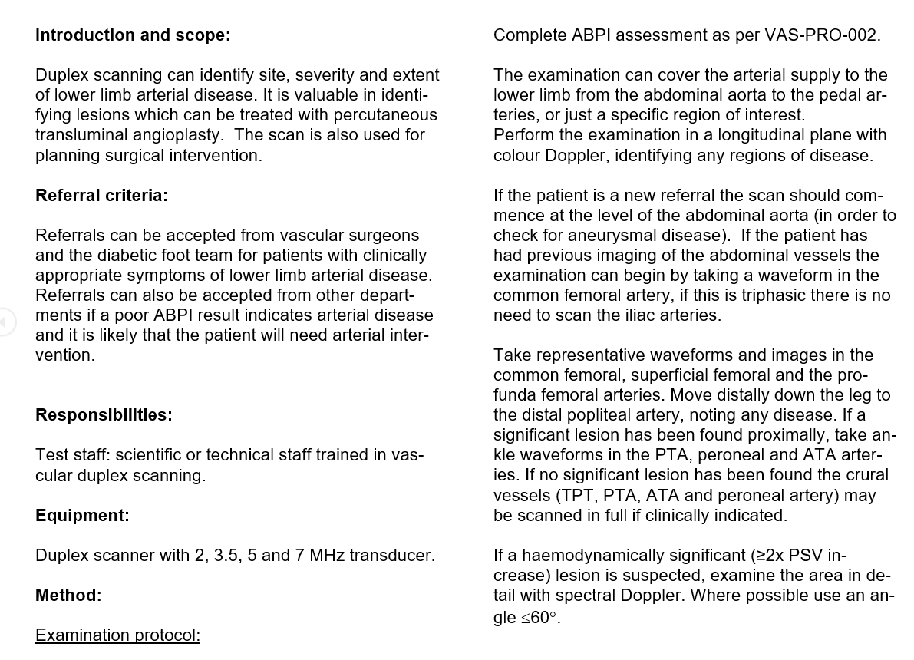
Protocol Document

Slide 3
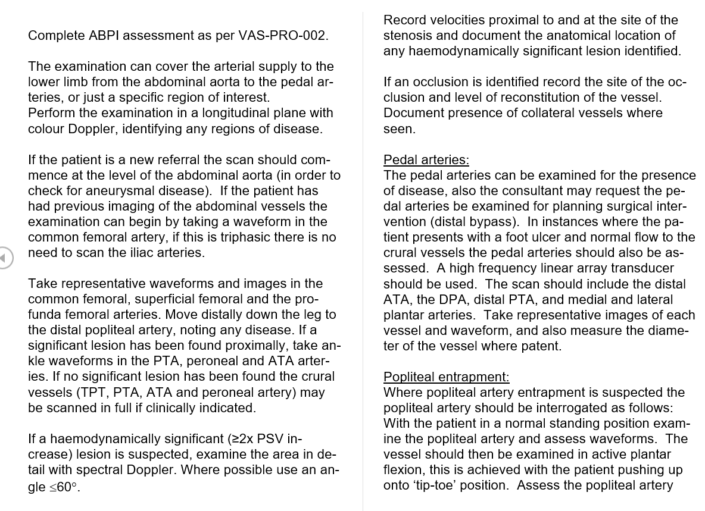

Slide 4
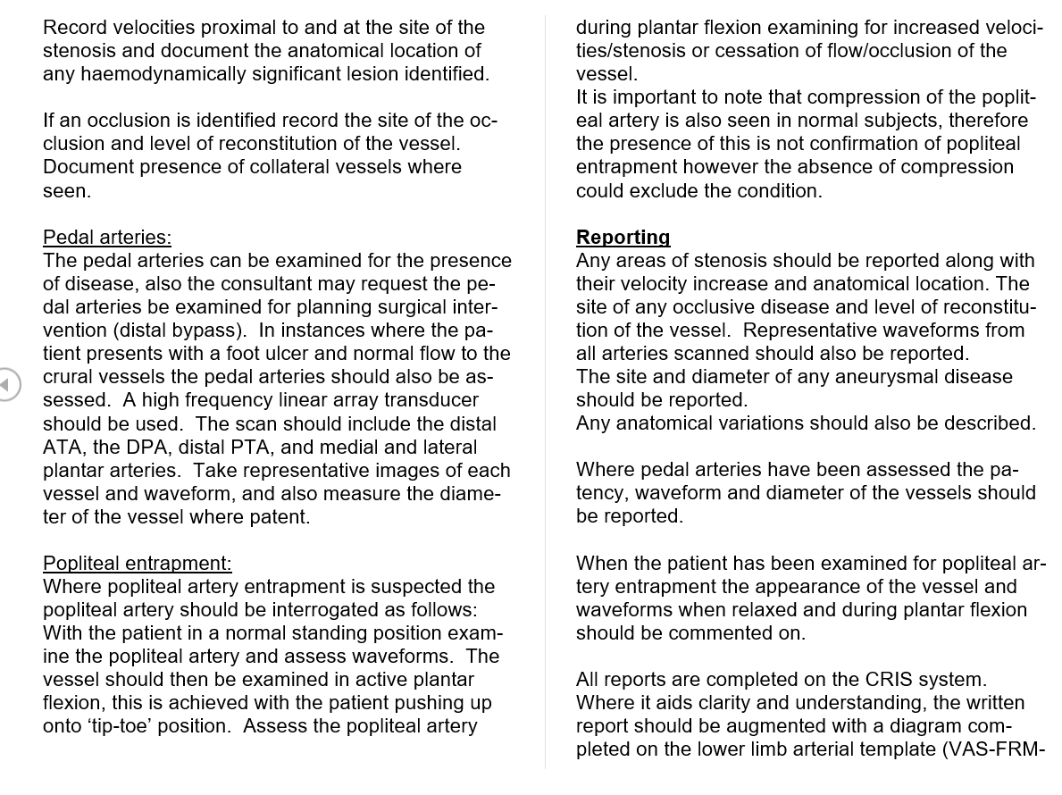

Slide 5
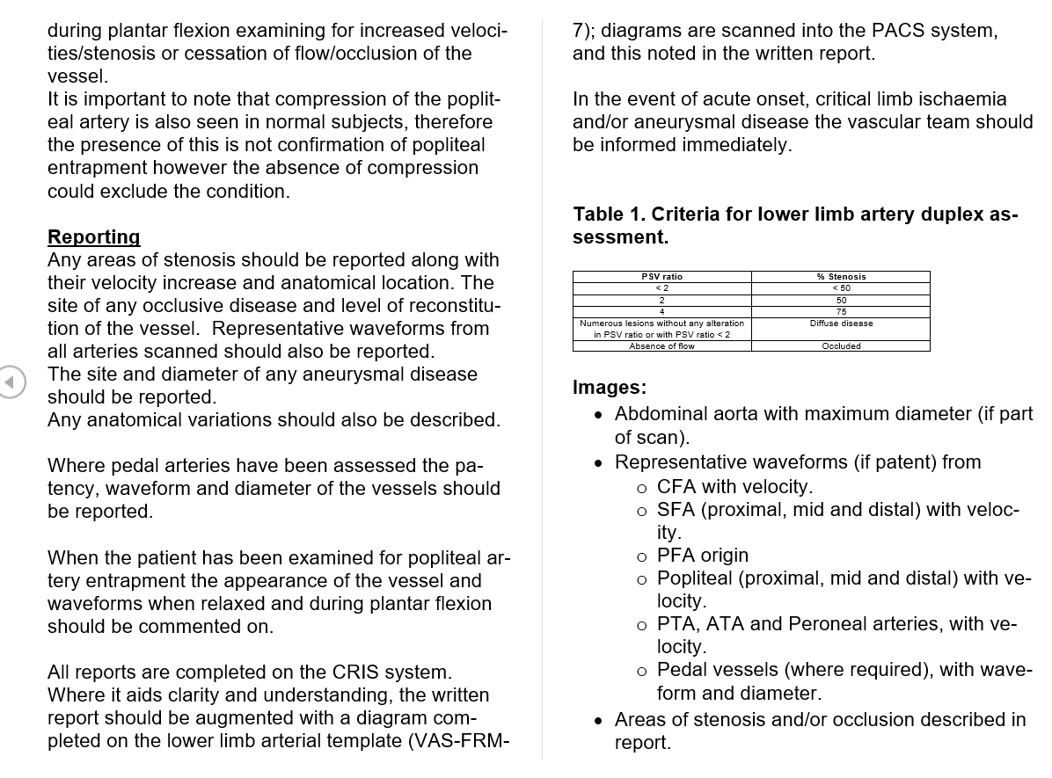

Slide 6
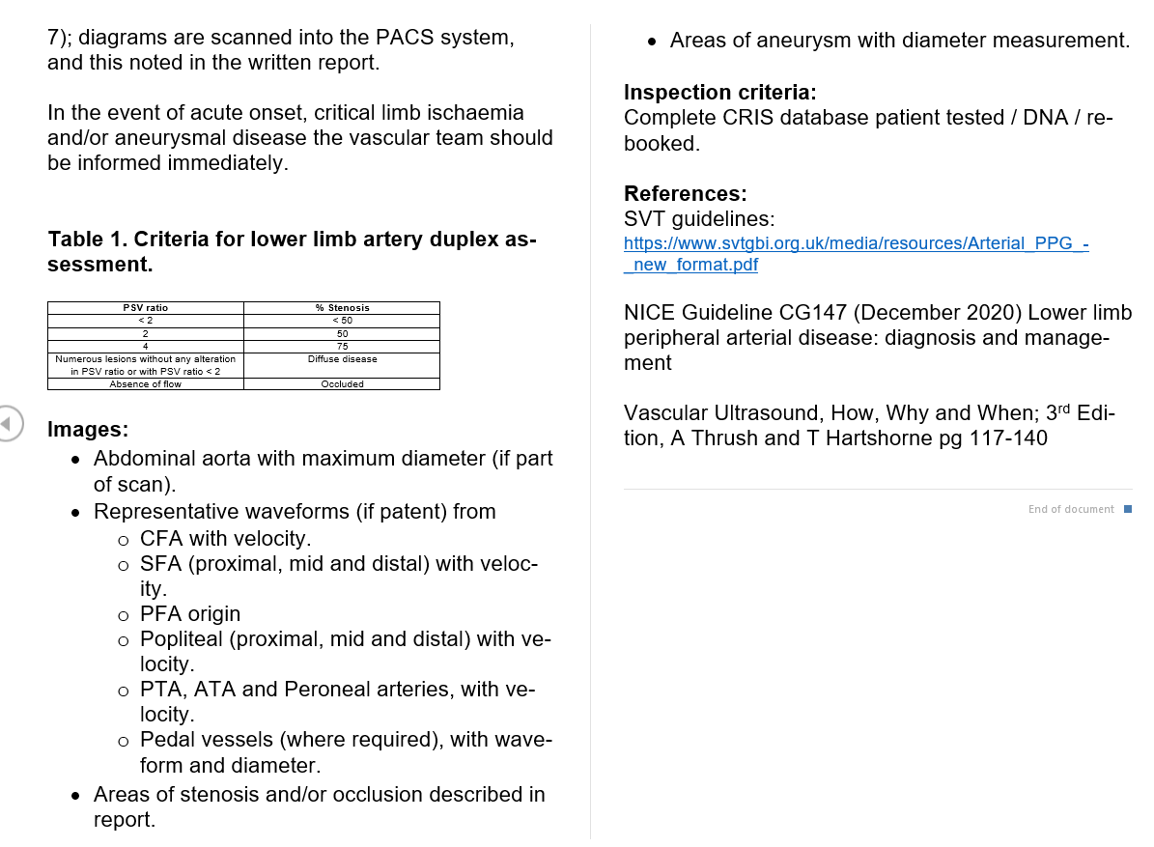

Slide 7
Evidence: 25x Peripheral arterial duplex reports

Slide 8

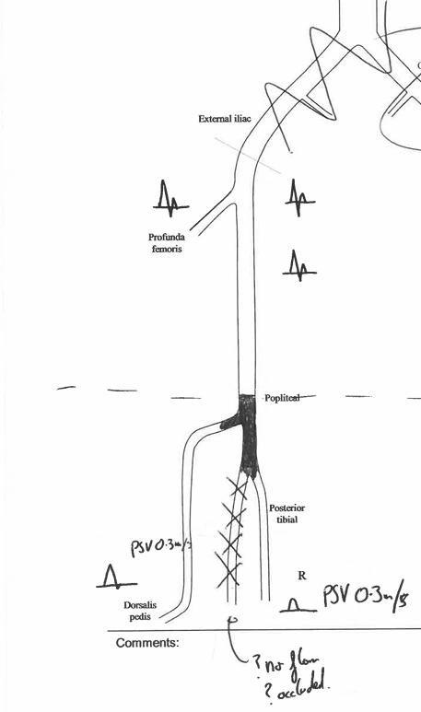

Slide 9


Slide 10


Slide 11
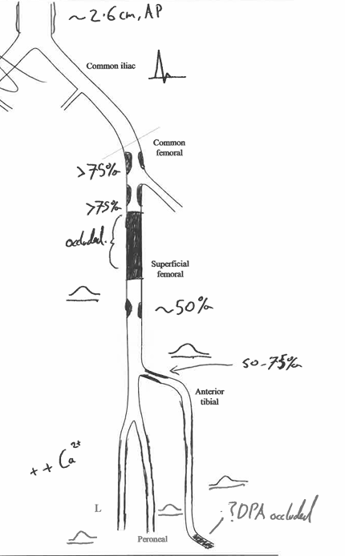
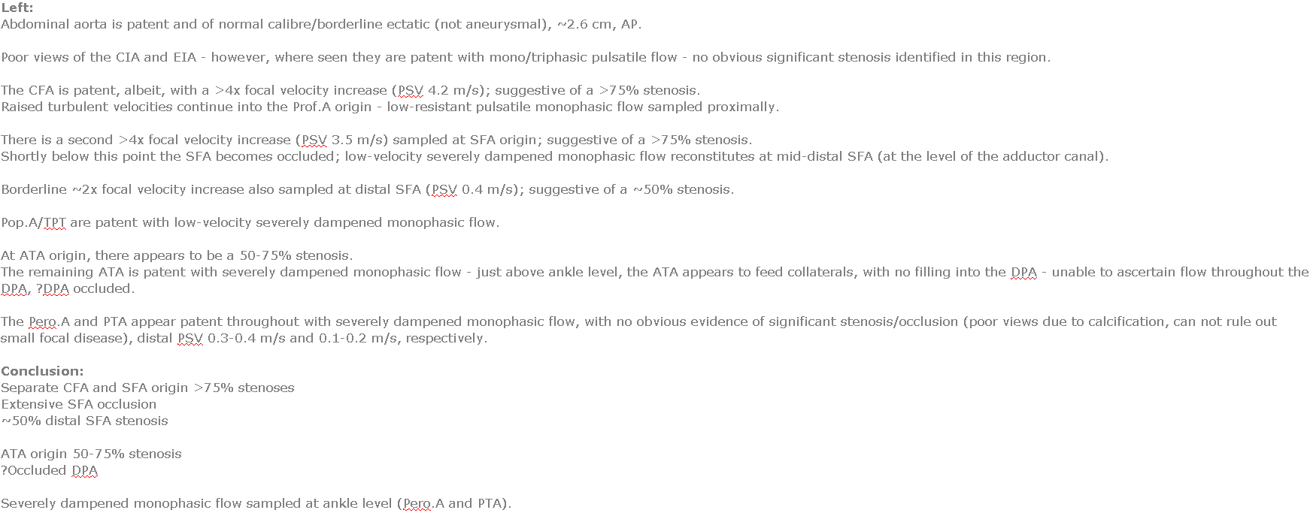

Slide 12
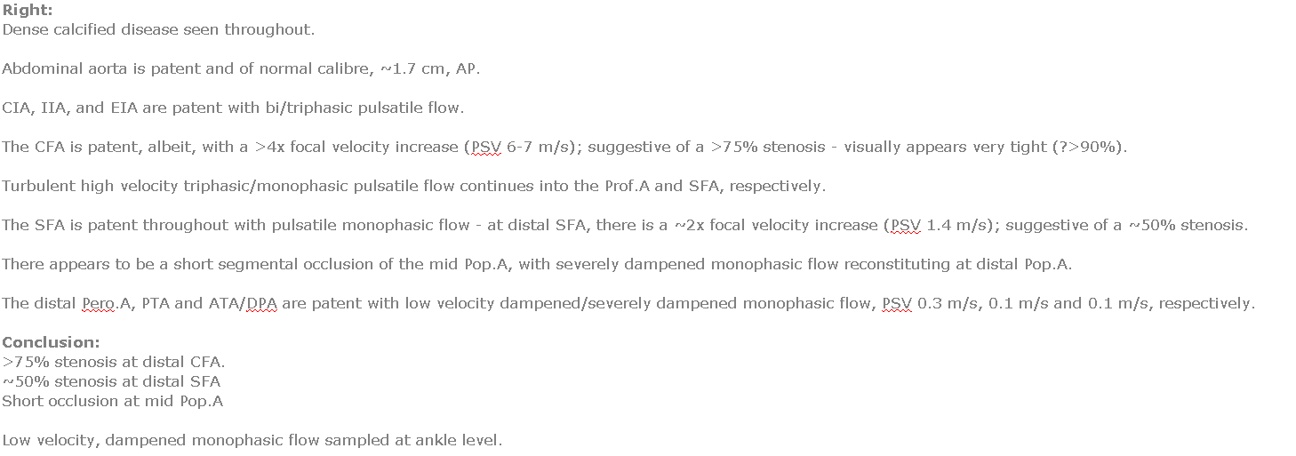

Slide 13
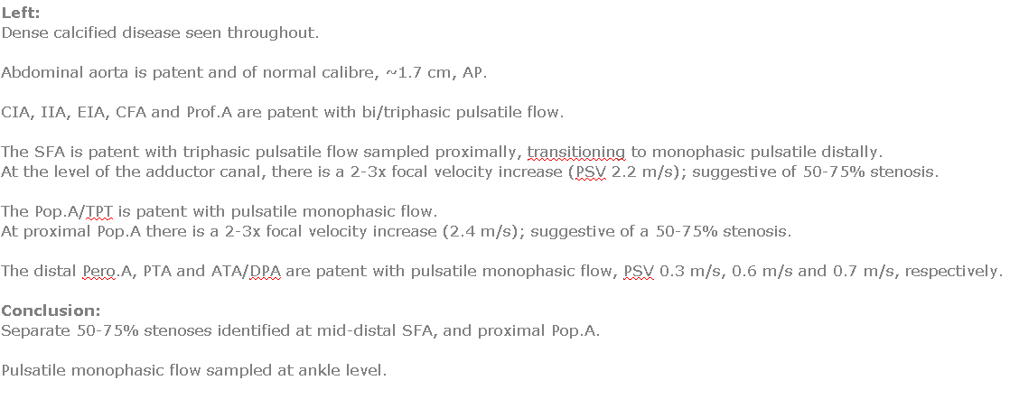

Slide 14


Slide 15


Slide 16


Slide 17


Slide 18


Slide 19


Slide 20
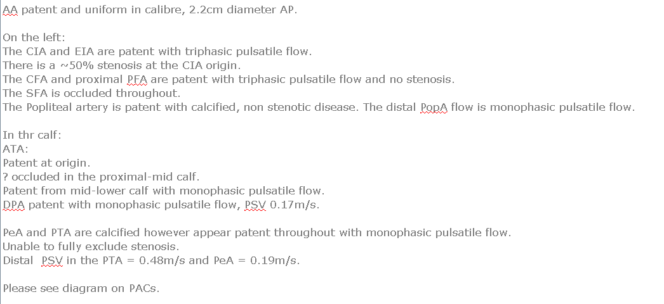

Slide 21


Slide 22


Slide 23
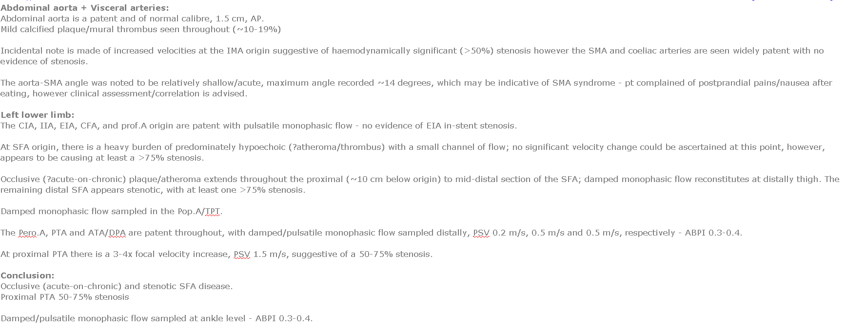

Slide 24


Slide 25


Slide 26
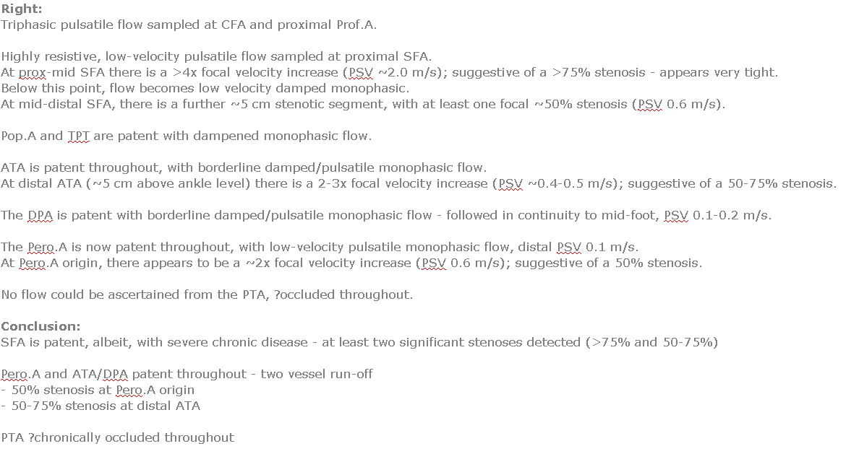

Slide 27
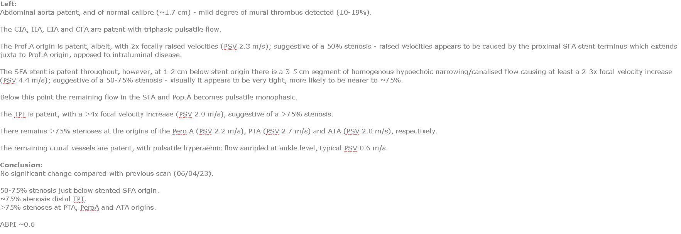

Slide 28
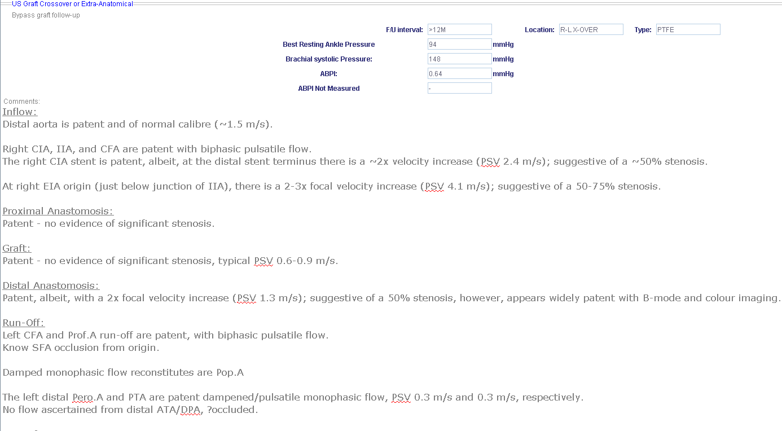


Slide 29
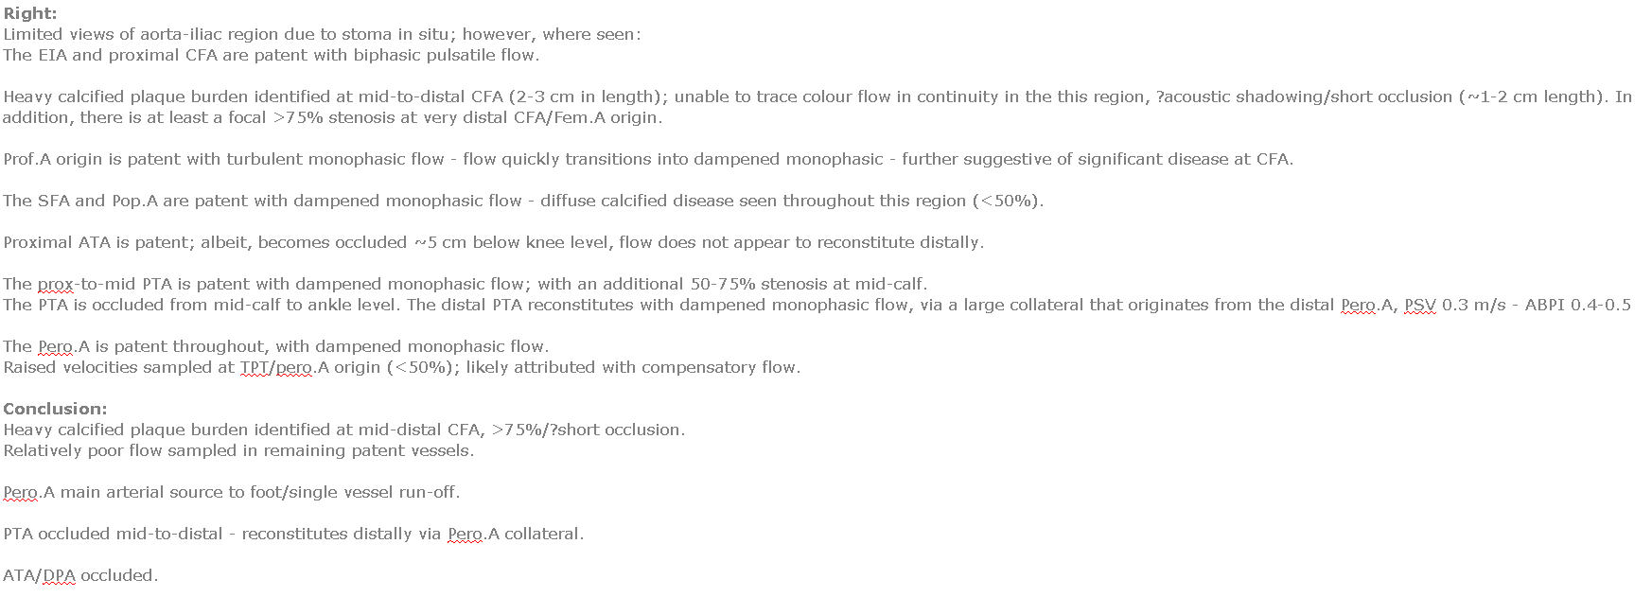

Slide 30


Slide 31


Slide 32
