Slide 1
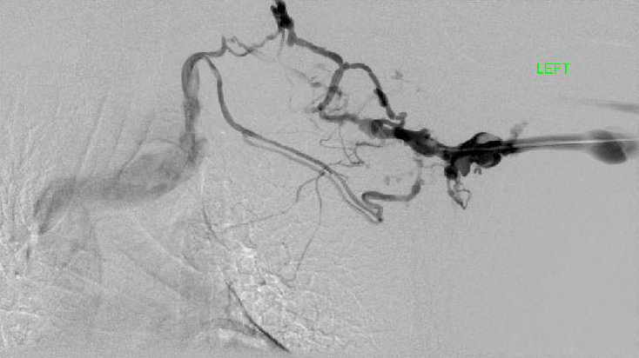
Venogram – Paget Schroetter Syndrome

