Slide 1
Sterile Technique and
Medication Management
In the Vein Center
The presentation will begin in a
few moments….
For technical support, call
877-796-1325
Notes:
{ On hold slide – shows 15 minutes prior to the start of the webinar, accompanied by music }

Slide 2

Sterile Technique and Medication Management
in the Vein Center
Presented by
Katherine Hays, DNP, ACNP-BC, FSV
Jessy Farris, MHS, RVT, RPhS
Laura Humphries, BS, RVT, RPhS

Slide 3

Housekeeping
  Audio streams to your computer or device.
  Be sure volume is turned on/up.
  Submit a question for Q&A – click Questions tab (left panel)
  Download handout(s) – click Resources tab (left panel)
  Technical support – Request Support button (lower left) or call 877-796-1325
  This webinar is being recorded
  To receive 1 SVU CME credit:
    Must be individually registered
    Must be logged in as yourself
    Must complete the survey (within 3 business days)
Notes:
{ Kellie – introduction / instructions }

Slide 4
Part I –
Sterile Technique and Medication Management
Presented by
Katherine Hays, DNP, ACNP-BC, FSV
Notes:
{ Presentation Slides }

Slide 5
Notes:
{ Presentation Slides – KATHERINE - Screenshare }

Slide 6
Part II –
Patient Prep, Dos and Don’ts
Presented by
Jessy Farris, MHS, RVT, RPhS
Notes:
{ Presentation Slides }

Slide 7

Jessy Farris MHS RVT RPhS
12 years phlebology
Education, training, and accreditation
Forth Worth TX
Notes:
{ Presentation Slides – JESSY - Screenshare }

Slide 8
Part III –
Safety Issues Identified During
IAC Vein Center Site Visits
Presented by
Laura Humphries, BS, RVT, RPhS
Notes:
{ Presentation Slides - LAURA }

Slide 9
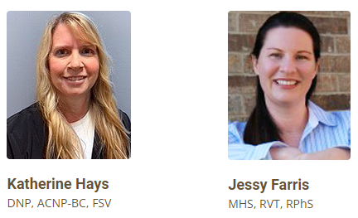
Thank you

Slide 10

Why?

Slide 11
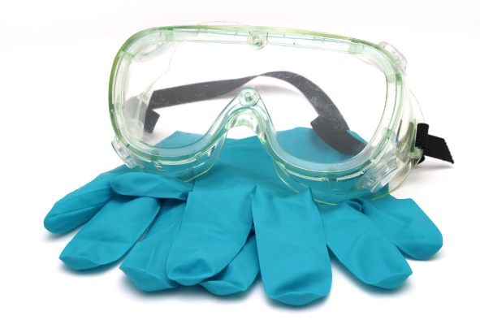

Safety Issues Identified During IAC Vein Center Site Visits
Aim: To report common safety issues observed during site visits.

Slide 12
Methods
Retrospective review of the IAC Database
All site visits occurring since 2014
The overall site visit results and safety issues are reported.

Slide 13
Methods
Safety issues were categorized into 9 groups.
Autoclave
Emergency Equipment/Drugs
Eyewear
Autoclave
Emergency Equipment/Drugs
Sterilization
Laser Safety
Sterilization
Medications
Laser Safety
Medications
Infection Control
Complication Tracking
Time Out
Infection Control
Time Out

Slide 14

Results
Total site visits: 284
Initial applicants (first cycle): 194
Reaccredit applicants (cycle >2): 90
Total safety deficiencies identified:
54.9% (n=156)

Slide 15
Results: Safety Deficiencies Identified
1
Emergency Equipment/Drugs
(n=89, 31.3%)
Emergency medications are not secured with a disposable or plastic lock.
Emergency medication inspection log is incomplete or missing.
Incomplete documentation of routine inspection of emergency supplies (AED, O2).
Expired medications (Dextrose, ASA, epinephrine, benedryl, EpiPen)
Missing required medications (methylprednisolone, epinephrine, ASA, diphenhydramine, solumedrol, EpiPen, all).
Missing emergency equipment (defibrillator/AED, oxygen).

Slide 16
Results: Safety Deficiencies Identified
2
Sterilization and Autoclave Procedures
(n=70, 25%)
Sterilization
Insufficient identification of sterilized medical instruments
Multi-use fibers (unclear usage and sterilization; failure to document number of times used, dates and sterilization date; reuse of single use fibers)
Heat indicators
Autoclave:
Missing autoclave log documenting maintenance, biological monitoring, and sterilization.
Failure to perform weekly biologic monitoring.

Slide 17
Results: Safety Deficiencies Identified
1
Emergency Equipment/Drugs
(n=89, 31.3%)

Slide 18
Results: Safety Deficiencies Identified
2
Sterilization and Autoclave Procedures
(n=70, 25%)

Slide 19
Results: Safety Deficiencies Identified
3
Infection Control Issues
(n=42, 14.8%)
Improper sterile technique/patient preparation was witnessed
Contamination of the sterile field
Sterile draping contaminated
Sterile gloves contaminated and not changed
Sterile table was contaminated
Hand hygiene
Staff members did not wash hands prior to procedure

Slide 20
Results: Safety Deficiencies Identified
3
Infection Control Issues
(n=42, 14.8%)

Slide 21
Results: Safety Deficiencies Identified
4
Medication Issues
(n=40, 14.1%)
Consistent use of compounded sclerosants
Expired medications
Multi-dose vials not properly identified
Non-FDA approved sclerosant
Pre-drawn syringes missing proper identification
Pre-mixed tumescent not identified or improperly stored

Slide 22
Results: Safety Deficiencies Identified
4
Medication Issues
(n=40, 14.1%)

Slide 23
Results: Safety Deficiencies Identified
(Other)
Complication tracking
Performance of time out (procedure, patient, site)
Protective eyewear (EVLA procedures)
Other laser issues
  Missing laser safety signage
  Laser activated for an extended period of time post procedure
  Energy exceeded amount of time dictated by physician

Slide 24
Results: Safety Deficiencies Identified
(Other)

Slide 25

Conclusion
IAC accreditation aids in the identification and correction of patient safety issues.
There is always room for improvement.

Slide 26
Thank you

Slide 27

Question & Answer Session
Notes:
Q&A slide

Slide 28

Thank you for
joining us today!
Questions?
Contact webinars@ intersocietal.org
NOTE:
To receive SVU CME credit for this
webinar, you must complete the survey.

