Slide 1
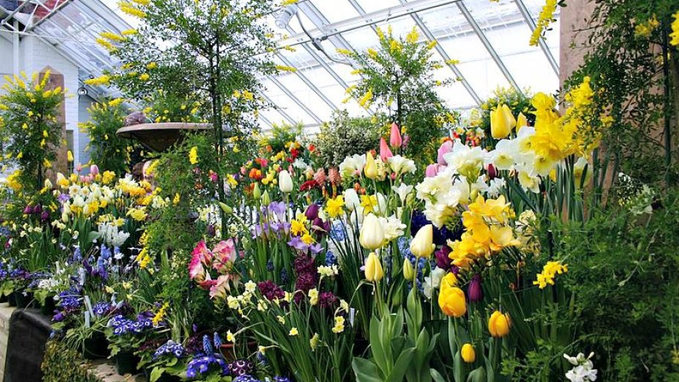

Creative Thinking ……… letting your ideas grow

Slide 2

Creative World vs Operational World
And many more such activities / behaviours / stuff that you may recognise…
And many more such activities / behaviours / stuff that you will recognise…
Creative World
of Work
Operational
World of Work
A lot of listening
Meetings
Follow
process
Prototyping
Workshops
Planning
High
energy
Expanding / exploring
others ideas
Can be
low energy
Deliver
outcomes
Reports
Take
risks
Audits
IT &
Tools
Don’t worry
about rules
Reviews
Problem solving
options
Roles &
Responsibilities
Documentation
capture
Foresighting
Visualisation
Facilitation
Customer & supplier
relationships
Low
risk
No right or
wrong answer
Organisation

Slide 3
Changing Rivers Of Thinking – Fresh Stimulus
Related Worlds
Looking at other areas where a
similar issue or benefit can be
seen
Revolution
Identifying and then deliberately
challenging the rules and
assumptions we are using
Random Links
Making connections and links
between the issue and random
items found in the world
Re-expression
Finding an alternative way of
describing or experiencing an
issue or problem
© ?WhatIf! Ltd, 2002 – Sticky Wisdom

Slide 4

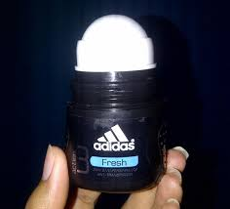
Related Worlds
Looking at areas where a similar issue or benefit can be seen
Learn from someone else

Slide 5
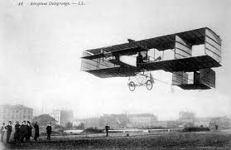
Revolution
Identify and then deliberately challenging the rules and assumptions we are using
"Heavier-than-air flying machines are impossible." - Lord Kelvin,
president, Royal Society, 1895.

Slide 6


Random Links
Making connections and links between the issue and random items found in the world

Slide 7
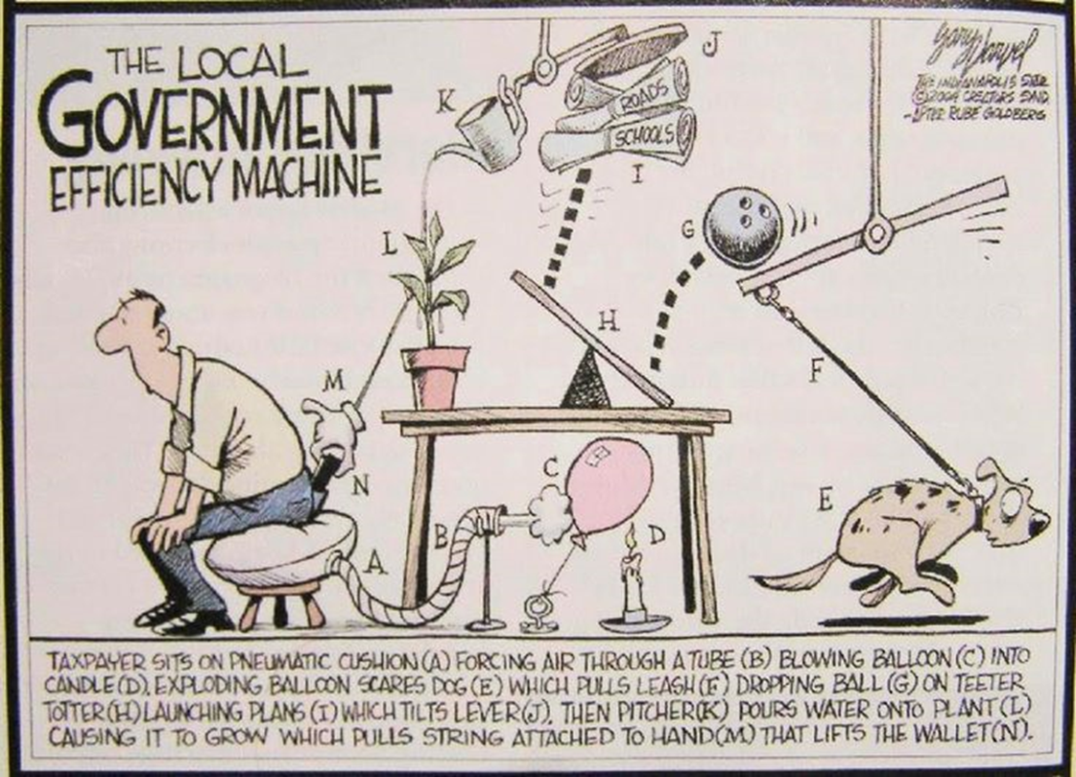
Re-Expression
Finding an alternative way of describing or experiencing an issue or problem
Approach a problem from a different viewpoint
“If at first an idea is not absurd then there is no hope” Albert Einstein

Slide 8




How you need to be when thinking creatively
You can’t “get it wrong!”
  With innovation & creativity there are no right or wrong answers, so jump in, be free in your thinking and willing to explore
You have permission to have fun!
  An open minded, “playful” approach is where creativity comes from
Great creative
Behaviour
Non-creative
Behaviour
SUN Behaviour
SUSPEND your judgement
UNDERSTAND peoples ideas
NURTURE the ideas
RAIN Behaviour
REACT to what is being said
ASSUME what more is going to be said
INSIST that you are right, they are wrong
© ?WhatIf! Ltd, 2002 – Sticky Wisdom

Slide 9

From Stimulus to Visual Idea Capture
Develop a mind-map to capture anything and everything the group knows about a chosen stimulus (10 minutes)
  Do not judge anyone’s input → capture all inputs legibly → fill the sheet!
Structure for your visual idea capture activity (20 minutes)
  Initial group discussion → make new connections between the information captured in the mind-map and the group’s identified challenge → start developing novel idea/solution elements → DON’T START DRAWING YET – HOLD YOUR NERVE (~7 mins)
  Keep the group discussion going, using & combining these connections, to focus in on one novel idea/solution → STILL DON’T START DRAWING YET – HOLD YOUR NERVE (~5 mins)
  When a single novel idea/solution is becoming clear → OK, START DRAWING NOW → keep the group discussion going to add as much detail as possible in the final multi-colour visual idea capture (~7 mins)
  Decide on and write a sexy/playful title in the captured visual (~1 min)

Slide 10
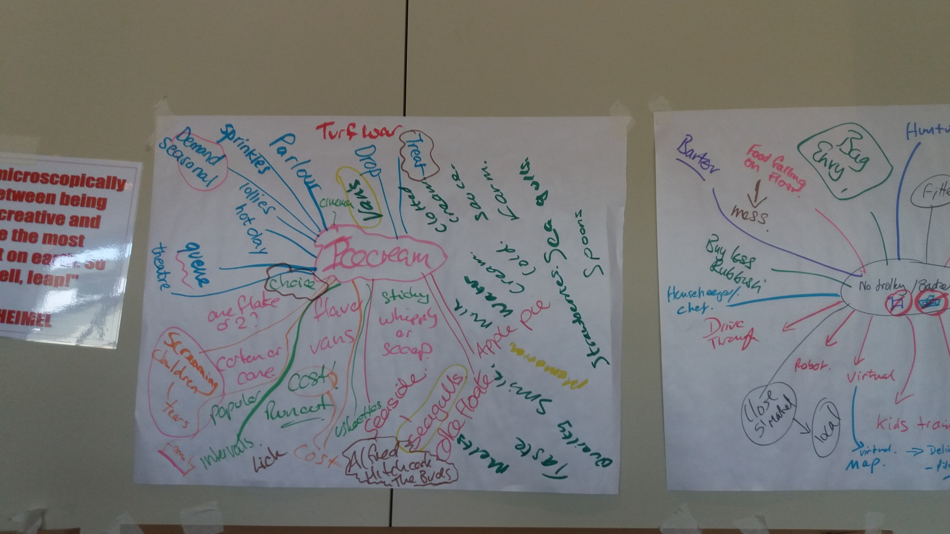

Slide 11
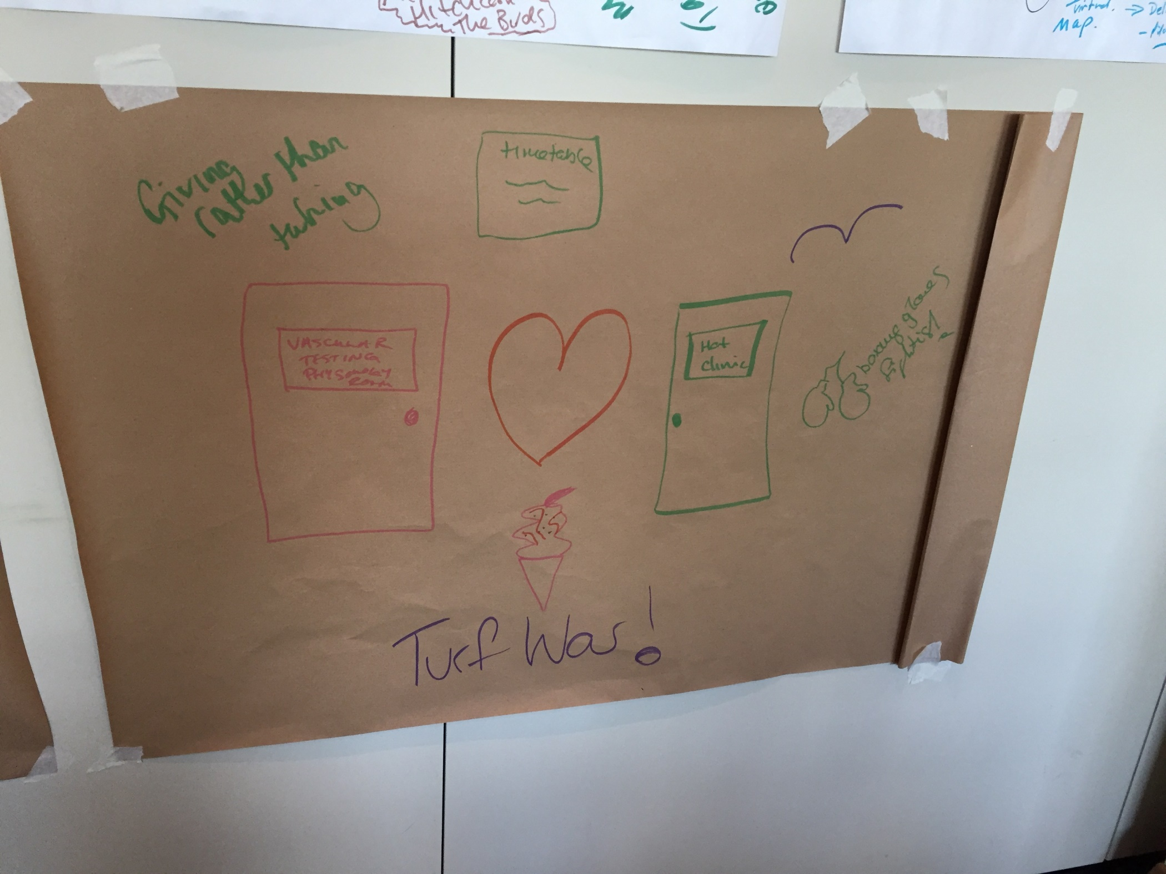

Slide 12
