Slide 1
Carotid Doppler ULTRASOUND
Janine Fletcher, Vascular scientist

Slide 2
Who do we scan?
Pre-cardiac surgery
Pulsatile tinnitus
Postural symptoms, vertigo
Stroke/TIA

Slide 3
What is a stroke/TIA?
A stroke or TIA occurs as a result of infarction in the brain. This can be caused by 2 types of situation:
Thrombo-embolic; clots or debris travel within arterial system and lodge in cerebral hemisphere. Can arise from disease in the carotid arteries. Often leads to transient weakness or sensory dysfunction
Haemodynamic; very narrow stenosis or an occlusion causes fall in perfusion pressure and ischaemia results. Symptoms produced tend to be progressive

Slide 4
Signs and symptoms
Bruit
Unilateral weakness
Loss of sensation
Aphasia
Amaurosis fugax

Slide 5
When is carotid imaging required?
NICE guidelines
“All people with suspected TIA who after specialist assessment are considered as candidates for carotid endarterectomy should have carotid imaging within 1 week of onset of symptoms.”

Slide 6
Carotid duplex ultrasound
Duplex = imaging plus Doppler (flow) studies
B mode imaging
Colour Doppler
Spectral Doppler

Slide 7
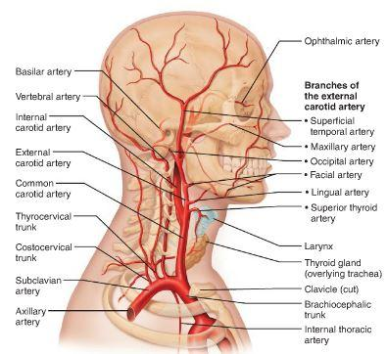
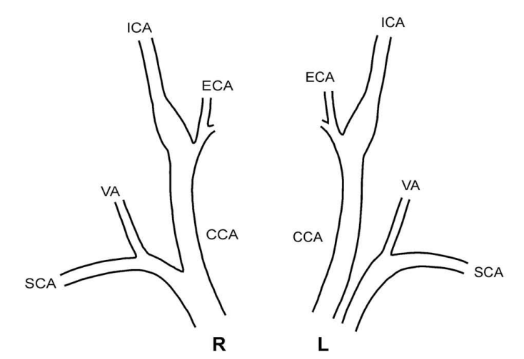
What do we scan?
Extracranial anatomy

Slide 8
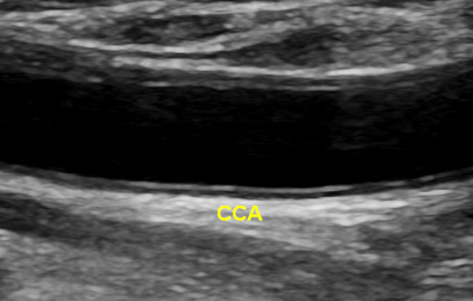
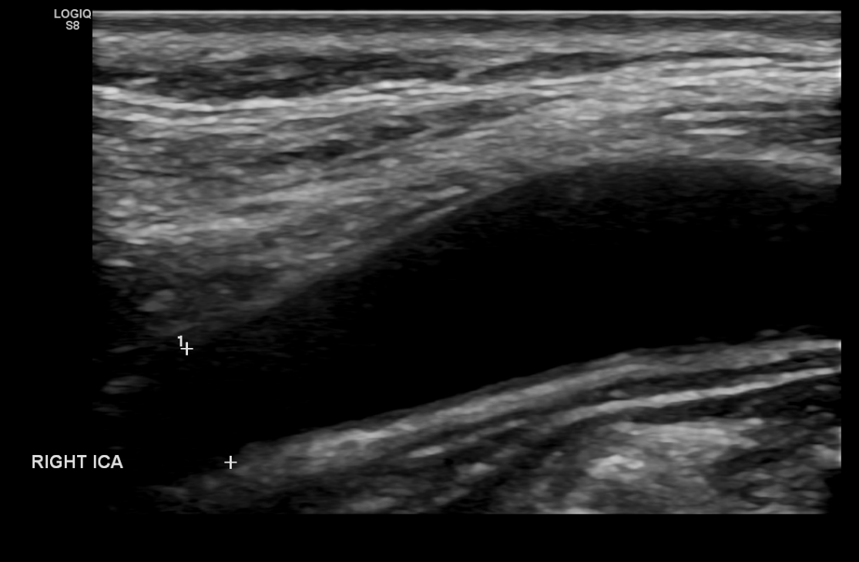
B mode imaging
Normal

Slide 9
B mode imaging
Plaque classification
Echogenic/echolucent
Heterogeneous/homogeneous
Irregular/smooth
Isolated/extensive
Ulcerated?

Slide 10
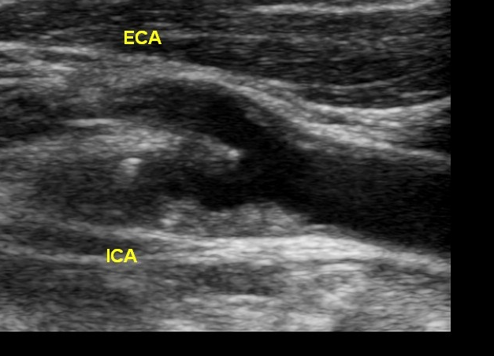
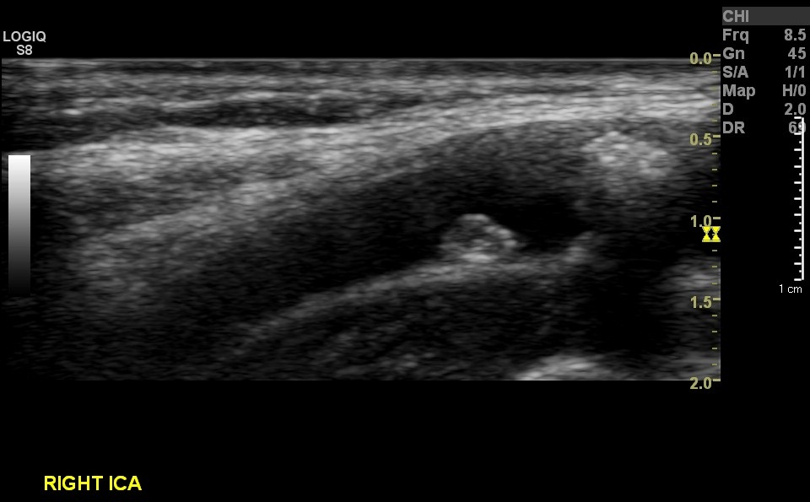
B mode imaging
Disease

Slide 11
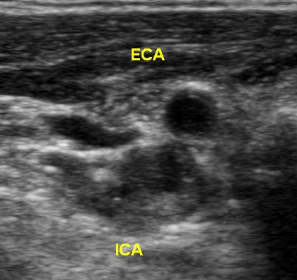
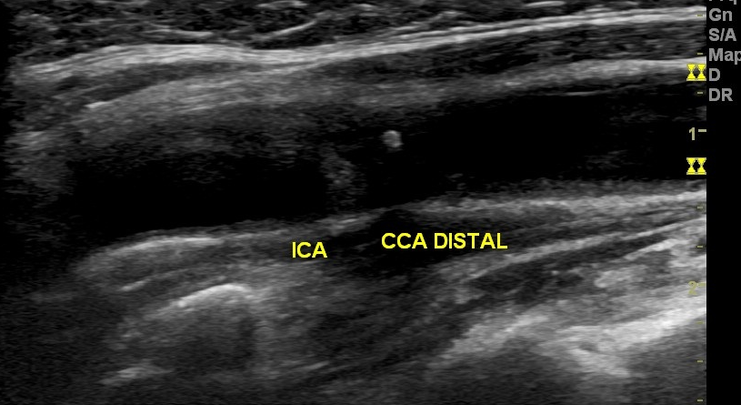
B mode imaging
Disease

Slide 12
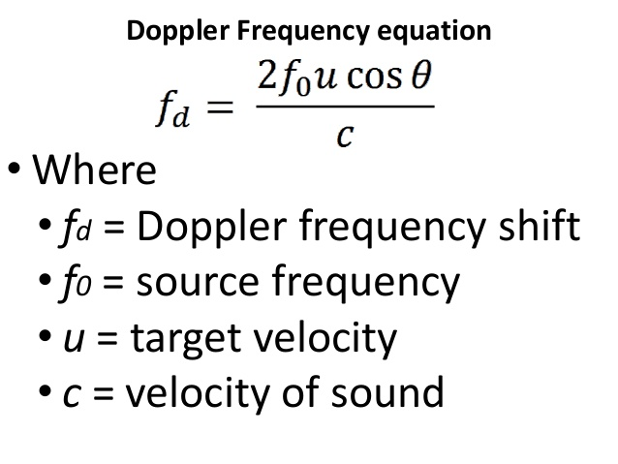
How does Doppler work?

Slide 13
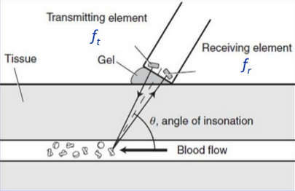
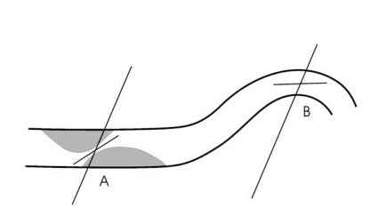
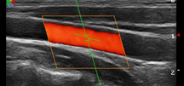
Importance of Doppler angle

Slide 14
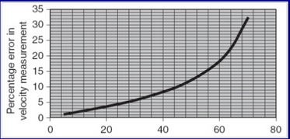
Importance of Doppler angle
Angle of insonation should NOT be more than 60° as % error is too great

Slide 15
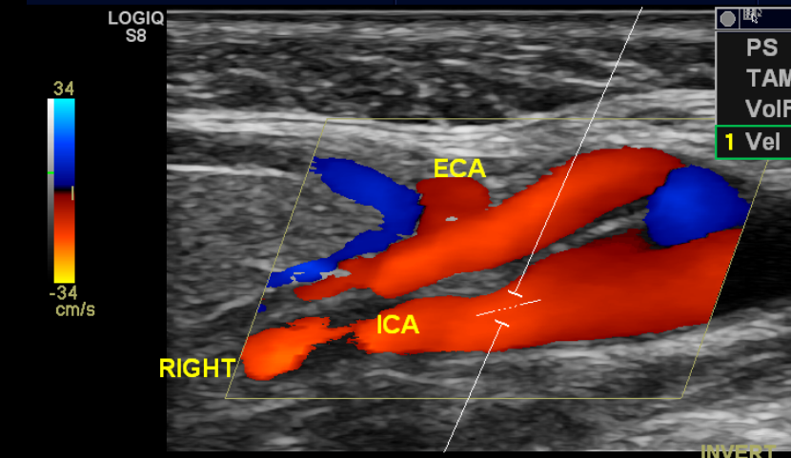
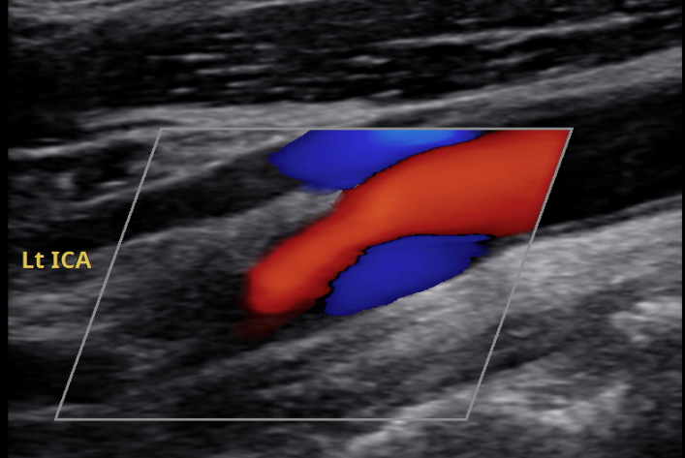
Colour Doppler
Normal

Slide 16
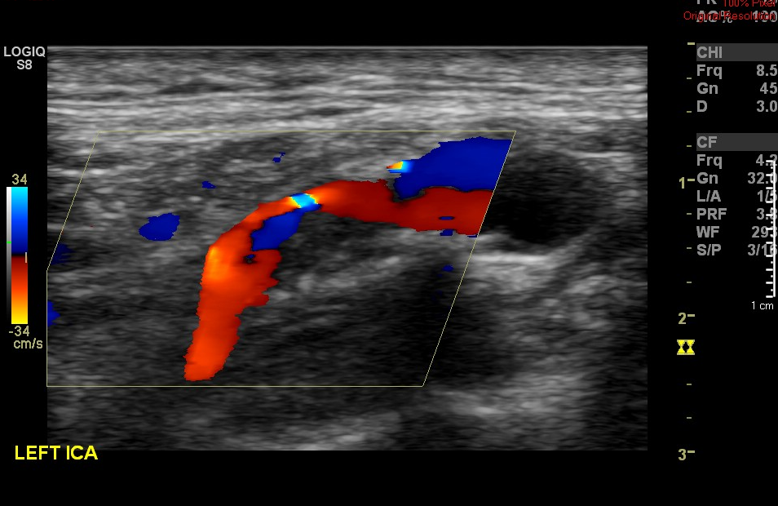
Colour Doppler
Stenosis

Slide 17
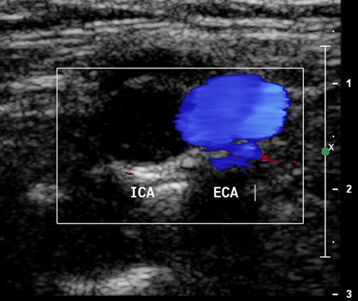
Colour Doppler
Occlusion

Slide 18
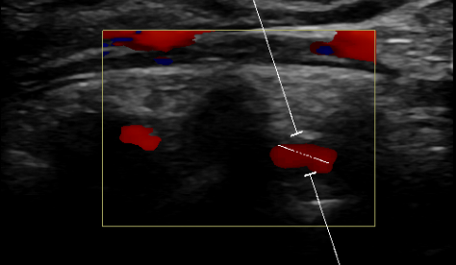
Colour Doppler
Vertebral artery assessment

Slide 19
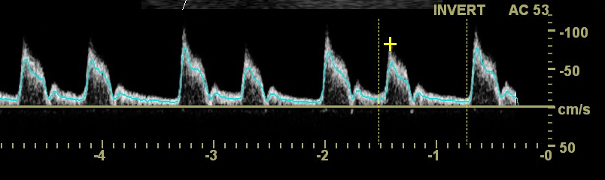
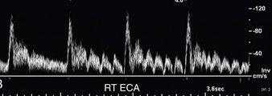
Spectral Doppler
Normal ECA

Slide 20
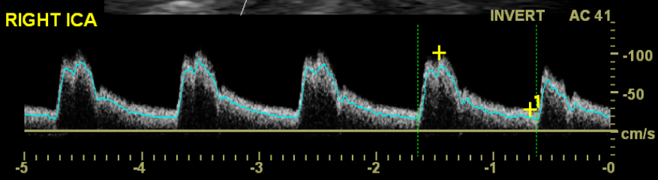
Spectral Doppler
Normal ICA
Notes:
At systole: Sharp systolic rise time, Clear Systolic Window, At diastole: Continuous forward flow through diastole

Slide 21
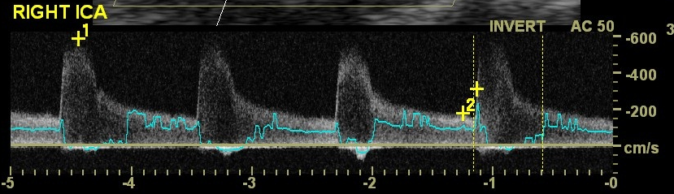
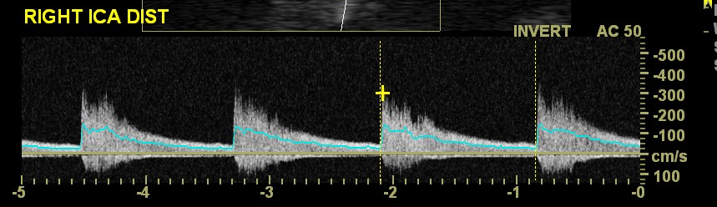
Spectral Doppler
Stenosis

Slide 22
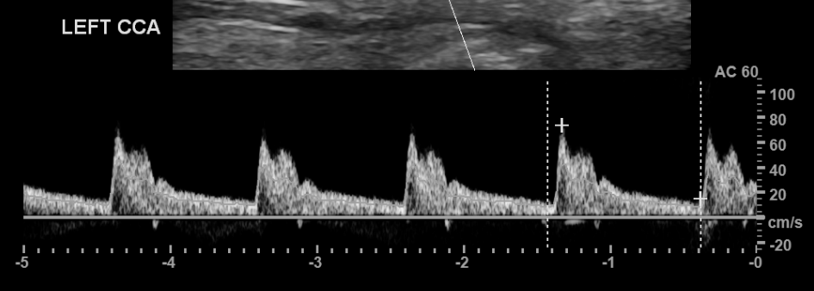
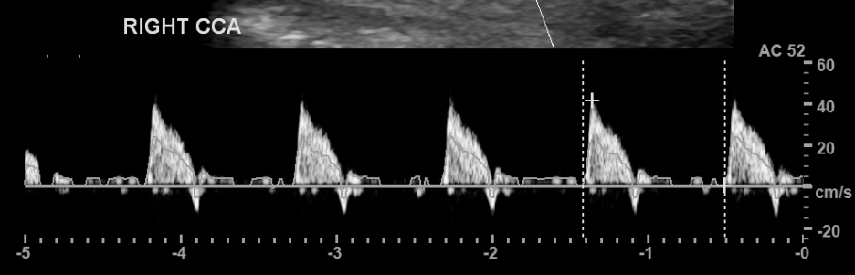
Spectral Doppler
Normal CCA
Pre-occlusion

Slide 23
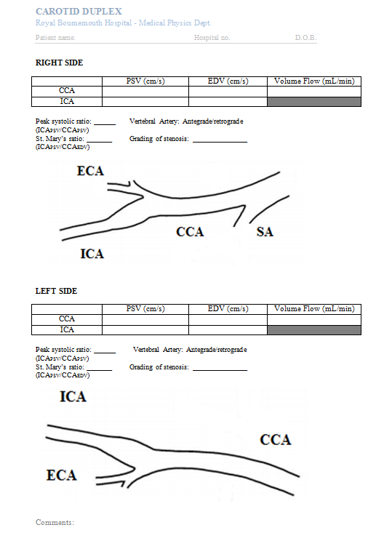
Overview

Slide 24
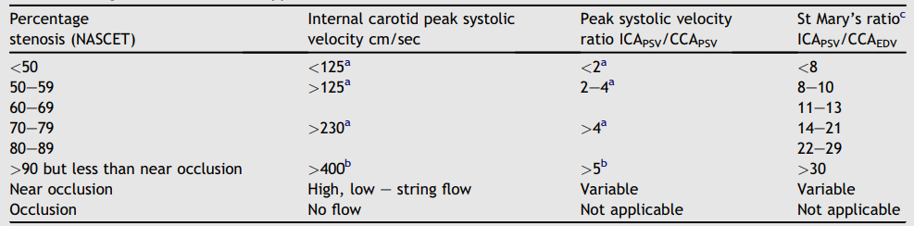
How do we grade a stenosis?
Haemodynamic significance
Velocity measurements
Oates, C. P. et al. 2008. Joint Recommendations for Reporting Carotid Ultrasound Investigations in the United Kingdom. European journal for vascular and endovascular surgery. Volume 37 (3) p251-61

Slide 25
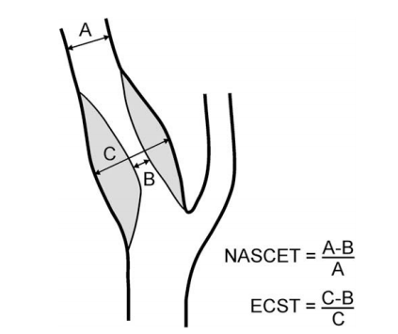
How do we grade a stenosis?
Diameter reduction

Slide 26
Case study
80 year old male
Ex-smoker
Hypertension
Known CAD
Episode of left leg weakness
Right arm was also weak later

Slide 27
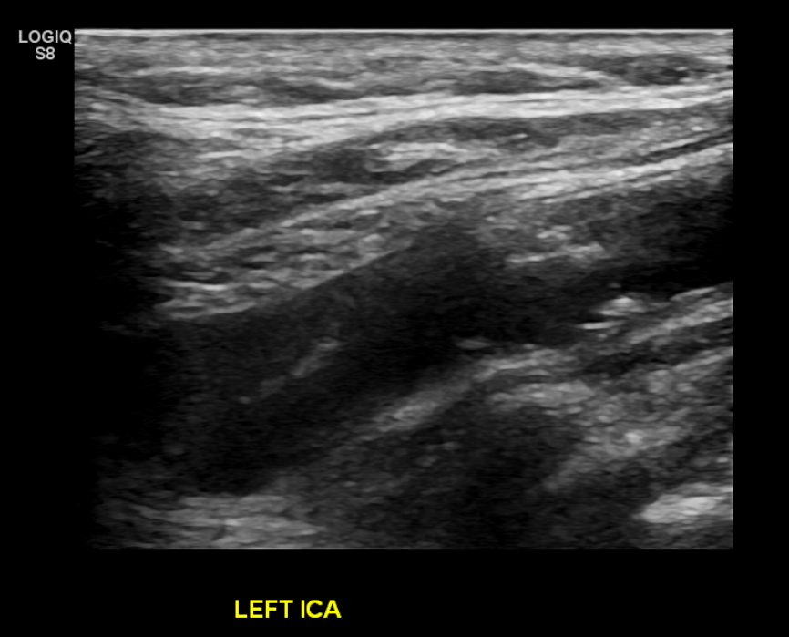
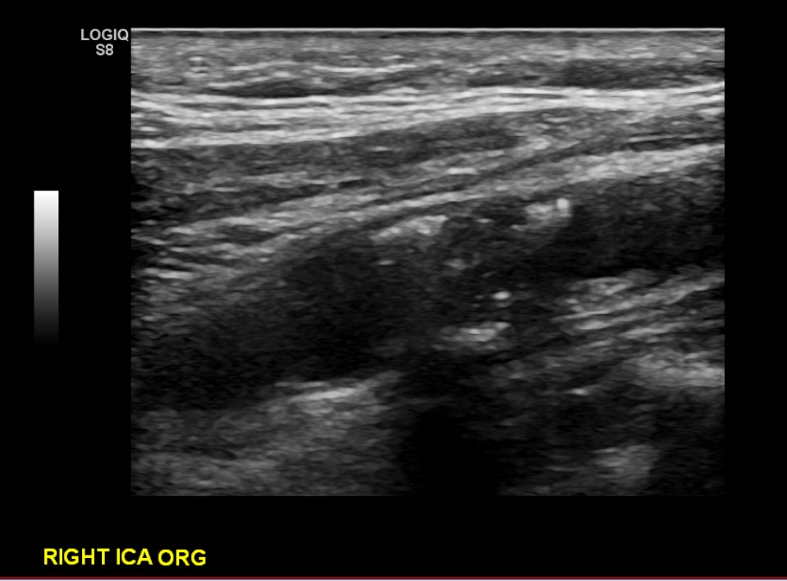
Case study

Slide 28
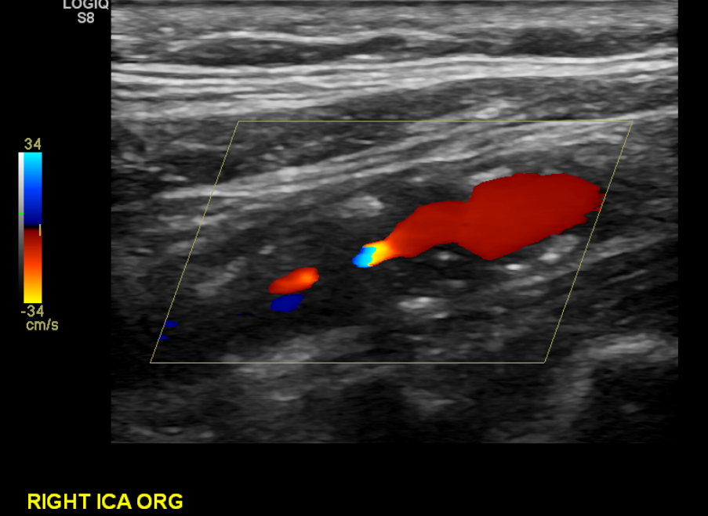
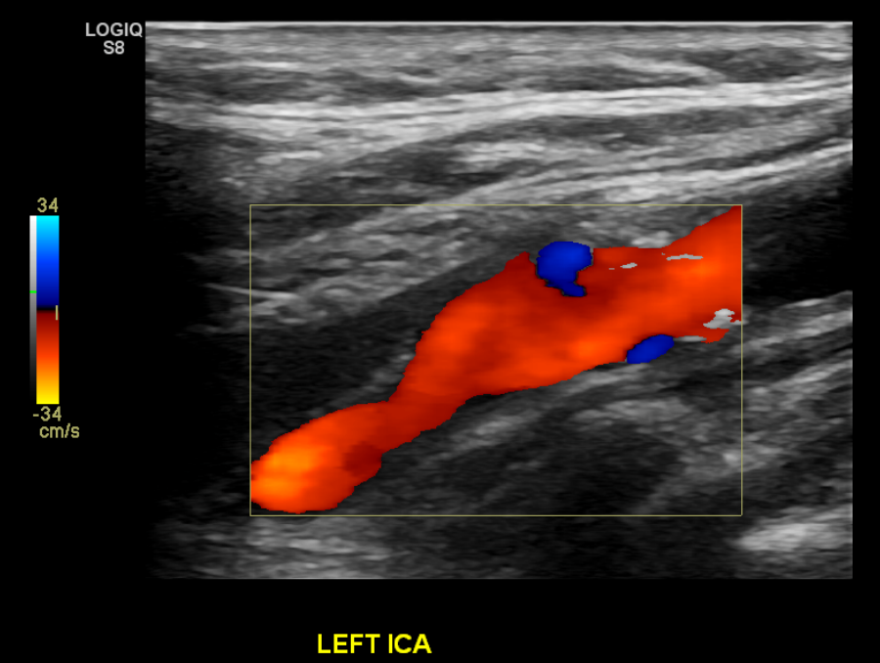
Case study

Slide 29
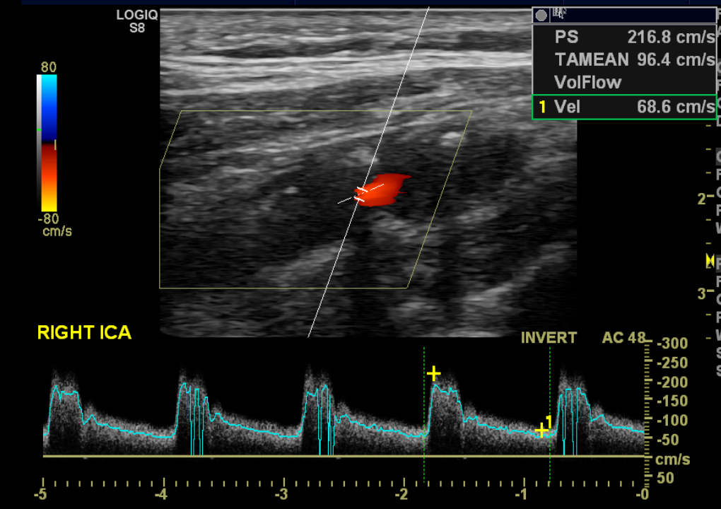
Case study

Slide 30
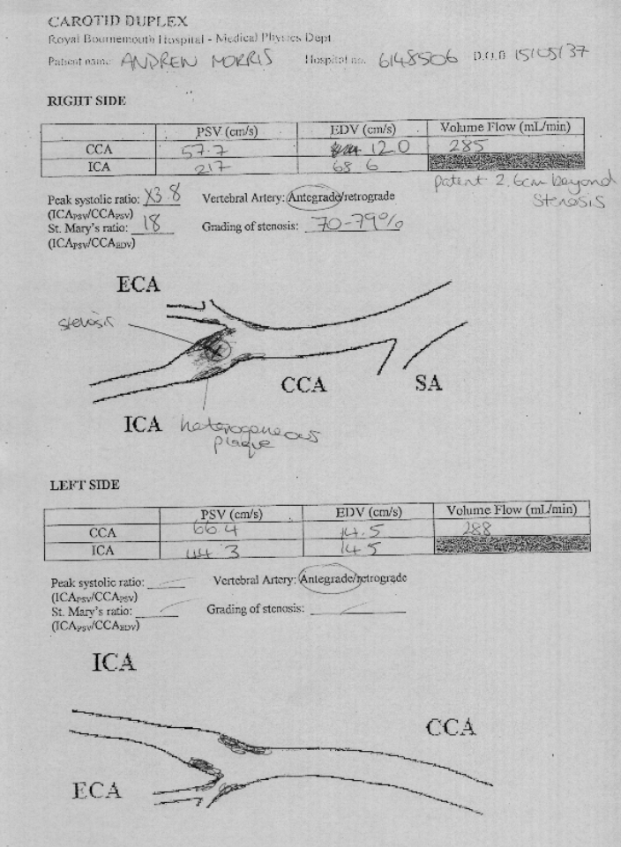
Case study

Slide 31
Case study
Vascular referral
Right carotid lesion is not consistent with bilateral symptoms
Risk of right sided carotid endarterectomy not deemed appropriate
7 day heart monitor requested to look for other sources of emboli

Slide 32
Other abnormalities
Subclavian steal
Dissection
Aneurysm
Carotid body tumour

Slide 33
Are there limitations?
Patient positioning/mobility
Neck size/length
Acoustic shadowing from calcified plaque
Doppler angle correction

Slide 34
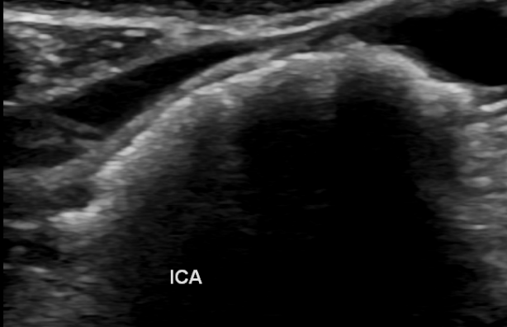
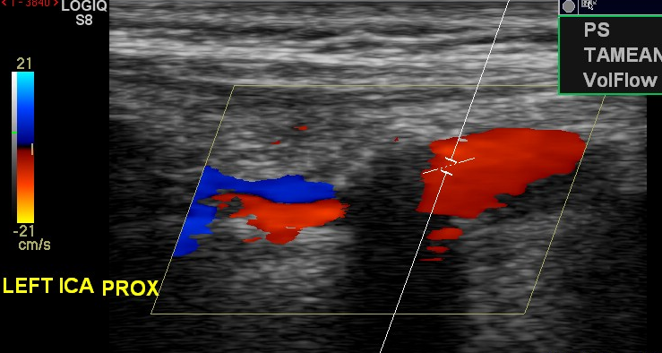
Are there limitations?
Acoustic shadowing limits Doppler information

Slide 35
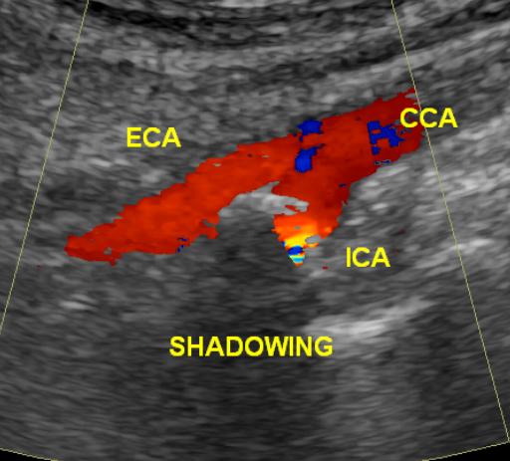
Are there limitations?
Difficult to correct Doppler angle due to shadowing

Slide 36
Scanning pre-endarterectomy
Confirm disease
Confirm patency of ICA
Mark bifurcation

Slide 37
Case study
53 year old woman presenting with severe expressive dysphasia and right facial droop
NIHSS score of 9
MRI showed left side infarct
Dopplers also done
Subsequent CTA showed extensive left carotid occlusion
High dose aspirin, PPI
Not a candidate for surgery

Slide 38
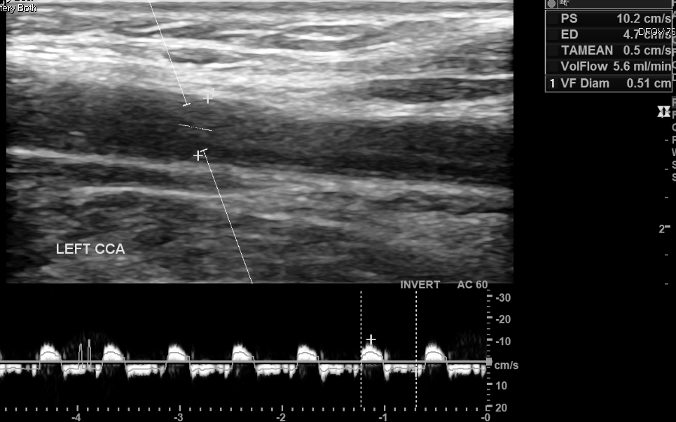

Slide 39
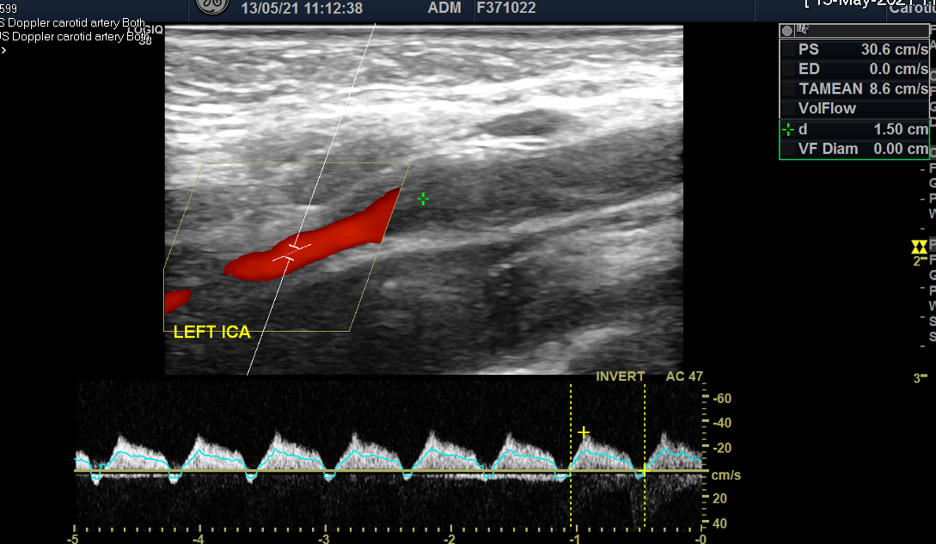

Slide 40
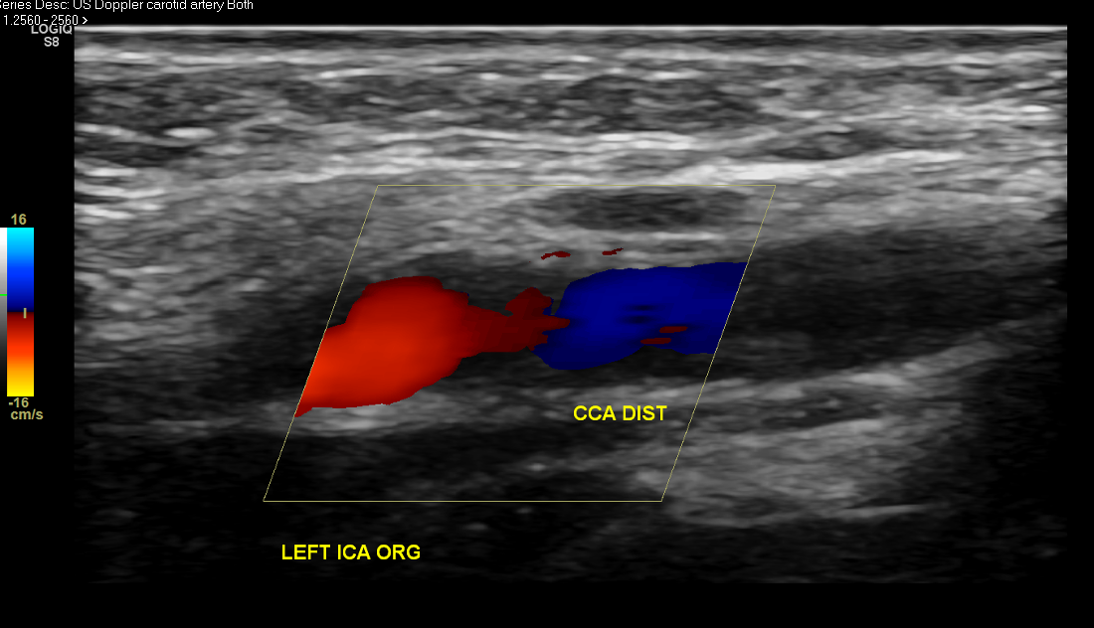

Slide 41
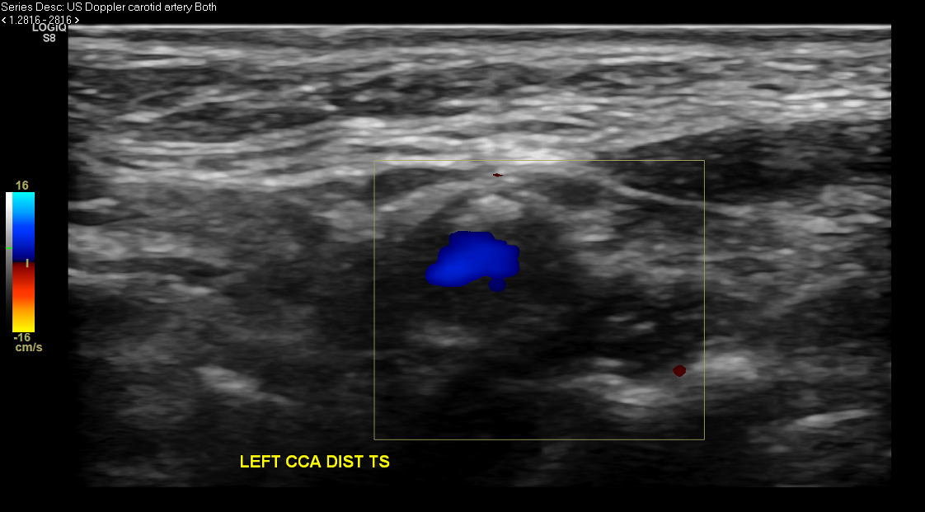

Slide 42
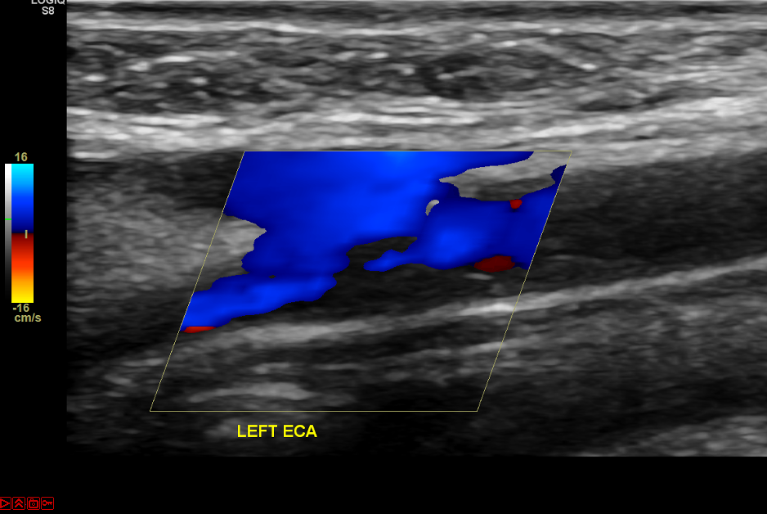

Slide 43
