Slide 1
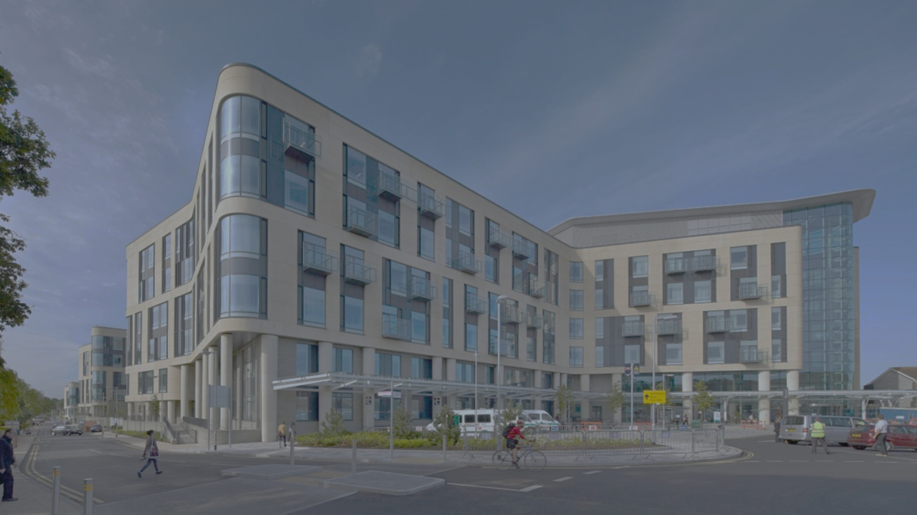






Course programme Renal Failure and Haemodialysis Access: A multidisciplinary team perspective
08:45 – 09:00 Registration
09:00 – 09:10 Welcome Louise Fearnside/ Antonio Sassano
09:10 – 09:30 Renal Failure and aetiology Mohammed Al-Talib
09:40 – 10:10 Renal replacement therapies and haemodialysis Simon Daniel
10:20 – 10:40 Patient perspective John Gardner
10:40– 11:10 Tea/Coffee break
11:10 – 11:30 Ultrasound overview Louise Fearnside
11:40 – 12:10 Radiological Intervention Graham Collin
12:20 – 12:50 HD Access and formation Shakeeb Khan
13:00 – 13:45Lunch
13:50 – 14:10 Ultrasound assessment William Owen
14:15 – 16:00 Practical Sessions to include afternoon break
16:15 – Close
Notes:
Good morning everyone..
Firstly we would like to welcome you all to our renal failure and haemodialysis study day. I thought it would be nice if we could all introduce ourselves, so tell us who you are, your role and where you have come from today. So I’m…
This morning we have a theory session with a variety of talks. Mo is going to give an overview of renal failure. Simon will look at renal replacement therapies and haemodialysis. We have John Gardner, who has kindly agreed to give you a patient perspective which is a really important insight.
We will break for tea and coffee around 10:40.
After morning break, I will give you an overview of the role ultrasound in renal dialysis. You will then hear from Graham Collin about radiological intervention and Shakeeb Khan about HD access and formation . Feel free to ask the speakers any questions during the talks and there is also some time after each talk to ask any questions that you may have.
We will break for lunch at 13:00 which will be served here in the room. Will is going to talk after lunch about ultrasound assessment in a bit more detail before breaking into the practical sessions where you will observe ultrasound assessments on fistula patients and have a go yourself.
We are lucky to have four medical companies here who will be available throughout the day and are also involved in our practical workshops this afternoon. GE have kindly brought ultrasound machines that we can demo later. Medtronic and orca are going to be involved in the cannulation workshops this afternoon and Kimal supply our trust with transonic machines and will be available later in the workshops to demonstrate a transonic machine.
Just a few other things to note – toilets…. We are not expecting a fire alarm testing today so if the fire alarm sounds, please make your way to the nearest exit which is
Also we would appreciate it if you could check that your phones are on silent or vibrate.
So I think that’s about it for now. So now we are going to start with…

