Slide 1
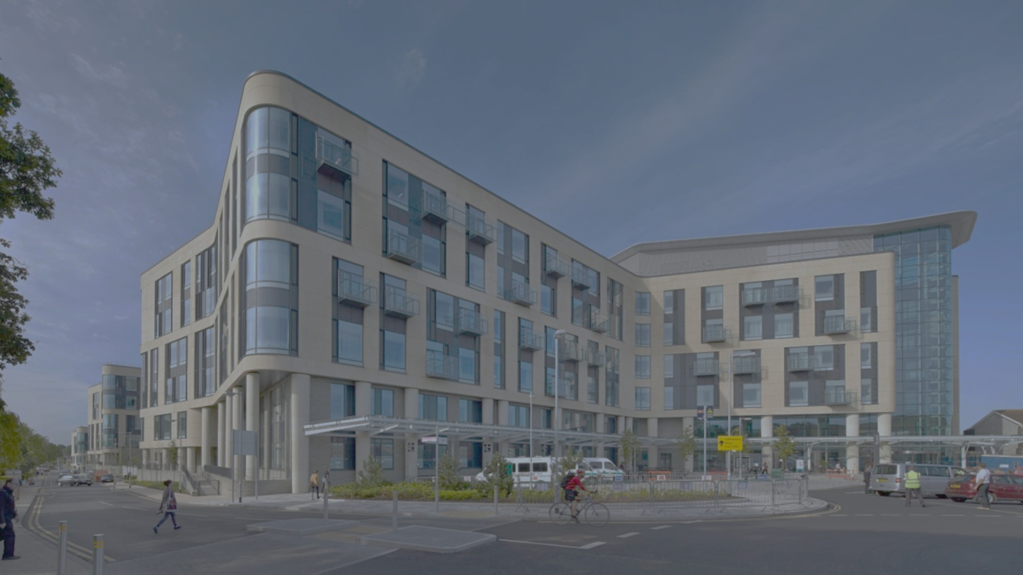



Course programme The Diabetic Foot: A virtually delivered collaborative study day
09:15 – 09:25 Online Room Registration Mel Williams/ Louise Fearnside & Introduction
09:25 – 09:55 Overview of the diabetic foot & Clinical review Andy Weale
09:55 – 10:15 Podiatry review Nikki Drake
10:15 – 10:45 The ABPI assessment Maria Morgan
10:45 – 11:00 Tea/Coffee break
11:00 – 11:30 Perfusion assessments Louise Fearnside
11:30 – 11:50 The Duplex assessment William Owen
11:50 – 12:00 Break
12:00 – 12:10 Perimed - World leading in advanced instruments for Peripheral Vascular Diagnosis Petri Markkanen
12:10 – 12:35 Radiological Imaging & Intervention Tarryn Carlsson
12:35 – 12:50 Diabetic foot management Andy Weale
12:50 – 13:00 Patient experience Stephen Lambert
13:00 – 13:15 Close

