Slide 1
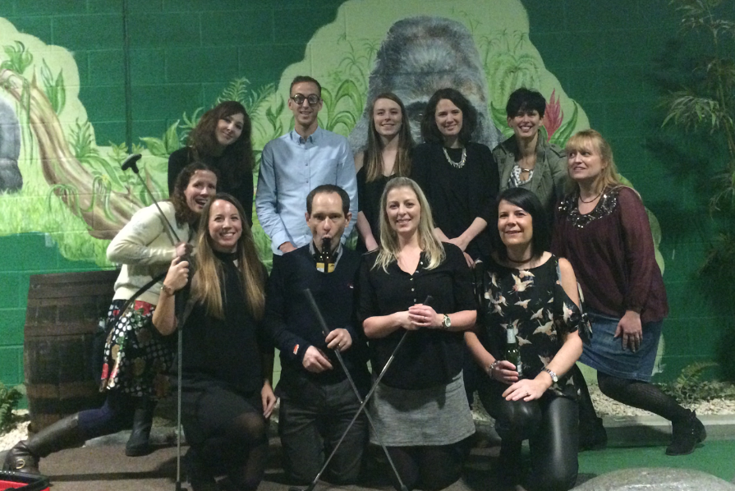
Southmead Hospital Vascular Testing Staff

Slide 2
Southmead Hospital Vascular Testing
Staff 7 clinical vascular scientists (4FT, 3PT), 2 renal specialist nurses trained to scan fistulas (PT), 1 STP vascular scientist trainee (FT), 3 support workers (PT)
Equipment
3 large ultrasound machine at Gate 5
2 mobile ultrasound machine used for ward scanning
Outpatient, hot clinic and one stop scanning done at Gate 5
On-call mobile scanning provided Mon-Fri 0800-1730
Urgent referral please call Ext 45300 or bleep on-call Scientist 9050 or 9051
REFER EARLY AND PHONE TO GARRANTEE SAMEDAY SCAN

Slide 3
Duplex investigations
Upper and lower limb arterial
Venous incompetence
Upper and lower limb DVT
Fistula
Graft and stent surveillance
AAA surveillance
Pre-operative marking: vein mapping and pre carotid endarterectomy
+ ABPI
Physically demanding especially mobile scans on the ward

Slide 4
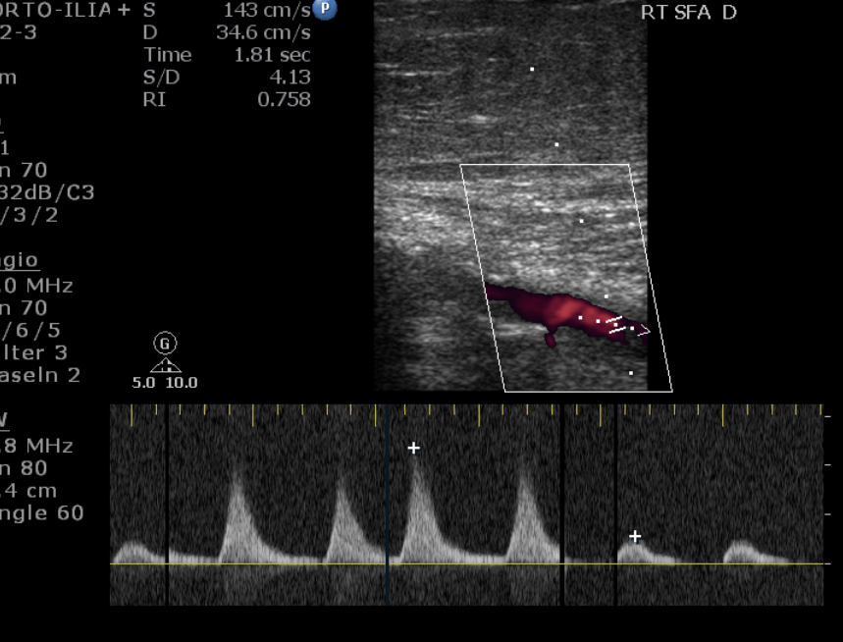
Arterial Duplex
Ultrasound with B-mode, colour flow and Doppler waveform information
Locate diseased vessels
Grading of disease to indicate severity of stenosis
Total occlusion
Level of disease | Degree of stenosis (diameter reduction) | Peak Systolic Velocity Ratio (PSVR)
Minimal disease | 1-10% | No velocity change
Mild disease | 10-49% | Less than 2:1
Mild-moderate disease | ~50% | 2:1
Moderate disease | 50-75% | 2:1 – 3:1
Severe disease | 75-99% | 4:1 or greater
Thread flow | Thread flow | Very low velocity flow. Pre-occlusive vessel.
Occluded | Occluded | No flow

Slide 5
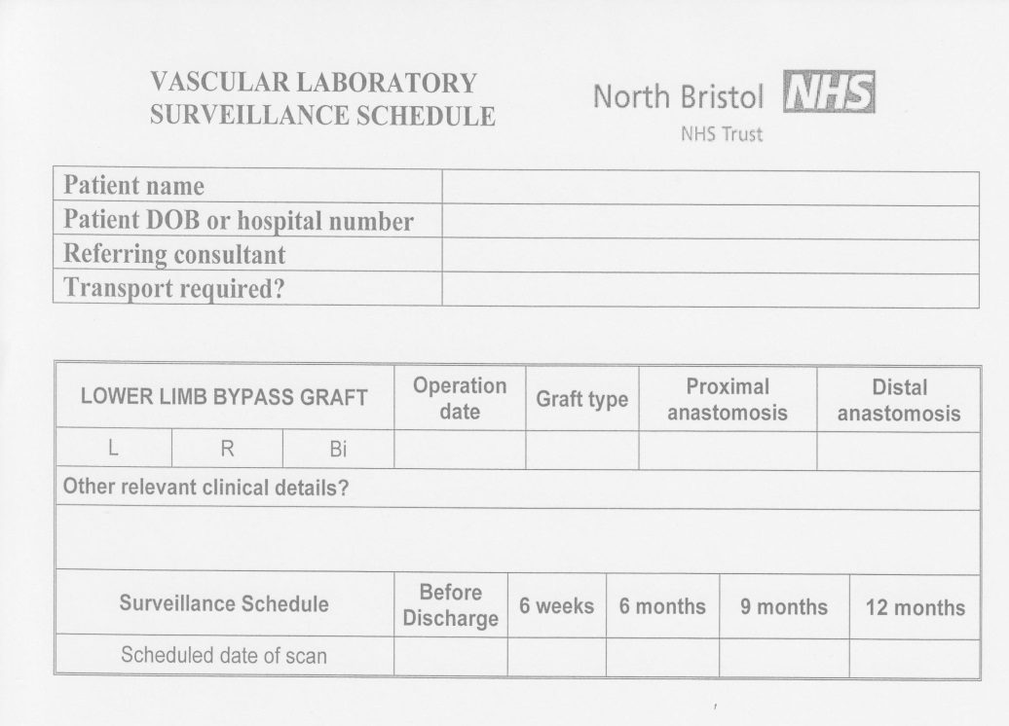

Graft surveillance
Elective patients have pre-op marking on day of surgery – emergency bypasses can be missed please fill out referral for surveillance
Duplex before discharge very limited
Will highlight concerns in report - scan just a patency check
6 week scan more detailed

Slide 6
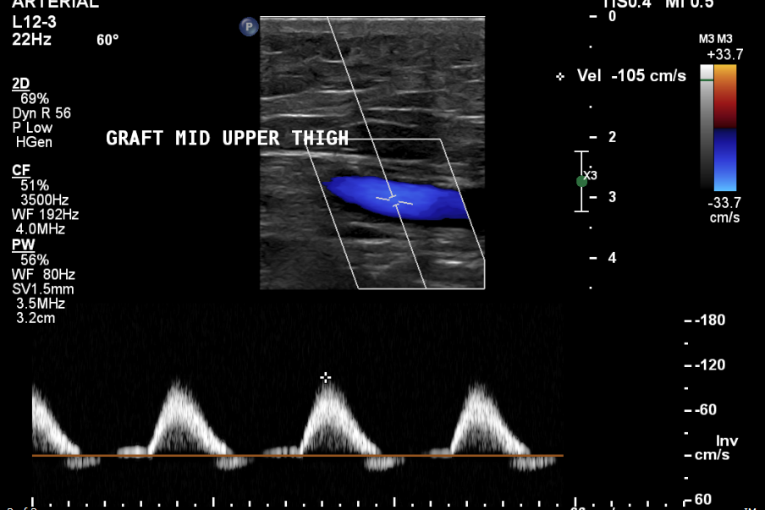
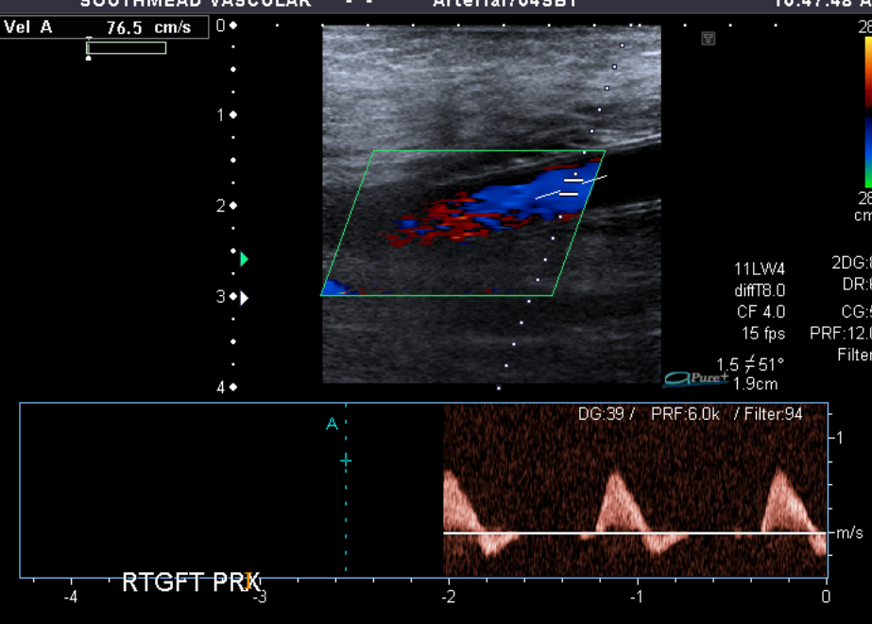
Graft surveillance
Vein graft
Looks like native vessel
Retained valves
PTFE
Uniform diameter
High echo walls
Kinking

Slide 7
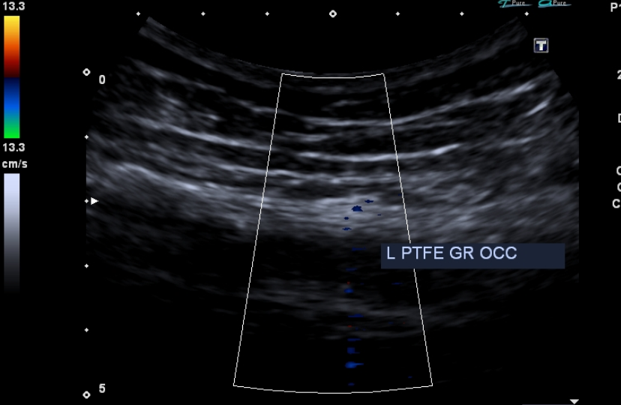
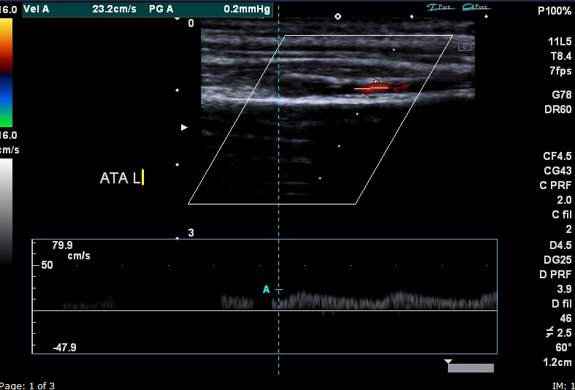
Graft surveillance
Graft occlusion
Damped monophasic Doppler signals distal to occlusion

Slide 8
Graft surveillance
Early pick up of graft stenosis
Complications are highlighted on report and depending on severity email consultant or contact on call registrar/consultant
If graft has intervention radiological or surgical – surveillance re-starts

Slide 9
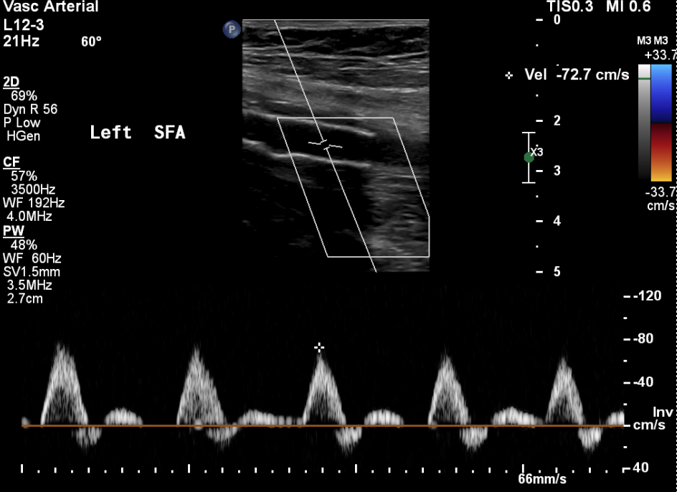
Stent Surveillance
Entered into surveillance via referral and MDT outcome list
Scan 6 weeks, 6 months and 12 months
Similar to grafts, complications seen on surveillance reported back to Vascular team and restart surveillance if stent intervention performed

Slide 10
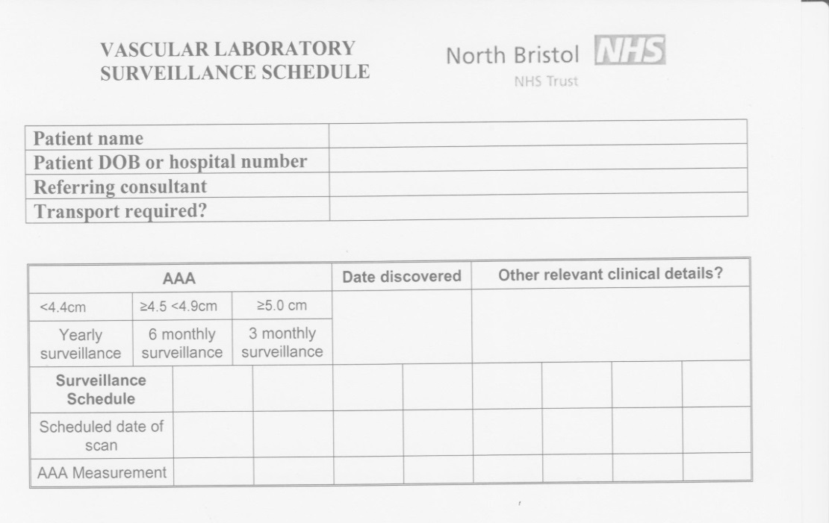
AAA Surveillance
All AAA surveillance patients are referred vascular team
Placed on surveillance with schedule dependent on size
Inner to inner lumen measurements with small AAA measuring >3cm
When at threshold (≥5.5cm) discharged from surveillance and referred back to vascular surgeon

Slide 11
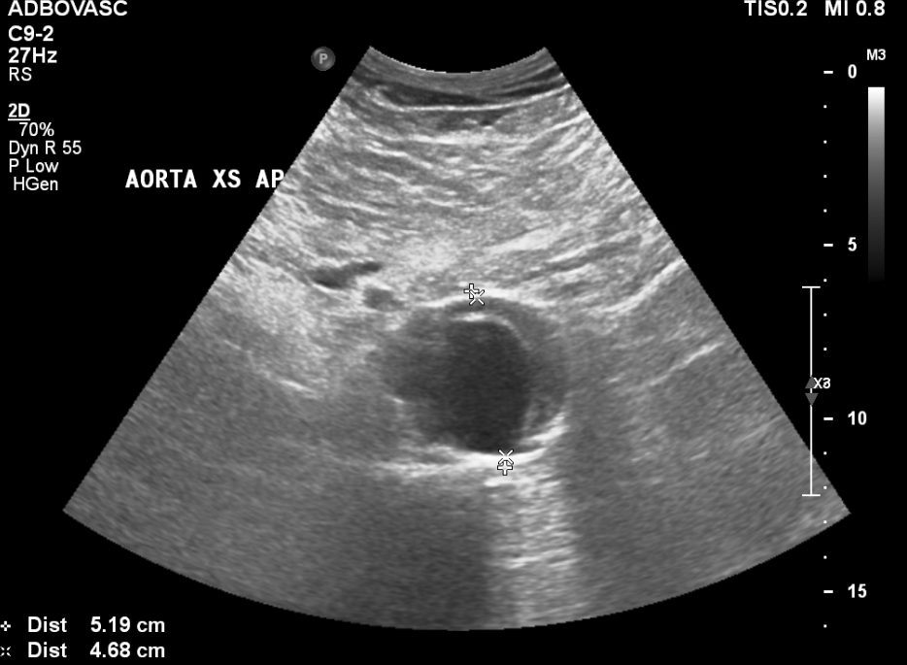
AAA Surveillance

