Slide 1


Slide 2


Venous Duplex

Slide 3
Lower limb venous duplex
For DVT

Slide 4
Structure of veins
Three layers (like arteries)
Tunica adventitia – very thin layer of loose tissue surrounded by elastic lamina
Tunica media – smooth muscle layer surrounded by fibrous tissue
Tunica intima – layer of elastic lamina supporting single layer of endothelial cells – specialised to secrete thrombolytic substances.
Contain one-way valves (unlike arteries).

Slide 5
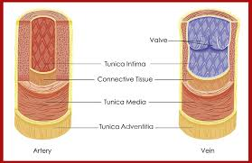
Structure of veins

Slide 6
Venous Physiology
Flow of blood towards the heart
Not always de-oxygenated e.g. Pulmonary vein
Non-pulsatile system – how does blood flow?
Low pressure environment (16-4 mmHg)
Contain valves to direct flow back to the heart.
Valves are bi-cuspid (or semi-lunar)
Notes:
Deep veins are low pressure conduits typically 16 – 4mmHg. They contain valves to control and direct blood flow back to the heart. Valves are formed by folds of intimal epithelium and occur at intervals throughout the venous system.
The number of lower limb valves increases towards the foot.
Valves open and close in conjunction with action of muscles – in response to the calf muscle pump. During contraction of the calf muscles the blood within the deep system of veins is propelled proximally into the popliteal/superficial femoral veins etc. This reduces the pressure within the deep veins and allows blood from the superficial and perforating veins to slowly drain into them. Once the superficial veins are empty blood from the arterial tree will refill them.
The competence of the valves maintains this pressure difference. Within the superficial veins the pressure is generally higher whilst standing typically 100-120mmHg which then reduces on walking to approx 30mmHg. This is called ambulatory venous pressure. This can be measured by inserting a needle into the dorsal vein on the foot and connecting to a pressure transducer and strip chart recorder. The patient then dorsiflexes the foot and the pressure changes are recorded. This measurement of AVP can indicate failure of the calf muscle pump and venous hypertension causing damage to the capillary network and long standing problems such as chronic oedema, skin changes and ulceration.

Slide 7
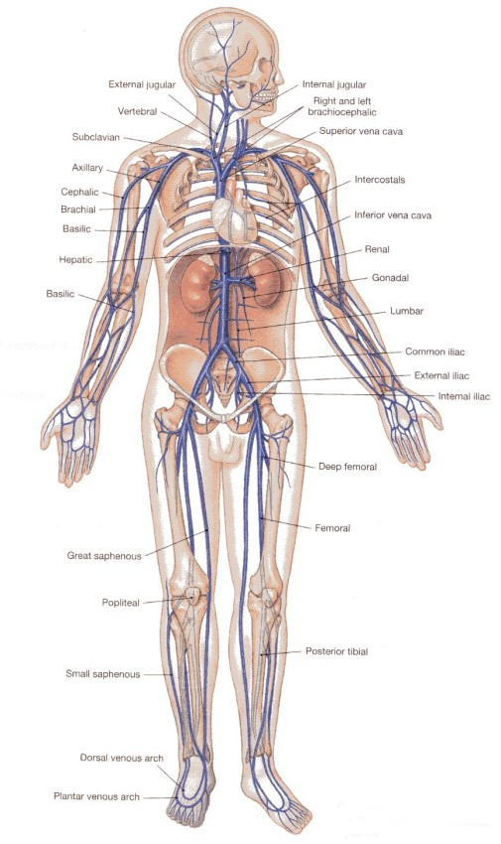
Venous Anatomy

Slide 8
Venous Anatomy
Important to know in order to understand venous disease.
Two venous systems:
Deep system – deep to fascia, supported by muscle compartments.
Superficial system- within or superficial to fascia, unsupported hence more muscle fibres.

Slide 9
Venous Anatomy
Must know your anatomy very well including common anatomical variations.
Above knee anatomy includes
CFV,
PFV,
SFV
(AND) popliteal vein.
Notes:
Most common anatomical variant is duplicate superficial femoral veins over part or all the length of the vein. It is not uncommon to find duplicate veins elsewhere.

Slide 10
Calf anatomy
Gastrocnemius veins (varying number of pairs) drain into popliteal vein.
Distal popliteal vein divides into the tibio-peroneal trunk veins which divide into the posterior tibial and peroneal veins.
Soleal veins usually drain into proximal posterior tibial or peroneal veins. Always check for them!
Anterior Tibial veins

Slide 11
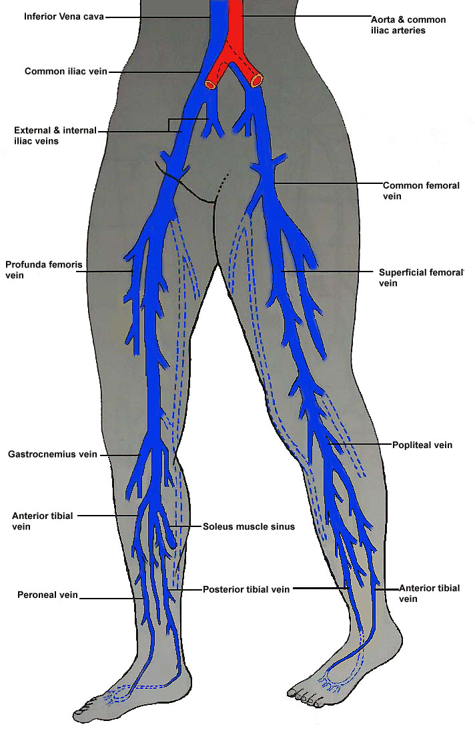
Deep Vein Anatomy
IVC and Iliac Veins
Common Femoral Vein
Profunda
Superficial Femoral
Popliteal
Gastrocnemius and Soleal
Posterior Tibial
Peroneal
Anterior Tibial

Slide 12
Superficial veins
LSV originates in front of the medial malleolus and extends medially to drain into the CFV at the groin.
SSV originates from lateral malleolus and drains into the popliteal vein.
Perforating veins communicate between deep and superficial veins.
Notes:
LSV has two main branches in the calf, just below knee called the dorsal arch vein and the anterior superficial tibial vein.
Two main thigh branches are anterolateral and posterolateral (or medial) vein.
These branches are common sources of recurrence of varicose veins.
SSV has no named branches.

Slide 13
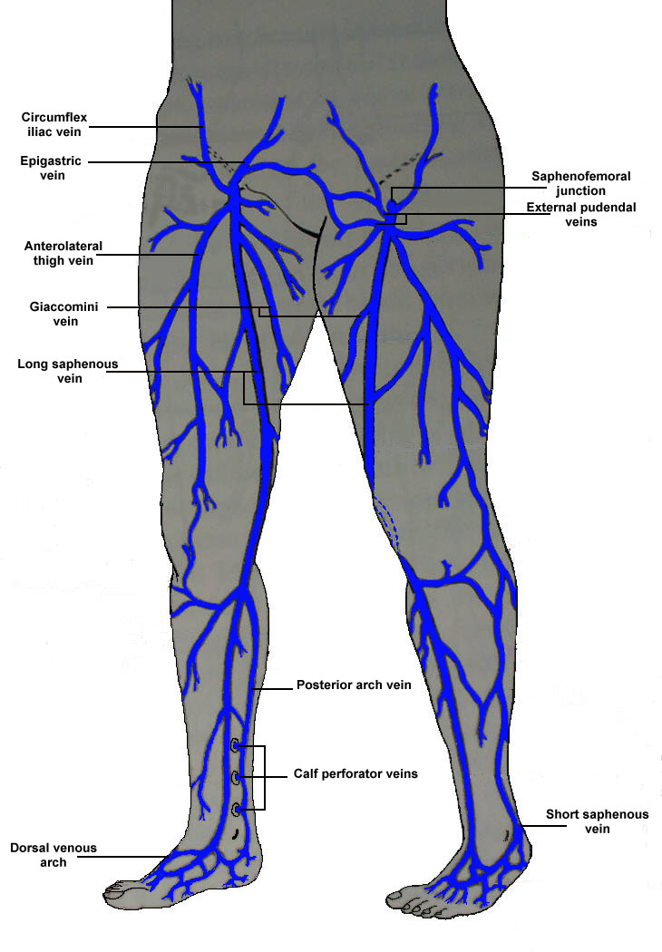
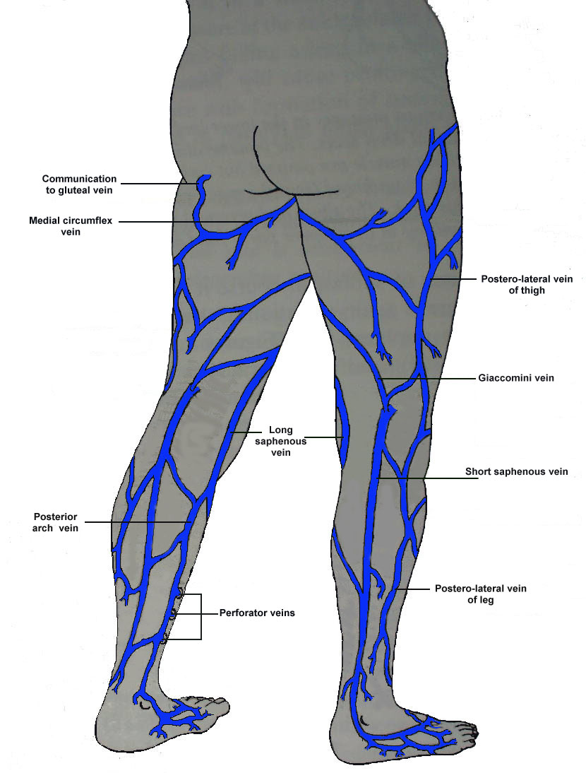
Superficial Vein Anatomy

Slide 14
Reason for referral/ venous aetiology
Deep vein thrombosis (DVT)
Superficial Thrombo-phlebitis
Varicose veins
Chronic venous insufficiency (CVI)
Vein mapping (and/or marking)
Venous malformation
Notes:
Important to understand the information and level of detail required for the investigation.
Depending on your local protocol, a DVT scan may not require any information on competency. Varicose veins scans may need to be very detailed or as simple as junctional incompetence.
Vein mapping for lower limb arterial bypass grafting or coronary artery bypass grafting – need to know length eg. Fem-pop or number of coronary arteries to be bypassed – number of short lengths required.

Slide 15
What is DVT?
Deep vein thrombosis (DVT) is a blood clot in one of the deep veins in the body often impeding flow.
DVTs usually occur in the deep leg veins.
DVTs cause pain and swelling in the leg and may lead to complications such as pulmonary embolism (PE).

Slide 16
Definitions
DVT – Deep vein thrombosis
Thrombus – clot that forms in a blood vessel.
Embolus – clot of blood that has become detached from its original site.
VTE - Venous thrombo-embolism also called a Pulmonary embolism (PE)
PE occurs when a piece of blood clot breaks off into the bloodstream and blocks one of the blood vessels in the lungs.
Can be confirmed by CTPA- Computerised tomography pulmonary angiogram.

Slide 17
Risk factors of DVT:
Age
Venous disease
Obesity
Thrombophillia
Pregnancy
Contraceptive pill
Surgery
Malignancy
Chemo/radiotherapy
Immobility
External compression
Dehydration
Trauma
IVDU
Notes:
Over 65’s have significantly increased risk of developing DVT.
Obesity causes compression of common femoral vein and hinders venous return due to increased abdominal pressure.
Pregnancy also causes compression of veins but hormonal changes cause veins to dilate and immunological changes can lead to hypercoaguable state.
patients are immobilised for varying periods of time. Surgery leads to increased coagulability.
Chemo/radiotherapy can damage vein walls or increase coaguability of blood.
But to understand why these are increase risk factors we need to understand what causes a DVT.

Slide 18
Causes of DVT
Virchow’s Triad
Two of Three factors present
Changes in blood flow (venous stasis)
Changes in vein wall (trauma)
Changes in the blood constituents (Hyper-coaguability)
Blood Flow
Coagulation
Vessel Wall

Slide 19
Changes in Blood Flow
Slow flow related to sitting or lying for long periods of time
- Immobility
- Hospitalisation
- External compression of the vein
- Air travel
- Long car or coach journeys
- Varicose veins
Notes:
Immobility – not moving causes blood to pool and clot in the calves
Hospitalisation- immobility but also trauma- lines, surgery etc
External compression of veins can be caused by malignant growths, aneurysm (popliteal), popliteal entrapment, cysts (Baker’s cysts), compartment syndrome.
Air travel – long periods sitting
varicose veins- blood pooling in veins and clotting and travelling into deep system.

Slide 20
Changes in the vessel wall
Things that affect the vein wall
- Damage from Trauma
Surgery, injections or injuries, Sepsis, Smoking
- Varicose veins
- Previous DVT
Notes:
Venous disease
Surgery – Knee and hip surgery are high risk due to immobility and vascular damage and varicose vein surgery increases likelihood of DVT.
Trauma can increase risk of DVT indirectly eg external trauma or by direct trauma eg needling, insertion of lines.
IVDU – trauma
Varicose vein- valves are damages wall become stretched
Increased risk of developing DVT if have had previous DVT or varicose veins – scarring from old DVT vessel wall changes- varicose veins – blood pooling in veins and clotting and travelling into deep system.

Slide 21
Changes in the Blood
Things that make the blood thicker or more likely to clot
  Oral contraceptive pill/HRT
  - Dehydration
  - Smoking
  - Thrombophilia
  (Factor V Leiden, Protein S, Protein C)
  - Malignancy
Notes:
Pill - Although they do not cause blood clots, most birth control pills do increase a woman’s chance of developing a blood clot by about three to four times, they contain hormones that increase the levels of clotting factors in the blood.
Dehydration increases viscosity of blood and hence hypercoaguable state.
Thrombophilia (sometimes hypercoagulability or a prothrombotic state) is an abnormality of blood coagulation that increases the risk of thrombosis (blood clots in blood vessels). When you cut yourself and injure a blood vessel, tiny cells called platelets stick to the damaged vessel wall to form a plug.
Proteins in the blood called clotting factors cause strands called fibrin to form around the plug. These strands get tangled up with the platelet plug to form an even stronger blood clot. If you have thrombophilia, you have an imbalance in clotting chemicals. You either have too much or too little of the substance that stops clotting (clotting factor).
Malignancy causes increased coaguability of blood.

Slide 22
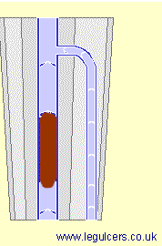
Deep Vein Thrombosis
Clot in Deep Vein
Symptoms more generalised
  Swelling
  Aching / Tender
  Difficult to walk
  Superficial veins may become prominent
Treatment
  Anti-coagulation
  Low Molecular Weight Heparin / Warfarin

Slide 23
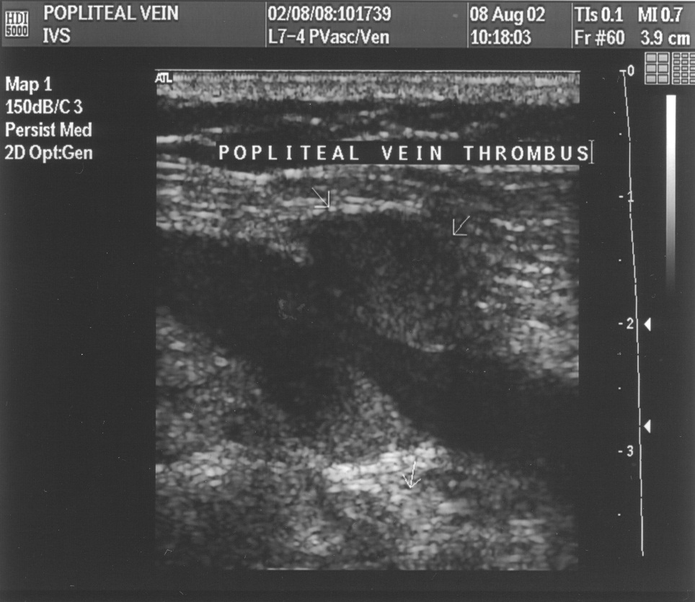
How is thrombus formed?
Majority of thrombi form in calf and propagate more proximally.
Venous thrombi may originate from valve cusps.
Caused by platelet aggregation from the slow or absent motion of blood.

Slide 24
Incidence of DVT
Each year in the UK approx 2 in 1000 people will develop a DVT.
Hospital inpatients are at higher risk as may already have several risk factors.
PE occurs in approx 15% of all cases of DVT.
Approx 30% of PE are fatal.
50-70% of PE’s are caused by silent DVT.
Autopsy Studies show approx 80% of DVT and PE remain undiagnosed.

Slide 25
NICE Guidelines
Refer immediately for same-day assessment and management, if deep vein thrombosis (DVT) is suspected in a woman who is pregnant or has given birth within the past 6 weeks.
For all other people with suspected DVT, use the two-level DVT Wells score to assess the probability of a DVT.
For people likely to have DVT (based on Wells score >2)
  Refer for proximal leg ultrasound scan (within 4 hours)
  If cannot be carried out in 4 hours
    Take blood sample for D-Dimer testing
    Give interim 24 dose of parenteral anticoagulant
    Arrange for proximal leg vein ultrasound scan (to be carried out within 24 hours of being requested.
For people who are unlikely to have a DVT (Wells <1)
  Offer D-Dimer testing
    If positive refer for proximal leg ultrasound scan (within 4 hours)
  If cannot be carried out in 4 hours
    Take blood sample for D-Dimer testing
    Give interim 24 dose of parenteral anticoagulant
    Arrange for proximal leg vein ultrasound scan (to be carried out within 24 hours of being requested.
If D-Dimer Negative, consider alternative diagnosis to explain symptoms
Notes:
IVS protocols differ from nice guideline as we tend to scan the whole leg. Why do we scan the whole leg?

Slide 26
Most frequent site of DVT
IVC 1.6%
Iliacs 4.7%
Femoral 27%
Popliteal 3.2%
Calf 63.5%

Slide 27
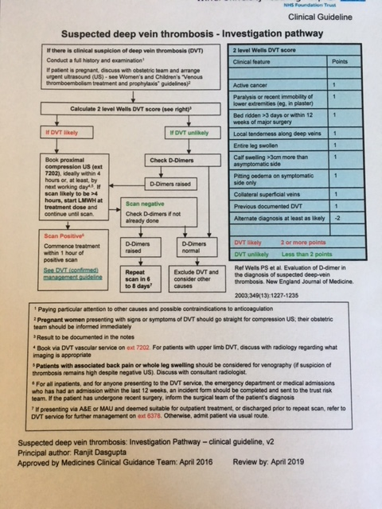
DVT Pathway

Slide 28
Clinical Diagnosis
D-Dimer Blood test
- Small protein fragment present in blood after a blood clot has been degraded.
- Negative D-Dimer rules out the presence of DVT (mostly)
- Positive D-Dimer can occur due to various causes (pregnancy, recent surgery, inflammation, DVT).

Slide 29
Clinical Diagnosis
Risk Assessment (Well’s Score)
1 - Active cancer - 1 point
2 - Calf swelling >3 cm compared to other calf - 1 point
3 - Collateral superficial veins (non-varicose) - 1 point
4 - Pitting oedema (greater than the asymptomatic leg) - 1 point
5 - Swelling of entire leg - 1 point
6 - Localized pain along distribution of deep veins -1 point
7 - Paralysis, paresis, or recent cast immobilization of leg -1 point
8 - Recently bedridden > 3 days or major surgery - 1 point
9 - Previous DVT - 1 point.
10 - Alternative diagnosis at least as likely - Subtract 2 points
DVT likely if Score > 2
Notes:
2- measured 10cm below the tibial tuberosity
8- major surgery within the last 12 weeks requiring gereral or local anaesthetics

Slide 30
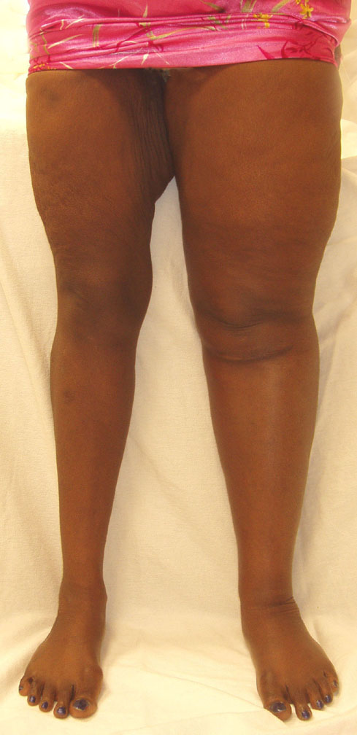
Clinical Diagnosis
Clinical features of DVT include:
Can be difficult to diagnose on just examination.
Usually just one leg (or arm).
Usually acute presentation.
Lower leg oedema
Discolouration (cyanosed/purple)
Swelling in calf or thigh
Limb pain and tenderness along deep veins
Distension of superficial veins
Increased temperature of skin
Notes:
Calf swelling – generally no ankle oedema present with acute DVT – consider inverted champagne bottle shape
Redness/ warmth – superficial veins prominent? - Thrombophlebitis
Discolouration/ blue toes and oedema?
Prominent varicose veins, ulceration.
Hypertrophy - Klippel-Trenaunnay syndrome

Slide 31
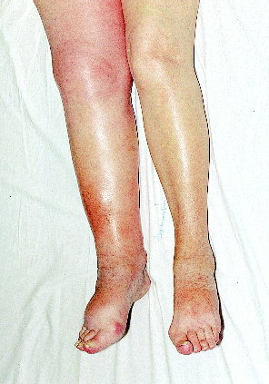
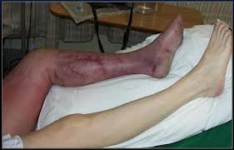
Clinical diagnosis
Symptoms may vary due to extent of DVT.

Slide 32
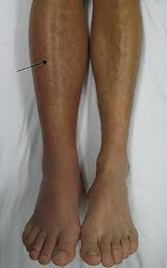
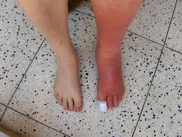
Visual assessment
DVT
Cellulitis

Slide 33
Why Scan for DVT’s?
Clinical diagnosis of DVT difficult
- 50% of all positive DVT’s show few clinical symptoms.
- 50% of all symptomatic legs are negative for DVT.

Slide 34
Duplex ultrasound
Gold standard for investigation of DVT and venous insufficiency.
Operator dependent.
Can identify thrombus and classify as old or fresh, occlusive or non-occlusive.
Can identify incompetent valves – important in post thrombotic limb.
Can identify differential diagnosis.

Slide 35
Other Diagnostic Techniques
Doppler Ultrasound (now the gold standard)
Venography (old gold standard)
Plethysmography
MR and CT Venography

Slide 36
Ultrasound vs Venography
Non-invasive
Relatively painless
Quick Diagnosis
Operator dependent
Calf and Iliac vein DVT detection low (60-70%)
Invasive and painful
Allergy to contrast possible
Does not exclude DVT in venous variants.
Doesn’t give Differential Diagnosis
Endothelial trauma can cause DVT
30% fail to gain access to vein
Expensive

Slide 37
How to scan a DVT
Deep Venous Thrombosis Assessment (4-7MHz linear array)
The transducer is placed in the groin in transverse plane and the common femoral vein (CFV) is identified medial to the common femoral artery.3
The Doppler sample volume is placed in the CFV, corrected to a 60 degree angle and steered to align parallel with common femoral vein flow. The sample volume gate should span the full diameter of the lumen.1,8 Venous flow should be phasic with respiration. The patient is asked to perform a Valsalva manoeuvre, i.e. a cough. If a cough does not produce a satisfactory response, a full Valsalva manoeuvre should be performed.1,6 Ask the patient to take a breath in and hold it, then to increase the pressure in their thorax. This is achieved by asking the patient to ‘bear down’ – pretending to go to toilet.1,4 This should result in a temporary reversal of venous flow and indicate patency of proximal veins. With a proximal obstruction, flow in the CFV will be continuous and aphasic with respiration, with poor or no response to Valsalva manoeuvre.1 If this occurs then the CVS should scan the iliac veins and IVC to assess whether there is a proximal DVT and/or a mass causing external compression of the vein.1,5,6
Following completion of the Valsalva manoeuvre, the common femoral vein should be compressed using external transducer pressure, to confirm patency.1 Assessment of competency (using colour/spectral Doppler) and patency (using compression) of all other deep proximal veins should be performed as follows. The distal CFV bifurcates into two deep veins. The deeper vein is the profunda femoris vein, the more superficial vein is the superficial femoral vein (SFV). The profunda femoris origin should be assessed whilst the SFV should be assessed along its length, adopting an increasingly anterio-medial approach.2,5 The popliteal vein is located within the popliteal fossa – care should be taken to scan as proximally as possible to overlap with the distal SFV.1

Slide 38
Manual compression of the deep veins should be repeated at regular intervals (2-3cm); failure to fully compress the veins may indicate the presence of thrombus.2 The echogenicity of the thrombus indicates its age. 11 Thrombus becomes increasingly echogenic over time, as it becomes more organised.1 In time, the vessel may begin to re-canalise – old residual thrombus can be seen to produce a scarred appearance, with multiple channels of flow seen.1 Slow or partial re-canalisation can result in deep venous insufficiency.1 Competency is assessed by calf augmentation using both colour and spectral Doppler - on release of the calf there should be no or very slight (<0.5sec) retrograde flow, which indicates no significant reflux.4
Deep calf veins should be assessed using manual compression, colourflow and spectral Doppler to assess competency. The transducer is placed into the popliteal fossa and the popliteal vein is identified lateral to the mid line. Up to eight gastrocnemius veins may be visualised in the proximal calf, within the gastrocnemius muscle.2 The soleal veins are imbedded in the soleus muscle and are often less easily identified. Several soleal veins may be present which may have connections with other deep calf veins – often the posterior tibial or peroneal veins. Soleal veins are identified more distally than the gastrocnemius veins.2 If gastrocnemius or soleal veins appear particularly dilated, they should be assessed for competency using colour/spectral Doppler.
The anterior tibial veins may be seen as the first deep communication with the popliteal vein. Distal to this junction the tibio-peroneal trunk veins divide to form the posterior tibial and peroneal veins.1,12 It is sometimes easier to trace the deep calf veins from the ankle proximally. Placing the transducer posterior to the medial malleolus, both posterior tibial veins can be visualised adjacent to the posterior tibial artery.2 If the probe is angled slightly posteriorly the peroneal artery and veins should be visualised deep to the posterior tibial vessels.2 Placing the transducer on the anterior aspect of the ankle, the anterior tibial artery and veins can be visualised and traced.14 Placing your thumb and first finger on the anterio-medial or anterio-lateral aspects of the ankle and applying pressure can augment flow in posterior tibial, anterior tibial and peroneal veins in order to assess competency.1,2

Slide 39
When a DVT scan is requested the LSV, SSV and their junctions with the deep venous system should be assessed for superficial thrombophlebitis and obvious signs of incompetence.1,2,11 If the LSV is incompetent within 0.5cm of the SFJ, it is assumed that the SFJ is slightly incompetent even if no reflux is seen in the CFV.
Differential diagnoses of clinical DVT include (but are not limited to): Bakers cysts, superficial oedema, cellulitus, lymphodema, thrombophlebitis, popliteal arterial aneurysms and superficial venous incompetence. If you identify an abnormal lesion during the course of your scan, note site, dimensions and descriptive information.
Rescan Policy
In some situations it is difficult to be certain that a vein is patent along its length. In such cases we state that we are “unable to fully exclude a DVT”. The scan is equivocal and upon the clinicians discretion usually requires a rescan 6-8 days later to check for DVT progression.2 Local protocols differ slightly as below:
Oldham: The patient is brought back to have a further scan following an equivocal result. The equivocal vein and up to the popliteal vein is rescanned assessing for progression of the potential DVT.
South Manchester/Bury/Stepping Hill: The patient is brought back to have a further scan following an equivocal result. The symptomatic leg is fully rescanned from the CFV to ankle.
Bolton/NM/Blackpool/Arrowe Park/NC: The patient is brought back to have a further scan following an equivocal result. The symptomatic leg is rescanned from the CFV to popliteal vein only, assessing for progression of the potential DVT in line with NICE guidelines

Slide 40
SM – Additional information
Beacon Pathway patients:
Negative DVT – Prepare IVS report, give report the patient in an envelope AND fax report to Beacon office using pre-set fax number, patient can go home.
Positive below the knee (distal to popliteal) - Prepare IVS report, give report the patient in an envelope AND fax report to Beacon office using pre-set fax number, patient can go home.
Positive DVT knee level and above – Prepare IVS report, fax report to Beacon office using pre-set fax number, discuss with patient that they have to attend AMRU for clinical follow up and treatment.
North Cheshire – Additional Information
IVS staff are required to verbally give the patient their result to facilitate the patients’ progression through the DVT pathway. This is confined to a confirmation of whether the result is POSITIVE, NEGATIVE or EQUIVOCAL and does not require the vascular scientist to engage the patient in any further discussion about the result, further testing or prophylactic treatment (i.e. heparin injections). The appropriate letter should be given to the patient for their information following the scan as outlined below:
For inpatients, put a copy of the report into the patient notes & scan a copy to CRIS. No letter needed.
For A&E/GP/outpatient referrals:
If negative result, give a copy of the appropriate DVT negative letter (available in the scan room) to the patient. Scan a copy of the report to CRIS. No further action is needed.
If positive – send patient to the DVT clinic in Ambulatory Care Unit – Ground Floor (located near GP out of hours). Patient is to sign a copy of DVT positive letter (available in scan room) which can be scanned into CRIS documents. Patient to then take copy of letter to DVT clinic.

Slide 41
If equivocal – Patient is to sign a copy of DVT two-part scan letter (available in scan room) which should be scanned into CRIS documents. Patient can go home - no further action is needed. General ultrasound admin staff will arrange a follow-up appointment.
For pregnant patients referred for ?PE – patient is to return to DVT clinic regardless of result.
Stepping Hill – Additional Information
DVT referrals can be accepted from HASU (ED or A10) or the rapid access stroke clinics to aid patient flow through the ward/clinic. The patients are stent back to the ward/clinic with the result and the ward/clinician is informed of an equivocal result so that the patient can be brought back in a week for a rescan. The ward or clinician in clinic should arrange this and send us a repeat referral.

Slide 42
Taking a History
How long has oedema been present?
Where do they get the pain?
Any obvious varicose veins.
Any trauma to the leg?
Ay history of DVT?
Any previous varicose vein surgery?
Notes:
Important to understand the duration of the symptoms and location of discomfort/ pain.
How long has the leg been swollen for – 6mths post TKR or 2 days with no history of trauma!

Slide 43
Patient position
Standing where possible.
Alternatively sitting on edge of the couch with legs dependent.
If unavoidable, sitting in chair.
Bed bound patients – no alternative but may be restricted imaging and will be unable to assess competency. Try to sit patients up and lower legs where possible.
Notes:
Assessing the patient whilst standing, improves images by allowing veins to dilate slightly under hydrostatic pressure. If the leg is unsupported then there is less likely to be compression of the veins and more adequate augmentation of the calf.
If you assess competency at the same time then legs must be dependent – cannot assess competency with patient supine.

Slide 44
Scan Procedure
Explain scan to patients – use of jelly and compression, squeezing of leg etc.
Explain scan might be uncomfortable.
Not uncommon to experience dizziness when standing– warn patient.
Gain verbal consent.
If you are a trainee – tell patient at start that someone else will be checking your scan (this does not mean you have to ask patient if it is ok).
Begin scanning!

Slide 45
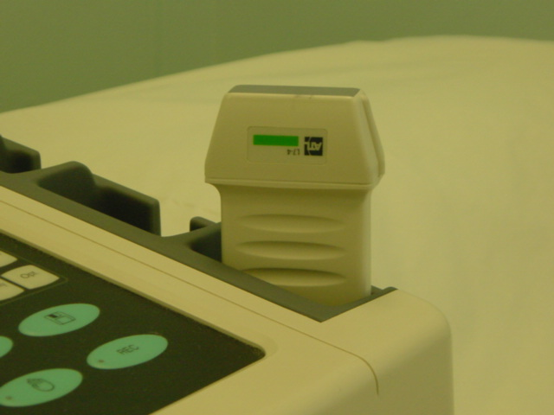
Transducer Selection
Linear (9-3)
- Femoral
- Popliteal
- Calf Veins

Slide 46
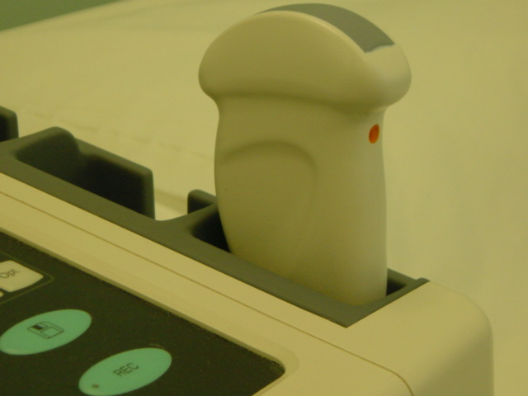
Transducer Selection
Curvi-Linear (C9-1, C5-1)
- IVC
- Iliac Veins
- Adductor Canal
- Large Patient
- Oedema

Slide 47
B-mode Scanning
Select venous setting on machine
Begin in groin, push probe in cross section into inguinal crease.
Visualise ‘Mickey Mouse’ and apply controlled pressure to collapse common femoral vein.
Continue along the thigh compressing veins every 2 -3 cms.
Use appropriate pressure! – very easy when training to press too hard
Notes:
Venous setting will automatically adjust colour and spectral Doppler scales and optimise B-mode image for venous scanning – applications specialist can help if this needs adjustment.

Slide 48
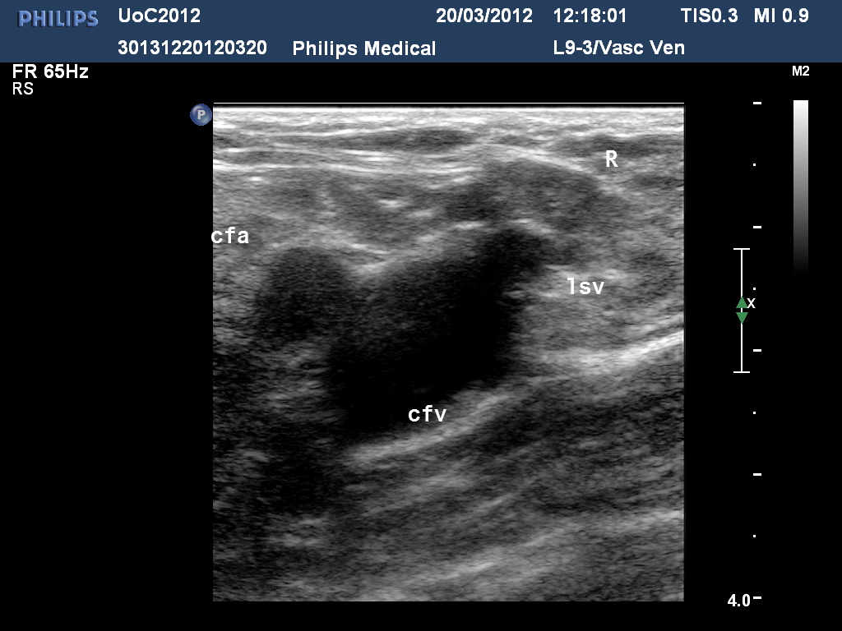
‘Mickey Mouse’

Slide 49
B-mode Scanning
Ensure you visualise the profunda vein – can have isolated thrombus.
Scan as much of the profunda vein as you can visualise – not just origin.
Scan the length of the SFV – check for duplicate branches – hence x-section first.
Scan as far into the adductor canal as possible.
If difficult to compress-place other hand onto back of thigh.

Slide 50
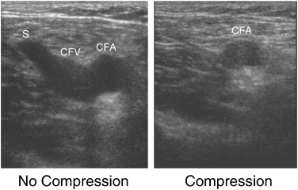
Common femoral vein

Slide 51
Colour duplex
Visualise the CFV in LS.
Activate colour mode and adjust PRF and gain.
If good colour filling with respiration don’t need to augment calf.
Follow veins to adductor level, augmenting blood flow every few cms.
Notes:
Ty to optimise colour so good filing with no colour bleed outside the vessel walls, want to optimise colour to identify filling defects.

Slide 52
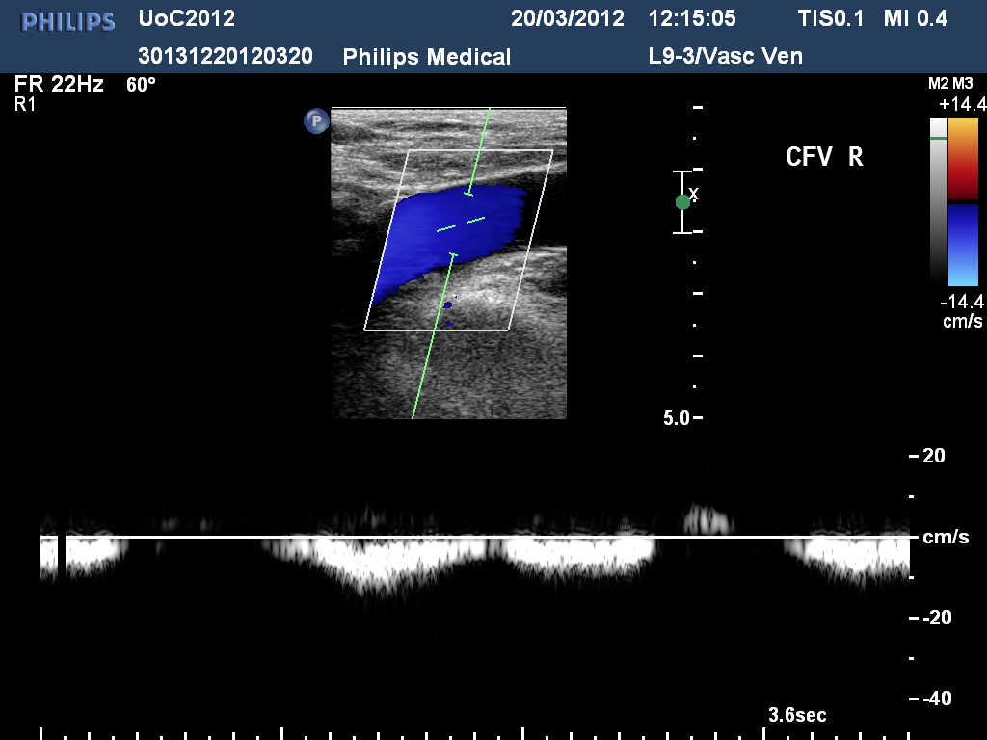
CFV - LS

Slide 53
Pulsed wave Doppler
Visualise the CFV in LS
(colour or B-mode).
Active PW and position sample gate in centre of vessel. Open sample gate to width of vessel.
Activate PW and observe waveform.
Valsalva – ask patient to take deep breath in and hold- then release breath.
Notes:
Open sample gate to width of vessel to allow adequate sampling of low velocities.

Slide 54
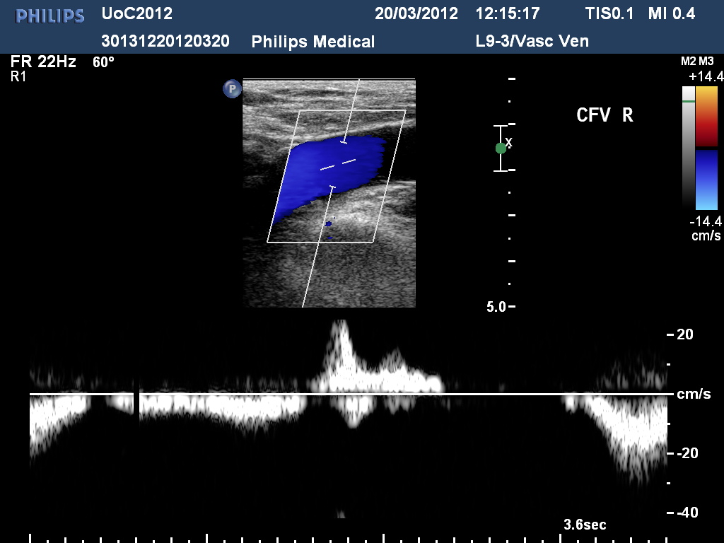
Valsalva manouevre
Notes:
Respiration causes changes in abdominal pressure. On inspiration, lungs fill and diaphragm descends increasing abdominal pressure, this causes cessation or reversal of blood flow in the CFV. On expiration the abdominal pressure decreases allowing flow into the abdominal veins again – all venous flow should typically be phasic with respiration.

Slide 55
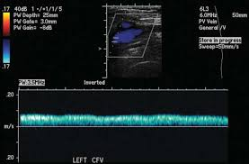
Notes:
An abnormal CFV waveform may demonstrate continuous, aphasic flow and should be suspicious for proximal vein obstruction.
Always compare both CFV’s if any suspicion of abnormal waveform.

Slide 56
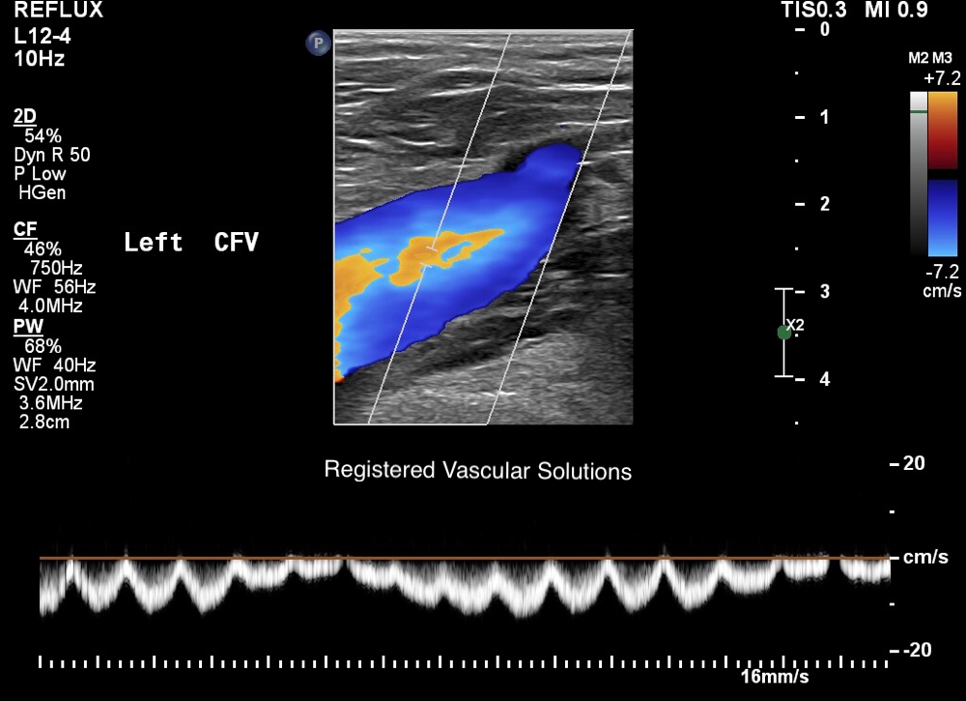
Notes:
Indicative of right sided heart failure however only for about 50% of patients – hence why not used for screening.

Slide 57
Calf DVT
Important to assess calf veins
20-30% of people with PE’s have calf DVT
20-30% of untreated calf DVT extend to above the knee.
2% of patients with calf DVT will have a fatal PE

Slide 58
Calf scanning
Visualise popliteal vein in x-section at knee crease.
B-mode – compress popliteal vein working upwards to over lap with SFV and then distally to TPT veins.
Repeat in LS with colour.
Systematically trace gastrocnemius veins.

Slide 59
Calf scanning
From medial aspect of calf identify posterior tibial (and peroneal veins).
Use B-mode and colour to assess.
From anterior calf identify anterior tibial (and peroneal veins)
From posterior calf identify peroneal (and ATV or PTV) and soleal veins.

Slide 60
Calf Scanning
Keep going over calf veins until you are completely satisfied you have visualised all the veins clearly.

Slide 61
Image Acquisition
Our protocols state we need to take images of –
  The Common femoral vein including valsalva
  PFV
  SFV origin and distal
  Popliteal vein
  Only take calf images if DVT present or differential diagnosis
Notes:
Right/left leg - CFV including Valsalva, PFV, SFV origin and distal, Popliteal. Only take image in the calf if DVT identified or differential diagnosis eg. Muscle tear, Baker’s cyst, superficial oedema or thrombo-phlebitus. Need to record images with measurements of abnormal masses such as enlarged lymph nodes, Bakers cysts, muscle tears. If required to demonstrate occlusive vein or compressibility use dual image function to show venous compression.

Slide 62
RSI
Patient positioning very important especially during DVT scans as not to cause injury to self.
As applying pressure you need to be in a good position as not to case injury.
Can use the legs to help with compressions.
Know your limitations!

Slide 63
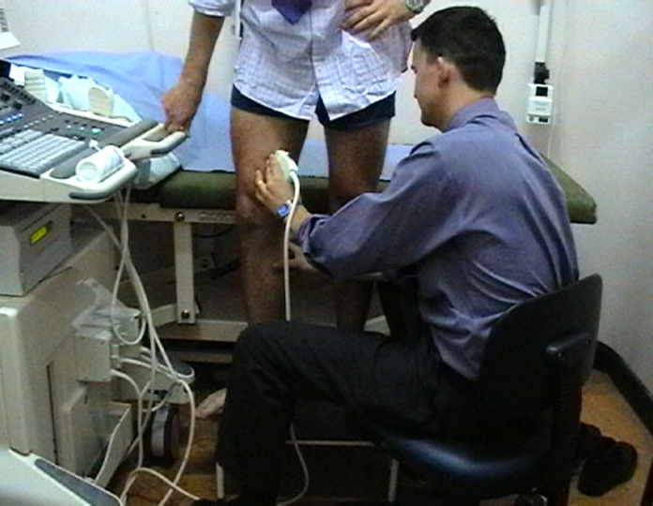
DVT scan
Standing patient position (proximal veins)

Slide 64
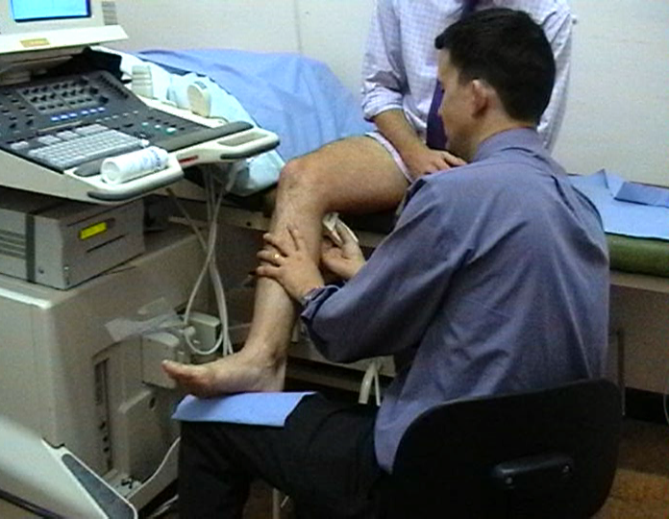
DVT Scan - Calf
Seated Patient (calf veins)

Slide 65
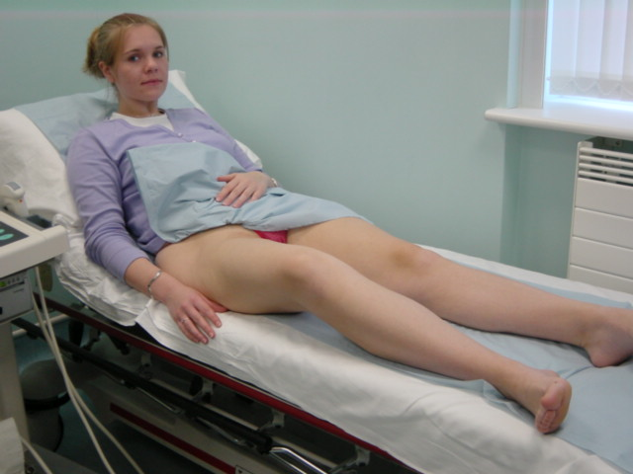
Venous Duplex Scan
Supine patient position (thigh and calf veins)

Slide 66
IVS Reporting protocols
5. Lower Limb venous duplex
a. Always comment on common femoral phasicity and Valsalva response.
b. Always comment on whether or not there is evidence of a previous DVT
DVT
c. Always state whether deep veins are compressible or not.
d. Comment when veins are not viewed, especially in the calf. If you cannot identify a vein state ‘ cannot fully exclude a calf DVT’

Slide 67
Reporting
Relate back to initial request:
?DVT, positive or negative
Positive - Evidence of Thrombus
  Location of thrombus (above/below knee)
  Extent of thrombus (occlusive/non-occlusive)
  Age of thrombus (acute/chronic)

Slide 68
Reporting Cont
May be occlusive or non-occlusive
Fresh thrombus is more echolucent
Mixed thrombus more echogenic
Old thrombus highly echogenic (possibly calcified)
Recanalised thrombus – irregular channels of (likely incompetent) flow through it.

Slide 69
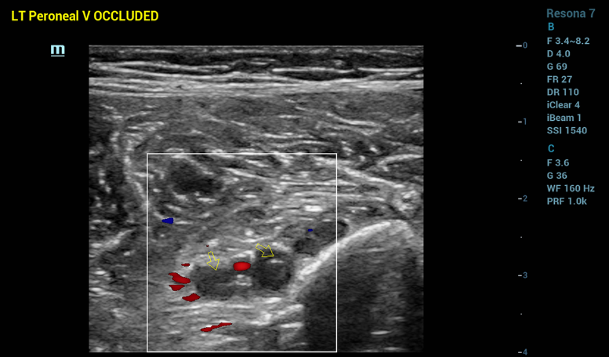
Thrombus Morphology

Slide 70
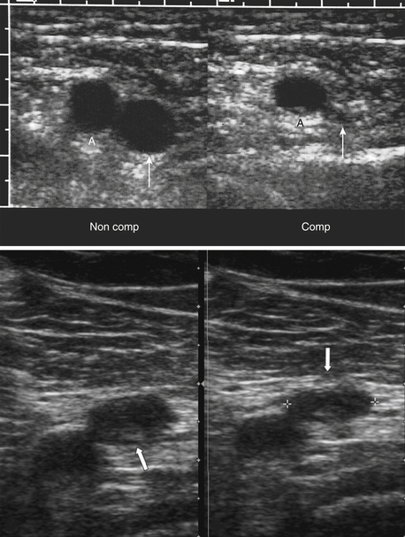
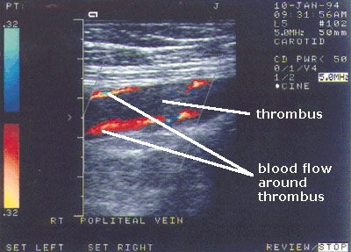

Slide 71
Acute vs Chronic thrombus
Acute
Chronic
Vein dilated
Echolucent
Not strongly adhered to vessel wall
Risk of PE
Needs immediate treatment
Vein not dilated
Echogenic/echoic bright appearance
Strongly adhered to vessel wall
No risk of PE
Does not need treatment
Notes:
Vein dilated
Echolucent
Not strongly adhered to vessel wall
Risk of PE
Needs immediate treatment
Vein not dilated
Echogenic/echoic bright appearance
Strongly adhered to vessel wall
No risk of PE
Does not need treatment

Slide 72
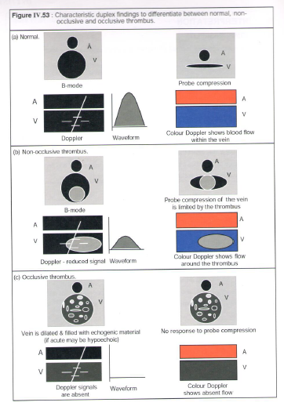

Slide 73
Red Flags
If you find a DVT as an incidental finding, e.g. On an arterial or varicose vein scan.
Follow red flag policy for the site you are in. Patient will need to be reviewed medically and started on anti-coagulant medication.
Free-floating thrombus – High risk of DVT

Slide 74
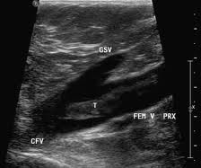
Free floating thrombus
High risk of PE
Measure length where possible

Slide 75
Reporting Cont
  Negative
    Differential diagnosis

Slide 76
Differential Diagnosis
Superficial thrombophlebitis
Haematoma
Lymphoedema / Oedema
Cellulitis
Baker’s Cyst
Venous incompetence
Muscle tears
Popliteal aneurysm
Acute arterial occlusion
Achilles tendon
Cyst/lumps
Lymph nodes
Notes:
Superficial thrombophlebitis
Haematoma
Lymphoedema / Oedema
Cellulitis
Baker’s Cyst
Venous incompetence
Muscle tears
Popliteal aneurysm
Acute arterial occlusion
Achilles tendon
Cyst/lumps
Lymph nodes

Slide 77
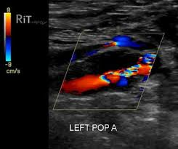
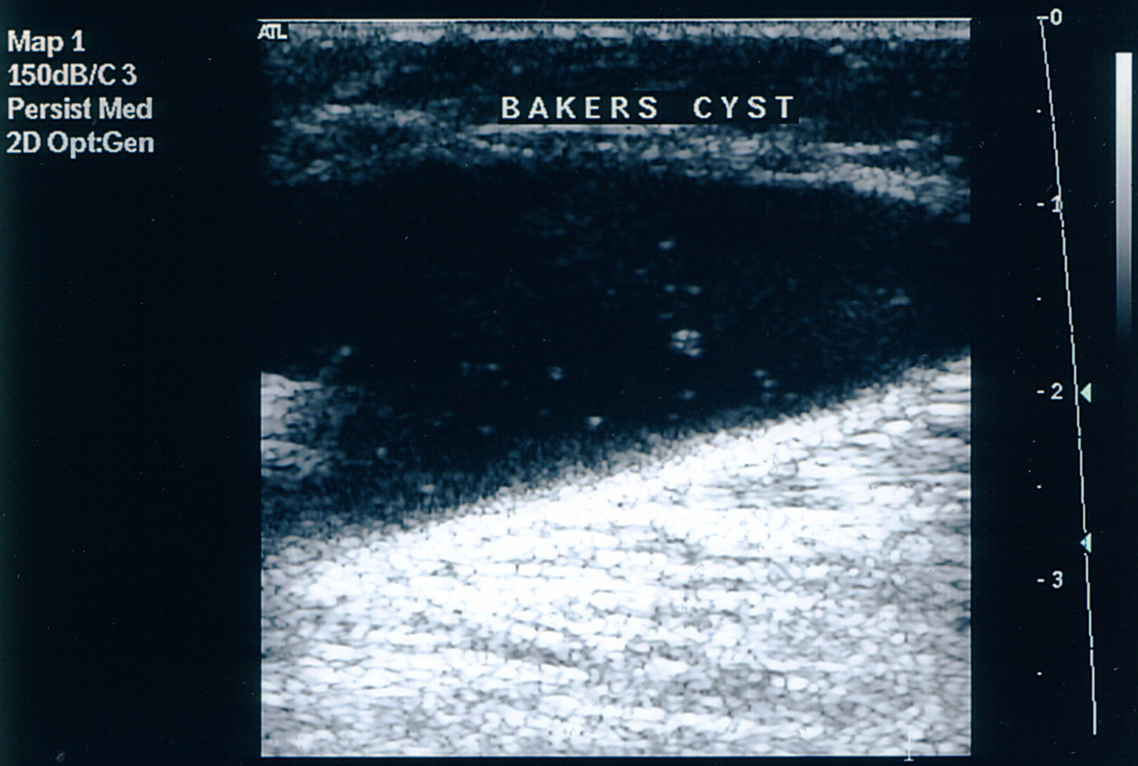
Differential diagnosis
Bakers Cyst
Popliteal Aneurysm

Slide 78
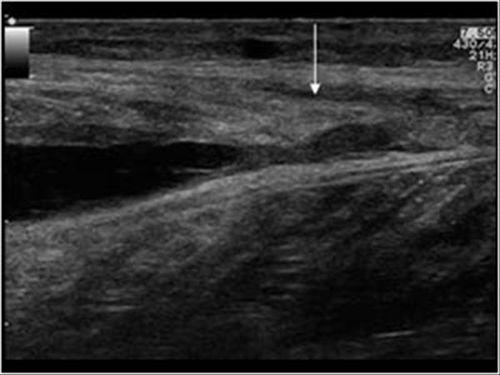
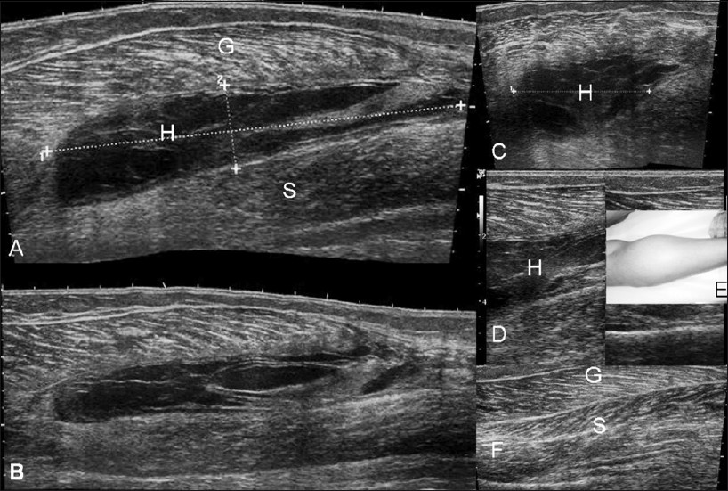
Haematoma
Muscle Tear

Slide 79
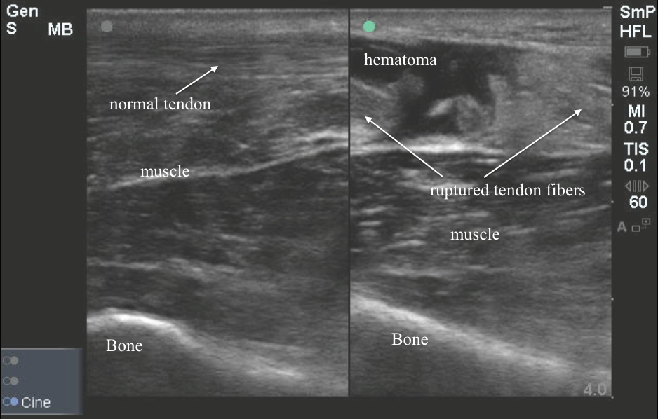
Ruptured Tendon

Slide 80
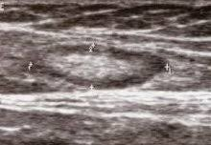
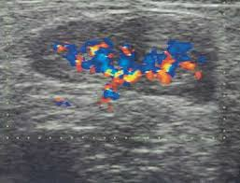
Lymph node normal
Lymph node vascularised

Slide 81
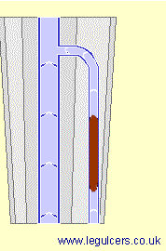
Thrombophlebitis
Clot in Superficial Vein
Skin over vein
  Hot
  Red
  Tender/Painful
  Inflamed
Treatment
Check local protocals

Slide 82
Technical Difficulties
Iliac veins not visualised due to depth or overlying bowel gas
  Always use Curved Low frequency probe
  Change angle of probe on skin
Limited access to calf due to ulceration, cellulitis or pain.
  Use alternative approach
Large / oedematous limb
  Use low frequency curved Probe

Slide 83
Technical Difficulties
Distinction between superficial and deep veins
  Clearly identify fascial layer
Anatomy Variation
  Bifid SFVs found in 24% of people
  Assess veins in transverse section compressing all veins visualised

Slide 84
Treatment
Anticoagulation Drugs
  LMWH Heparin / Warfarin
Initial treatment by IV infusion followed by long term oral anticoagulation drugs.
Vena Cava filters for patients with high risk of embolisation.
Catheter directed Thrombolysis
Notes:
A blood clot (thrombus) in a vein is usually treated with anticoagulant drugs. This stops further clotting but does not dissolve the thrombus. For severe deep vein thrombosis (DVT) thrombolysis is sometimes used: a catheter (tube) is inserted into a vein (usually in the leg) and used to deliver clot busting drugs to dissolve the clot (thrombolysis). In this procedure ultrasound energy is also used, with the aim of making thrombolysis work better and faster.

Slide 85
Outcome of DVT
May resolve without complications
  Lysis of thrombus through fibrinolytic activity
May cause damage to the valves
  Post-phlebitic limb (post thrombotic limb) i.e. eczema, discolouration and ulceration.
Propagate or Embolise
  Pulmonary embolism
Notes:
Signs and symptoms of PTS in the leg may include:^{[1]}
pain (aching or cramping)
heaviness
itching or tingling
swelling (edema)
varicose veins
brownish or reddish skin discoloration
ulcer
These signs and symptoms may vary among patients and over time. With PTS, these symptoms typically are worse after walking or standing for long periods of time and improve with resting or elevating the leg.^{[1]}

Slide 86
Upper limb venous scanning

Slide 87
Upper Limb DVT
Rare
Risk factors and symptoms similar to lower limb DVT
Main causes include
  Trauma (long term catheterisation)
  Breast cancer
  Thoracic outlet syndrome
Subclavian and Axillary veins are the commonest site for thrombosis.
Notes:
Upper limb DVT may be due to thoracic outlet syndrome – external compression of subclavian or axillary vein due to cervical rib or muscle compression.

Slide 88
Why scan upper limb veins?
Assessment for DVT
Vein marking for arterial bypass grafts
Pre-operative assessment for AVF
Assessment for suitability for venous access.
Notes:
Requests for upper limb venous duplex scanning for DVT are less common than for lower limb. Most upper limb ?DVT requests are for inpatients who have had venous lines insitu etc.
Venous duplex scanning may also be requested for assessment of cephalic veins when lower limb veins are unsuitable or have been previously used. Protocol for these assessments are similar to those of lower limb. Size of aprox 3-6mm diameter and fairly linear, unbranched vein. Upper limb varices are rare.
Patients who require constant venous access such as those with cystic fibrosis may need venous mapping prior to insertion of a new line to assess for thrombus and venous anatomy.

Slide 89
Visual exam and history
Oedema
Prominent superficial veins visible on chest on neck
Localised redness on skin
Lines insitu
Notes:
How long has oedema been present?
Prominent veins may indicate chronic deep venous obstruction.
Occluded IJV may be obvious visually – thick hard cord on side of neck.
Localised red cord on arm – thrombo-phlebitis.
May identify line during scan or have work around them. Will appear highly echogenic and linear – should be obvious.

Slide 90
Patient positioning
Sitting with arm supported or lying down with arm supported to side.
Turn head away to improve access to supra-clavicular veins.
Notes:
Be aware that veins of head and neck will dilate or collapse under changes in hydrostatic pressure and may need to change position to facilitate scanning.
For pre-operative vein mapping eg cephalic vein assessment – have arm dependent to dilate veins.
For AVF surveillance scans – use same position consistently.

Slide 91
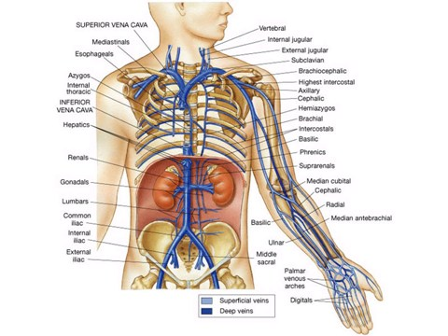
Upper limb venous anatomy
Notes:
Common anatomical variants: Multiple brachial veins, High bifurcation of brachial artery with subsequent high venous confluence.
Absent/ duplicate superficial veins eg cephalic and basilic veins.
Duplicated subclavian veins. Variations of the median cubital vein.
Superficial veins drain as much blood as deep veins and should always be examined. Basilic vein lies deep to fascia but has no arterial counterpart – usually large calibre so should be assessed during investigations for DVT.

Slide 92
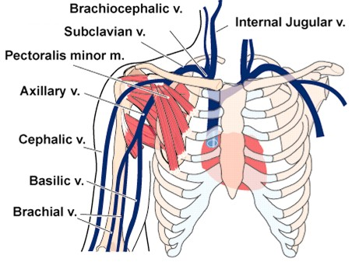
Upper limb venous anatomy
Notes:
Common variants are duplicate veins. Variation in position of median cubital vein between cephalic and basilic vein.
High arterial bifurcation in the upper arm will have corresponding high brachial vein confluences.

Slide 93
Normal physiology
Venous flow is influenced by respiration
Two main differences to lower limb venous flow:
Reversed Valsalva effect – increased flow with inspiration.
Venous flow in larger proximal veins is influenced by right atrial pulsations – making waveform pulsatile.
Notes:
Like within the lower limbs, veins of the upper body contains valves and are low pressure – 2 main differences compared to lower limb veins are reversal of Valsalva effect and pulsatility.

Slide 94
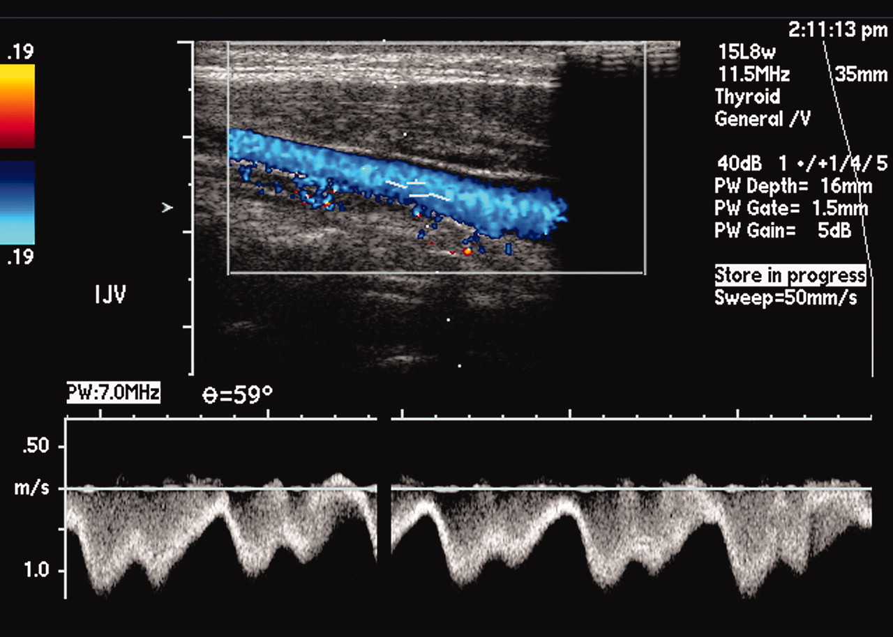
Normal venous waveforms

Slide 95
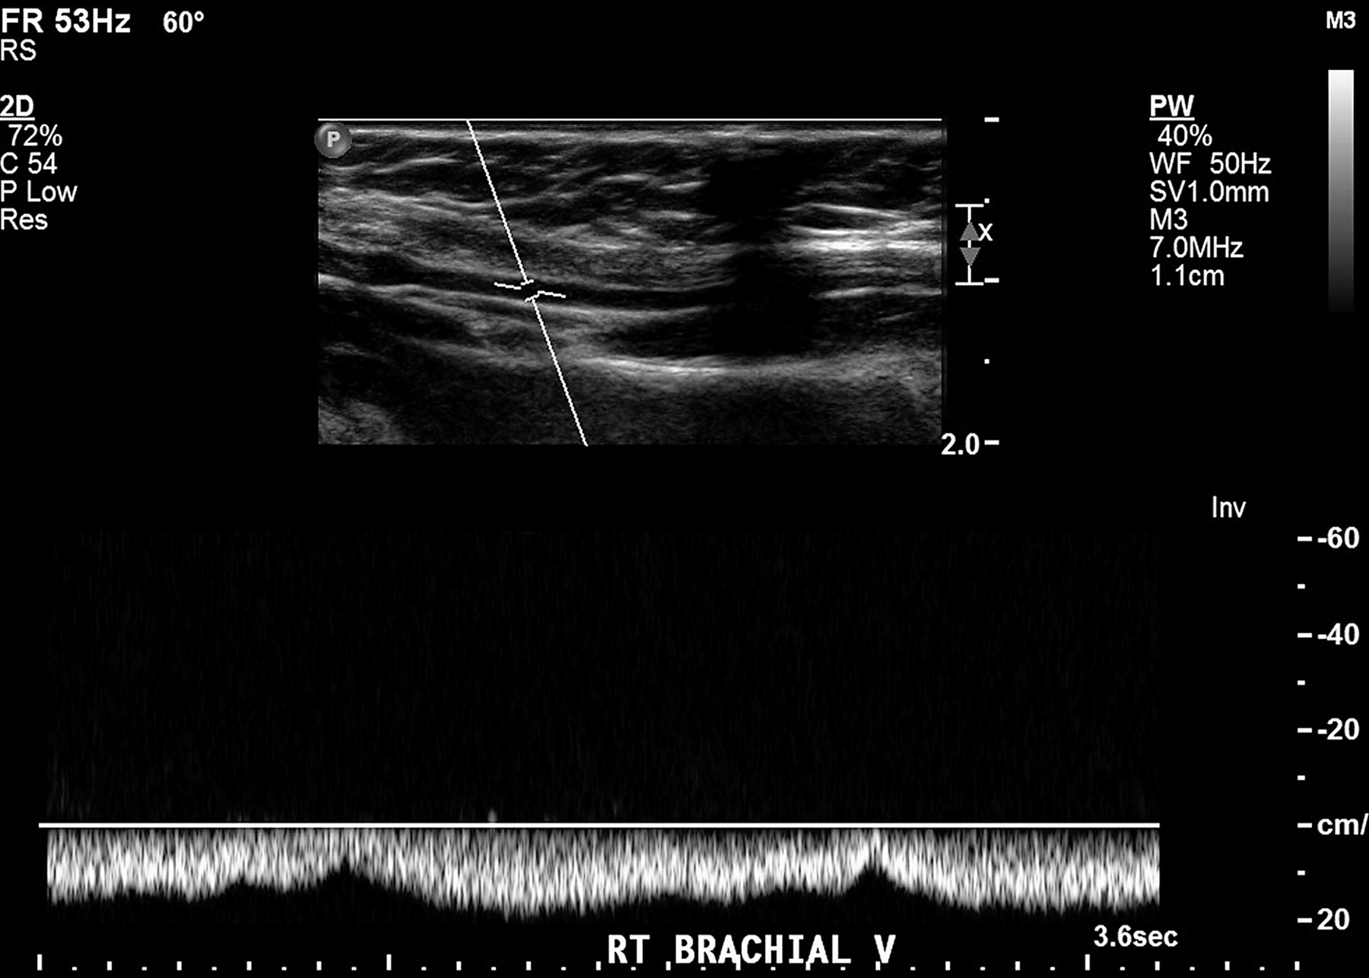
Normal venous waveforms

Slide 96
Scanning
Scan length of IJV – be careful if compressing. Use colour flow and SD.
Scan subclavian vein in LS using colour flow from supra and infra-clavicular aspect –try to overlap as much as possible.
Scan axillary vein in LS through axilla region for optimum images.
Can use x-section in the upper limb to compress veins to ante-cubtial fossa.
Notes:
Unable to compress proximal veins due to bony stuctures. Use colour and optimise controls as much as possible.
Can use B-mode image in x-section and compressions to assess veins in upper limb.
Cephalic and Basilic veins carry significant blood volume approx = to brachial veins so important to assess.
Depending on protocol may not need to assess radial and ulnar veins due to small size.
Check both subclavians veins even for a single arm scan.

Slide 97
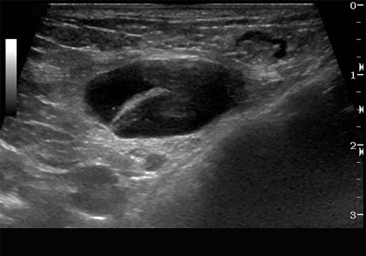
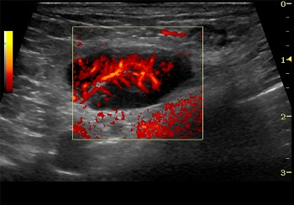
Axillary lymphnodes

Slide 98
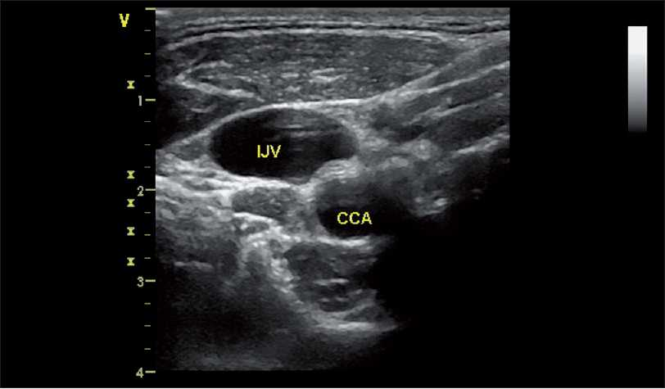
IJV patent

Slide 99
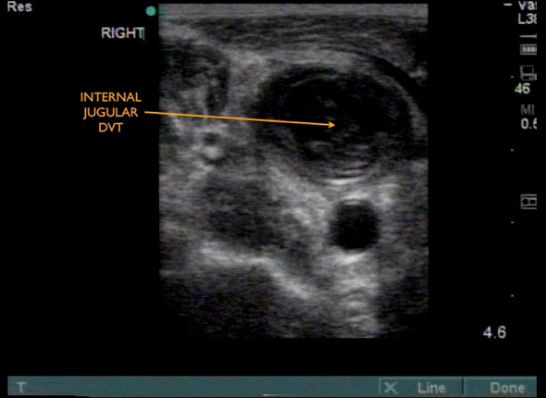
IJV DVT

