Slide 1

Vein Mapping
Interactive Vascular Ultrasound Masterclass

Slide 2
Course timetable
14:00 Presentation
14:45 Afternoon tea
15:00 Practical session – live patient + practicing on each other

Slide 3
Why do we do vein mapping?
To find a suitable conduit for an arterial bypass graft to ensure a successful outcome for the patient.
To reduce unnecessary trauma caused by surgically searching for veins.
To eliminate surgical candidates who do not have suitable veins.
We do this by assessing the intraluminal diameter, presence of thrombus, continuity and branching of the veins we assess.

Slide 4
Types of bypass
Femoral popliteal – most common
Femoral distal – requires more vein(distal anastomosis is onto posterior tibial, peroneal, anterior tibial or dorsalis pedis artery)
Coronary artery bypass graft (CABG) – don’t normally need mapping. Only if significant history of varicose veins or previous harvesting.
Fem-fem crossover (CFA to contralateral CFA). Prosthetic commonly used for these.
Axilla femoral / Axilla-bifemoral – Prosthetic commonly used.
Require a lot of vein.

Slide 5
Scanning Protocol
TAKE A HISTORY – This is possibly the most important step in the process.
Not all previous harvests, surgeries, VVs, VTEs are noted on the referral e.g. For FPBG only is common to see. If more info is needed CALL THE CONSULTANT.
Ask the patient if they have had any clots in their leg veins, any previous varicose vein procedures, any previous vein harvests.
This can save a huge amount of time if the patient tells you they have had bilateral strippings and this is their 3rd graft!

Slide 6
Scanning Protocol
Patient should be sat upright, on a tilted couch to fill veins.
Start with ipsilateral leg (the leg to receive bypass)
Assess great saphenous vein (GSV) for thrombus and intraluminal diameter – preferably >3mm.
Take diameter measurements at SFJ, mid-thigh, knee and mid-calf as minimum.
If focal dilatations, sudden change in calibre, make additional measurements.
Make note of excessive branching, such as varicose veins, or potential suitable branches.
Assess for DVT.
If in doubt call the patient’s vascular consultant.

Slide 7
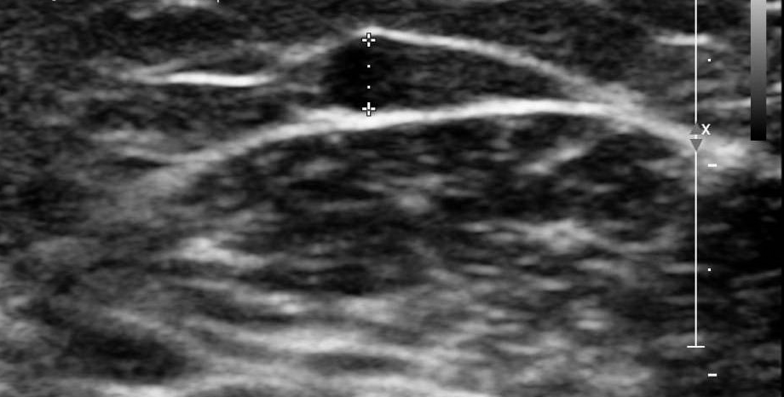
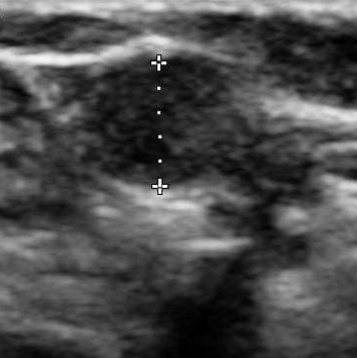
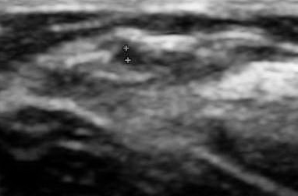
Diameters – 9-3L probe

Slide 8
Scanning Protocol
If not vein in ipsilateral leg, move to contralateral leg, then too arm veins.
Preference differs between consultants.
Once suitable veins have been found, they can be marked. If in doubt, call the patient’s vascular consultant.

Slide 9
Scanning Protocol
For arms veins, assess the upper arm, ACF, forearm and wrist for cephalic and basilic veins.
Map median cubital vein (MCV) if present as this can be used to make a loop from upper arm veins.
Use a tourniquet.
Assess for thrombus, particular in areas where they have lines/previous lines.
Make note of anatomical variations – discontinuous veins.
It may be appropriate to measure the length of a suitable segment.
If in doubt call the consultant!

Slide 10
Marking
Once suitable veins identified, proceed to marking.
Wipe all the jelly off leaving a tiny bit on the probe.
In transverse section, get the vein in the centre of the image.
Place a dot with marker pen in the centre just above the probe.
Repeat till there is a line of dots (approx. 5-6cm apart).
Wipe off the remaining gel and carefully join the dots.
Check your line.
Mark any major branches, narrower segments.

Slide 11
Reports
Genesis sheet
Documents diameters, anatomy, presence of thrombus, veins marked (including length, possibly depth).
Whether a tourniquet was used.
Whether this was discussed with the consultant.
Technical difficulties e.g. patient position, movement etc.
Email them to reporting radiologists, PACS and vascular consultant.

Slide 12
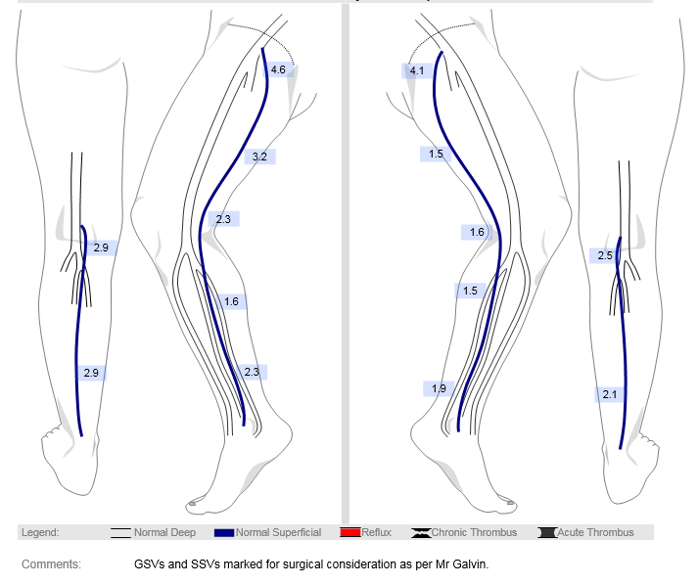

Slide 13
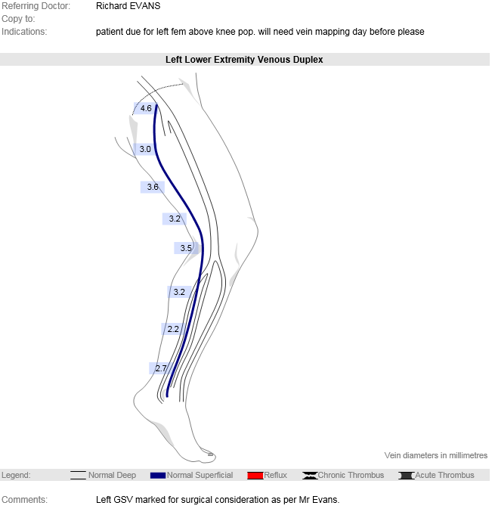

Slide 14
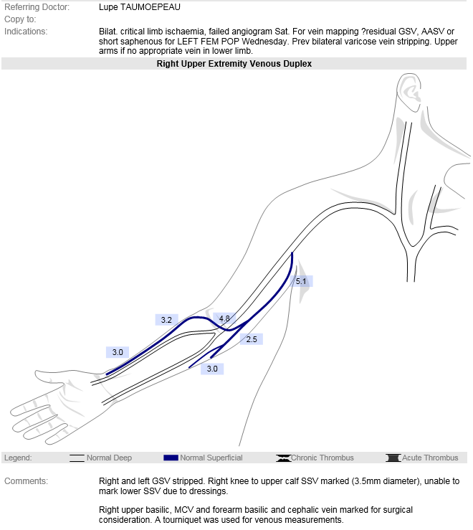

Slide 15
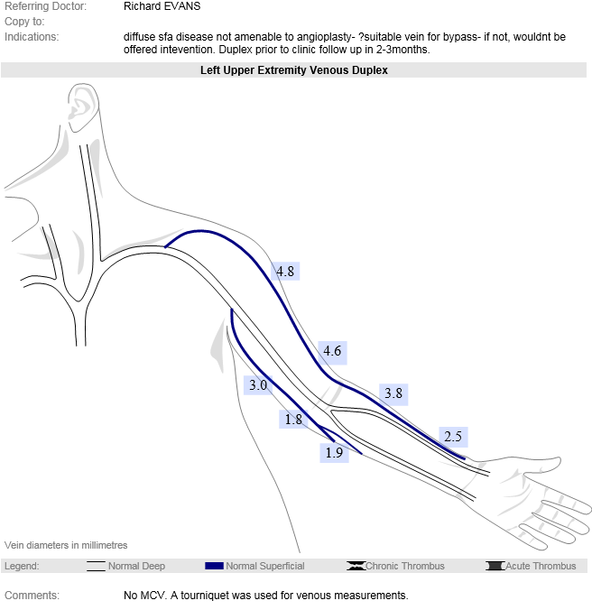

Slide 16
Avoiding issues
Communication is key!
You may think a vein is suitable, but actually Mr Naik doesn’t like using contralateral leg, Mr Wicks is saving that vein for another procedure, there’s too much oedema or chronic pain issue in that leg, they want you to find no vein so they don’t have to operate.
Take the time to take a history - you have 1 hour!

