Slide 1
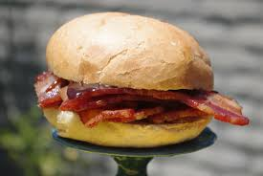

Slide 2
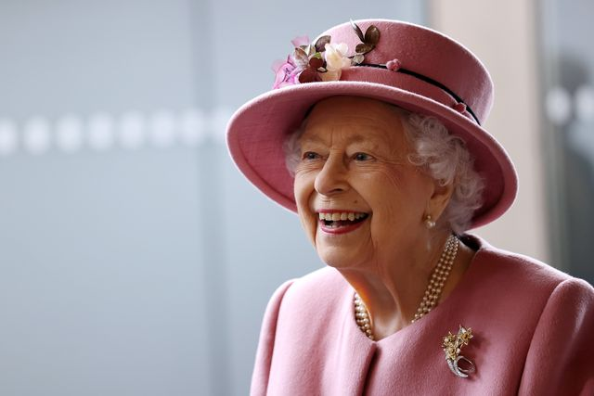
Where is my marmalade sandwich?

Slide 3
Vascular meeting 15th June
Agenda
Nicky update
Image audit review
Akam crural audit update
Viewpoint update
DVT clinic
Trainee update
Alannah and Heulwen case study
Alannah

Slide 4
Dame Heulwen, how are those images coming along?

Slide 5

Image Audit

Slide 6

Deleting of unnecessary images
Check through your images when
you finish a scan to make sure you:
Have all images as per protocol
Have no images which aren’t of a good quality i.e. images which show raised velocities (a stenosis) when you’ve actually sampled a collateral vessel and then realised but forgotten to delete the images.

Slide 7
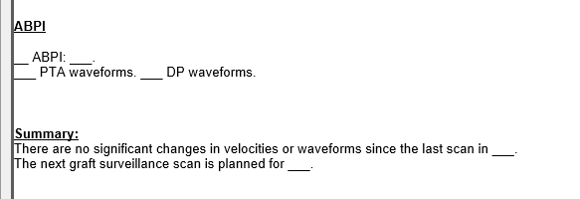
Reporting
Make sure to proof-read reports for sentences which don’t make sense and obvious spelling mistakes.
Make sure that the summary matches the information you’ve provided in the main body of the report.
Some reports look rushed with very strange spelling mistakes.
It makes us look as though we don’t know what we’re talking about!
This is an example of a report that was signed off.

Slide 8
Portable machine
Images are of a much lower quality (expected as performed on ward).
I think the pre-sets need changing as images do seem to be of a much lower quality lately.
However, machine controls are not being optimised as well as they could be to get the best quality images (mostly carotids).
Particular issue with the B-mode image (looks very grainy) and colour-filling is poor. The following may help:
Write priority (for colour filling)
Decrease B-mode gain
Decrease dynamic range to increase vessel wall clarity.

Slide 9
Akam, are we doing jolly good or jolly bad?

Slide 10
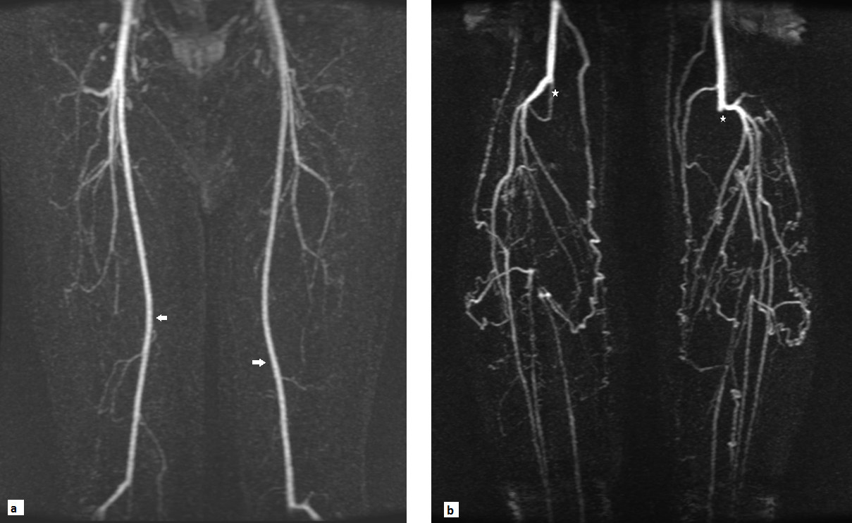
Akam crural audit

Slide 11

What is the latest?
Recap – audit to compare crural Duplex to MRA to determine accuracy of Duplex.
Potential for Duplex to replace/decrease the need for MRAs in certain patients.
Retrospective part of the study is almost complete.
Better agreement than expected.
Our crural scans have an ~60-70% agreement to MRA.

Slide 12
Robert, what is this viewpoint I hear of?

Slide 13

Viewpoint update

Slide 14
Customisation phase - NOW
Designing the report layout (drawing lots of legs)
Selecting relevant information to present
Selecting the type of inputs (drop down vs hand typed etc)
This is in phase now.
Training phase - NEXT
I will be trained by Viewpoint staff and then I in turn will train you.
There will be 2 ‘super-users’ initially that will be given back door access so that we can tweak things if needed (this will be myself and Heulwen). We will also be able to run statistical queries through viewpoint too, I believe.
It is going to be awkward at first – but I promise it will be easier after a while!

Slide 15
Implementation
Aiming to go live in November 2022.
Although this depends on many things out of our control.
But – our back end limit is February 2023. So it could be a while yet.
RDH Maternity have just gone through this process though - so I hope with their mock run before us has ironed out some of the wrinkles with our IT department etc.

Slide 16
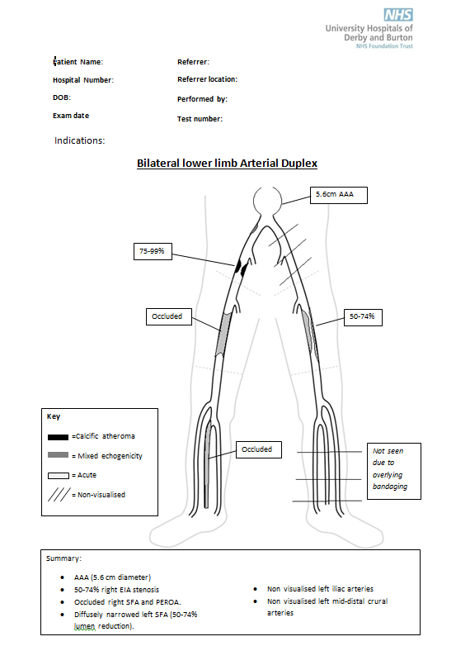
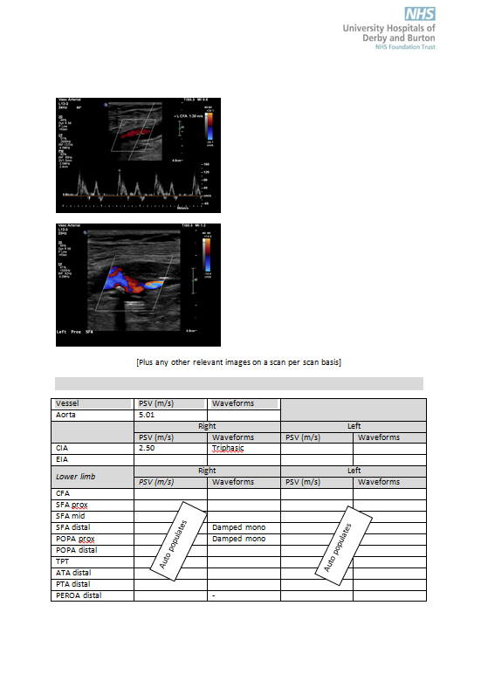
Example reports

Slide 17
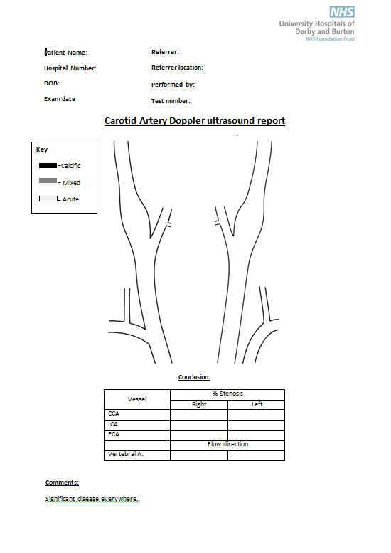
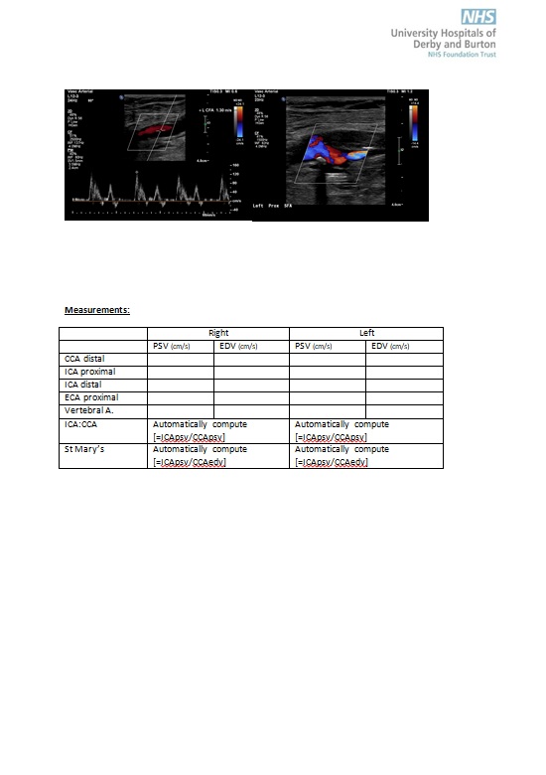
Example reports

Slide 18
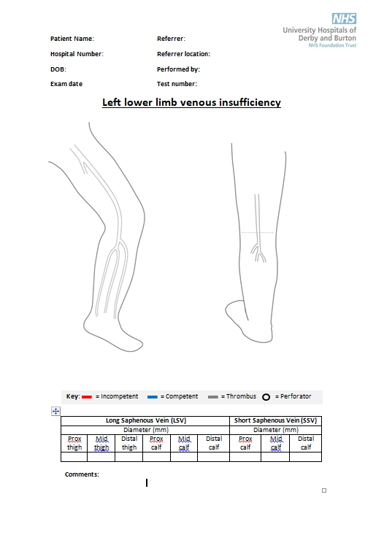
Example reports

Slide 19
By Jove, we’re doing a lot of DVTs lately!

Slide 20

DVT clinic service evaluation

Slide 21






May 2022
…..A sad story of ? doing too many DVTs
BUT, what do the stats say?

Slide 22
Fun Fact: May 2022 was the most DVT clinic scans we have ever performed
ACLAPH | 31
ALMOBR | 10
ASWAN | 5
HEUGIL | 37
NPALIN | 7
PLEIVERS | 31
RJAMES | 80
RLAWFORD | 29
1st: May 2022 230
2nd: March 2022 203
3rd: July 2020 / July 2018 200

Slide 23
So the Questions to ask
Are we generally doing more DVTs?
Was this a one off
… or does this correlate with seasonal variance?
How many more are we generally doing?
Do we need more slots?

Slide 24
Total scans PCM

Slide 25
Does this correlate with seasonal variance?
= Mean number of scans each month
Mean number of annual scans
(collected between Jan 2018 and May 2022)
The DVT season is March – October.

Slide 26
Does this increase correlate with seasonal variance?
Kind of. But it is way above what we would normally expect the increase to be?

Slide 27
So what is going on?
The referral patterns have changed this year, but not seasonally…
The referral patterns have changed (more on Mondays and Tuesdays)
Average scans each day per year

Slide 28

So the next question is – How much does this impact our service?
/ Do we need to offer more slots?

Slide 29
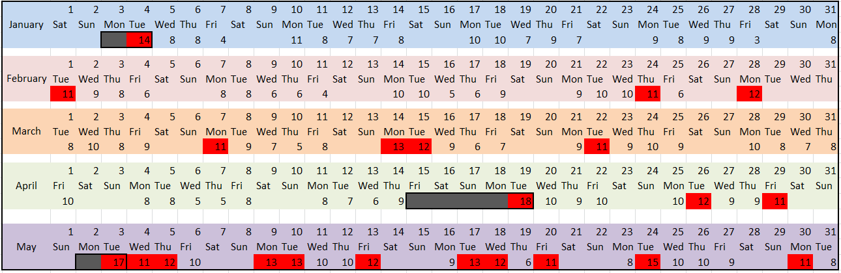
2022
Red = > 10 scans
Grey = Bank Holiday

Slide 30
Red = a day following a Bank Holiday
Note: 10/19 of these are all in May!!

Slide 31
As a % of total working days, how often do we do >10 DVT scans?

Slide 32
As a % of Monday and Tuesdays (2022), what proportion of days do we do >10 DVT scans?
 | Mondays | Mondays with >10 scans (n) | Mondays with >10 scans (%) | Tuesdays (minus BH) | Tuesdays with >10 scans (n) | Tuesdays with >10 scans (%)
Jan | 4 | 0 | 0% | 3 | 0 | 0%
Feb | 4 | 1 | 25% | 4 | 1 | 25%
March | 4 | 2 | 50% | 5 | 2 | 40%
April | 3 | 0 | 0% | 3 | 1 | 33%
May | 4 | 2 | 50% | 4 | 3 | 75%
Average = 25%
Average = 35%
What threshold is acceptable, and is this going to be continuous or is it part of the seasonal trend?

Slide 33
How many extra slots?
When we have gone over 10 slots in 2022, how many scans have we done?
(excluding BH follow up)
January | -
February | 11.3
March | 11.8
April | 11.5
May | 12.3

Slide 34
What we are doing
2 extra V10 scans on Mondays and Tuesdays
At least for peak seasons (flexible)

Slide 35
How are out little ducklings doing?

Slide 36

Ryan and Alannah training update

Slide 37
Alannah
Ryan
Needs significant carotid scan assessments, then will be fully signed off for carotids.
A couple more assessments left for grafts.
Made a good start with varicose veins.
1 x SVT theory exam to go.
Needs to see and do as many grafts as possible to build up competency and get ready to be assessed.
Has recently started learning varicose veins.
2 x SVT theory exams to go.

Slide 38

Both have a SVT theory exam tomorrow… good luck!!!

Slide 39
Have there been any interesting cases lately Heulwen and Alannah?

Slide 40
Congenital absence of the ICA (Alannah and Heulwen case study)

Slide 41
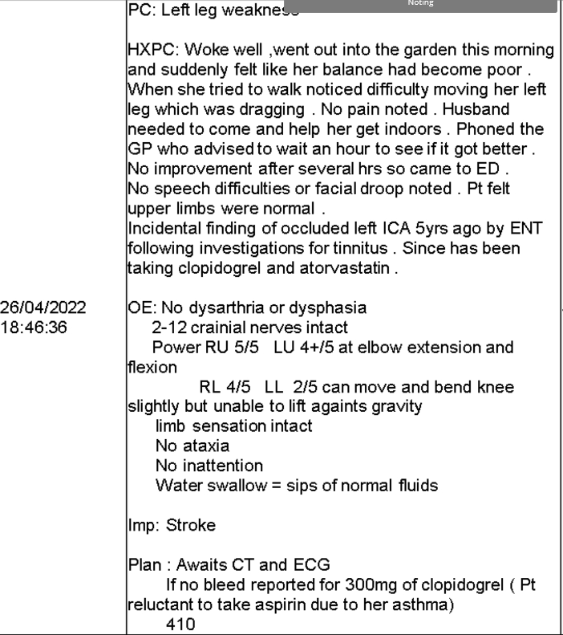
66 year old female.
Presented to ED with balance disturbance and left leg weakness.
No dysarthria or dysphasia, no ataxia, no inattention, no headache, no facial droop.
Left sided lower limb weakness
Admitted to 410.

Slide 42
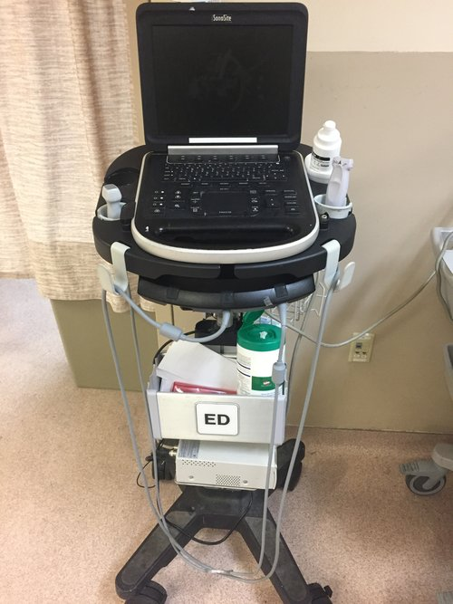
Patient was treated for Rt LACS (clinically) – head CT showed no acute infarct.
Patient made a reasonable recovery -> So a carotid Duplex was performed.
Carotid referral – ‘left leg weakness,
known carotid stenosis’.
Patient informed us that an MRI was performed in 2017 by ENT for investigation into Otalgia.
An incidental finding of this was an occluded left ICA.

Slide 43

Carotid Duplex
Unremarkable findings on right side – so nothing which would explain the left leg weakness.

Slide 44
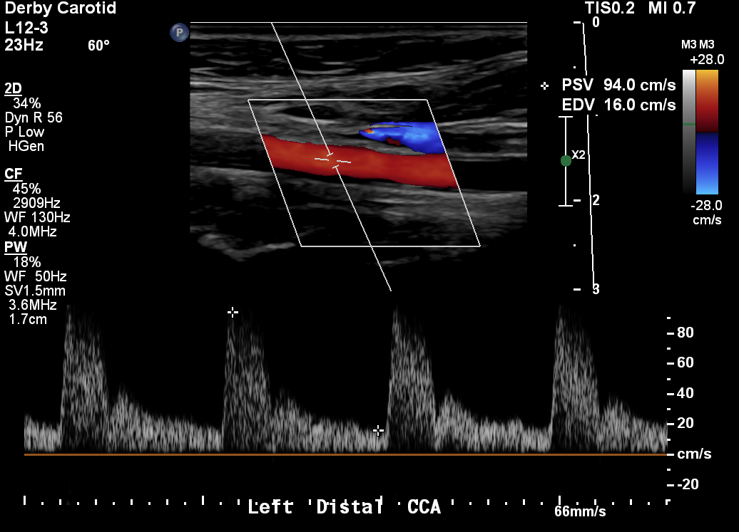
Carotid Duplex
Low resistance ipsilateral CCA waveform – occlusion of ICA = normally high resistant CCA flow with no diastolic component.

Slide 45
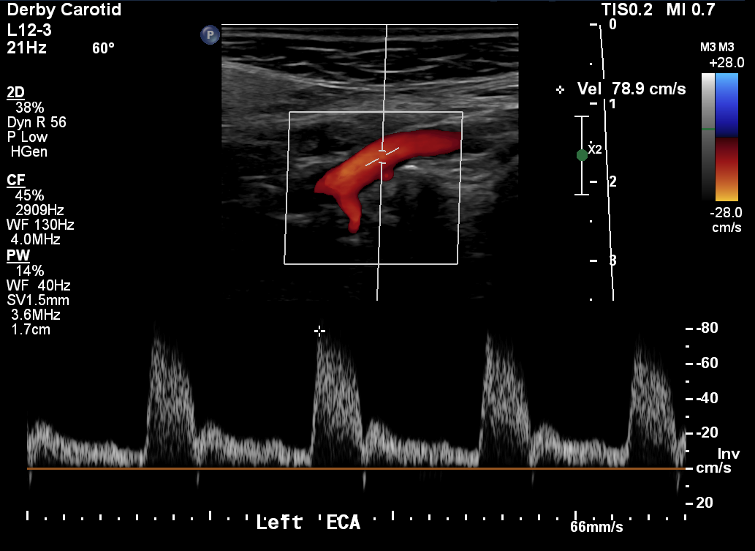
Carotid Duplex
Low resistant ipsilateral ECA waveform with lots of diastolic flow – ? Potential for ECA to be supplying collateral flow.

Slide 46

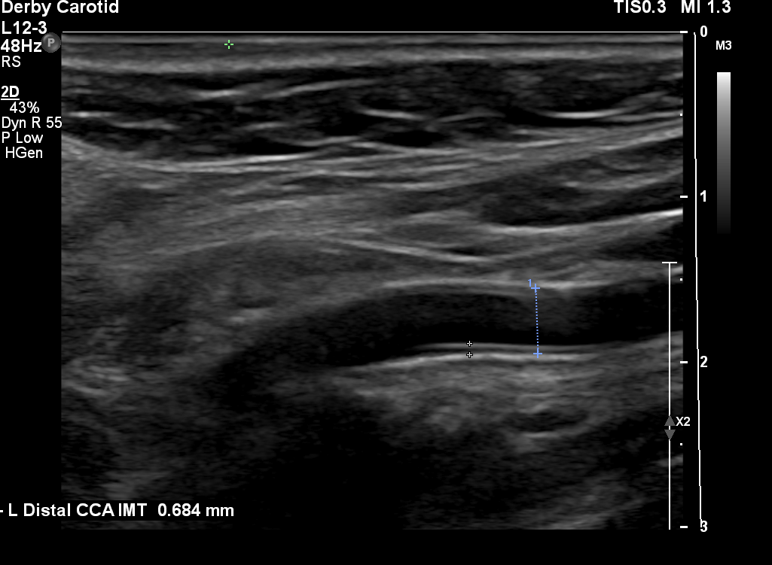
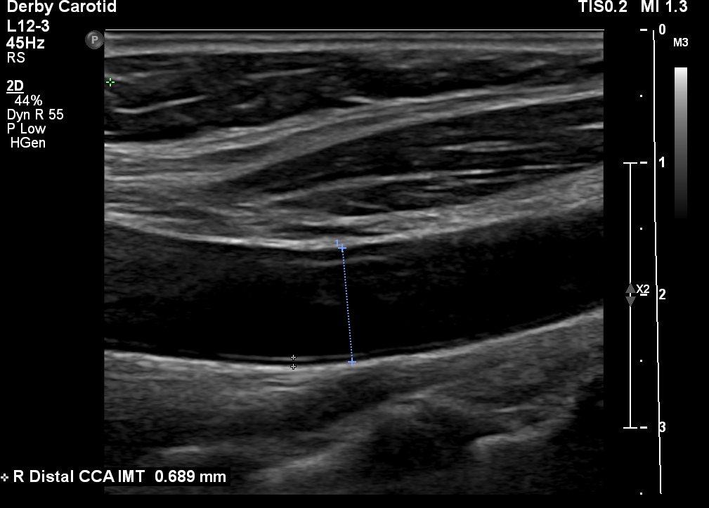
Carotid Duplex
Small calibre left CCA (possibly hypoplastic) – 4mm when compared to 8.6mm on the right side.

Slide 47

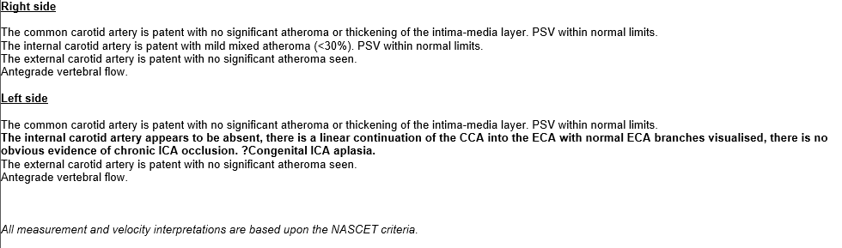
Our report
We reported an absence of the left ICA as there was no evidence of chronic occlusion – we were just simply unable to visualise an ICA or bifurcation.
No obvious evidence of atherosclerotic disease.

Slide 48

What is ICA agenesis?
Rare congenital abnormality occurring in less than 0.01% of the population.
Only around 100 cases have been reported in the literature.
The internal carotid artery fails to form and is therefore absent.
Is most commonly unilateral.
In most cases is symptomatic due to sufficient collateral circulation via circle of Willis.
Absence of the bony carotid canal is essential to differentiate this anomaly from chronic ICA occlusion.

Slide 49
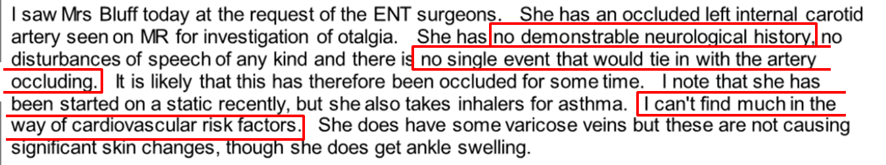
Review of PMH
No neurological history or a single event that would tie in with the ICA occluding.
No cardiovascular risk factors.

Slide 50
Follow up
Findings discussed with Stroke consultant.
Stroke consultant reviewed MRI images from 2017 and confirmed absence of carotid canal.
28/04/2022 MRI requested to further evaluate.

Slide 51
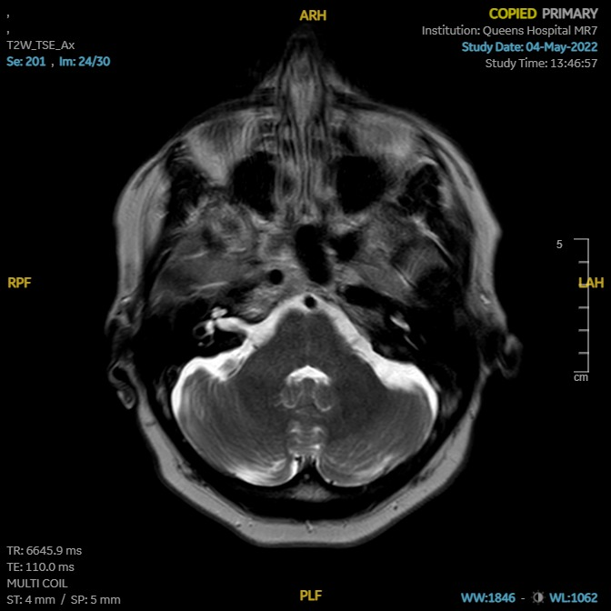
MRI
Right carotid + carotid canal
Absent left carotid + carotid canal

Slide 52
Why is an understanding of ICA agenesis important?
Very rare and is therefore relatively unheard of, this can lead to misdiagnosis which was the case with this lady.
Correct diagnosis is important because:
Patients with ICA agenesis have an increased incidence of various intracranial pathologies such as:
Intracranial aneurysms.
Abnormality of the basilar artery.

Slide 53
After all our hard work we should be looking after ourselves…

Slide 54


