Slide 1
Vascular Ultrasound
The Basic Principles
Notes:
Hello I’m Daniela and I’m a clinical vascular scientist here are the RCHT. I’ve been asked to give you all a brief insight into the basic principles of ultrasound and the relevance to Doppler ultrasound techniques used in the vascular labs, in theatre or on the wards. What level have you all studies physics to???
Given the limited time we have you will hopefully grasp the basics by the end of this session but I strongly recommended you do some further reading around Doppler physics as this will help you to better understand and appreciate how you as the operator will have a huge influence on the quality of your images and therefore the interpretation of the results.
At the end of this session I will give you the details of a course run by the SVT on the fundamentals of Vascular Ultrasound which takes place at Addenbrooks hospital January 26-27th if anyone is interested

Slide 2
Aims
Principles of Doppler Ultrasound
Spatial resolution in relation to the scan plane
Limitations of ultrasound
Requirements for imaging different vascular territories
Ultrasound interpretations
Notes:
As you can see there is a lot of theory to cover but I will try and keep it brief as you can all read a book but for the technical skills part I’m going to do a hands on session – so be prepared I am going to want volunteers! The best way to learn and appreciate about vascular ultrasound by you actually holding a probe and having a go.
We will look at the basic principles of Doppler ultrasound and spatial resolution in relation to the scan plane
We will discuss the various limitations of ultrasound and the pitfalls associated with scanning and importantly discuss the need for you to recognise and accept your own limitations, vascular ultrasound is very operator dependant and knowing when to seek help or advice is crucial
For the last 2 we can discuss during the practical session the different types of vascular scans and investigations in terms of patient positioning and preparation for optimal results
And how as the operator you will also be required to interpret your results. By using your knowledge of the physics behind Doppler ultrasound you will be able to diagnose vascular conditions or offer an expert opinion to guide management of the patient

Slide 3
Technical Skills
Select appropriate probe
Optimise grey scale imaging
Optimise colour flow imaging
Optimise pulsed wave settings
Perform arterial ultrasound studies for intraoperative control
Screen for abdominal aortic aneurysm & measure diameter of an aorta
Notes:
There is a huge amount of theory behind Doppler Ultrasound which will underpin your technical skill so gaining a solid understanding of the basic physics principles is key
This will help you achieve the best quality images and information from your investigation enabling you to know how to optimise your images.
I’ll go through the different types of probes we use for different scanning modalities , how to optimise the grey scale or B-mode image, colour flow and pulsed wave settings
Obviously I can’t demonstrate this in my scanning room! As surgeons you will be required to perform arterial u/s studies or HHD monitoring for intraoperative control such as assessing flow in a bypass graft at the end of a procedure or following a carotid endartectomy…although only very limited examinations these are obviously extremely important examinations, being confident in your abilities is essential
Finally you are required to be able to screen of AAA and measure the diameter of an aorta

Slide 4
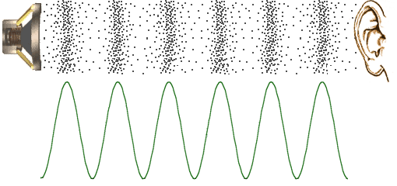
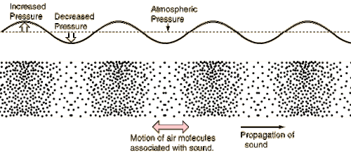
Basic Physics Principles
Sound waves
Ultrasound > 20 kHz
Diagnostic medical ultrasound > 1 MHz
Notes:
Sound waves are mechanical vibrations of particles or molecules within a medium
The vibration of 1 particle transmits a corresponding vibration to an adjacent particle and so the wave passes through the medium
The rate an individual particle vibrates is termed the FREQUENCY and is measured in Hertz which is the number of cycles per second
Ultrasound is defined as sound which has a frequency above the audible hearing range of human which is >20 kHz or 20,000 cycles per second
Diagnostic medical ultrasound operates at frequencies above 1 MHz or 1 million cycles per second

Slide 5
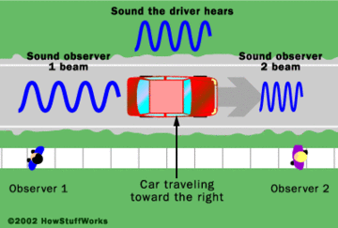
Doppler Ultrasound
Doppler principle
Johann Christian Doppler
“When an observer is moving relative to a wave source, the frequency he measures is different from the emitted frequency. If the source and observer are moving towards each other, the observed frequency is higher than the emitted frequency; if they are moving apart the observed frequency is lower”
Notes:
You are probably all familiar with the doppler principle? Well in 1842 a very clever Austria mathematician by the name of Johann Christian Doppler worked out that “ QUOTE”.
Applying the Doppler principle in vascular U/S differs from Doppler’s original theory because the moving targets are the blood cells and they don’t emit any form of radiating waveform.

Slide 6
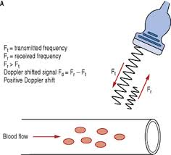
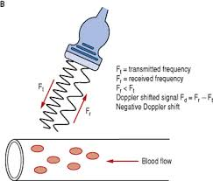
Doppler Effect
A: Flow towards transducer results in
Fr > Ft i.e. increased frequency of
waveform
B: Flow away from transducer results in Fr < Ft i.e. reduced frequency of waveform
Notes:
In vascular ultrasound we are observing the Doppler effect
The ultrasound transducer is both the source and receiver and directs pulses of u/s at targets i.e blood vessels
The reflected or scattered waveform and the corresponding change in frequency from the transmitted frequency can then be observed.
The difference between the transmitted and received frequencies is known as the Doppler shift frequency
This enables us to determine direction of flow within vessels and build complex

Slide 7
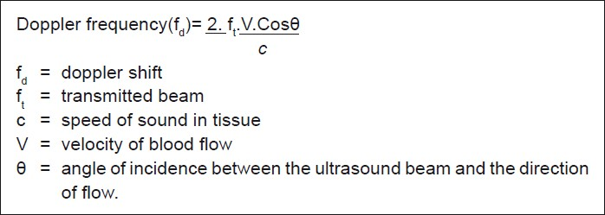
Doppler Equation
Fd = fr – ft
V = fd . C
2ft (Cos θ )
Notes:
This is the Doppler equation we use in vascular ultrasound which shows a quantitative relationship between the Doppler shift frequency and the blood cell velocity
The Doppler shift is calculated by the difference between the transmitted and received frequencies, this happens to fall within the audible hearing range, hence we can hear the flow or waveforms
The speed of sound within the medium, in this case soft tissue, is 1540m/s
Cosine theta is the angle of incidence between the u/s beam and direction of flow – this is really important to understand as small error is angle of incidence can have large errors in reporting we’ll look at this next
By rearranging this equation we can determine the velocity and direction of blood flow within vessels based on either a positive or negative Doppler shift frequency…good news is the machine does all this for us!

Slide 8
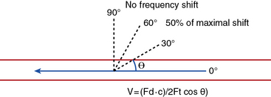
Angle of interrogation
If θ = 0°, Cos θ = 1
Cos θ 1 = maximum Doppler shift
If θ = 60°, 50% maximum Doppler shift
If θ = 90°, No Doppler shift
Angle between direction of Doppler beam and direction of blood flow
θ = Angle of interrogation
Notes:
It’s of fundamental importance in the clinical use of Doppler to understand the significance of the angle of insonnation.
As the angle of interrogation angle increases the Doppler shift decreases until at 90° angle where no shift is detected and therefore no signal will be observed
In vascular ultrasound golden number to remember is 60…you angle of insonnation should never exceed this as your values will be erroneous
Even using a hand held Doppler where we can’t measure the angle of insonnation if you play around with the angle of interrogation you will notice subtle differences in the Doppler signal which when you are trying to determine if it’s a good biphasic as opposed to a damped biphasic signal will make all the difference

Slide 9
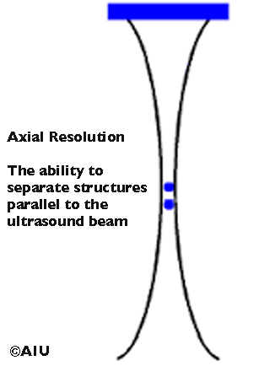
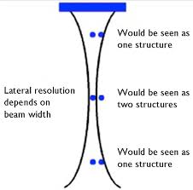
Spatial Resolution
Axial Resolution
Lateral Resolution
Axial resolution = ½ SPL
↑ frequency = ↓ SPL
Lateral resolution = beam width
Notes:
Now this is the last piece of physics I’m going to discuss as this is specifically mentioned on your syllabus
Resolution it the systems ability to distinguish between closely spaced objects
Axial resolution is the ability to separate structures parallel to the ultrasound beam – and this is determined by the spatial pulse length. With PWD there are pulses of sound waves with “quiet periods” before the next pulse is fired.
The SPL is the length of space over which a pulse occurs. Axial resolution is dependent on the SPL, the shorter the wavelength or higher the frequency the shorter the SPL and therefore better axial resolution. Broadly speaking the higher frequency, the more superficial imaging, the better resolution. Conversely the deep imaging depths, lower operating frequency the poorer the axial resolution. There’s always a trade off in ultrasound
Lateral resolution is the minimum separation perpendicular to the beam between 2 objects or reflectors that can produce 2 separate echoes. This is equal to the beam width. We can very easy narrow the beam with by focusing it at a given depth which improves lateral resolution – we’ll have a look at the effects of resolution in images shortly

Slide 10

Limitations & pitfalls of Ultrasound
Patient
Skin contact
Equipment
Artefacts
Operator
Notes:
You’ll be relieved to hear that’s all the physics I’m going to talk about….there is so much more but I want to get you scanning!
The other limitation include:
The patient – body habitus is a big one (pardon the pun), if they are too large ultrasound only operates to an optimal depth you will not be able to obtain good images. Conversely very thin patients can also be tricky to images. Also patient positioning and mobility
Skin contact…it sounds obvious but when we get referred patients in pop cast it comes as a surprise to the ward/doctor that we can’t scan them
Same with open wounds or dressings insitu, you need good skin contact or a clear adhesive dressing/cling film over the area with no air pockets
Artefacts – this is things like overlying bowel gas or heavy calcification which causes acoustic shadowing and loss of information, flash artefact where heavy breathing causes excessive movement of tissues and large flashes of colour are seen, aliasing – improper representation of information that’s been insufficiently sampled
Equipment operating limited, portable vs full size machine, also the HHD you use, these are continuous wave Doppler (as opposed to PWD) systems and so cannot differentiate the depth of returning echos – use with caution in the popliteal fossa you cannot differentiate between vessels
There are manly limitations and pitfalls associated with vascular ultrasound and as the operator you & I are one of them, please don’t get cajolled into performing a scan or investigation you have not been trained to do, it’s easily done but from a medicolegal perspective you will be out on your own if you cannot prove competency.

Slide 11
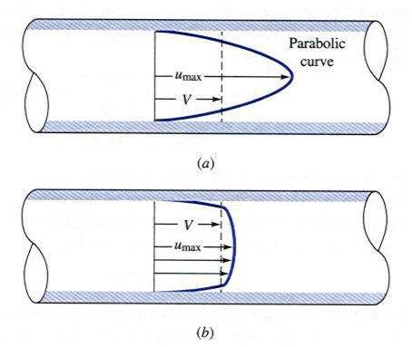
Doppler Spectrum
Velocity profiles
Waveforms:
Triphasic
Biphasic
Monophasic
Turbulent
Parabolic flow
Uniform profile (plug flow)
Notes:
I’m going to quickly look at Ultrasound interpretation – I’m assuming you will be mainly using HHD is that correct? In which case identifying the waveforms are going to be key in your assessment.
In peripheral arteries not all blood cells move at the same speed – the range of velocities across the vessel is known as the velocity profile
At low velocities or in smaller calibre vessels the velocity profile is parabolic
But at higher velocities and in larger vessels the profile becomes flatter to give plug flow
Each of the velocities give a different Doppler shift to produce what’s known as a Doppler spectrum, this is a visual presentation of the blood cells travelling at different speeds as a function of time – sometimes referred to a a sonogram
We describe these waveforms as triphasic, biphasic, monophasic or turbulent you should to be able to distinguish between these and practice is the best way
Each vessel within the body has a characteristic waveform depending on their size and where they are going. Quick example is the external carotid artery – lots of extra-cranial branches so the vessel is getting smaller and smaller, distal resistance is therefore increasing so we see a high resistance waveform with some flow reversal – this is normal. The internal carotid artery however has no extra-cranial branches, the brain wants lots of oxygen and doesn’t offer resistance so low resistance flow noted with no flow reversal in the cardiac cycle. Dissections however in the intracranial ICA alter this and we can pick those up by abnormal waveforms observed proximally.
We can look at these in a minute on the actual machine and I’ll explain a bit more about changes to the waveforms and the implications.

Slide 12
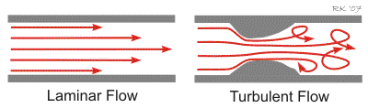
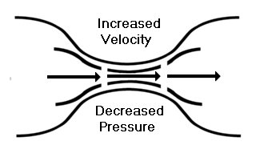
Turbulent flow
Effects of a stenosis on blood flow
Bernoulli’s Principle
= spectral broadening
Notes:
Very quickly and I know I promised no more physics but with vascular ultrasound you really can’t get away from it…
Turbulent flow, it’s important to understand why we get spectral broadening. As blood flow goes through a narrowing flow becomes turbulent beyond and this leads to changes in the waveforms i.e. reducing from triphasic to biphasic or monophasic flow. This is due to the Bernoulli effect whereby as the blood goes through a narrowing there is a reduction in pressure but an increase in velocities beyond which flow becomes disturbed

Slide 13
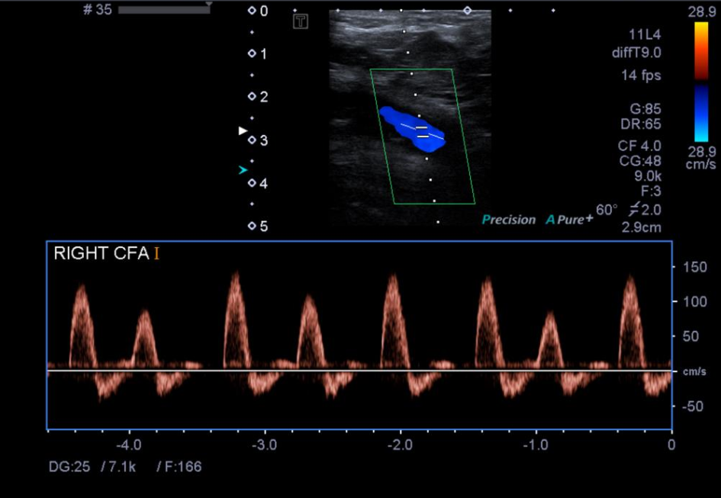

Slide 14
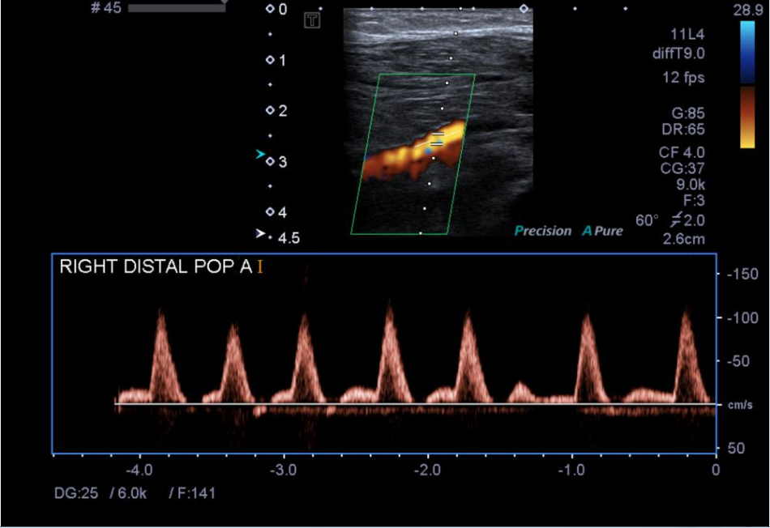

Slide 15
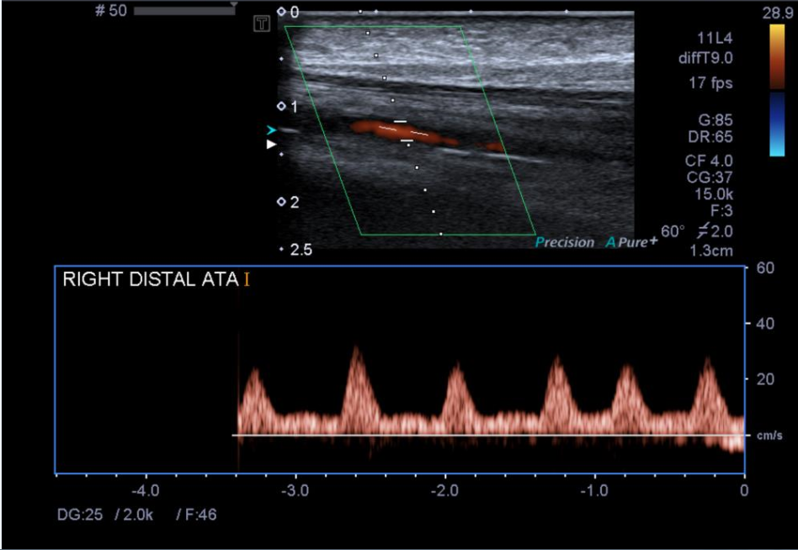

Slide 16
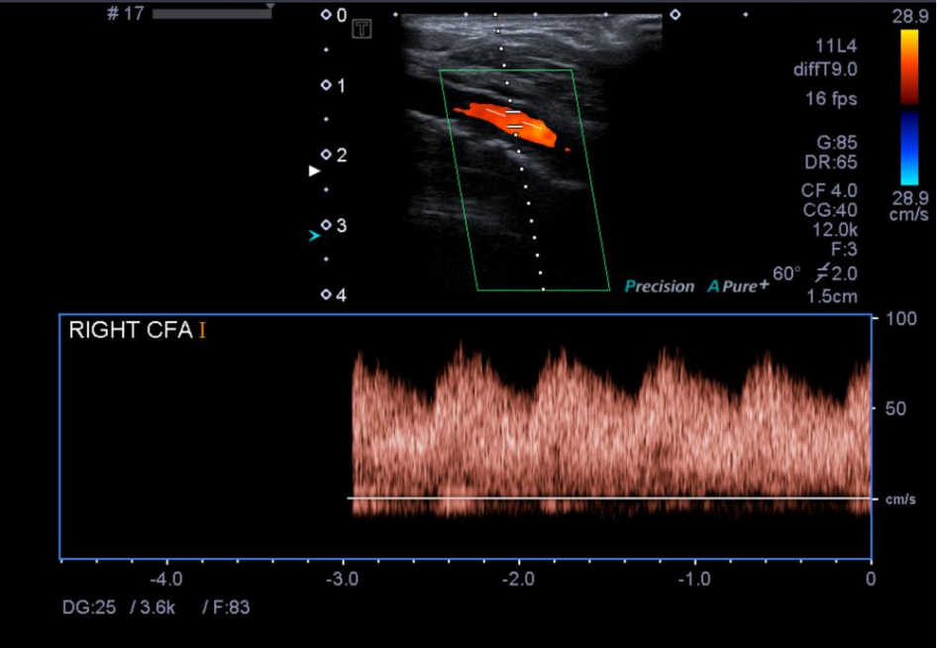

Slide 17


