Slide 1

Fellowship Showcase Event: 6/10/22
HEE Healthcare Science Fellowship
Vascular Science
0.4 wte
October 2021-2022
Kate Houghton
Senior Vascular Scientist and Deputy Head of Vascular Science
University Hospitals Bristol & Weston (UHBW)

Slide 2
Healthcare Science Fellowship
Aims:
WORKFORCE
Better understand the WF needs
TRAINING CAPACITY IN THE REGION
Gain a detailed understanding
Preferred training routes
What works/what doesn’t work?
Do centres require support?
NEW TRAINING OPPOURTUNITIES
Do we need a vascular apprenticeship?
Do we need new ways of training?
Can we build consortia

Slide 3
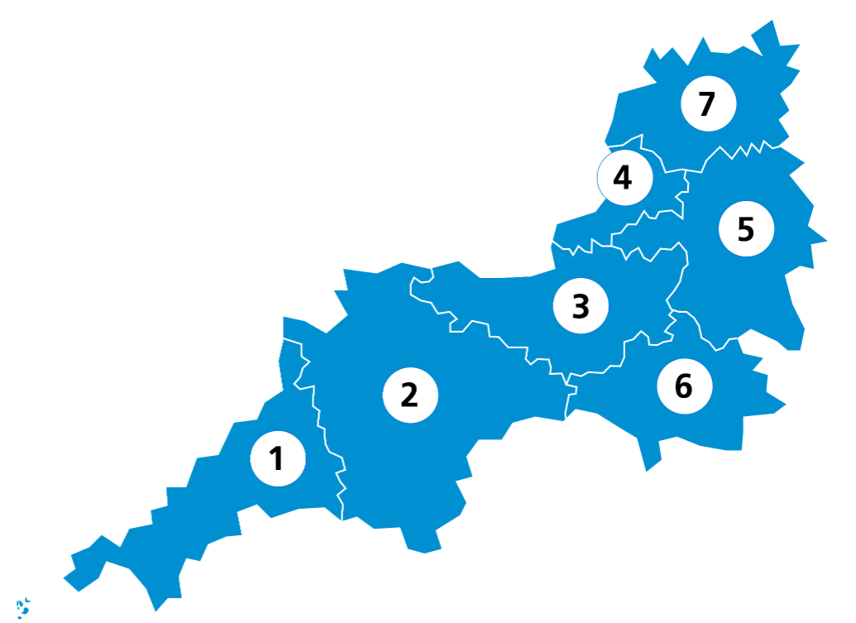
1. Cornwall & the Isles of Scilly
2. Devon
3. Somerset
4. Bristol, North Somerset & South Gloucestershire
5. Bath & North East Somerset, Swindon & Wiltshire
6. Dorset
7. Gloucestershire

Slide 4
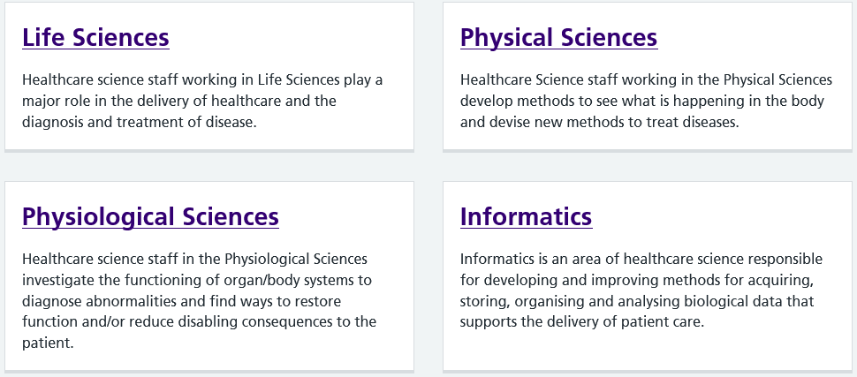
HEE Healthcare Science Specialities
e.g.
Biochemistry
Embryology
Immunology
Haematology Genomics
e.g.
Clin. Engineering
Clin. informatics
Radiation safety
Radiotherapy
e.g.
Cardiac
Respiratory
Neurophys
GI
Ophthalmic
Vascular
e.g.
Clin. Bioinformatics
Clin. Informatics
Clin. Scientific computing

Slide 5
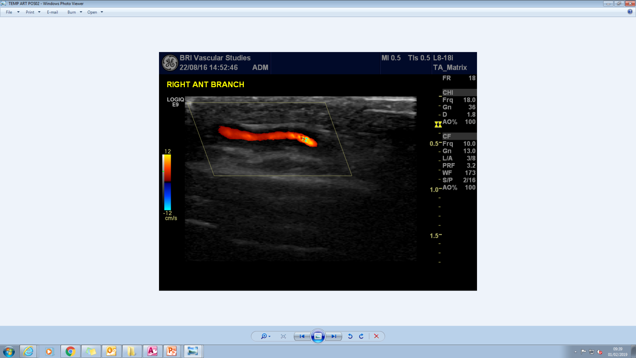
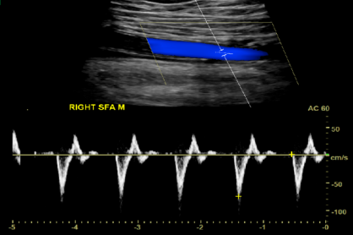
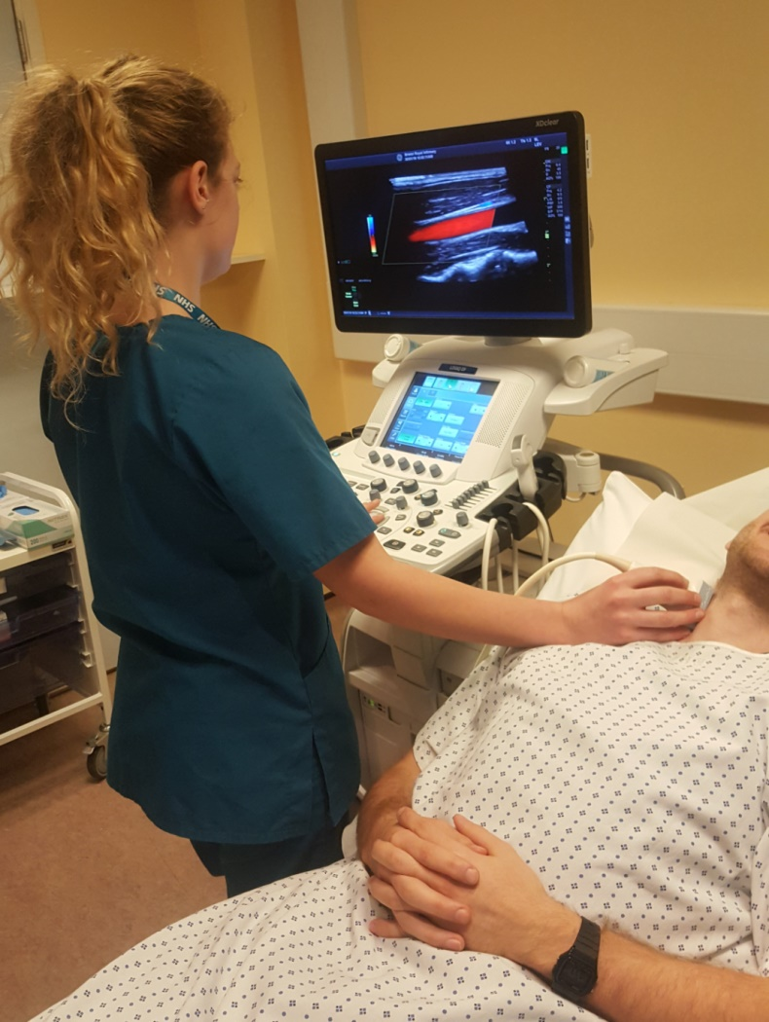
Healthcare Science/Physiological Sciences/Vascular Science
Clinical Vascular Scientists perform diagnostic ultrasound imaging for a variety of vascular diseases
Scan arteries & veins from head to toe
Triage request, offer advice for best test, perform scan, interpret images, inform the patient of results and write the report
We run urgent & routine services for IPs & OPs
Work closely with other teams – ED, thrombosis clinic, stroke clinic, vascular surgeons, oncology, eye hospital, GPs
Scans take 20mins – 90mins
Ultrasound is safe, cheap and provides live diagnostic information but it’s user dependent
3-4 years of training with a masters degree either STP or AVS (Accredited Vascular Scientist- awarded by educational body)
Vascular scientists are salaried at band 7

Slide 6


SEMI-STRUCTURED INTERVIEWS
Collect people’s opinions
Quantitative & Qualitative data
Peer reviewed
Interview Topics:
Your service & workforce
Experience of training
Introducing new training routes (Vascular Apprenticeship)

Slide 7
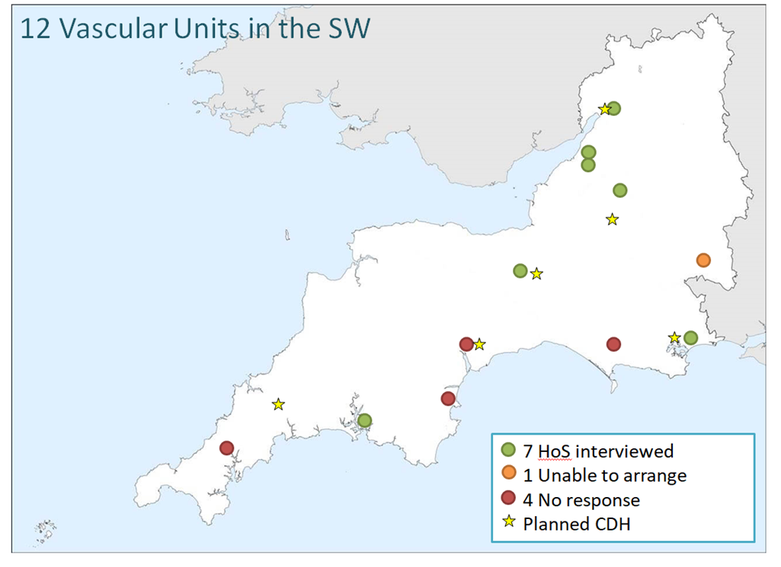

Slide 8
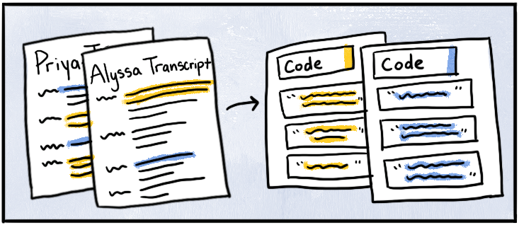
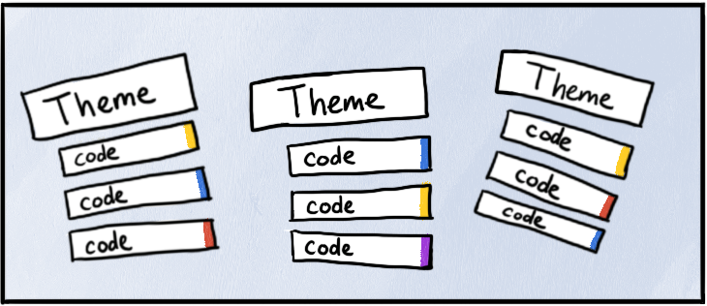
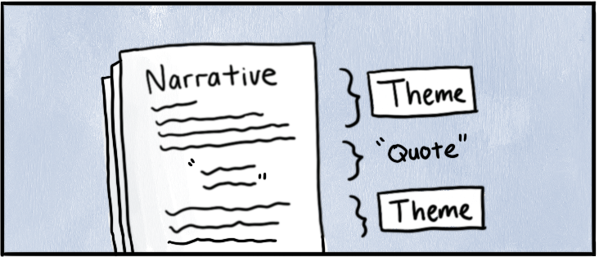
ANALYSIS
Pages of transcript (50-70 pages each interviews)
Based analysis on Braun & Clarke’s guide to thematic analysis to identify codes and themes
I used an online mind map to visualise all information in one place
Written up as a final report [in progress]

Slide 9
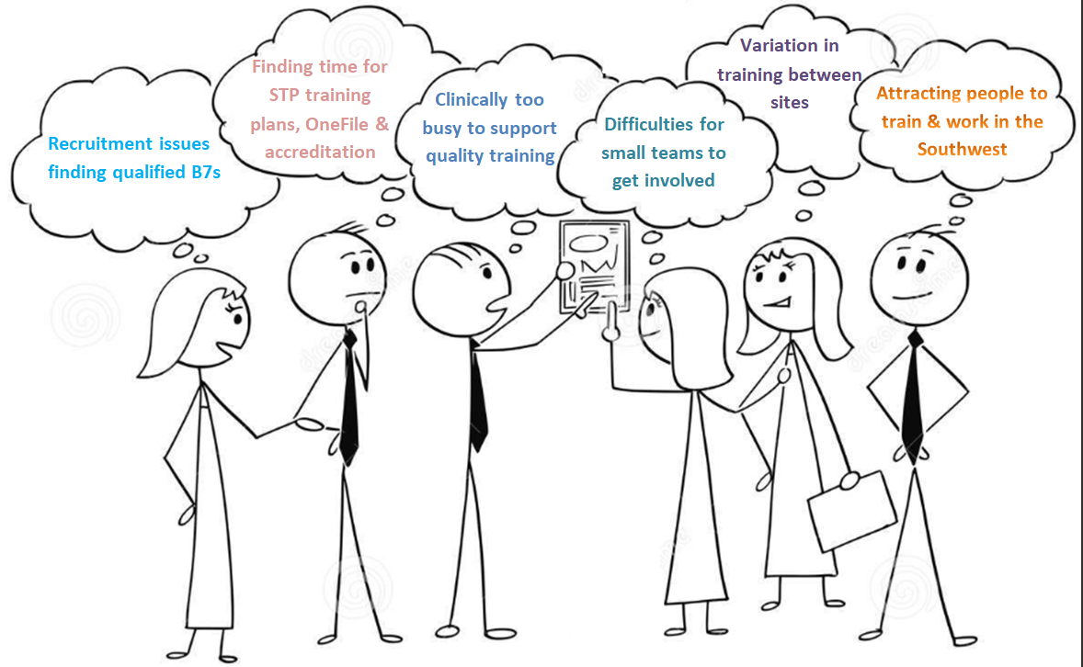
FINDINGS
WORKFORCE & TRAINING ISSUES
Academic barrier to get into Vascular
Some tests should be done in the community

Slide 10
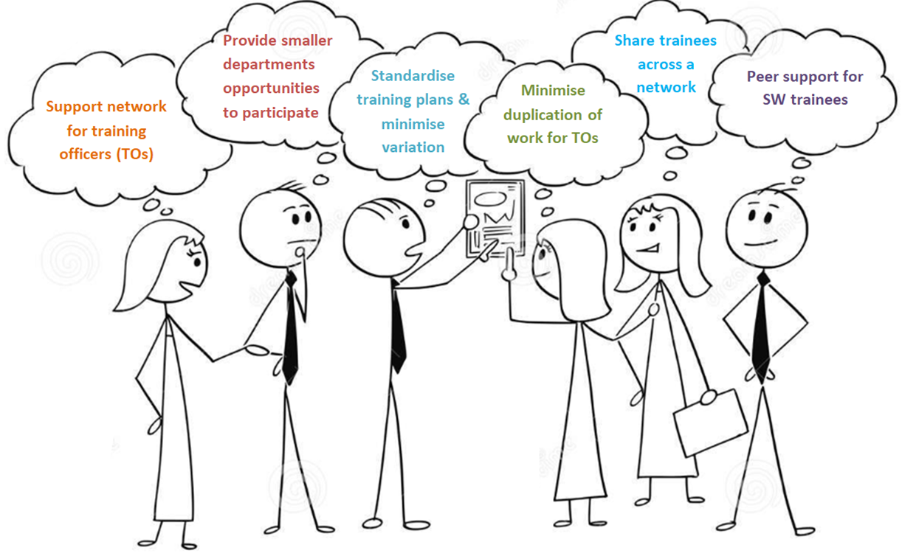
RECOMMENDATIONS
Utilise apprenticeships
Create a career ladder

Slide 11
ACTION PLAN
WHAT’S HAPPENING NOW
3 Vascular HCS Fellows starting October/November 2022
  An STP Lead to build networks across the region and develop consortium options
  An Apprenticeship Lead to fill the education gap
  A Practice Educator role to support trainees across the region

Slide 12
REFLECTION
Oct 2021
Oct 2022

