Slide 1
Vascular Investigations Peterborough City Hospital

Slide 2
Vascular Investigations Who are we?
55,000 healthcare science staff within the UK
Contribute to 80% of all diagnosis and treatment
Healthcare Scientists
Just 5% of the NHS workforce
Life Sciences
Physiological
Medical Physics
Bioinformatics
e.g.
Genomic sciences
Cellular sciences
Microbiology
e.g.
Cardiac Physiology
Neurophysiology
VASCULAR SCIENCE
e.g.
Biomechanical engineering
Nuclear medicine
e.g.
Computer science and modelling
Bioinformatics and genomics
52 Specialisms!

Slide 3
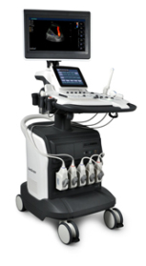
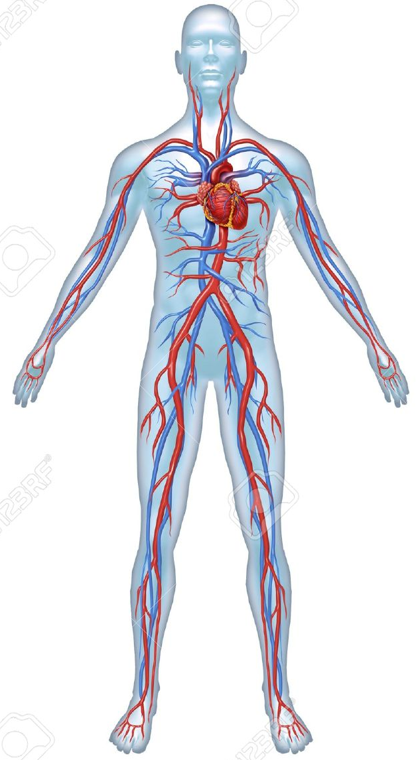
Vascular Scientists What do we do?
We use ultrasound imaging techniques to visualise vessel structure and assess blood flow.
Detects/rules out the presence of disease in arteries and veins.
This information is used by doctors for the management and treatment of patients.
Notes:
Image from https://clipartfest.com/categories/view/76147ffac5bcfc46a2896e86e2f6e293629b269a/vascular-anatomy-clipart.html
US image from http://gz-medequipment.en.made-in-china.com/product/QSuJvMhKanpD/China-Sonoscape-S40-Echo-Cardiovascular-Color-Doppler-Cardiac-Vascular-Ultrasound-Machines.html

Slide 4
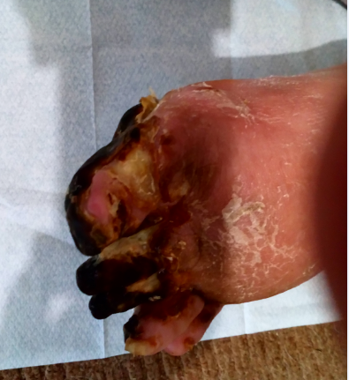
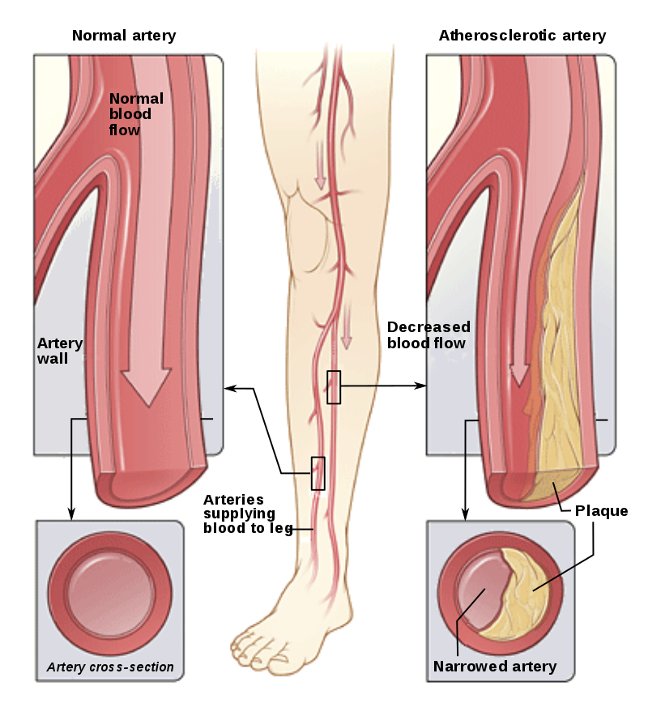
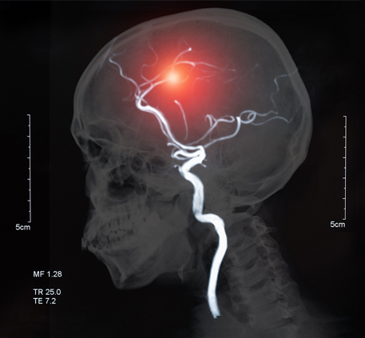
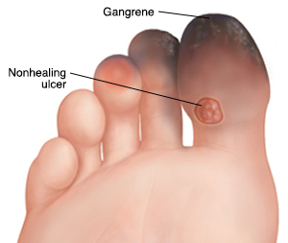
Arterial Diseases
Examples
Peripheral arterial disease (PAD)
Carotid artery disease
Notes:
Images from: https://www.pennmedicine.org/for-patients-and-visitors/patient-information/conditions-treated-a-to-z/abdominal-aortic-aneurysm
http://www.alastairlewisveins.com/varicose-veins/
https://faoj.org/2008/09/01/creating-the-ideal-microcosm-for-rapid-incorporation-of-bioengineered-alternative-tissues-using-an-advanced-hydrogel-impregnated-gauze-dressing-a-case-series/
https://www.researchgate.net/figure/Arterial-dissection-The-intimal-tear-allows-blood-to-track-sub-intimally-and-create-a_fig2_290379187
https://encrypted-tbn0.gstatic.com/images?q=tbn:ANd9GcQhaF6UE88RGG7MkkQBOdOSr5EvfAJbcgkmbbISK4xfIDf7dgedjuiH7Q:https://upload.wikimedia.org/wikipedia/commons/thumb/7/70/Blausen_Peripheral_Arterial_Disease_eng.svg/220px-Blausen_Peripheral_Arterial_Disease_eng.svg.png

Slide 5
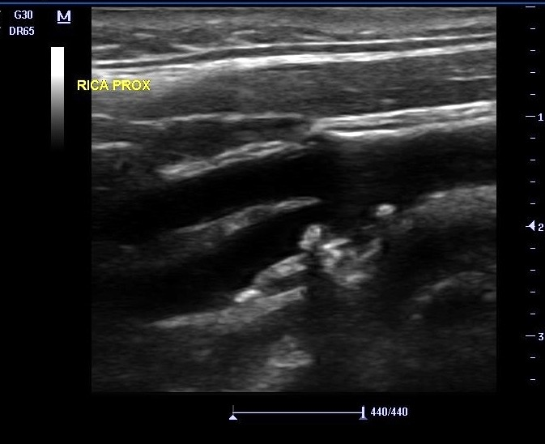
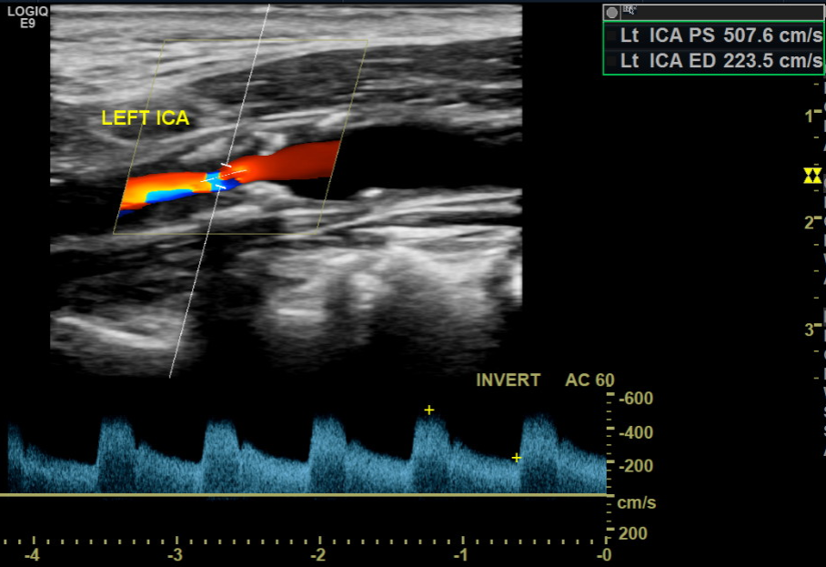
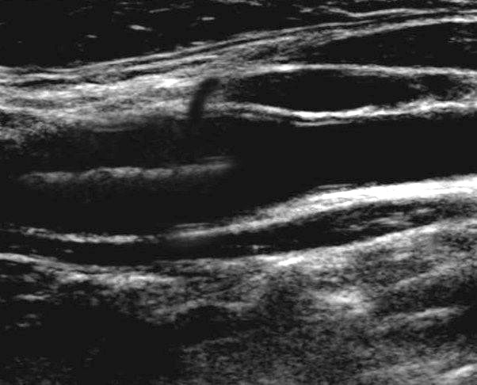
Carotid Artery Disease
Carotid Arteries
Findings:
>90% narrowing.
Therefore:
~22% chance of a recurrent cardio-embolic stroke within 3 years.
However:
Surgery for this patient can reduce the relative risk of a recurrent event by ~48% !!
Our role:
We identify patients which are most likely to benefit from this surgery.
We identify patients that may benefit from other treatments instead e.g. medical management to reduce disease progression.
FOR EXAMPLE
Notes:
https://static1.squarespace.com/static/56d4988801dbaeda39b5fd8e/57135e1437013bc9757ed344/57157aad45bf21fedbf8a8f1/1461025563051/201604140956030032VAS.JPG
http://www.ultrasoundpaedia.com/uploads/53003/ufiles/vascular/carotids/car-bif.jpg

Slide 6
Onset of Symptoms
(Limb weakness, slurred speech, vision disturbances)
Patient presents
(GP, A&E, Ophthalmology)
Discharge to GP/Further investigations
Patient stroke risk assessed
Not TIA
Medically managed (e.g. aspirin)
Carotid Ultrasound
MRI (Brain)
TIA
Intervention
Patient seen by stroke specialist
Investigations
ECG
Drug Therapy/Surgical Intervention
Blood Pressure
Bloods

Slide 7
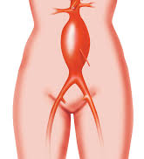
Arterial Diseases
Examples
Peripheral arterial disease (PAD)
Carotid artery disease
Abdominal aortic aneurysm (AAA)
Notes:
Images from: https://www.pennmedicine.org/for-patients-and-visitors/patient-information/conditions-treated-a-to-z/abdominal-aortic-aneurysm
http://www.alastairlewisveins.com/varicose-veins/
https://faoj.org/2008/09/01/creating-the-ideal-microcosm-for-rapid-incorporation-of-bioengineered-alternative-tissues-using-an-advanced-hydrogel-impregnated-gauze-dressing-a-case-series/
https://www.researchgate.net/figure/Arterial-dissection-The-intimal-tear-allows-blood-to-track-sub-intimally-and-create-a_fig2_290379187
https://encrypted-tbn0.gstatic.com/images?q=tbn:ANd9GcQhaF6UE88RGG7MkkQBOdOSr5EvfAJbcgkmbbISK4xfIDf7dgedjuiH7Q:https://upload.wikimedia.org/wikipedia/commons/thumb/7/70/Blausen_Peripheral_Arterial_Disease_eng.svg/220px-Blausen_Peripheral_Arterial_Disease_eng.svg.png

Slide 8
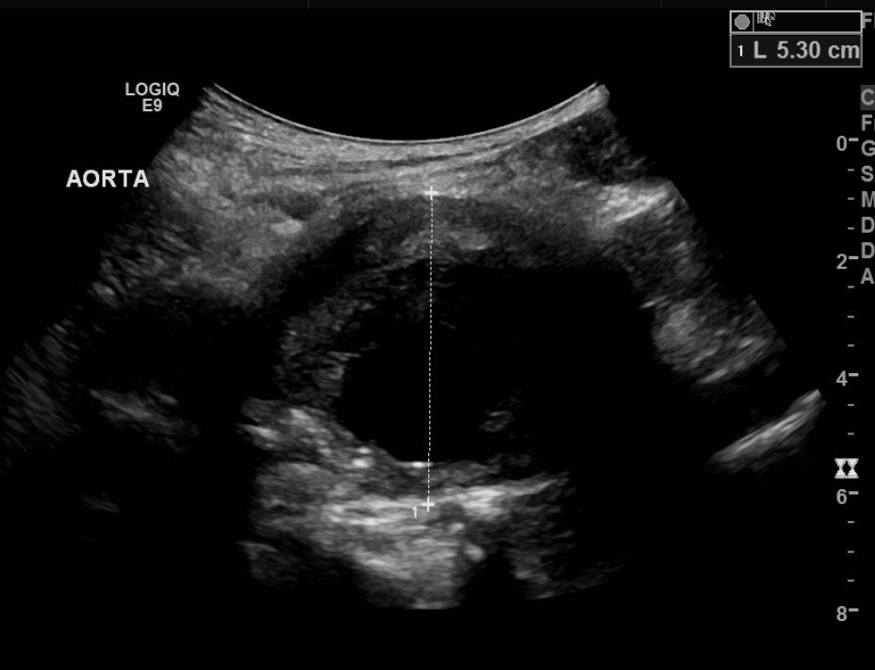
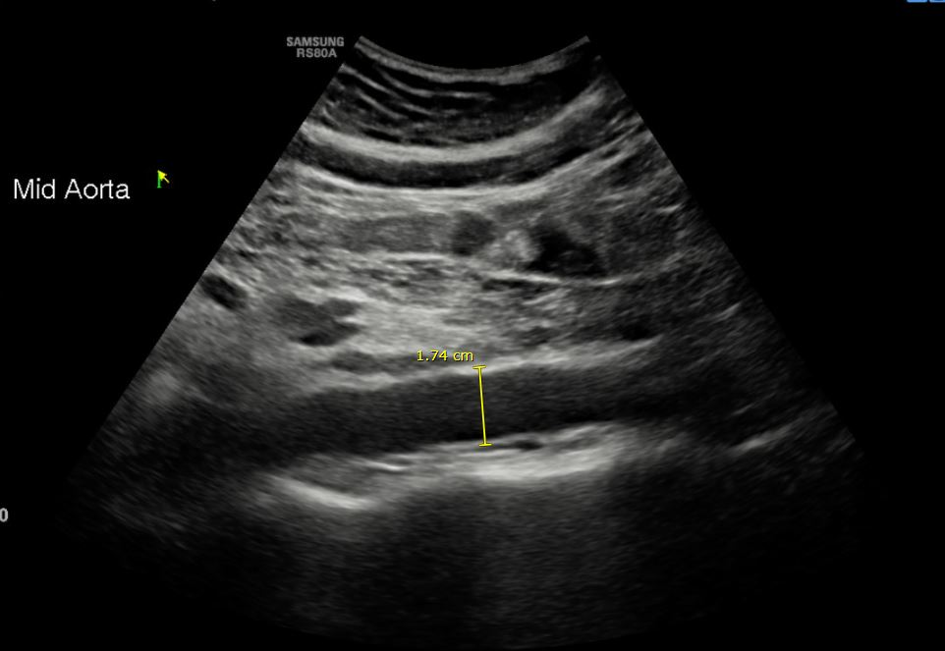
Abdominal Aorta
Abdominal Aortic Aneurysm
FOR EXAMPLE
When an Abdominal Aortic Aneurysm reaches 5.5cm for males or 5.0cm for females, these are then considered for surgical repair.
Notes:
https://static1.squarespace.com/static/56d4988801dbaeda39b5fd8e/57135e1437013bc9757ed344/57157aad45bf21fedbf8a8f1/1461025563051/201604140956030032VAS.JPG
http://www.ultrasoundpaedia.com/uploads/53003/ufiles/vascular/carotids/car-bif.jpg

Slide 9
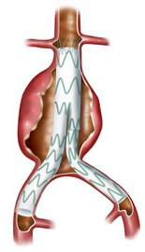
Abdominal Aortic Aneurysm - REPAIRED
We keep these under surveillance to ensure that there are no leaks and check that the graft is still correctly positioned.
Notes:
https://static1.squarespace.com/static/56d4988801dbaeda39b5fd8e/57135e1437013bc9757ed344/57157aad45bf21fedbf8a8f1/1461025563051/201604140956030032VAS.JPG
http://www.ultrasoundpaedia.com/uploads/53003/ufiles/vascular/carotids/car-bif.jpg

Slide 10
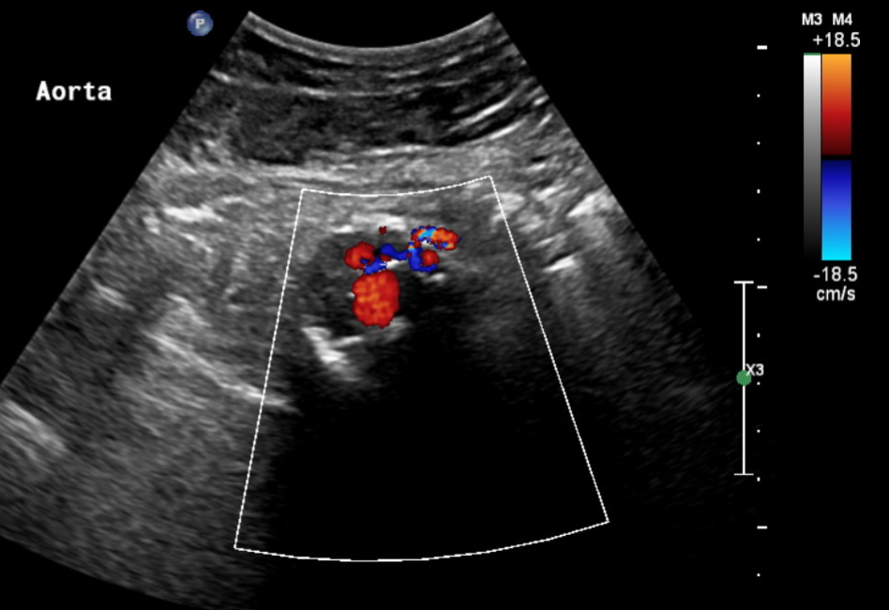

Abdominal Aortic Aneurysm - REPAIRED
Abdominal Aortic Aneurysm - REPAIRED
- But unsuccessfully?
FOR EXAMPLE
Leak
Aneurysm
Notes:
https://static1.squarespace.com/static/56d4988801dbaeda39b5fd8e/57135e1437013bc9757ed344/57157aad45bf21fedbf8a8f1/1461025563051/201604140956030032VAS.JPG
http://www.ultrasoundpaedia.com/uploads/53003/ufiles/vascular/carotids/car-bif.jpg

Slide 11
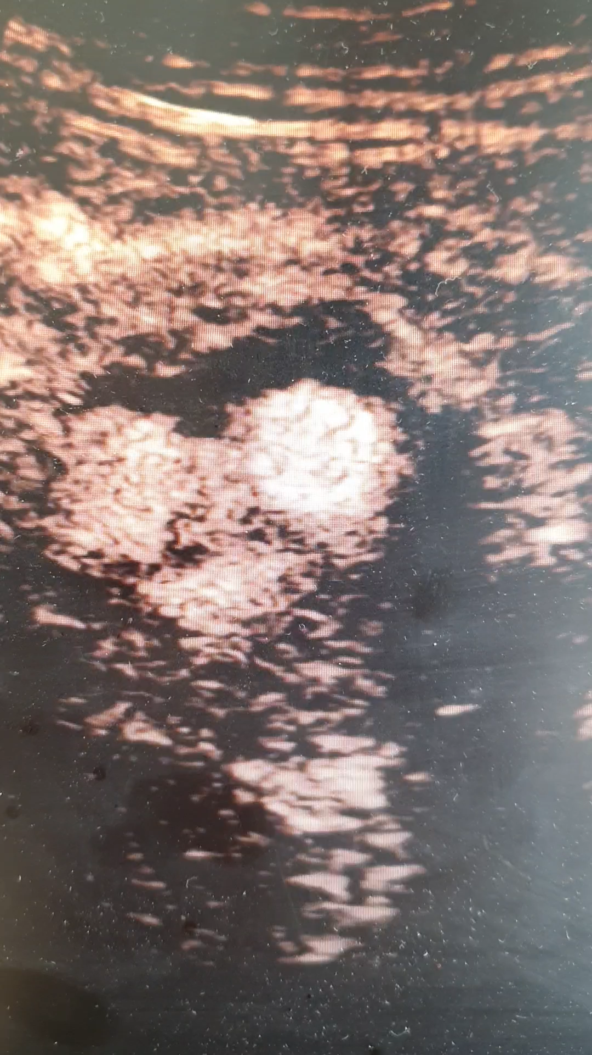
Abdominal Aortic Aneurysm - REPAIRED
- But unsuccessfully?
BUT…
Sometimes it can be difficult to see small leaks.
So we can do a contrast enhanced ultrasound scan.
- This means injecting the patient with tiny microbubbles before scanning them. This increases our ability to see the low flow.
Leak
FOR EXAMPLE
Notes:
https://static1.squarespace.com/static/56d4988801dbaeda39b5fd8e/57135e1437013bc9757ed344/57157aad45bf21fedbf8a8f1/1461025563051/201604140956030032VAS.JPG
http://www.ultrasoundpaedia.com/uploads/53003/ufiles/vascular/carotids/car-bif.jpg

Slide 12
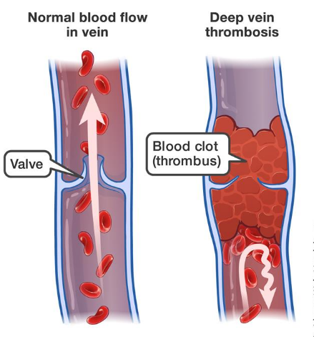
Venous Diseases
Examples
Deep vein thrombosis (DVT)
Notes:
Images from: https://www.pennmedicine.org/for-patients-and-visitors/patient-information/conditions-treated-a-to-z/abdominal-aortic-aneurysm
http://www.alastairlewisveins.com/varicose-veins/
https://faoj.org/2008/09/01/creating-the-ideal-microcosm-for-rapid-incorporation-of-bioengineered-alternative-tissues-using-an-advanced-hydrogel-impregnated-gauze-dressing-a-case-series/

Slide 13
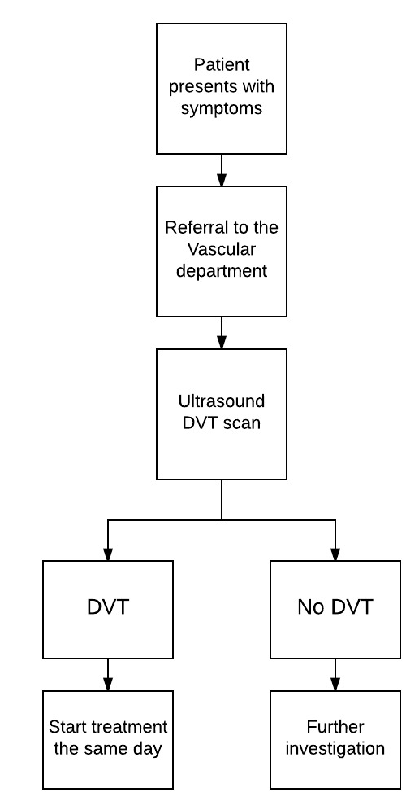
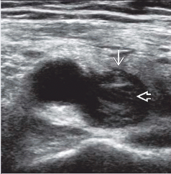
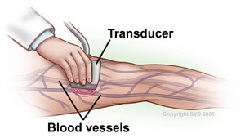
FOR EXAMPLE
Deep Vein Thrombosis
Vein Compression
This should cause the vein to completely collapse
However, this vein didn’t squeeze together when compressed.
Notes:
This is where we come in as vascular scientists. Patients are referred to us from GPs, A and E and inpatients to the vascular lab for and ultrasound scan.
We scan the patients legs from groin to ankle assessing all the veins by putting pressure on the patient leg to see if the vein compresses. Here is a video of a normal vein with blood clot present.
Once we have finished the scan we inform the patient of the results and write a report for the doctor/nurse to review with the patient the same day. The doctor will the make a decision on the patients treatment plan. This is normal a drug to thin the blood such as warfarin which prevents the blood clot from getting worse/growing. It is important to start treatment as soon as possible after diagnosis as this will vastly reduce the risk of the blood clot dislodging and travelling to the lungs, causing a PE.

Slide 14
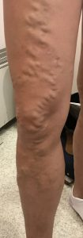
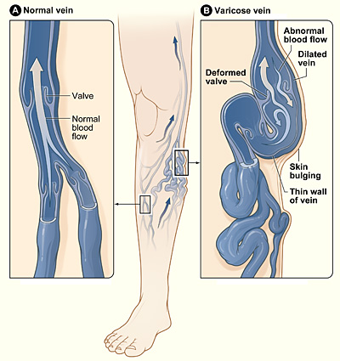
Venous Diseases
Examples
Deep vein thrombosis (DVT)
Varicose veins
Notes:
Images from: https://www.pennmedicine.org/for-patients-and-visitors/patient-information/conditions-treated-a-to-z/abdominal-aortic-aneurysm
http://www.alastairlewisveins.com/varicose-veins/
https://faoj.org/2008/09/01/creating-the-ideal-microcosm-for-rapid-incorporation-of-bioengineered-alternative-tissues-using-an-advanced-hydrogel-impregnated-gauze-dressing-a-case-series/

Slide 15
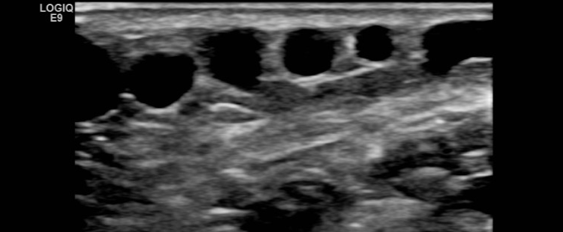
Varicose veins
We find where they come from.
That helps devise a treatment plan.
Notes:
Images from: https://www.pennmedicine.org/for-patients-and-visitors/patient-information/conditions-treated-a-to-z/abdominal-aortic-aneurysm
http://www.alastairlewisveins.com/varicose-veins/
https://faoj.org/2008/09/01/creating-the-ideal-microcosm-for-rapid-incorporation-of-bioengineered-alternative-tissues-using-an-advanced-hydrogel-impregnated-gauze-dressing-a-case-series/

Slide 16
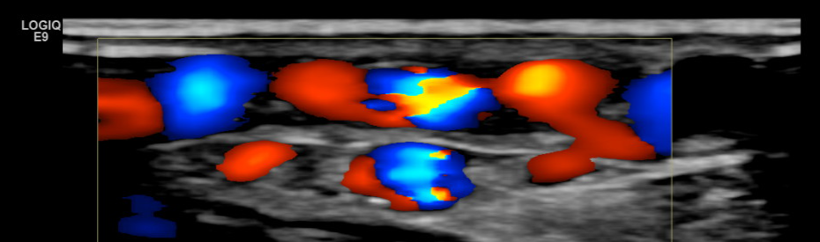
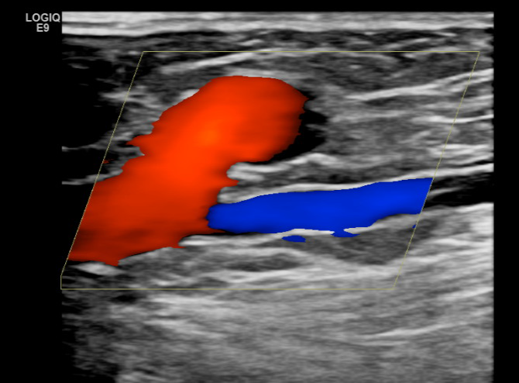
Varicose veins
Valves not working
The wrong way
Valves working
To the head
Notes:
Images from: https://www.pennmedicine.org/for-patients-and-visitors/patient-information/conditions-treated-a-to-z/abdominal-aortic-aneurysm
http://www.alastairlewisveins.com/varicose-veins/
https://faoj.org/2008/09/01/creating-the-ideal-microcosm-for-rapid-incorporation-of-bioengineered-alternative-tissues-using-an-advanced-hydrogel-impregnated-gauze-dressing-a-case-series/

Slide 17
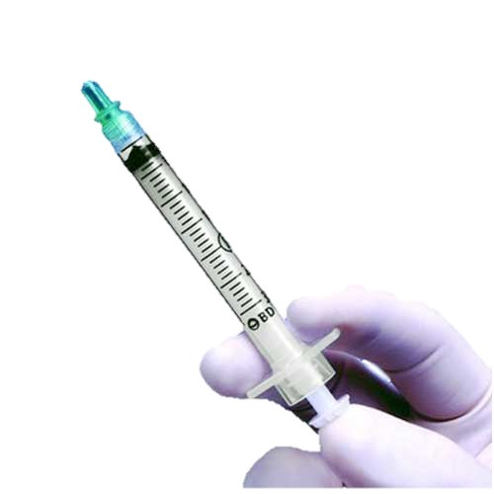
Varicose veins - Treatment
Destroying the Veins at fault.
In our Vascular Investigations here at PCH, we do this in 2 ways.
1) Injecting them with foam
This irritates the veins, and causes an inflammatory response.
This leads to thrombosis within the veins and closes them.
80% success rate.
Notes:
Images from: https://www.pennmedicine.org/for-patients-and-visitors/patient-information/conditions-treated-a-to-z/abdominal-aortic-aneurysm
http://www.alastairlewisveins.com/varicose-veins/
https://faoj.org/2008/09/01/creating-the-ideal-microcosm-for-rapid-incorporation-of-bioengineered-alternative-tissues-using-an-advanced-hydrogel-impregnated-gauze-dressing-a-case-series/

Slide 18
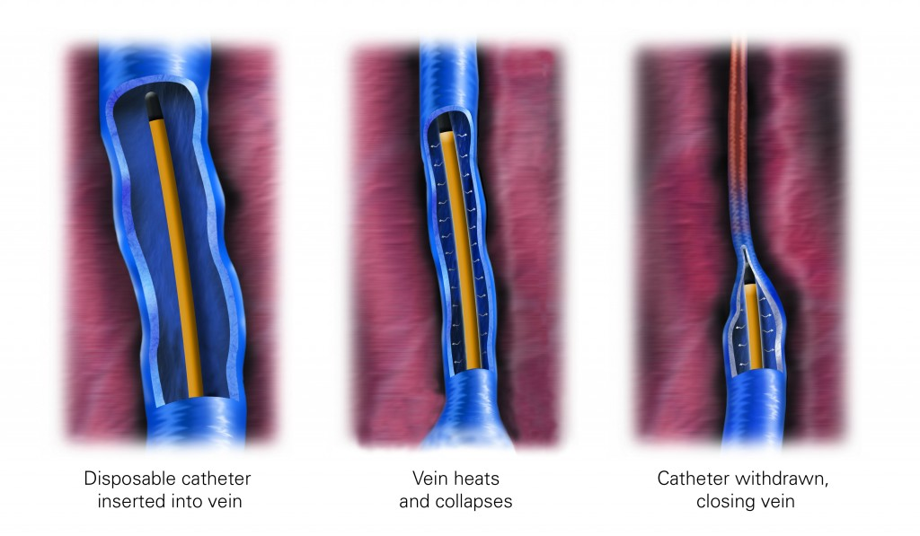
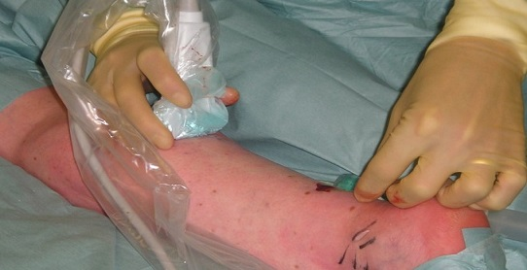
Varicose veins - Treatment
Destroying the Veins at fault.
2) Destroying them with heat – Endovenous ablation
Notes:
Images from: https://www.pennmedicine.org/for-patients-and-visitors/patient-information/conditions-treated-a-to-z/abdominal-aortic-aneurysm
http://www.alastairlewisveins.com/varicose-veins/
https://faoj.org/2008/09/01/creating-the-ideal-microcosm-for-rapid-incorporation-of-bioengineered-alternative-tissues-using-an-advanced-hydrogel-impregnated-gauze-dressing-a-case-series/

Slide 19
It’s not ALL JUST scanning…
Research.
Improving patient care and treatment
Investigating causes/mechanisms of disease
Clinical audit
Teaching
Patient advice for disease prevention and management
Aside from treatments, we also work fully autonomously.
This means that we don’t rely on doctors to report our diagnostic work. We do it all ourselves.

Slide 20
Useful background knowledge for Vascular Science roles
Biology
Human Biology
Physiology
Etc…
Understand and identify normal function
Understand and identify diseases
Causes and progression
Ultrasound science
Why do we see what we see?
Haemodynamics
Why is the blood flow doing what it is doing?
Physics

Slide 21
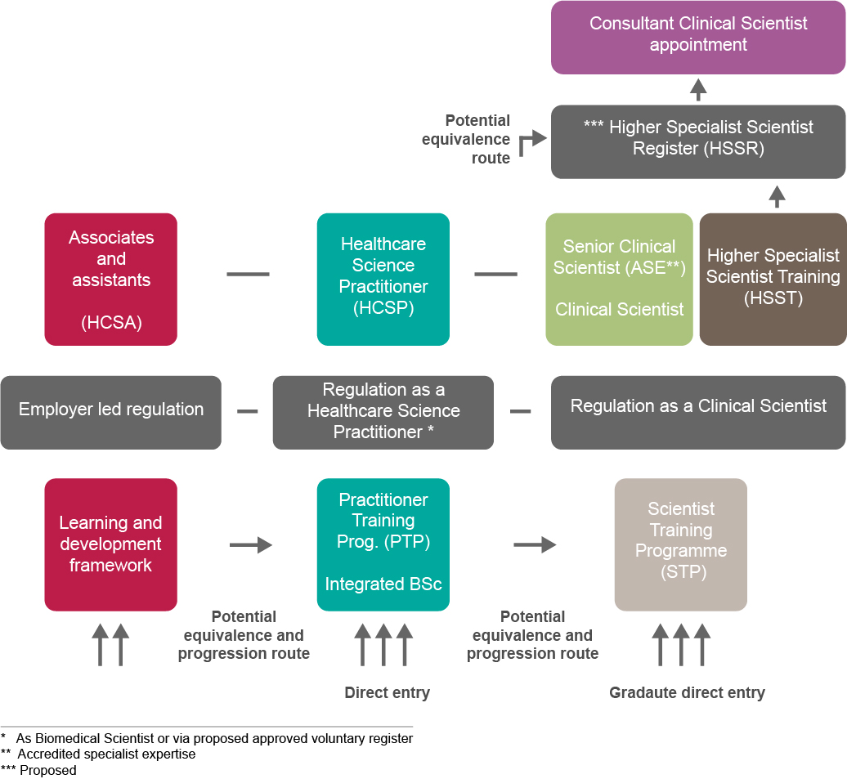
Routes to becoming a ‘Healthcare Scientist’.
“In-house” training route
No experience
Vascular Scientist
BSc
(or higher)
A-levels (or equivalent)
BSc
(or higher)

Slide 22
Healthcare Scientists
Life Sciences
Physiological
Medical Physics
Bioinformatics
e.g.
Genomic sciences
Cellular sciences
Microbiology
e.g.
Cardiac Physiology
Neurophysiology
VASCULAR SCIENCE
e.g.
Biomechanical engineering
Nuclear medicine
e.g.
Computer science and modelling
Bioinformatics and genomics
52 Specialisms!

Slide 23
Thanks for listening!

