Slide 1
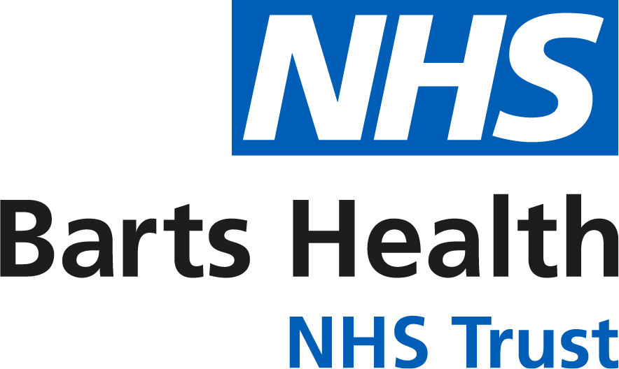
Vascular Science
Reag Bermejo
Clinical Vascular Scientist
Barts Health NHS Trust

Slide 2
What is Vascular Science?
We aid in the diagnosis and management of patients with diseases of the circulation.
We use non-invasive imaging and investigations to assess blood flow in the arteries and veins.
We see inpatients and outpatients.
We mostly work in a dedicated department, but also on the ward and occasionally in theatres.

Slide 3
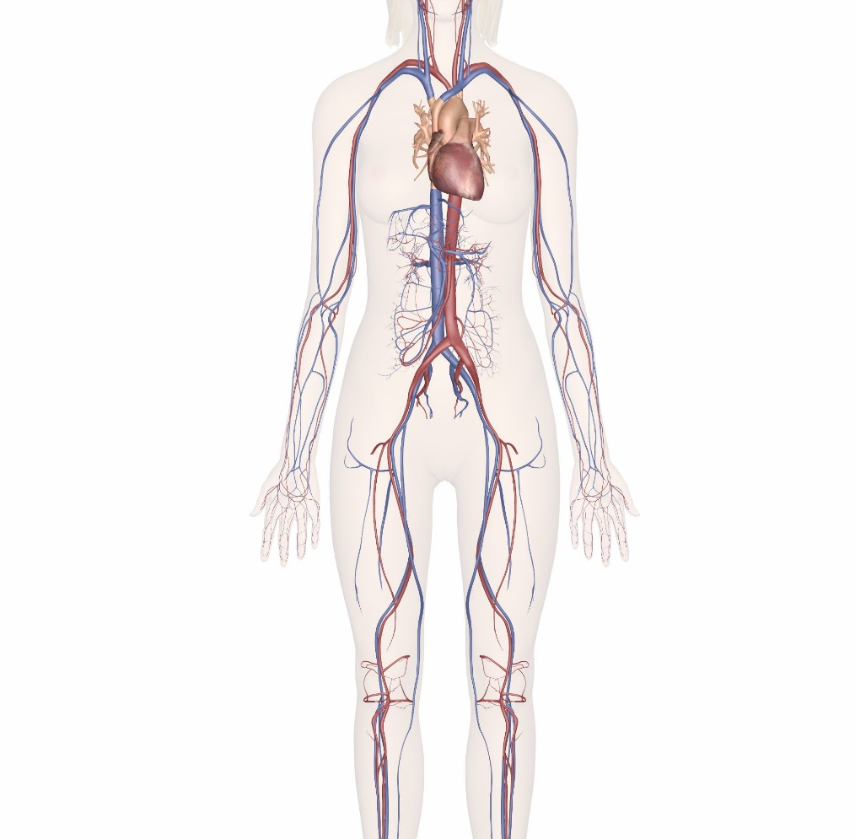
Vascular Disease
Arterial Disease
  Peripheral Arterial Disease (PAD)
  Carotid Disease (Stroke/TIA)
  Abdominal Aortic Aneurysm (AAA)
Venous Disease
  Varicose Veins
  Deep Vein Thrombosis (DVT)

Slide 4
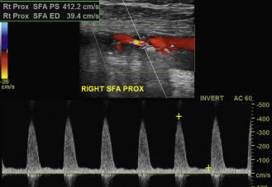
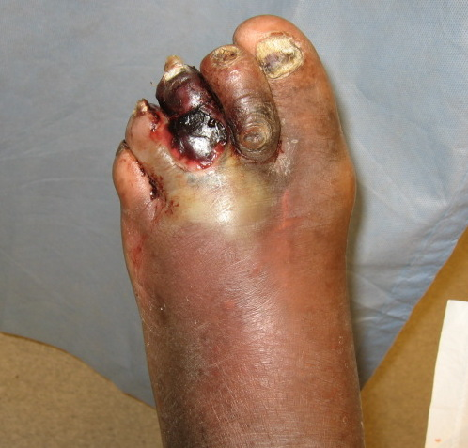
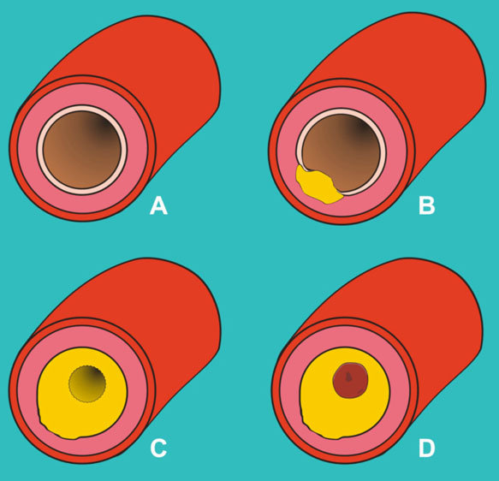
Peripheral Arterial Disease
Narrowing/occlusion of the peripheral arteries, most commonly in the lower limbs.
Atherosclerosis/Diabetes.
Claudication.
Ulceration, gangrene, limb loss.
-------------------------------------------
Identify location(s) of lesion.
Grade the degree of stenosis.

Slide 5
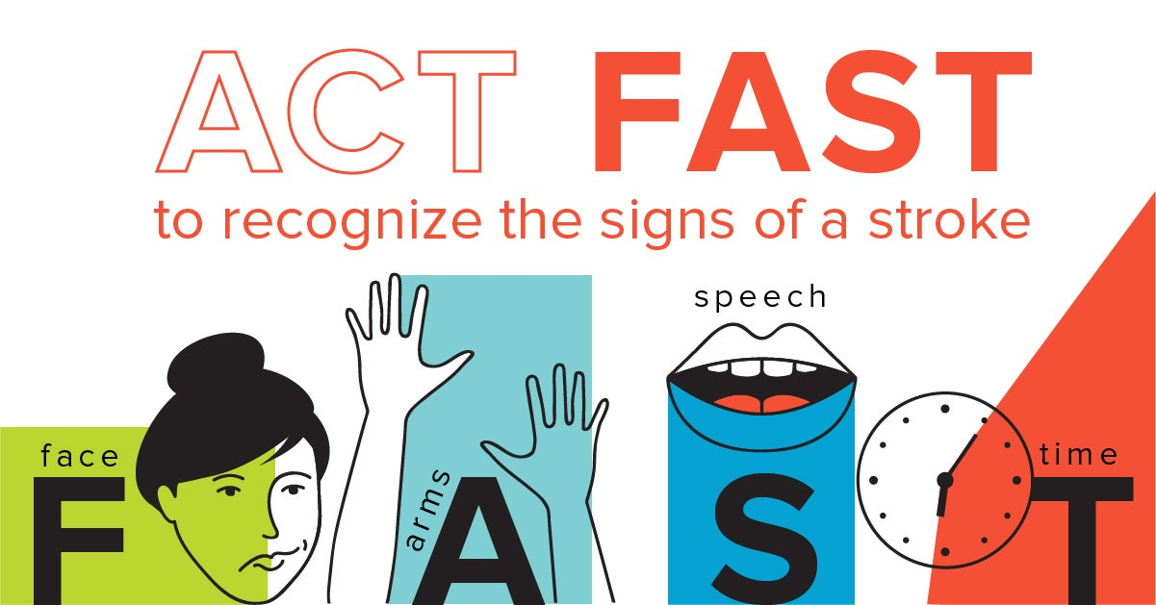
Carotid Disease
Narrowing/occlusion of the Carotid Arteries – leading to TIA/Stroke.
--------------------------------------------
Assess the degree of narrowing in the carotid arteries.
Assess plaque morphology.

Slide 6
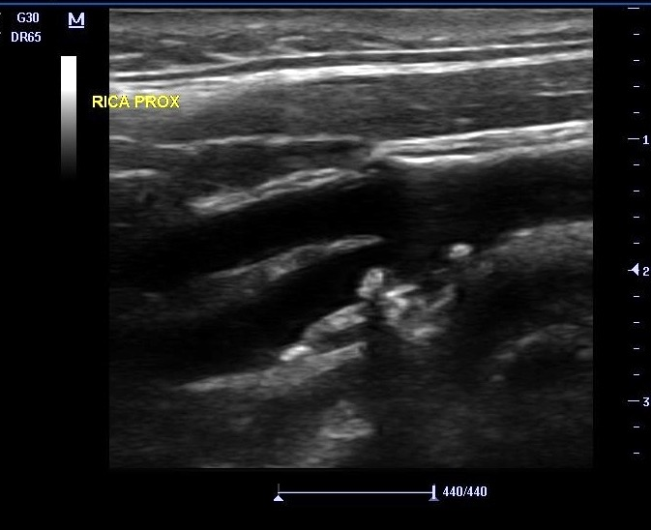
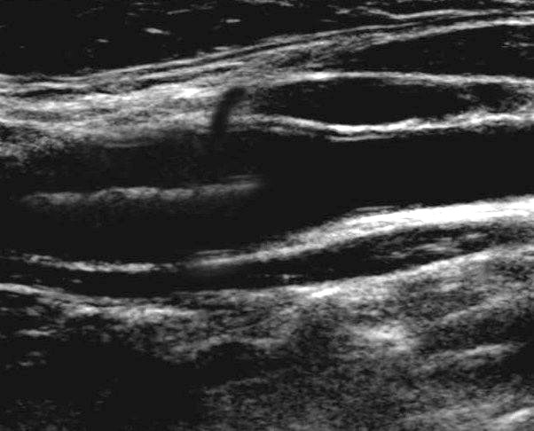
Notes:
This is an example of a carotid scan I performed on a patient with healthy carotids
You can see the external carotid artery on the top, and the internal carotid artery at the bottom
By turning on the Doppler function we can see blood moving through the artery, and this pulse wave function shows the speed of the blood moving at a certain point
Here we can see that the arteries have nice clear walls, with no plaque deposits, and the blood is flowing unobstructed
There are no raised blood flow velocities in the ICA (normal speed is <100cm/s), which suggests that there is no narrowing in the vessel and indicating good blood flow to the brain

Slide 7
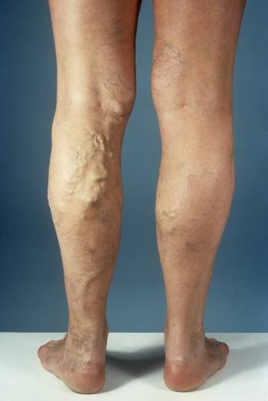
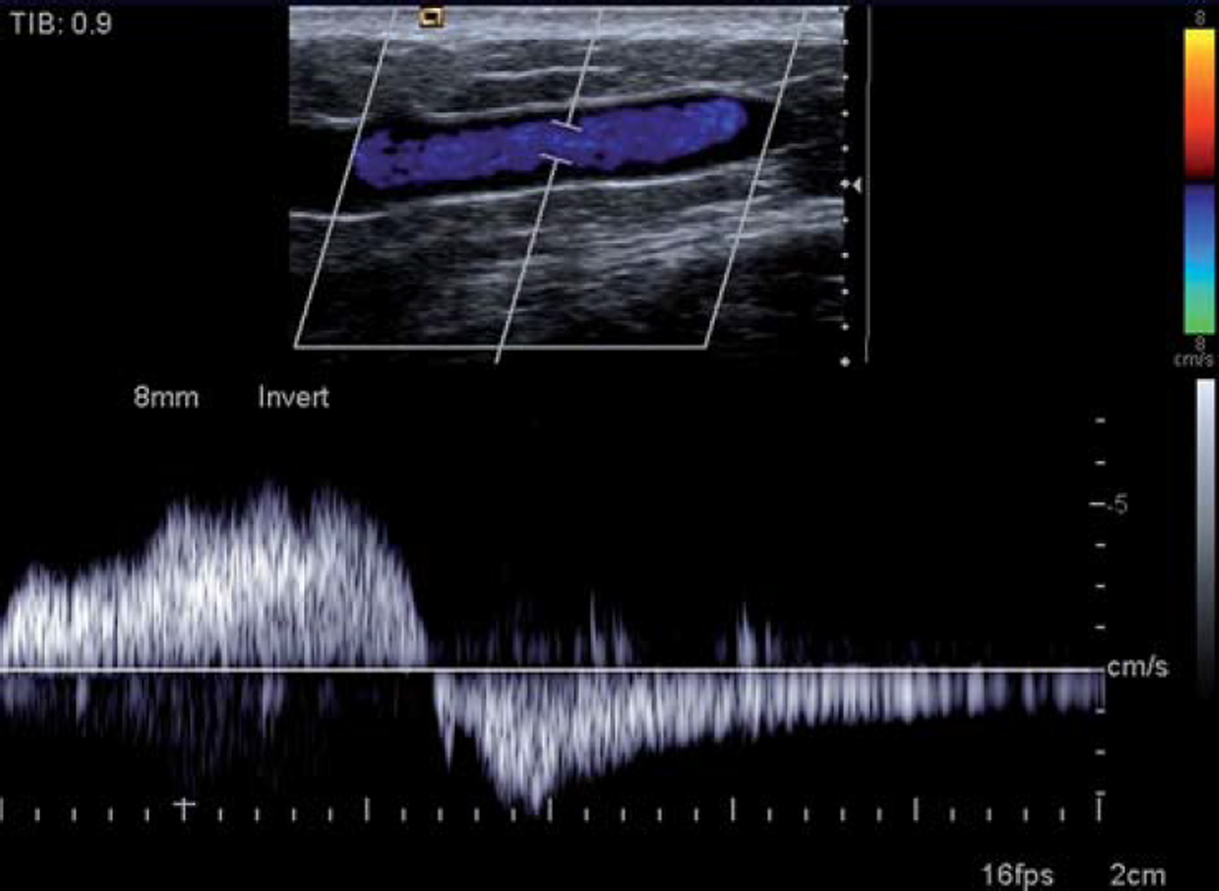
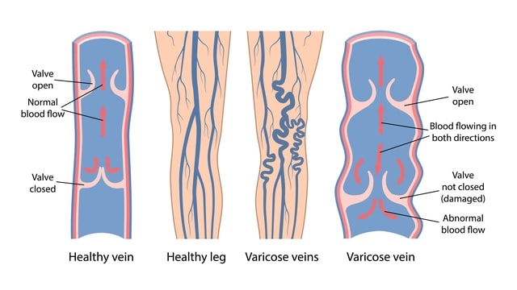
Varicose Veins
A failure of valve function in the superficial veins of the lower limbs.
Venous Hypertension, Ulceration.
--------------------------------------------
Identify source of reflux.
Assess suitability for treatment.

Slide 8
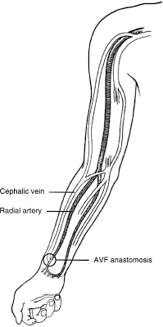
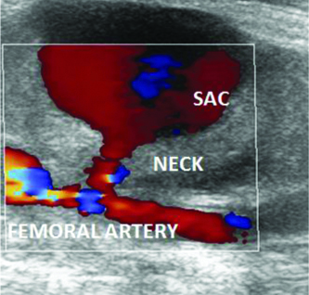
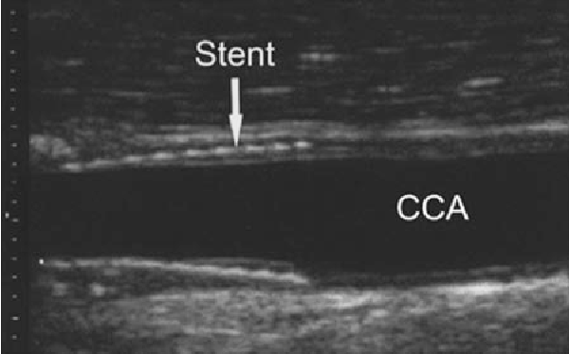
What else do we do?
Trauma.
Check suitability of veins for bypass.
Stent surveillance.
Renal patients.

Slide 9
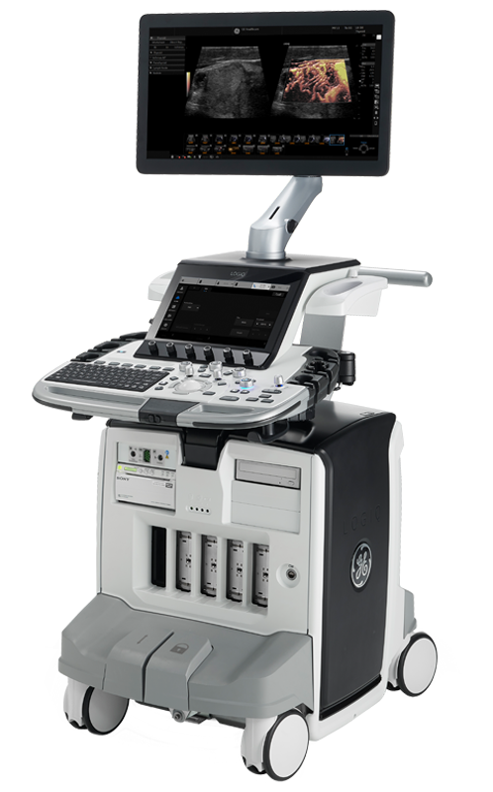
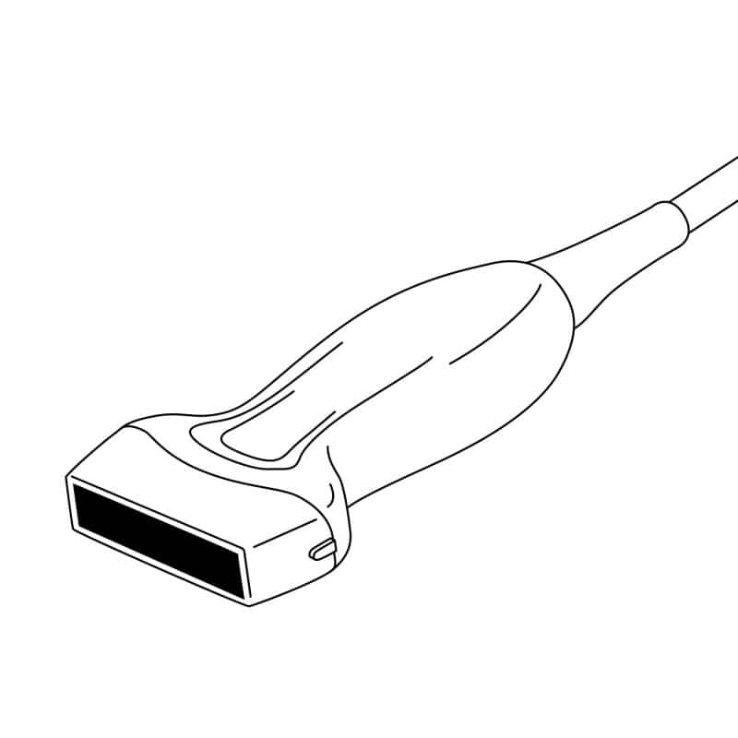
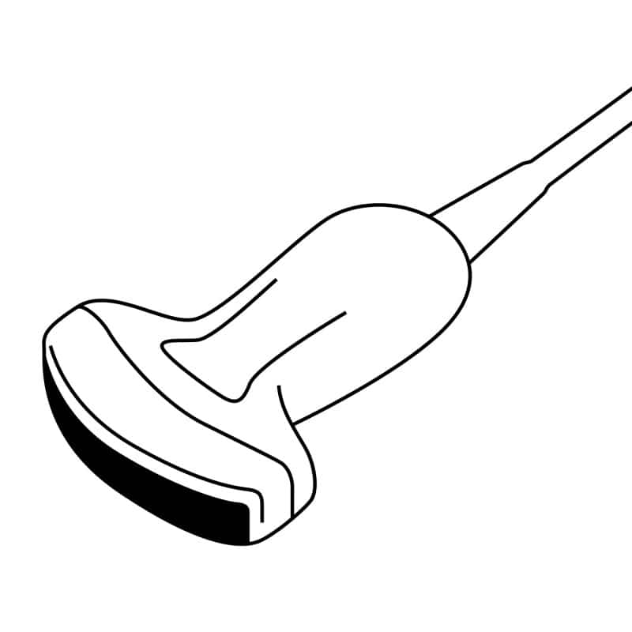
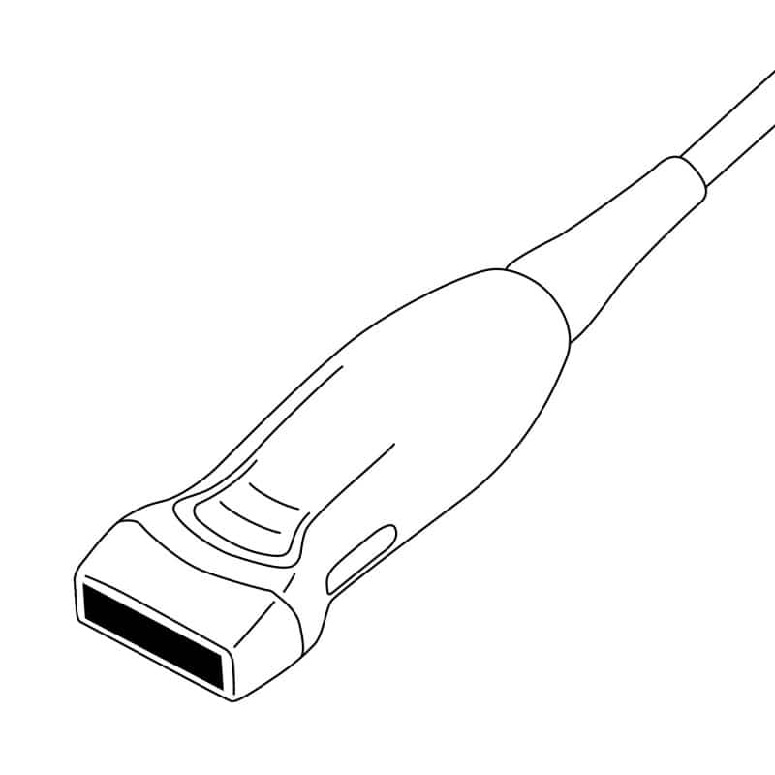
Equipment Used
Ultrasound.
Non-invasive, non-ionising.
Different machines can have different applications.
Maintenance and QA.

Slide 10
Role and Responsibility
Patient facing.
Interpret results and report accordingly.
Work as part of a Multidisciplinary Team.
Research.
Training.

Slide 11
Summary
Satisfying job with plenty of responsibility.
Highly skilled.
Variety and problem solving.

Slide 12
Thank You

