Slide 1
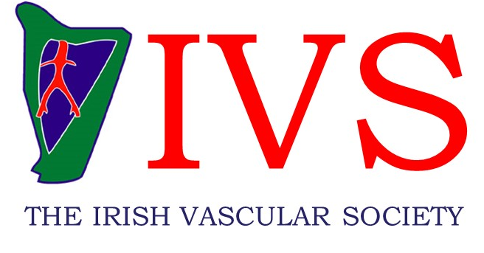

The Incidence of AAA Found During Screening of a High Risk Vascular Population
O Eltahir, S Murray, M Medani, T Aherne, E Mulkern, M O’Donohoe, C McDonnell, C Gray
Mater Misericordiae University Hospital, Dublin, Ireland
BACKGROUND
Abdominal aortic aneurysm (AAA) is a potentially fatal often silent condition, until it ruptures, producing catastrophic life-threatening haemorrhage.¹
Population screening is gaining ground world-wide but whether the screening of a high risk population for AAA is beneficial has been debated for many years.
Screening programmes for AAA using duplex ultrasound are now established in many countries and have been shown to reduce the mortality from ruptured AAA as well as being cost-effective.^{1,2}
The current recommendations by the Journal of Vascular Surgery are to screen all men over 65 years of age, women aged 60 to 85 years with cardiovascular risk factors and both men and women greater than 50 with a family history of AAA.³
No such programme formally exists in the Republic of Ireland.
AIMS
To evaluate the yield of an on-going “high-risk” screening program that has been in place in our institution since 2010, with an attempt to identifying a subgroup of patients that would gain the most benefit from a AAA screen.
METHODS
This study is a retrospective clinical audit of this AAA screening programme and included all patients who received an abdominal aorta duplex scan for the purpose of AAA screening while attending an Irish Vascular Laboratory between 1st January 2010 and 31st December 2016
RESULTS
6,656 first visit studies were identified, with 63% being carried out in male patients (fig. 1), 662 of which were subsequent to an incidental AAA pick up via another modality.
The most common reason for referral was an incidental finding of AAA picked up on another imaging modality such as CT, general ultrasound, X-ray, MRI or angiography. Patients were also referred for other reasons as shown in fig. 2
The remaining 5,994 patients were scanned following referral for an AAA screen in patients with cardiovascular risks.
603 (10.1%) were found to have an aortic diameter of >2.5, with 334 (5.6%) having a AAA (>3cm).
The majority of aortic dilation was found to be in the 2.5 - 2.9cm range (ectatic aorta), with increased size associated with decreased prevalence as shown in fig. 3
Of the 603 patients with an ectatic aorta or AAA, 484 were Male (80%) and 119 were Female (20%).
CONCLUSION
AAA screening may prove beneficial in an appropriately-selected population
REFERENCES
Thompson SG, Ashton HA, Gao L, Buxton MJ, Scott RA. Final follow-up of the Multicentre Aneurysm Screening Study (MASS) randomized trial of abdominal aortic aneurysm screening. The British journal of surgery. 2012;99(12):1649-56.
Lindholt JS, Vammen S, Juul S, Henneberg EW, Fasting H. The validity of ultrasonographic scanning as screening method for abdominal aortic aneurysm. European journal of vascular and endovascular surgery : the official journal of the European Society for Vascular Surgery. 1999;17(6):472-5.
Kent KC, Zwolak RM, Egorova NN, Riles TS, Manganaro A, Moskowitz AJ, et al. Analysis of risk factors for abdominal aortic aneurysm in a cohort of more than 3 million individuals. Journal of vascular surgery. 2010;52(3):539-48.
ACKNOWLEDGENT
Vascular Lab MMUH
Notes:
Please export the PowerPoint document as a PDF (File – Save as – PDF) and upload the PDF into the system. Please use the font in the document or a similar one and do not use a font size smaller than 16.

