Slide 1
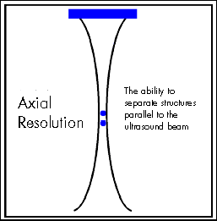
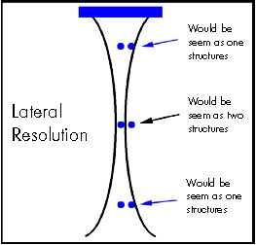
SPATIAL RESOLUTION

Slide 2
Lateral Resolution – The ability to resolve two structures in the lateral dimension. Lateral resolution is equal to the beam width. The best lateral resolution is at the focus. High frequency beams improve lateral resolution because they diverge less in the far field.
Axial Resolution – The ability to distinguish between two structures n the axial dimension. AR is dependent on frequency, pulse duration, and the medium. Shorter pulse durations and higher frequencies result in lower axial resolutions which yield more accurate images. Typical AR values are from 0.1mm to 10mm.

Slide 3
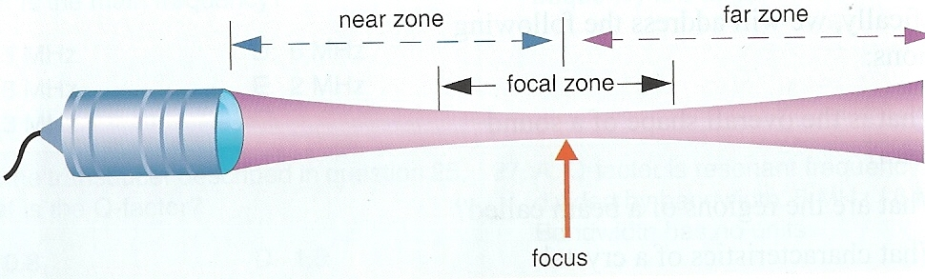
FOCAL ZONE

Slide 4
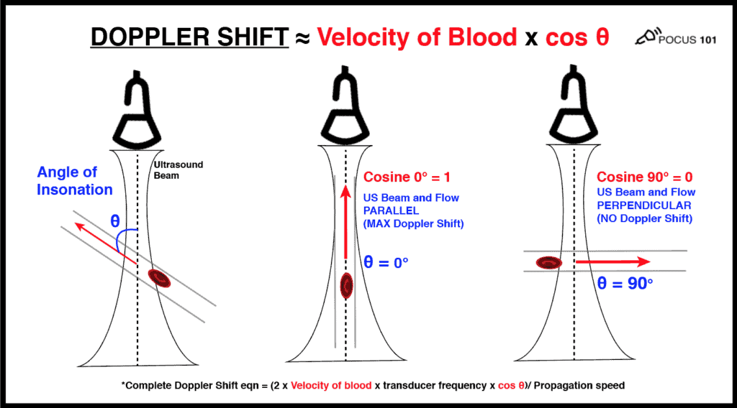
DOPPLER SHIFT

Slide 5
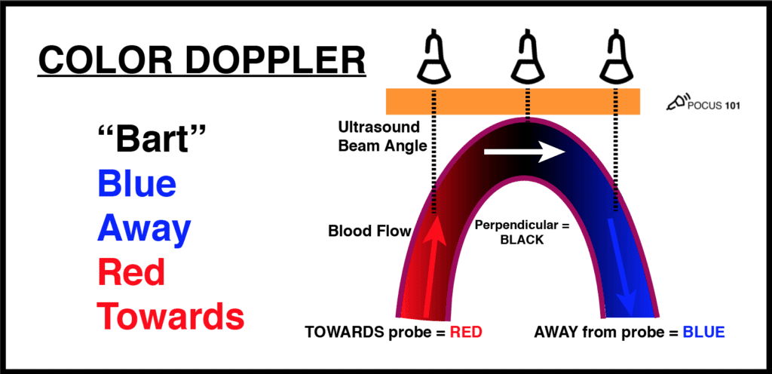
COLOUR DOPPLER

Slide 6
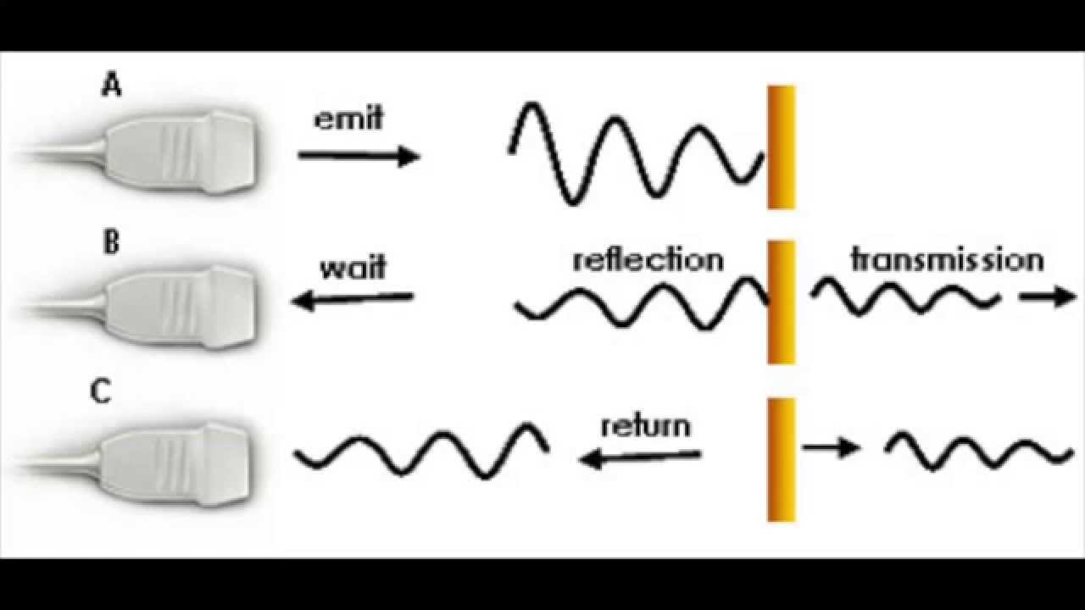
IMAGE FORMATION

Slide 7
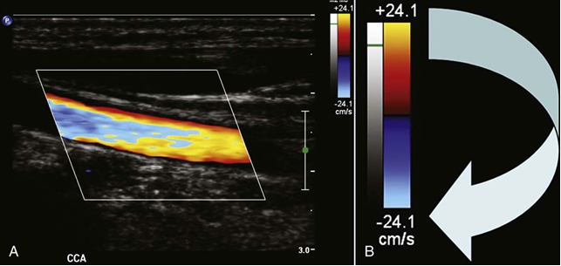
ALIASING

Slide 8
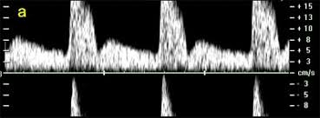
SPECTRAL ALISING

Slide 9
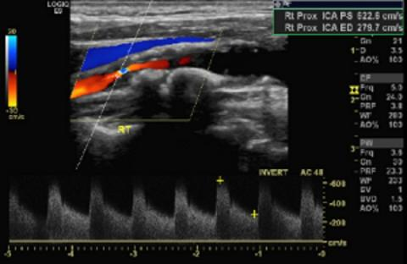
CAROTID STENOSIS

Slide 10
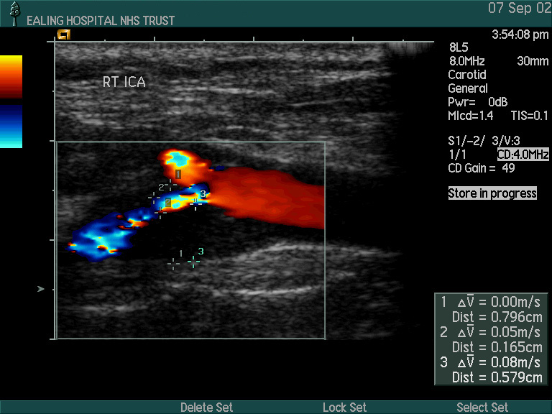
CAROTID STENOSIS

Slide 11
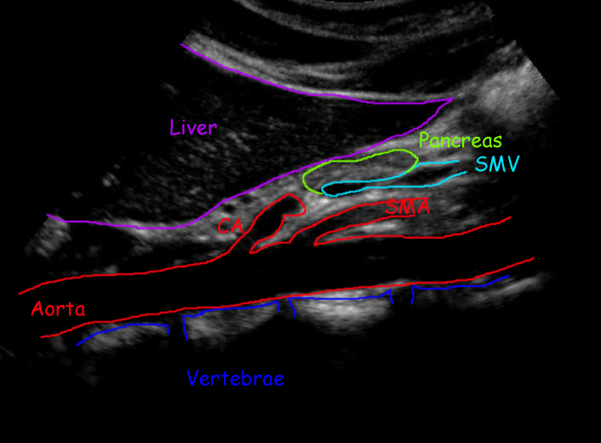
PROXIMAL AORTA

Slide 12
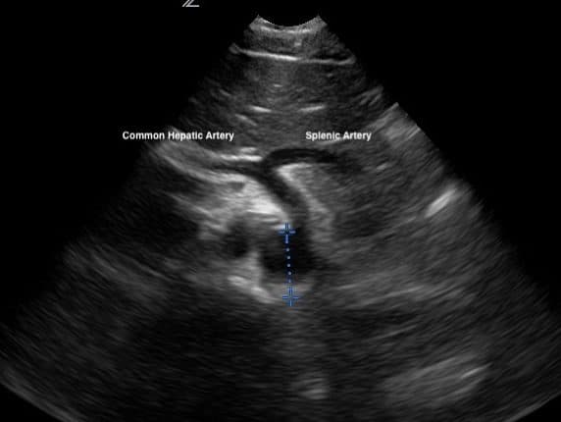
PROXIMAL AORTA

Slide 13
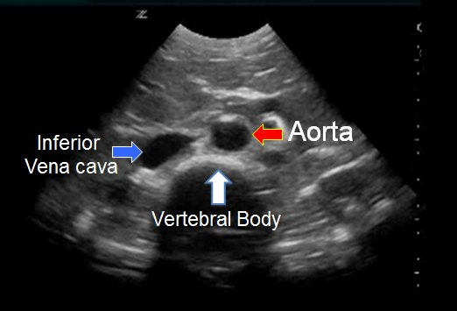
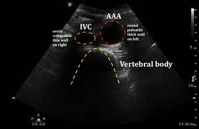
TRANSVERSE AORTA

Slide 14
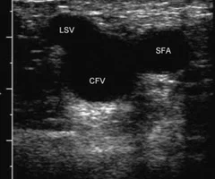
SAPHENOFEMORAL JUNCTION

Slide 15
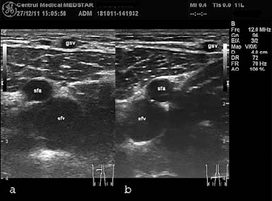
LONG SAPHENOUS VEIN

