Slide 1
Vascular Interesting cases meeting
Sept 2022

Slide 2
History
30 Year old Female
C/O intermittent claudication and foot pain
200yd calf pain, occasionally foot turns purplish

Slide 3
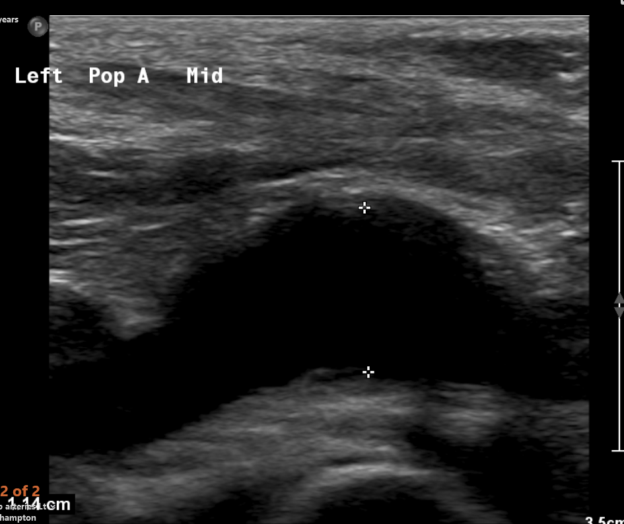

Slide 4
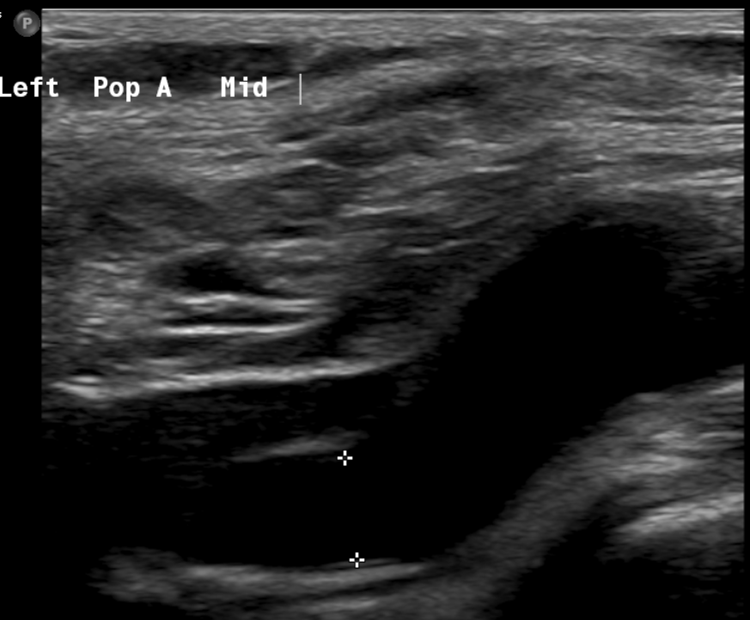

Slide 5
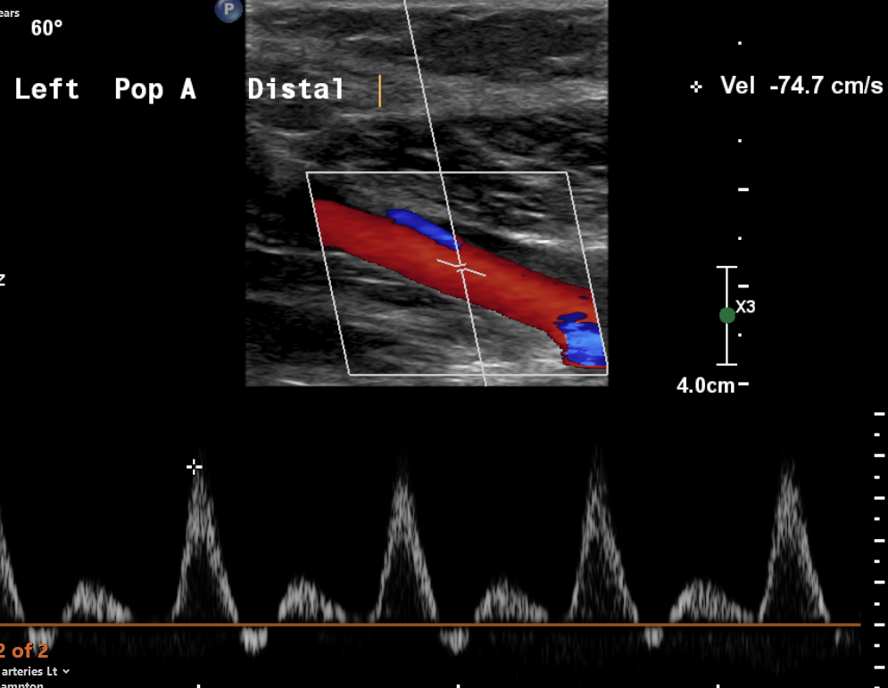

Slide 6
Lower limb arterial requested
THIS REPORT CONTAINS SIGNIFICANT AND/OR UNEXPECTED FINDINGS THAT REQUIRE ACTION BY THE REFERRER
Summary:
- Aneurysmal left mid Popliteal Artery noted, measuring 1.1cm in longitudinal and 1.2cm in transverse, compared to the normal uniform lumen proximal to this measuring 0.5cm
- No evidence of significant arterial disease in the left leg
- Low velocity flow noted in the left Posterior Tibial and Peroneal Arteries
- No aneurysmal dilatations noted in the abdominal aorta, the right Popliteal Artery or the Common Iliac Arteries
Maximum diameter of the Abdominal Aorta (AP inner to inner wall measurements, as per NAASP guidelines):
Transverse: 1.4cm
Longitudinal: 1.4cm

Slide 7
Case discussed at MDT
MRI and repeat Duplex and ABPI to look for popliteal artery entrapment.

Slide 8
MRA Lower Limbs :
Comparison: US Doppler lower limbs 25/03/22.
Findings:
The popliteal artery displays characteristic aberrant medial displacement at the level of the medial head of gastrocnemius. There is a 18 mm saccular aneurysm in the P2 segment just distal to a where the artery crosses over the gastrocnemius muscular band and appears compressed. Otherwise, the right popliteal artery is normal in calibre. There is three-vessel run off to the feet on either side.
The medial head of gastrocnemius originates as normal from the superomedial aspect of the intercondylar notch however is atrophic compared to the other side.
Opinion:
18 mm saccular aneurysm of the left popliteal artery with evidence of entrapment by the medial head of gastrocnemius.

Slide 9
MDT
MEMO
This lady's case and imaging was reviewed in the MDT. She has a saccular aneurysm of her left popliteal artery which may be from entrapment. She needs a posterior approach to the saccular aneurysm repair. She needs to be warned that the symptoms that she has may not resolve after performing this procedure and the finding of the saccular aneurysm may actually be incidental. She will be informed of this in clinic.
Miss Nandita Pal
Consultant Vascular Surgeon

Slide 10
PRE Exercise ABPI
LEFT: PRE-Exercise
Posterior Tibial artery = 130mmHg (ABPI = 1.0)
Anterior Tibial artery = 120mmHg (ABPI = 1.0 )
Within normal limits
Left PTA (distal) = triphasic
Left ATA (distal) / DPA = triphasic
The above waveforms suggest no evidence of significant arterial disease.

Slide 11
Post Exercise ABPI
LEFT:
Posterior Tibial artery = 120mmHg (ABPI = 0.8)
Anterior Tibial artery = 115mmHg (ABPI = 0.8 )
Moderate disease
Left PTA (distal) = pulsatile monophasic
Left ATA (distal) / DPA = pulsatile monophasic

Slide 12
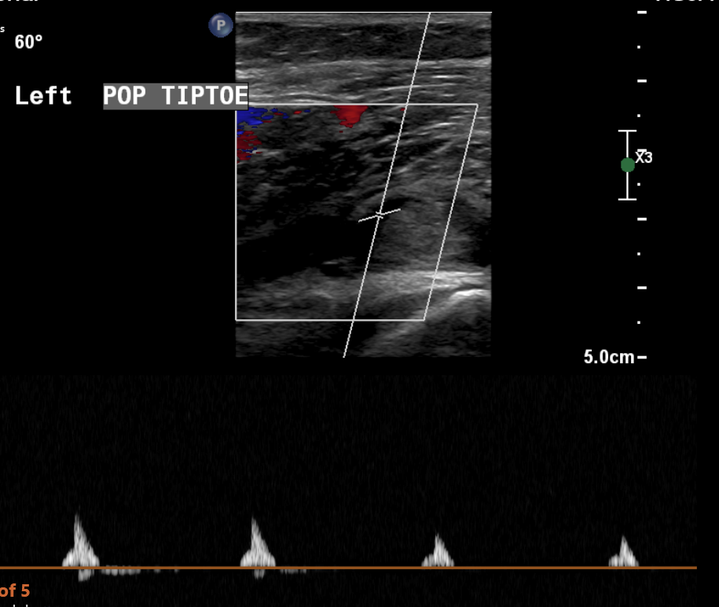
Popliteal artery Entrapment ultrasound

Slide 13
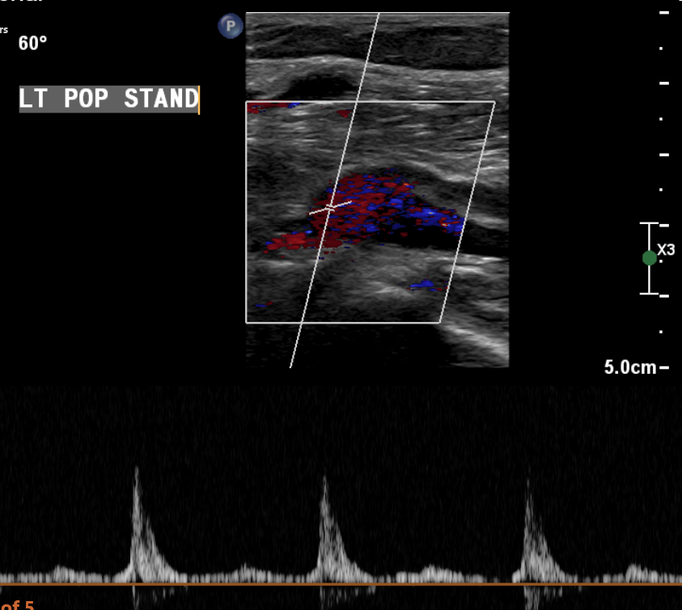

Slide 14
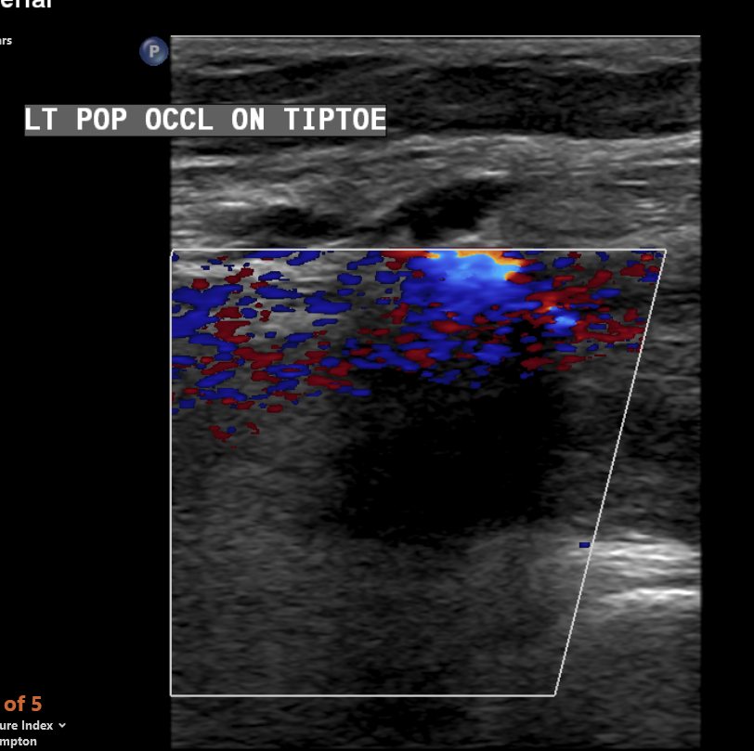

Slide 15
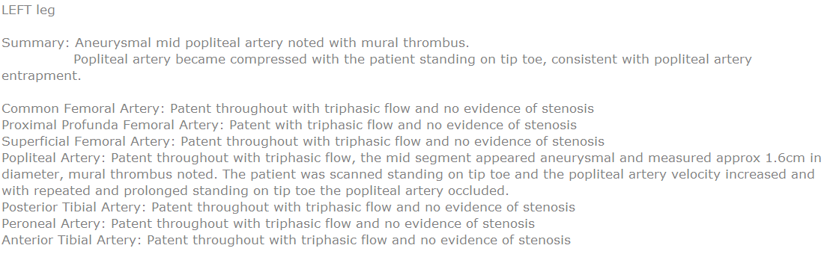

Slide 16
Popliteal Artery Entrapment Syndrome (PAES)
Popliteal artery entrapment syndrome is an uncommon condition in which an abnormally positioned or enlarged calf muscle presses on the popliteal artery.
5 anatomic types of entrapment
The artery becomes trapped, restricting blood to flow to the lower leg and foot.
Risk factors: Younger age, rarely diagnosed in people over 40, more common in young men, athletes who undertake strenuous activity.

Slide 17
Diagnosis by Ultrasound
Raised velocities noted in the popliteal artery during plantar flexion which returns to normal in a neutral position
Journal of endovascular Surgery 2013- Study showed found preoperative DUS to have perfect agreement with the intraoperative findings in diagnosing PAES.
None of the healthy volunteers were able to compress the popliteal artery during plantar flexion.

Slide 18
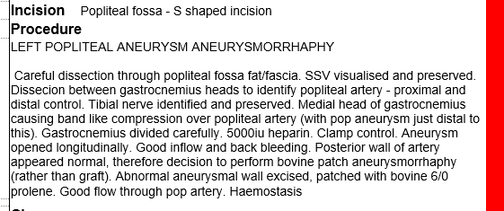

Slide 19
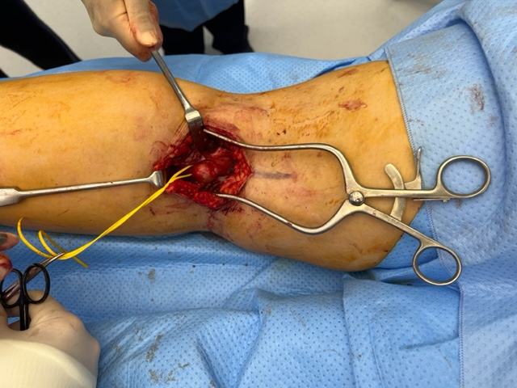

Slide 20
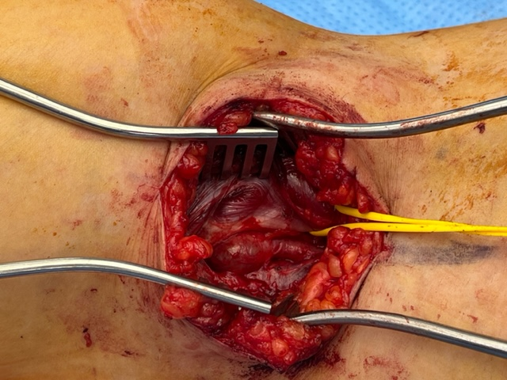

Slide 21
Aneurysmorrhaphy
The surgical suture of the sac of the aneurysm.
Closure by suture of the sac of an aneurysm to restore the normal lumen dimensions

Slide 22
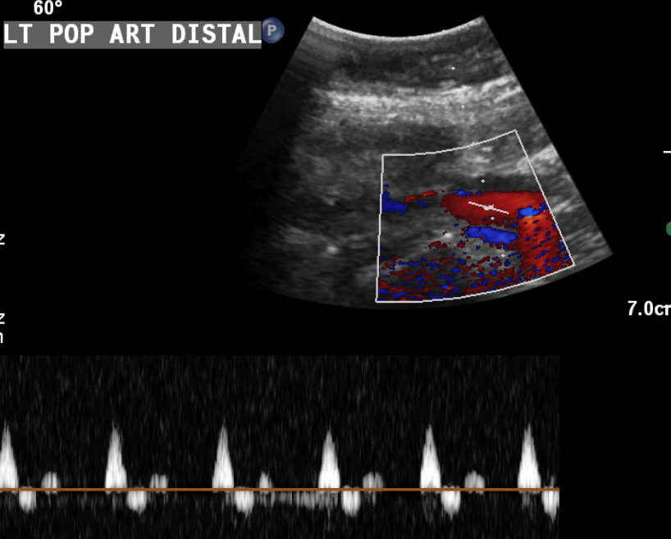
Post-op Duplex

