Slide 1
Vascular Interesting Cases Meeting
09-03-22

Slide 2
History
52 year old male
Admitted to AMU 2 with sudden onset abdo pain, fever and loose stools
Referred for an abdo scan for ? Intra-abdominal source of infection

Slide 3
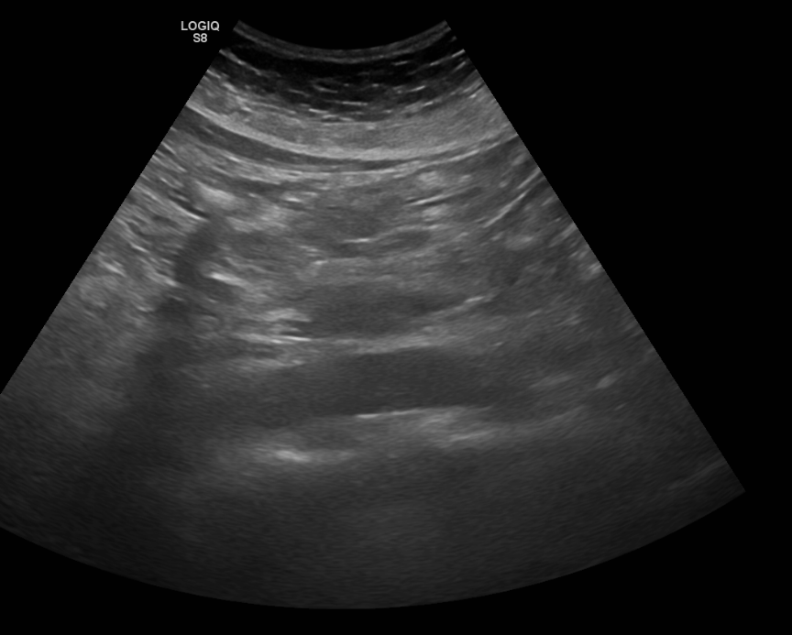

Slide 4
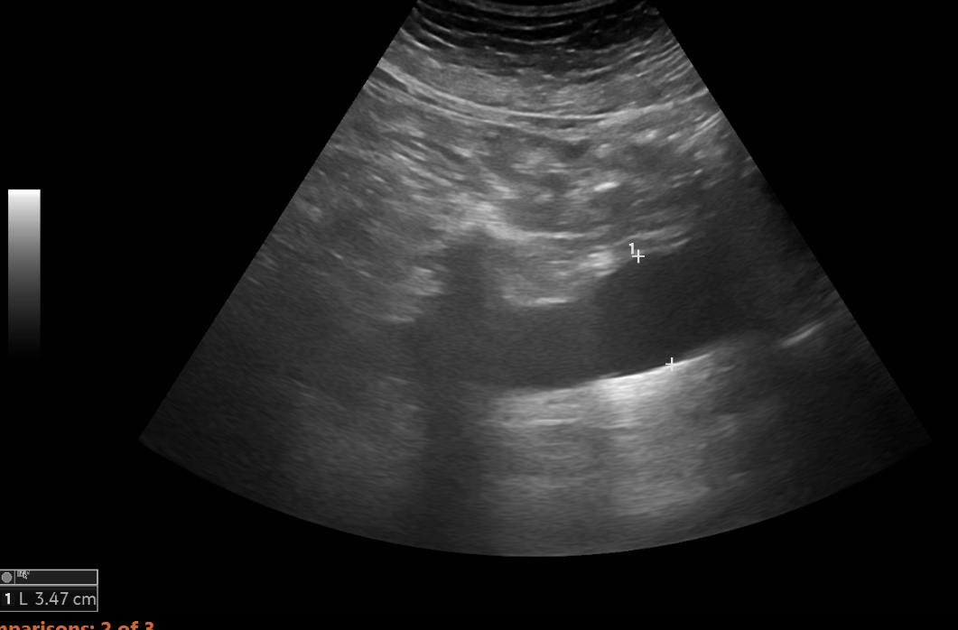

Slide 5
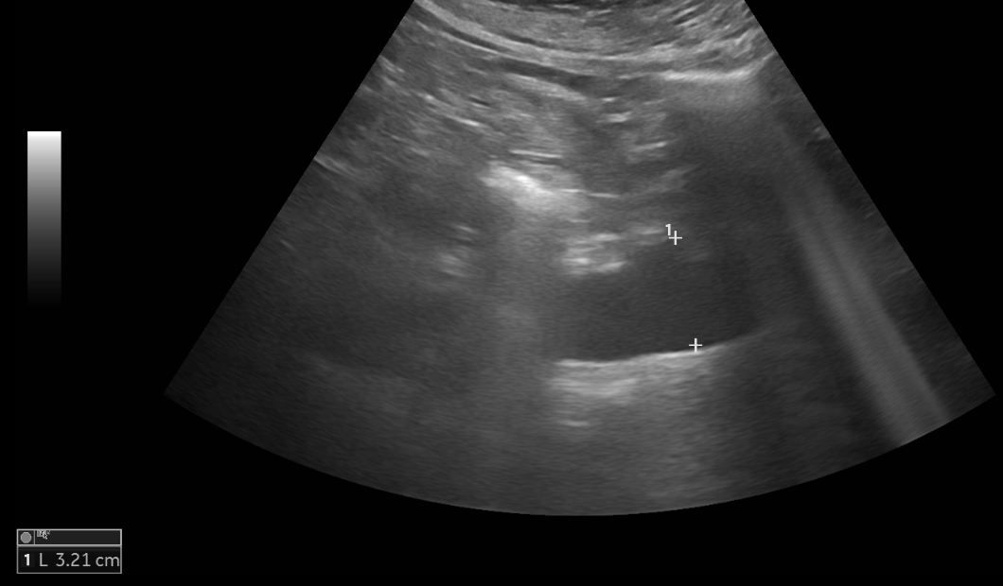

Slide 6
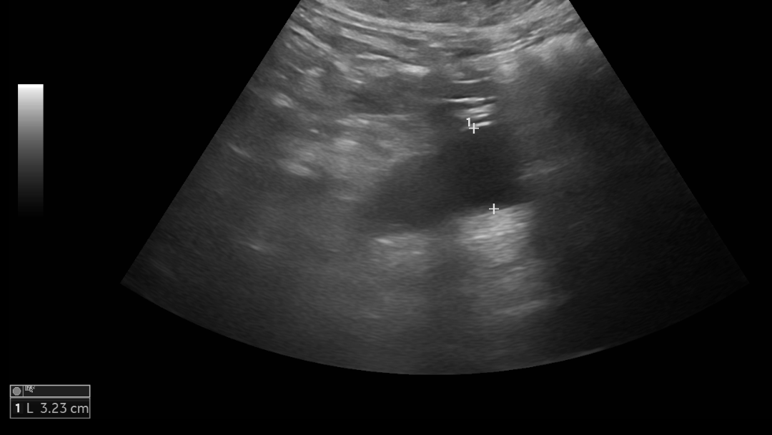

Slide 7
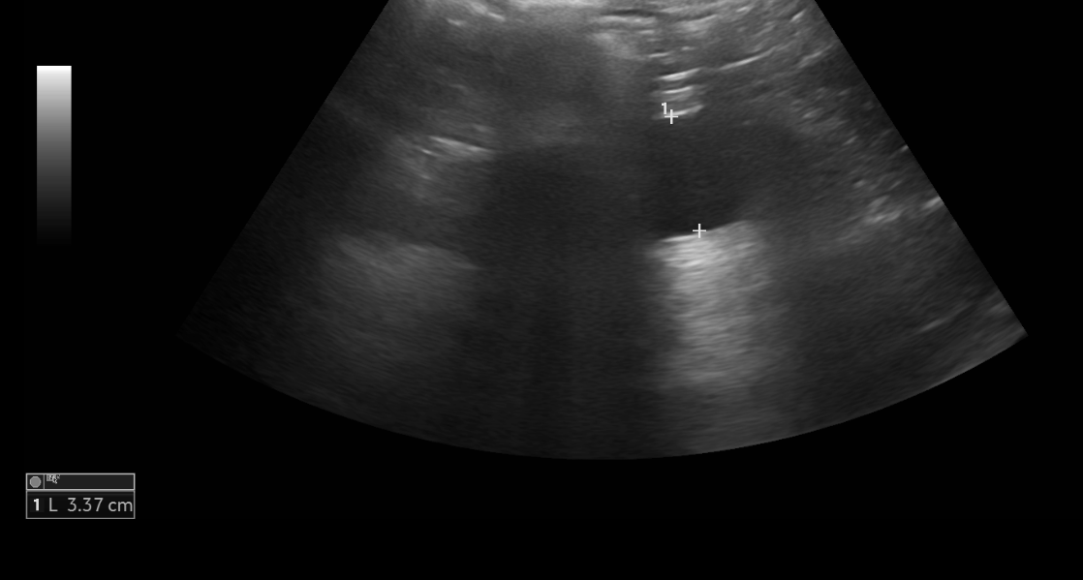

Slide 8
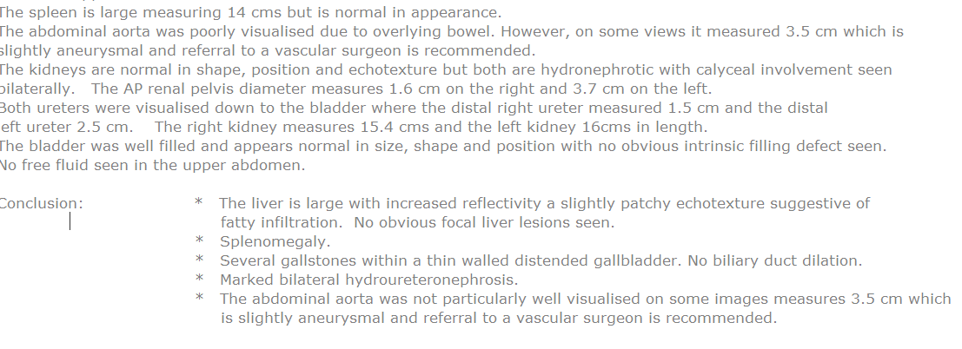
US abdo report
20/01/22

Slide 9
Vascular ultrasound requested performed 23/02/22
?35mm AAA on US abdo. Aorta poorly visualised. US to check aortic diameter.
(Information via Order Comms)

Slide 10
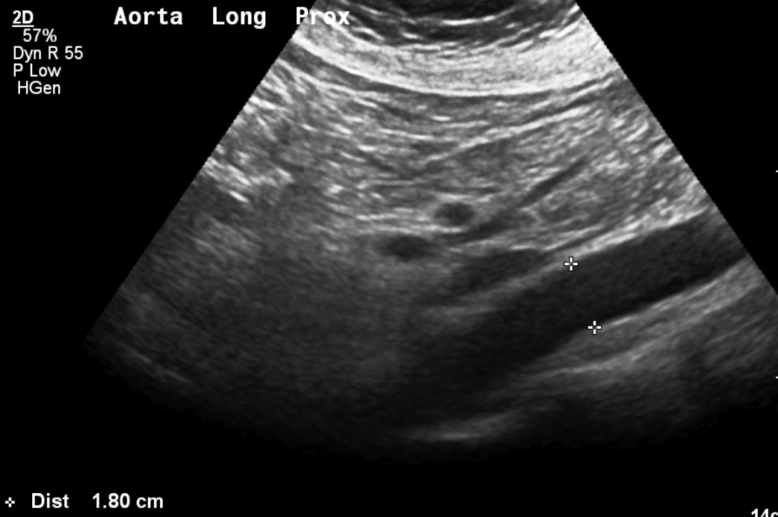

Slide 11
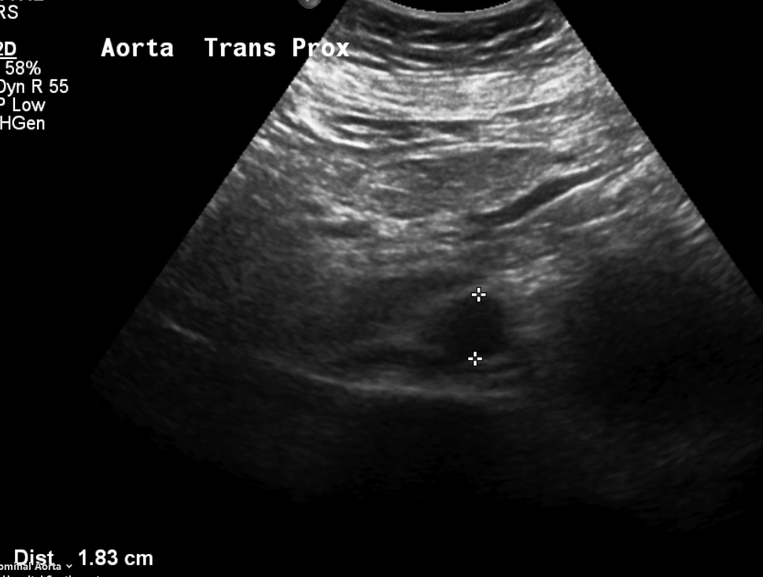

Slide 12
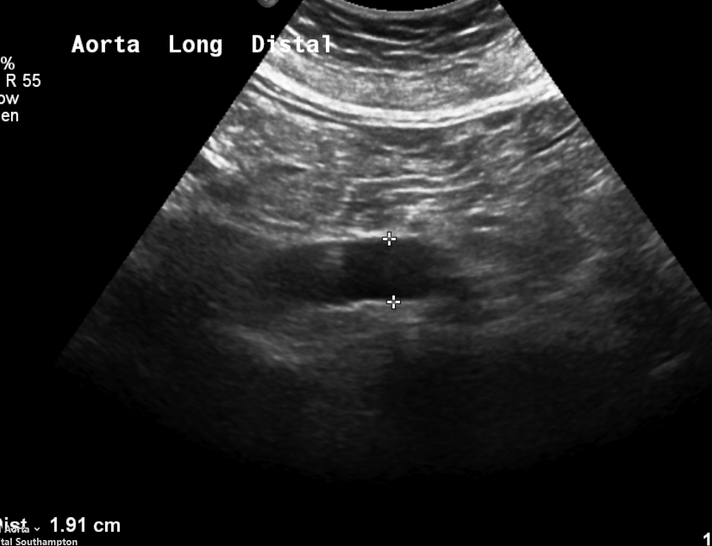

Slide 13
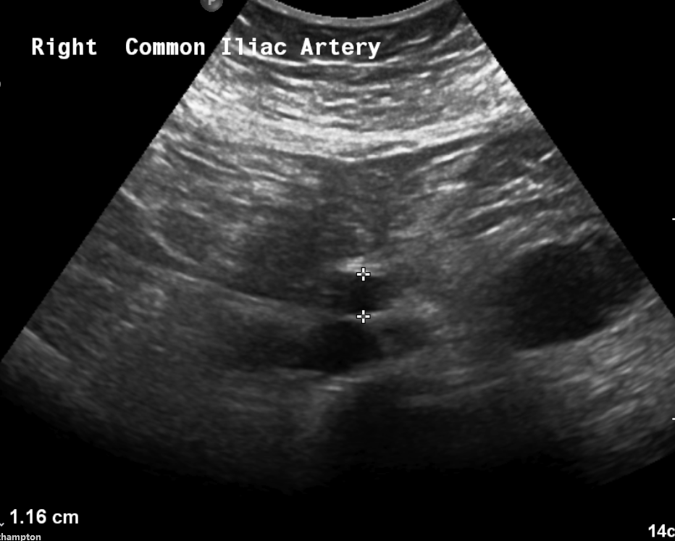

Slide 14
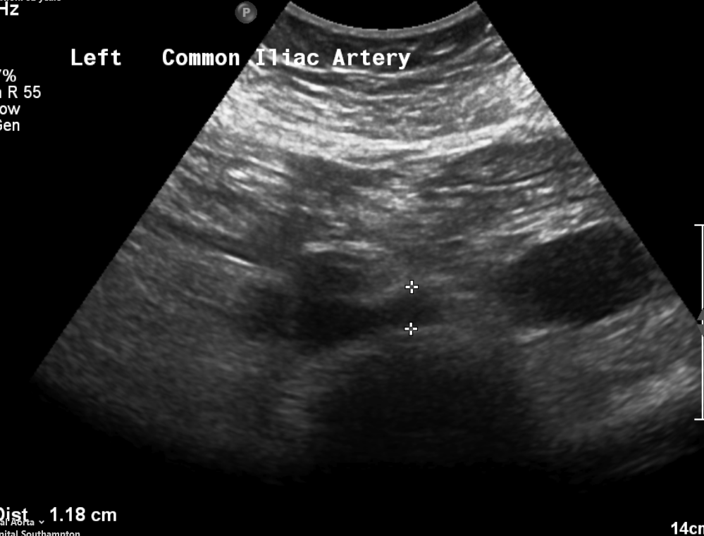

Slide 15
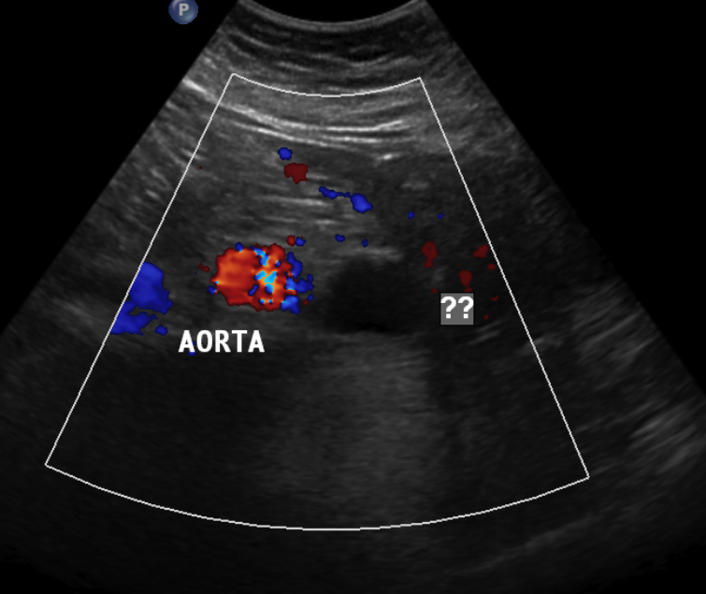

Slide 16
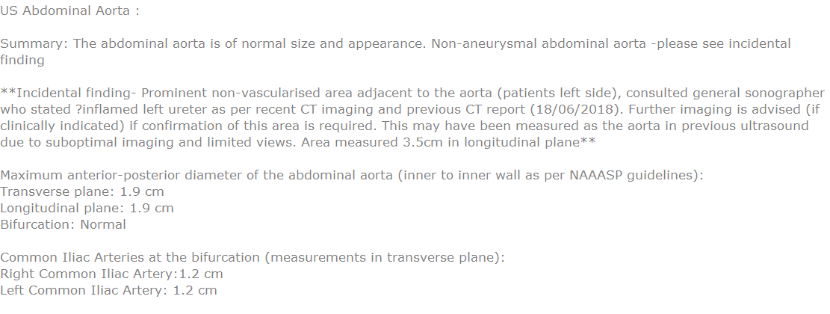
Vascular Ultrasound Report

