Slide 1
Vascular Interesting Cases
January 2023

Slide 2
Patient
73 Year old Male Critical limb ischaemia
History of heart disease and stroke Arterial scan at QAH

Slide 3
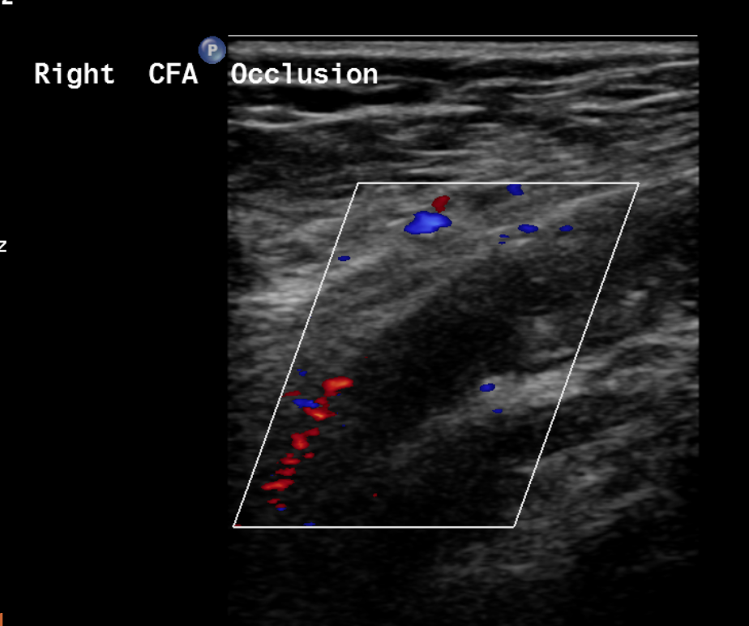
Lower limb arterial scan at QAH Sept 22

Slide 4
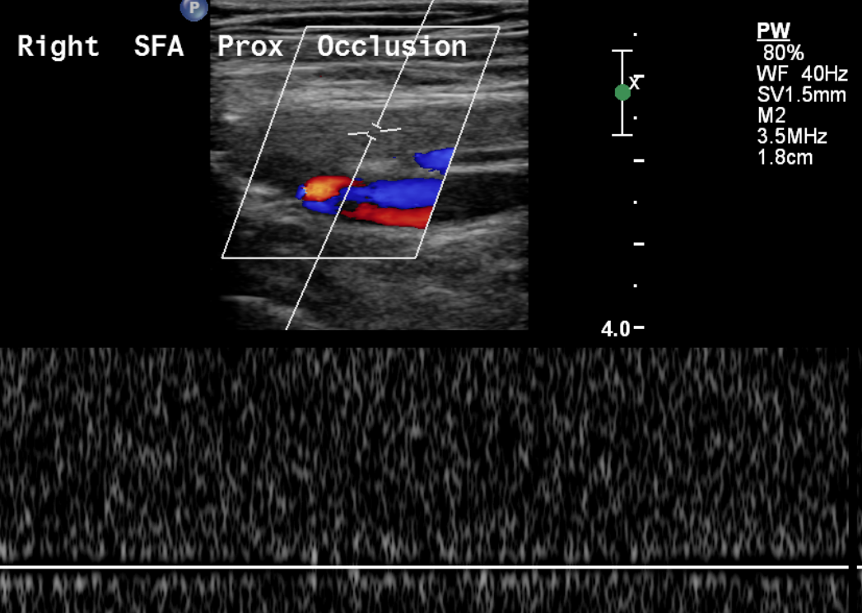

Slide 5
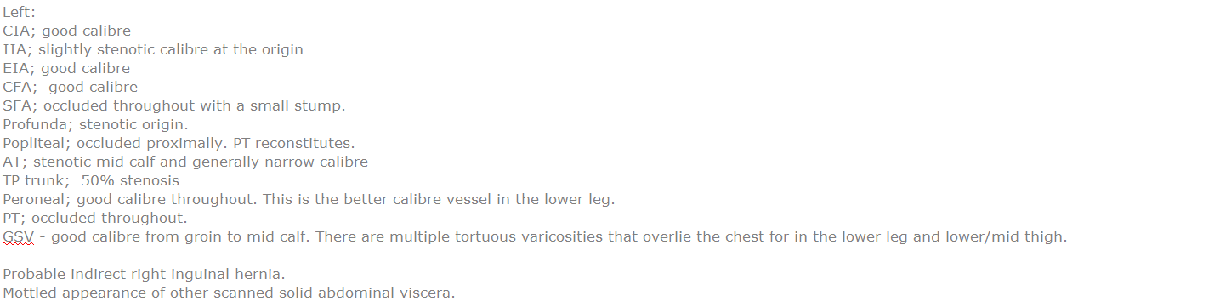
CT Report NOV 22

Slide 6
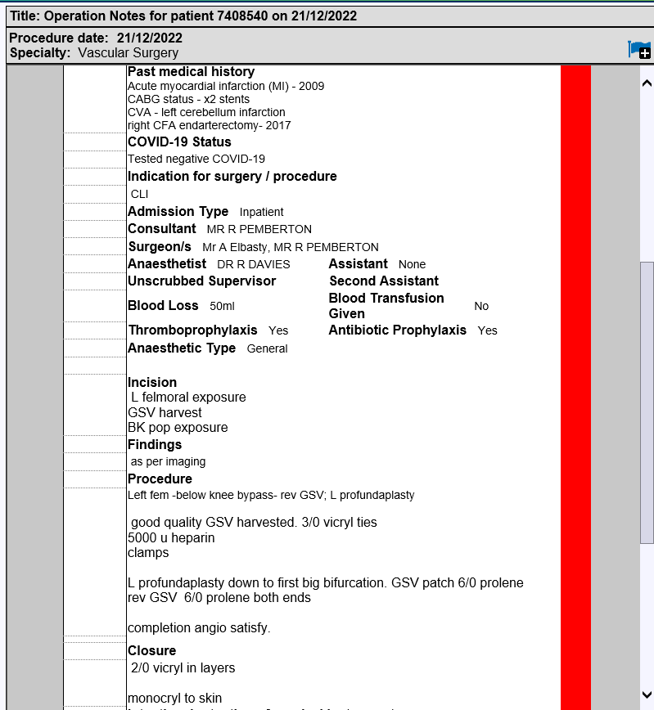

Slide 7
Post-op Graft check , pre-discharge
Clinical History :
Left fem-BK pop bypass yesterday. No signal in graft. Monophasic PT pulse. ?graft patency

Slide 8
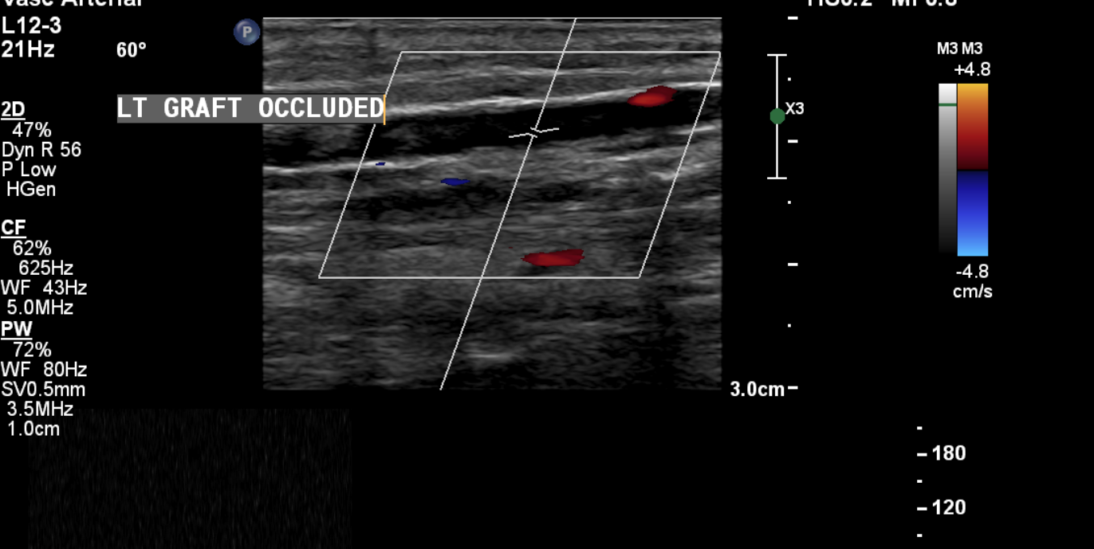

Slide 9
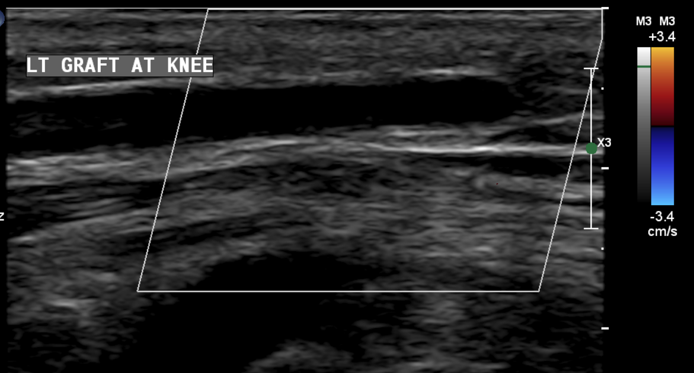

Slide 10
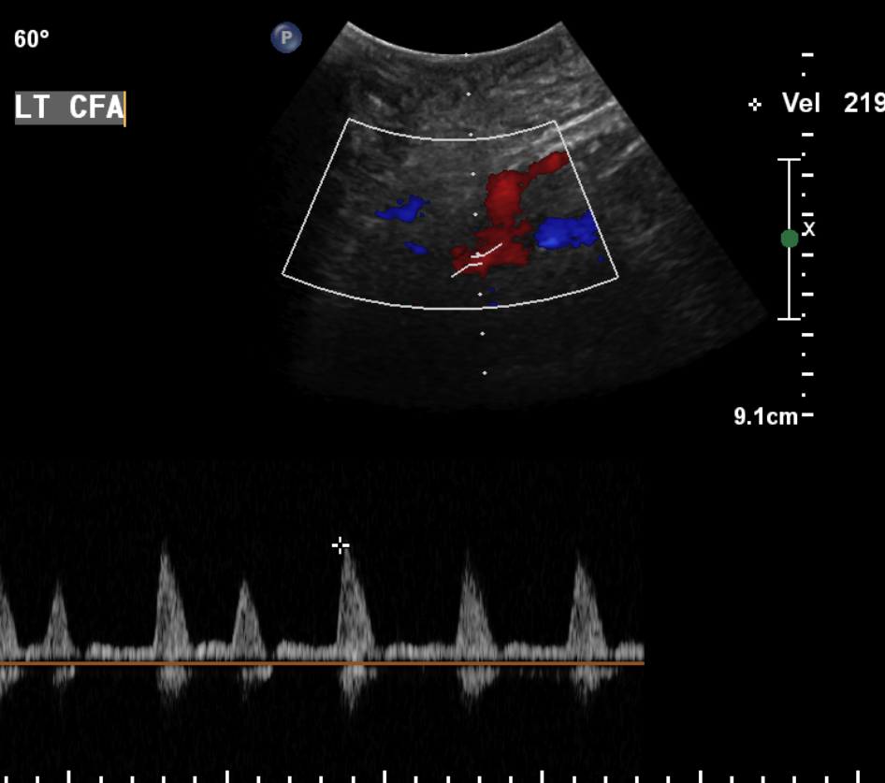

Slide 11
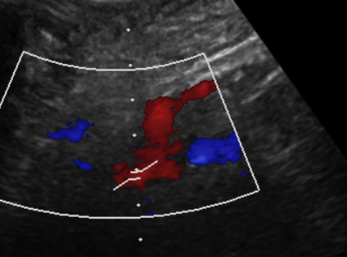

Slide 12
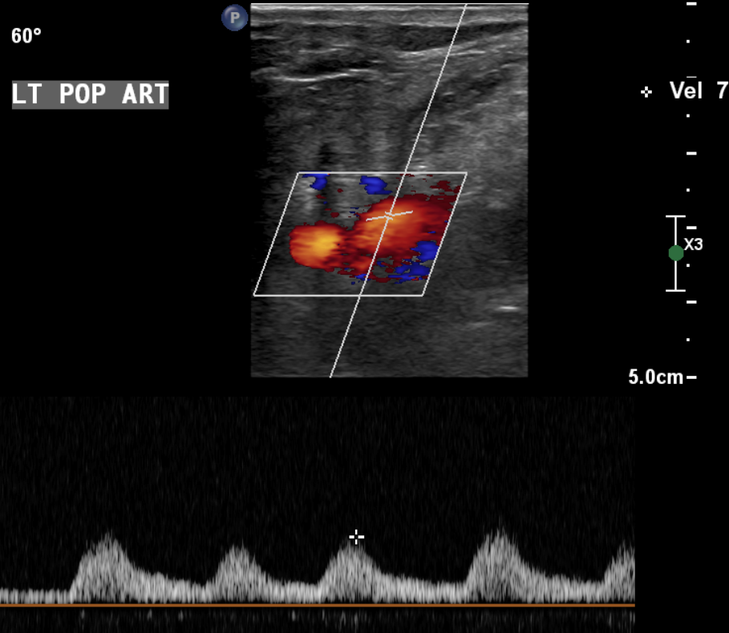

Slide 13
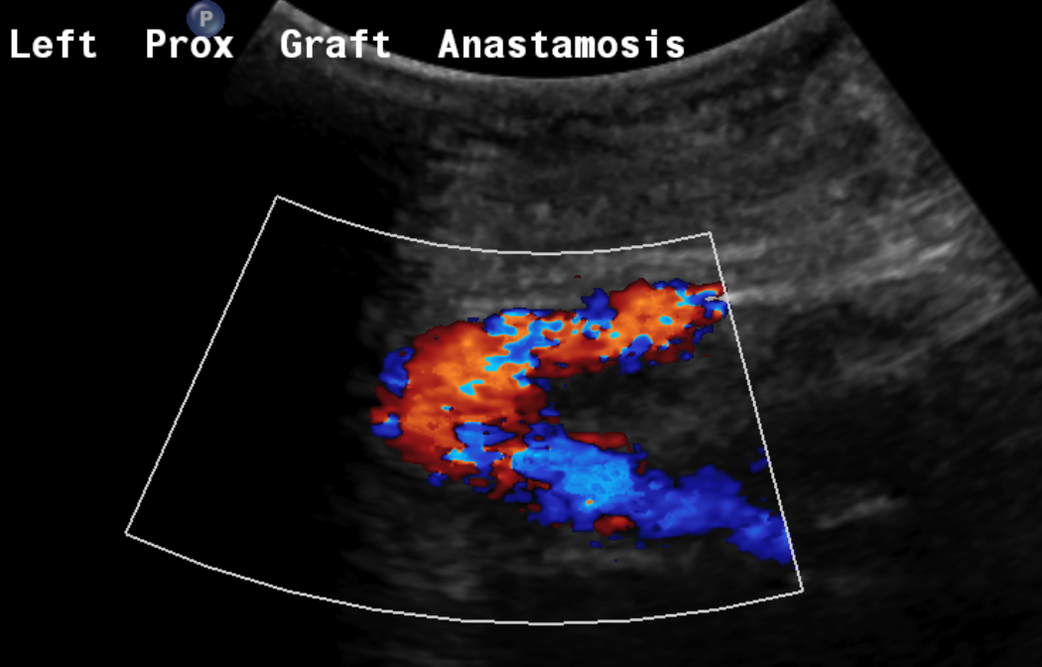
Scanned from posterior thigh approach
GRAFT
CFA
PFA

Slide 14
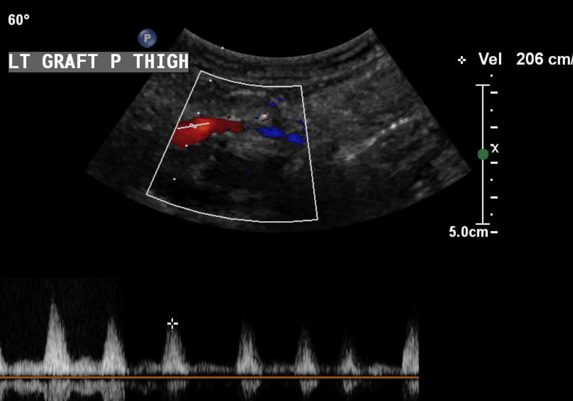

Slide 15
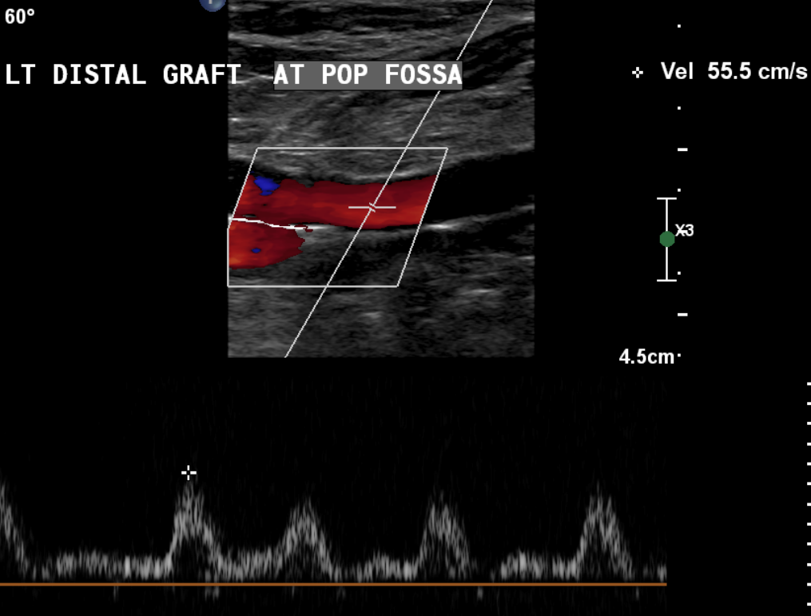

Slide 16
Deeply Tunnelled Bypass Grafts
Provide protection from wound infection, bleeding or damage
Prevent compression of the graft by the fascia.
Difficult to access if revisions are required

