Slide 1





Vascular Society Annual Scientific Meeting
Dublin, 22-24th November 2023
William Owen
Clinical Vascular Scientist
North Bristol NHS Trust
William.owen@nbt.nhs.uk

Slide 2
Carotid Imaging Session
  Mr Dominic Howard
  Consultant vascular surgeon
  Oxford University Hospitals NHS Trust
  Artificial Intelligence enthusiast
  Dr Steven Rogers
  Scientific Director
  MAVRIC – Manchester Vascular Research & Innovation Centre
  3D US fanatic

Slide 3
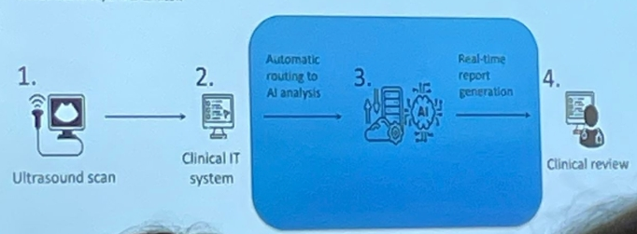
Advances in AI to assess carotid artery disease
Imaging and reporting workflow
No change to routine patient pathway
Integration into IT system with audited security
Automatic extraction and analysis of scans and report generation
Immediate AI report to clinician

Slide 4
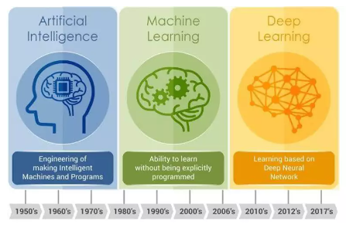
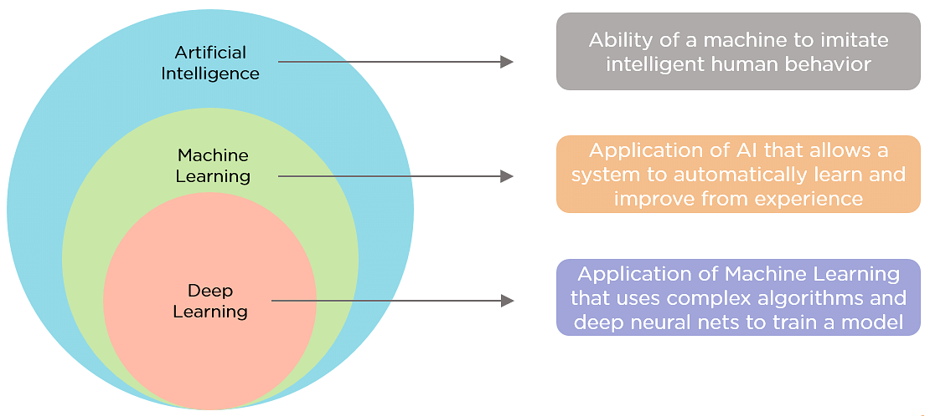
Advances in AI to assess carotid artery disease
Degree of stenosis guides clinical decision making
Plaque composition could be a better predictor of stroke risk
Can AI detect at risk plaque?
Notes:
The easiest way to think about artificial intelligence, machine learning, deep learning and neural networks is to think of them as a series of AI systems from largest to smallest, each encompassing the next.
Artificial Intelligence: a program that can sense, reason, act and adapt.
Machine Learning: algorithms whose performance improve as they are exposed to more data over time.
Deep Learning: subset of machine learning in which multilayered neural networks learn from vast amounts of data.

Slide 5
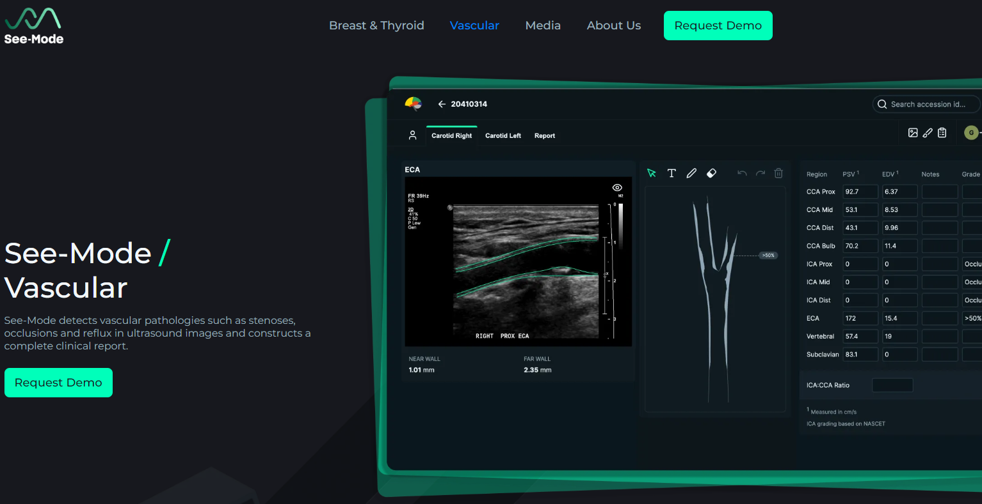
Advances in AI to assess carotid artery disease
Mr Dominic Howard
See-Mode
“Our AI-enhanced ultrasound reporting software automatically reads and assesses ultrasound images, producing accurate clinical reports”

Slide 6
Advances in AI to assess carotid artery disease
  AI classification of symptomatic/asymptomatic carotid plaque
      Carotid US scans labelled
      Deep learning model trained to classify status
      Evaluate model on a test against assessments
  Initial dataset: 103 US scans containing:
      53 scans of symptomatic carotid plaques
      50 scans of asymptomatic plaques
  Inclusion criteria
      Subjects >18 years old
      Greater than 50% stenosis on ultrasound
      Longitudinal B-mode or colour flow

Slide 7
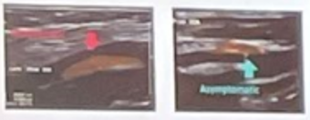
Advances in AI to assess carotid artery disease
  Machine Learning
    Training data to train model
    Cross-validation to tuning parameters
    Test data to measure final performance
Labelled: 447 images
  364 training images (75 patients)
  83 images for test (28 patients)
    43 images asymptomatic (11 patients)
    40 images symptomatic (17 patients)

Slide 8
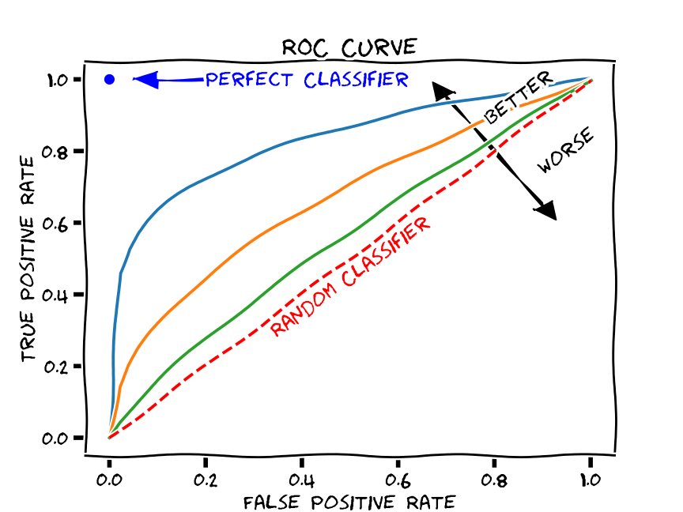
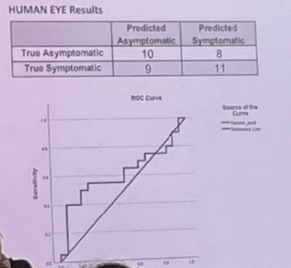
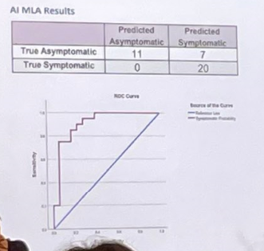
Advances in AI to assess carotid artery disease
Measure the accuracy of diagnostic tests
Random model: 0.5
Perfect model: 1.0
ROC AUC: 0.61
ROC AUC: 0.91

Slide 9
Advances in AI to assess carotid artery disease
  Dr Steven Rogers
  Abstract:
  Patients with symptoms associated with carotid artery disease and PAD have the same high-risk of Major Adverse Cardiovascular Event (MACE, including stroke) as those with ischaemic heart disease
  Long term effects of atherosclerosis largely preventable (BMT)
  Early detection screening
  Reduction in frequency and cost of MACE
  Screening with 2D US requires skilled staff, unlikely to be cost-effective at population level
  Using AI combined with tomographic 3D-US

Slide 10
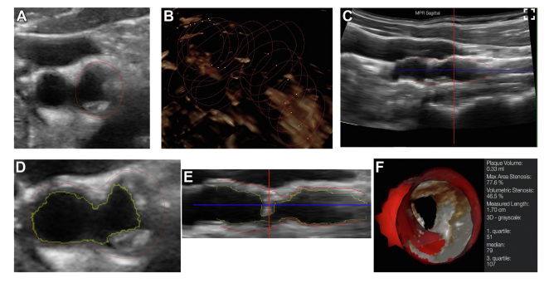
Advances in AI to assess carotid artery disease
  The usual Steve Rogers carotid artery 3D US stuff…
  “Accelerated Measurement of Carotid Plaque Volume Using Artificial Intelligence Enhanced 3D Ultrasound”
  3D US images for 121 individuals analysed by 2 blinded operators to measure CPV
  Corresponding endarterectomy specimen volumes calculated (saline suspension)

Slide 11
Advances in AI to assess carotid artery disease
  Take home message:
    Highly accurate method to measure CPV
    Significantly faster than manual method
      Auto-CPV measurement took 43% the time of manual planimetry; median (IQR) 05:39 (01:58) minutes compared to 13:05 (04:15) minutes, Wilcoxon rank-sum test, P < 0.01
      Improved feasibility means that the utility of CPV can be assessed in large population studies to stratify risk in asymptomatic carotid disease or assess response to medical treatment

Slide 12
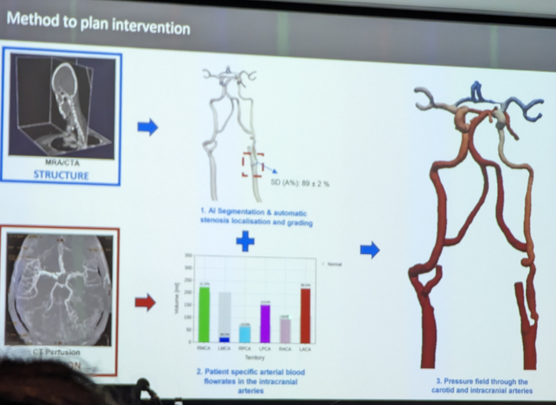
Advances in AI to assess carotid artery disease
  Using MRI and AI to assess stenosis and perfusion to predict benefit of CEA

Slide 13


Welcome to our new robot overlords

Slide 14

Less work, more time for Guinness

