Slide 1
UPPER LIMB DVT ASSESSMENT
Michael Crook, AVS
10/07/2024

Slide 2
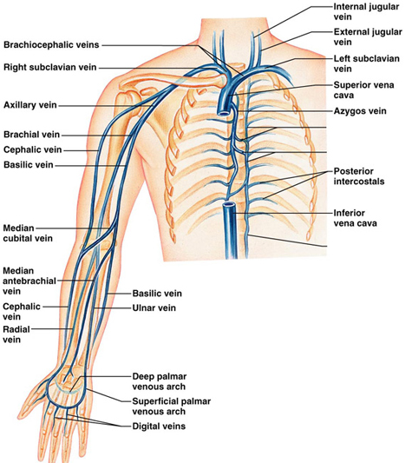
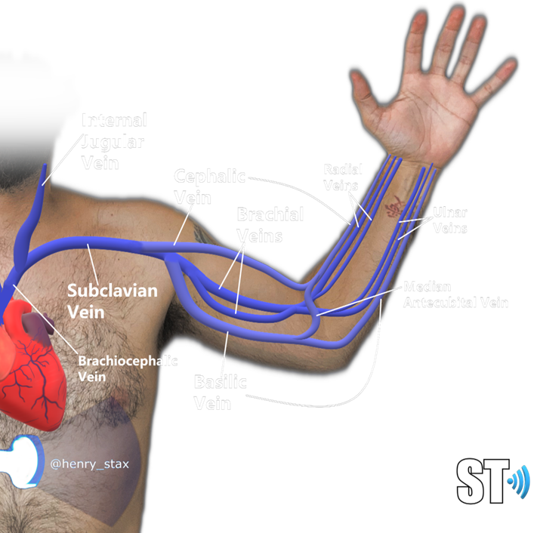
Venous anatomy
Key landmarks
Subclavian vein becomes axillary distal to clavicle
Axillary vein becomes brachial distal to the basilic confluence
Radial and ulnar veins confluence in the antecubital fossa
Deep venous system comprises:
Internal/External jugular
Brachiocephalic
Subclavian
Axillary
Brachial (bifid)
Radial (bifid)
Ulnar (bifid)
Superficial venous system comprises:
Basilic
Cephalic
Medial cubital

Slide 3
Upper limb DVT stats
DVT primarily involves brachial, axillary, and subclavian veins
There are 2 forms of upper extremity DVT: primary and secondary. Paget-Schroetter syndrome (PSS) (see notes)
Upper extremity DVTs currently comprise 5% to 10% of all DVTs
PSS accounts for only 10% to 20% of cases.
Rate of upper extremity DVT in all patients with central catheterization is between 14% to 23%
PE occurs in up to 6% of DVTs affecting the upper extremities compared to 15% to 30% in the lower extremities
Post-thrombotic syndrome occurs in less than 5% of DVTs in the upper extremities (50% in the lower extremities)
Duijzer D et al. (2021). Upper Extremity Deep Vein Thrombosis and Asymptomatic Vein Occlusion in Patients With Transvenous Leads: A Systematic Review and Meta-Analysis.
Front Cardiovasc Med. 8:698336
See notes section for more info
Notes:
Upper extremity DVT primarily involves brachial, axillary, and subclavian veins. The primary form is known as Paget-Schroetter syndrome (PSS) and typically occurs in the dominant arm of younger athletic patients involved in activities requiring excessive and repeated motion of the upper extremities such as tennis, swimming, bodybuilding, gymnastics, and sports involving repetitive ball throwing. The secondary form occurs most commonly in patients with central venous catheterization or patients with malignancy.
In the primary form (PSS), repeated motions of the upper extremity result in hypertrophy of the scalene muscles, compromising the neurovascular bundle as it exits the thorax between the cervical rib and surrounding musculature. Repeated compression of the subclavian vein results in venous stasis and perivenous microtrauma, activating the coagulation pathway with eventual thrombosis. In the secondary form, catheterization disrupts the endothelial lining and activates a similar coagulation cascade. Additionally, congenital and acquired cases of coagulation disorders such as Factor V Leiden mutation or malignancy also increase the risk for upper extremity DVT.
Check out Virchow's triad this applies to lower limb DVTs as well: https://radiopaedia.org/articles/virchow-triad?lang=gb
Check out post thrombotic syndrome: https://radiopaedia.org/articles/post-thrombotic-syndrome-2?lang=gb#:~:text=Post%2Dthrombotic%20syndrome%20(PTS),reflux%20and%20chronic%20venous%20hypertension.

Slide 4

Scan protocol
Patient supine (dilates veins in the neck)
Check brachiocephalic vein colour
flow and cardiac/respiratory phasicity.
Compare to contralateral side
Check subclavian vein for wall to wall
colour flow. Augment lower arm if
needed
Check IJV for wall to wall
colour flow
Move below clavicle and check
axillary vein colour flow. Move arm
over head for distal access
Assess brachial veins for colour flow
and compressibility. Usually
a bifid system
Assess radial and ulnar veins from
the wrist proximally for colour flow
and compression. Bifid systems
Assess superficial veins for
thrombophlebitis via compression.
Usual site is antecubital fossa
Left arm is difficult: If needed sit the patient up over the side out the couch when assessing the
axillary veins and below as this will dilate those veins , plus allow more access
See notes section for more info
Notes:
The majority of patients present only with limb swelling and arm discomfort. The onset and duration of limb swelling along with any previous history of DVT should be obtained. Patients may also complain of arm heaviness. The physical exam may also reveal limb erythema with visible veins across the chest and upper extremity (Urschel’s sign). Personal and family history of hypercoagulable disorders are relevant, as well as if any prior central venous catheterization has been attempted. In the primary form (PSS), patients will present with a sudden onset of severe limb pain and swelling, often in the dominant arm. These patients are younger and often participate in activities requiring excessive and repeated motions of the upper extremity. This subset of patients may go on to have a test for thoracic outlet syndrome, which may include stress positional ultrasound with the arm in abduction and rotation positions and chest x-ray to check for extra cervical rib.

Slide 5
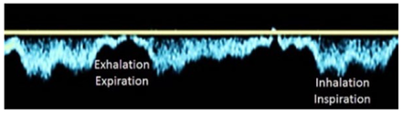
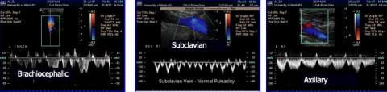
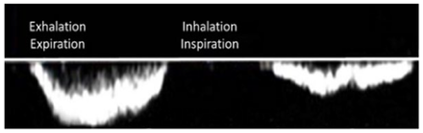
Venous waveform analysis
Upper extremity normal respirophasic
Pulsatility in upper extremity veins decreases peripherally
Lower extremity normal respirophasic
The single best paper of vascular waveforms analysis:
Kim ES, Sharma AM, Scissons R, Dawson D, Eberhardt RT, Gerhard-Herman M, Hughes JP, Knight S, Marie Kupinski A, Mahe G, Neumyer M, Poe P, Shugart R, Wennberg P, Williams DM, Zierler RE. Interpretation of peripheral arterial and venous Doppler waveforms: A consensus statement from the Society for Vascular Medicine and Society for Vascular Ultrasound. Vasc Med. 2020 Oct;25(5):484-506. doi: 10.1177/1358863X20937665. Epub 2020 Jul 15. PMID: 32667274.
See notes section for more info
Notes:
Upper extremity – normal respirophasic
Antegrade flow increases with inspiration due to negative intrathoracic pressure and decreases with expiration due to increased intrathoracic pressure.
Lower extremity – normal respirophasic
Antegrade flow decreases with inspiration due to higher intra-abdominal pressure and increases with expiration due to decreased intra-abdominal pressure.

Slide 6
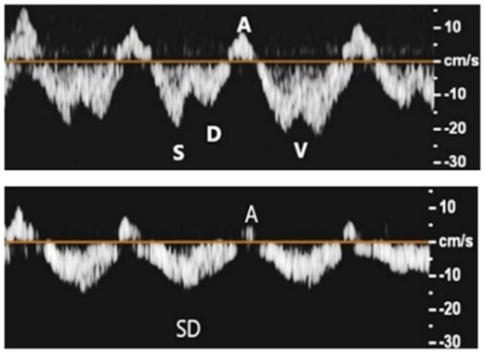
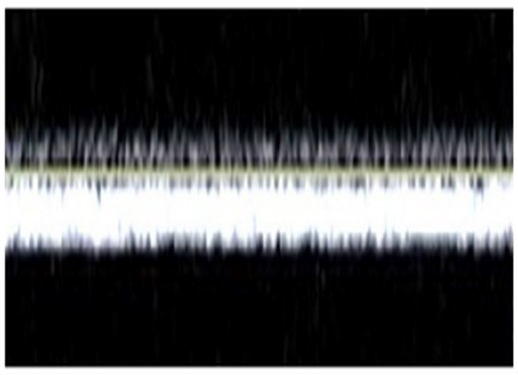
Central vein waveform analysis cont
subclavian/brachiocephalic/axillary
Normal subclavian
Abnormal
See notes section for more info
Notes:
Normal pulsatile (subclavian/brachiocephalic/Axillary)
Subclavian vein waveforms demonstrate pulsatility due to the proximity to the heart and transmission of right atrial pressure.
Pulsatile venous flow demonstrating antegrade flow with S and A-waves during early systole and diastole, V-notching during late systole, and A-wave during right atrial contraction.
Pulsatile venous flow demonstrating antegrade flow with so-called S-D complex in systole and early diastole, and possible retrograde flow with A-wave during right atrial contraction.
Abnormal Continuous (loss of pulsatility and spontaneity/respiratory phasicity)
A steady and unwavering waveform identifies a more central obstruction (proximal to site of insonation) intrinsic to the veins (fully or partially occluding thrombus or stenosis) or from extrinsic compression. The increased venous pressure at the Doppler sample level obviates the influence of respiratory and cardiac factors on the waveform.

Slide 7
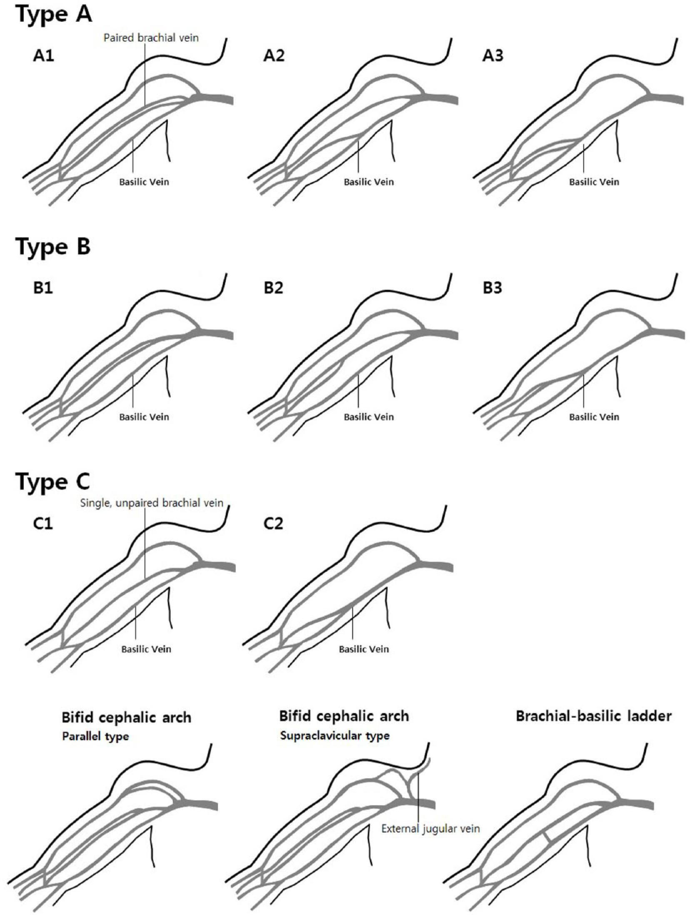
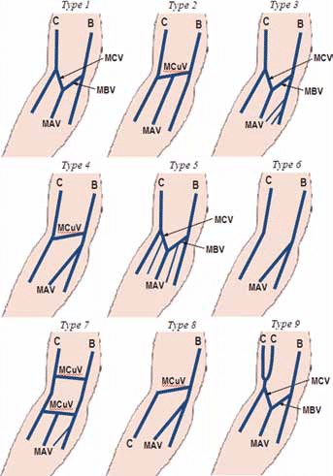
Anatomical Variants
Lee HS et al. 2019. Anatomical variants of upper arm veins on preoperative mapping venography for hemodialysis access in Korean adults. J Vasc Access. 20(3):270-275.
C-cephalic vein B-basilic vein MAV-median antebrachial vein MCV-median cephalic vein MBV-median basilic vein MCuV-median cubital vein

Slide 8
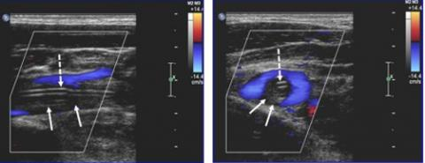
Pathology
Color Doppler image of a PICC line with thrombosis in a patient with symptomatic upper extremity DVT
https://www.iame.com/course/1091/take

Slide 9
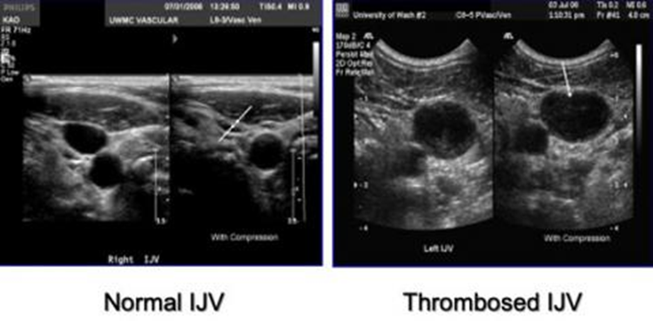
Pathology
https://www.iame.com/course/1091/take

Slide 10
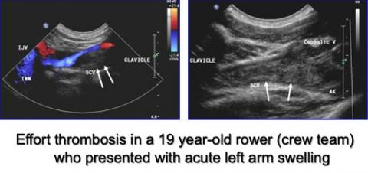
Pathology
Color and B-mode images of subclavian thrombosis in a young athlete. There is incomplete color filling and echogenic material in the lumen.
https://www.iame.com/course/1091/take

Slide 11
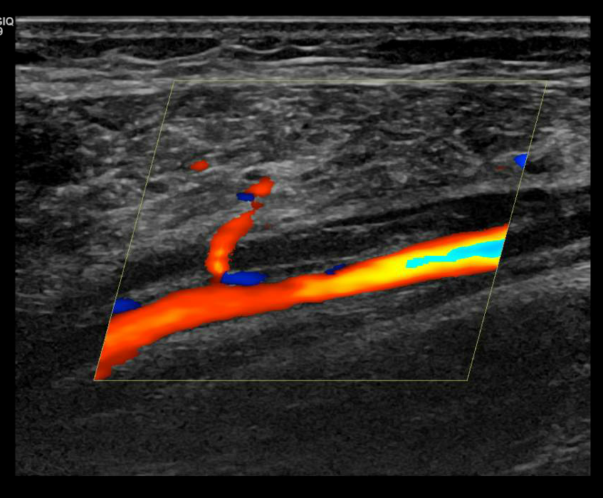
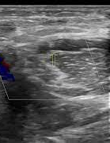
Pathology
Brachial vein thrombosis
Radial vein thrombosis

Slide 12
Differential diagnosis
Cellulitis
Superficial thrombophlebitis
Lymphoedema
MSK injury
Haematoma

