Slide 1
Ultrasound Investigation of Lower Limb Venous Thromboembolism (VTE)
Ben Warner-Michel
Clinical Vascular Scientist

Slide 2


Agenda
What is VTE?
What causes clots?
Screening for and managing DVT
Venous anatomy and physiology
Ultrasound appearances of lower limb veins
DVT case studies
Superficial thrombophlebitis
Scan limitations
Scanning tips

Slide 3
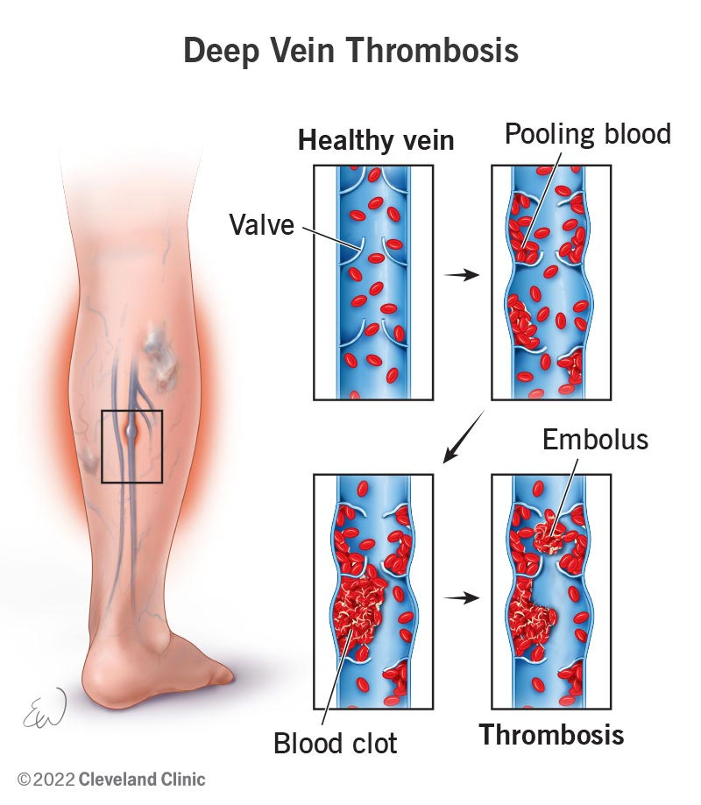
What is VTE?
Blood clots in veins within the body, usually lower limb but can be upper limb or centrally
Two-fold condition – localised thrombosis (DVT) and thromboembolism
Symptoms of localised thrombosis – pain, swelling, immobility
Symptoms of thromboembolism – chest pain, haemoptysis, hypoxia, death

Slide 4
What causes clots? Virchow’s Triad
Venous stasis
Hypercoagulability
Venous trauma

Slide 5
Venous stasis
Long-haul
flight
Reduced mobility
(e.g. lower limb injury)
Immobility (e.g. post-op)
Sedentary lifestyle

Slide 6
Venous trauma
Lower
limb injury
Operation
(e.g. knee replacement)
Intravenous drug use
Inflammation (phlebitis)

Slide 7
Hypercoagulability
Cancer
Intravenous
drug use
Prothrombotic
drugs (e.g. oral contraceptives)
Hypercoagulability
disorders (e.g. Factor V Leiden)

Slide 8
Virchow’s Triad
Clots often form as a result of a combination of two or more risk factors, for example:
Post-operative (e.g. knee replacement)
Venous stasis
Venous trauma
IV drug use
Venous trauma
Hypercoagulability
Patients in hypercoagulable states, such as patients with Factor V Leiden, antiphospholipid syndrome, activated protein C resistance, or patients taking oral contraceptives, are significantly more likely to undergo venous thrombosis when exposed to venous stasis or venous trauma

Slide 9
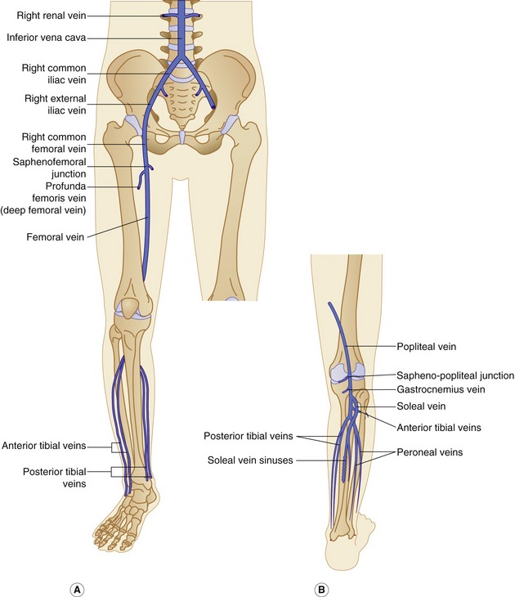
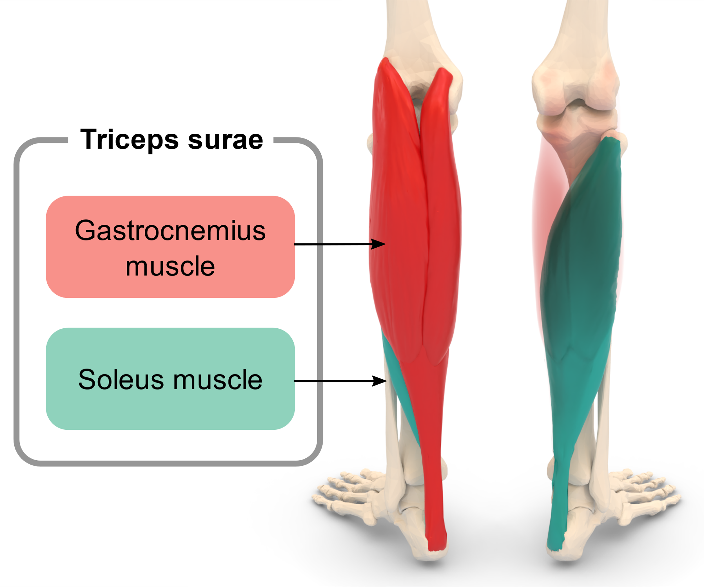

Slide 10
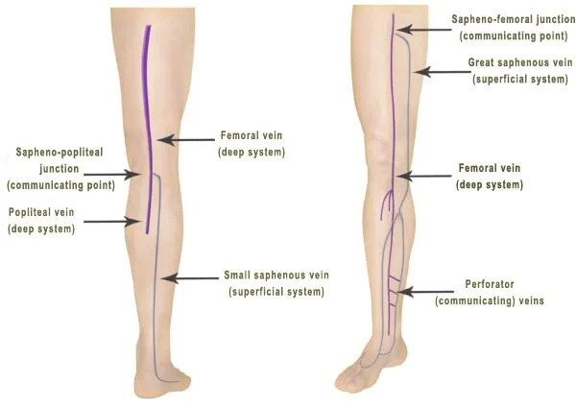

Slide 11
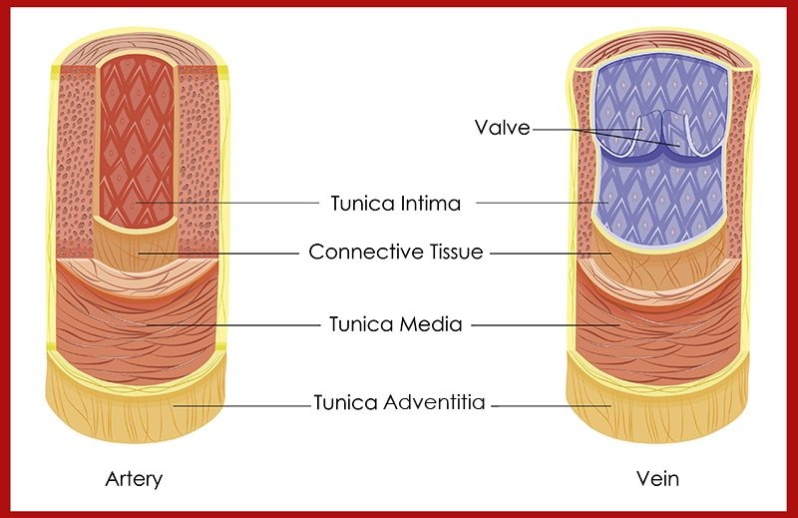
Notes:
Vein walls are much thinner than arterial walls, which have to be stronger to contain the increased pressure of arterial blood.
Venous blood pressure is much lower than arterial pressure.
As a result of these two factors, veins are easily compressible with relatively little pressure.
Because there is no cardiac pressure constantly pushing venous blood around the body and back towards the heart, peripheral veins have valves within them to prevent backflow of blood when standing or moving.

Slide 12
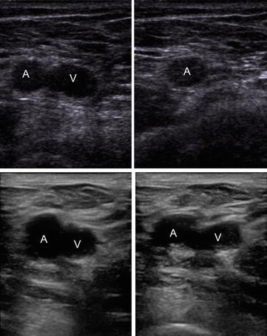
No compression
Femoral artery
Femoral vein
Compression
Femoral artery
Femoral vein (compressible – no DVT)
No compression
Femoral artery
Femoral vein
Compression
Femoral artery
Femoral vein (incompressible – DVT)

Slide 13
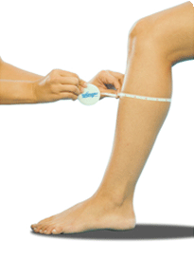
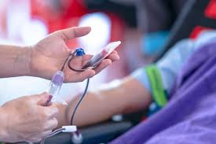
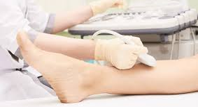
Screening for lower limb DVT
D-dimer (blood test)
Well’s score
Ultrasound

Slide 14
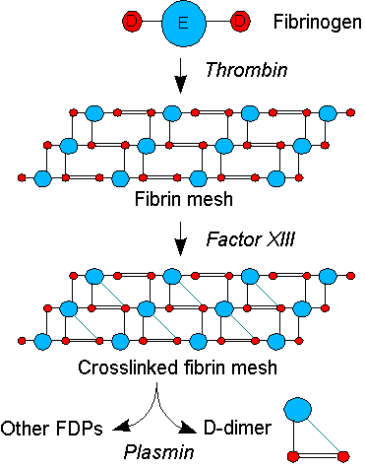
D-dimer test
D-dimer is a protein fragment present in the blood after degradation of thrombus
Normal range for adults is <500ng/mL
A D-dimer of <500 is strongly predictive of no DVT
A number of other phenomena can increase D-dimer, including inflammation, cancer, pregnancy, smoking
Therefore, the D-dimer test is highly sensitive but poorly specific for DVT

Slide 15
Wells Score
Clinical feature | Points
Active cancer | 1
Paralysis, paresis or immobilisation | 1
Recently bedridden ≥3 days or major surgery <12 weeks | 1
Localised tenderness along the deep venous system | 1
Entire leg swollen | 1
Calf swelling ≥3cm larger than asymptomatic side | 1
Unilateral pitting oedema | 1
Collateral superficial veins (non-varicose) | 1
Previously documented DVT | 1
An alternative diagnosis at least as likely as DVT | -2
Clinical probability | Points
DVT likely | ≥2
DVT unlikely | ≤1

Slide 16
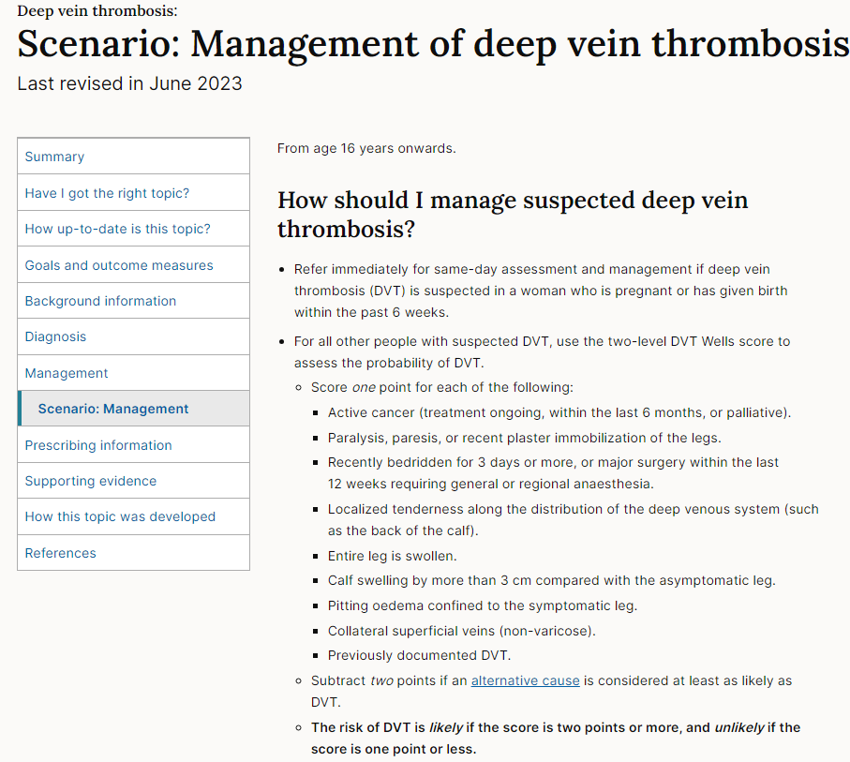
Management of DVT
Negative USS
Suspend anticoagulant therapy
Consider alternative diagnosis
Inconclusive USS (calf veins not visible)
Prescribe prophylactic anticoagulant therapy
Repeat scan in 7 days – if negative / still inconclusive then discharge
Positive USS (DVT confirmed)
Prescribe treatment dose of anticoagulant therapy (warfarin, apixaban, edoxaban, rivaroxaban)
Treatment usually lasts 3 months, but may be longer depending on risk factors
If unprovoked DVT (no obvious cause) – investigate for potential undiagnosed cancer / thrombophilia

Slide 17
Venous physiology
Unlike the arterial system, there is no systolic pressure gradient forcing blood around the circulation
In the lower limb, venous blood must travel against gravity to return from the legs back to the heart
There are three main anatomical phenomena which control venous return from the lower limb to the heart:
Intravenous valves
The calf muscle pump
Pressure changes during respiration

Slide 18
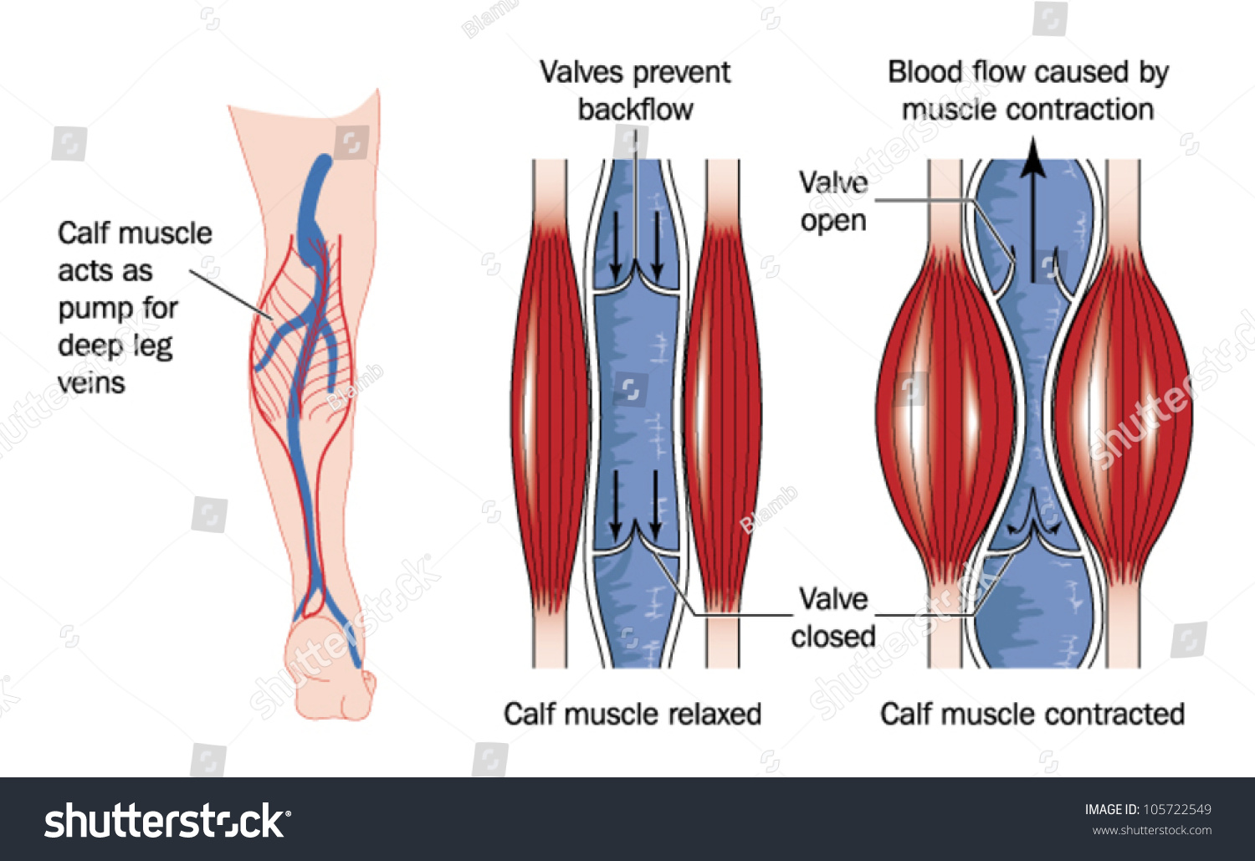
The calf muscle pump
Venous return from the lower leg to the upper leg is primarily controlled by the calf muscle pump
Increased pressure caused by contraction of the gastrocnemius heads during plantarflexion propels blood proximally
During muscular relaxation, the intravenous valves close and prevent blood from refluxing back down the leg (this is referred to as venous competence)

Slide 19
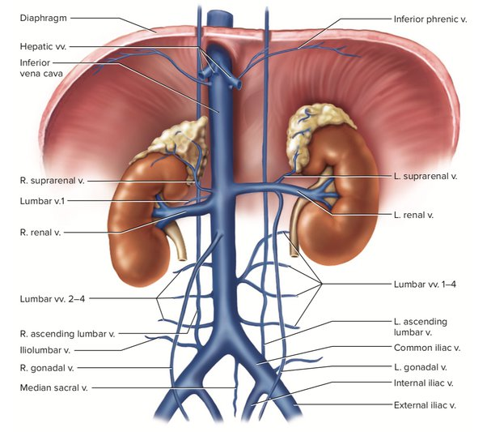
The respiratory venous pump
Venous return from the upper leg into the abdomen and thorax are controlled by changes in abdominal pressure during respiration
Movement of the diaphragm during respiration causes increased or decreased abdominal pressure

Slide 20
The respiratory venous pump
Blood flows from abdominal IVC into thoracic IVC
During inspiration:
The diaphragm moves down to allow the lungs to expand
This increases abdominal pressure and compresses the large abdominal veins (IVC and iliac veins)
This also decreases pressure within the thorax
Compression of the iliac veins and decreased thoracic pressure forces blood from the abdominal veins into the thoracic veins
Diaphragm moves down
Abdominal pressure increases, compressing IVC and iliac veins
Blood flow from lower limbs into abdomen ceases

Slide 21
The respiratory venous pump
Blood flow from abdominal IVC into thoracic IVC ceases
During expiration:
The diaphragm moves up to compress the lungs
This increases pressure within the thorax and reduces abdominal pressure and releases the pressure on the large abdominal veins
Increased pressure within the thorax prevents blood draining from the IVC into the thorax
Decreased pressure within the iliac veins allows blood from the lower limbs to fill the iliac veins and IVC
Diaphragm moves up
Abdominal pressure decreases, releasing IVC and iliac veins
Blood flows from lower limbs into abdominal veins

Slide 22
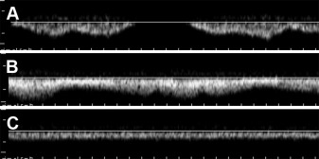
Common femoral vein flow patterns
A – spontaneous antegrade phasic flow
B – spontaneous antegrade minimally phasic flow
C – spontaneous antegrade aphasic flow
Exp
Insp
Exp
Insp
Exp
Insp
Insp
Exp
Kayılıoğlu et al., 2013

Slide 23
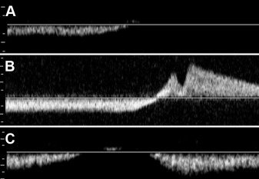
Common femoral vein flow patterns
complete cessation of flow with Valsalva
reversal of flow with Valsalva (reflux)
unceasing forward flow despite Valsalva.
Val
Val
Val
Kayılıoğlu et al., 2013

Slide 24
Common femoral vein flow patterns
Phasic flow has a 32% PPV for iliac vein obstruction and 0% PPV for iliac vein occlusion
Aphasic flow alone has a 93% PPV for iliac vein obstruction and 51% PPV for iliac vein occlusion
Aphasic flow combined with unceasing forward flow at Valsalva has a 100% PPV for iliac vein obstruction and 76% PPV for iliac vein occlusion
So… if common femoral vein flow is monophasic +/- if forward flow is seen despite Valsalva – image the iliac veins!
Kayılıoğlu et al., 2013

Slide 25
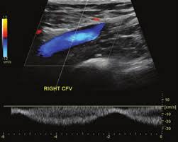
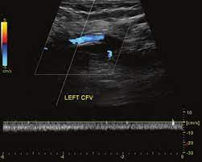
Phasic CFV waveform
Continue with lower limb DVT scan
Aphasic CFV waveform
Scan the IVC and ipsilateral iliac veins for proximal DVT

Slide 26
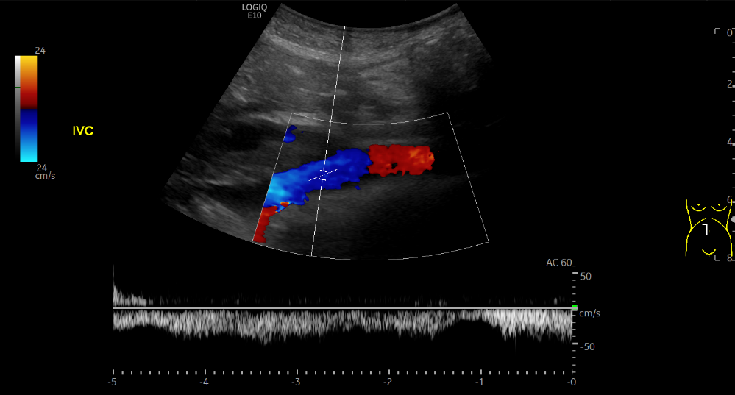
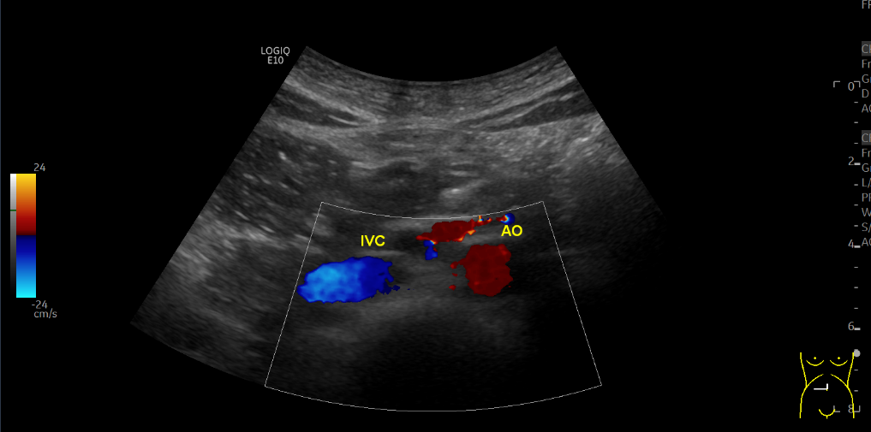

Slide 27
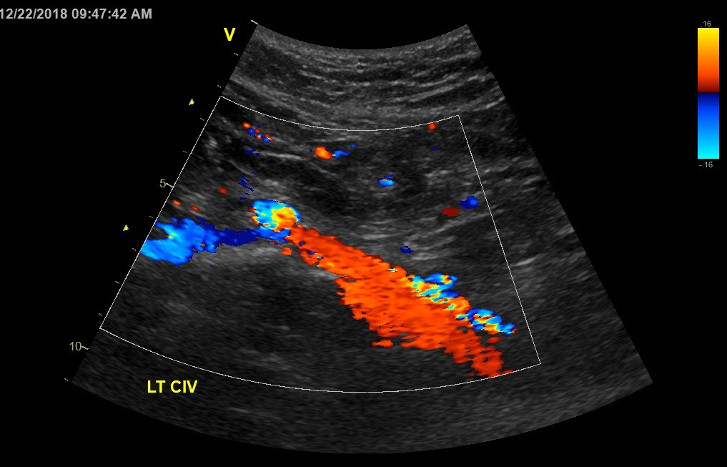
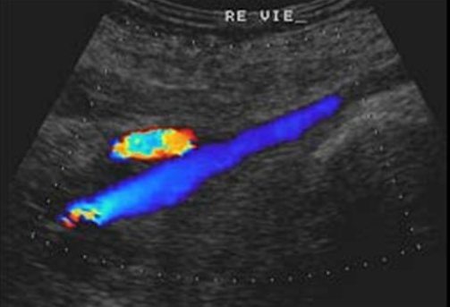

Slide 28
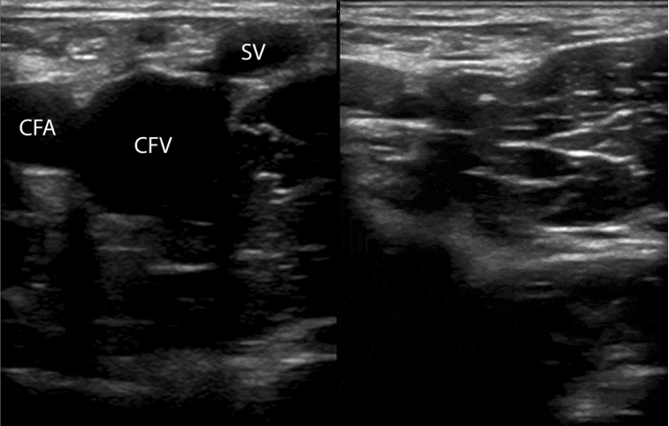
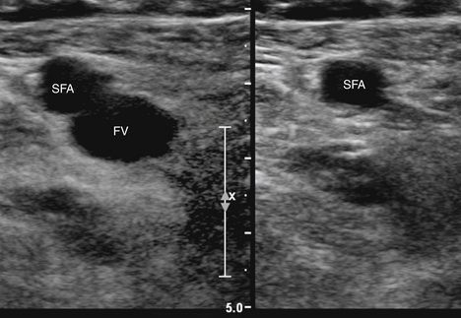
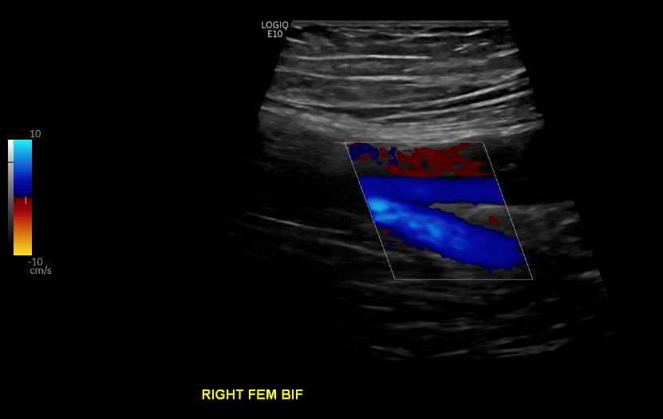
G

Slide 29
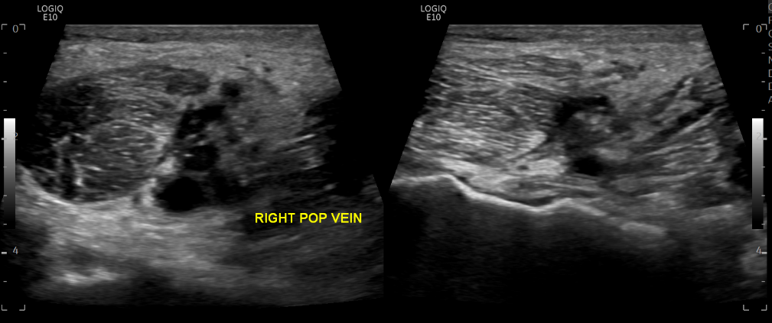
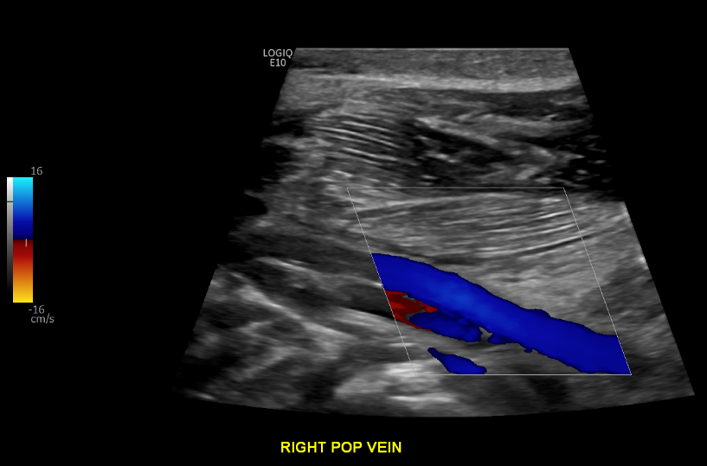

Slide 30
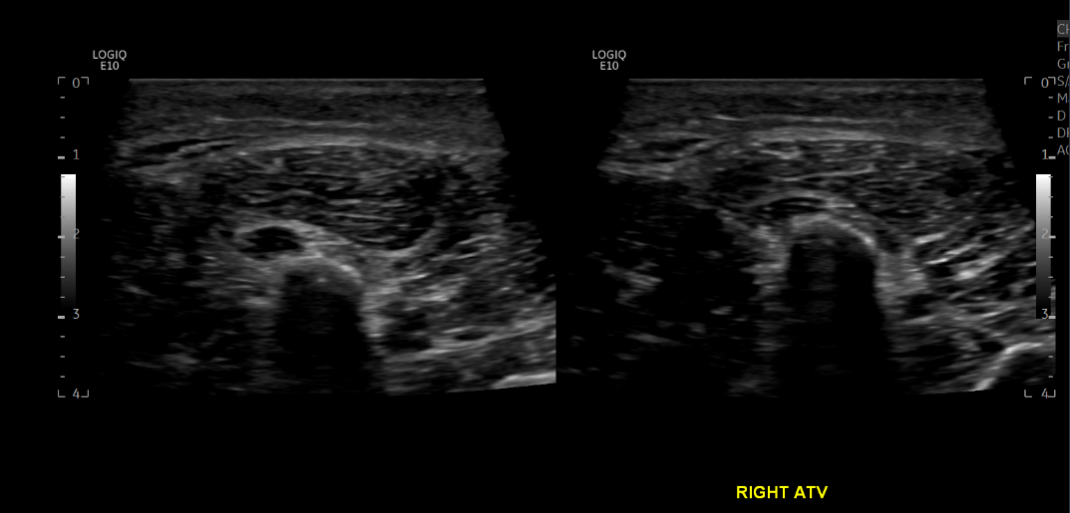

Slide 31
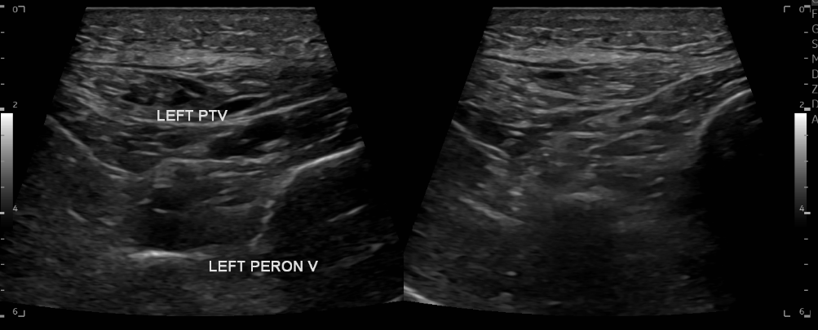
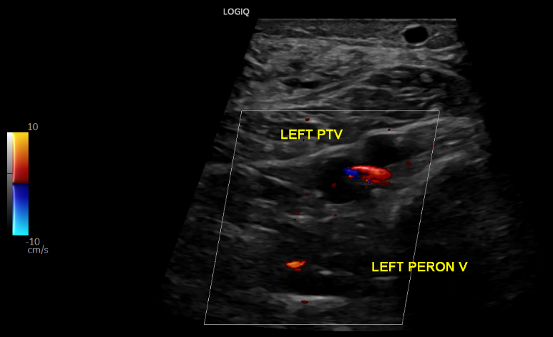

Slide 33
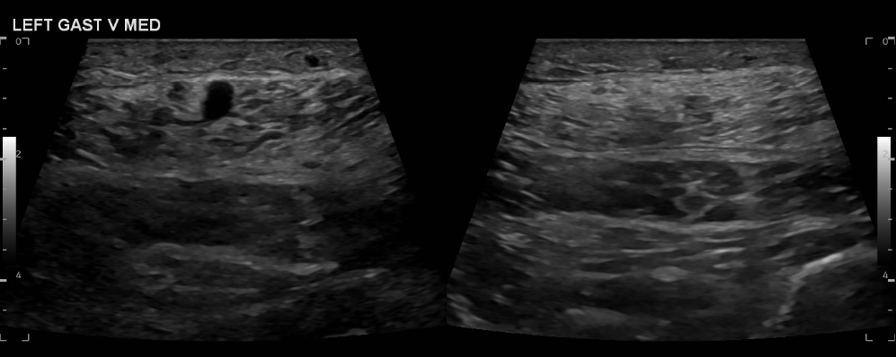
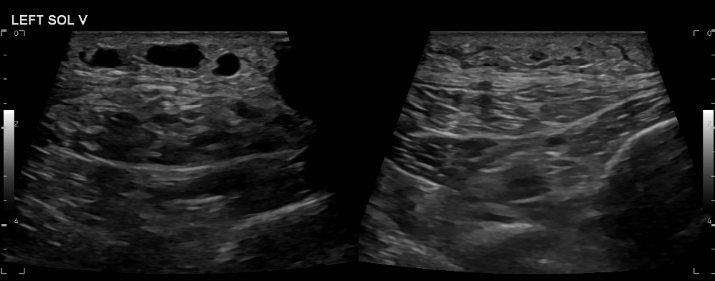

Slide 34
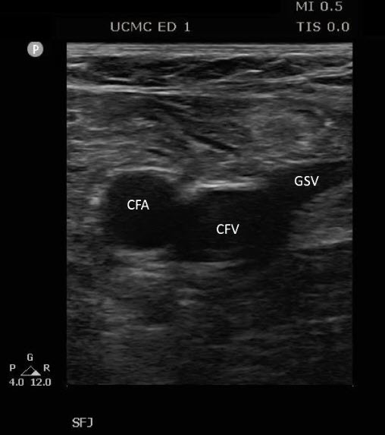
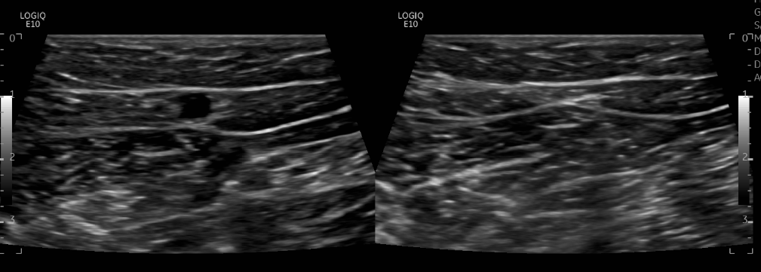

Slide 35
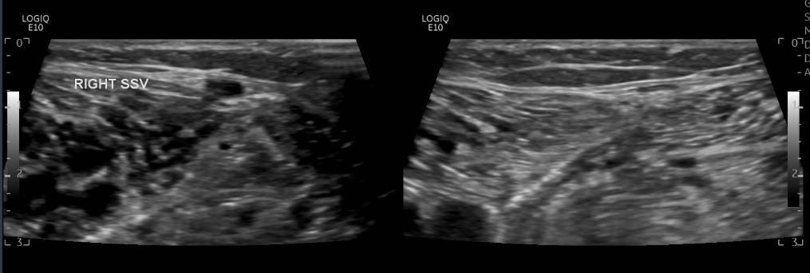
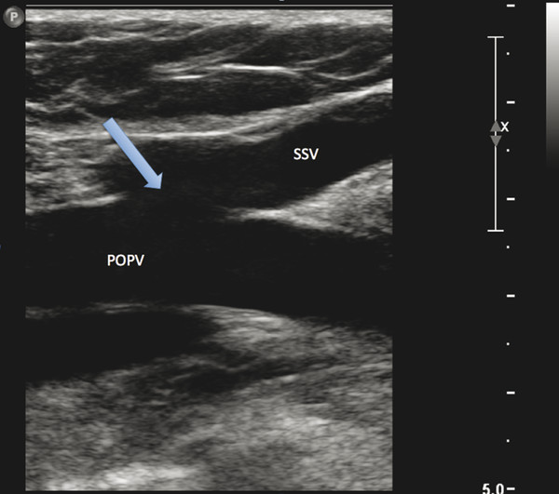

Slide 36
Case study 1:
28y/o male
Presented to A&E with calf pain and swelling
D-dimer = 913

Slide 37
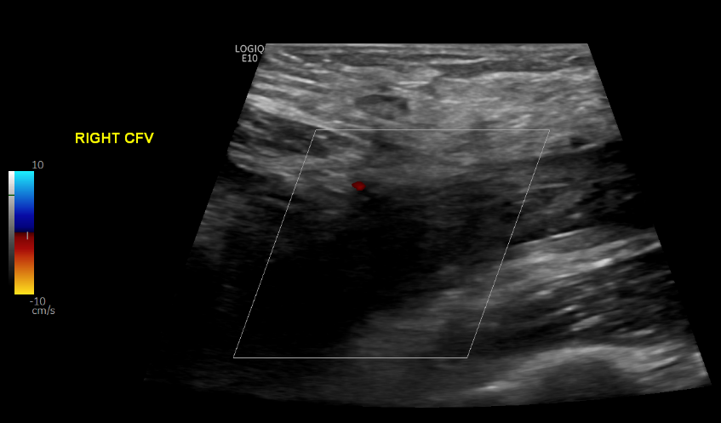
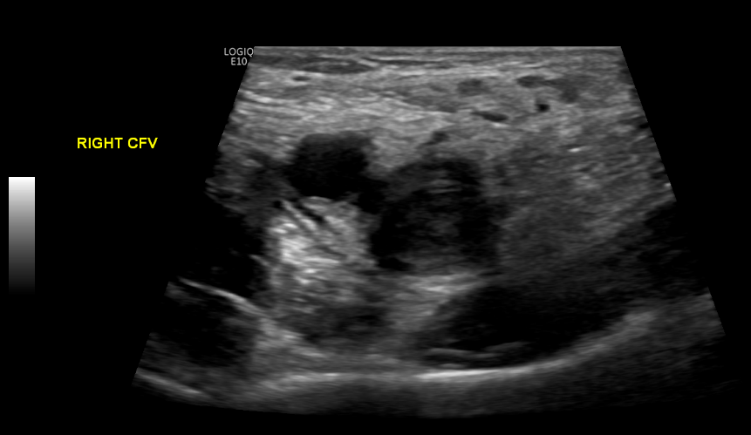
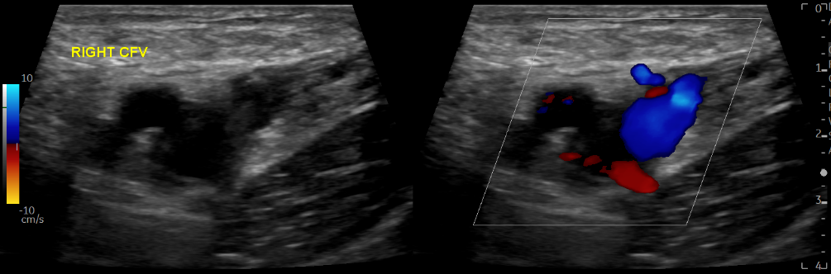

Slide 38
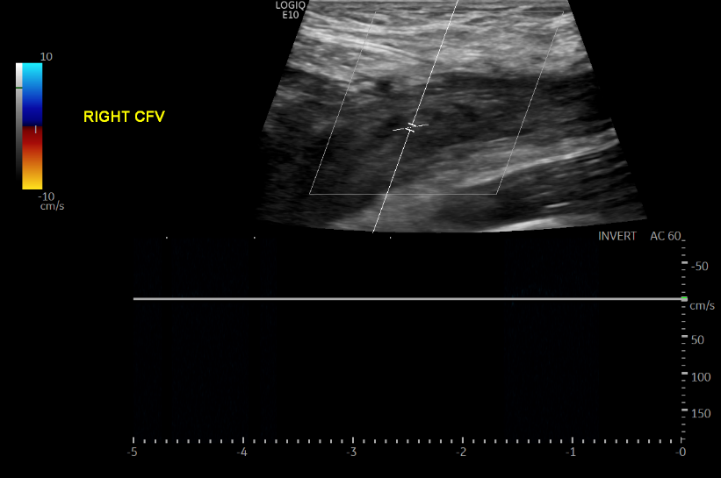

Slide 39
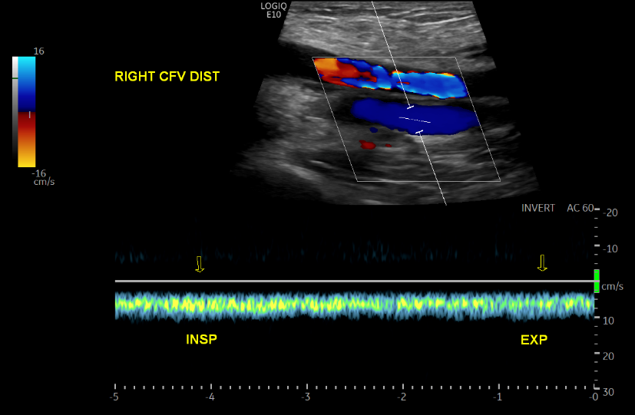

Slide 40
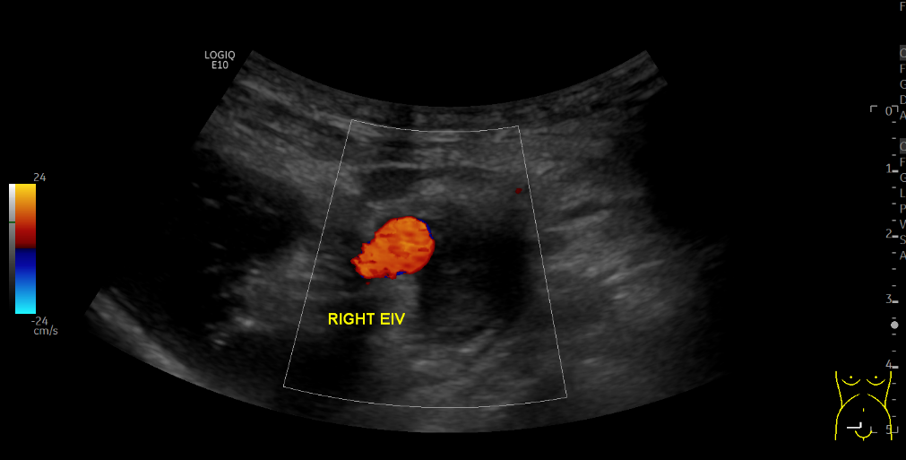

Slide 41
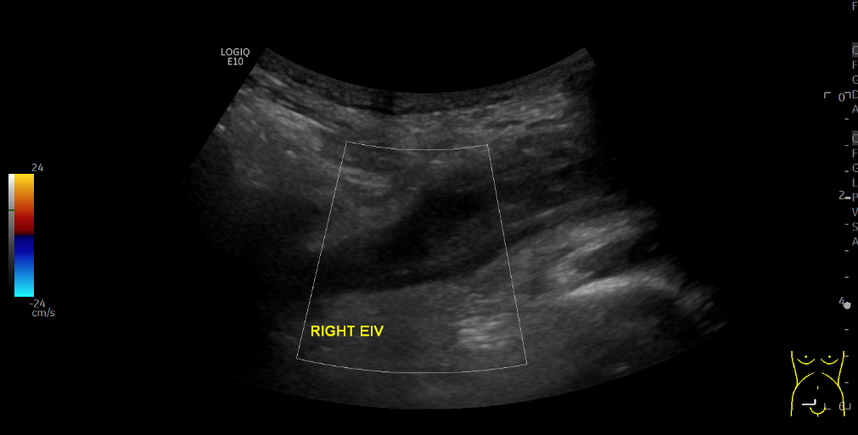

Slide 44
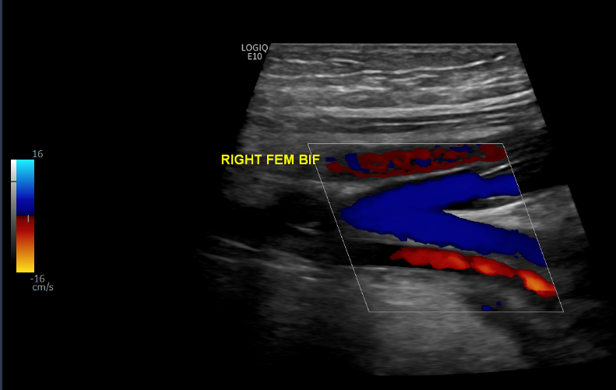
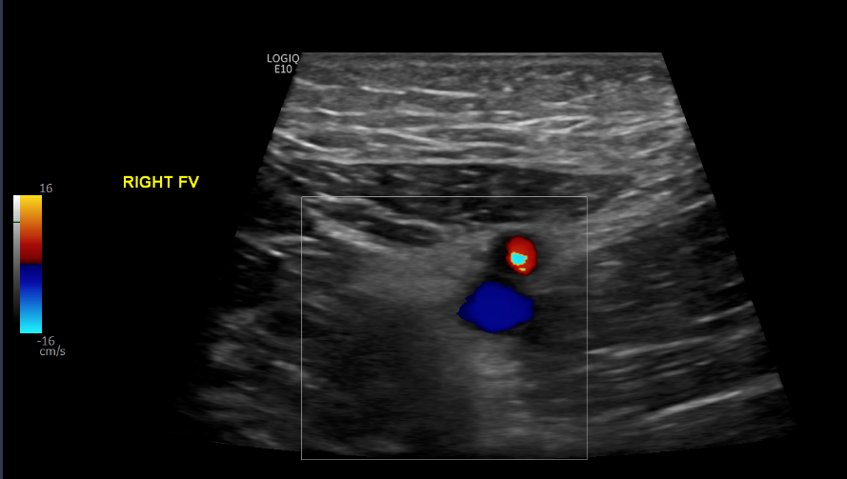
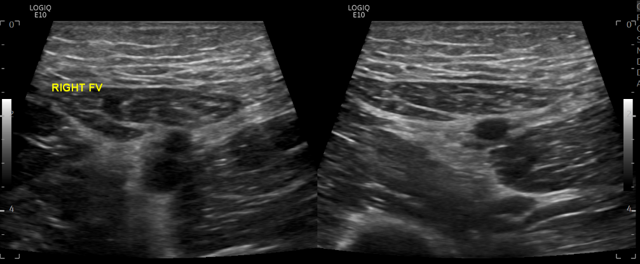
With compression

Slide 45
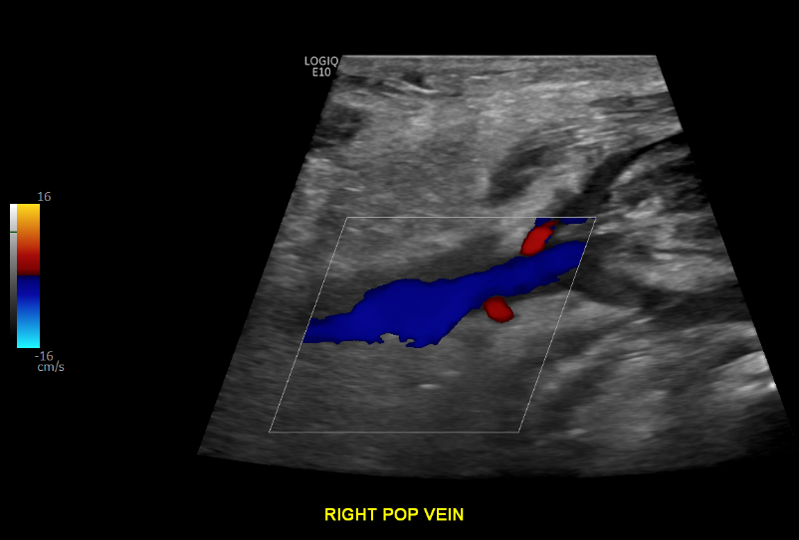
With compression

Slide 46
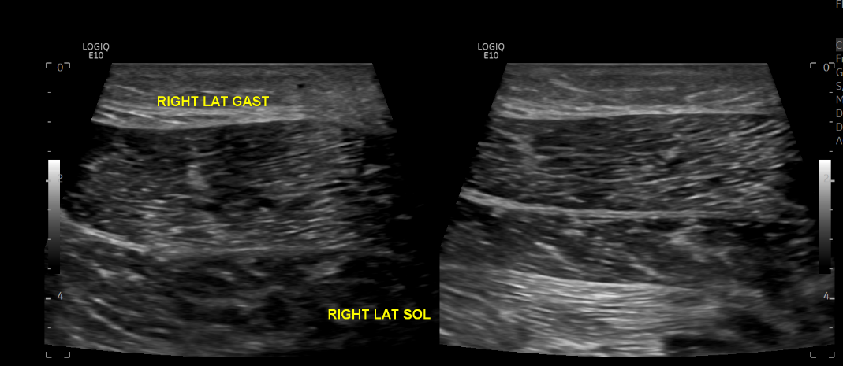
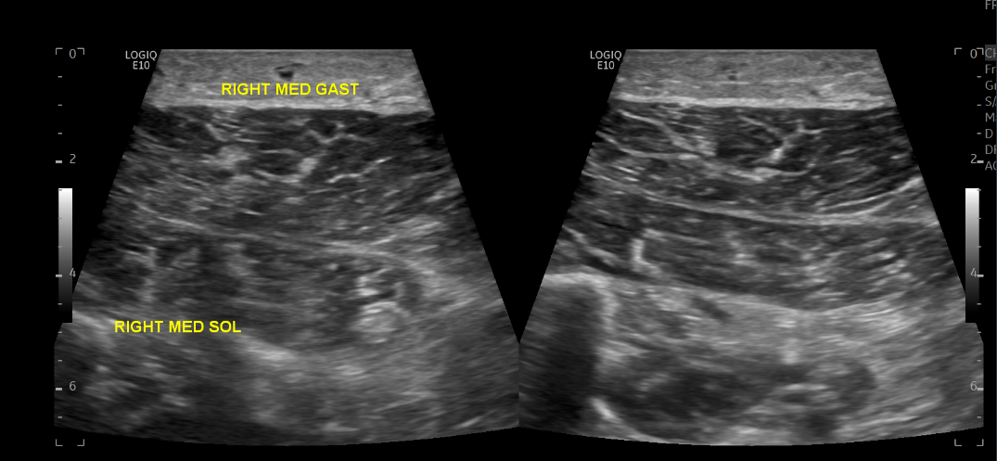
With compression
With compression

Slide 47
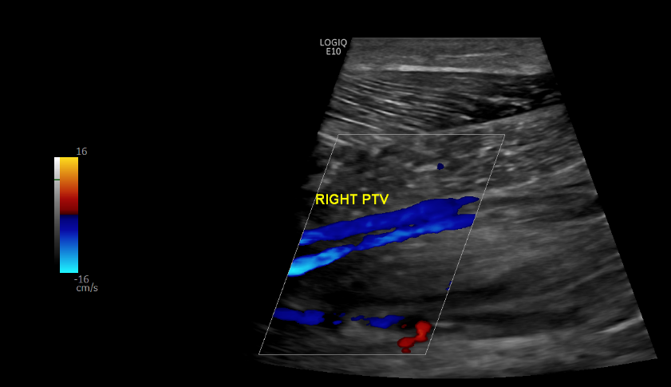
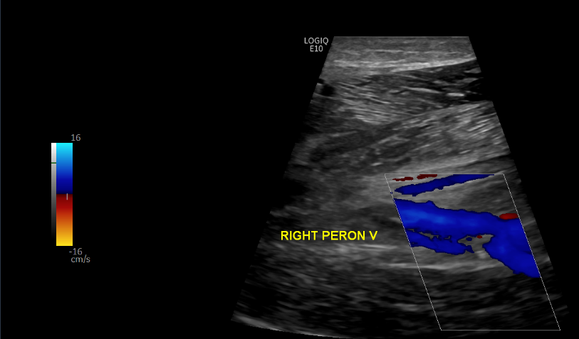
With compression

Slide 48


With compression
With compression

Slide 49
Diagnosis:
Iliofemoral vein thrombosis
(iliac - femoral vein DVT)

Slide 50
Case study 2:
64yo male
Calf pain and swelling
Elevated D-dimer

Slide 51



With compression
With compression

Slide 52




With compression
With compression

Slide 53




With augmentation
With compression

Slide 54




With compression
With compression
With compression
With compression
With compression
With compression

Slide 55
Diagnosis:
Femoropopliteal vein thrombosis
(femoral – popliteal vein DVT)

Slide 56
Case study 3:
44yo male
Calf pain and swelling
Wells score 2, recent flight

Slide 57



Slide 58




With compression
With compression

Slide 59




With compression

Slide 60


With compression

Slide 61


With compression

Slide 62




With compression
With augmentation

Slide 63
Diagnosis:
Extensive lower limb thrombosis
(Femoral, popliteal & calf vein DVT)

Slide 64


Superficial thrombophlebitis
Inflammatory thrombosis of a superficial vein (great saphenous / small saphenous vein)
Usually presents with painful lump under the skin with skin discolouration / erythema
Distinct from a DVT as the clot is not in a deep vein, but the thrombus can migrate proximally into a deep vein

Slide 65
Superficial thrombophlebitis

Slide 66





Slide 67


Scanning STP
GSV
SFJ
Imaged the same way as deep vein thrombosis, with two additional measurements to include:
Length of thrombosed vessel
Distance between proximal edge of thrombus and deep venous junction (SFJ / SPJ)
Thrombus
CFV
Thrombus
SPJ

Slide 68

Limitations
A number of things may prevent good views of the lower limb veins including:
Swelling
Dressings
X-fix
Limited mobility
These usually obscure the veins below the knee, meaning that it is not possible to completely exclude DVT
In these instances, scan as much of the leg as possible and report the veins that could not be visualised
Write in the report conclusion “unable to exclude below-knee DVT. Please arrange re-scan in 7 days”

Slide 69

Scanning tips
Change patient position to improve visualisation of lower limb veins
Reduce B-mode / Doppler frequency or use curvilinear array to improve visualisation of lower limb veins
Perform distal augmentation using colour Doppler to visualise flow within crural veins

Slide 70

What to take away…
Always take a spectral Doppler trace in the common femoral vein
If the trace is damped or aphasic – scan the iliac veins
Compress every deep and superficial vein throughout the entire lower limb
If the vein is incompressible – check flow with colour Doppler
If no flow with colour Doppler – likely DVT
Use colour Doppler and distal augmentation to demonstrate colour flow in poorly visualised veins
If you are unable to visualise all of the lower limb veins – report as inconclusive and repeat the scan in 7 days

Slide 71
Thanks for listening!
Any questions?
ben.warner-michel@nhs.net

