Slide 1
Ultrasound assessment of Deep Vein Thrombosis (DVT)
By Sam Davis BSc MSc AVS RVT

Slide 2
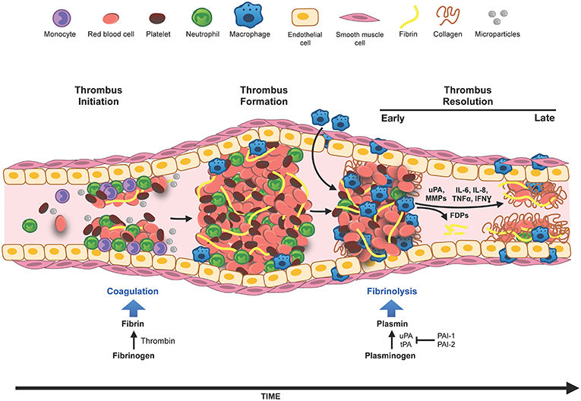
Process of thrombus formation and resolution.

Slide 3
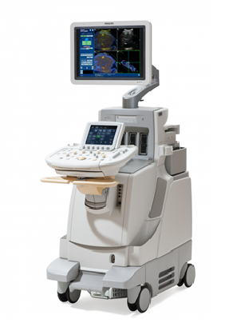
Tests and the role of ultrasound
Wells score
D-dimer test – looks for products of thrombus resolution.
Ultrasound scan

Slide 4
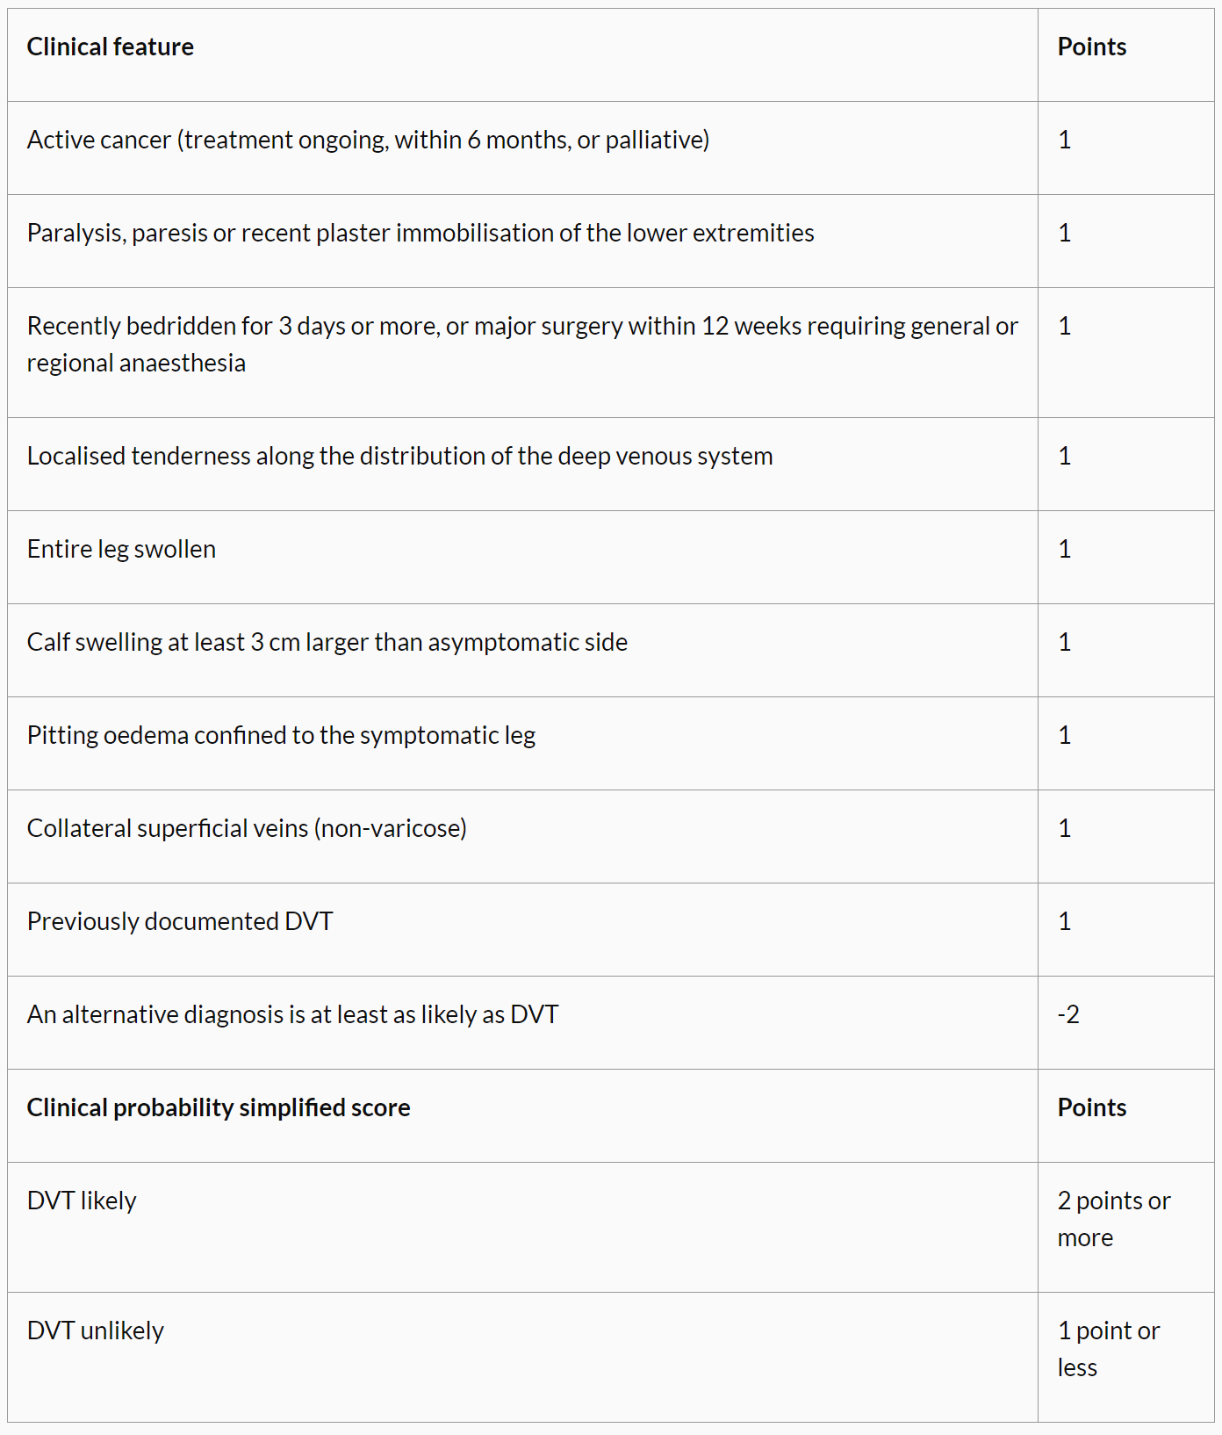
Wells score

Slide 5
Methods for US DVT assessment
Indirect methods e.g. assessing presence of phasic flow
Direct methods e.g. compression and colour flow

Slide 6
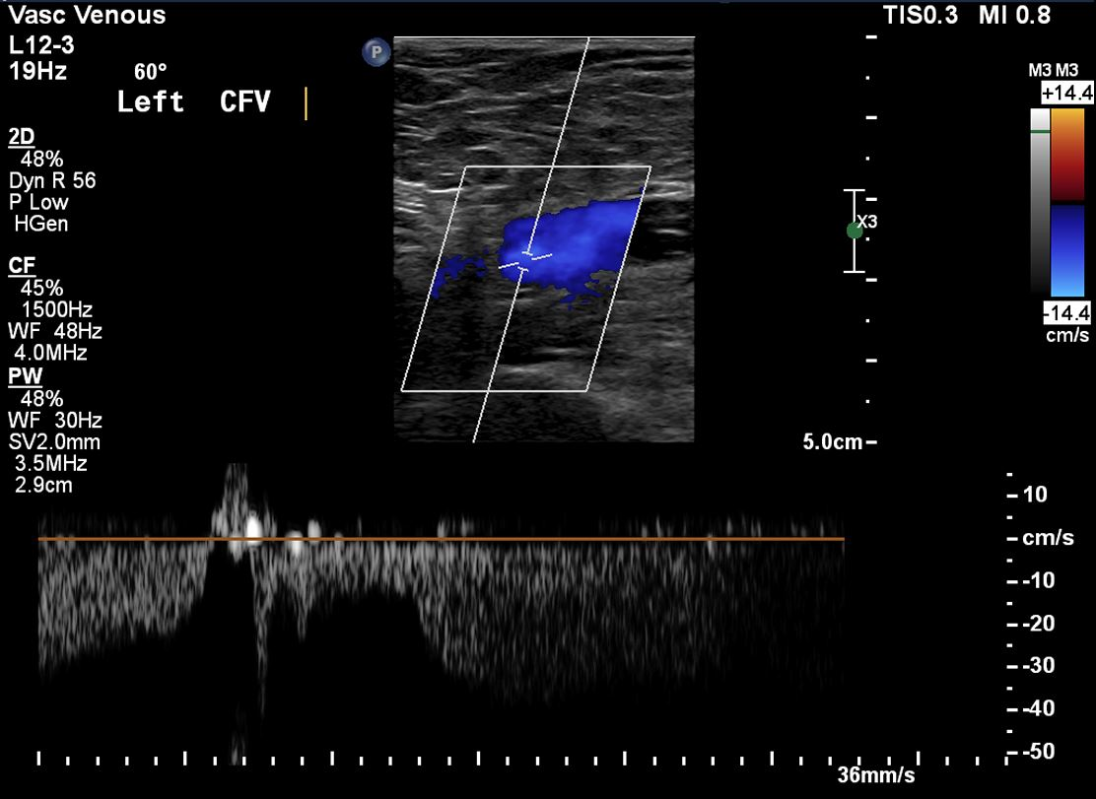
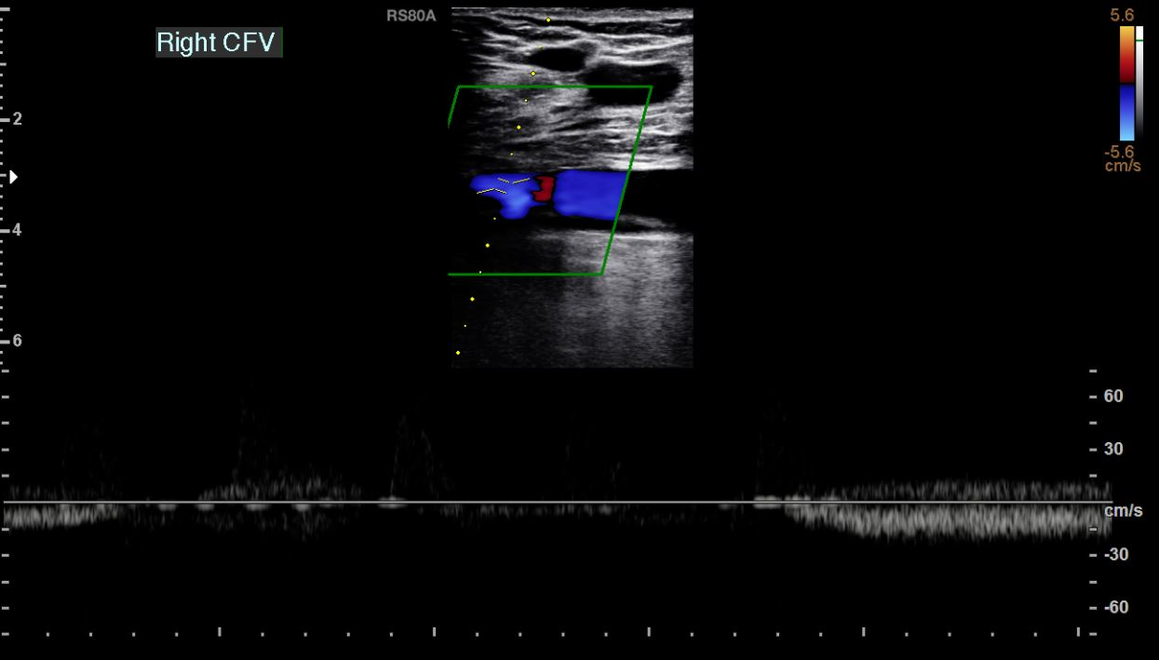
Assessing for phasic flow in the common femoral vein.

Slide 7
Assessing for phasic flow in the common femoral vein.
Excludes occlusive thrombus in the common femoral, external iliac, common iliac and IVC.
Does NOT exclude non-occlusive thrombus.
Does not exclude presence of any type of thrombus inferior to sample site.
If aphasic, the scan should be extended to the iliacs, or, assessment of the contralateral common femoral vein.

Slide 8
Compression
Pros
Excludes occlusive and most non-occlusive thrombus.
Gives an excellent cross sectional view of the veins, allows easier assessment of bifid systems.
Cons
Can be difficult to visualise the deep vessels and see the compression.
Compression can be painful for the patient.
Must be done at regular intervals, every ~3cm to avoid missing isolated thrombus.
Can cause thromboembolism!

Slide 9
Colour flow
Pros
Comfortable for the patient
Excludes occlusive thrombus
Can be effective at depth when b-mode imaging not adequate
Cons
Very poor at identifying bifid systems
Colour can mask non-occlusive thrombus. Cannot exclude non-occlusive thrombus if scan is solely colour flow.
Can sometimes require augmentation of the calf = discomfort.

Slide 10
Occlusive and non-occlusive thrombus
Compression
Vein doesn’t compress at all with occlusive thrombus, partly compresses with non-occlusive thrombus.
If chronic thrombus, the vein may appear to partially compress…

Slide 11
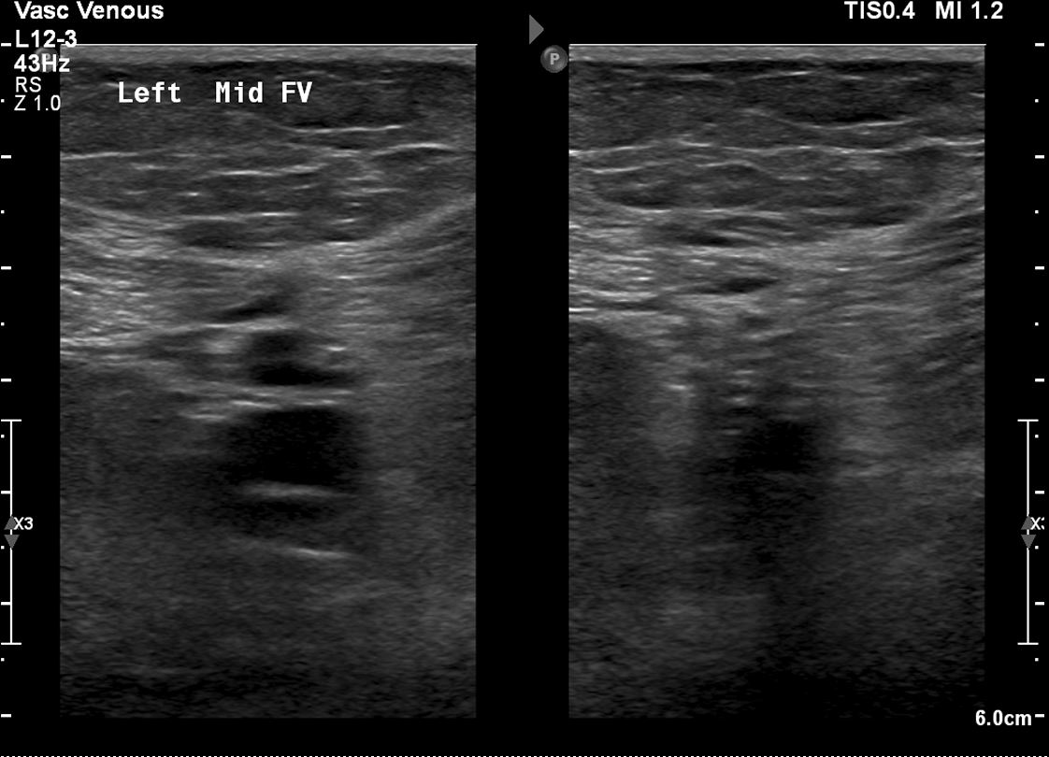
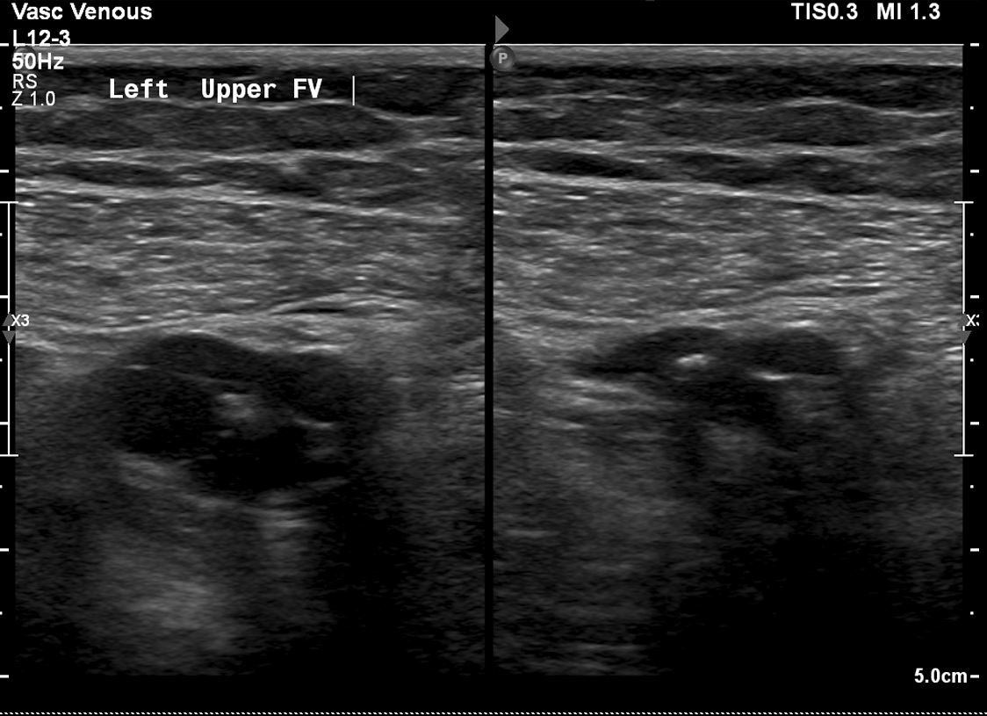
Chronic thrombus - compression

Slide 12
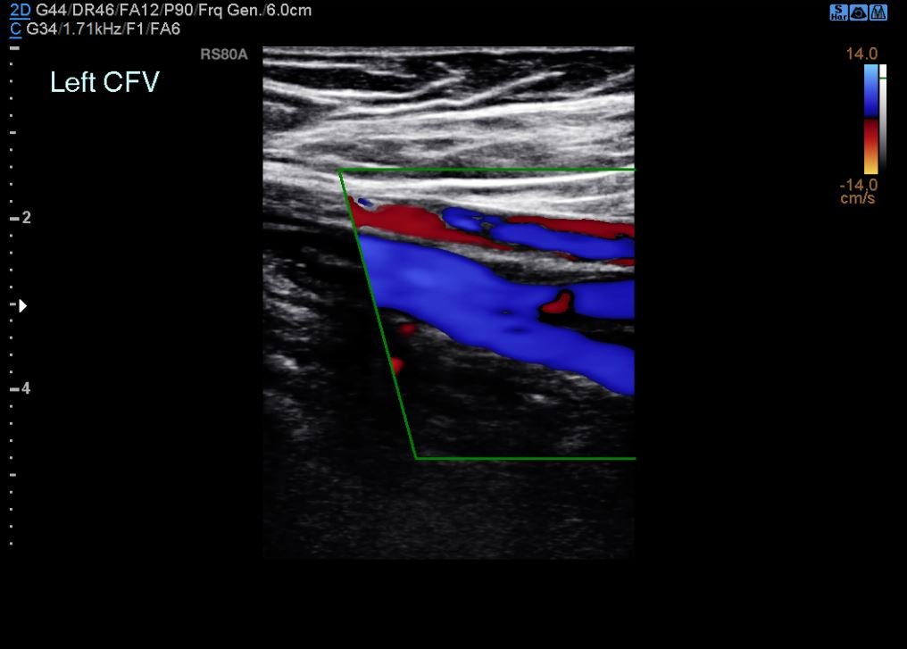
Chronic thrombus – colour flow

Slide 13
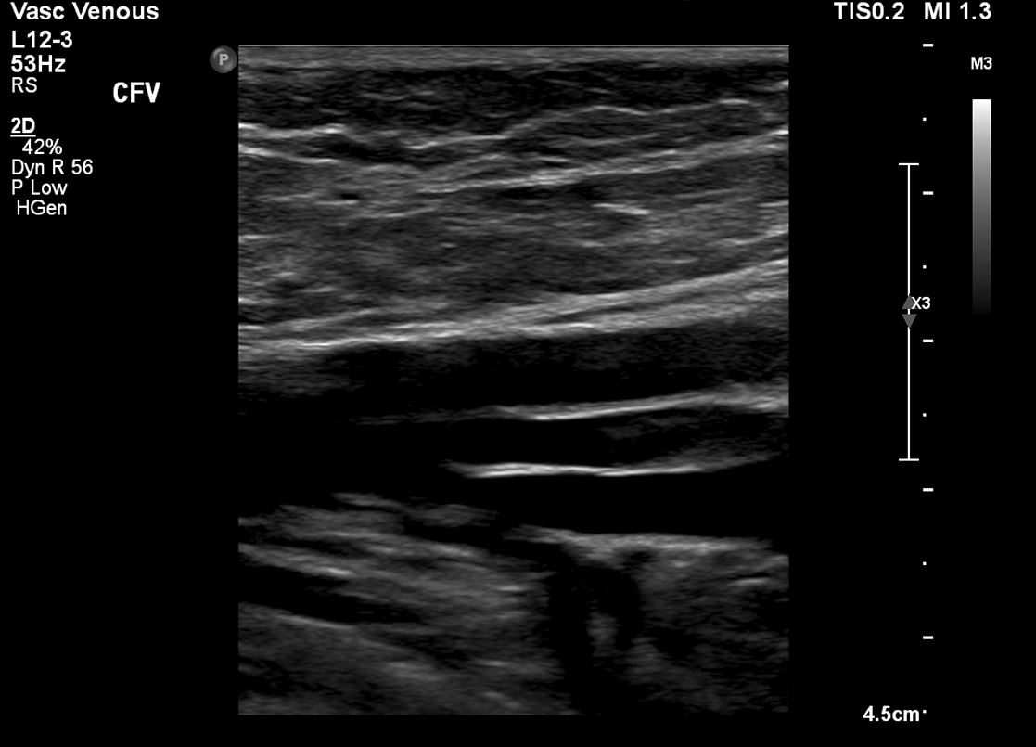
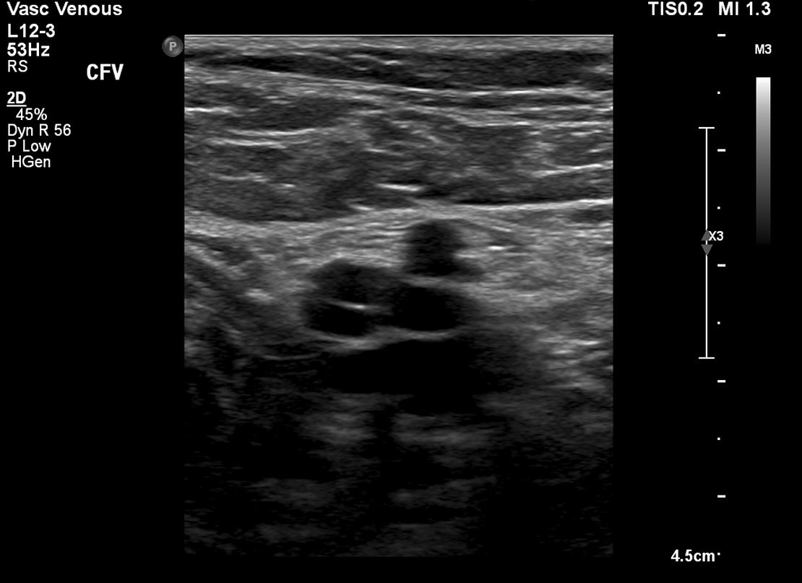
Chronic thrombus – B-mode wins

Slide 14
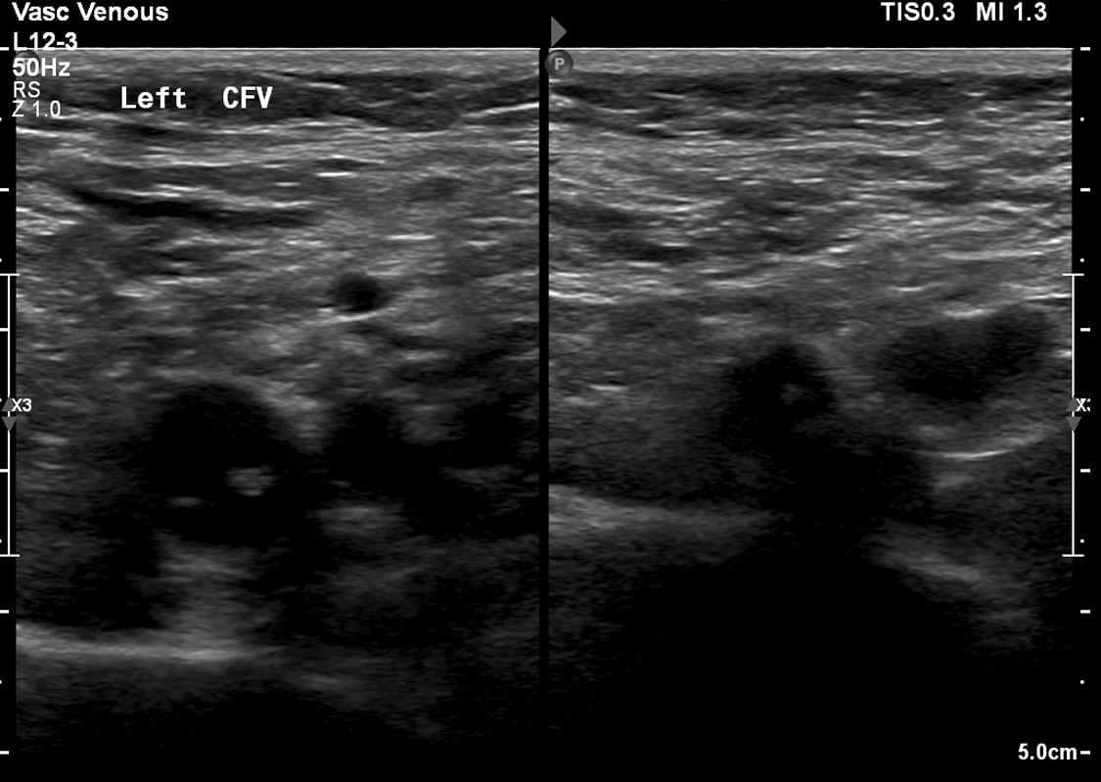
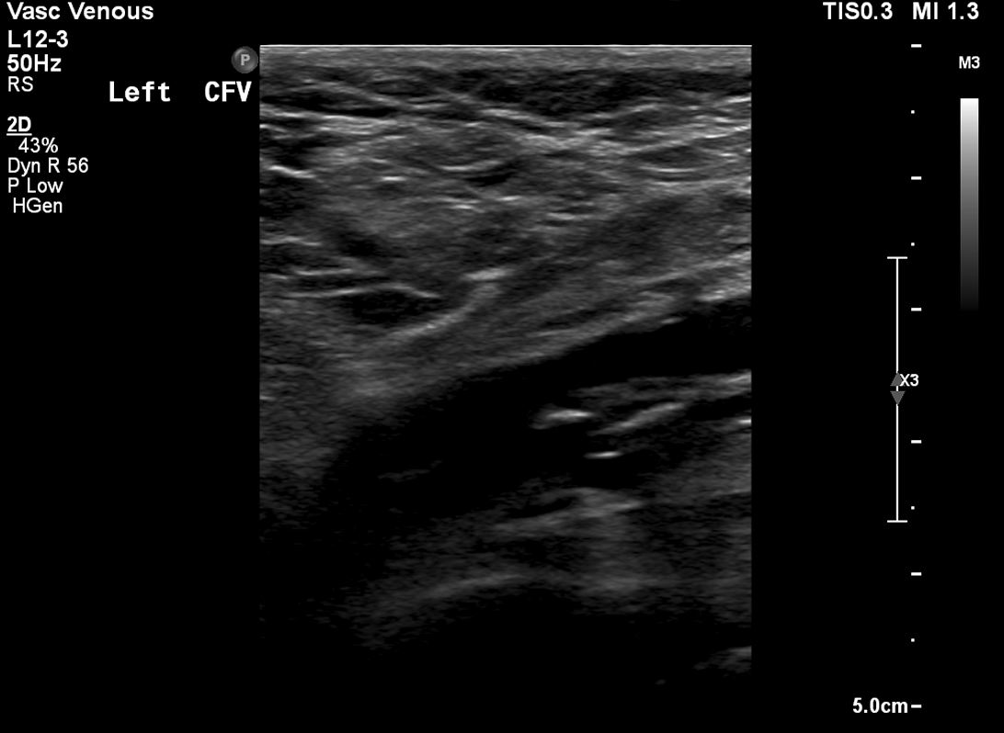
Chronic thrombus – B-mode wins

Slide 15
Chronic thrombus
Interferes with venous valves leading to venous incompetency and post-thrombotic leg syndrome.
Appears echogenic, non-occlusive and “web-like”
The chronic thrombus can act as a anchor for new thrombus to form on.
It can be very difficult to differentiate from chronic and acute on chronic thrombus on ultrasound.

Slide 16
Chronic thrombus – reporting
“There is non-occlusive, echogenic, web-like thrombus in the common femoral and femoral veins. Presence of acute thrombus cannot be excluded on background of new symptoms.”
“There is non-occlusive, mixed echogenicity thrombus in the femoral veins. Appears to be acute on chronic thrombus.”
“There is thrombus within the femoral vein, which appears to be mostly occlusive, however shows some evidence of recanalization.”

Slide 17
Questions?

Slide 18
Calf veins
NICE guidelines 158 for treatment of VTE are based on proximal leg scanning only.
OPINION – if you have the expertise to scan the calf veins, and the calf veins can be visualised, then the calf should be scanned.
Calf DVTs can embolise, and can propagate above knee very quickly, e.g. Posterior tibial veins to CFV in a day.

Slide 19
Calf veins
Much smaller than above knee. Compression is best as colour is not sensitive enough.
Scanning can be limited by oedema, skin condition, scan being too painful etc.
Deep veins include the posterior tibial, peroneal, anterior tibial, soleal and gastrocnemius veins. All paired with arteries except the soleal veins.
Superficial veins include the long and short saphenous veins (greater and lesser).

Slide 20
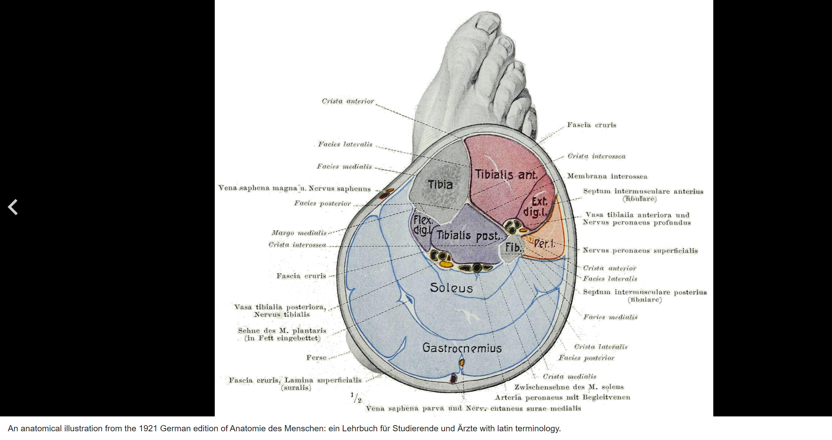
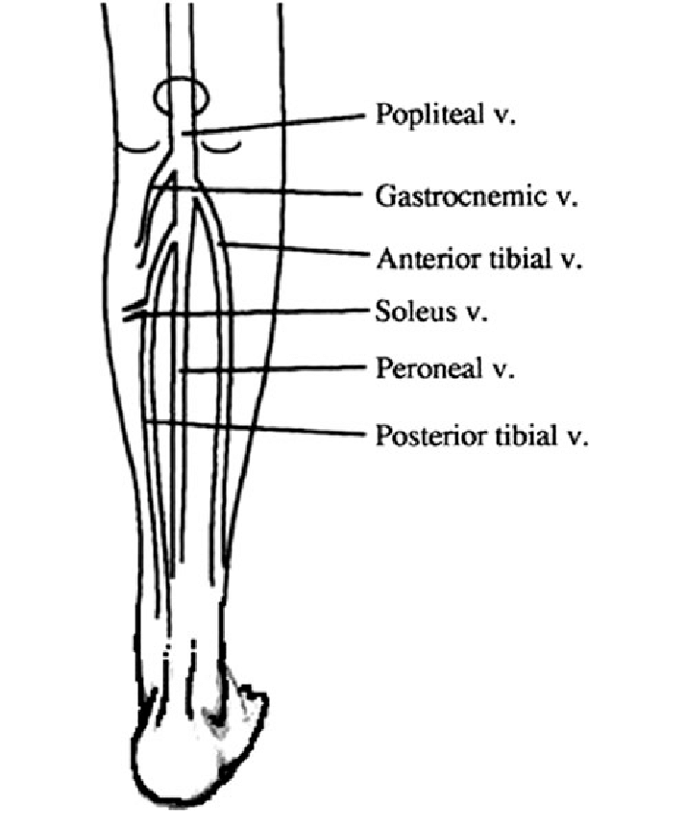
Calf vein anatomy

Slide 21
Movie time
https://medsquares.com/data/mdguideline/svuperipheralvenous/video_peripheralvenous_001.mp4

