Slide 1
Ultrasound and Clinical Vascular Science

Slide 2
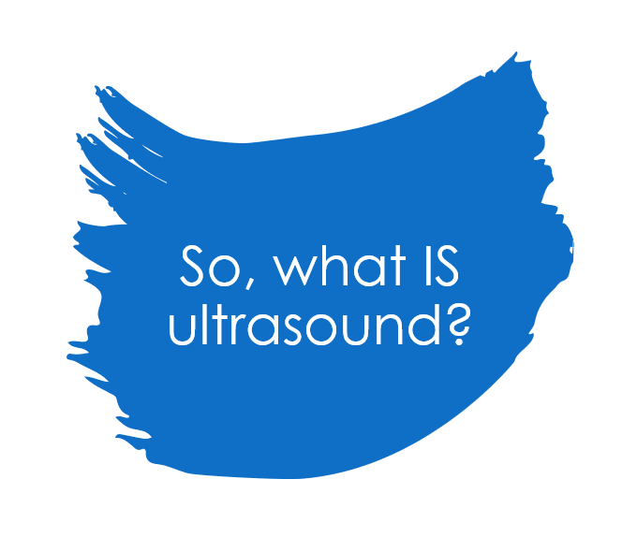
So, what IS ultrasound?
It’s in the name – sound waves are transmitted through a probe and ultrasound gel.
This transmits through different mediums i.e. you – and the different movements of the particles inside us present a picture.
You can then begin to imagine how different tissues reflect soundwaves to form an image.
Reflection, refraction, absorption and scattering all play a part (very physics heavy I know)
Ps sonographers simply hate gas

Slide 3
Ultrasound
Ultrasound is non-ionizing, more readily available, less wait time on referrals
You have vascular, MSK, general, obstetrics and so on.
US is often used for guided biopsy, injections and other outpatient procedures
It shows a real time image, is readily portable and can show physiology e.g. fetal heartbeat.

Slide 4
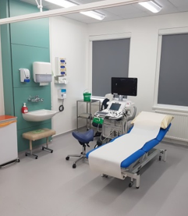
Vascular Studies Department
Use specialised, non-invasive equipment, especially ultrasound
Evaluate vascular function and diagnose abnormalities
95% of NHS diagnostics from 5% of the workforce (healthcare scientists)
Scanning arteries and veins throughout the body
Arteries: peripheral arterial disease, AAA surveillance, EVAR surveillance, pre-renal transplant, TIA, post-carotid endarterectomy, arteriovenous malformations, mesenteric (coeliac trunk, SMA, renals)
Veins: DVT (anywhere), varicose veins, klipple trenaunay syndrome, AV fistulas
Mainly clinical work, in a hospital with patients
Carry out research to improve diagnostics

Slide 5
Referrals for a Vascular Duplex
Most referrals come through A&E, GPs and Vascular Surgeons
A&E refer for urgent investigations such as
?deep vein thrombosis (DVT)
?critical limb ischaemia (CLI)
GPs can only refer directly to us for:
?DVT
Vascular Surgeons refer for urgent and routine investigations
Everything else (will be triaged and seen in appropriate time-frame).

Slide 6
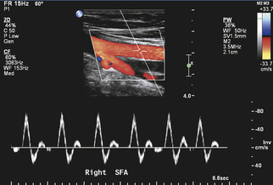
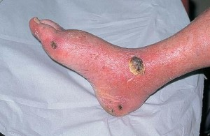
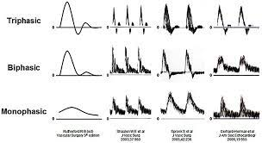
Peripheral arterial disease (PAD)
Healthy arteries will have palpable pulses at DPA and PTA
Calcification (from diabetes or old age) or proximal disease (e.g. atherosclerosis) can eliminate distal pulses
Can cause claudication, cold limbs
Worse in smokers, males, over 40s
If symptomatic and considered for intervention, the patient can have a full duplex ultrasound
The scan will show what/where the problem is
Surgeon can then treat based on this, e.g. exercise therapy, angioplasty, stenting, bypass graft, amputation
https://www.hopkinsmedicine.org/health/conditions-and-diseases/atherosclerosis
http://almawiclinic.com/2015/05/29/ischemic-or-arterial-ulcers/

Slide 7
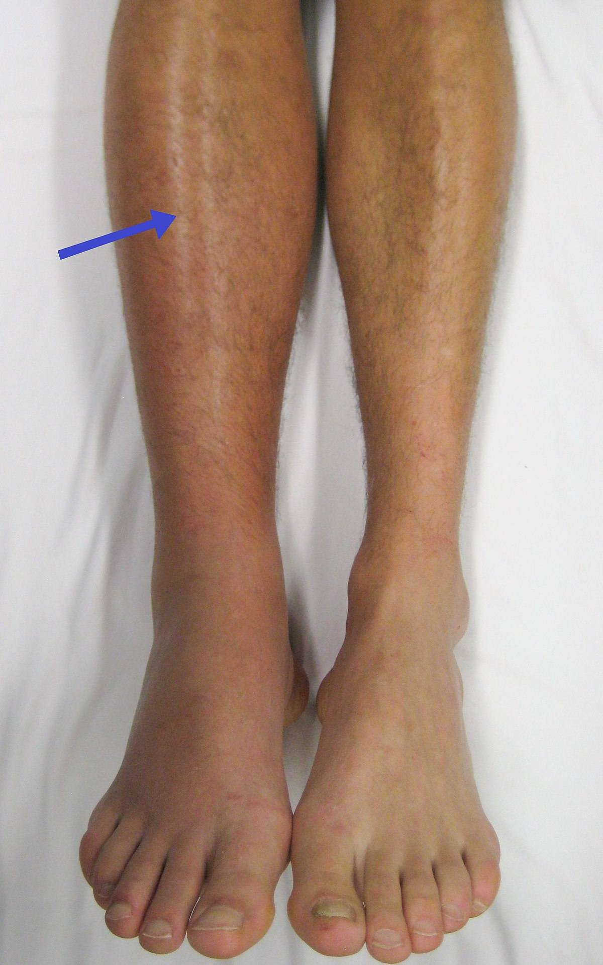
DVT
Can happen to anyone but increased risk with:
Venous stasis (e.g. bed-bound inpatients, reduced mobility, long-haul flights)
Vascular injury (e.g. IVDU, surgery, trauma)
Hypercoagulability (e.g. genetics)
Pregnancy
Cancer
Old age
Presents acutely with red, hot, swollen, painful lower limb
https://en.wikipedia.org/wiki/Deep_vein_thrombosis

Slide 8
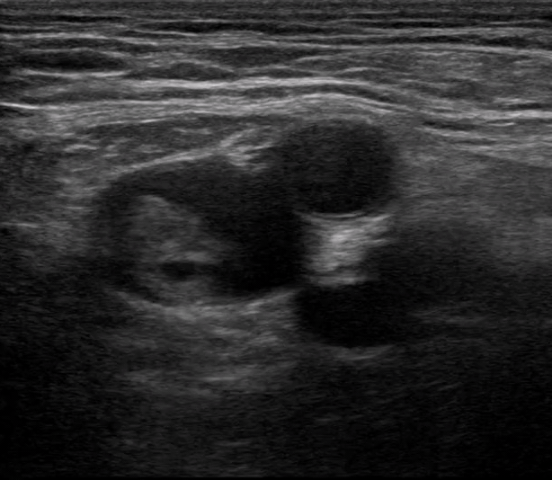
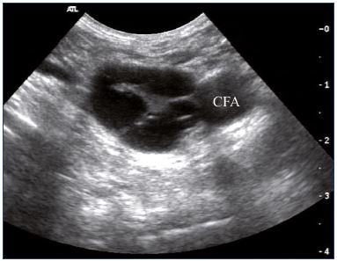
Sub-occlusive DVT in the proximal femoral vein
https://www.phlebolymphology.org/role-duplex-ultrasound-investigation-management-postthrombotic-syndrome/
https://www.pocus101.com/dvt-ultrasound-made-easy-step-by-step-guide/

Slide 9
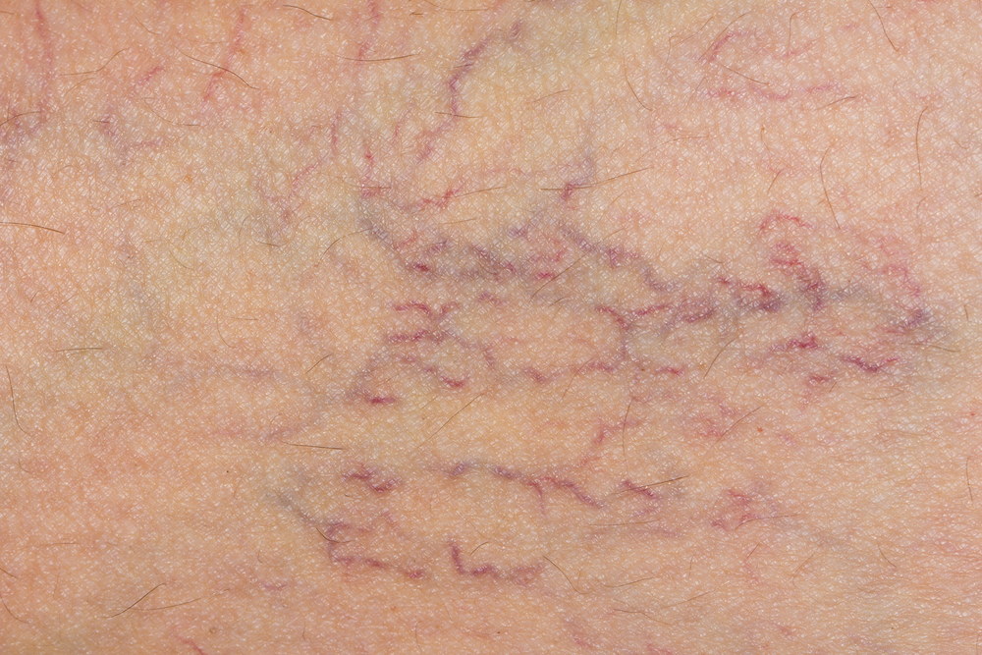
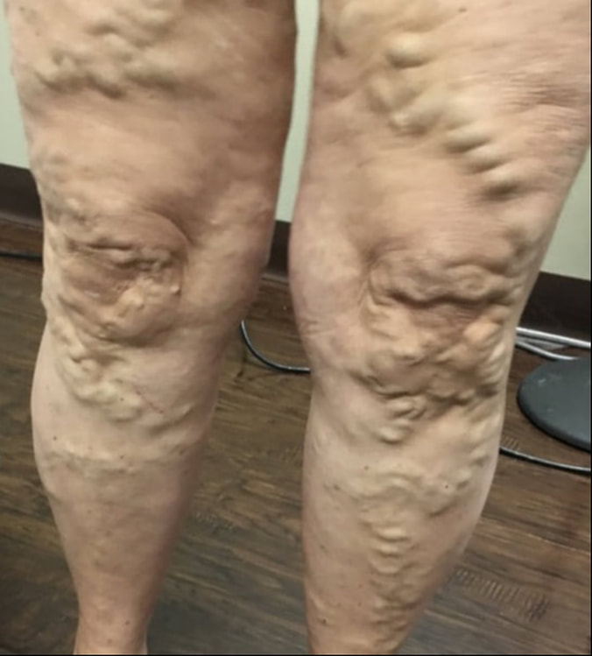
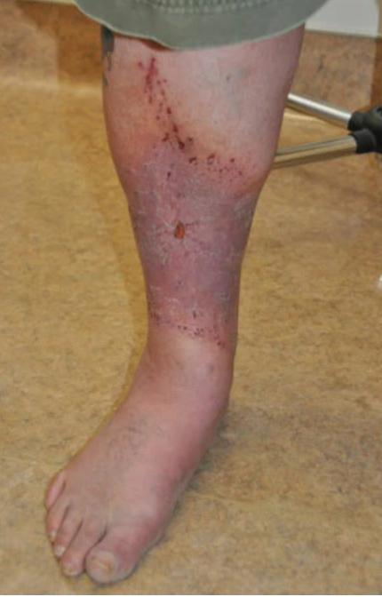
Varicose veins
These are spider veins; NOT varicose veins! →
https://www.estemedicalgroup.uk/blog/spider-veins-why-they-appear-how-to-treat-them
Develop at any age, male or female
Worse if there is increased pressure from above (pregnancy, obesity)
Can cause aching, heaviness, itching, ulceration
Not treated on NHS unless very symptomatic because it’s otherwise considered cosmetic
If symptomatic and considered for intervention, the patient can have a full duplex ultrasound
Aim of scan is to identify the source of venous reflux
Vascular surgeon can then perform ablation, sclerotherapy, stripping
https://www.fsavein.com/blog/what-are-varicose-veins
https://www.sfveincenter.com/leg-ulcer-venous-ulcer-treatment/

Slide 10
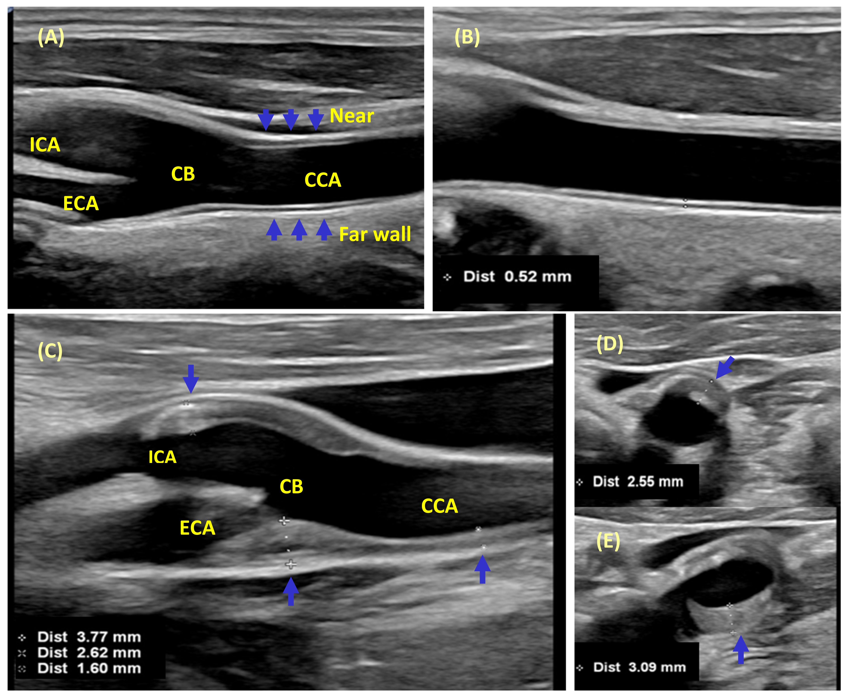
https://www.mdpi.com/2077-0383/10/20/4628/htm

Slide 11
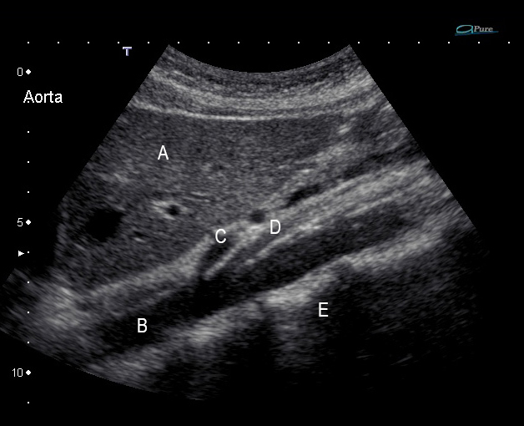
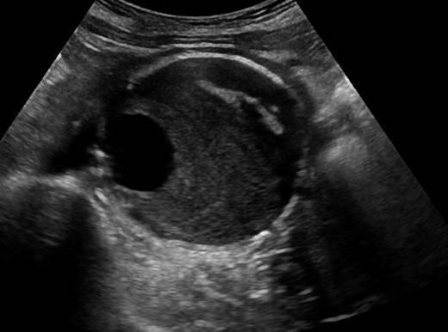
AAA
https://wfumb.info/2020/04/07/abdominal-aortic-aneurysm-quiz-01/
https://www.ultrasoundcases.info/aortic-aneurysm-7021/#gallery-1

Slide 12
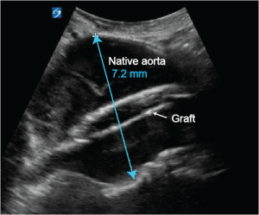
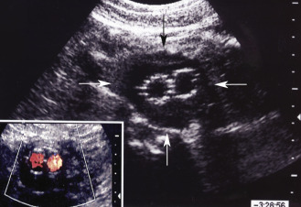
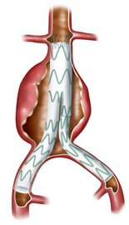
EVAR (endovascular aortic repair)
https://www.criticalcare-sonography.com/2016/09/10/the-mystery-of-the-falling-haemoglobin/
https://radiologykey.com/ultrasound-assessment-following-endovascular-aortic-aneurysm-repair-2/
https://www.circulationfoundation.org.uk/help-advice/abdominal-aortic-aneurysm/endovascular-aneurysm-repair-evar

Slide 13
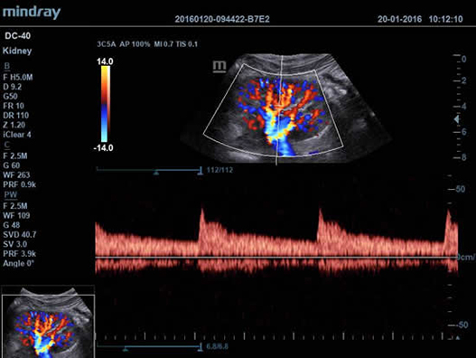
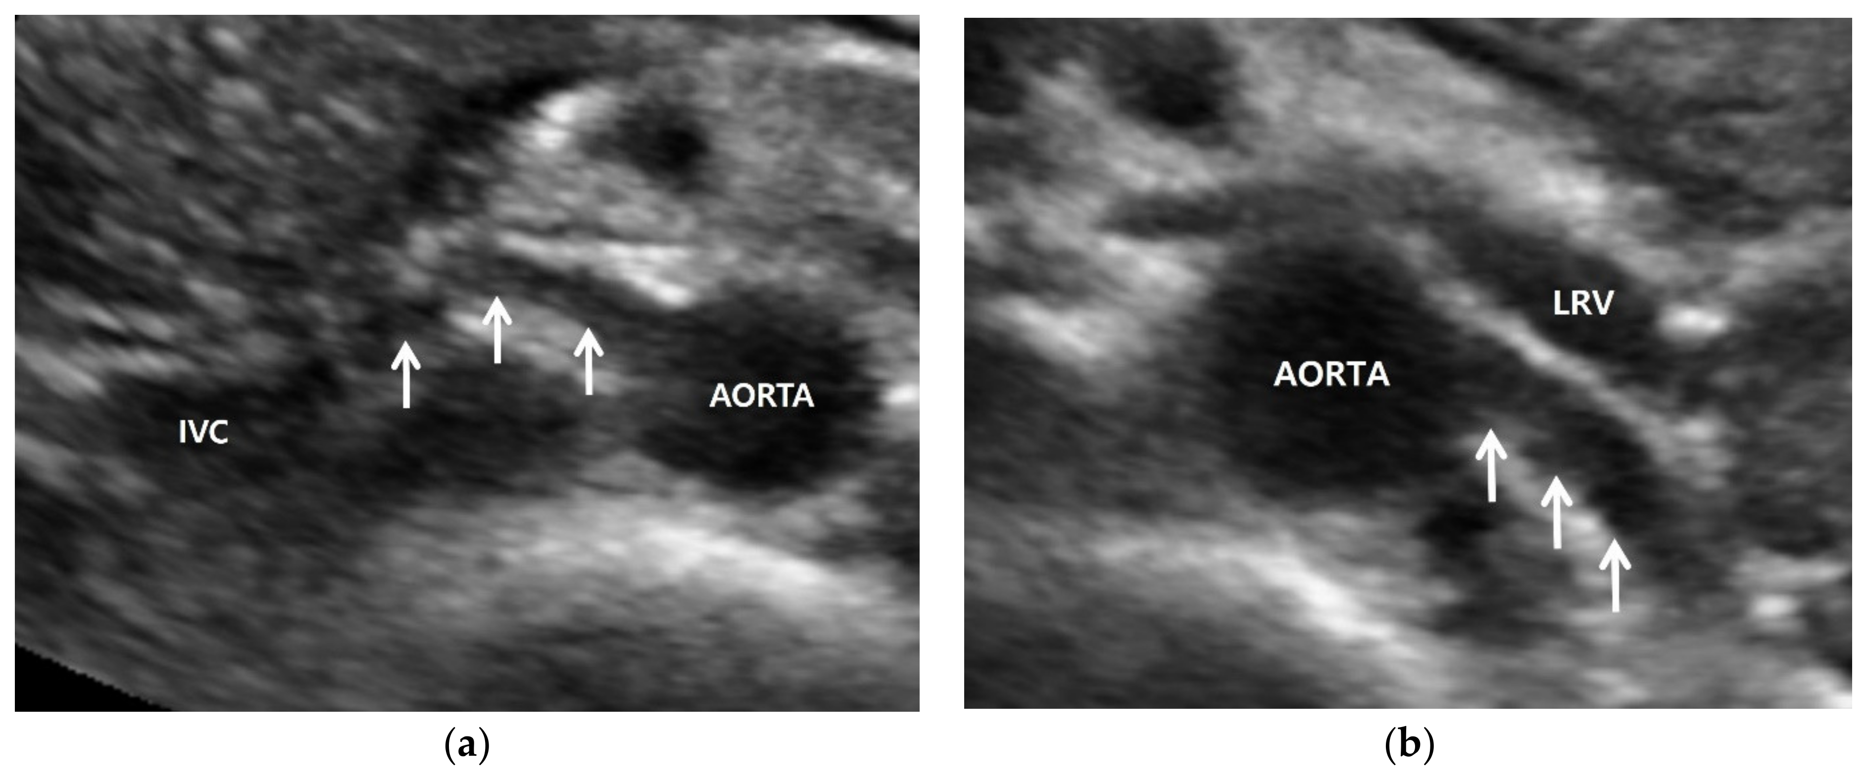
Kidney and renal arteries
https://www.mdpi.com/2077-0383/11/14/3961
https://northwestultrasound.com/project/dc-40-hd/pulse-wave-of-kidney-artery/

Slide 14
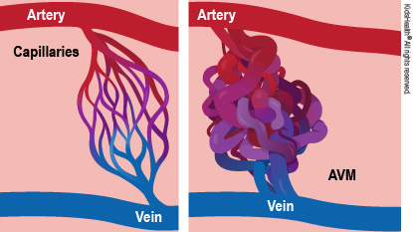
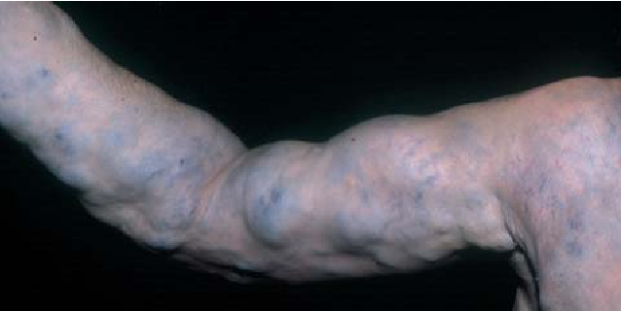
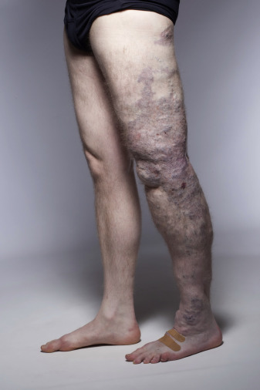
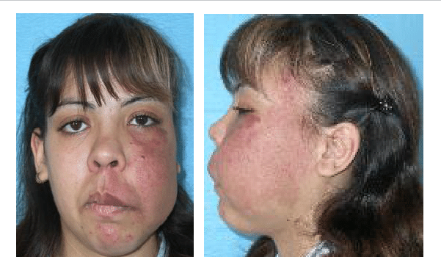
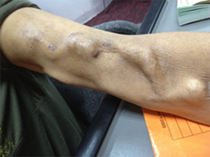
https://kidshealth.org/en/parents/arteriovenous-malformations.html
https://www.semanticscholar.org/paper/%5BVascular-malformations-(I).-Concept%2C-pathogenesis-Redondo/38a7fd415b24f1ef6bcbb7f171942e6cab7f1e2a/figure/10
https://www.sunwaymedical.com/blogpost/arteriovenous-fistula
https://www.sciencedirect.com/science/article/pii/S2213333X18301598
https://www.semanticscholar.org/paper/%5BVascular-malformations-(I).-Concept%2C-pathogenesis-Redondo/38a7fd415b24f1ef6bcbb7f171942e6cab7f1e2a/figure/10

Slide 15
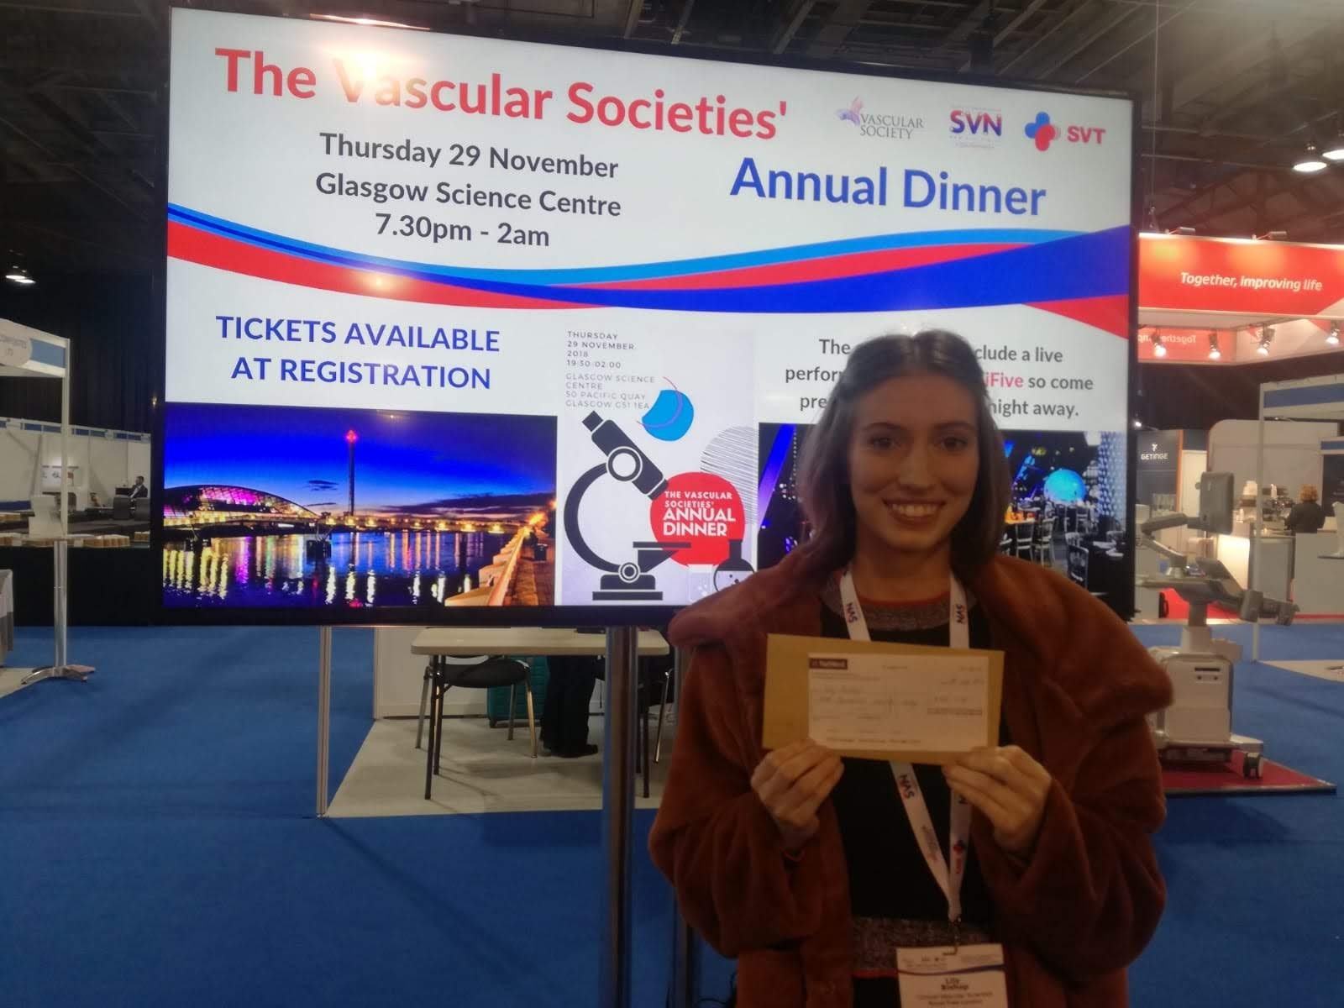
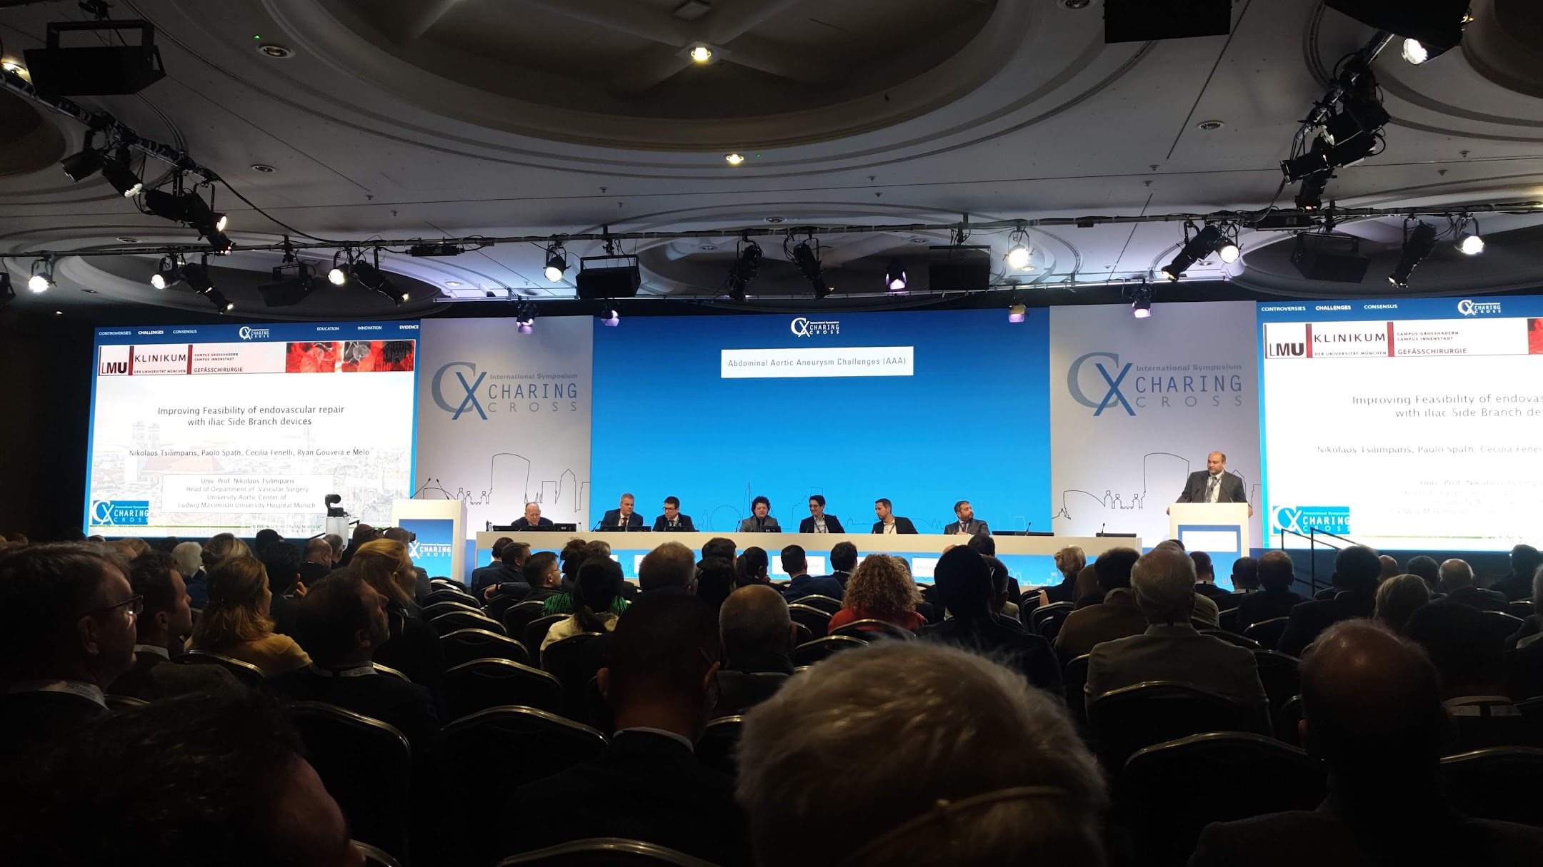
https://www.ncbi.nlm.nih.gov/pmc/articles/PMC8020236/

Slide 16
The End. Questions?

