Slide 1

Ultrasound Scanning for Renal Dialysis patients
Bridget Boyle BA AVS RVT

Slide 2


Ultrasound Scanning for Renal Dialysis Patients

Slide 3

Scanning for Vascular Access –It’s a team effort

Slide 4

Vascular lab renal patients - 2 main groups
Patients who have not started haemodialysis
Need a mapping scan prior to access creation
Need a fistula check scan prior to commencing dialysis
Patients are on haemodialysis
Having problems with dialysis
Scan may be done by you the in dialysis unit – TIPS and TRICKS to come!

Slide 5
Never had a vascular access
Mapping scan
Vascular lab

Slide 6
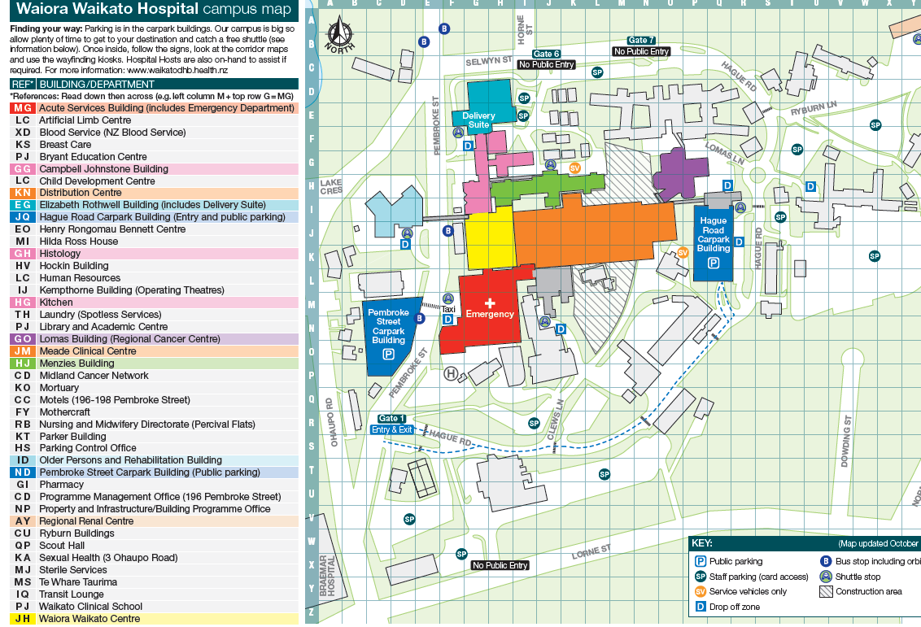
Mapping Scan
Looking for optimal site for vascular access creation
Native fistula preferable to graft
As far distally as possible
Non-dominant arm preferable
Vein diameter at least 3mm

Slide 7
Mapping Scan
First choice: radio-cephalic, non-dominant
Other options:
Radio-cephalic dominant
Brachio-cephalic non-dominant
Brachio-cephalic dominant
Transposed brachio-basilic
Then options for synthetic graft placement

Slide 8
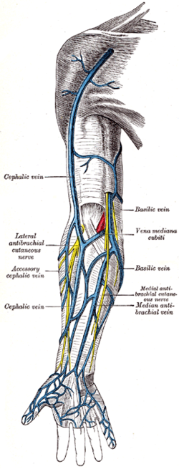
Venous Anatomy
Superficial Veins:
Cephalic starting at wrist
~ 7cm above wrist
Outflow of cephalic vein
Basilic vein

Slide 9
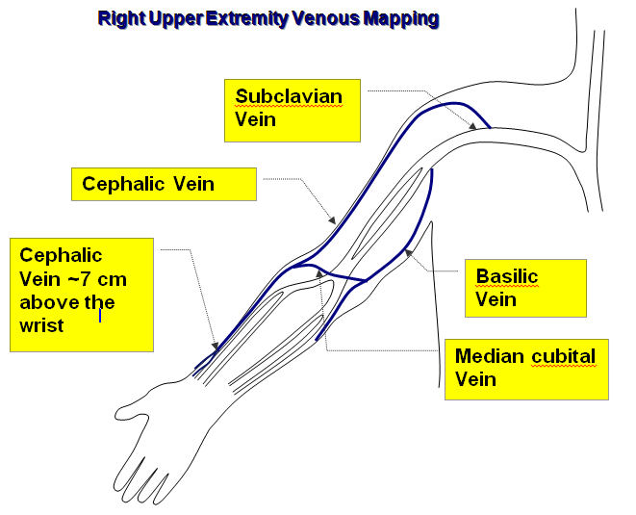
Mapping Scan

Slide 10
Venous Anatomy – Variation is the rule!
Forearm cephalic with basilic outflow only
Forearm cephalic vein duplicated
Forearm cephalic has cephalic and basilic outflow
Forearm cephalic with deep outflow only – cubital fossa perforator

Slide 11
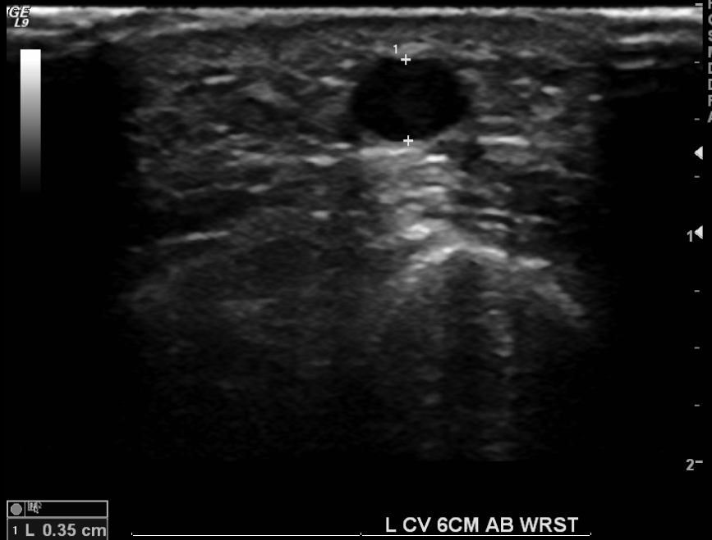
Superficial vein scanning
Tourniquet applied!

Slide 12
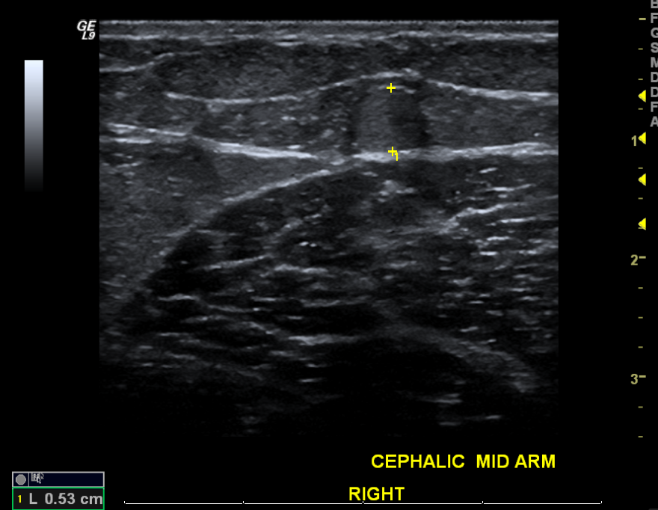
Superficial vein scanning- where did the vein go??
Tourniquet applied, blood becomes stagnant and appears echogenic – normal ultrasound appearance.

Slide 13
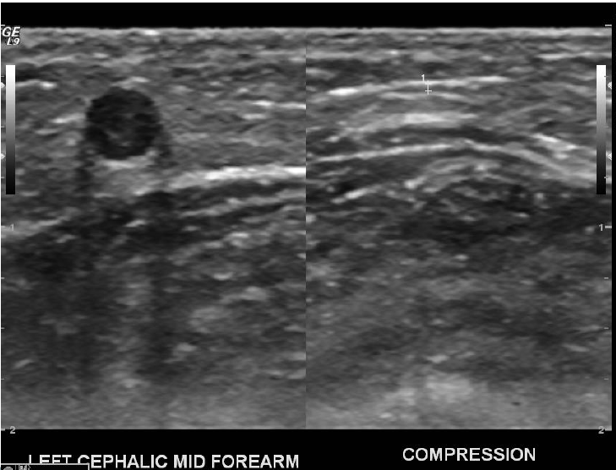
Superficial vein scanning- potential pitfall
Beware of compressing superficial veins inadvertently

Slide 14
Mapping-Deep Veins
Scanning the deep veins prior to AVF creation if the patient has had previous neck lines
Scarring or chronic thrombus in central veins may prevent adequate venous outflow when a fistula is present
May result in high venous pressures and inadequate dialysis

Slide 15
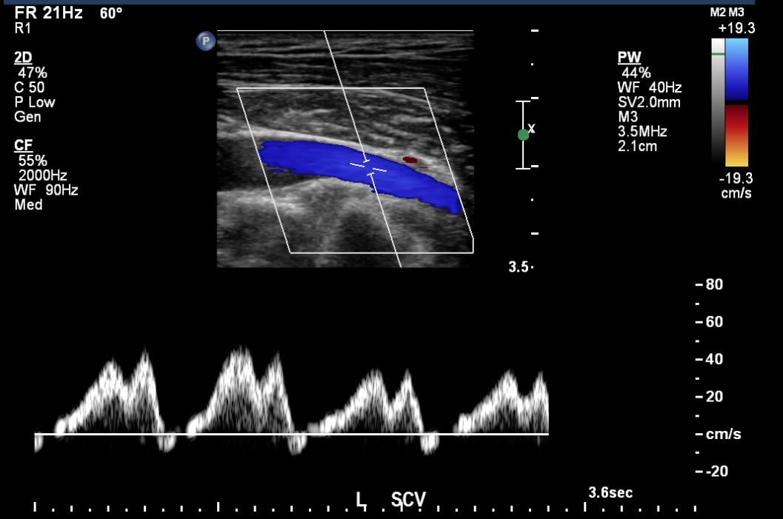
Deep vein check – PW waveform

Slide 16
Normal Deep Venous Outflow
Responds to respiration – phasic, gaps between waveform, cyclical (4 cycles here)
Slight pulsatility of waveform due to unimpeded connection to right heart

Slide 17
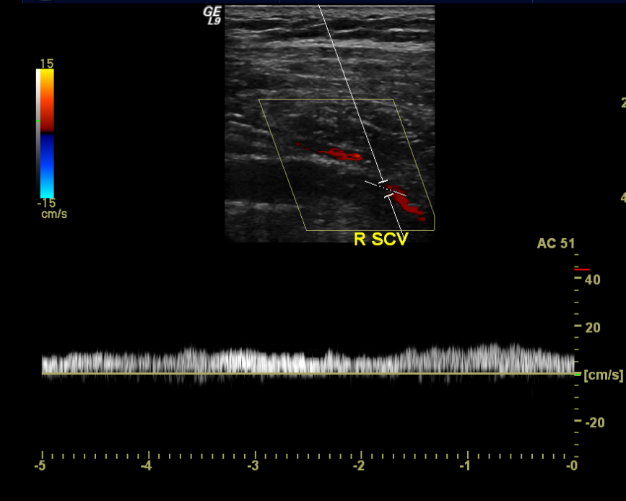
? Venous outflow obstruction
Slender or scarred vein on ultrasound images
‘Flat’ PW doppler waveform
No obvious phasicity or pulsatility
Alternative imaging may be required to rule out or confirm central vein stenosis

Slide 18
Mapping – Arterial Inflow
Doppler waveform most important
Systolic upstroke gives an indication of the state of the arteries proximal to where you are scanning – inflow
Size of the artery also measured
Can see calcification with ultrasound but this does not usually affect surgeon’s decision on site of access creation

Slide 19
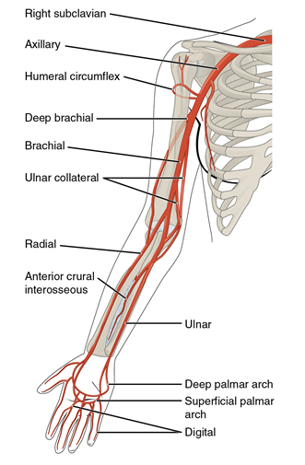
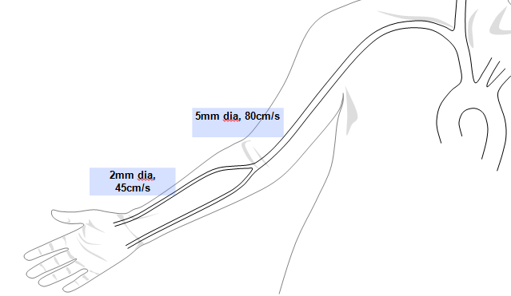
Anatomy – Upper Limb Arteries
Brachial artery
Radial artery

Slide 20
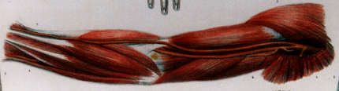
Upper Limb Arteries – anatomical variant
High origin of the radial artery and ulnar artery
‘Bifurcation’ at level of axilla
Two arteries present in the cubital fossa
Document size of each artery and proximity to superficial veins

Slide 21
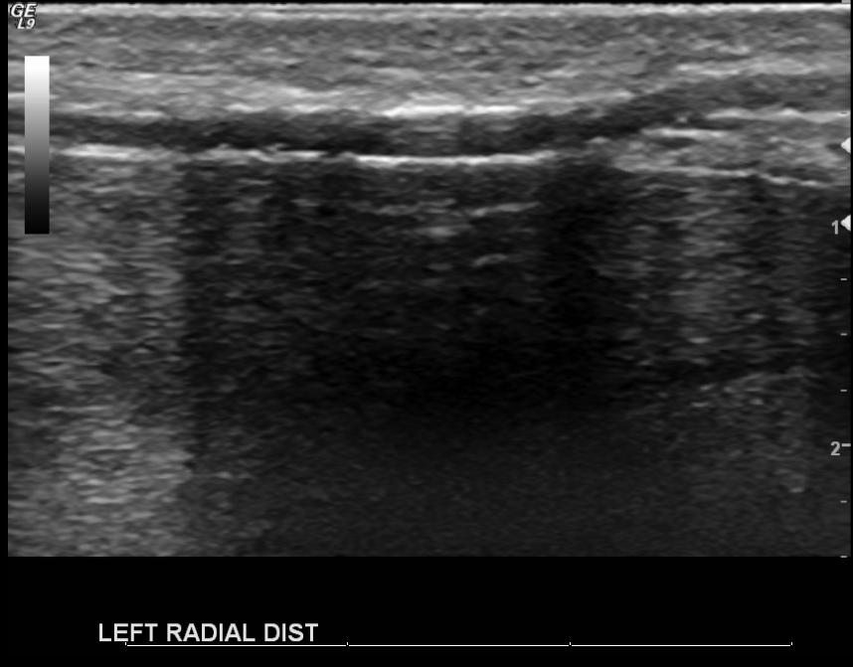
Arterial wall calcification
Calcium is echogenic, strong reflector
Vessel walls appear white
Most of the ultrasound is reflected back, very little penetrates beyond vessel wall, tissue deep to vessel is poorly imaged

Slide 22
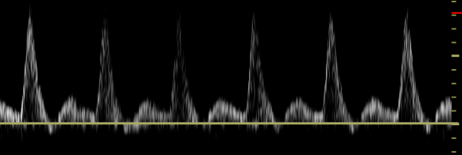
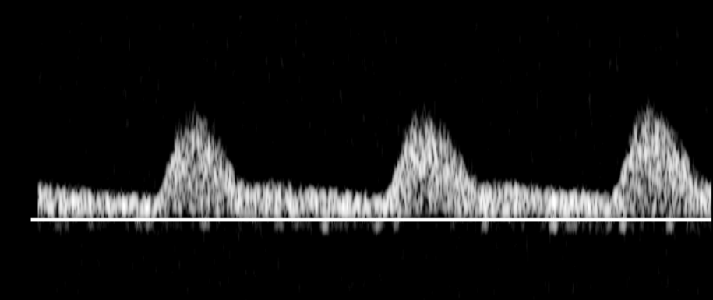
Doppler Arterial Waveforms- Systolic Phase Interpretation
Systolic upstroke – gives information about inflow arteries
Sharp systolic upstroke suggests absence of significant proximal arterial stenosis
Important for ensuring that fistula will have adequate arterial inflow
Damped or rounded systolic portion of the waveform suggests proximal arterial disease – arterial tree needs to be completely scanned to check for stenosis/occlusion

Slide 23
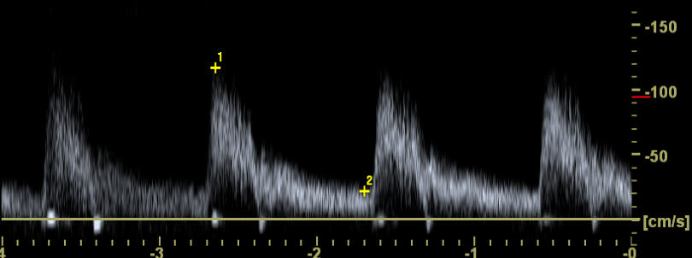
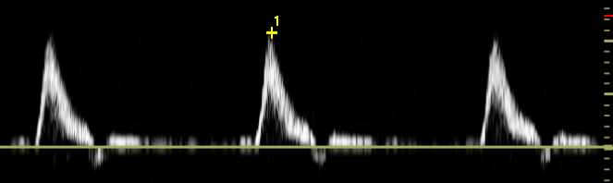
PW Doppler Arterial Waveforms- Diastolic Phase Interpretation
Length of diastolic phase and direction of flow in diastole depends on distal vessels
Plenty of antegrade flow in diastole = low resistance vessels distally: patent fistula, or vasodilation distally
Minimal or retrograde flow in diastole= high resistance vessels distally: absence of a patent fistula or vasoconstriction distally

Slide 24
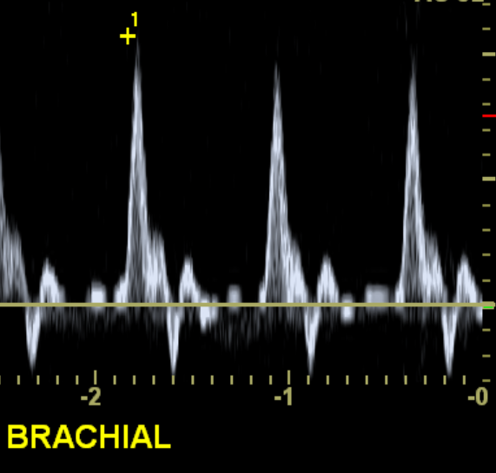
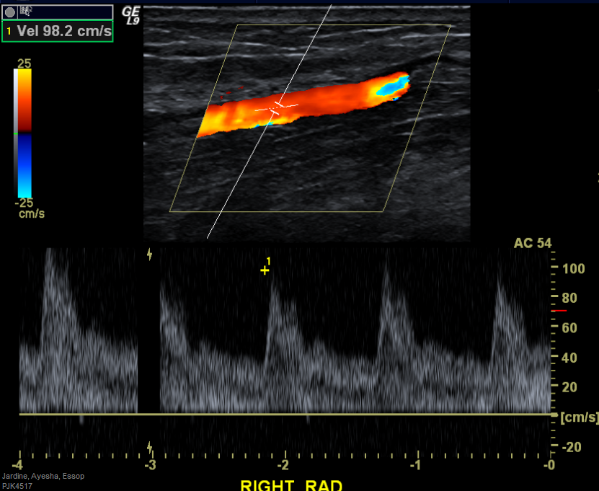
Inflow artery – look for sharp systolic upstroke
Both of these waveforms demonstrate normal sharp systolic upstroke, although diastolic phases are markedly different

Slide 25
Damped/Rounded Systolic Upstroke = trouble
Rounded systolic peak, suggests arterial inflow problem proximal to this point

Slide 26
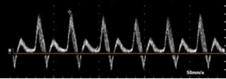
Arterial waveform – low resistance, patent fistula distally
Low resistance diastolic portion of waveform characteristic of patent fistula distally.
High resistance waveform in an artery
supplying an AVF would be abnormal

Slide 27

Mapping Scan
Superficial vein at least 3mm dia
Patent artery with sharp systolic upstroke
No suspicion of central vein stenosis

Slide 28
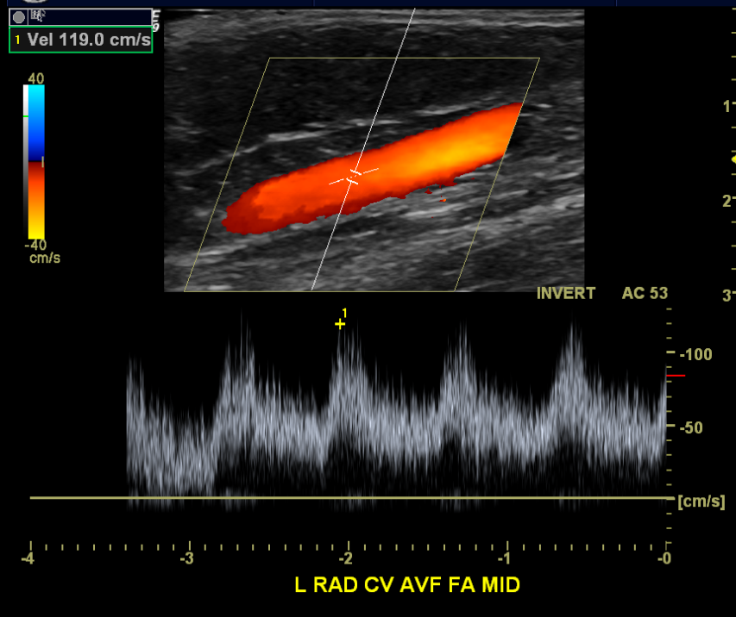
Post creation AVF check scan
Patent with arterialised flow
Good calibre (~5mm dia)
Reasonable velocity
LOW RESISTANCE waveforms – indicate good outflow for the AVF

Slide 29
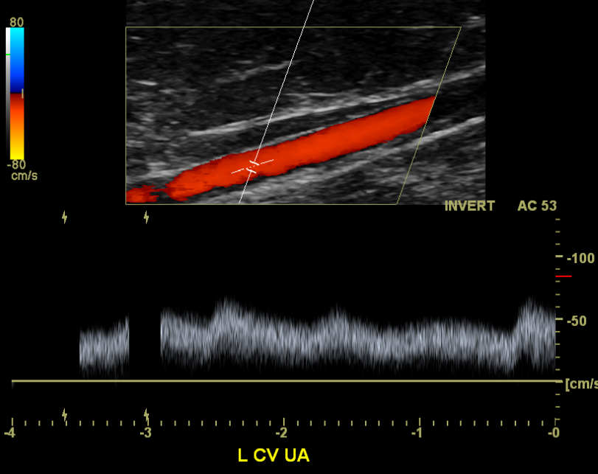
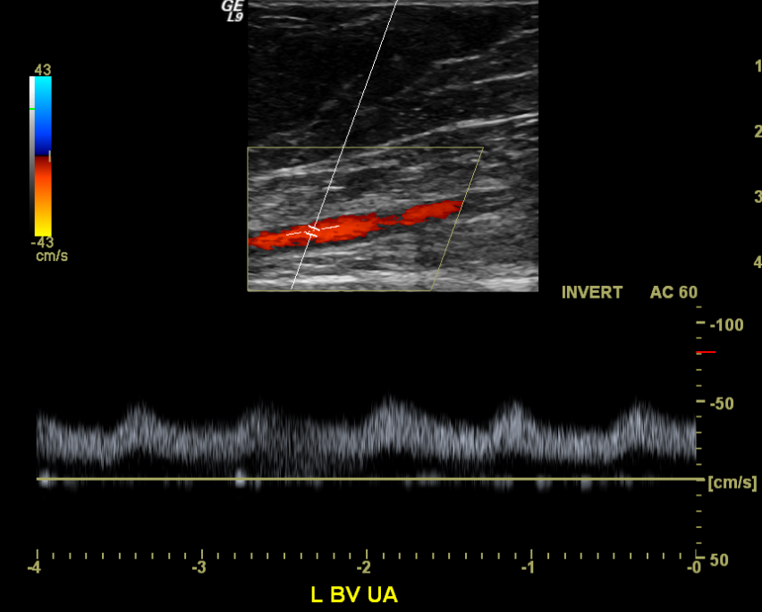
Post creation AVF check scan
Low resistance flow and good calibre of proximal AVF

Slide 30
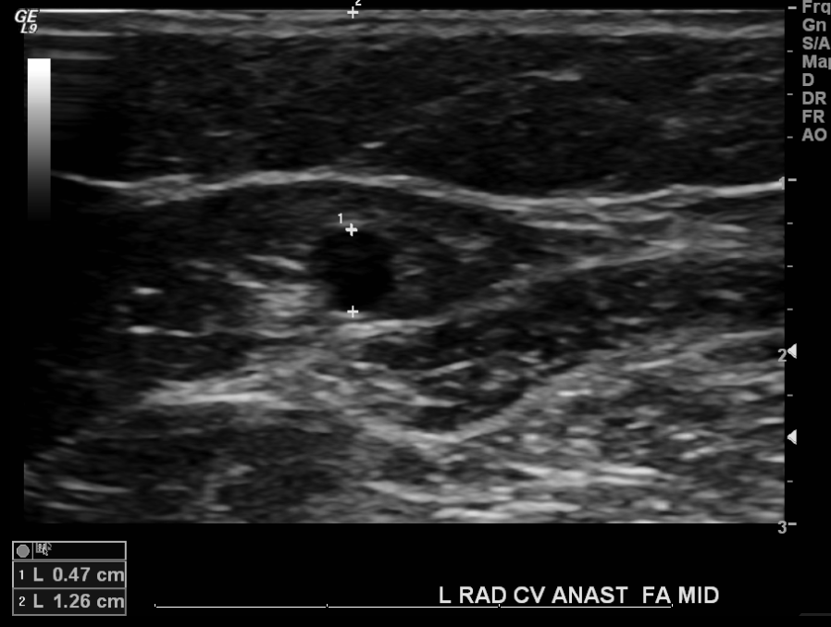
Post creation AVF check scan
Size and depth of AVF where needling will occur

Slide 31
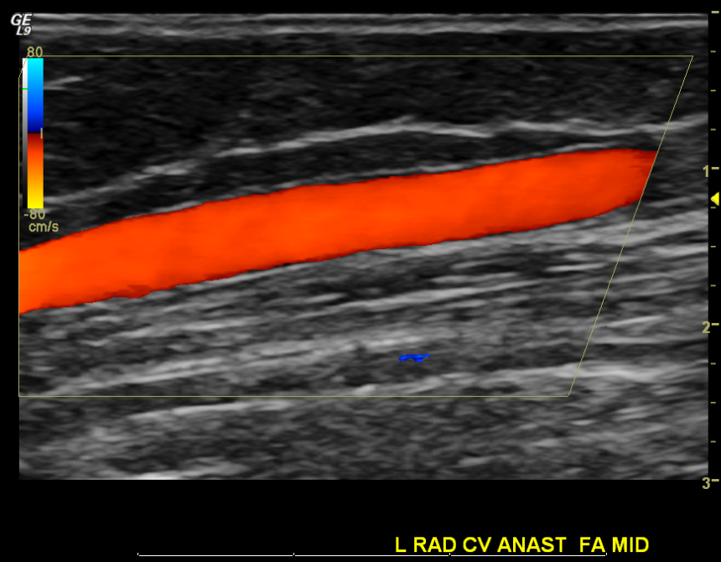
Post creation AVF check scan
Any tortuosity or large tributaries

Slide 32
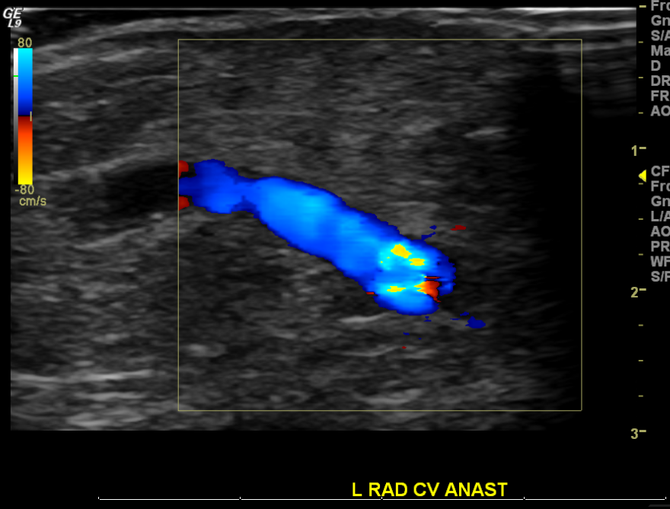
Post-creation AVF check scan
No significant anastomotic stenosis
Radial artery
Cephalic vein
No anastomotic stenosis

Slide 33
Patients who are having problems with haemodialysis
Difficulty needling
High venous pressures
Low arterial pressures
Swelling or collection
Pain

Slide 34
Problems with dialysis- difficulty needling
We aim to help you and the patient find optimal sites for needling and where NOT to needle
Size and depth of AVF (5mm dia or greater, less than 10mm deep)
Tortuosity
Presence of tributaries
Pseudoaneurysm or haematoma

Slide 35
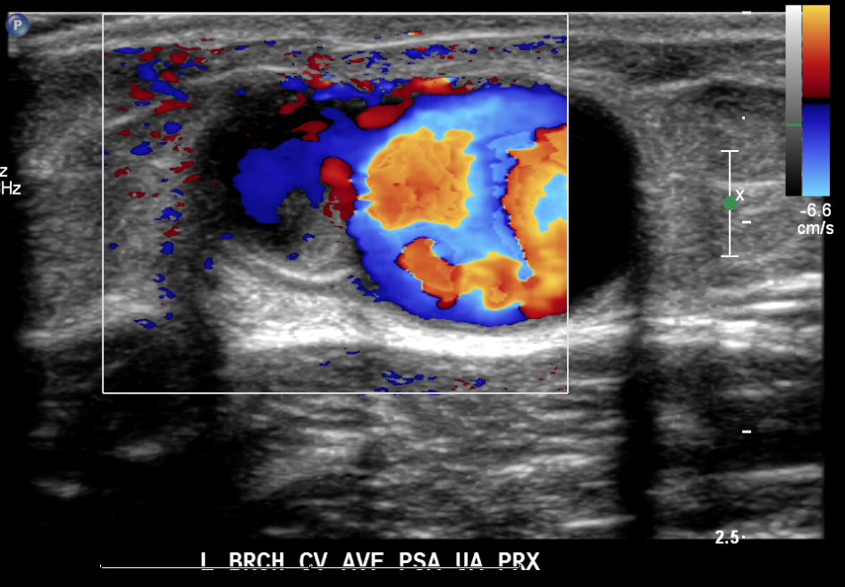
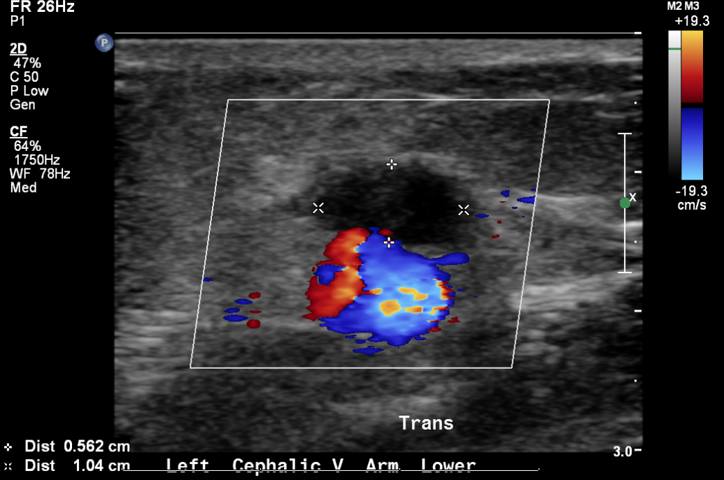
Problems with dialysis- difficulty needling
Pseudoaneurysm or haematoma

Slide 36
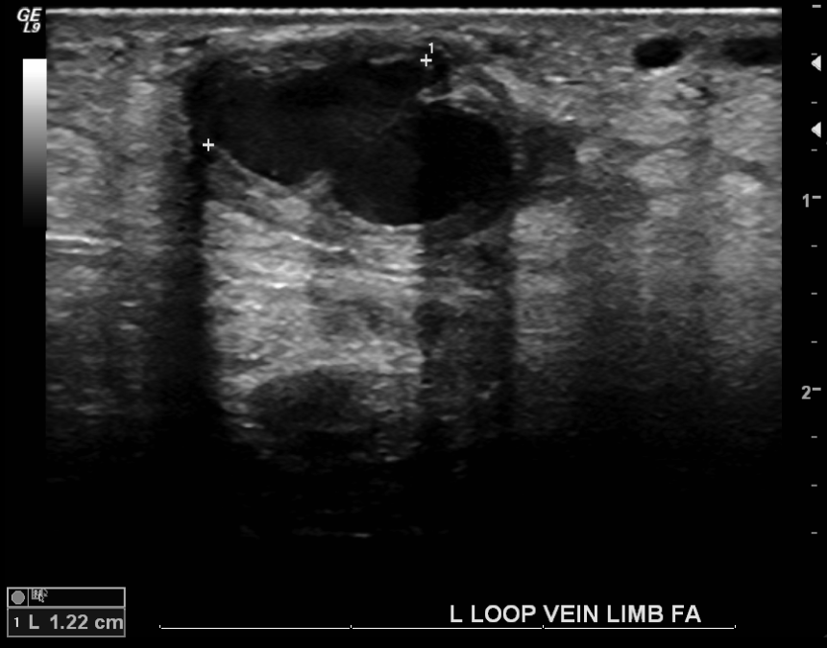
Problems with dialysis- difficulty needling
Pseudoaneurysm or haematoma – graft

Slide 37
Problems with dialysis- high venous pressures
Stenosis in the AVF proximal to venous needle
Stenosis at confluence of cephalic vein and subclavian vein
Central venous stenosis or occlusion
Duplex is not useful for directly imaging the central veins but we can try to infer the state of the central veins using waveforms
Duplex findings can be used to prompt further investigation

Slide 38
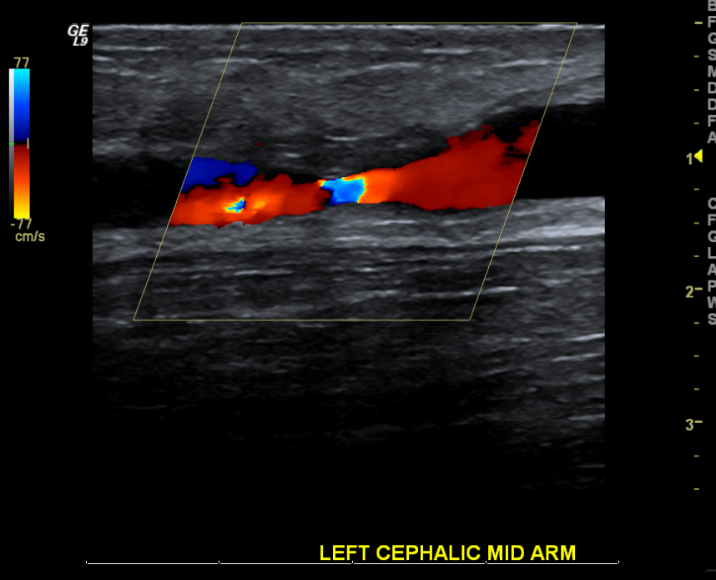
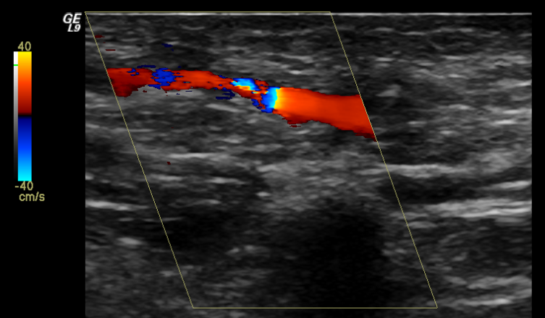
High Venous Pressures – proximal AVF stenosis
Stenosis in the proximal AVF – not perianastomotic - above venous needle site
Second image is at the level of the clavicle

Slide 39
High Venous Pressures –central vein stenosis
Small subclavian vein
‘Flat’ waveform- no significant phasicity or pulsatility

Slide 40
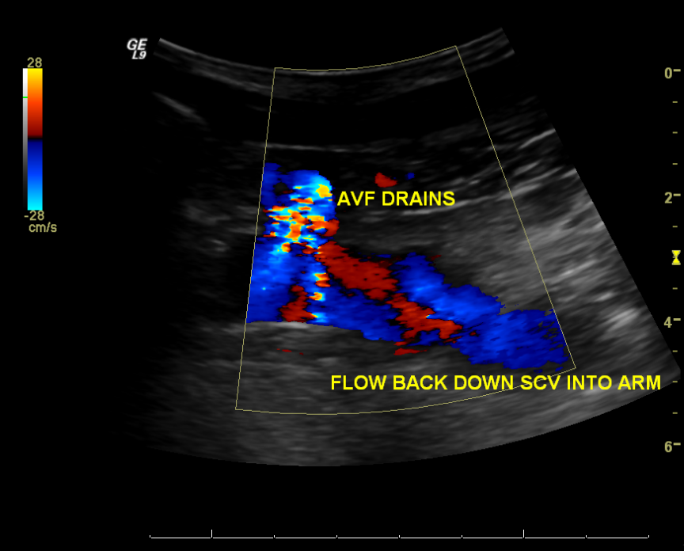
High Venous Pressures – definite central vein stenosis
Hugely swollen arm!
Patent AVF
Retrograde flow in deep veins

Slide 41
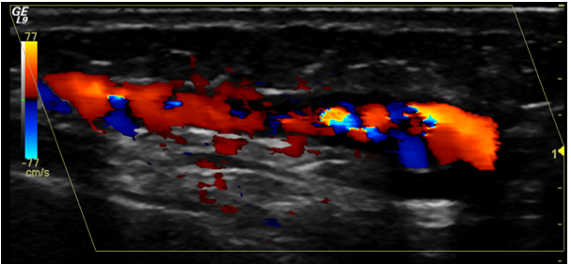
Problems with dialysis – low pressures
Arterial pressure of <100mmHg or pump speed <300ml/min
Culprit: ‘swing segment’ of fistula/peri-anastomotic stenosis

Slide 42
Diagnosing haemodialysis fistula stenosis
No consensus on criteria for determining significant stenosis in a fistula
Velocity measurements and ratios from different points along the AVF can be used, but are of limited value due to the fact that the AVF varies in diameter along its length
B-mode (greyscale) and colour image characteristics at stenotic site are useful: presence of thrombus, scarring, valve, wall thickening, colour filling defect, aliasing AND LUMENAL DIAMETER <2.7mm
Colour mixing (aliasing) on ultrasound indicates presence of turbulent or high velocity flow

Slide 43
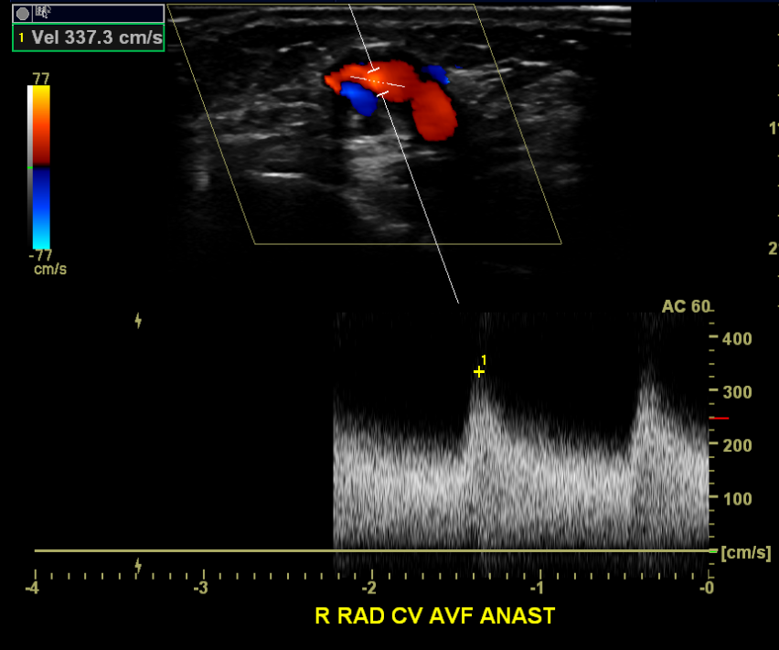
Peri-anastomotic stenosis – velocity comparison, V1
V1 = normal peak systolic velocity upstream of stenosis

Slide 44
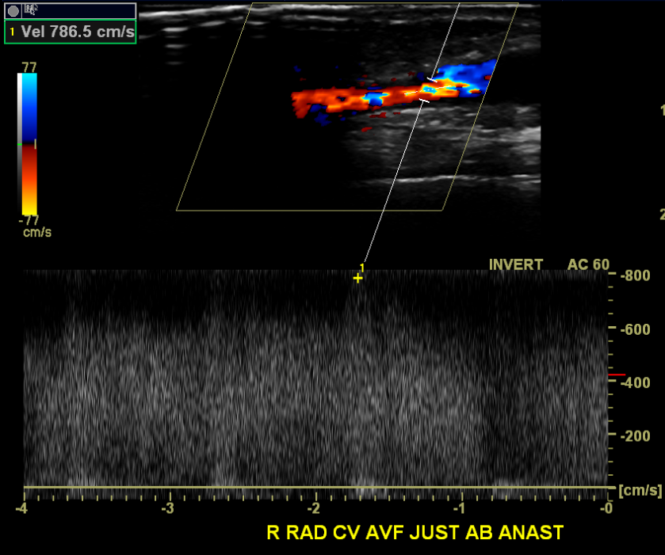
Peri-anastomotic stenosis – velocity comparison, V2
V2 = peak systolic velocity at the stenosis
V2/V1= 787/337 = 2.3 which suggests >50% stenosis, NOT HARD AND FAST RULE

Slide 45
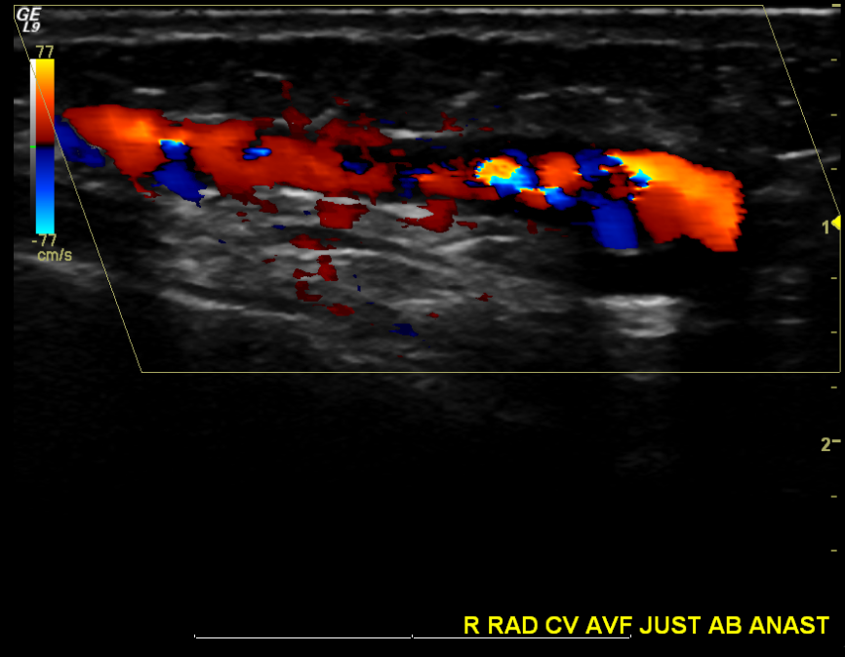
Peri-anastomotic stenosis
Aliasing and colour filling defect

Slide 46
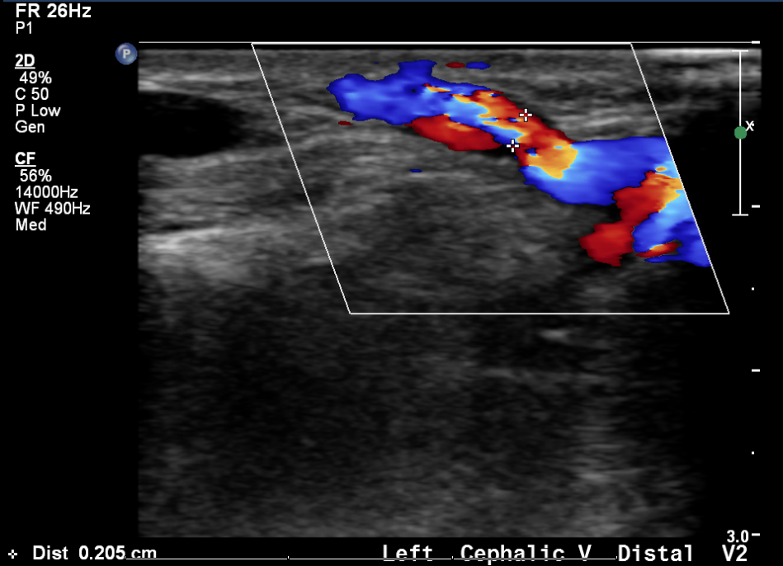
Peri-anastomotic stenosis
Residual diameter, aliasing

Slide 47
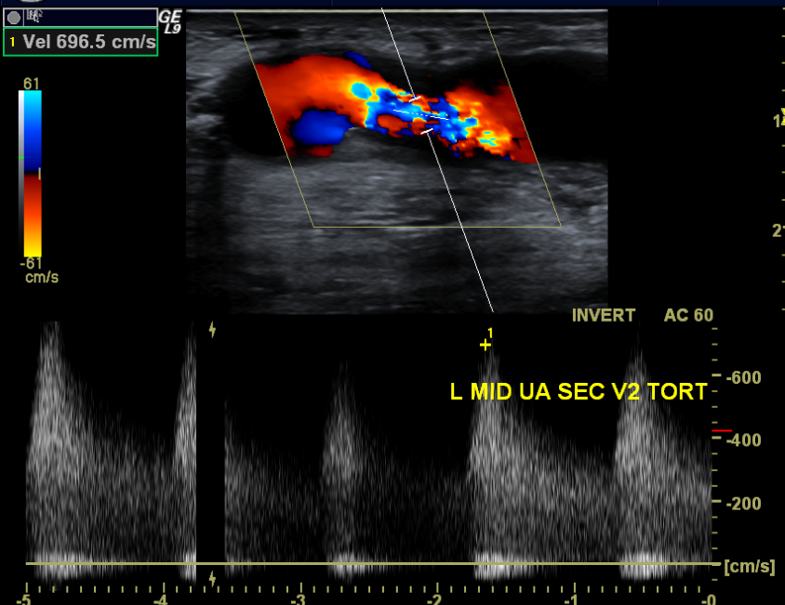
Mid fistula stenosis
High PSV, colour aliasing

Slide 48
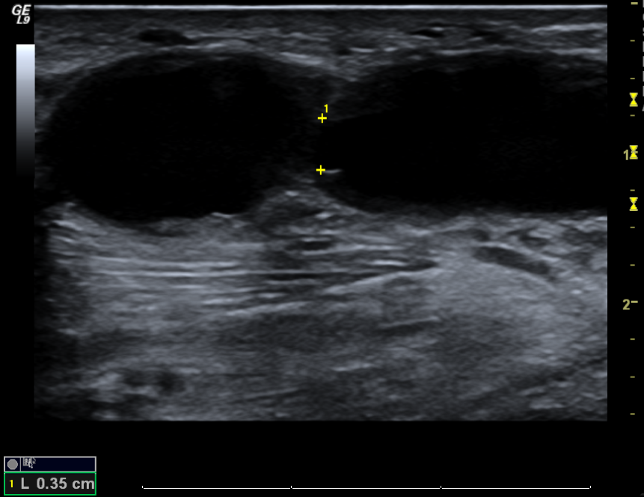
Residual Diameter – B-mode ultrasound
Wall thickening causes reduction in lumenal diameter

Slide 49
Duplex ultrasound scanning of the autogenous arterio venous hemodialysis fistula: a vascular surgeon's perspective Jan Swinnen Australas J Ultrasound Med. 2011 Feb; 14(1): 17–23. Published online 2015 Dec 31. doi: 10.1002/j.2205-0140.2011.tb00181.x
“In essence, a stenosis in the dialysis circuit exists when the dialysis machine can no longer dialyse the patient adequately. We believe this stenosis is determined by an absolute minimal luminal diameter – 2.7 mm – although other factors in the dialysis circuit need to be taken into account.”

Slide 50
Problems with dialysis- collections
Size of collection
Presence of arterial flow in collection – is it a pseudoaneurysm?

Slide 51
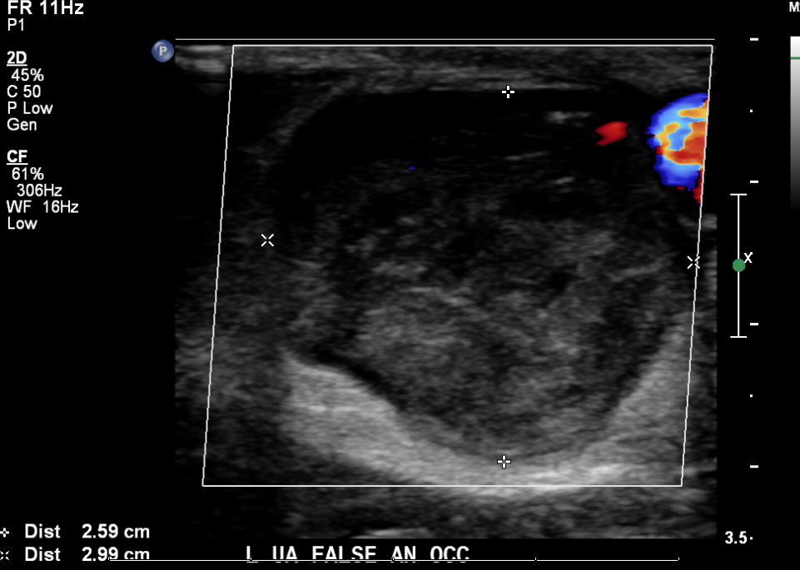
Collections
Size

Slide 52
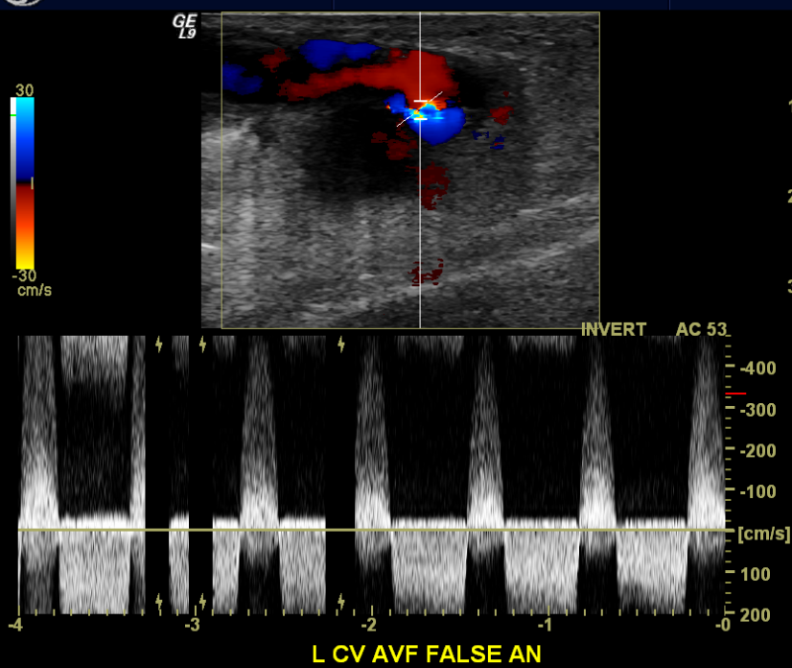
Collections
Confirm false aneurysm with ‘to and fro waveform’ and colour

Slide 53
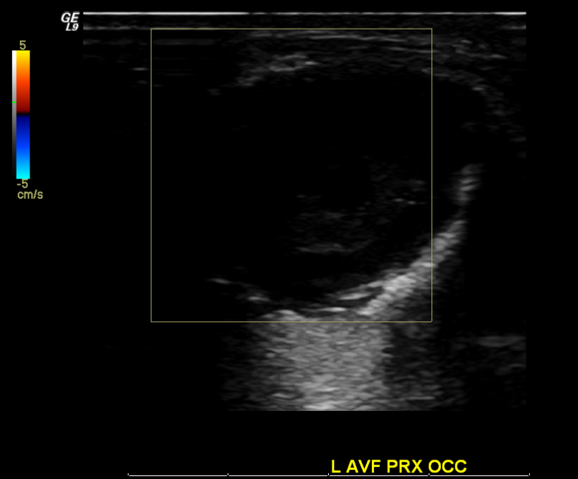
Collections
Heterogenous – this is not a false aneurysm, this is an occluded AVF

Slide 54
Why are there no images of fluid collections around synthetic grafts?
Because we can’t answer the question that always comes with a patient who has a synthetic graft and a hot, red, swollen arm:
Is there an infection?
If the primary question is regarding infection, the vascular lab won’t be able to answer that question

Slide 55
Problems with dialysis – pain, ? steal
Flow direction in arteries distal to the fistula
Stenosis in arteries proximal to and distal to the fistula
Size of the fistula
Why do we report these findings rather than commenting ‘steal’ or ‘no steal’?
Ischaemic or clinical steal is a clinical diagnosis

Slide 56

Two types of steal syndrome
Physiological
reversal of flow in artery distal to the fistula
very common finding in patients with a functioning radio-cephalic fistula!
Ischaemic or Clinical steal
physical findings most important, pallor,
ulceration or tissue loss
sensory or motor neuropathy

Slide 57
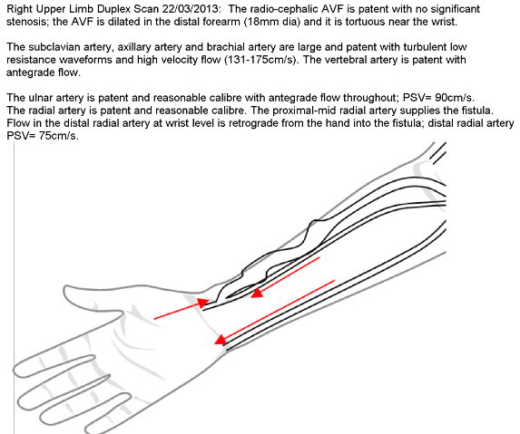
? Steal – Duplex Scan

Slide 58
Diagnosis and Treatment of Ischaemic Steal
Compression of AVF to assess relief from symptoms and changes in flow characteristics with compression
If doctor makes a diagnosis of steal, they may decide to undertake a DRIL procedure
Distal Revascularisation Interval Ligation
???

Slide 59
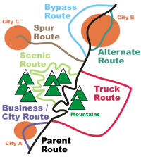
Distal Revascularisation Interval Ligation graft (DRIL)

Slide 60
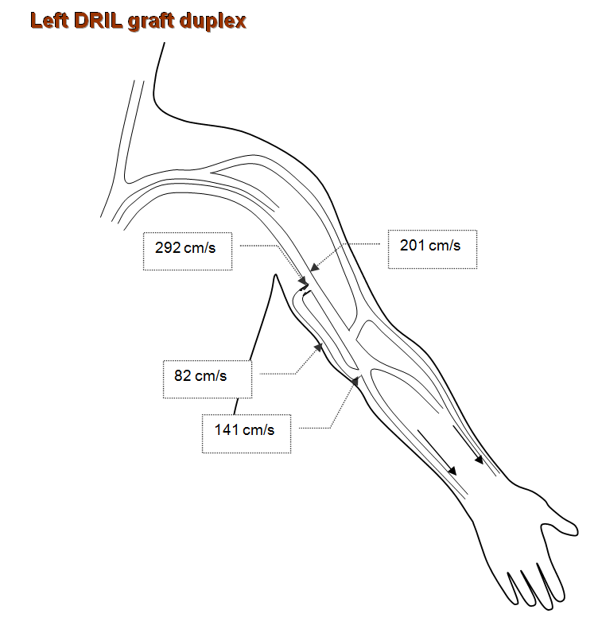
DRIL bypass graft

Slide 61
What happens when a patient’s vascular access suddenly stops working?
Patient has AVF or graft which they suddenly cannot dialyse from, it has just stopped working
The obvious question:
Is the vascular access still patent?
Initial scan will probably be done in the dialysis unit

Slide 62
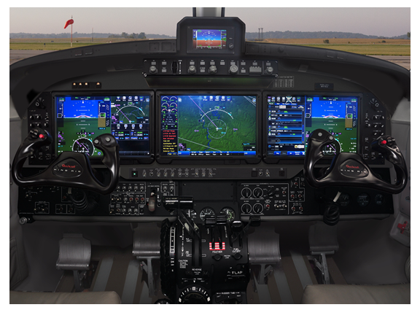
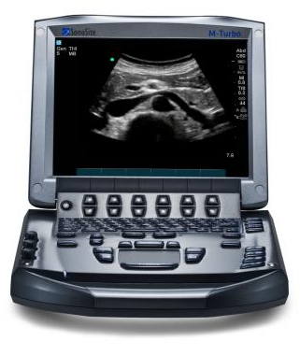
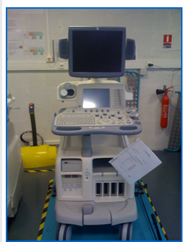
Tips for Performing Ultrasound Scans
Use your machine to the best of its capabilities

Slide 63
Image Optimisation
First things first – select correct transducer and exam/setting/preset
‘Exam’: vascular
Transducer: highest frequency (MHz) that gives adequate penetration will give the best quality image
Transducer: usually we are looking at relatively superficial structures = linear probe – rectangular field of view

Slide 64
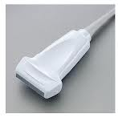
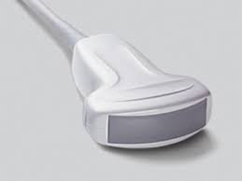
Transducer

Slide 65
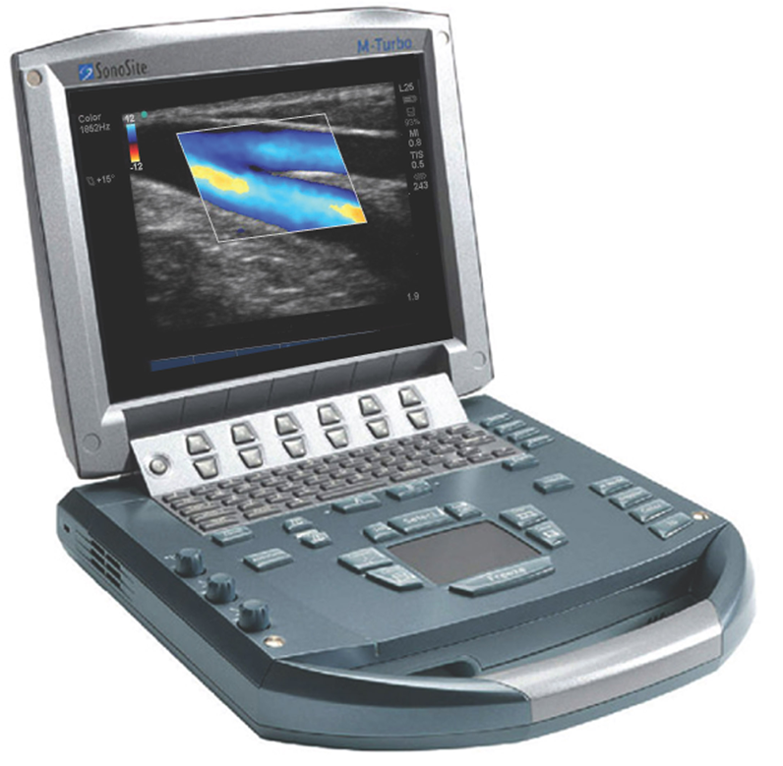
Image Optimisation – Adjustable Machine Controls
You can’t break the machine – controls are there for you to adjust and play with
Depth
Gain – brightness or colour gain

Slide 66
Image Optimisation – 2D controls
Depth – don’t image what you don’t need to see, use as much screen as possible for what you are interested in
Overall gain – brightness of entire screen
Gain in the near-field and far-field - adjust brightness of the screen according to depth

Slide 67

Image Optimisation - Depth
Adjust depth so that most of the screen is occupied by your target
Put your target in the centre of the screen for best resolution

Slide 68

Image NOT Optimised for Depth
Depth is too deep! Nothing important in the bottom 3cm of this image.
Best resolution for this small vessel would be in the centre of the screen

Slide 69

Image Optimisation – Colour Controls
High, Med, Low flow
Scale/PRF
Gain

Slide 70

What do the colours mean?
Presence of flow
Patent fistula fills with colour
No colour in haematoma therefore as long as colour controls have been properly adjusted, we can state that there is no flow in the adjacent haematoma

Slide 71
Image Optimisation – Colour Controls
High, Medium or Low flow settings – adjust to the state of flow you are expecting, high flow for patent fistula, low flow for native veins or searching for any flow present
Scale/PRF (pulse repetition frequency)
High setting and scale for patent AVF
Low setting and scale for ? occluded AVF and ? false aneurysm
excessive colour gain = noise
insufficient colour gain = vessel won’t fill properly

Slide 72

Colour Image Optimised –Scale/ PRF
Scanning to check for occlusion
Is there ANY flow present
Notice the low scale/PRF used

Slide 73

Colour Image Optimised – Scale/PRF
Occluded basilic vein AVF, note low scale

Slide 74

Colour Image NOT Optimised- Scale/PRF too high
Scale too high – patchy colour filling
If scale was a bit higher no colour filling vessel looks occluded when it is actually patent!

Slide 75


Colour Controls – colour box steering
Align colour box with the direction of the vessel

Slide 76

Image optimisation for ? occluded fistula
Do the best with what you have and don’t be afraid to play around with the controls
? Patent or occluded – quick check with colour on low flow, low scale, high gain

Slide 77


What do the colours mean?
Colour scale/PRF set at 10cm/s
Colour scale/PRF set at 77cm/s
Indication of average flow velocity

Slide 78

What do the colours mean – direction of flow
Leading edge
Direction of flow with reference to the transducer
Flow towards or away from the transducer face
Transducer face

Slide 79

Which way is it flowing – leading edge of transducer
Leading edge detail on probe corresponds to leading edge symbol on screen
The tissue under the ‘leading edge’ of the transducer will appear next to the leading edge symbol on the screen

Slide 80
What do the colours mean – direction of flow
Leading edge
Direction of flow with reference to the transducer
Flow towards or away from the transducer face
Transducer face

Slide 81
What do the colours mean – direction of flow
Transducer face
The colour on the TOP of the colour bar indicates flow TOWARDS the transducer face
The colour on the BOTTOM of the colour bar indicates flow AWAY from the transducer face
In this image, flow that is blue is going towards the transducer face.

Slide 82
Which way is it flowing?
Is the colour in the vessel on the top or the bottom of the colour bar?
Bottom = flow AWAY from the transducer face
Which arrow allows for flow AWAY from the transducer face?
Flow in the vessel following the solid arrow is either towards the leading edge or away from the leading edge
Flow following the solid arrow is towards the leading edge of the transducer

Slide 83

Towards Arnold’s wrist or towards Arnold’s elbow?
Is the colour in the vessel on the top or the bottom of the colour bar?
Bottom = flow away from the transducer face
Which arrow allows for flow away from the transducer face?
SOLID ARROW. Flow is towards the leading edge of the transducer, therefore flow is towards Arnold’s…..
elbow

Slide 84

Towards Larry’s wrist or towards Larry’s elbow?
Is the colour in the vessel on the top or the bottom of the colour bar?
Top = flow towards the transducer face
Which arrow allows for flow towards the transducer face?
SOLID ARROW. Flow is towards the leading edge of the transducer, therefore flow is towards Larry’s…..
elbow

Slide 85

Towards the Hulk’s elbow or towards the Hulk’s shoulder?
Is the colour in the vessel on the top or the bottom of the colour bar?
Top = flow towards the transducer face
Which arrow allows for flow towards the transducer face?
DOTTED ARROW. Flow is toward the transducer face and away from the leading edge of the transducer, therefore flow is towards the Hulk’s…..
shoulder

Slide 86
Image Optimisation – PW doppler controls
Scale
Sample volume size
Angle correct
Beam steer
Gain

Slide 87
Image Optimisation – PW doppler controls
Gain – too high and doppler waveform is obscured by noise, too low and waveform is invisible or faint
Sample volume size – large for large vessel or low velocities, small for small vessel or high velocities
Angle correct or angle adjustment – only essential when taking velocity measurement, i.e. PSV

Slide 88
Gain – waveform is easily visible with no background noise
Scale/PRF – same as colour controls: high scale setting for high flow, low scale setting for low flow or for possible occlusion

Slide 89
PW beam has been steered to in the same direction as the vessel (same direction as colour steering box as well!)

Slide 90
Sample volume small and in centre of vessel to sample high velocity flow
Angle has been corrected to match angle of flow for accurate peak systolic velocity measurement

Slide 91

PW doppler controls – Overgain!
PW Gain set too high, background noise distracts from doppler waveform

Slide 92
Image Optimisation for ? occluded fistula
Do the best with what you have and don’t be afraid to play around with the controls
? Patent or occluded – quick check with colour on low flow, low scale, high gain, all angles of beam steering
? Patent or occluded – PW doppler cursor, low flow setting, low scale, high gain, all angles of beam steering and sample volume over whole vessel

Slide 93

Scanning Tips and Tricks
Use enough gel
Stabilise the probe by keeping it and your fingertips on the patient
Heavy pressure will crush superficial veins, use a fairly light touch

Slide 94



Scanning – how NOT to hold the probe
Don’t be afraid of the probe, the patient, or the gel

Slide 95

Scanning – how to hold the probe
Fingers anchored on patient and near the face of the transducer – not the cable
Stabilises the probe and allows for small movements – the vessels we are looking at are usually small

Slide 96

Be nice to your machine

Slide 97


AVF stenosis progression- mapping scan
Good calibre cephalic vein
Normal radial artery waveforms: sharp systolic upstroke, high resistance

Slide 98



AVF stenosis progression
3 months post radio-cephalic AVF creation, patient unable to dialyse, ? stenosis or clot

Slide 99



AVF stenosis progression
Three subsequent angioplasties

Slide 100

AVF stenosis progression
Progressed to occluded AVF.

Slide 101

Something I have learned along the way….
Trying to pronounce patient’s names correctly puts them more at ease
Ahakoa he iti he pounamu.
Although it is small it is precious.

