Slide 1
UWE AHP Student Conference Highlights
5th June 2017

Slide 2
Research opportunities for Allied Health Professionals
Prof. Nicola Walsh Physiotherapist
Personal attributes of a successful researcher
  Effective presenter
  Good debating skills
  Creative and scientific writing
  Critical thinking and problem solving
  Leadership
  Ability to work independently and within a team
  Receptive to critical feedback
  Resilience

Slide 3
Research opportunities for Allied Health Professionals
Prof. Nicola Walsh Physiotherapist
Enhancing your potential
  Publish
  Conferences
  Lecturing opportunities
  Secondments
  CPD/Training (CLAHRC is free) and has a group in South West
  CAHPR membership
  Higher degree(s)/ M level credits
  UWE opportunities
  Clinical research/audit/service evaluation (publish)

Slide 4
Council for Allied Health Professions Research (CAHPR)
Dr Anne Johnson (Occupational Therapist)
Ideas
Opportunities
Contacts – speed dating to meet other AHP with a research interest (CAHPR events)
Mentor
Funding

Slide 5
Identify whether massage is effective in reducing agitation in people with dementia a systemic review
S Everall, Radiographer
To appraise studies published after the last review of this subject in 2012 ( Moyle et al).
To identify areas for further research around this topic.
NICE guidelines recommend a holistic approach to dementia care, offer massage to those who may respond well.
6 studies included. Results leaned towards massage having a beneficial effect, but it remained unclear as to whether this was any more effective than 1 to 1 human interaction.
Further research would involve a direct comparison between companion in room +/- physical massage, aromatherapy vs non aromatherapy massage, recruitment participants not on antipsychotic drugs.

Slide 6
Standardisation of bowel and bladder preparation for prostate cancer
A Walkman, Radiographer
Standardisation of bowel and bladder preparation for prostate cancer
9 questionnaires sent out across the region- 6 responded
Results: Wide variation in prep used :no prep to mini prep, 300ml liquid to 750ml
No agreed protocol
?Rest of UK
Adoptive radiotherapy – patient focus with a reduction to no prep, reduce unpleasantness to patient.

Slide 7
Head and Neck transplant a step too far?
Dr Julie Woodley Centre for Ethics in Medicine
Is it a head transplant or a body transplant, creating a cranio-anastomosis
Are we creating a new hybrid individual
Conventional test for identity may not be appropriate
DNA
Off spring

Slide 8
Head and Neck transplant a step too far?
Dr Julie Woodley Centre for Ethics in Medicine
Need to be clear on benefits
Agreed level
-risks patient should be allowed to consent to (desperation)
-risk should the medical profession allow patient take
  First time procedure done unknown but risks HIGH, this will allow lessons learnt to reduce risk
Probability of harm occurring and severity of harm HIGH
Future misuse/abuse

Slide 9
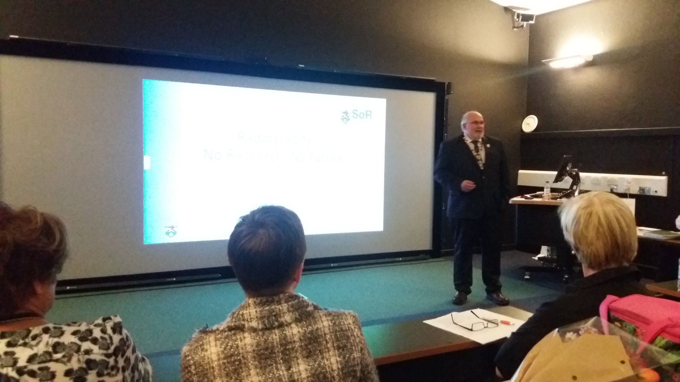
Radiography
No research No future
Steve Herring President SCoR

Slide 10
Radiography
No research No future
Steve Herring President SCoR
Profession needs to be research based
  Policy influence
  Professional influence
  Social Influence
  Best practice, use of current best evidence in care of individual patients
  Patient focused research
  Information SOR website

Slide 11
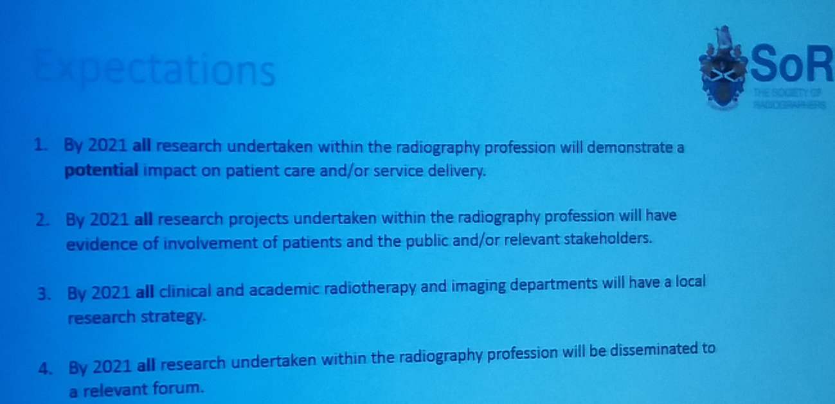
Radiography
No research No future
Steve Herring President SCoR

Slide 12
Doctorate research proposal:
Redesigning a diagnostic radiography curriculum
Janice St John Matthews
Novel idea for research
  An action research study looking a pre-registration curriculum requirements
UWE syllabus with national requirements
Crowdfunding
    Peer group – curriculum review panel
    General public
Lots of reflective logs with regular review
Unique work to crowd source

Slide 13
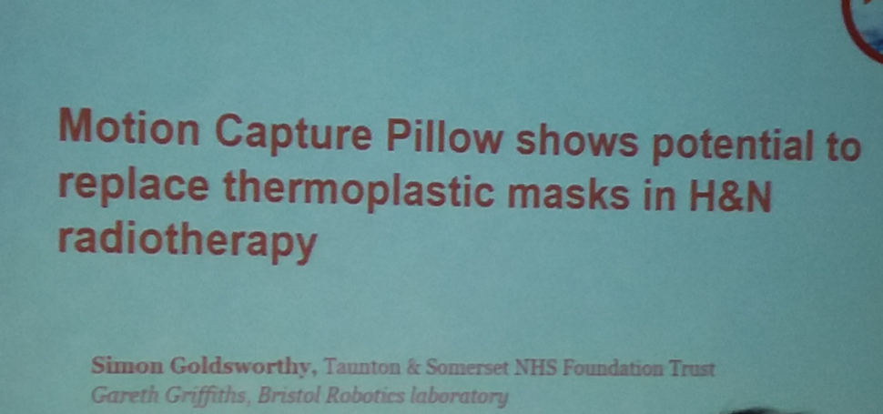
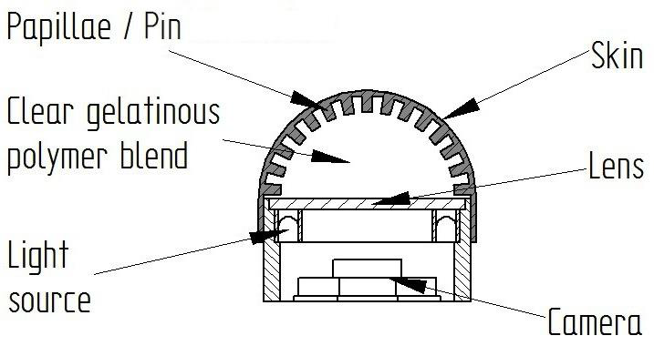
Motion capture pillow for head and neck radiography
Simon Goldsworthy PhD, Principal research radiographer, Musgrove Park (Taunton)
Justification argument – patients voice – develop a motion capture pillow- pillow with camera fingerprints (fibre optics under a pillow
Prototype done, next phase proof of concept work – replicating planning and treatment phases, user satisfaction questionnaire
TACTIP technology developed at Bristol Robotic Laboratory

Slide 14
Motion capture pillow for head and neck radiography
Justification of anatomical site:
Focus group consultation around experience of head and neck radiotherapy
Themes emerged: Physical comfort, mental perception, passivity
‘It felt like I was being suffocated ..’
‘I was waiting to hear the footsteps of the radiographer to remove the mask’

Slide 15
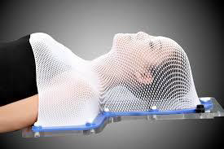
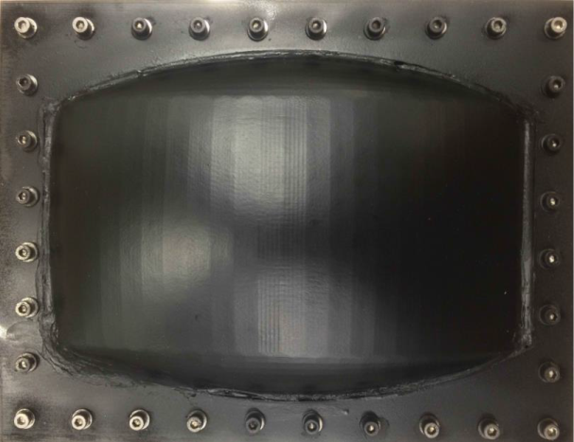
Patient comfort and position monitoring in radiotherapy treatments
Motion tracking for radiotherapy
Complex patient positioning during Head and Neck intensity modulated radiotherapy
Improving patient experience and comfort related to immobilization
Current immobilization technique include use of patient bespoke thermoplastic masks
Twofold problem: position monitoring and immobilization

