Slide 1

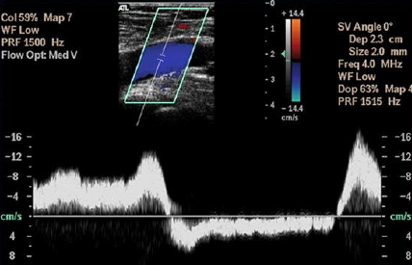
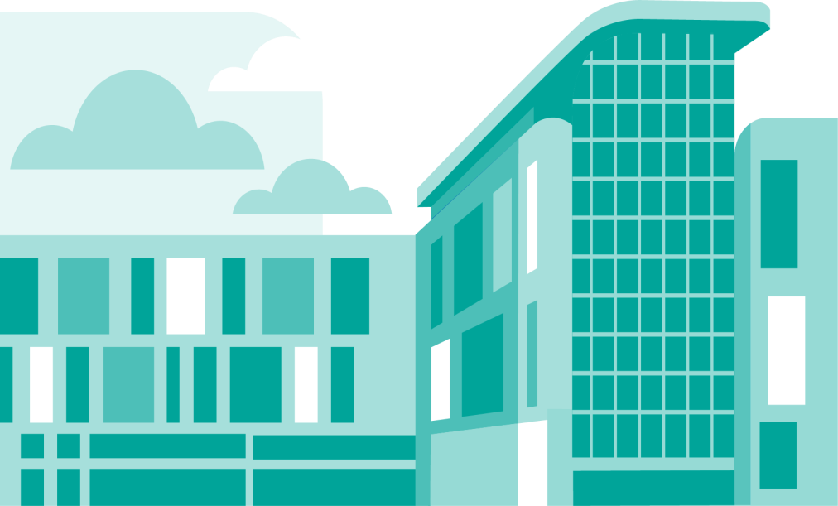
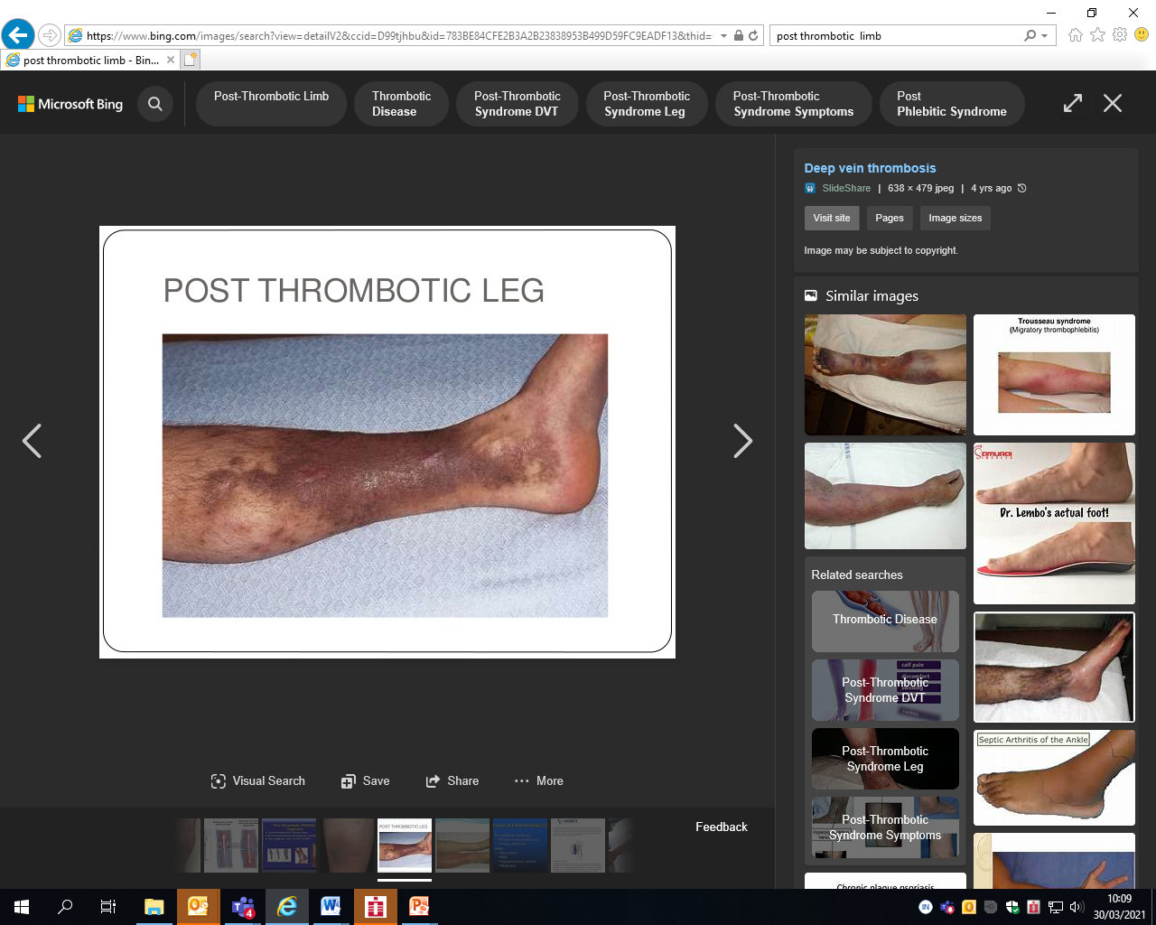
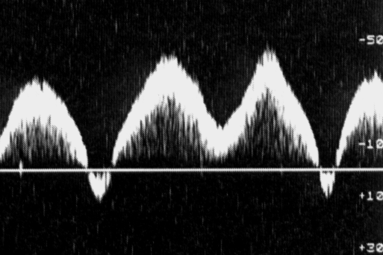
Venous Insufficiency
Louise Fearnside
Clinical Vascular Scientist
North Bristol NHS Trust
Louise.fearnside@nbt.nhs.uk

Slide 2
Introduction and Overview
Venous Haemodynamics and Anatomy
Clinical Presentation of CVI & Etiologies
More advanced forms of CVI and NICE guidelines
Treatment overview and the role of Vascular Testing
Venous pathologies involved and ultrasound assessment
Report writing /schematics
***********************
Centre success story - management and treatment of leg ulcers
North Bristol iliac vein thrombolysis and stenting service
Notes:
So today the aim is to give you an introduction and overview of Chronic venous insufficiency

Slide 3
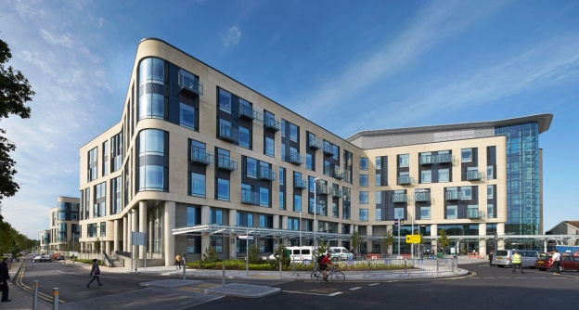
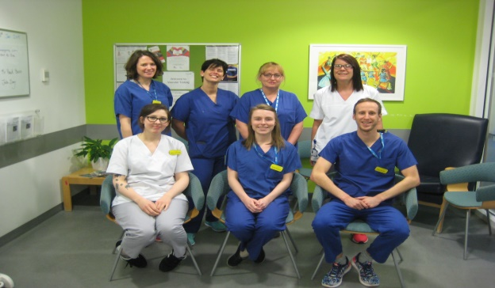
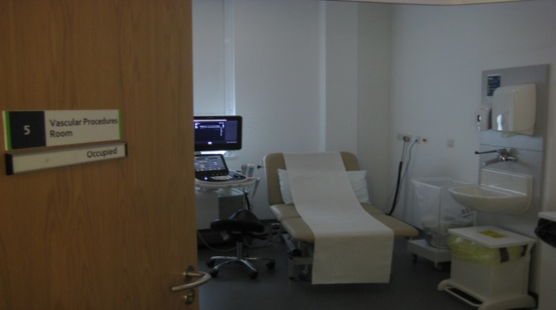
Vascular Testing Department
Carotid duplex
Lower and upper limb arterial duplex
Graft surveillance
Ankle & Toe Brachial Pressure Indices
Lower and upper limb deep vein thrombosis duplex
Aortic Aneurysm Surveillance
Venous stent surveillance
Renal fistula ultrasound
Renal Access Mapping
Vein mapping pre surgery
Lower limb venous insufficiency duplex
EVAR stent graft surveillance
Temporal artery duplex for Temporal Arteritis
PPG assessment
Toe pressures and TCPO2 (Transcutaneous oxygen measurements)
Notes:
So my name is Louise Fearnisde and I am one of the Vascular Scientists in the vascular testing department at North Bristol Trust. I have been in the profession for almost 14 years and I performed my training in the vascular unit in Cheltenham which had a very substantial venous assessment workload and treatment.
Here at North Bristol, we also have a venous assessment workload in amongst a wide range of other vascular imaging scans as depicted in this diagram.

Slide 4
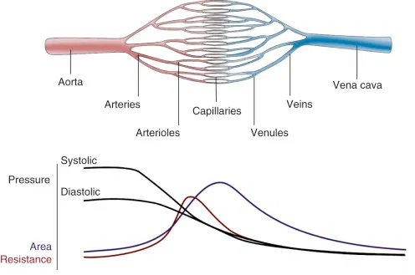
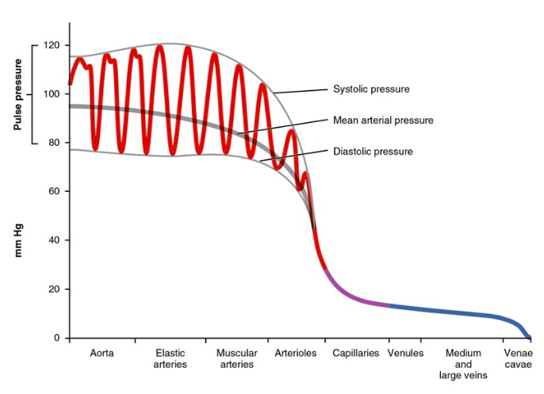
The cardiovascular system
40 mmHg
16 mmHg
4 mmHg
Why is there flow?
  Pressure difference across system
  High pressure arterial reservoir – low pressure venous reservoir – connected microcirculation
  Pressure/energy arterial to venous side
  ? Why – energy losses (Friction) – greater in smaller vessels – greater resistance to flow
  Pressure drop important
  Role of microcirculation. Gate keeper altering resistance to regulate flow & capillary pressure
  Essential due to direct connection to low pressure system
  Effective exchange of nutrients/waste products across capillaries
120 mmHg
Notes:
So before I dive into everything venous, I thought I would take a brief moment to give an overview of the cardiovascular system and the role of the veins in that system.
For blood flow to occur between any two points in the circulatory system, there must be an energy difference between these two points.
Usually, this difference in energy levels is due to a blood pressure difference.
The circulatory system generally consists of a high-pressure, high kinetic energy arterial reservoir and a low pressure venous reservoir connected by a system of smaller arteries and veins and by the resistance vessels of the microcirculation (which are the arterioles, capillaries and venules.
Pressure and energy levels decrease from the arterial to the venous ends with the largest pressure drop occurring across the small arterioles and capillaries. So why is this? For the most part, energy losses occur due to friction which is largely due to the dimensions of the vessels. In small vessels, especially the microcirculation, the layers in the middle to the lumen are close to the wall, resulting in significant resistance to flow. Explained by Poiseuilles Law which relates flow to pressure and resistance.
The ability to provide resistance is an important role for the arterioles/ microcirculation. They are known as the gatekeepers and can alter resistance by vasodilating or vasoconstriction, this altering flow and adjusting capillary pressure. The pressure needs to drop at this level as the arterioles are directly connected to very thin blood vessels that cannot withstand a high pressure and as the blood travels through the capillaries slowly, effective exchange of nutrients and waste products takes place. The blood then flows through the venules, smaller veins and eventually into the larger veins and the vena cava.
Pressure and flow velocity within the veins is low due to their structure and due to the movement of blood against the force of gravity

Slide 5
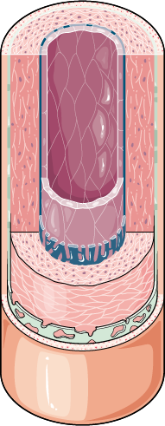
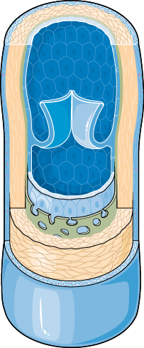
Arteries vs Veins
 | Arteries | Veins
Function | Away from the heart at high pressure | Return to heart at low pressure
Wall structure | Thick, more muscular and elastic tissue | Thin, less muscle and elastic tissue
Lumen | Narrow | Wide
Valves | No | Yes
Energy losses replenished by pumping action of the heart
High pressures in larger arteries
Low pressures in veins
Notes:
SO how are these pressure differences facilitated? By the different structure of the arteries and veins
The flow and pressure changes are facilitated by the different structures of the arteries and veins.
The pressure and energy losses in the system and constantly replenished by the pumping action of the heart. Blood pressure is the pressure that the blood exerts on the wall of the blood vessels and the structure of the larger arteries , ie thick and elastic, mean that they can withstand this pressure. The elastic arteries store energy during systole and maintain blood flow during diastole (during those different phases of the heart contraction)
As you move more to the arterioles, they have more smooth muscle than elastic which means they can dilate/constrict to regulate flow.
Venous system acts as a low resistance pathway for blood to return to the heart, therefore the veins are thin walled, compressible and larger in cross sectional area than the corresponding arteries.
Veins are
Thin walled
Compressible
Larger in cross sectional area than corresponding arteries

Slide 6
Distribution of Blood
Notes:
So this chart just gives you an indication of how much blood is stored in the different vessels of the body. In fact around 60% of the total blood volume is found in the veins. This is because of the low pressure and their distend able walls, acting as a reservoir.
It has an important role in cardiac output as essentially you need the blood volume to flow back to the right atrium to be pumped out again.
So the veins need to return blood to the heart from the periphery and to serve as a capacitance to maintain filling of the heart. SO they are important as serving as a reservoir that can easily and immediately change volume in it to maintain filling pressure in the right heart.

Slide 7
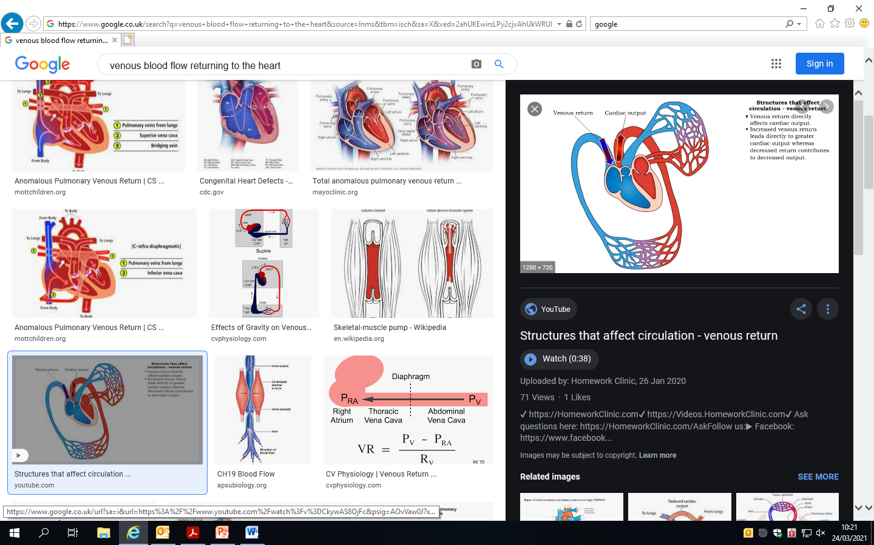
Venous Flow – Multifactorial
Respiration
Sympathetic vasoconstriction
Muscle activity
Changes in Posture
The cardiac cycle
Venous Valves
Notes:
To get a grasp of assessing venous flow and competency of flow, we have to have an understanding of Venous haemodynamics in the circulatory system.
In order for the blood to be returned to the heart, there must be some force pushing blood through the venous circulation
This force not a single entity but like the arteries depends on the interaction of a number of factors. The main ones being;
Respiration
Muscle activity
The cardiac cycle
Changes in posture
This force not a single entity but like the arteries depends on the interaction of a number of factors
The pressure difference between the arterial and venous systems results in a gradient of 12-20 mmHg to propel blood from the distal venules to the right heart.
The presence of valves prevent reverse flow during low pressure states
Pressure differences in the abdomen during respiration result in flow changes in the venous system
Venous pressure low compared to arterial pressure – end pressure in veins after traversing the arterioles and capillaries is approx 20mmhg
When supine, this 20mmHg pressure gradient is adequate to return blood to the right atrium (veins have relatively large diameter when compared to arteries and provide little resistance to flow).
The effect of the cardiac cycle in changes in venous pressure due to cardiac contractions are mainly evidence in the IVC and the central veins due to proximity to the heart.

Slide 8
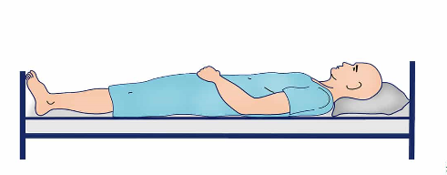
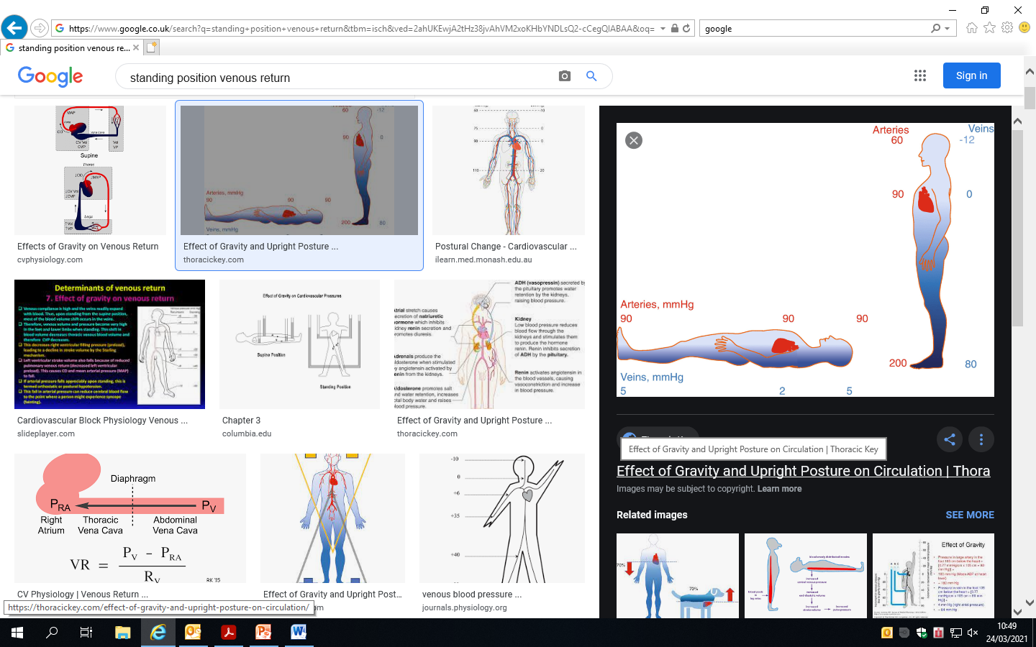
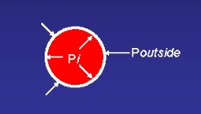
Changes in posture
Hydrostatic pressure
Evenly distributed flow
20mmHg pressure gradient
Gradient adequate for return blood to RA
+
How does the system counteract increasing hydrostatic pressures ?
Transmural pressure = pressure inside – pressure outside
Notes:
In the supine position, blood is evenly distributed in the veins and the 20mmHg pressure gradient that exists is adequate to return blood to the right atrium (veins have relatively large diameter when compared to arteries and provide little resistance to flow
So in the upright position, gravitiational forces pull venous blood to the lower limbs. Due to the high compliance of the vessels, you can get venous pooling, a longer transmit time of venous blood flowing through the system. This can lead to an immediate drop in stroke volume and a drop in cardiac output.
However, mean arterial blood pressure is normally preserved, as there are compensatory increases in vascular tone mediated by the autonomic nervous system. Nevertheless, even healthy humans sometimes experience light headedness due to a transient drop in arterial pressure that occurs in the initial few seconds of standing.
So this ‘column of blood’ or weight of blood exerts a hydrostatic pressure and is referenced to the right atrial pressure. The further away from the right atrium, the greater the column of blood and the pressure.
This hydrostatic pressure increases the transmural pressure and the distention of the vessels. Transmural pressure is the difference between blood pressure and extramural pressure (ie pressures outside the vessel wall)

Slide 9
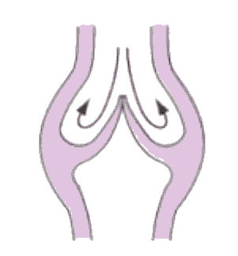
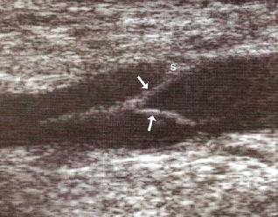
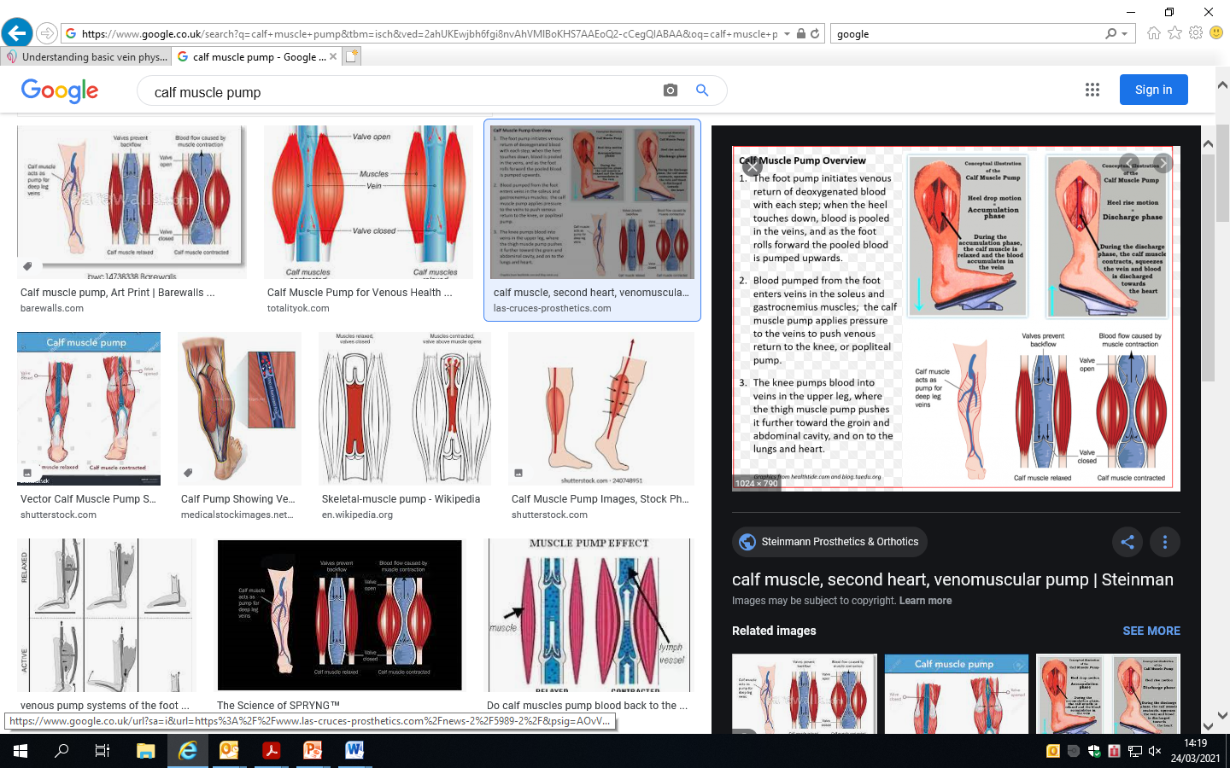
Muscle activity & Venous valves
“Heart of the legs”
Facilitate venous flow under more pressurised conditions
Notes:
So both muscle contraction, squeezing the veins and propelling the blood, alongside vein valves which prevent the reflux of blood facilitate venous flow to the heart under pressure conditions such as a standing.
This increases venous return and cardiac output and also interrupts the hydrostatic column of venous blood from the heart, decreasing pressure in the periphery .
So, the activity of skeletal muscles of the legs as well as competent valves (I will go into venous valves in a bit more detail later) results in the lowering of pressure in the veins of the extremity, leading to decreased venous pooling, capillary pressure, reduced filtration of fluid into the extracellular space and increased blood flow because of increased arteriovenous pressure difference
muscle squeezes the veins and propels the blood toward the heart. Muscular contraction not only increases venous return and cardiac output but also interrupts the hydrostatic column of venous blood from the heart and thus decreases pressure in the peripheral veins.
They work hand in hand
I’ve always thought that a nice analogy for this muscle pump in the heart of the legs

Slide 10
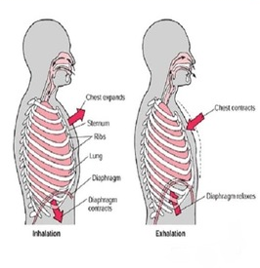
Respiratory Effects on venous flow
Thorax pressure
Abdominal pressure
Blood into IVC and RA
Flow from leg
Thorax Pressure
Abdominal pressure
Increased flow to abdomen from legs
Notes:
Respiration has a profound effect on venous pressure and flow.
During inspiration, the volume in the veins of the thorax increases and the pressure decreases in response to reduced intrathoracic pressure.
Thorax pressure reduces (ribcage expands, diaphragm descends) at the same time abdominal pressure increases (due to diaphragm descending) . This results in a pressure gradient along the IVC so you get increased flow from the abdominal IVC towards the heart.
During expiration the reverse is true – Thorax pressure increases, abdominal pressure decreases resulting in flow in the thorax decreasing and flow from periphery to abdomen increases
**The respiratory effects are usually associated with clear phasic changes in venous flow in the extremities and having a knowledge of what these normal respiratory changes look like in certain vessels in the normal presentation can help when it comes to assessing these veins. **
For example the valsalva manouevre which I will go into during the ultrasound assessment bit later (basically Valsalva increases intrathoracic pressure and abdominal pressures and decreases flow in the peripheral veins

Slide 11
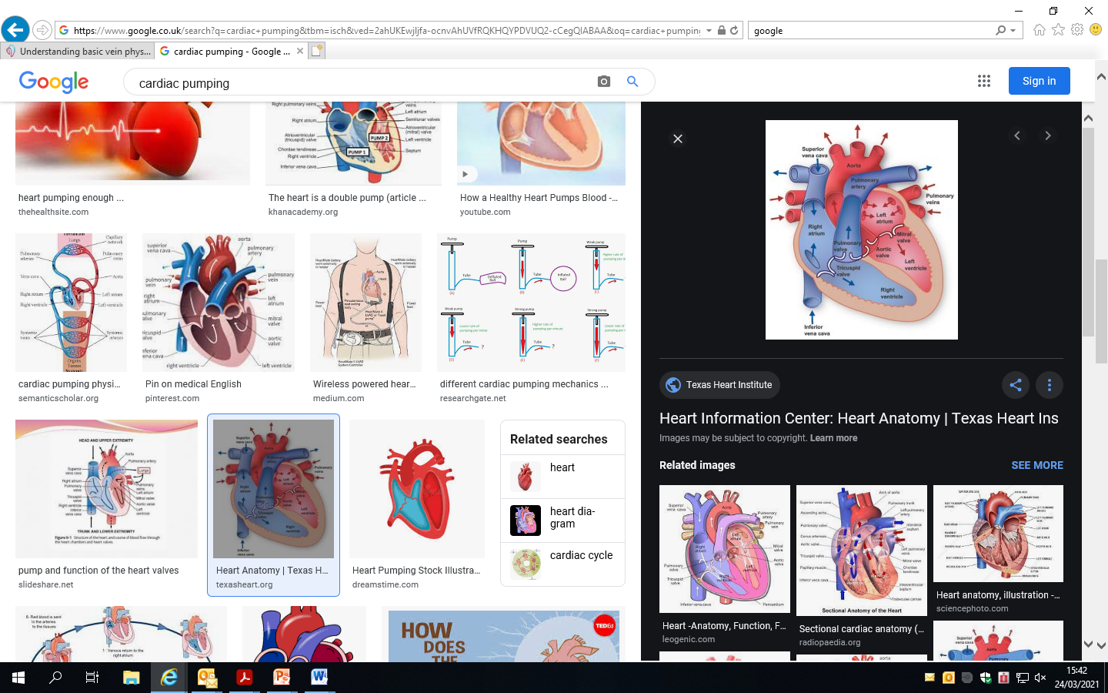
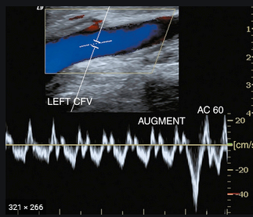
Cardiac Effects on venous flow
Notes:
I don’t want to go into this in too much detail but there are cardiac effects to venous flow.
The pressure changes and changes in flow in the large central veins that are associated with the events of the cardiac cycle are not usually evidence in the peripheral veins of the extremities. This is probably the result of damping related to high compliance of the veins., as well as compression of the veins by intra abdominal pressure. The venous pressure waves are associated with changes in flow. In the central veins, 3 positive pressure waves can be distinguished in in central venous pressure and reflect the corresponding changes in pressure in the atria.
There are two periods of increased venous flow during the cardiac cycle.
But they may highlight an abnormal condition - in congestive heart failure, venous pressure is increased. This elevation of venous pressure may lead to the transmission of the cardiac phasic changes in pressure and flow to the peripheral veins of the lower limbs.

Slide 12
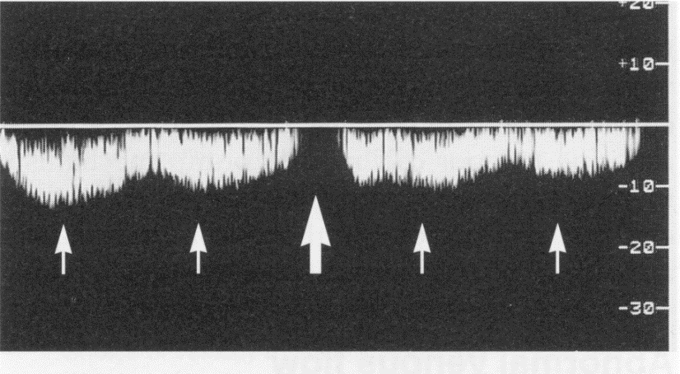
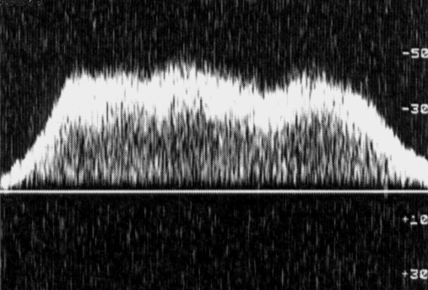
Normal Venous Flow
Spontaneous
Phasic – flow changes with respiration
Augmentation of flow possible
Ability to produce Valsalva - what does
Normal look like?
Flow patterns differ in relation to level
Notes:
With all these things, it’s important to get a sense of what normal looks like.
Generally in the larger deep veins, you are going to get spontaneous flow. You’re will see phasic flow, that is a change in flow with respiration. You will be able to augment flow in the veins – think about their structure and low pressure. With a manual augmentation (which I will speak about later) you are effectively reproducing the calf muscle pump in the resting patient.
That’s why it’s important to have a bit of an understanding of venous flow, the type of system it is and the factors that influence its flow.

Slide 13
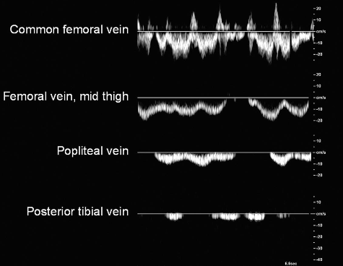
Normal Venous Flow Patterns
Deep veins
  Spontaneous, phasic flow, compressible, affected by respiration, subtle differences at vein level
Superficial veins
  Normally little or no flow in the GSV and SSV when the patient is sitting or standing – augmentation required
Notes:
Just going on from flow patterns differing in relation to level..
Effects of respiration diminishing as you move lower down the leg.

Slide 14
Anatomy and Physiology
•Transport deoxygenated blood
•Thin walled with 3 layers and bicuspid valves
Tunica Intima
Single layer endothelium
Secrete thrombolytic substances
Tunica Media
Muscle, collagen and elastic tissue
Tunica Adventitia
Fibrous tissue & smooth muscle tissue
Subtle structure differences
  IVC, large adventitia, collagen, some elastic fibres
  Superficial veins – more muscle fibres in media layer
Notes:
Medium and large veins have venous valves

Slide 15
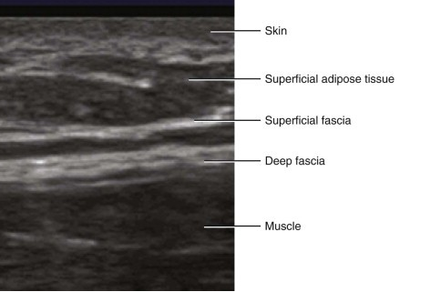
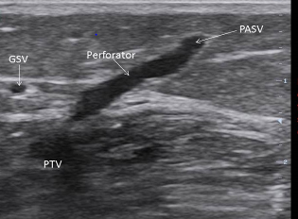
Lower Limb venous Anatomy
Deep
  Lie next to artery and are larger
Superficial veins
  Not accompanied by an artery
  Superficial
Perforators
  Connections between superficial to deep
Notes:
The superficial veins – ie the GSV lies within the subcutaneous tissues of the leg, in the saphenous compartment which is bounded posterior ally by the deep fascia and superficially by the saphenous fascia

Slide 16
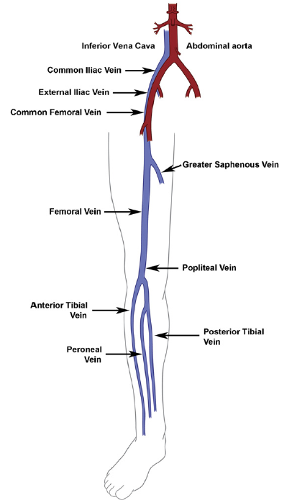
Deep venous Anatomy
Accompany artery of the same name
- Superficial femoral vein
Lie deep to the deep fascia
FV and Popliteal vein may be duplicated
Below knee veins are paired (sometimes can be triplicated)
Notes:
FV duplicated in 25% - bifid
Venous system much more variable than arterial, often bifid, and termination of superficial veins is varied. PTV can be triplicate.

Slide 17
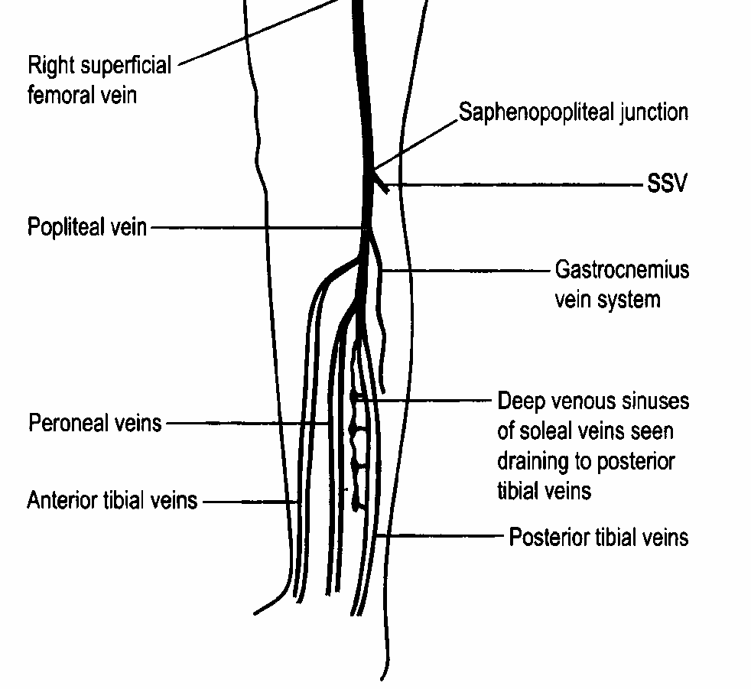
Deep Calf Veins
Deep veins
  Paired anterior tibial
  Paired posterior tibial
  Paired peroneal
Muscular Veins
  Soleal
    Drains into calf veins
  Gastrocnemius
    Drains into popliteal

Slide 18
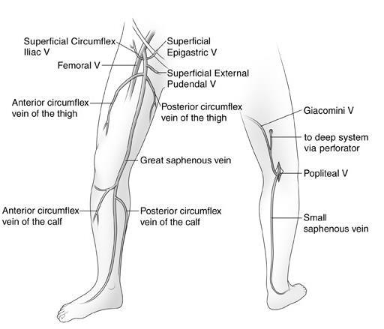
Superficial Veins
SFJ
Two main systems
Great Saphenous vein (GSV)
Short Saphenous vein (SSV)
Anterior Thigh Vein
Giacomini Vein
Junctions between the two
Saphenofemoral Junction (SFJ)
Saphenopopliteal Junction (SSV)
SPJ
Notes:
Greater Saphenous Vein
(Long Saphenous Vein)
Origin is located in front of the medial malleolus
Runs along the medial aspect of the calf and thigh
Drains into CFV approx 2.5cms below the inguinal ligament at the SFJ
Short Saphenous
Runs from the lateral malleolus to popliteal vein, between the heads of the gastrocnemius

Slide 19
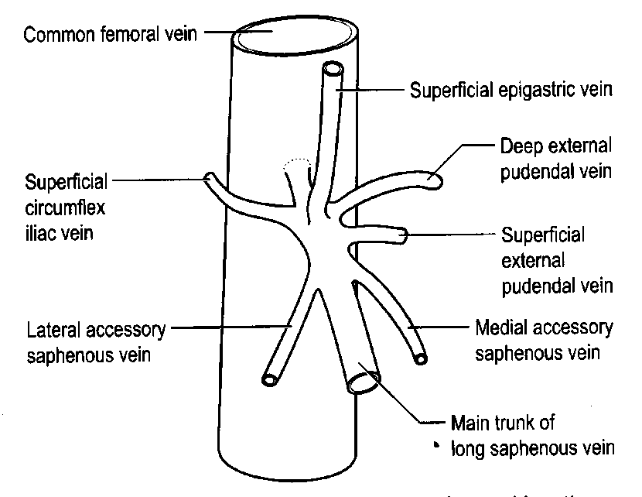
Anatomy of the SFJ
Notes:
6 major tributaries of the GSV at the groin
Important to have good understanding
Can be source of recurrent varicose veins
Anterior and medial tributaries can be a source of reflux when GSV is normal

Slide 20
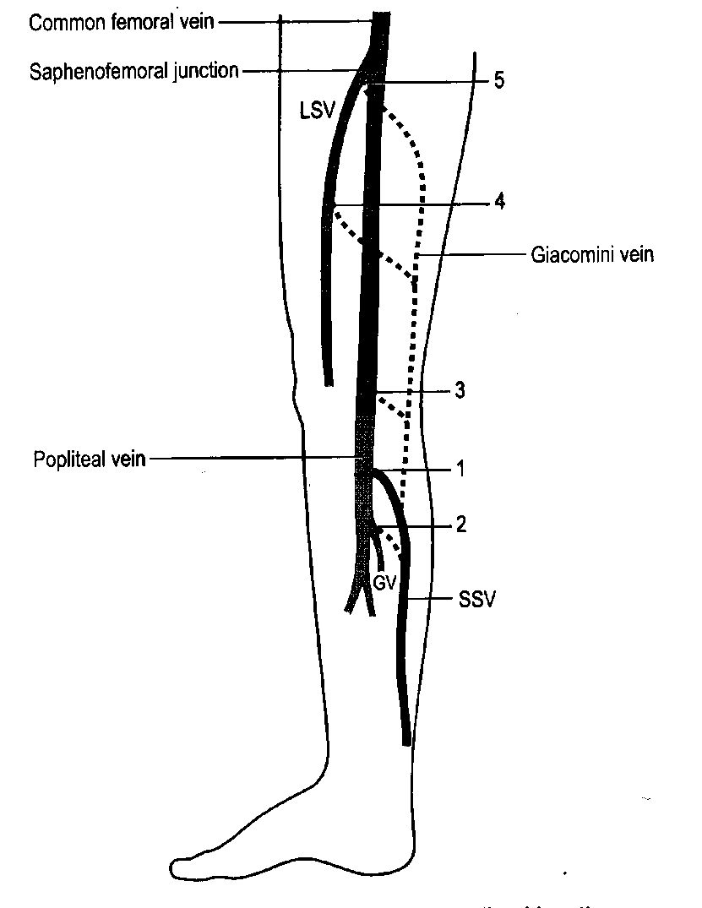

Anatomy of the SPJ
Position of the SPJ can be highly variable
- 60% join popliteal vein within 7cms of knee joint
- 20% join GSV at varying levels in thigh
Giacomini
Occasionally combine with junction of Gastroc /PopV
Remainder join
      SFV
      Profunda
      Tributaries of the internal iliac vein
Notes:
If it’s small and competent ,I don’t tend to worry too much about where it is joining – especially if it is heading high up into posterior thigh

Slide 21
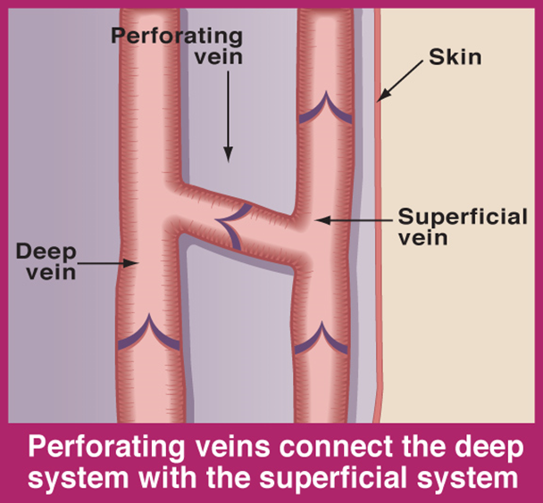
Perforating Veins
Transport blood from superficial to deep veins
Reversal of flow normally prevented by valves
Clinically significant in the lower leg
Large in size? Suspect abnormal flow

Slide 22
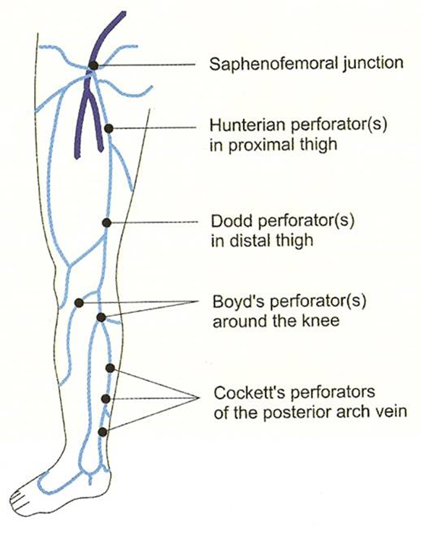
Perforating Veins
Often referred to by the proper names of the anatomists who first described them
  Cockett’s
    Connect GSV to distal PTV’s
    Usually three lying in a line
    7, 12, 18cms above the medial malleolus
  Boyds
    Lies 10cms below and medial to the knee joint
    joins GSV
  Dodd’s or Hunter’s
    Connects GSV to SFV
    Lies in the adductor or Hunters canal in the thigh

Slide 23
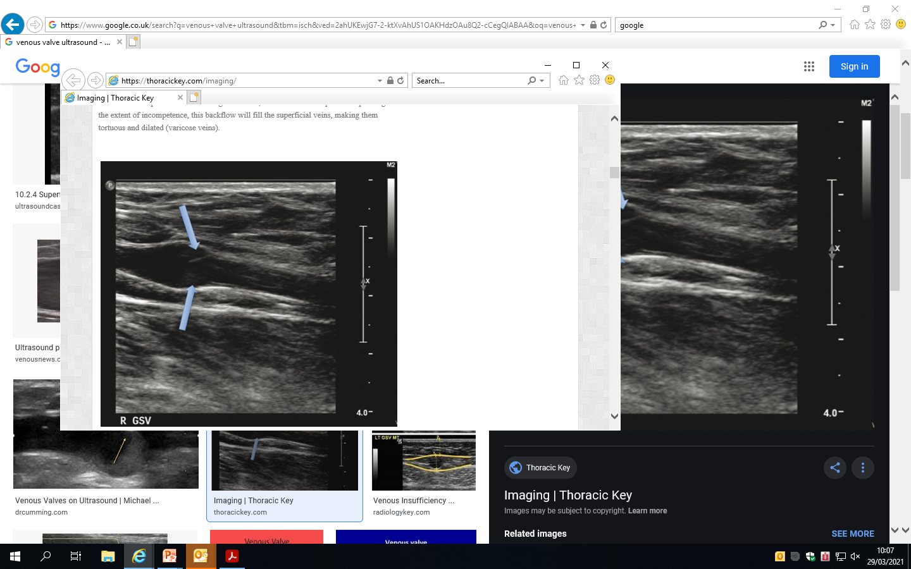
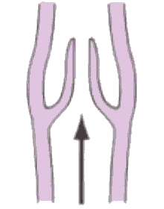
Back to Valves
Distribution of valves
IVC 0
CIV 0
EIV 1 (22%-23%)
CIV 1 (67-80%)
SFV 1-4 (100%)
Popliteal 1 (100%)
LSV approx 10
SSV approx 10
Notes:
We’ve talked about venous valves before but just wanted you to get a sense of their distribution. As I’ve already discussed, they prevent the reflux of blood and if working correctly, can withstand up to 200 – 300 mmHg of back pressure
Veins contain valves to prevent the reflux of blood to the extremities
Bicuspid
Characteristic dilatation of the veins at the vein site
Can withstand upt o 200-300mmHg of back pressure

Slide 24
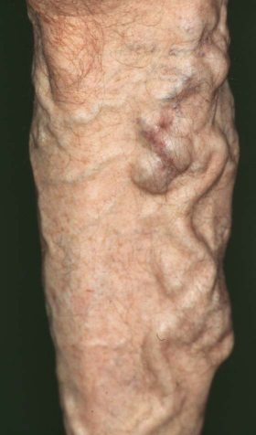
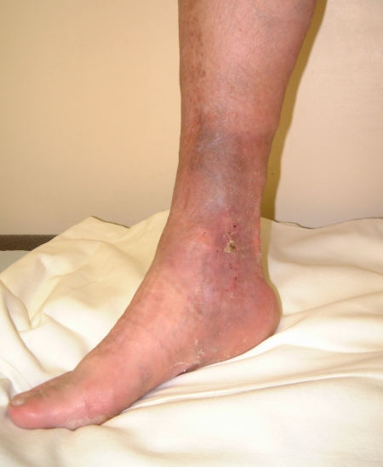
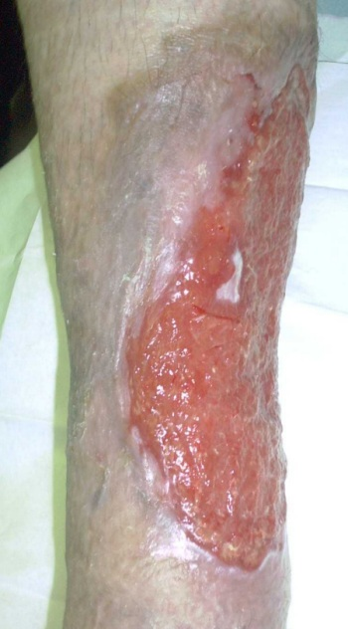
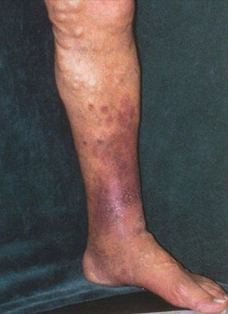
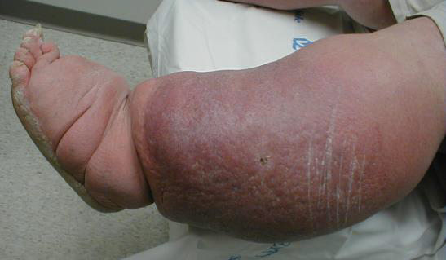
Chronic venous insufficiency
How does it present itself and what might you see in a vascular clinic?
SO what’s going on?
Systems that facilitate optimum venous flow failed/ failing
Notes:
So now I’m going to discuss Chronic venous insufficiency presentation – how does it present itself and what might you see in a vascular clinic?
Well basically some of the systems that I have talked about earlier facilitate optimum venous flow have failed to work efficiently. What can those systems be?

Slide 25
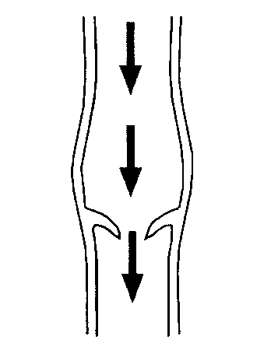
CVI Etiology – Incompetent valves
  Venous valves which allow backflow (reflux) are classified as incompetent
    Results in distal venous hypertension
    Primary etiology for CVI
Notes:
So one of the systems to potentially fail are the valves in the veins, which under normal conditions, inhibit the backflow of blood. The valves open in conjunction with the action of the muscles and in the lower limb particularly, in response to the calf muscle pump.
They can however not work properly and allow a significant column of blood to pool in the veins, increasing the pressure in the distal limb and resulting in distal venous hypertension. This is thought to be one of the primary aetiologies for CVI

Slide 26
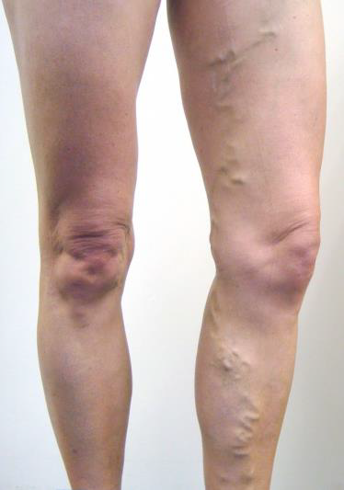
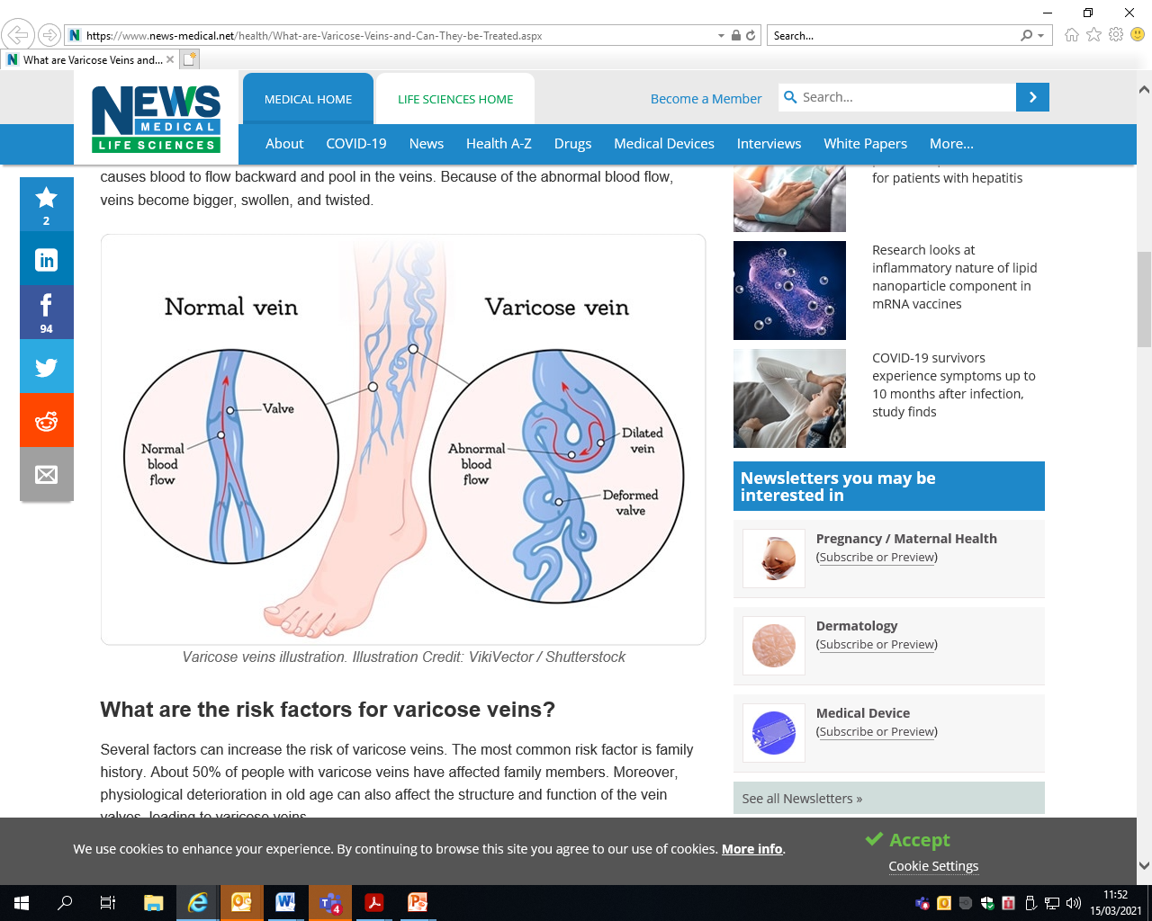
CVI Aetiology – Primary Varicose Veins
VV’ s common – 20-25% females, 10-15% males
Definition – pathologically enlarged subcutaneous channels
Common Causes? Familial….obesity….
Pregnancy….prolonged standing…..advancing age….
Notes:
So as a consequence to incompetent valves or even in conjunction with, varicose veins can also produce this venous flow insufficiency and venous hypertension in the distal limb
**These are primary varicose veins**

Slide 27
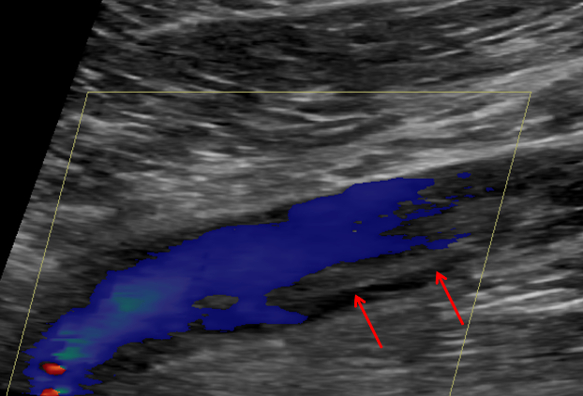
CVI Etiology – Secondary Varicose veins
Previous Deep vein thrombosis an important factor
- Chronic occlusive/ partial disease in the deep system
- Damaged veins/valves
Resulting in Deep vein/ perforator incompetence
- Pressure on the superficial system
Varicose veins
Other causes
- AV malformations
- Congenital - ie Klippel Trenaunay Syndrome
- Pelvic masses
……………Anything that raises intra-abdominal pressure!
Notes:
You can get secondary varicose veins where previous deep vein thrombosis an important factor
KTS – involves capillary haemangiomas, excessive limb growth, sometimes absence of venous valves causing venous varicosities
Basically anything that raises intra – abdominal pressure

Slide 28
Post thrombotic Limb
Venous Hypertension
Increase pressure in;
- Capillaries
- Reduced Reabsorption
- Damage to capillary walls
- Leakage of RBC into tissues
-Brown pigmentation
Big problem, chronic condition ~ 43% patients with DVT within 2 yrs
Residual/chronic deep vein damage/ narrowings – pressure on superficial system
Reflux in vein systems (flow the wrong way)
Pressure build in extremities
Notes:
Just wanted to touch on the post thrombotic limb. People with CVI might find themselves in this position
Anticoagulation protects against pulmonary embolism but post-thrombotic syndrome is common after DVT
Post-thrombotic syndrome is a chronic debilitating condition seen in about 43% of patients with DVT within two years
Patients present with a painful swollen heavy leg and may also have cramps, paraesthesia, and pruritus
The primary cause of PTS is when the valves and walls of the veins become damaged as a result of a DVT. Prompt diagnosis and treatment of a DVT is necessary to prevent this damage from occurring, as once the valves and walls of the vein are damaged, they cannot be repaired.
Vein valves are necessary to ensure that the blood flows in an upward direction toward the heart. They are incredibly fragile and can become damaged easily. When valves are damaged, blood can flow the wrong way. This is called reflux. It causes pressure to build up in the veins in the lower part of our legs, which leads to swelling and discomfort.
The walls of the vein can also become damaged and scarred after a DVT. When we do certain physical activities, like walking, the flow of blood through our veins increases. Scarred veins do not expand as normal veins do, so when the flow of blood increases and they cannot expand, it causes a throbbing pain and swelling in the lower part of our legs.
Eventually, this can cause damage to the skin on the leg. It becomes dry around the ankles, discoloured, and itchy. It later becomes brown in colour, hard, and leathery to touch. A minor abrasion can then become a larger sore that doesn’t heal. This is called a venous ulcer.
In incredibly severe cases, the vein can be so badly damaged that it becomes completely blocked off. No blood is able to flow through it at all. This is the most serious type of PTS
More than one third of people who have DVT then develop PTS, the symptoms of which include redness, swelling, ulcers, and chronic leg pain. PTS can affect your mobility and is expensive to treat, so it’s best to take preventative measures. It is most common for a DVT to occur in the legs.

Slide 29
Leg Ulceration
Affects 1-2% of the population
Due to chronic venous insufficiency /distal vein hypertension
Associated with post thrombotic syndrome
40% of venous ulcers are due to superficial venous disease
Rare causes include
    rheumatoid arthritis
    Malignancy (biopsy)
    syphilis
Want to avoid at all Costs!
50% re occur at 1 yr
Huge burden on services
Notes:
SO the end result from skin changes can be a breakdown of the skin and ulceration
Affects 1-2% of the population
Due to chronic venous insufficiency and distal vein hypertension
Due to primary valvular incompetence
Associated with post thrombotic syndrome
40% of venous ulcers are due to superficial venous disease
Rare causes include
rheumatoid arthritis
malignancy
syphilis

Slide 30
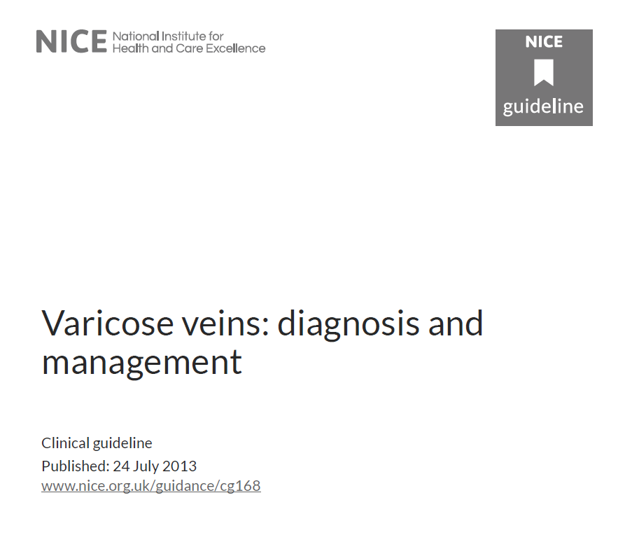
NICE Guidelines
Refer people to a vascular service if they have any of the following
  Symptomatic primary/symptomatic recurrent vv’s.
  Lower‑limb skin changes
  Superficial vein thrombosis and suspected venous incompetence.
  A venous leg ulcer (a break in the skin below the knee that has not healed within 2 weeks).
  A healed venous leg ulcer (recurrence prevention)
Notes:
Because of this, NICE have produced guidelines
Lower‑limb skin changes, such as pigmentation or eczema, thought to be caused by chronic venous insufficiency.
Superficial vein thrombosis (characterised by the appearance of hard, painful veins) and suspected venous incompetence.
A venous leg ulcer (a break in the skin below the knee that has not healed within 2 weeks).
A healed venous leg ulcer (recurrence prevention)

Slide 31
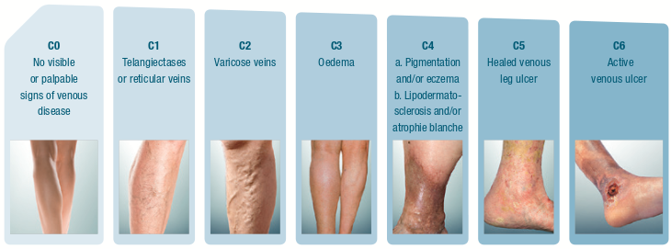
CEAP Classification
Notes:
I’m not going to go into the CEAP classification in too much detail, only to day that nowadays clinicians tend to focus on the C that is the clinical severity for classification
SO for clinician with a patient coming into the clinic with say C2 to C6, they should be keen to avoid C2 progressing to C4 or C6

Slide 32
What Treatment are available
So what treatments are available?
How do we fit in with this?
Conservative
  Leg elevation
  Compression stockings
  Diuretics
  Anticoagulation (DVT)
Physical treatment of
venous Pathology
Surgical Strip/ ligation
Foam Sclerotherapy
Radiofrequency (RF) Ablation
Endovenous Laser Ablation
Iliac vein thrombolysis/ stenting
Notes:
So broadly speaking, the treatment options can be separated into conservative options or the physical treatment of venous pathology
Conservative can depend on the setting – ie in the hospital, its toes to nose and they do not routinely put them in compression (3 layer) – staff training issues

Slide 33
Overview of Vascular Studies Role
How can we help?
Is there any Venous pathology present?
Vein reflux ………Level, extent, systems involved
Vein obstruction…….. Chronic/acute pathology, recannalisation
Is there an arterial element to the ulcerative disease?
ABPI, arterial duplex
Help Guide treatment options inc conservative
“….do you think it is suitable for….”
Pre/post & intra treatment support
- Marking ie SPJ, treatment guidance, effectiveness monitoring

Slide 34
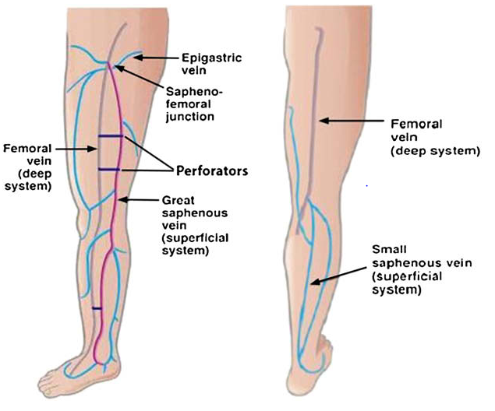
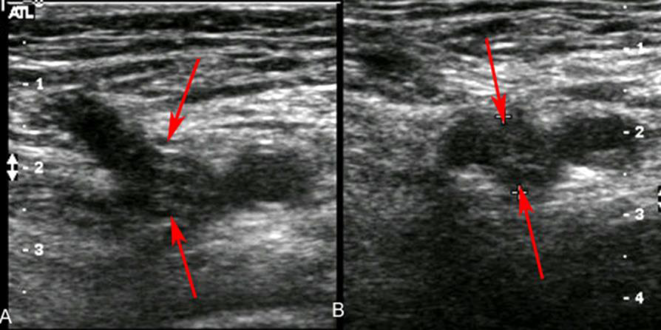
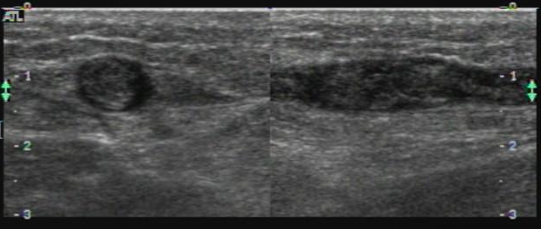
Venous Pathology – patency, reflux
Notes:
Looking for sites /extent of reflux
Patency – either acute occlusions ie thrombosis, chronic narrowings of the deep system ie recannalisations

Slide 35
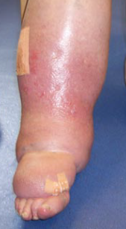

How do we assess for reflux?
Two common techniques employed for assessing venous valve competency
Calf compression (most common)
  To augment the flow in veins to the heart.
  Assess valve closures
  - Can be Challenging
Valsalva manoeuvre
  Examine the competency of the proximal veins
  - CFV/ SJF
Notes:
Calf compression – acting like the calf muscle pump with your hand

Slide 36




What does that look like in practice?

Slide 37

Grading of Superficial and Deep Venous reflux
Grade Reflux Duration
Normal valve function <0.5 sec
Moderate reflux 0.5-1 sec
Severe >1 sec
CAN BE CHALLENGING!
Trickle/ low volume reflux due to partially incompetent valves
Incipient deep vein reflux due to gross superficial vein reflux
Continuous flow due to limb infection
Vasoconstriction reducing venous flow
Pulsatile flow in peripheral veins – congestive heart failure
Notes:
Flow augmentation should be sufficiently strong to produce a transient peak flow velocity of >30 cm/s in the main superficial vein trunks so that valve clousre should be rapid on squeeze release.
Trickle or low volume flow can occur due to partially incompetent valves
Incipient deep vein reflux may occur due to gross superficial vein reflux causing overload of the deep venous system – impairing valve function
Patients with infection may have high continuous flow (hyperaemic flow) meaning they are dififcult to assess
Congestive heart failure causing pulsatile flow in the peripheral veins
When there is increased vasocontriction, ie conserve heat, venous flow is also markedly decreased and there may be no audible doppler signals over a perihery vein

Slide 38


Equipment
Suitable temperature controlled room
Start with machine default venous setting
B-Mode/Colour PW Doppler capabilities
  Colour sensitivity low
  Velocity scale 5-15cm/s
  Large Doppler sample volume size
Notes:
Colour Doppler:
Provides anatomical and blood flow information
Differentiates between normal and abnormal veins
patent, competent, reflux, DVT
Detects sites of possible reflux
Identifies other pathologies
PW:
Confirms Colour findings
Enables you to quantify the degree of reflux by measuring time

Slide 39



Before you Begin!
Visual examination with patient standing…. With lights on!
Notes:
Physical inspection can provide clues as to which sites are involved – veins dilate – you can see them easily!

Slide 40






Patient Positioning & Preparation
Notes:
Limited patient preparation.
I tend to like to have mine raised over the edge of a couch
Alternatively with patient lying in reverse Trendelenburg’s position
supine
leg externally rotated and knee slightly flexed
tilt couch to at least 30 degrees
<30 degrees significant detectable reflux may not be identified
lie patient on side with knee slightly flexed to assess popliteal vein

Slide 41







Deep Vein Assessment
Notes:
Look at deep veins whenever performing superficial venous assessment
surgery contraindicated if there deep venous occlusion
Venous disease can dramatically alter flow patterns seen in veins
Valve incompetence
Venous hypertension
Outflow obstruction (thrombosis)
Loss of spontaneous phasic flow
Change of direction

Slide 42



Superficial Vein Assessment
Superficial thrombophlebitis –
Comment on length/distance from
Deep systems

Slide 43




When Training – create a scan routine!

Slide 44
Report writing
Vary hugely across units
Terminology (Long/greater saphenous vein…..short/small/lesser saphenous vein
Level of detail – can be dictated by treatment option . i.e foam sclerotherapy
Functional map of the venous system with a “brief” report
  Arrows indicating flow directions …. Competent Incompetent
  Crosses/circles indicating incompetent perforator sites
  Sometimes easier to describe with a schematic. i.e recurrence
  Remember to answer the clinical questions

Slide 45

Recurrence scans can be very tricky!
Lots of different scenarios… Lots of tortuous veins which are difficult to follow…
Incomplete ligations
Incompetent tributaries – ie incompetent groin tribs
Neovascularisation
  - Diffuse formation of web like veins
Thigh of Calf Perforator
Secondary Varicose Veins
  - not directly associated with main systems
Notes:
They tend to come back with a vengence in really complicated patterns

Slide 46



Schematic examples

Slide 47



Proximal vs Distal when talking veins
Anatomical positions and directional terms
Artery description simple – flow is going in that direction from heart to periphery
In veins it is the reverse!
No universally accepted terminology
If using proximal/distal – describe in relation to a reference point ie “proximal thigh”
Notes:
This can cause a great deal of confusement
Easy with arteries and the flow is going in that direction from heart/torso level to the periphery
Obviously in veins – it is the other way around – flow is from the extremities back to the torso
No universally accepted terminology, inclusion of more explicit descriptors
Best to avoid distal/ proximal unless you’re explicitly describing a relationship to a references point

Slide 48

Pitfalls
Determining reflux can be tricky – for moderate reflux always back up colour Doppler findings with Spectral assessment
Remember to optimise colour/Doppler scale and wall filters
Might miss low grade reflux
Can’t demonstrate any source reflux with obvious VV’s seen?
Change patient positioning , ie sitting raised on a couch to standing
Did they come in compression bandaging/ hosiery?
Room temperature – too Cold?
Highlight limitations of scan

Slide 49

Incidental Findings

Slide 50

Vein treatments

Slide 51

Compression
Wounds Uk, Compression Made Easy, Vol 10 Issue 3, Sept 2014
Notes:
Even after other treatment s - compression should be a belt and braces long term option for CVI

Slide 52

So going back to treatments…
Vein ligation/ Strip
Level, extent of reflux, systems involved
How large are the veins? Strip may be the best option
?Deep reflux – may leave alone
Marking prior to surgery – ie level of SPJ
Notes:
The connections between the superficial varicose veins and the deep veins must be tied off, SFJ or SPJ and occasionally a perforating vein
The recurrence rate from varicose vein surgery is reduced if the GSV is stripped.
Varicose tributaries are teased out with small hooks through tiny stab incisions.
Abulutions

Slide 53


Injection Sclerotherapy (more recently foam)
Pre Tx
Systems involved, Check of Deep system
Size of vein, depth,
During Tx
Visualisation of target vein
Treatment guiding
Compression of deep vein in groin
Post Tx
Scan if complications – ie superficial
Thrombophlebitis, suspect DVT
Determine success
Notes:
Ultrasound guided treatment of GSV and SSV
Superficial varices which are not associated with long or short saphenous vein reflux, may be injected.
The sclerant is just an irritating solution which is foamed up by passing it into two syringes with air – it is thought to create better adherence
The foam begins to react immediately with the vein wall. It causes inflammation within the vein and pushes out any blood in the area. The walls of the vein become sticky and eventually close off the vein. Over several weeks or months, your varicose vein will shrink and disappear.
The long term results can be disappointing.
Can cause pain or even ulceration
Staining of the skin over the injected vein can occur
Can be repeated

Slide 54


Radiofrequency/ Laser Ablation
Pre Tx
Systems involved,
Check of Deep system
Size of vein, depth, tortuosity
During Tx
Visualisation and catheter guiding
Post Tx
Scan if complications – ie superficial
Thrombophlebitis, suspect DVT
Determine success
Notes:
The VNUS Closure procedure uses radiofrequency energy to occlude, or close, the saphenous vein
Minimally invasive treatment alternative to traditional vein stripping surgery.
A thin catheter is inserted into the vein through a small opening, using a single needle stick. With the aid of ultrasound, the catheter is appropriately placed and delivers radiofrequency (RF) energy to the vein wall, causing it to heat, collapse, and seal shut.
Performed as an outpatient hospital procedure under local anaesthesia.
The principle is similar to VNUS ablation. A laser catheter is passed up the long saphenous vein (GSV) under ultrasound guidance to the sapheno femoral junction.
The laser is activated and withdrawn down the GSV obliterating it by thermal ablation

Slide 55


Non – Surgical Techniques
The potential advantages of these technique are:
+ No groin incision
+ Faster recovery - back at work 24hrs
+ No GA
+ Options for patients with tortuous veins/recurrence
(i.e Injections)
BUT Complications can arise….
Thrombophlebitis/Deep vein Thrombosis
Skin staining
Recurrence/patency of VV’s
V small risk of serious complication (stroke due to air embolism)
Important to manage patient expectations – discomfort, long term successes
Type of treatment offered very patient dependent

Slide 56

Centre Success Story
Notes:
So the Gloucestershire Leg ulcer service was created in 1995, initially as a two year funded research study to evaluate the impact of a one stop service in the east of the county using the West of the county as a control. It was set up and run by specialist leg ulcer nurses and had an easy open access referral system whereby referrals were accepted from any department and even the patient themselves. The clinic worked along side the vascular laboratory and patients would all receive a clinical assessment, an ABPI and Venous Duplex scan. They looked at this data in 1998 and found that following the introduction of the leg ulcer service, ulcer healing rates at 24 weeks had increased from 29% to 68% when you compared the two sides of the counties.
They are dedicated to evidence based treatment and they have been going from strength to strength ever since.

Slide 57

How did they manage it?
Notes:
So Colin Davis is the lead manager for the leg ulcer service and gave us an interesting talk about the service. What really struck me was the success that they have had with ulcer healing and recurrence rates. State results. So they put this down to Proactive Management and evidence based treatment in their one stop assessment Clinic.
80% of ulcers are venous in nature and due to chronic venous hypertension resulting in venous stasis and oedema – this is often due to incompetent/damaged valves or calf pump failure. The one stop clinic would highlight a venous or arterial component or if fact both. If appropriate, patients would be put in compression, either 4 layer or modified compression to reduce pressure and venous hypertension. They would also suggest elevation and exercise.
1-2% of ulcers are due to an underlying malignancy so they might do a biopsy if there is a history of skin cancer or the ulcer has a sinister presentation.
They might offer pinch skin grafting where they use forceps to pinch and cut out small areas of the epidermis from another part of the body and transfer to ulcer site – to aid ulcer healing.
In many cases they treat the varicose veins – so treating the underlying cause of the ulcers.
They might use larvae therapy where sterlie maggots are put on the ulcer which remove devitalised tissue – effectivley cleaning the ulcer.
Once healed and wearing support hosiery, patients are offered routine surveillance follow-up after 3, 6 and 12 months and then annually thereafter in a well leg clinic.

Slide 58


North Bristol Trust iliac Vein thrombolysis & Stenting
Ilio-femoral DVT major risk factor for PTS – conservative treatments in these patients have limited impact on PTS – 95% treated with anticoagulation alone report venous hypertension at 5 yrs
Acute and chronic occlusive disease present different management strategies
Clear NICE guidelines for acute presentation
- Consider catheter-directed thrombolytic therapy for people with symptomatic iliofemoral DVT who have:
  symptoms lasting less than 14 days and
  good functional status and
  a life expectancy of 1 year or more and
  Low bleed risk
Catheter Directed Thrombolysis, pharmaco – mechanical thrombectomy, mechanical thrombectomy
- Early removal of thrombus methods
Notes:
I’ve been talking about the devastating effect of Post thrombotic syndrome and I just wanted to talk about a service here at North Bristol trust
Spectrum of presentation
Phlegmasia alba and cerula dolens
Gross persistent leg swelling
Gross leg swelling responding to conservative treatment
Moderate/mild symptoms
No symptoms
The permissive lesion
•May-Thurner/CockettSyndrome
•Other compressive syndromes
•Diagnosed by intravascular ultrasound
•Require venoplastyand stenting
Why do iliac vein stents work? Iliac veins are major outflow tracts

Slide 59




Acute Thrombus recovery
Notes:
Early removal of thrombus could involved surgical thrombectomy or more systemic thrombolysis however
Catheter directed thrombolysis allows a clot dissolving drug to be placed directly into the clot though a catheter – accelerates thrombolysis – lessens overall dose and duration of influsion
Pharmaco mechanical thrombectomy – refers to catheter directed drug but also uses a device to macerate the thrombus to speed up removal (newer therapy)
Mechanical thrombectomy – clot physically removed – broken up and sucked out
I guess which method is patient dependent and needs shared decision making
? CDT rather than pharmacomechanical in patients with extension of thrombus into IVC
No need for routine IVC filter even in cases with IVC thrombus
Angiojet can be used for completion if CDT unsatisfactory – ie two different methods could be used to aid success

Slide 60

Complex Mechanisms
Risk factors: post surgery, immobility, malignancy, pregnancy, inherited hypercoagulable conditions …..ie Virchow’s triad
HOWEVER
Typically affects those with anatomic predisposition to venous stasis – ie iliac vein compression ~80%
May Thurner type vein lesions (non thrombotic) common in normal population
“Permissive pathology” – they remain silent until additional secondary insult
Post thrombotic lesions are also permissive
Notes:
Ie satisfying Virchow's triad for Thrombosis generation
May turner syndromes – may see chronic lesions as well as acute thrombus

Slide 61




An underlying chronic problem ?
An acute clot is removed and a chronic lesion is detected – what next?
- These patients high risk for recurrence and more established PTS
New dedicated venous stents – for advanced/established PTS
Balloon Angioplasty & stenting
Notes:
Chronic lesion may be due to compression type syndromes or a previous DVT which has left a damaged vein?
At North Bristol Trust they have a large waiting list of people who are in this position – living with chronic disease and terrible symptoms of PTS – the pandemic has stopped the service but Baris one of our consultants is keen to start treating this subset of patients

Slide 62




Imaging
US initial go to imaging
Notes:
Ultrasound Imaging of the pelvic veins can be difficult, especially the IVC – due to bowel gas, large body habitus
CT venography and or MR venography of the pelvis may be required to evaluate the pelvic veins for DVT
CTV not very good at diagnosing compression!
IVUS intravascular ultrasound can measure area unlike venography. Intravascular ultrasound
80% of patient with iliofemoral DVT have underlying venous stenosis proximally such as May- Thurner syndrome

Slide 63


Our Role!
Initial imaging modality
Full report highlighting iliofemoral extent with suggested referral to vascular team
Important to comment on Inflow patency ie Profunda vein
WHY? There need to be enough flow from below to keep the stent open
Surveillance of stent post procedure for 12 months
Notes:
Can be challenging to scan iliac stents – ie lower flow – areas where you can’t get good colour filling may be due to thrombus build up but also may be due to poor colour representation with abdominal probe – good heel toe technique and optimisation of the image

Slide 64
Conclusions
Important role in the diagnosis, treatment and management and chronic venous insufficiency
Practice can vary widely between units – important to read the relevant protocols!
Ultrasound assessment requires some time and patience
  Good knowledge of venous anatomy and waveforms
  Appreciation of what needs to be assessed/ measured
  Good methodological approach
  Appreciate their complexity but don’t get too bogged down on insignificant detail
  Numbers game for confidence!
  Important to give the finer detail to guide treatment options

