Slide 1
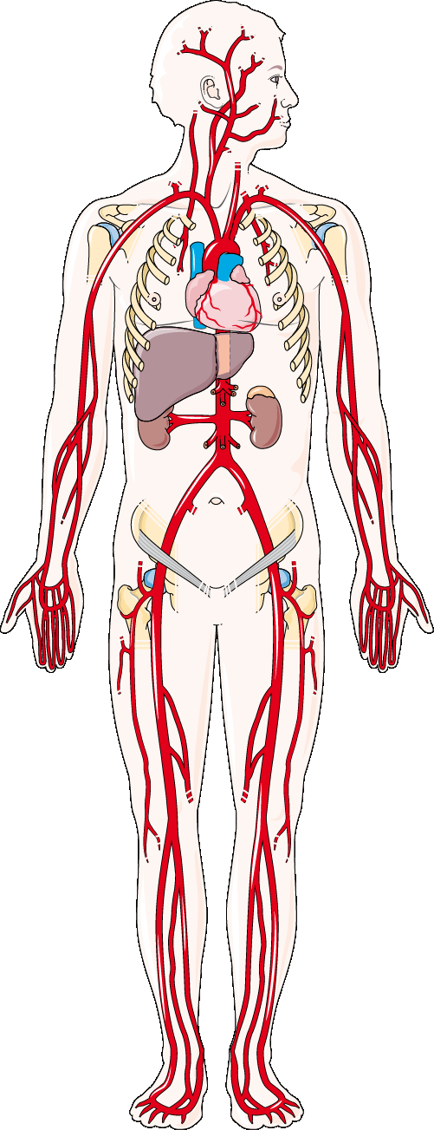
Vascular Ultrasound
Isabel Softley
and
Joseph Law

Slide 2
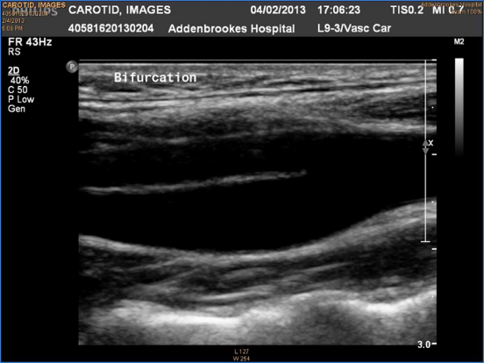
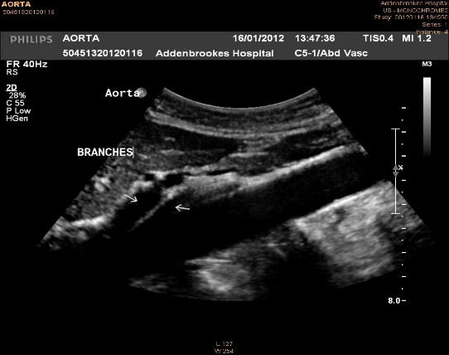
What is ultrasound?
Developed from SONAR used to detect submarines
Transmission of high frequency acoustic energy (2-18MHz)
  audible for humans is 20KHz
Sound waves reflect between boundaries of differing densities (ie. Organs, fluid, bone, gas) and returns to the transducer
  Blood vessels = black, echo in vessel = thrombus
The strength of returning signal is plotted with varying brightness; time taken to return is plotted as depth
  produces a grey scale or Brightness mode (B-mode) image.

Slide 3
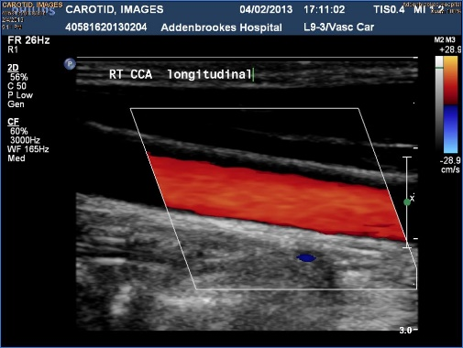
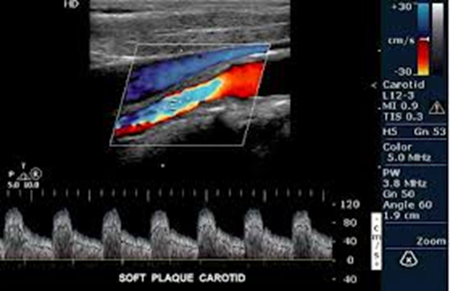
Colour Doppler Ultrasound
Doppler effect used to superimpose a colour map indicating blood flow on top of the anatomical B-mode map
Doppler shift frequencies determine direction/colour
  positive shift = flow toward the transducer = often displayed as red
  negative shift = flow away = often blue
If a mix of colours with a mosaic type appearance it may indicate turbulent flow or a region of high speed flow and therefore an area to interrogate.

Slide 4
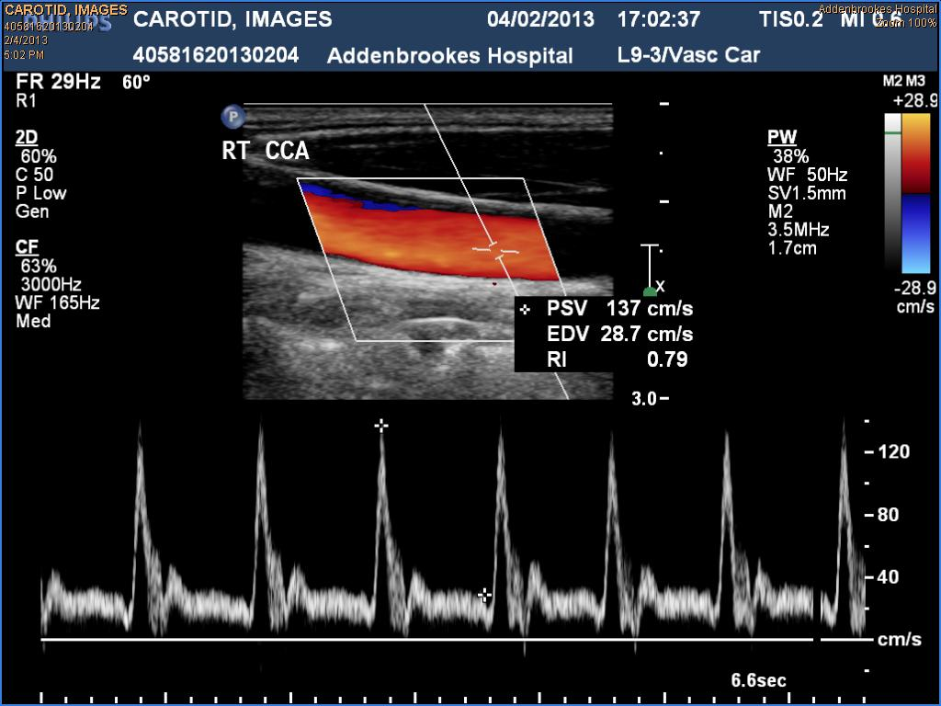
Spectral Doppler
Velocity of RBC plotted against time to provide ‘live’ graph / trace
  Velocity/speed of blood flow can be measured
  uniformity of waveforms (AF)
  shape of waveforms
Velocity is measured by the change in the frequency of the sound wave being sent out and then received back – information is inputted into the Doppler equation
Doppler equation calculates velocity of blood

Slide 5
Vascular Studies Unit
ARTERIAL
  Lower limb arterial
  Upper limb arterial
  Carotid arteries
  Aorto-iliac
  EVAR
  Thoracic outlet
VENOUS
  Venous insufficiency
  Upper limb veins
  Chronic DVT baseline
  Iliac veins
OTHER
  Toe pressures
  ABPI
  Pseudo-aneurysms
  AVF
  AVM

Slide 6
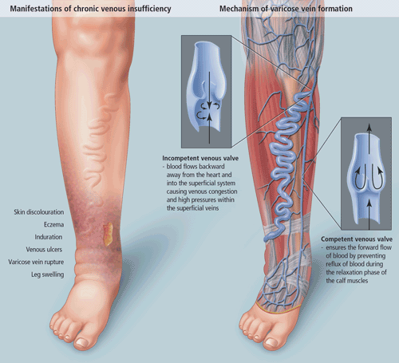
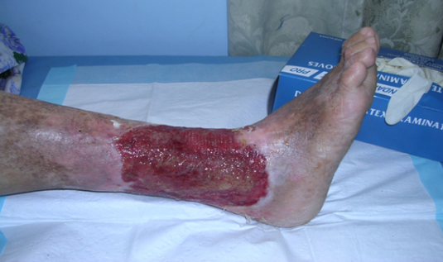
Venous incompetence
Faulty one-way valves = venous incompetence
Gravity pulls blood down
  damages next valve
  creates column of pressure
  Varicose veins can result as pressure on valve stretches weak venous walls
  leads to distended and enlarged veins
Fluid retention → swelling
Components of blood seep into tissue = skin discolouration
Overloaded fluid leads to inability to heal
  →Venous ulceration
  → Infection risk

Slide 7
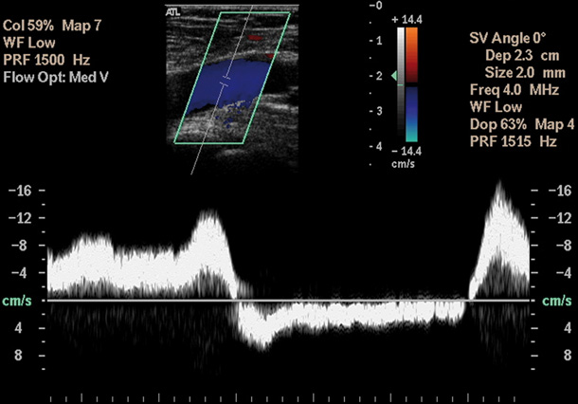
Ultrasound diagnosis of incompetence
B-mode to confirm anatomy
  compression of veins to assess for clot
Colour has important role
  colour indicates flow direction
  squeezing distally moves blood
    should be one direction/colour
    if two colours, duration of second determines reflux
Spectral used to quantify length of duration
  <1s = normal ; 1-2s = significant ; >2s = gross

Slide 8
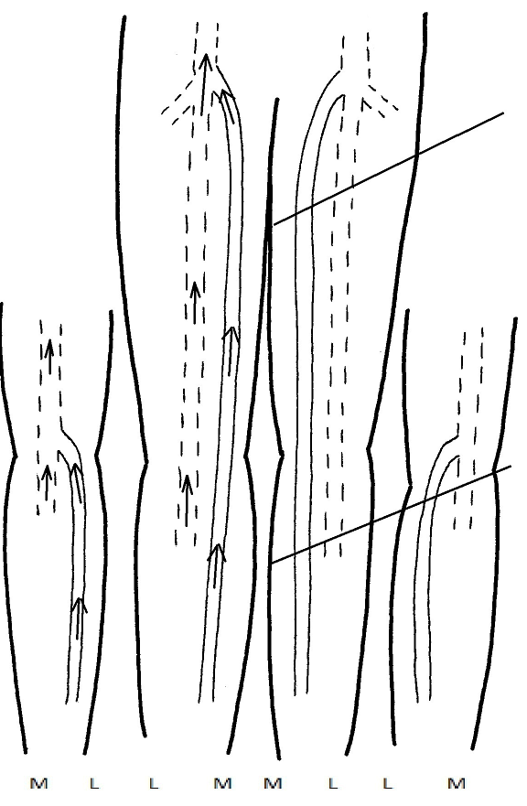
Reporting example: No DVI
RIGHT:
Phasic flow in the CFV.
Competent Deep system
Competent SFJ and LSV
Competent SPJ and SSV

Slide 9
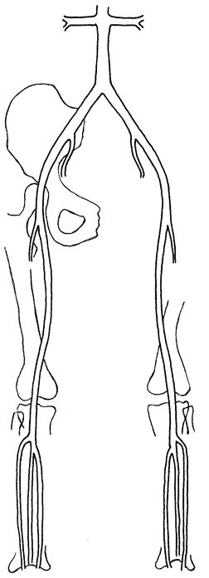
Peripheral Vascular Disease
Symptoms :
Claudication
Rest pain
Tissue loss
            Renal arteries
            Abdominal Aorta
            Common Iliac Artery (CIA)
            External Iliac Artery (EIA)
            Internal Iliac Artery (IIA)
            Common Femoral Artery (CFA)
            Profunda Femoral Artery (PFA)
            Superficial Femoral Artery (SFA)
            Popliteal Artery (POPA)
            TibioPeroneal Trunk (TP Trunk)
            Anterior Tibial Artery (ATA)
            Peroneal Artery
            Posterior Tibial Artery (PTA)
            Dorsalis Pedis Artery (DPA)

Slide 10
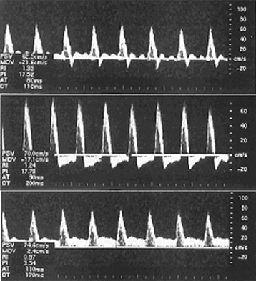
Ultrasound assessment of PAD
Spectral Doppler
  Direction of blood flow
  Blood velocity
  Haemodynamics/waveforms
    Triphasic, biphasic, monophasic
  Quantify narrowing by velocity ratio
    Doubling = >50% stenosis
    Quadrupling = >75% stenosis
  Confirming occlusive disease
  Unusual pathology

Slide 11
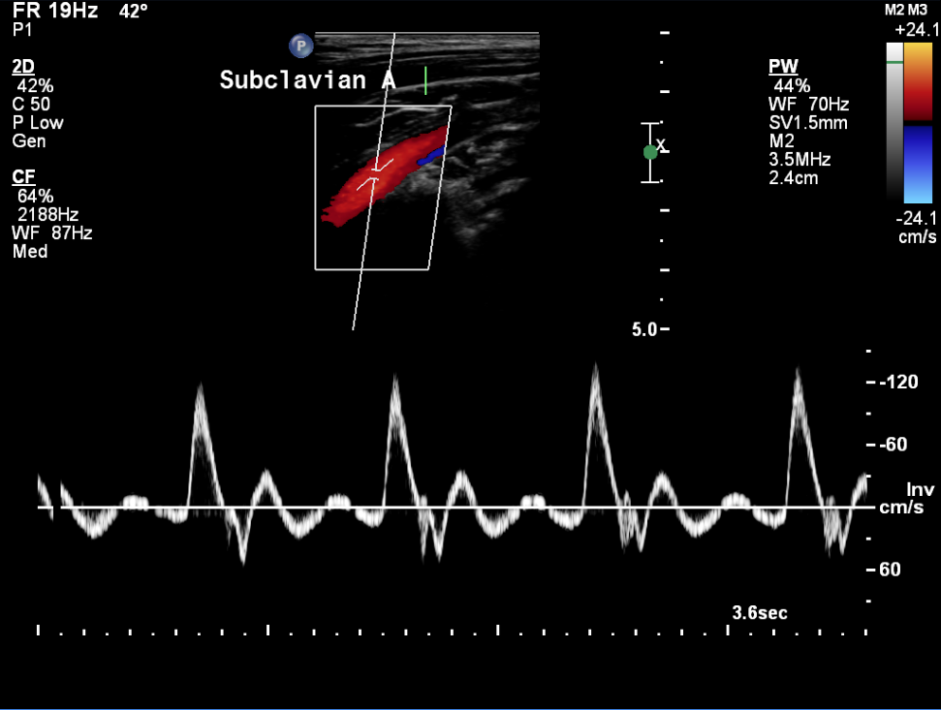
The Triphasic (multiphasic) waveform
Normal waveform in arteries in the Upper and lower limb.
Indicative of vascular bed being supplied and the status of the vessel (disease, compliance etc.)
The upstroke/systolic rise time can indicate proximal disease
The downstroke can indicate distal disease

Slide 12
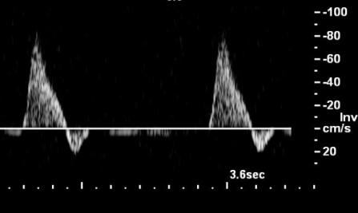
Biphasic Flow
Usually a variant of a normal waveform
Loss of third phase usually due to reduced compliance of vessels
Calcified arteries, but no significant stenotic disease

Slide 13
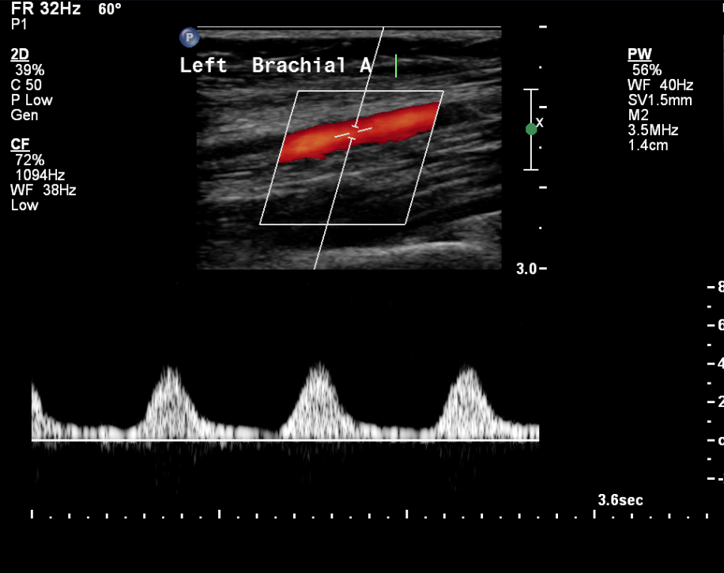
Monophasic flow
Indicative of disease
Delayed systolic rise time
Loss of energy through stenosis/collaterals
Vasodilatation of arterioles due to restricted blood supply
N.B. Can be a normal waveform e.g. AVF

Slide 14
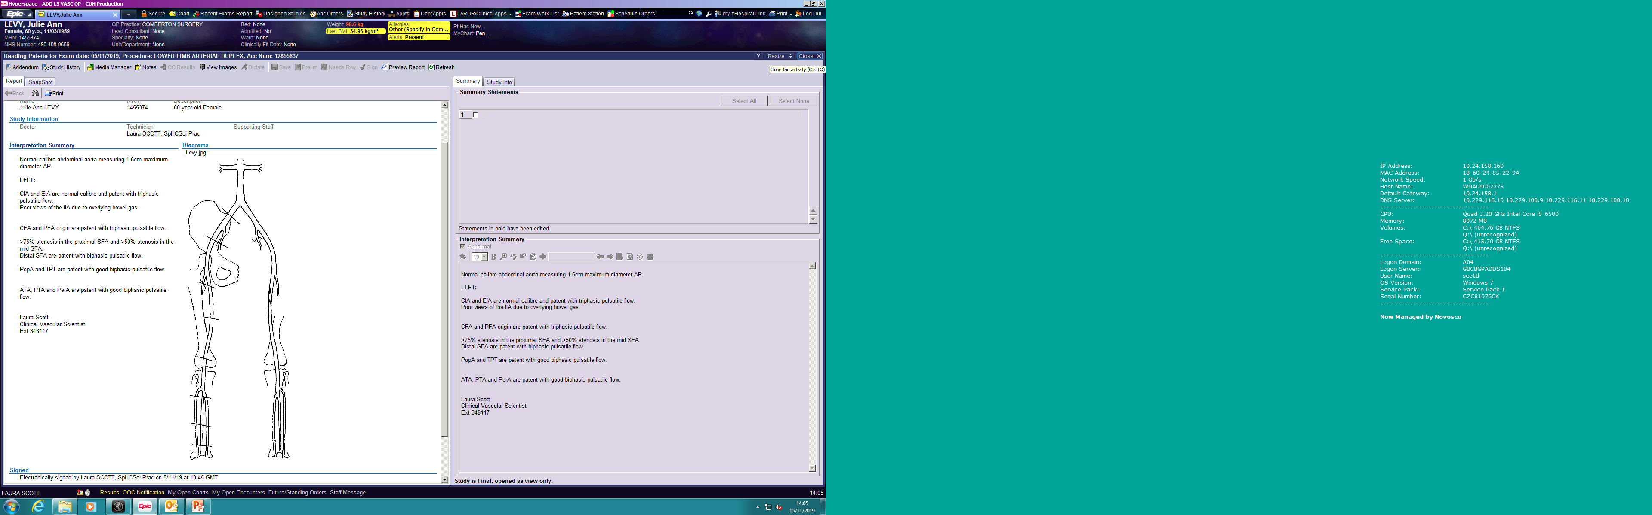
Reporting examples: SFA stenosis

Slide 15
ABPIs
How to and interpretation of the results

Slide 16
What are ABPIs and why are they important?
  Non-invasive
  Excellent PAD screening test
  Provides physiological information
  Can help exclude PAD, or direct the patient to more extensive assessments

Slide 17
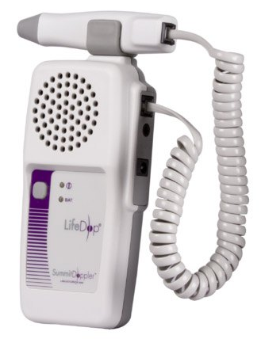
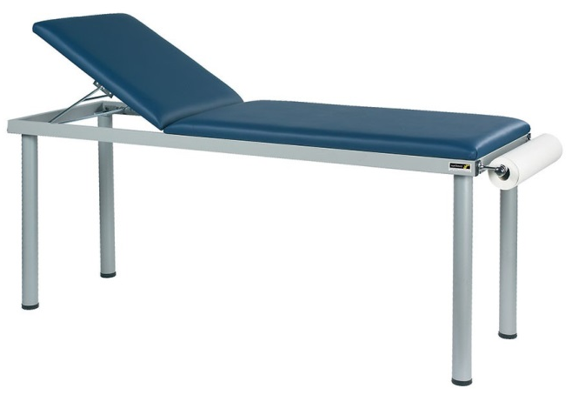
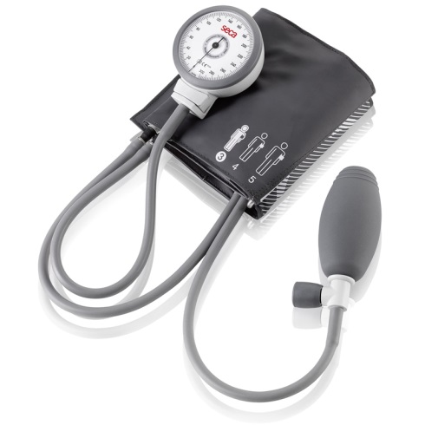
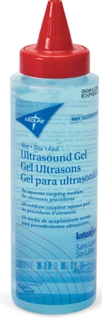
Set up
Hand Held Doppler
Couch
Sphygmomanometer
Gel

Slide 18
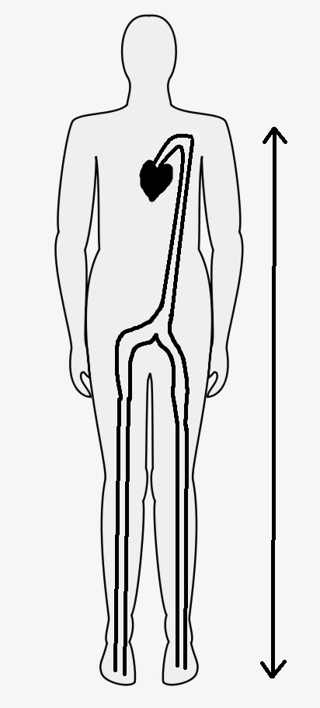


Importance of supine patient positioning
++

Slide 19
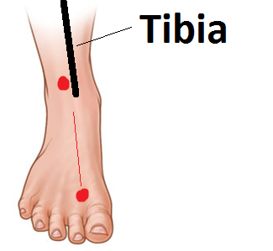
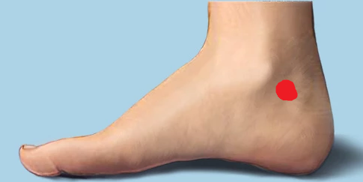
Tips - finding the pulse

Slide 20
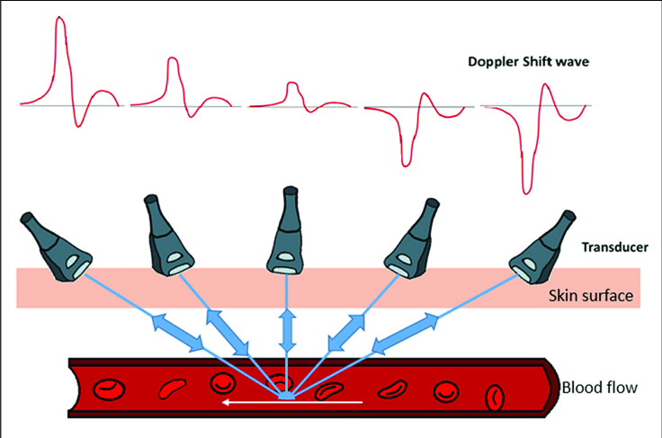
Tips – Doppler angle

Slide 21
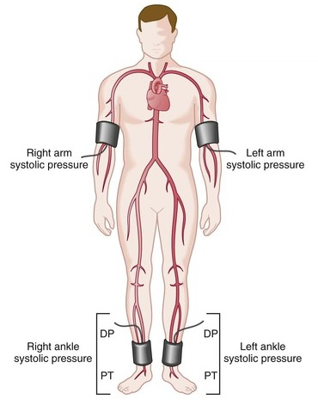
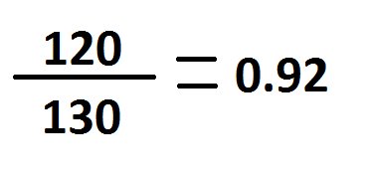
Calculation
Ankle
Brachial
ABPI

Slide 22
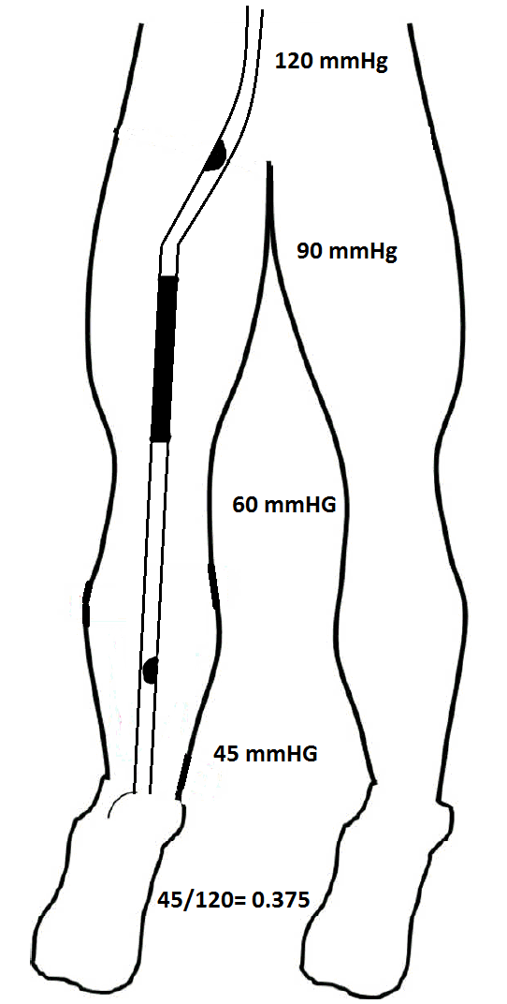
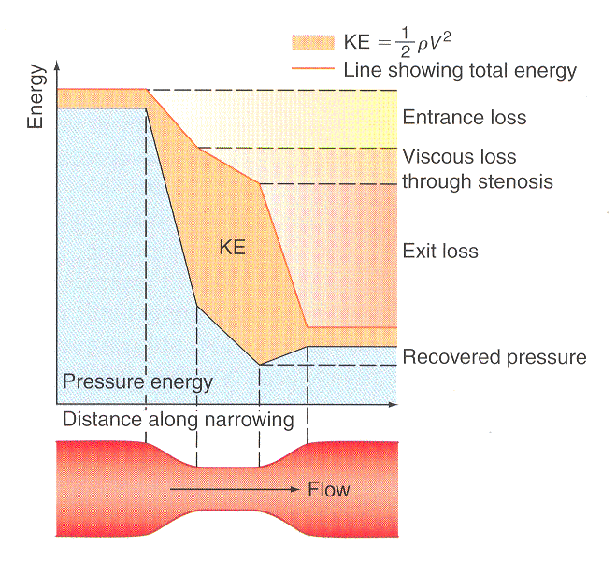
Why compare the brachial pressure with the ankle pressure
As blood squeezes through a narrowing, or around an occlusion the blood travels faster through the smaller section
Bloods pressure energy is converted to kinetic energy so the overall pressure energy reduces through a stenosis
Distal to the stenosis, the pressure will be lower

Slide 23
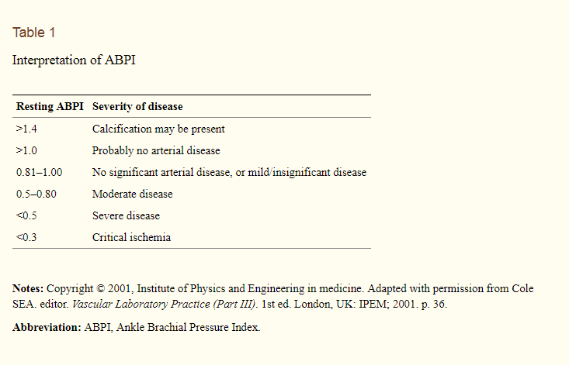
Basic conclusions (index)

Slide 24
Challenging situations
Incompressible arteries
Patient can’t tolerate cuff compression
Can detect a signal in one pedal pulse but not the second
Large swollen leg (venous insufficiency/lymphedema/heart failure etc).
Patient unable to lay supine
Irregular heart rate
Ulcers present in gaiter area

Slide 25
Example 1
Ulcer on right great toe
Right brachial pressure: 100 mmHg
Right PTA pressure: 50 mmHg
Index: 0.5
Monophasic waveforms
Conclusions?

Slide 26
Example 2
Diabetic with right foot ulcer
Left brachial pressure: 120 mmHg
Right arteries incompressible: >240 mmHg
Monophasic waveforms
Conclusions?

Slide 27
Example 3
Patient with CKD stage 4
Been on dialysis for 4 years
Complaining of pain in their calf when they walk, goes away when they rest
Index 0.9
Monophasic waveforms

Slide 28
Toe pressures
  Alternative test for people with arterial calcification (diabetics and CKD)
  Less well evidenced compared to ABPIs
  Likely normal >100mmHg
  Significant disease <60mmHg
  Critical limb ischaemia/non-healing tissue <30mmHg
  Taken from the first or second toe only

Slide 29
Lets practice!

