Slide 1
The importance of quality assurance in clinical thermography: A case study
Georgina Parsons, Kevin Howell, Roy Smith†, Ved Ramnani
Dept. of Vascular Studies and †Dept. of Medical Electronics, Royal Free London NHS Foundation Trust, London, UK
Notes:
Hello and welcome.
My name is Georgina Parsons and today I will be presenting a presentation on the importance of quality assurance in clinical thermography: a case study
Thank you to Dr Kevin Howell, Ved Ramnani and Roy Smith for their help in this study.

Slide 2
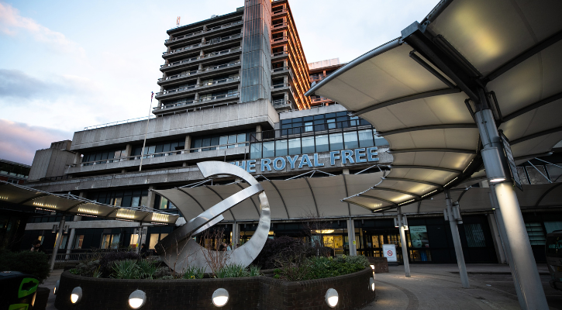
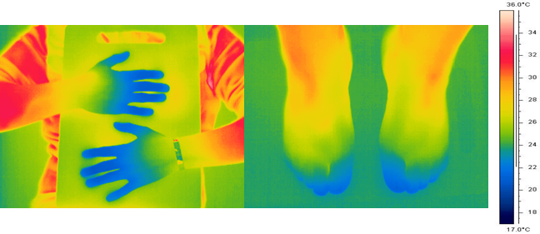
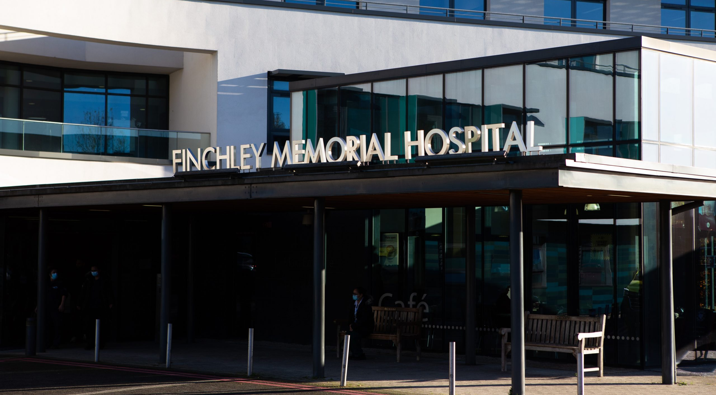
A bit about us…
Vascular Science background.
2024: we integrated the Royal Free Microvascular Diagnostics service into our current Vascular Studies department.
A portfolio of thermal imagers operated across 2 sites in north London.
Thermography for clinical imaging to aid in diagnosis for conditions such as
  Raynaud’s phenomenon
  Linear scleroderma
  Complex regional pain syndrome
Notes:
So some information about us..
I am a Vascular Scientist by job title having finished a scientist training programme to become one
In 2024 we integrated the microvascular service into our current Vascular Studies department so it could become one department after Dr Kevin Howell retired from 30 years in the microvascular service
We have a portfolio of thermal imagers which operate across 2 hospitals in north London
We use thermography for clinical imaging to dis in diagnosis for conditions such as Raynaud’s phenomenon, lineal scleroderma, complex regional pain syndrome and many more

Slide 3
What is Quality Assurance (QA) and why is it important?
Any clinical measurement should be valid and reliable and therefore we want to make sure any medical device we are using is accurate.
Compare against a gold standard device or accredited national standard (UKAS).
Measurements should be traceable to an agreed international standard
– International Temperature Scale of 1990 (ITS-90).
Documentation to provide evidence that measurements made for patient care are accurate.
Notes:
What is quality assurance and why is it important? Especially in clinical practice
We wants any clinical measurements to be valid and reliable and therefore we want to make sure any medial device we are using is accurate
We can do this by comparing against a gold standard device or an accredited national standard which in our case is the United Kingdom Accreditation Service or UKAS for short.
All measurements should be traceable to an agreed international standard. We ensure that our measurements can be traced back to the international temperature scale of 1990. There have been many versions of this temperature scale with the first in 1927 and the latest being 1990.
Quality assurances ensures we have documentation to provide evidence that the measurements used in patients care are accurate, so that we can aid in diagnostics confidently
Before ITS90 was , 68 (ammeded in 75), 48 (ammeded in 60) and 27

Slide 4
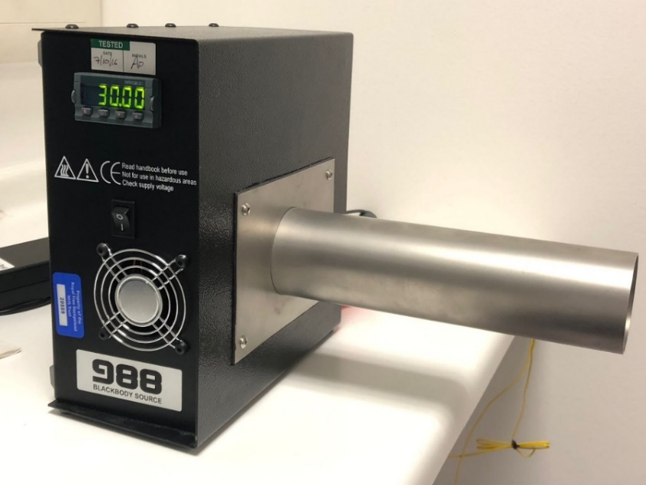
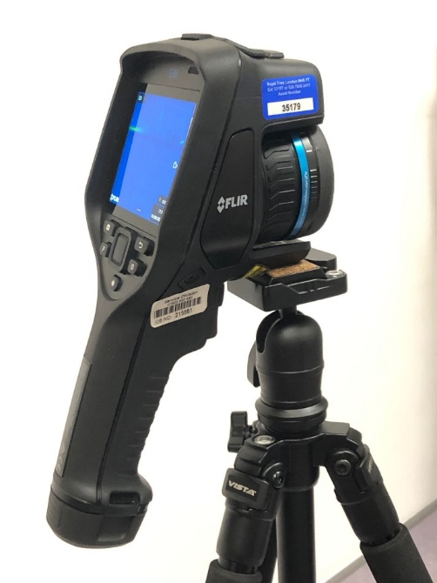
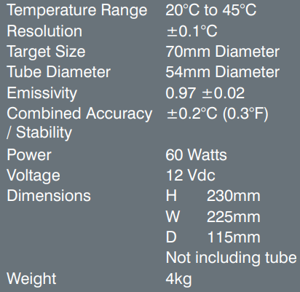
Equipment used in this case study
Handheld microbolometer focal-plane array (FPA) thermal imager.
Isotech 988 blackbody source.
(Isothermal Technology Ltd., Stockport, UK)
464 x 348 pixels.
Accuracy ± 2ºC.
Notes:
In this case study we used a handheld microbolometer focal plane arranfe thermal imager with 464 × 348 pixels and a stated accuracy by the manufacturer of + or – 2 degrees Celsius.
The blackbody we used was the Isotech 988 which has a range of 20-45 degrees Celsius which is enough for medical imaging use with an assumed emissivity of .97.

Slide 5
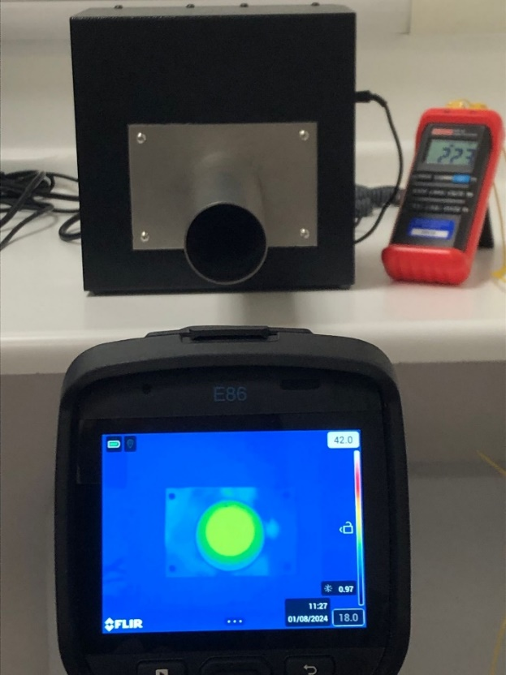
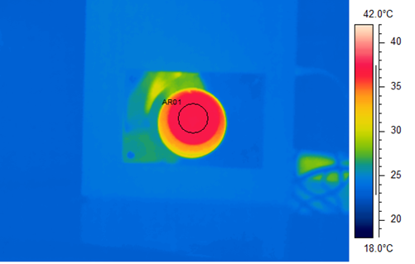
The set-up
Test within the microvascular lab at the hospital.
Room is temperature controlled.
Thermal camera set on a tripod pointing towards the blackbody aperture.
Camera configured to record images sequentially over a set period, or frames captured manually as required.
ɛ=0.97
Notes:
We test within the microvascular lab at the hospital where the room is temperature controlled, we try to keep the room to 23 degrees Celsius
Our thermal camera is set on a tripod and pointed towards out black body aperture to allow us to focus on the centre of the black body to take our measurements as you can see in the bottom image.
The centre of the black body is in the centre of our thermal imaging screen, this will allow us to easily calculate the temperatures after the testing has finished
We set the thermal to continuingly record over a set period of time according to what we are testing, 51 minutes for our stability test, a picture every 3 minutes for our accuracy test

Slide 6
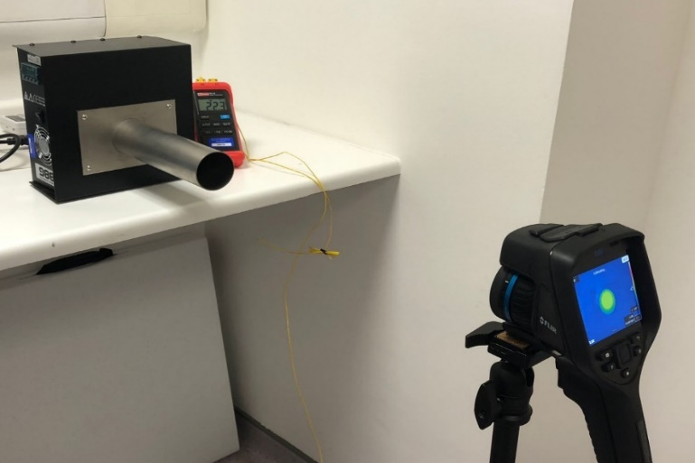
Process
Two tests were conducted to assess the performance of the thermal camera before use:
Stability of the temperature readings after switch on
Blackbody at 30ºC, images every 2 mins (5-51 mins after switch on).
2. Accuracy over a range of typical skin temperatures
20ºC - 40ºC.
These are two recognised
issues with thermal imaging
cameras…
Notes:
Two tests were conducted in this case study:
The first was stability after switch-on. The blackbody source was stabilized to a temperature of 30°C, and thermal images were captured every 2 minutes from 5 until 51 minutes after the imager had been switched on.
A plot of thermal imager temperature readings over time was produced, to investigate how quickly the imager stabilised after switch-on.
This was performed against a fixed temperature o the black body over an extended period.
The second was accuracy over a range of typical skin temperatures.
The blackbody was stabilised at 20°C, a thermal image of the aperture was recorded, and the process was then repeated by increasing the blackbody temperature in incremental steps of 1°C, up to a maximum temperature of 40°C.
A minimum of 3 minutes was allowed for the blackbody to stabilise at each temperature setting.
The data from this test were presented using a “difference plot”, which allowed the assessor to visualise how closely the thermal imager reading was to the “true” value of the blackbody across a range of test temperatures
We decided to use these tests as they are two recognised issues previously reported within literature, the following slide will show this.

Slide 7
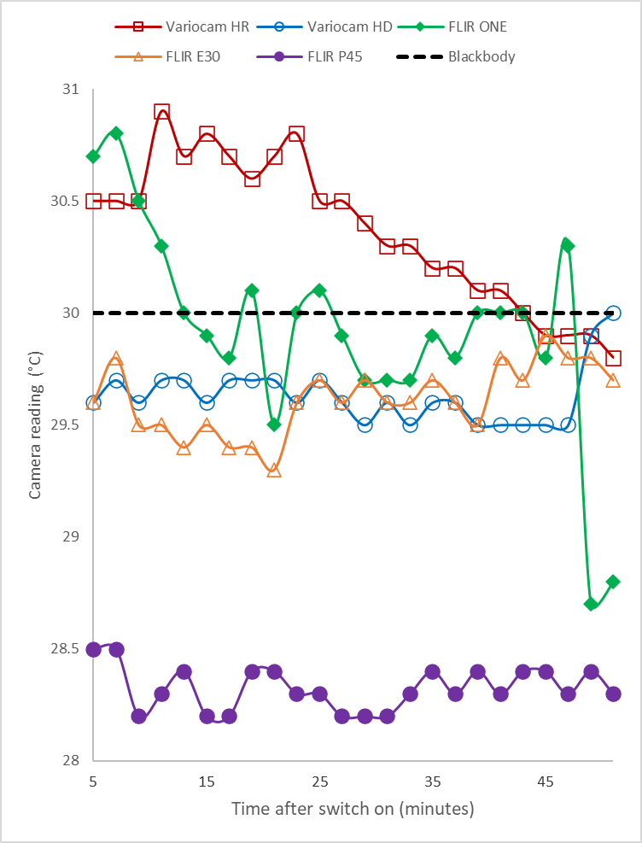
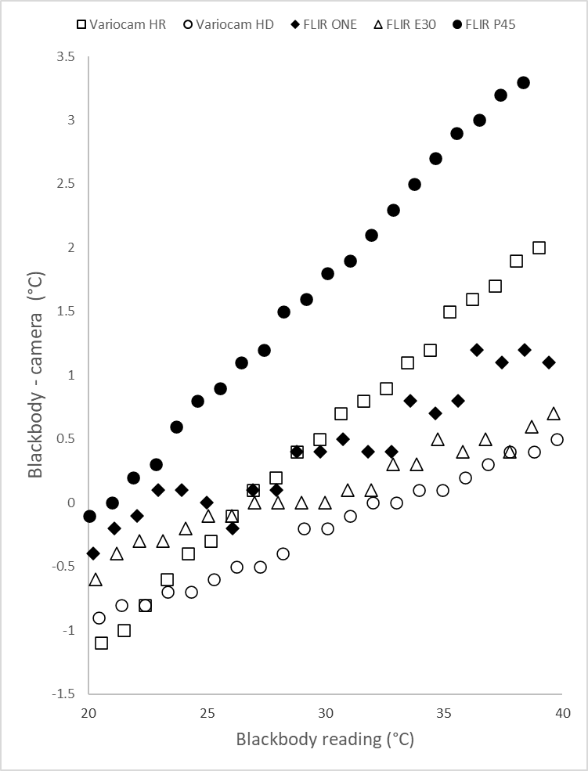
Howell K, Dudek K, Soroko M. Thermal camera performance and image analysis repeatability in equine thermography. Infrared Phys. Technol. 2020. https://doi.org/10.1016/j.infrared.2020.103447.
Notes:
These are graphs taken from a paper in 2020 which performed exactly the same 2 tests however it was performed on 5 thermal cameras that were in use for equine thermography
Explain graphs
As you can see there is considerable variability in performance between the tested cameras

Slide 8
Brief overview of the case study
Thermal imaging camera purchased
QA testing using our in-house testing
Failed QA testing
Sent back to manufacturer to correct fault
Returned to us and tested again
Passed QA testing and fit for use on patients
Failed QA testing again
Sent back to the manufacturer to reassess fault
Returned to us for testing again
Notes:
Here is a brief overview of the case study we performed
A thermal imaging camera was purchased brand new and delivered to our laboratory
We performed our in-house QA testing using the tests previously explained.

Slide 9
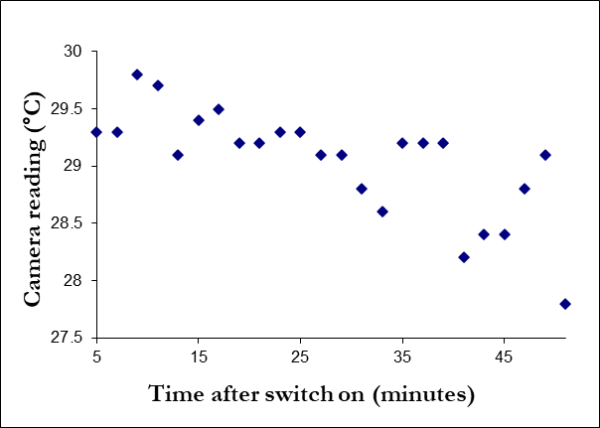
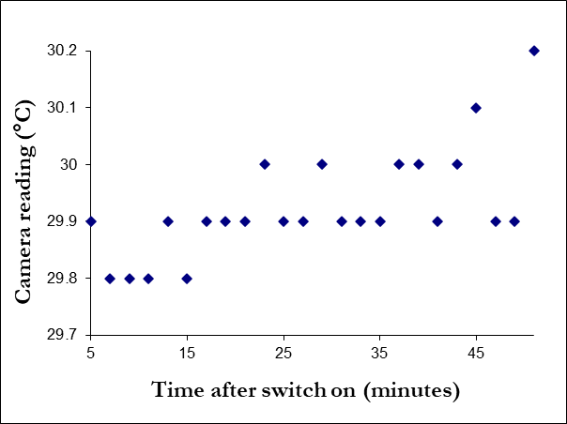
Stability of the temperature readings after switch on
Failed QA: Temperatures ranged from 27.5 to 30°C over the 51 minutes
Black body set to 30°C
Passed QA: Temperatures ranged from 29.8 to 30.2 °C over the 51 minutes
Notes:
Manufacturers data sheet dictates an accuracy of +- 0.2 degrees Celsius
Failed QA is outside of this error of margin as temepratures ranged from 27.5 to 30 degrees which is 2.5 degrees out of the blackbody temperature of 30 degrees
Passed QA is within the 2 degrees error margin as ranges from 29.8 to 30.2 degrees over 51 minutes

Slide 10
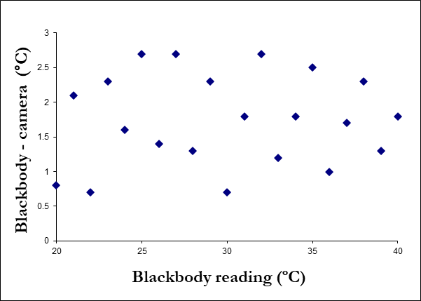
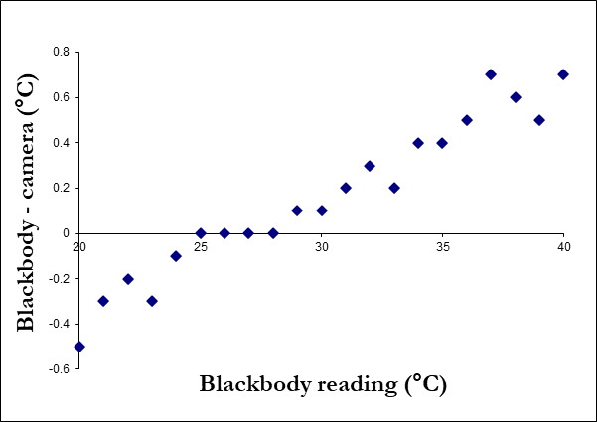
Accuracy over a range of typical skin temperatures
Failed QA: Camera compared to blackbody set between 20ºC and 40ºC.
Some temperature readings on the camera were almost 3°C higher than the blackbody measurement
Passed QA: Camera errors now range over 1.2°C.
Notes:
Along the x axis is the temperature of the blackbody ranging from 20 to 40 agrees in 1 degree increments. Along the y axis is the difference between the thermal camera temperature reading and the blackbody reading. As you can see some measurements were 3 degrees different between the blackbody and thermal camera reading. At no point did the black body and the thermal camera read the same temperature value.

Slide 11
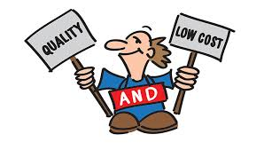
Take home messages
Is your camera working in acceptable standards?
What would be the implications if it is not?
Low cost involved
Gives us and patients peace of mind
Easy process – takes half a day
Notes:
Do you know how your thermal camera is performing, are you able to prove it is working within acceptable standards?
What would the clinical implications be for your service if an undetected fault developed like the one we've described in a brand-new device?
There is a low cost involved - small expense of the black body
My lessons from this QA progress:
It’s an easy process! It takes us half a day to test the equipment
Gives us and patients peace of mind that equipment is fit for use

Slide 12

Notes:
Thank you for listening

Slide 13
