Slide 1
Thames Valley AAA Manual Handling Training Review Course
1st September 2017
Felicity Woodgate

Slide 2
What are we doing today?
Get to know our spines
Look at the rules and regulations
Assess the risks we encounter at work
Office chair speed dating
Put into practice what we’ve learnt.

Slide 3
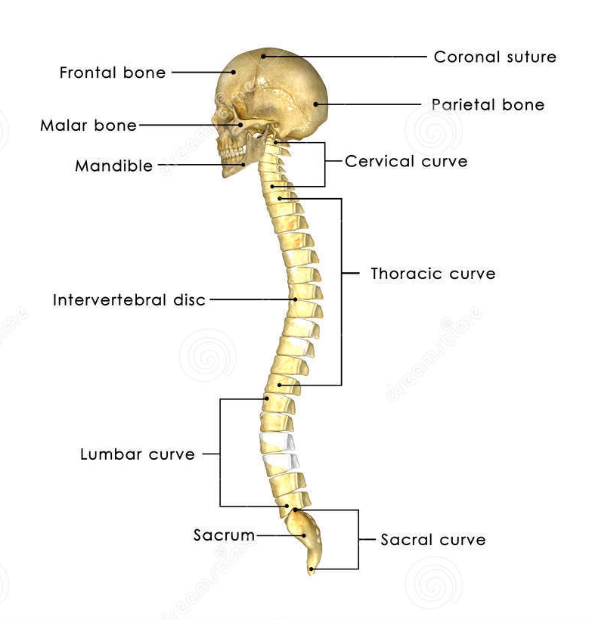
My spine
Notes:
Fun facts about the spine:
We start to develop our backbone approx 2 months into our conception
We have the same number of cervical vertebrae as a giraffe
You are at your tallest when you wake up in the morning as the night laid flat allows cartilage to expand as there has been no gravitational force pulling it downwards for eight hours.
The spine is made up of four key sections which allow us to conduct various twisting, and moving actions

Slide 4
Spinal structure
The spine is the major supporting structure of the body
It consists of 24 moveable vertebrae and 9 fixed vertebrae
It is split into five sections
Cervical
Thoracic
Lumbar
Sacrum
Coccyx

Slide 5
Cervical
Allows for nodding, rotation of the head, bending and twisting movements
Can we think of when we might use this part of our spine in clinic?
Notes:
Looking at the screens when scanning and setting up clinic.

Slide 6
Thoracic
Allows rotation of the trunk, forward bending and some sideways trunk movement
It is the least mobile area of your spine
When is this part of the spine the most important?
Notes:
Sitting down

Slide 7
Lumbar
Allows for backward bending, sideways movement, and some trunk rotation.
Provides a flexible connection between the upper and lower body and so has a greater function in load bearing.

Slide 8
The other important bits…..
Intervertebral discs- Pads of cartilage which act like a spongy cushion between the vertebrae.
Facet joints- these link the vertebrae and slide as we bend and twist
Spinal cord

Slide 9
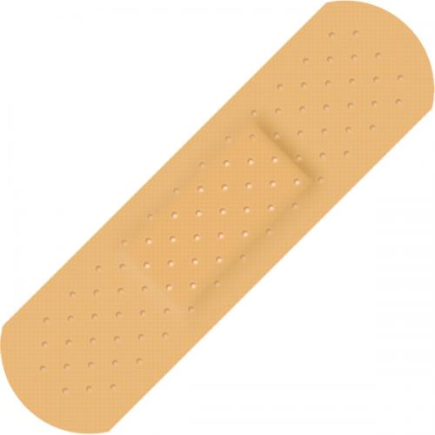
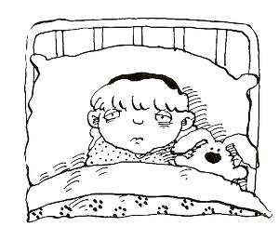
Assessing risk
If our spines are so important ?
What are we at risk of ?
Notes:
Are we at risk?
If so what are we at risk of ?
The Health and Safety Executive (HSE) defines manual handling as the transporting or supporting of a load, including lifting, putting down, pushing, pulling, carrying or moving. For some members of staff, manual handling accidents can result in long periods of sick leave and for others it can even lead to the end of their career.

Slide 10
Lifting
Driving in a hunched position
Carrying
Standing or bending for long periods
Twisting
Driving for long periods
Notes:
The trust states the risk factors for back pain or musculoskeletal injury are as stated
As screening technicians you do all of these things.
Work-related musculoskeletal disorders (MSDs), including manual handling injuries, are the most common type of occupational ill health in the UK. Back pain and other MSDs account for approximately 40 per cent of all sickness absence in the NHS, resulting in a cost in the region of £400 million each year.
So what regulations are in place to stop these things from happening?

Slide 11
Manual handling Regulations and important movement principles
Notes:
What do we know about manual handling regulations?
Anyone know what the law states?
What does the law define as manual handling?
What other key laws effect us as screeners?
There are also other regulations that impose specific requirements including:
Management of Health and Safety at Work Regulations 1999
Workplace (Health, Safety and Welfare) Regulations 1992
Manual Handling Operations Regulations 1992
Reporting of Injuries, Diseases and Dangerous Occurrences Regulations 1995.
Manual handling Operations of 1992
The Health and Safety Executive (HSE) defines manual handling as the transporting or supporting of a load, including lifting, putting down, pushing, pulling, carrying or moving. For some members of staff, manual handling accidents can result in long periods of sick leave and for others it can even lead to the end of their career.
These manual handling regulations help to reduce the risk of illness and absence associated with manual handling tasks. Within the NHS we use the AAR principle. Which I like to think of as the pirate ‘AAR’ principle. If possible the manual handling task should be avoided. If this isn’t possible then you should assess the task to in turn reduce the risk of injury.
What are the trusts responsibilities?
The trust has a duty of care to you as an employee . In short they are responsible for providing you with the necessary training to conduct manual handling tasks. They are also responsible for providing you with the necessary equipment to do your job safely and for maintaining this equipment to a high level.
What are your responsibilities as an individual?
You are responsible for using the equipment provided to you in the way it was intended and for using the correct process to get the patients up and off the bed. If you do not use the correct manual handling manoeuvres and subsequently injury yourself whilst at work they will not support you.
You are responsible for making sure your training is up to date.
You are also responsible for noting any shortcomings or failure of equipment.
Other important regulations to be aware of are the PUWER 1998- The provision and use of work equipment and the LOLER 1998- Lifting operations and lifting equipment regulations.
PUWER- Is I nplace to ensure any employer keeps work equipment in a good condition, safe to use and suitable for its intended use. Work equipment is defined as “ any machinery, appliance, apparatus, tool or installation for use at work” Clinically this includes wheel chairs, transfer board, slide sheets, hoists, slings and rota stands.
LOLER- This is in place to keep staff safe whilst using lifting equipment. This includes things like hoists, slings and other lifting accessories i.e a sara steady.
Important principles for efficient movement.
Spine in line
Stable base
Body weight transfer
Load close

Slide 12
What do we do to reduce the risk?
ask
T
I
L
E
E
O
ndividual
oad
nvironment
quipment
rganisation
Notes:
Risk assessments are conducted and before each task the following six components should be considered.
Think about the Task- what does the task involve? Is the task repetitive with time for rest breaks and chance to recover? Does it involve poor postures such as bending , twisting and reaching.
Individual- Do you have the capability to carry out the task? – Are there any pre-exsisting injuries?
Load- How does the load present? Is it inanimate? , Is it a patient?, Is it unpredictable? Is it likely to move?
Environment- Is the environment appropriate? Is there sufficient space? Is the floor sloped, uneven or wet? Is the lighting adequate?
Equipment- Does the task require any equipment? Do you have the equipment you require? Is the equipment safe ? Is the safe working load of the equipment appropriate?
Organisation- Are they any organisational factors? Is there good communication within and between departments can sufficient staff be made available when required? Are rest breaks taken to aid recovery?

Slide 13

When you’re in the office

Slide 14
Office speed dating
Getting to know your chair and your work station
Notes:
Think about when if ever you went speed dating- what were the first things you thought about or what checklist did you go with to find the right partner. Setting up your workstation and chair is exactly the same think about what you want from your workstation
Workstation: Do you only use the computer or do you do handwriting as well, do you need space for documents you might need to refer to.
Your desk : Is there enough space to carry out the functions identified? Is it the correct height for you? Is the space under the desk
Number one priority : Your chair should be comfortable !!
It should support your spine in the s shaped position with the lumbar arch well supported.
Adjust the seat pan height so that your elbows are above the level of the desk when your arms are by your side.
Sit right back in the seat there should be no pressure on your knees
Adjust the backrest height
Adjust the tilt of the backrest.

Slide 15



Slide 16
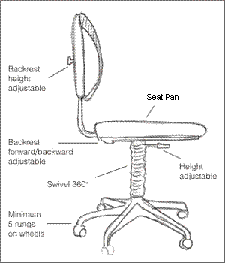
Chair
Your chair should support the S shape of your spine.
Ensure the arch of your back is well supported
Pull the chair into your desk and sit right back in the seat
Adjust your chair to suit you
Notes:
Number one priority : Your chair should be comfortable !!
It should support your spine in the s shaped position with the lumbar arch well supported.
Adjust the seat pan height so that your elbows are above the level of the desk when your arms are by your side.
Sit right back in the seat there should be no pressure on your knees
Adjust the backrest height
Adjust the tilt of the backrest.
Remember getting your workstation and chair setup like you do in the car. It is always set to you and you don’t want to be uncomfortable in the car so why would you be uncomfortable at your desk.

Slide 17
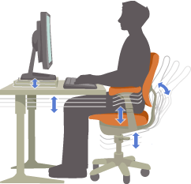
Desk
Is there enough space to carry out all the functions you identified?
Is it the correct height for you?
Is the space under the desk unobstructed?

Slide 18
Screen
The screen must be directly in front you.
The top of the screen should be at eye level
It should be approx. an arms length away
The screen should be free of reflection
For those wearing vari- or bifocal glasses you may prefer to have the screen lower and tilted away.

Slide 19


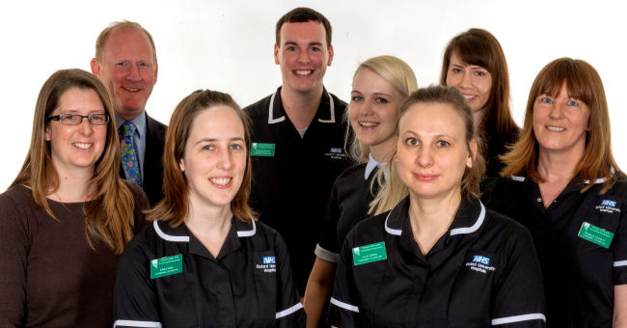
When you’re out in clinic
Notes:
You’ve navigated traffic
And driven across the county
This is a completely different environment to being in a clinical area or being in the office and therefore there are different manual handling challenges and you must complete a different risk assessment. For one you are dealing with animate objects rather than inanimate objects which will be far more unpredictable.
What happens if we do hurt ourselves in clinic? Well a self referral can be made to occupational health- it can take up to 6 weeks to get an appointment but you will be assessed and seen.
You can carry out the regular exercises which I have included in the handout sheets.

Slide 20
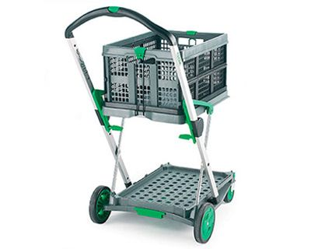
What has already been done in the department : Assembling and handling trolleys

Slide 21
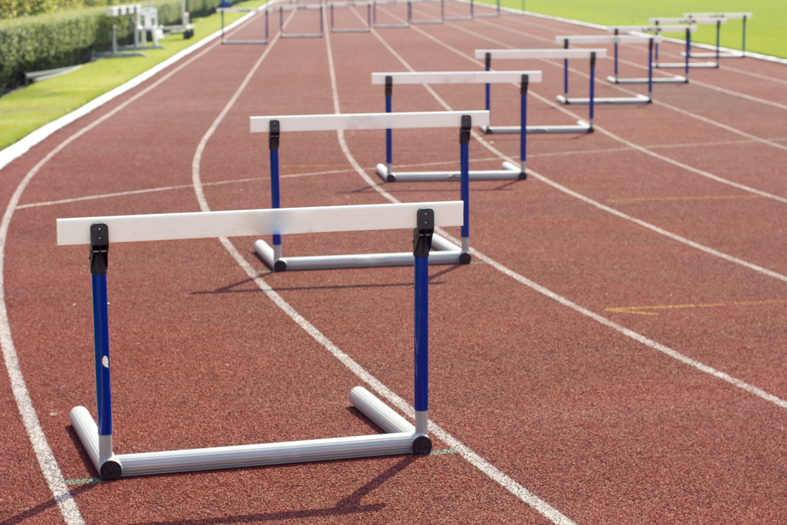
But what problems or manual handling hurdles can you think of in clinic

Slide 22
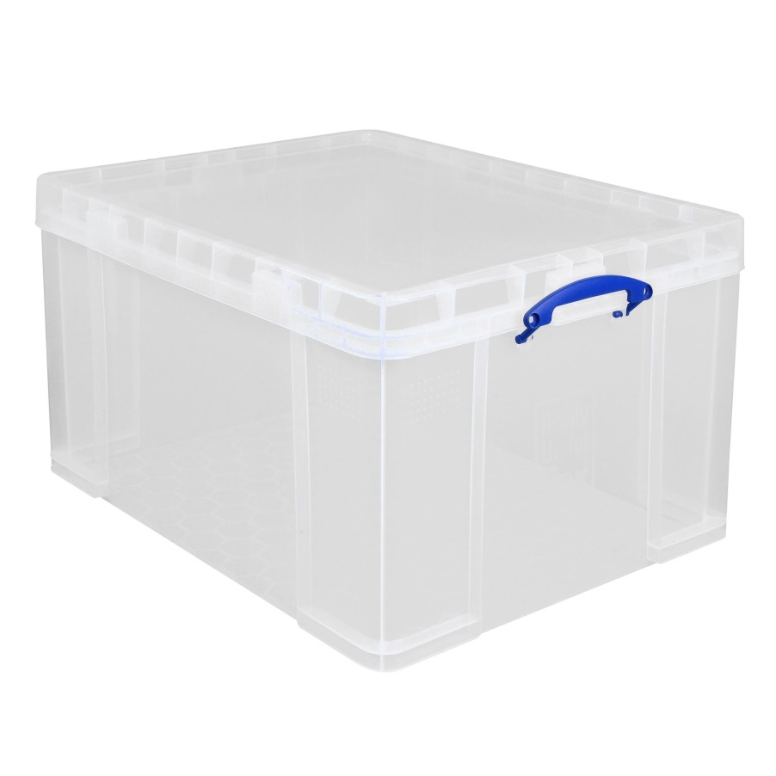
Lifting the kit boxes
Clear storage box with a lid holding the couch rolls and clinell wipes.
Notes:
Is there a clear route from the rear of the car into the clinic location?
Is the box securely packed so items are less likely to move unexpectedly?
Precautions to the risks: If possible the box should be secured to the trolley to avoid spills
Staff should not try and catch the box from falling or sliding off the trolley
If having to walk long distances make sure there are regular rest breaks along the route.
Do not have any unnecessary items in the box to avoid unnecessary weight.
If there are two staff members use both of you to move the box from the car to the clinic.
Where possible try and slide the box into positions that do not require lifting.
Carry out a TILLEEO assesment for moving the box from one place to another.
The task is moving the box
The load is the box – distribute the weight evenly between boxes, try not to overload the boxes with too much weight in one area . Are the boxes packed carefully making sure that the load is predictable and nothing is going to fall out.
Environment: Is the ground level? Have you parked somewhere it is easy to get the box in and out of the car?
Equipment: can you use the trolley to carry the box if you have to walk a long distance to the clinic. Can you make sure the trolley is at the correct height. If you know the boot is difficult to get the boxes out from have you considered putting things securely on the back seat so that you can just slide them out however being careful as this involves stooping and bending down.
Organisation- the trust provides you with the trollies and boxes are these well maintained is there anything that needs fixing on them?
The whole idea with this is to get you to think for your self and think about your own safety and how you can improve things for you.

Slide 23
Safe System of Work
One
Make sure there are no obstacles or hazards likely to affect the removal of the box from the car
Two
Place the trolley as close to the vehicle as possible to place the box on after removing it.
Three
Plant both feet shoulder width apart and bend knees slightly.
Four
Take hold of the box with both hands at either end and if leaning forward make sure that the bending is done from the hips and not the back.
Five
Straighten the knees and bring the body back into an upright neutral position, keeping the load close to the body as possible.
Six
Avoid any twisting of the trunk and move the feet around towards the trolley in a suitable position to place the box down on it
Seven
Bend the knees and keep the back straight, bending the hips to lean forward and place the box onto the bottom level of the trolley.
Eight
Secure the box onto the trolley if possible
Notes:
Every manual handling task you undertake has an associated safe system of work.
Demonstrate what the safe system of work looks like and where to find it

Slide 24
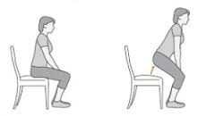
Assisted sit to stand
Notes:
Is the chair height appropriate?
Can the patient follow commands?
Can they move from chair sitting to edge sitting?
Can they place and maintain their feet on the floor?
If standing from a wheeled item make sure the brakes are on.
Encourage patient to lean forward so their back is away from the back of the chair. Ask the patient to keep their head up, look ahead, not at the floor.
• Ask the patient to shuffle their bottom towards the edge of the surface.
• Patient places their feet flat on the floor, hip width apart (legs at 90 degree angle) with the weaker foot/leg slightly forward.
• Encourage the patient to place their hands on the arms of the chair, or just above their knees.
• Ensure the patient has leaned their shoulders forward so their chin is over their knees.
• Handler stands on the patient’s weaker side facing the direction of movement. (If two handlers, one handler stands either side of the patient).
• The handler adopts a stable base with feet slightly apart and the outer foot ahead. Hips and knees are flexed to lower the handler’s position.
• Handler places their inside hand either at patients shoulder level or lower down their back depending on which prompt assists the patient. Place the outer hand so it cups the patient’s nearside shoulder. Look ahead.
• Clear instructions “Ready, Steady, Stand” are given with or without a rocking motion as instructions are said so that when the command word ‘stand’ is said the patient’s body weight is moving forward and they push up on the arms of the chair and through their legs to the floor.
• On the instruction “stand”, both handler and patient move together, first forward, then upward in direction of movement.
• The handler transfers his/her body weight from the back foot to the front foot or steps forward with the back foot.
• Stabilise at the end of the move .If the patient is unstable ask them to sit down (Please see SSOW C9 for Falling Patient).
• Once stable and standing the patient can begin to mobilise or transfer (See SSOW C6 Assisted walking).

Slide 25
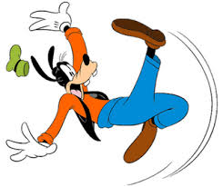
The falling patient
Notes:
Does the patient have a history of falling?
Do they have suitable non-slip footwear on.
Do they have a good sitting balance.
If the patient should fall. Quickly release hold of the patient and if possible swiftly move behind the patient and gently pull the patient towards you by placing both your hands on his/her hips, simultaneously moving backwards* whilst pointing both your hands to the floor, palms uppermost, keep moving backwards all the while bending your knees, this is with the sole aim of protecting the patient’s head.
• *If possible you may need to redirect the fall away from fixed items of furniture.
• Please do not attempt to catch or support the falling patient as there is a very high risk of injury to the staff member if this happens. Remember the most you are aiming to do is to protect the patient’s head.
If the patient is falling out of a chair an “on the spot” risk assessment as to whether it is safer to assist the patient back into the chair or help lower them to the floor must be carried out. If the patient’s bottom is mostly off the front of the chair it is probably easier to lower them to the floor, protecting the head as this is done. This is the same process for getting the patient to the floor in an emergency and can be done by:-
• Two people kneeling on the floor. If the patient is wearing trousers or a skirt with a waistband/belt this can be grasped, alternatively use a cotton sheet placed partially under the patient’s sacrum and partially up his back, hammock style so that the two people kneeling on the floor can pull on either side of the sheet to lower the patient to the floor. At the same time the nearside hand can grasp behind the patients knee to assist the patient to the floor
• A third member of staff may safeguard the patients head and a fourth to stabilise the chair/commode.
• Once the patient is on the floor, especially if the fall was un-witnessed, they must be checked for injuries prior to considering getting them up from the floor. Where necessary a medical assessment may be required to check for spinal/hip fractures or head injuries.

Slide 26
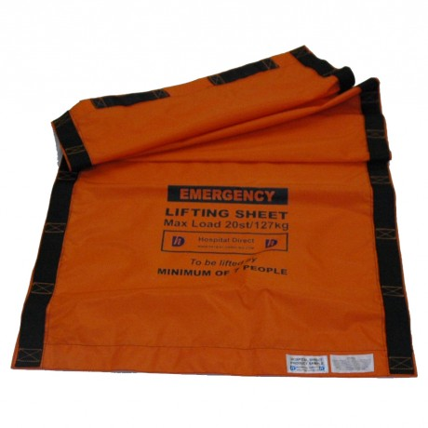
Chair to floor in an emergency
Notes:
This is a high risk activity and one which you may be asked to participate in whilst out in clinic or up in the vascular lab on training.
One handler is required to secure the chair, one handler to maintain patient’s airway, and two to kneel on the floor on either side of the patient’s knees to assist in transferring the patient to the floor.
• Ensure the patient’s arms are placed across the body and their shoes are removed.
• If patient is undressed or just wearing a hospital gown a bed sheet from the patient’s bed or slide sheet or blanket should be obtained.
• Place the bed sheet length-wise behind the patient’s back, swiftly fan the sheet out to encompass buttocks and lower back
• Ensure that ends of sheet are facing forward of the patient and not obstructed by arms of chair
• Two handler’s must kneel facing the patient
• Each will grasp either end of the bed sheet.
• Both handlers should pull the on the bed sheet on command and in unison, ensuring an incremental movement to pull the patient to the floor, while third handler maintains patients airway and fourth handler secures the chair.
• Once the patients bottom and legs are on the floor the fourth handler should remove the chair whilst the remaining three carefully lower the patient’s trunk and head to the floor.

