Slide 1
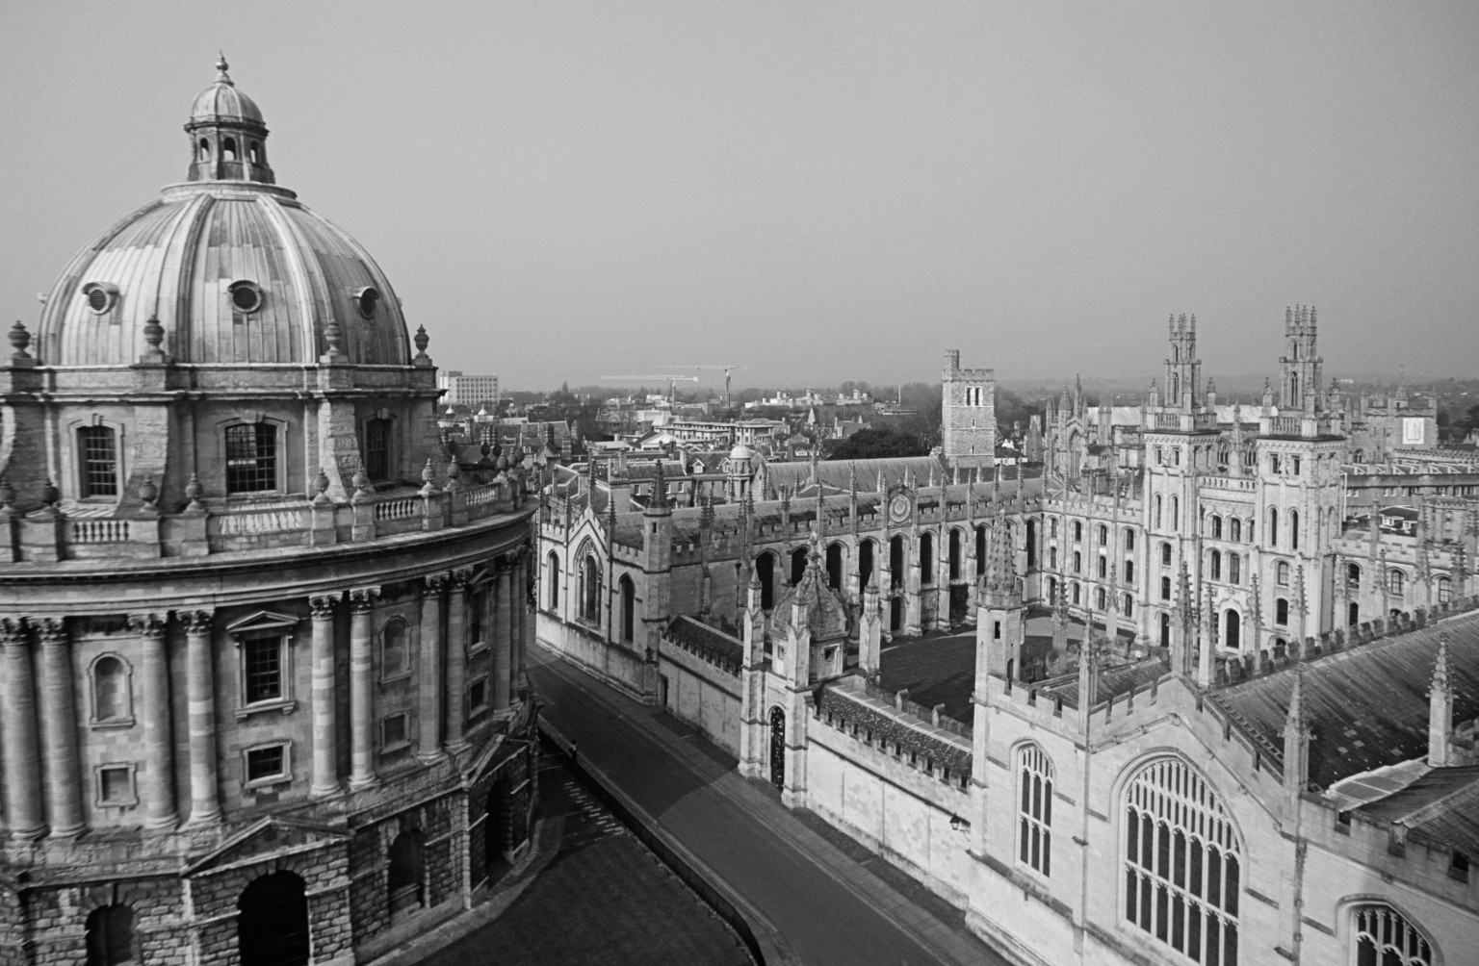




This is to certify that
Rachael Potter has attended the Oxford Venous Meeting on 17th March 2023
_______________________
Dr A Wigham
Consultant Interventional Radiologist
Oxford University Hospitals NHS Foundation Trust
_______________________
Miss E Wilton
Consultant Vascular Surgeon
Oxford University Hospitals NHS Foundation Trust
(6 hours of CPD time)
Kindly sponsored by Inari Medical

