Slide 1

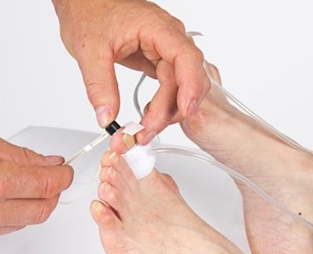

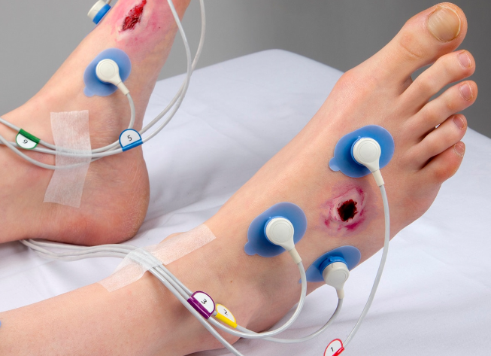
Transcutaneous partial oxygen tension (tcpO₂) & Toe Pressure
Louise Fearnside
Clinical Vascular Scientist
North Bristol NHS Trust
Notes:
My name is Louise Fearnside and I am a clinical Vascular Scientist at North Bristol Trust. This morning, I am going to talk to you about two non–invasive vascular assessments we routinely perform on patients attending the diabetic foot clinic which help guide the treatment and management of ischemic foot ulceration.
These are Transcutaneous partial oxygen tension (TCPO2) for short and Toe Pressures

Slide 2

Aims
Introduction to tcpO₂ & toe pressure assessment
Theory
Video demonstration
Interpretation and Challenges
Notes:
So during this 30 minute session I am going to cover four key areas;
Introduction to the assessments, why they are useful and what they can tell us
I’ll talk a little bit about the theory – what they are measuring and how we actually perform them
I’m going to play a video demonstration so you can see them being performed in practice on real patients
And then finally I’m going to talk a little but about interpretation of these tests and the challenges that we can face performing them in the clinic
Mete analysis and systematic review in 2016
Found that ABPI had poor performance in predicting healing of foot ulcers and a modest performance in predicting limb amputations.
TCPO2 was a better test for predicting both outcomes – they were unable to comment on TBI
Although peripheral neuropathy and extrinsic/intrinsic trauma are the most common cause of diabetic foot ulceration, it is frequently the unrecognised vasculopathy that prevents healing and increases the risk of amputation

Slide 3
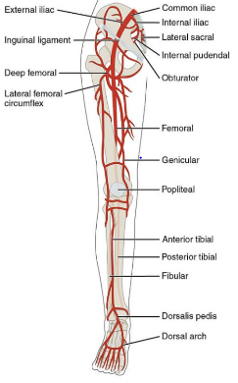
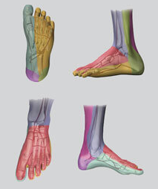
Why are they useful?
ABPI limitations in the diabetic patient
Calcified arteries
Limitations to what an ABPI can tell us
Screening tool assessing global arterial disease
More complex picture
More severe presentation to non diabetic
Neuropathy: Microvascular dysfunction: high flow : shunting
Poor collateral development
Reflect perfusion at foot level/area of tissue loss
***Wound healing***Amputation risk***
***Healing after amputation***
***Benefits from revascularisation***
ABPI
Notes:
So why are these useful and why do we use them?
ABPI Inaccuracies in the diabetic patient
More often that not we find that the ABPI is inaccurate/limited in the diabetic patient. Calcified arteries are common in the diabetic patient which can lead due to incompressible vessels (so you can’t actually occlude them at the ankle) or give falsely raised reading.
Limitations to what it can tell us
An ABPI is essentially a screening tool to assess global arterial disease in the arteries above ankle level. ** refer to pic – we’re putting a cuff on the ankle and insonating the vessels at the ankle which will tell us if there is potentially any significant arterial disease in the arteries above ankle level. It’s not giving us information about perfusion in the foot
More complex picture with diabetic foot
There can be a more severe presentation of foot ischemia to the non diabetic, even with similar patterns of arterial disease
This can be due to the complex mechanisms involved such as Autonomic Neuropathy which causes microvascular dysfunction. So an abnormally dilated vascular bed alongside rigid calcified arteries causes a faster rate of blood flow which results in new channels opening up between the arterial and venous systems in the lower leg and foot. This is called shunting and can result in the smaller vessels of the foot being bypassed therefore resulting in poor filling of the small vessels of the foot.
In fact the shunting can be clinically seen as distended veins over the dorsum of the foot and might be interpreted as good blood supply when it is not.
Poor collateralisation – diabetes affects the ability to form collateral supply in response to PAD thereby worsening limb ischemia.
Reflect perfusion at foot level/area of tissue loss ** refer to pic**
By assessing in the foot, these tests can more readily reflect the degree of perfusion at the actual level/area of tissue loss. Therefore giving an indication of any perfusion deficits and microvascular disease which is common in the diabetic foot.
And this can lead on to give us information on the likelihood of wound healing…
Autonomic neuropathy – autonomic nerves control vasodilation/constriction and sweating. Autonomic neuropathy from diabetes can result in decrease of sweating and increased rate of blood flow- due to disordered capillary function. Decreased sweat production leads to very dry ski and calluses or skin fissures which can become open and infected.
.

Slide 4


What do the guidelines say?
Guided by current evidence…
NICE guidelines (2012) updated & Published 2018
Global Vascular Guidelines (2019)
Systematic reviews e.g Forsythe et al 2019
Take home - Limb stratification should be performed e.g Wifi
messages: - PAD should not be ruled out in diabetics with normal/raised ABPI
- Further perfusion assessment required unless ABPI <50mmHg / 0.39
Local protocol - Diabetic patients require 2nd measure of perfusion
Notes:
It is important to be guided by the current evidence
Andy has discussed the guidelines so I’m not going to go into them in too much detail, only to point out a couple of take home messages from them.
Limb stratification should be performed to help improve clinical decision making. And this is using scoring systems such as the wifi classification
Local protocol:
In fact our local protocol states that diabetic patients require a second measure of perfusion and this is taking on board the evidence that the ABPI does not accurately predict the likelihood of wound healing in the diabetic foot.
So really these tests can be useful for not only assessing local perfusion deficits but clinical decision making as they can be used to calculate a Wifi score which will be discussed later in the talk
Current Guidelines recommend!
In fact, NICE guidelines published in 2012 didn’t specifically consider people with diabetes in relation to the ABPI as an initial test for peripheral artery disease detection. This was reviewed in 2017 and the 2018 publication and in essence they recommended that peripheral arterial disease should not be ruled out in diabetics displaying a normal or raised ABPI alone
Global Vascular Guidelines – bringing together several prominent societies (society for vascular surgery, European Society for Vascular surgery, and World federation of vascular societies). Essentially they recommend that all patients presenting with signs or symptoms of lower limb ischemia should have a wifi score calculated. This scoring (specifically the ischemia part of the scoring) requires ABPI plus or minus other secondary measures depending on the result of the ABPI
Wifi based on the three factors: wound, ischemia and foot infection and correlates with limb salvage, amputation risk and wound healing and can identify patients who are likely to benefit from revascularisation.
A limb staging classification system, such as wifi, should be used in all patients presenting with suspected CLTI. enabling clinicians to gauge the severity of limb threat and act accordingly to improve management and treatment of these patients
.

Slide 5
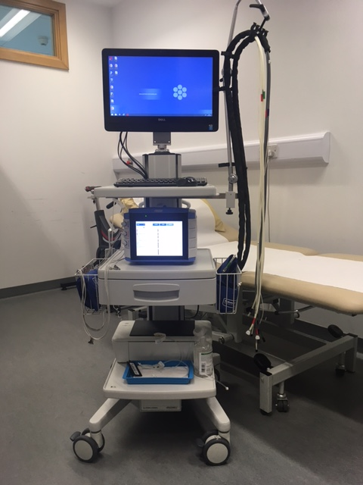
Equipment
Notes:
This is our equipment that we use to perform both tests – it’s a periflux 6000 machine, provided by Perimed and with this machine we are able to perform the tests either separately or simultaneously depending on what’s been asked of us.

Slide 6
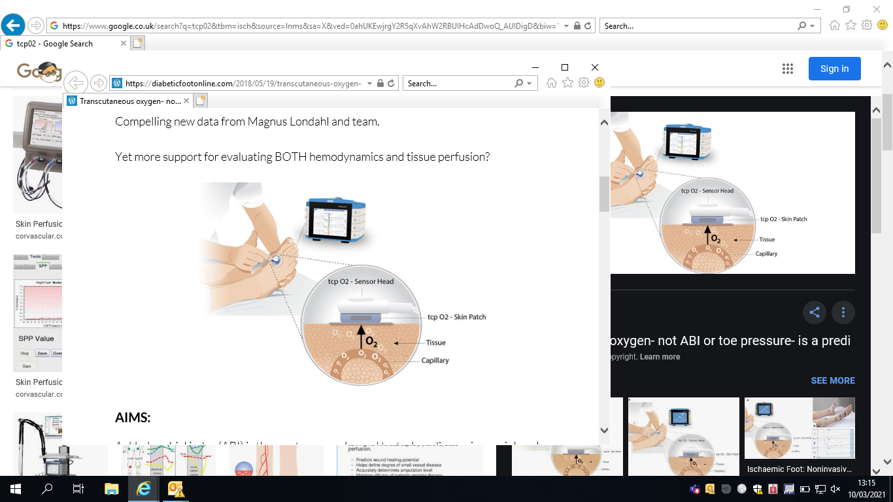
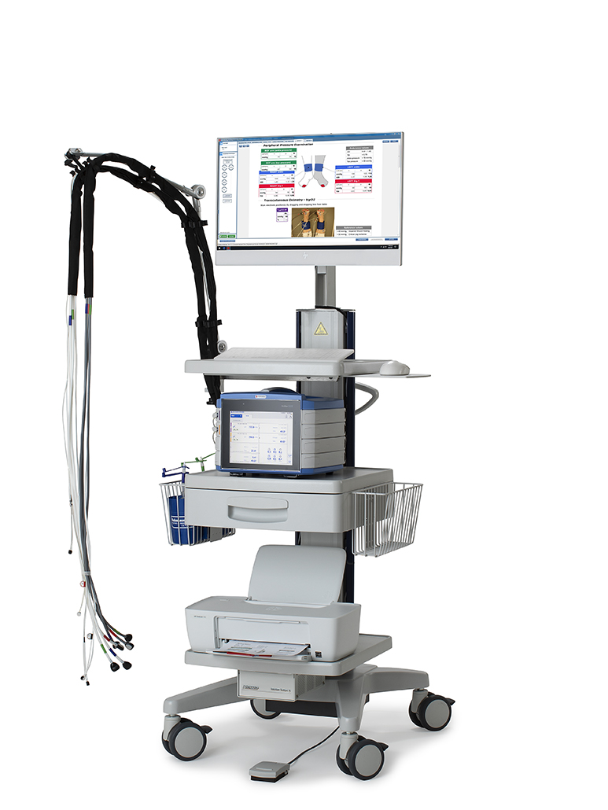
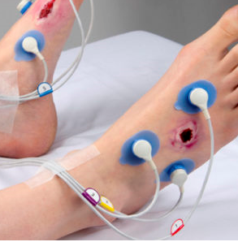
Transcutaneous oxygen tension (tcpO₂)
What is it measuring?
Transfer of oxygen to skin surface, Tissue O₂ perfusion
Sensors heat skin, vasodilation Blood Flow
O₂ diffuses through skin to sensor
Why measure?
local foot perfusion, capillary level
Healing potential, response to revascularisation
Quantify the severity of ischemia, wifi scoring
Preparation
Decide on sensor placement…….Clinically relevant sites!
Assess skin suitability, skin prep
Notes:
So starting with TCPO2, I’m just going to go through a bit of the theory
So what is it actually measuring?
SO this test is measuring the transfer of oxygen molecules to the skin surface, giving an indication of tissue oxygen perfusion at specific sites in the foot.
Sensors are attached to the skin and these heat the skin (44 degrees) , causing vasodilation of the capillaries and increased blood flow. Oxygen subsequently diffuses through the skin to the sensor which measures the TCPO2 value through an electrochemical reaction (reduction-oxidation reaction)
Why Measure?
So why measure this? Well it can tell us about local foot perfusion and therefore how much oxygenated blood is getting to the foot at the capillary level. So basically it can tell us about the metabolic state of the foot.
This in turn can assess healing potential at foot level and evaluate responses to revascularisation, either surgical or endovascular.
It can quantify the severity of ischemia by it’s validated correlation to ischemic wounds and likelihood of healing. Its values can also be used in the ischemia part of the wifi scoring, thereby aiding the clinical decision making
Preparation
So now onto preparation. We need to decide where to place the sensors on the foot and this may be governed by where the wounds are on the foot or the potential amputation level or you may want to go as distal as possible if the wounds are on the toes. It’s important to remember that the focal area under the sensor is being assessed so it’s important that they hare placed at clinically relevant sites
Once the general areas of sensor placement have been decided the skin needs to be assessed for suitablity for the sensor. They need to be away from bony prominences, dry hard skin areas and over any significant veins. We wipe with alcohol wipes which cleans the area and can get rid of any flaking skin. The skin is left to dry and then we attach the fixation rings which are these blue circular disks that the sensors sit in.
We place a couple of drops of coupling medium in the fixation ring and then twist the sensors into place, ensuring there are no potential air leaks. The leads are attached to the perimed machine, the measuring instrument.
TCpo2 measures transcutaneous partial oxygen pressure in mmHg.
Test is not affected by calcified leg arteries
Inter operator variability
Inclusion of an oxygen challenge or leg dependency
? Use of a regional perfusion Index? Chest probe is used in conjunction with the foot probes
A comparison of RPI Vs ABI or TBI could be made to determine diagnostic value
Transcutaneous oximetry (tcpO₂₎ is the only method to measure the local oxygen released from the capillaries through the skin, reflecting the metabolic state of the lower limb1Noninvasive Arterial Studies Including Transcutaneous Oxygen Pressure Measurements with the Limbs Elevated or Dependent to Predict Healing After Partial Foot Amputation. Karen L. Andrews, MD Mansour Y. Dib, MD Thomas C. Shives, MD Tanya L. Hoskin David A. Liedl, RN Andrea J. Boon, MD. DOI: 10.1097/PHM.0b013e3182876a06.. It is particularly useful for wound healing prediction, amputation level determination and qualification for hyperbaric oxygen therapy2Transcutaneous Oximetry in Clinical Practice: Consensus statements from an expert panel based on evidence. C. E Fife, D. R. Smart, P. J. Sheffield, H. W. Hopf, G. Hawkins, D Clarke. UHM 2009, Vol. 36, No. 1 – Transcutaneous oximetry consensus statements.. Transcutaneous oximetry is also recommended as a means to quantify the severity of ischemia and to stratify the prognosis in CLTI patients as well as being useful when diagnosing PAD in patients with calcified arteries and amputated toes³The impact of transcutaneous oxygen pressure measurement in patients with suspected critical lower limb ischemia Stefan Rosfors, Leila Kann, Thomas Nystrom. International Angiology 2016 Oclober;3S(5):492-7. .
The only method that provides information about the body’s ability to deliver oxygen to the tissue is tcpO₂.
Spontaneous wound healing will not occur without oxygen reaching the wound area.
An important tool in patients with diabetes where calcified vessels or missing toes make other methods impossible.
Objective measurement to support the clinical decision of amputation level, in order to improve patient quality of life and to avoid costly re-amputation

Slide 7
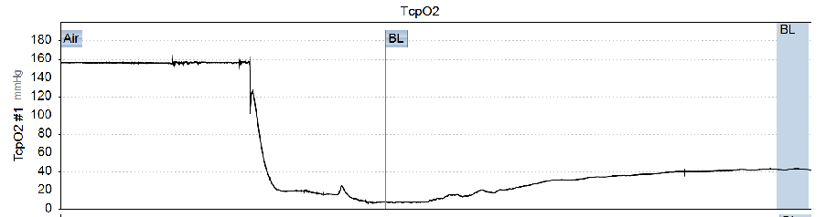
TcpO₂
Generation of a Value
mmHg
Partial O₂ Pressure
How is this useful?
Correlation between partial pressure (mmHg) and likelihood of healing
Clinically Validated
Reference Values
50-70 mmHg Normal
<40 mmHg Impaired Wound Healing
<30 mmHg Critical Limb Ischemia
Notes:
Generation of Value
How does the machine come up with a value?
Well, the oxygen diffusion creates a small electric current (due to an electrochemical, thermochemical reaction) which can be detected by the device and converted into a pressure, giving us a value in mmHg
This is graphically represented in real time as the partial oxygen pressure while the patient is undergoing the assessment. Once the sensors are in place in the fixation rings, the pressure starts to decrease from air level (160mmHg) reduces and stabilises to represent the transcutaneous partial oxygen pressure at the local area in the foot. Usually taking no more than 15 minutes
So how does this value help us?
The correlation between partial pressure and likelihoods of healing has been clinically validated in many studies. Notably a systematic review and meta analysis in the European Journal of Vascular and Endovascular Surgery in 2012.
This has led to widely accepted reference values;
Correlation
Clinically validated tool which reveals a linear correlation between higher partial pressure oxygen reading and wound healing potential.
There is a correlation between decreasing TCP02 values in patients with ischemic wounds and the likelihood of healing. Widely accepted after a systematic review in the European Journal of Vascular and endovascular surgery – highlighted that a value of <40mmHg represents a 24% increase in risk of healing complications.

Slide 8
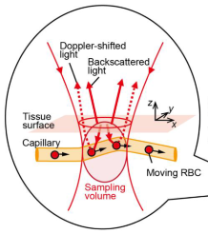
Toe Pressures
Useful in the diabetic patient
Sparing of pedal arteries from incompressibility
Measures pedal systolic pressures (absolute) can compare with Brachial artery (TBI)
Global arterial disease assessment inc foot
How?
PPG, Strain gauge, Laser Doppler
What is being measured?
Capillary flow by laser light
Hits moving blood cells
Doppler shifted light – detected/ processed
TP/TBI
Notes:
So now onto toe pressures:
Toe pressures may be more accurate in the diabetic patient because of the relative sparing of the pedal arteries from incompressibility as they are less likely to suffer from medial/intimal calcification.
Like the ABPI, it is measuring systolic pressures which can be compared to the brachial artery, creating an index (Toe brachial Index). You can therefore get a global arterial disease assessment which includes the foot which is useful in the diabetic foot where you may also be getting very small vessel (microvascular disease)
HOW?
So how do we achieve this.
There are several methods to measure systolic toe pressure, including photophlesmography (detecting pulsatile flow and producing a pulse wave curve) , strain gauge and laser Doppler. We use the laser Doppler technique using a perimed perdflux machine that can measure both toe presssure and TCP02 that I have discussed in the previous slide.
Laser Doppler measures capillary flow by laser light from a fibre optic probe. The light hits moving blood cells, which alter it’s original wavelength (this is known as a Doppler shift) and the backscatter (which has an altered wavelength) is detected by a sensor which is then processed by the machine.
An advantage that laser Doppler has over the other two methods mentioned above is that it is highly sensitive for the detection of low pressures
Laser Doppler can allow skin perfusion pressure – microvascular assessment as it measures the return of blood flow to the capillaries. Laser Doppler detects the movement of red blood cells when there is reperfusion of the skin
Inflated cuffs (approx 3 seconds) to above arm systolic pressure, then cuff is deflated and the laser Doppler probe measures skin blood flow throughout the deflation period. The software contains an algorithm that allows calculation of systolic pressure readings
Toe arteries are smaller and easier to occlude
Sensitive technique – laser Doppler
Toe pressures may be more useful because of the relative sparing of the pedal arteries from medial calcification
Toes pressures may be measured by photoplethysmography (detecting pulsatile flow and producing a pulse wave curve) or laser Doppler (detecting changes in wavelength when the laser encounters red blood cells)
The main reason is that they are suspicious that TCPO2 can often be falsely elevated, giving a better than it actually is representation. There are so many reasons for a TCPO2 to give inaccurate readings, for example infection (even if you don’t realise there is one) can cause the capillary beds to dilate increasing the blood supply and in turn give falsely high TCPO2. This is particularly common in diabetics with foot sepsis/bone infections/infected ulcers!
TBIs have less that can impact – although can still get inaccurate readings with these as there may be calcification of the microvascular!
So a more reliable measure of PAD in people with diabetes is the absolute toe pressure or the TBI. It is however more demanding and subject to positional and temperature variation. The size of the digit cuff is also critical, pressure measurements being overestimated with too small a cuff and underestimated with too wide a cuff
Local heat in the Doppler probe can increase the signal, standardise measurements

Slide 9
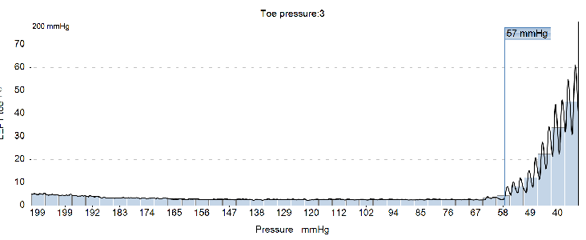
Toe pressures
Preparation & Generation of a Value
mmHg
40°C
Small pneumatic cuffs
Laser Doppler placement
Arm cuff if TBI
Inflation/deflation
Inflation to supra systolic level
Laser Doppler picks up flow
WIfI scoring
Ischemia
Toe Pressure/TCPO2
0: >60mmHg
1: 40-49
2: 30-39
3: <30
How does this correlate clinically?
Absolute toe pressures validated for wound healing : <30 mmHg
TBI used - ? Less evidence based: <0.7
Notes:
What does that look like in practice?
Preparation
A small pneumatic cuff is applied to the toe (usually hallux) and the laser Doppler sensor is placed on the toe using double sided adhesive tabs. Again, there is local sensor heating to help standardise and improve the signal. The cuff and sensor are connected to the machine via pressure tubes / appropriate wires
The inflation and deflation of the cuff is controlled by the machines inbuilt pressure system.
So the cuffs are inflated to a pressure sufficient to stop blood flow, given time to stabilise and then laser Doppler picks up flow following cuff deflation. This is the systolic pressure reading which is measured in mmHg and is an absolute pressure reading.
This is also graphically represented in real time during the assessment and the machine provides a pressure curve which is shown here.
So this curve indicates the cessation of blood flow, as indicated by the flat line and then the resumption of flow where you see the pressure start to rise and the machine picks this up which is something we can manually change if necessary.
How does this correlate clinically?
The measurement of absolute toe pressures is well validated in the diagnosis of CLI and is an accepted prognostic marker for wound healing (Hoyer et al 2013) . Toe pressure Index can be used but despite guidelines, it appears to be is less evidence based.
Reference ranges may vary but a systolic pressure of <30mmHg thought to suggest blood flow inadequate for healing
An index of <0.7 generally indicates arterial insufficiency.
The toe pressure measurement (or in fact the TCPO2 measurement) can be utilised in the ischemia part of the wifi scoring with >60mmHg suggesting no arterial disease, <30mmHg suggesting critical limb ischemia and mild to moderate disease in between.

Slide 10
TBI/ TcpO₂ video demonstrations
Video demonstration from Helsinki University Hospital, Finland featuring patients attending their clinic
Narrated by Professor Pirkka Vikatmaa
Video can be found in the educational library of ESVS (European Society for Vascular Surgery
Notes:
So now hopefully this will make more sense when I show you this video of the tests being performed on real life patients attending the clinic at Helsinki University Hospital

Slide 11


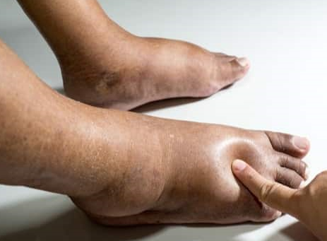
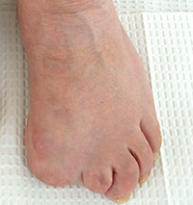
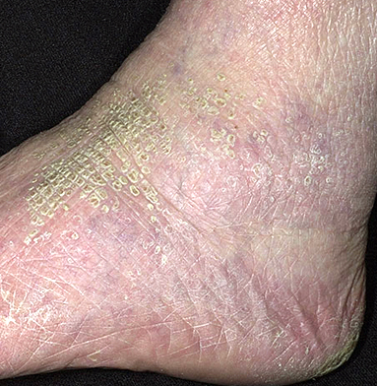
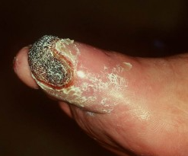
So which test?
TCPO2 Limitations
False elevation
Inaccurate readings
Autonomic Neuropathy
Arteriolar shunting
Callus/ dry skin (poor contact)
Infection
Active smokers (vasoactive effects)
Swelling (Barrier)
Environmental (Vasodilation)
Toe Pressure Limitations
Inaccurate readings
Digit Loss
Ill filling cuffs
Reliability on non hallux toes
Toe Ulceration
Heavily calcified digital vessels
Vasospasm
Limb tremor (noise artefacts)
Patient
Dependent
Notes:
So we have the research and evidence to guide us and the referral may be asking for one or the other..
So the scientific evidence evidence and guidelines might suggest a preferred test and in actual fact there is a leaning towards toe pressures over TCP02 in the diabetic foot patient.
BUT
However the potential limitations of each test is a significant factor and is very patient dependent.
So what we can perform on the ground in the clinic may more governed by limitations of each test and I’ll just run through these now
So with TCPO2 limitations ; there can be false elevation and inaccurate readings.
Automonic neuropathy can cause high flow and shunting as previously discussed which leads to inaccurate perfusion measurement. It can also lead to loss of sweating which causes callus or dry skin which creates a poor contact for the sensors
infection (even if you don’t realise there is one) can cause the capillary beds to dilate increasing the blood supply and in turn give falsely high TCPO2. This is particularly common in diabetics with foot sepsis/bone infections/infected ulcers!
Nicotine can cause vasoactive effects which can alter the results.
Swelling can create a barrier to the sensor picking up the oxygen diffusion and there may also be environmental factors which cause vasodilation and constriction and affect the reading
TBI Limitations
It is thought that toe pressures encounter less limitations however there are still several limitations to the test that can cause inaccurate readings.
The hallux is the first port of call but if it has been amputated, there may not be a second viable option and cuff placed on other toes may be ill fitting and not reliable. Toe ulceration may mean that you can’t actually place the cuffs on the toes.
Although toe vessels are less likely to suffer from calcification, it is still possible and can result in falsely raised pressures.
The digital arteries may also go into spasm which would produce inaccuracies and if the limb is not kept still, it can create noise artefacts and make it difficult to interpret when the signal has come back in.
So in conclusion, you may have to alter the test that’s been requested or highlight serious limitations of the test when you are in the clinic with a diabetic foot in front of you
One cannot place the probe over the plantar foot as the skin is too thick for oxygen permeation and it is also to difficult to use on edematous feet
If the toe pressure is <30mmHg then ignore the TCP02 – this is due to limitations due to swelling, temperature and swelling.
When deciding which one, a significant factor are the potential limitations of each test and this is very patient dependent.
TBI Limitations:
Loss of digits
Ill fitting cuffs
Interpretation of the generated curves
In low arterial pressure (close to venous pressure) the phases in the laser Doppler flow signal can merge and make it difficult to interpret when the arterial signal came back in – ie hard to distinguish from the venous signal
Microvascular disease
Weak signals – it might be difficult to interpret where the signals comes back in
Vasospasm
Limb tremor – noise artefacts
Oedema
The main reason is that they are suspicious that TCPO2 can often be falsely elevated, giving a better than it actually is representation. There are so many reasons for a TCPO2 to give inaccurate readings, for example TBIs have less that can impact – although can still get inaccurate readings with these as there may be calcification of the microvascular!

Slide 12
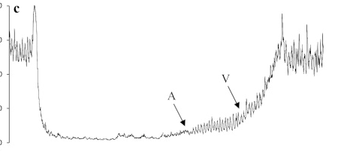
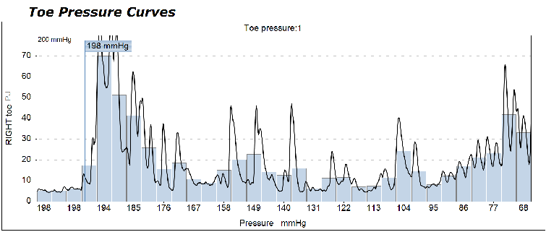
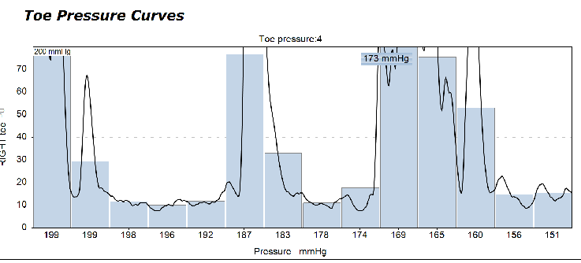
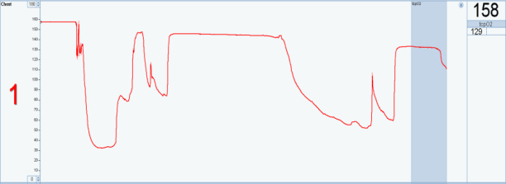
Interpretation of results : Analyse the Curve!
67mmHg
Arterial flow resumes
Venous stasis release
198 mmHg
173mmHg
Notes:
So just finishing off, I just wanted to talk about the interpretation of the results and why this is so important.
The machine will always produce a number of what it believes is the most accurate but the limitations I have discussed on the previous slide can confuse the machine and lead to inaccuracies.
So just to show you what a good pressure curve looks like, following inflation of the curve the systolic pressure has been occluded and the pressure has stabilised near zero. You can then see when deflation of the curve has come in with the sudden upstroke in pressure.
This second graph looks completely different and the pressure has not stabilised near zero following inflation. Actually you can’t see where the inflation and deflation has taken place but the machine has still produced a number. This is probably due to ill fitting cuffs and/or movement artefact.
It’s a similar picture with this graph below where even though a number has been generated, the pressure readings are everywhere and there’s no consistency. Also the scale (which the operator can change) has not been optimised to the highest pressure reading which could introduce interpretation issues.
In low pressure conditions, it might be hard to interpret where the arterial pressure resumes and may be confused or merge with the venous stasis release (these are shown with A and V on the graph) with V indicating when capillary flow resumes.
So really, we need to analyze the curve, make sure we are happy with them and not just accept the number

Slide 13
Conclusions
Valuable contribution - wifi scoring
Reflect degree of perfusion at foot level/ area of tissue loss
Mindful of limitations
Adequate training essential!
Notes:
So in conclusion
I think it is fair to say that these tests provide a valuable contribution to the management and treatment of the diabetic foot, through their validation and use in the wifi classification system.
Reflect degree of perfusion at foot level/area of tissue loss
Which can tell us the extent of microvascular disease and help with clinical decision making when it comes to assess whether healing is likely, the amputation risks or the effectiveness of any intervention
We need to be mindful of the limitations of each test as discussed and we may have to highlight the limitations or even make alterations to the test we perform, depending on what we face in the clinic.
This is why it is so important to have adequate operator training so that users can interpret the measurements appropriately and understand when they do not look accurate and make adjustments

Slide 14
Thank you for listening
References:
Arsenault KA, Al-Otaibi A, Devereaux PJ, Thorlund K, Tittley JG, Whitlock RP. The use of transcutaenous oximetry to predict healing complications of lower limb amputations: a systematic review and meta analysis.Eur J Vasc Endovasc Surg 2012; 43 (3): 329-336
Hoyer C, Sandermann J, Petersen LJ. The toe-brachial index in the diagnosis of peripheral arterial disease. J Vasc Surg 2013; 58 (1): 231-238
National Institute for Health, Excellence. NICE Guidelines [CG147] Peripheral arterial disease: diagnosis and management. 2012. Last updated 11 Dec 2020
Forsythe RO, Apelqvist J, Boyko EJ, Fitridge R, Pio Hong J, Katsanos K, Mills JL, Nikol S, Reekers j, Venermo M, Eugene Zierler R, Schpaer NC, Hincliffe RJ. Performance of prognostic markers in the prediction of wound healing or amputation among patients with foot ulcers in diabetes: A systematic review. Diabetes Metab Res Rev 2020:36 (s1): e3278
Conte MS et al. Global vascular guidelines on the management of chronic limb – threatening ischemia. Eur J Vasc Endovasc Surg 2019 S8, S1- S109
de Graaff JC, Ubbink DT, Legemate DA, de Haan RJ, Jacobs MJHM. The usefulness of a laser Doppler in the measurement of toe blood pressures. J Vasc Surg 2000; 32: 1172 -9
Forsythe RO & Hinchliffe RJ. Assessment of foot perfusion in patients with a diabetic foot ulcer. Diabetes Metab Res Rev 2016; 32 (Suppl. 1):232-238
Hoyer C, Paludan JPD, Pavar S, Biurrun Manresa JA, Petersen LJ. Reliability of Laser Doppler Flowmetry Curve Reading for Measurement of Toe and Ankle Pressures: Intra-vand Inter-observer Variation. European Journal of Vascular and Endovascular Surgery 2014; 47 (3): 311-318
Notes:
References:
Conte MS et al. Global vascular guidelines on the management of chronic limb – threatening ischemia. Eur J Vasc Endovasc Surg 2019 S8, S1- S109
de Graaff JC, Ubbink DT, Legemate DA, de Haan RJ, Jacobs MJHM. The usefulness of a laser Doppler in the measurement of toe blood pressures. J Vasc Surg 2000; 32: 1172 -9
Forsythe RO & Hinchliffe RJ. Assessment of foot perfusion in patients with a diabetic foot ulcer. Diabetes Metab Res Rev 2016; 32 (Suppl. 1):232-238
Hoyer C, Paludan JPD, Pavar S, Biurrun Manresa JA, Petersen LJ. Reliability of Laser Doppler Flowmetry Curve Reading for Measurement of Toe and Ankle Pressures: Intra-vand Inter-observer Variation. European Journal of Vascular and Endovascular Surgery 2014; 47 (3): 311-318
Hoyer C, Sandermann J, Petersen LJ. The toe-brachial index in the diagnosis of peripheral arterial disease. J Vasc Surg 2013; 58 (1): 231-238
National Institute for Health, Excellence. NICE Guidelines [CG147] Peripheral arterial disease: diagnosis and management. 2012. Last updated 11 Dec 2020
Forsythe RO, Apelqvist J, Boyko EJ, Fitridge R, Pio Hong J, Katsanos K, Mills JL, Nikol S, Reekers j, Venermo M, Eugene Zierler R, Schpaer NC, Hincliffe RJ. Performance of prognostic markers in the prediction of wound healing or amputation among patients with foot ulcers in diabetes: A systematic review. Diabetes Metab Res Rev 2020:36 (s1): e3278

