Slide 1
TCD clinical meeting
Tamara Walcott-Dhainy

Slide 2
The etiology of acute brain injury is diverse and may include varying disease pathologies due to injury to the brain itself (such as traumatic brain injury or stroke) or other organ dysfunction that has put the brain at risk
Frequent assessment of the child’s neurologic status is critical and often incorporates both invasive and non-invasive neuromonitoring.
The literature base for the use of TCD in the PICU is limited but quickly growing

Slide 3
Interpreting results
Interpretation of TCD data is dependent on a myriad of factors.
RAISED CEREBRAL BLOOD FLOW VELOCITY
Increases in childhood, peak near age 6 years, then slowly decline to adult levels. Therefore, in children, it is essential to compare measured values to published normative values for age. Measured CBFV is considered abnormal if the value is greater than or less than 2 standard deviations from the previously published normative data
Increase in fever due to cerebral metabolic demand
Anaemia
Hypertension
Elevated partial pressure of carbon dioxide
Seizures

Slide 4
REDUCED CEREBRAL BLOOD FLOW VELOCITY
Shock
Hypocapnia
Sedative medications, frequently used in the intensive care unit, have been associated with reduced CBFV in the absence of intracranial pathology

Slide 5
A survey of 27 centres reveal 93% use TCD. 74% use those TCD results to guide aspects of clinical care but only 30% have a standardised written protocol.
There are many standard protocols for adult TCD in various applications but these cannot be used in paediatrics.
Delphi study to develop consensus guidelines in 2020.
    When interpreting a TCD examination of a nonintubated child <18 y of age in the PICU, normative values from Bode and Wais should be used. ²
    To diagnose abnormal flow, mean flow velocities ≤ or ≥ 2 SD from age and gender normal value can be used.
    Abnormalities to the waveform characteristics such as delayed upstroke, reversal of flow, and embolic signals (if present) should be reported.
    If serial examinations are performed, reporting trends in measured velocities are encouraged.

Slide 6
Table 4
Recommended comparative values for the interpretation of TCD examinations in children (0–18 y) in the pediatric intensive care unit by age (mean [SD]) ² ¹⁰
Age | MCA | ICA | ACA | PCA | BA
Systolic peak velocity:
0–10 d | 46 (10) | 47 (9) | 35 (8) | – | –
11–90 d | 75 (15) | 77 (19) | 58 (15) | – | –
3–11.9 mo | 114 (20) | 104 (12) | 77 (15) | – | –
1–2.9 y | 124 (10) | 118 (24) | 81 (19) | 69 (9) | 71 (6)
3–5.9 y | 147 (17) | 144 (19) | 104 (22) | 81 (16) | 88 (9)
6–9.9 y | 143 (13) | 140 (14) | 100 (20) | 75 (10) | 85 (17)
10–18 y | 129 (17) | 125 (18) | 92 (19) | 66 (10) | 68 (11)
Mean flow velocity ª :
0–10 d | 24 (7) | 25 (6) | 19 (6) | – | –
11–90 d | 42 (10) | 43 (12) | 33 (11) | – | –
3–11.9 mo | 74 (14) | 67 (10) | 50 (11) | – | –
1–2.9 y | 85 (10) | 81 (8) | 55 (13) | 50 (12) | 51 (6)
3–5.9 y | 94 (10) | 93 (9) | 71 (15) | 48 (11) | 58 (6)
6–9.9 y | 97 (9) | 93 (9) | 65 (13) | 51 (9) | 58 (9)
10–18 y | 81 (11) | 79 (12) | 56 (14) | 45 (9) | 46 (8)
End-diastolic peak velocity:
0–10 d | 12 (7) | 12 (6) | 10 (6) | – | –
11–90 d | 24 (8) | 24 (8) | 19 (9) | – | –
3–11.9 mo | 46 (9) | 40 (8) | 33 (7) | – | –
1–2.9 y | 65 (11) | 58 (5) | 40 (11) | 35 (7) | 35 (6)
3–5.9 y | 65 (9) | 66 (8) | 48 (9) | 35 (9) | 41 (5)
6–9.9 y | 72 (9) | 68 (10) | 51 (10) | 38 (7) | 44 (8)
10–18 y | 60 (8) | 59 (9) | 46 (11) | 33 (7) | 36 (7)

Slide 7
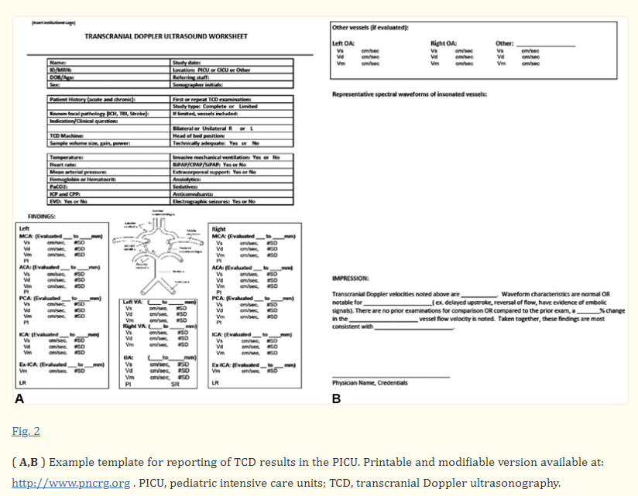
Transcranial Doppler velocities are… Waveform characteristics are normal OR notable for…. (eg delayed upstroke, reversal of flow, have evidence of embolic signals). There are no prior examinations for comparison OR compared to the prior exam, a … % change in the … vessel flow velocity is noted. Taken together, these findings are most consistent with …

Slide 8
Deeper search…
PI = (VS − VD)/VM (normal values = 0.82 ± 0.11)
Normal PI is 0.7 1.1.

Slide 9
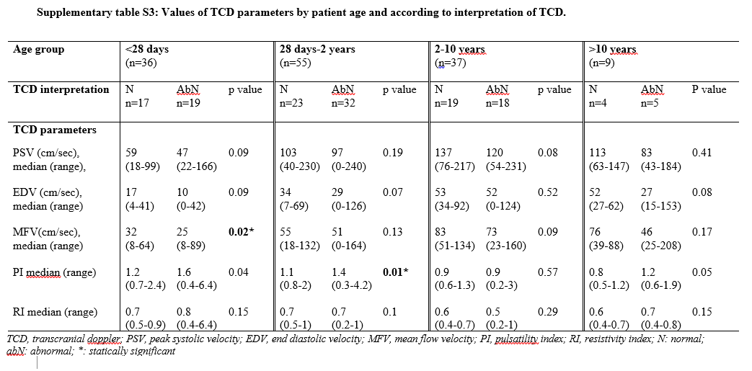

Slide 10
TCD in paediatrics on ICU
Applications:
1. Evaluation of cerebral haemodynamics
2. Investigating cerebral autoregulation and vasoreactivity
3. Evaluating intracranial pressure estimation and cerebral perfusion pressure
4. Screening for vasospasm
5. Monitoring cerebral emboli
    traumatic brain injury
    hypoxic-ischemic brain injury
    Stroke
    Sepsis
    diabetic ketoacidosis
    central nervous system infections
    hepatic encephalopathy
    monitoring while on extra-corporeal membrane oxygenation

Slide 11
Evaluating Cerebral Haemodynamics
Small studies on children with moderate to severe traumatic brain injury
EDV <25cm/s on arrival to A&E was associated with poor outcome
MCA cerebral blood flow velocity <2 SD from normative had bad neurological outcome

Slide 12
Small studies on children with hypoxic-ischaemic brain injury
Abnormal cerebral blood flow velocity within 48hrs of injury was associated with poor neurological outcome

Slide 13
Small studies on children on ECMO
Children on ECMO were noted to have lower cerebral blood flow velocity compared to normative data
Some of these children on ECMO developed acute cerebral hemorrhage and these children had abnormally high cerebral blood flow velocity. In these children, TCD elevation preceded clinical detection of acute intracranial hemorrhage by 2–6 days.

Slide 14
Evaluating Intracranial Pressure and cerebral Perfusion Pressure
ICP can be invasively measured but with risks
TCD can help to evaluate elevated ICP or risk-stratify patient who should have invasive ICP measurement
As ICP increases; there is a bigger reduction in diastolic velocity than systolic velocity which causes raised PI

Slide 15
Small studies on children with severe traumatic brain injury
pulsatility index may be most impactful in the early stage of illness
TCDs performed on the day of admission were characterized as being abnormal if they had evidence of flow reversal, no flow, reduction in diastolic velocity < 25 cm/s, or an elevated pulsatility index (PI > 1.31)
An abnormal TCD had 94% sensitivity for predicting an ICP > 20 mmHg
Beyond day 1 of injury, the sensitivity of PI ≥ 1.3 to detect intracranial hypertension fell to 47%

Slide 16
CASE STUDIES

Slide 17
Case 1- Hepatic failure
Twin II (DCDA twin) born at 35+2 weeks via emergency cesarean section due to pre term labour, uneventful birth, was discharged on D5 of life. Developed lethargy and poor feeding on D6 and was admitted to Broom fileds hospital where sepsis screen was done and she was found to have deranged liver enzymes with deranged coagulation and thrombocytopenia, and raised ammonia level. She had conjugated hyperbilirubinaemia which worsened over the stay.
Mother was unwell at time of labour and was given antibiotics prior to labour
She was positive for Enterovirus in blood and stool and received one dose of IVIG at Broomfields hospital. She was transferred to Luton hospital for further management. At Luton she required ventilation for 6 days due to repeated episodes of apnea. She is on room air since 5/4.
She received multiple blood products during her stay viz platelets, FFP, cryo, PRBC and albumin
She is transferred to KCH for further management
Notes:
35+2 is 35 weeks and 2 days. Full term considered from 37-40 weeks so Eva was premature

Slide 18
Twin sister Ivy, also enterovirus positive with disseminated enterovirus infection unfortunately passed away yesterday following transfer to GOSH for further management.
Mum reports her father has a background of Nonalcoholic fatty liver disease (NAFLD) as a child (non obese) and underwent investigation for this.
Most likely enterovirus infection is the main cause for Eva's clinical picture,

Slide 19
1st TCD- 10.4.24
RIGHT
MCA PI values | 1.8-2.0
MCA mean velocities | 33-34 cm/s
LEFT
MCA PI values | 2.0
MCA mean velocities | 37-42 cm/s
Conclusion:
Forward flow throughout the cardiac cycle in MCA bilaterally.
PI values are a bit elevated.
This is baseline scan, No previous scans for trend analysis.

Slide 20
2nd TCD- 12.4.24
RIGHT
MCA PI values | 2.54-2.80
MCA mean velocities | 34-33 cm/s
LEFT
MCA PI values | 2.14-2.55
MCA mean velocities | 43-40 cm/s
Conclusion:
PORTABLE SCAN
Bilateral:
MCA are patent with forward flow throughout the cardiac cycle.
Elevated PI values bilaterally.
Ward Doctor informed.

Slide 21
3rd TCD- 13.4.24
RIGHT
MCA PI values | 2.7
MCA mean velocities | 31-35 cm/s
LEFT
MCA PI values | 2.2-2.3
MCA mean velocities | 30-32 cm/s
Conclusion:
PORTABLE SCAN
Variable flows throughout the test, with occasional reversed flow component.
Mostly the flow was forward throughout the cardiac cycle.
PIs remain elevated.

Slide 22
Further assessments lean towards enterovirus infection as well as coagulation disorder leading to acute liver failure. Couldn’t find any metabolic cause. Notes comment on multiple babies in the same time period dying/very sick of varying strains of enterovirus. Unclear still which is the main cause and which is the consequence.
Worsening of patient and issue with multiple long bleeds, concerned for external bleed

Slide 23
Fourth TCD- 26.4.24
RIGHT
MCA PI values | 2.12-2.76
MCA mean velocities | 39-44 cm/s
LEFT
MCA PI values | 2.23-2.37
MCA mean velocities | 44 cm/s
Conclusion:
Baseline scan.
Bilaterally:
MCA is patent with forward flow throughout the cardiac cycle. Raised PI values noted in MCA.

Slide 24
Fifth TCD- 30.4.24
 | RIGHT
MCA PI values | 1.74-1.93
MCA mean velocities | 45-48 cm/s
LEFT
MCA PI values | 1.79-2.03
MCA mean velocities | 47-50 cm/s
There is forward flow in the MCAs throughout the cardiac cycle bilaterally.
Slight decrease in PI values compared to the previous scan (26/4/24).

Slide 25
Sixth TCD- 09.5.24
 | RIGHT
MCA PI values | 1.44-1.63
MCA mean velocities | 63-67 cm/s
LEFT
MCA PI values | 1.34-1.59
MCA mean velocities | 62-72 cm/s
Conclusion:
There is forward flow in the MCAs throughout the cardiac cycle bilaterally.
Further decrease to PI values compared to the previous scans (26/4/24 and 30/04/24).

Slide 26
Worsening with vomiting and tachycardia, more oedematous and increased ascites. Moved again from HDU to ICU
Had abdominal fluid drained and improved ventilation and ascities
Developed later blood in stools then severe rectal bleed- abdominal bleed

Slide 27
7th TCD- 24.6.24
RIGHT
MCA PI values | >5
MCA mean velocities | -cm/s
LEFT
MCA PI values | >3
MCA mean velocities | - cm/s
Conclusion:
There is very high resistance flow waveform in both right and left MCA with PI >3.
There is no flow in diastole on the right. On the left there is triphasic waveform but there is some forward flow at the last part of diastole.
Findings suggest possible poor perfusion or very raised ICP
Result discussed with team on ward at time of scan
Seems this was due to very high persistent ammonia levels which they struggled to control

Slide 28
8th TCD- 25.6.24
 | RIGHT
MCA PI values | 2.1-2.3
MCA mean velocities | 28-32 cm/s
LEFT
MCA PI values | 1.8-2.1
MCA mean velocities | 31-36 cm/s
Conclusion:
There is now forward flow throughout the cardiac cycle bilaterally and PI values are largely decreased since the previous scan.

Slide 29
9th TCD- 26.6.24
RIGHT
MCA PI values | 1.57-1.95
MCA mean velocities | 31.9-36.6 cm/s
LEFT
MCA PI values | 1.39-1.58
MCA mean velocities | 36.9-47.4 cm/s
Conclusion:
There is forward flow throughout the cardiac cycle bilaterally.
PI values are slightly reduced compared to the previous scan.

Slide 30
10th TCD- 1.7.24
RIGHT
MCA PI values | 1.20-1.32
MCA mean velocities | 44-50 cm/s
LEFT
MCA PI values | 1.09-1.28
MCA mean velocities | 47-50 cm/s
Conclusion:
MCA is patent with normal forward flow throughout cardiac cycle.

Slide 31
Sudden cardiac arrest- loss of cardiac output and severe hypotension, bradycardia and desaturation

Slide 32
Liver transplant on 24.7.24. On 25.7.24 hepatic artery occluded and was replaced in theatre. After this new artery was kinked and no flow into transplant, necrosis of new liver
donor artery graft positive for candida albicans – on antifungals
planned for re- transplant. On 6.8.24 had re-do which appears successful to now. Had another cardiac arrest and further complications, still on PICU

Slide 33
Case 2- brain injury
baby was on bed with mother asleep and ? Mother rolled over. Baby found not breathing - ambulance called.
Out of hospital cardiac arrest at home
Mother explains “she was out with a friend earlier, came home and Brody was well at that time, she picked him from the pram and put him into the bed. She then went to toilet for half an hour to an hour and when she came back she found that Brody was not breathing and did not respond to her calling him. She panicked and did CPR with two fingers as was instructed to her when Brody was in NICU. Brody changed color to purple and mum called ambulance. Mother told me that she was alone in the house at that time but was with a friend outside prior to that.”
Informed child abuse investigation team who said mothers story has change 4/5 times and she will be re-arrested and treated as a crime scene. Mother not allowed to visit patient.
Police were to remain resident in PICU due to query of non-accidental injury. Mum and dad arrested. Grandmother is legal guardian of older brother due to violent partner of mother. Mothers partner arrested, mother released. Mother found to have alcohol on breath whilst in parents room visiting.
Notes:
35+2 is 35 weeks and 2 days. Full term considered from 37-40 weeks so Eva was premature

Slide 34
First TCD- 25.6.24
RIGHT
MCA PI values | >10
MCA mean velocities | <10 cm/s
 | LEFT
MCA PI values | >10
MCA mean velocities | <10 cm/s
Conclusion:
Bidirectional waveforms with significant flow reversal and severely raised PI values are both suggestive of little to no perfusion to the brain. .

Slide 35
2nd TCD- 26.6.24
RIGHT
MCA PI values | >10
MCA mean velocities | <10 cm/s
LEFT
MCA PI values | >10
MCA mean velocities | <10 cm/s
Conclusion:
Bidirectional waveforms in the MCAs throughout the cardiac cycle with significant flow reversal and severely raised PI values. This is suggestive of low perfusion to the brain or severely raised ICP.
No significant change compared to previous scan.

Slide 36
CT from this morning reported: Irreversible infarction of the entirety of both cerebral hemispheres secondary to diffuse hypoxic ischaemic injury, there is swelling of both cerebral hemispheres, with effacement of the ventricles, sulcal spaces and basal cisterns, with bilateral uncal and central transtentorial herniation.
Eye injury on both sides (haemorghages)= sudden head movement or whiplash
Raised intracranial pressure, likely to have further cardiac arrest and placed on DNR

Slide 37
stopped breathing on Monday evening, his heart stopped for at least 23 minutes and as a consequence of this, his brain suffered catastrophic injuries.

Slide 38
References
Lovett ME, O'Brien NF. Transcranial Doppler Ultrasound, a Review for the Pediatric Intensivist. Children (Basel). 2022 May 16;9(5):727. doi: 10.3390/children9050727. PMID: 35626904; PMCID: PMC9171581.
O'Brien NF, Reuter-Rice K, Wainwright MS, Kaplan SL, Appavu B, Erklauer JC, Ghosh S, Kirschen M, Kozak B, Lidsky K, Lovett ME, Mehollin-Ray AR, Miles DK, Press CA, Simon DW, Tasker RC, LaRovere KL. Practice Recommendations for Transcranial Doppler Ultrasonography in Critically Ill Children in the Pediatric Intensive Care Unit: A Multidisciplinary Expert Consensus Statement. J Pediatr Intensive Care. 2021 Jun;10(2):133-142. doi: 10.1055/s-0040-1715128. Epub 2020 Sep 4. PMID: 33884214; PMCID: PMC8052112.
Rollet-Cohen V, Sachs P, Léger PL, Merchaoui Z, Rambaud J, Berteloot L, Kossorotoff M, Mortamet G, Dauger S, Tissieres P, Renolleau S, Oualha M. Transcranial Doppler Use in Non-traumatic Critically Ill Children: A Multicentre Descriptive Study. Front Pediatr. 2021 Jul 2;9:609175. doi: 10.3389/fped.2021.609175. PMID: 34277513; PMCID: PMC8282928.
Pediatr Radiol (2011) 41 (Suppl 1):S153–S165 DOI 10.1007/s00247-011-2038-y

