Slide 1
Recently Completed Research Projects
Connor Hiscocks – Oxford University Hospital NHS Trust
“A local evaluation of manual and automated Ankle Brachial Pressure Index techniques currently available within the Vascular Studies Unit”
Compared automated air plethysmography ABPI to manual ABPI and duplex ultrasound
24 patients
Compared to duplex; autoABPI 44% sensitivity and 89% specificity, manABPI 91% sensitivity and 100% specificity.
Findings suggest that autoABPI should not be primary method.
AutoABPI agreement with duplex worse at low results
Notes:
Manual ABPI shows better agreement with duplex

Slide 2
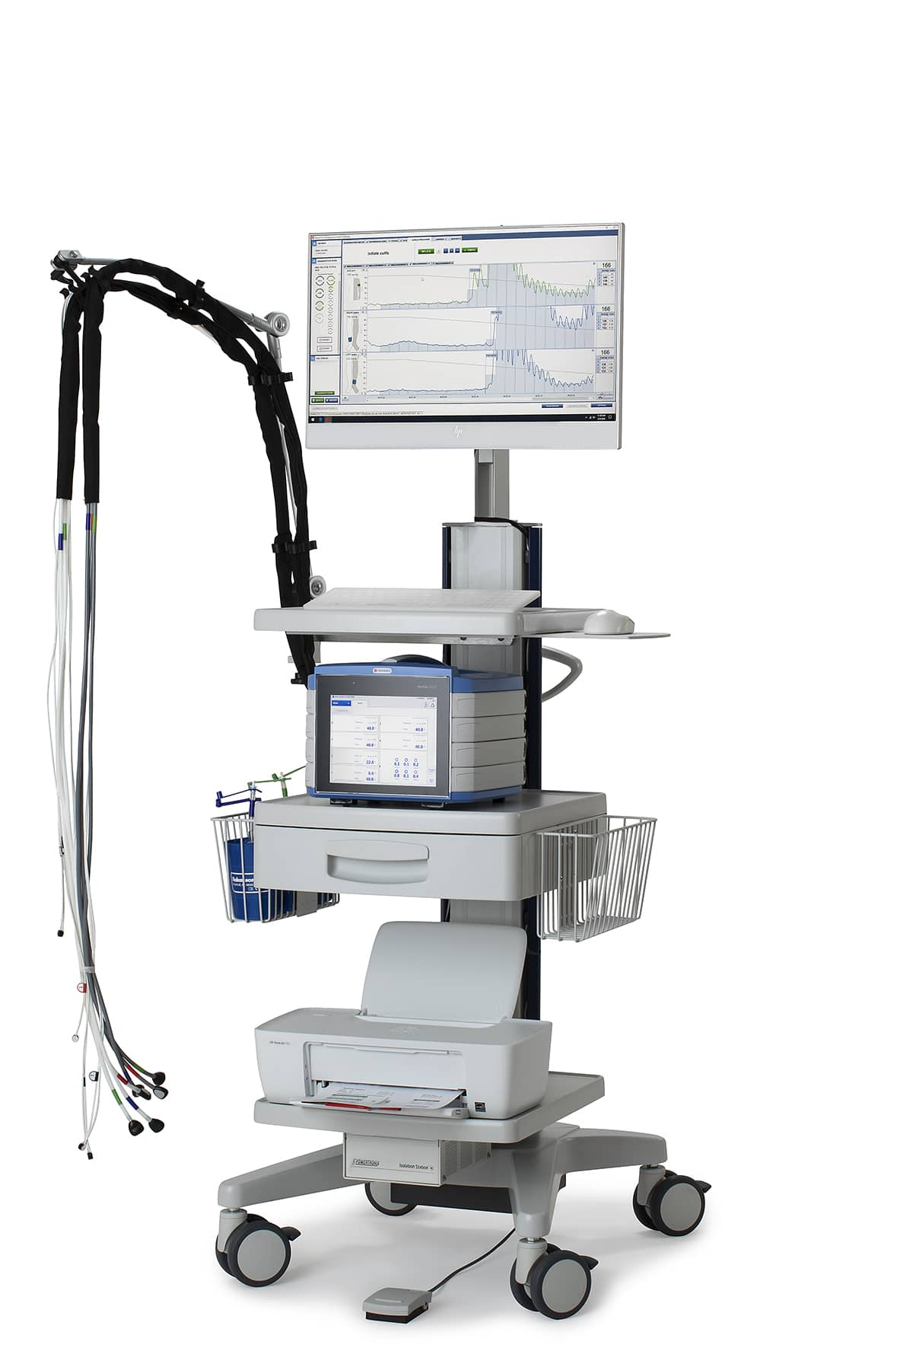
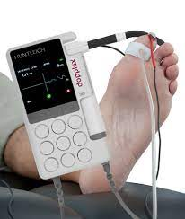
Department Audit
PERIMED Laser Doppler (LD)
VS
Huntleigh Dopplex Photoplethysmography (PPG)
Notes:
Department audit to compare TBI results from the PERIMED with the Huntleigh Dopplex.
The PERIMED uses laser Doppler and derives a perfusion signal from the Doppler shift undergone by the emitted infrared laser light after reflection from moving particles (red blood cells) and the probe locally heats the toes to 40 degrees.
The Huntleigh uses photoplethysmography (PPG). PPG is based on detecting changes in the blood filling of the digital arteries and arterioles. The PPG sensor emits infrared light that penetrates the tissue under the probe and is reflected by red blood cells. The more red blood cells present, the higher the reflected signal.
Perimed equipment uses laser Doppler (LD) technique for detection, combined with a unique local heating feature to ensure reliable and reproducible results. This is superior to photoplethysmography (PPG) because LD is better able to detect low pressures.

Slide 3
Department Audit
Compare toe pressure measurements obtained using the Laser Doppler method (LD) (PERIMED PeriFlux), with those obtained with a portable device using photoplethysmography (PPG) (Dopplex DMX, Huntleigh).
Six patients referred to our vascular laboratory for TBI measurements
During the study period six patients, comprising eight legs, were investigated. Their mean age was 78 years (range 60–86 years). Of these, 66% were males and 50% had diabetes. Their clinical symptoms were intermittent claudication, rest pain and/or ulceration, or prior to compression hosiery.

Slide 4
Results
In total, 3/8 (38%) limbs had TBIs of >0.70, and 5/8 (62%) limbs had TBIs of <0.70.
18.5mmHg mean difference in absolute toe pressure
Absolute toe pressure difference >10mmHg in 63% of patients
One patient, unable to obtain a reading using the Huntleigh Dopplex
Notes:
There were no patients which were classified as critically ischaemic
Unfortunately, none of these patients went on to have a duplex so I was unable to look at the agreement with these results.

Slide 5
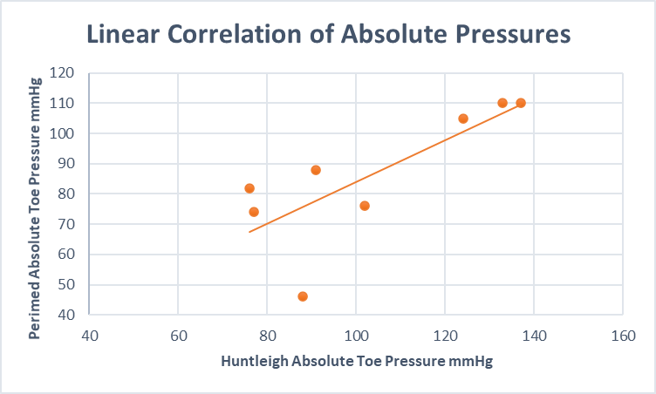
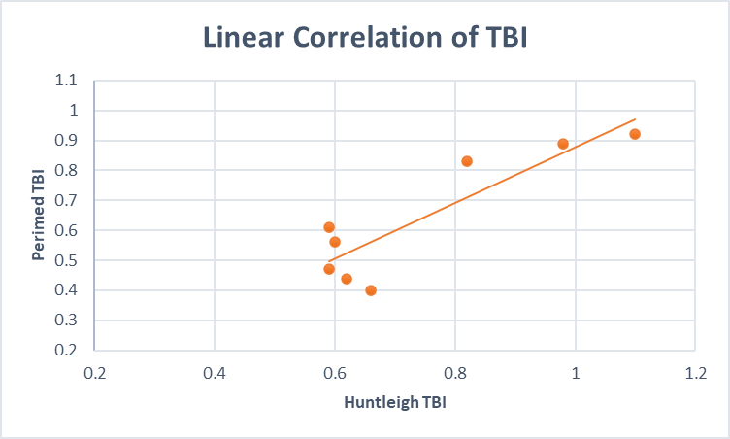
Results
Notes:
This highlights poor correlation at low pressures

Slide 6
Results
Comparison with Duplex results over 6 month period from March-September 2022
Reviewed PERIMED TBI reports with TBI <0.7 referred for lower limb arterial duplex
54 reports were compared, 36 of which were found to have significant disease and 18 no significant disease found on Duplex
Notes:
Most of these TBI results were lower than 0.7 and some indicating critical ischaemia.

Slide 7
Discussion
Toe pressures measured by the PERIMED were lower than those measured by Huntleigh with greater variation at low pressures
One third of PERIMED results compared with Duplex did not show agreement
The PERIMED showed reasonable agreement with the Huntleigh Dopplex and Duplex. However, this agreement became poor at low pressures which may result in a degree of overdiagnosis
This highlights the importance of clinical history
Record which equipment is used when reporting
Notes:
Firstly, this is a very small scale audit. TP values vary greatly depending on the device used.
Previous studies have shown that LD gives higher TBP values than the PPG.
Previous studies have commented that LD may detect lower toe pressures, notably in diabetics, because LD appeared more sensitive to perfusion changes than PPG. There was on patient in which LD could not detect a perfusion signal, whereas the PPG could not.
Using the LD for TBP measurements gave the investigators the impression of a more accurate assessment, because the exact moment of reappearance
of the perfusion could be assessed off-line, which was not possible with the PPG. Poor signals in the lower pressure range can be difficult to discern with both techniques, due to background noise.
Highlights the importance of clinical history and assessment. Do the patients symptoms match the TBI? Treat low readings with some caution. Record which equipment is used. PERIMED functions as a screening tool identifying patients in need of further imaging.
Huntleigh requires more training and is more operator dependent. Many staff are not confident to use it and does take more time.

