Slide 1
Are current triaging systems reflecting risk of significant carotid stenosis?
Joanne Clapp
Gloucestershire Hospitals NHS Foundation Trust

Slide 2


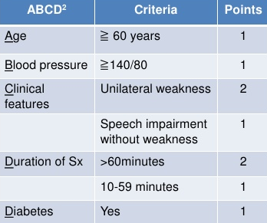
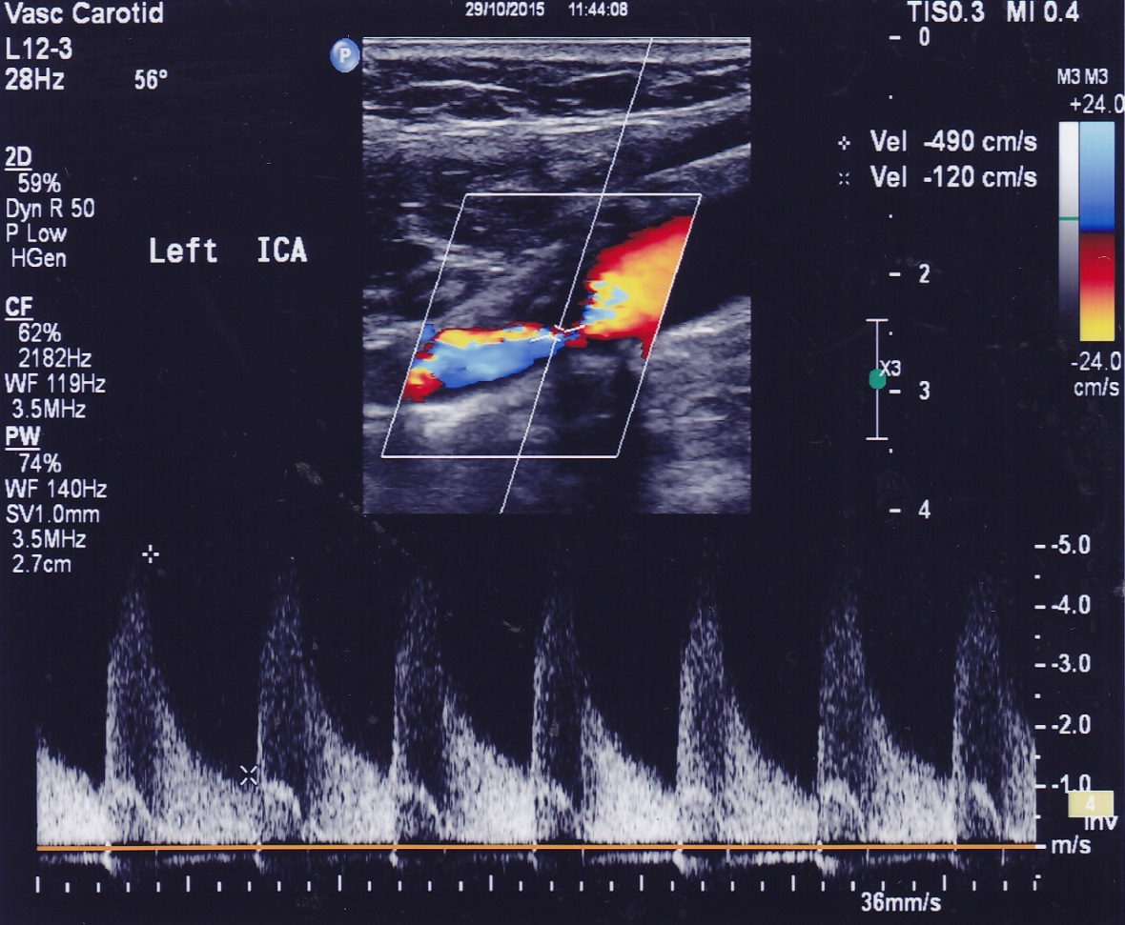
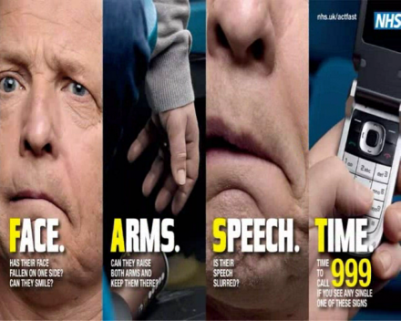
Introduction
TIA and stroke patients
ABCD2 score
Visual symptoms
Carotid ultrasound
Aim
Is significant carotid stenosis associated with visual symptoms?

Slide 3







Method
Initial feasibility study
Prospective observational study
Data collection June 2015 - Jan 2016
10 Vascular Scientists
Significant carotid stenosis = NASCET
Statistical analysis

