Slide 1



Open repair Abdominal Aortic Aneurysm (AAA) patients provide additional insights into their post-operative inpatient care compared to those undergoing endovascular repair
Anna Corby – Junior Vascular Scientist
Oxford University Hospitals (OUH) NHS Foundation Trust
Notes:
Hello
Anna from Oxford and I’m speaking about my project investigating AAA patients’ perceptions of their post intervention care at my trust (Oxford).

Slide 2

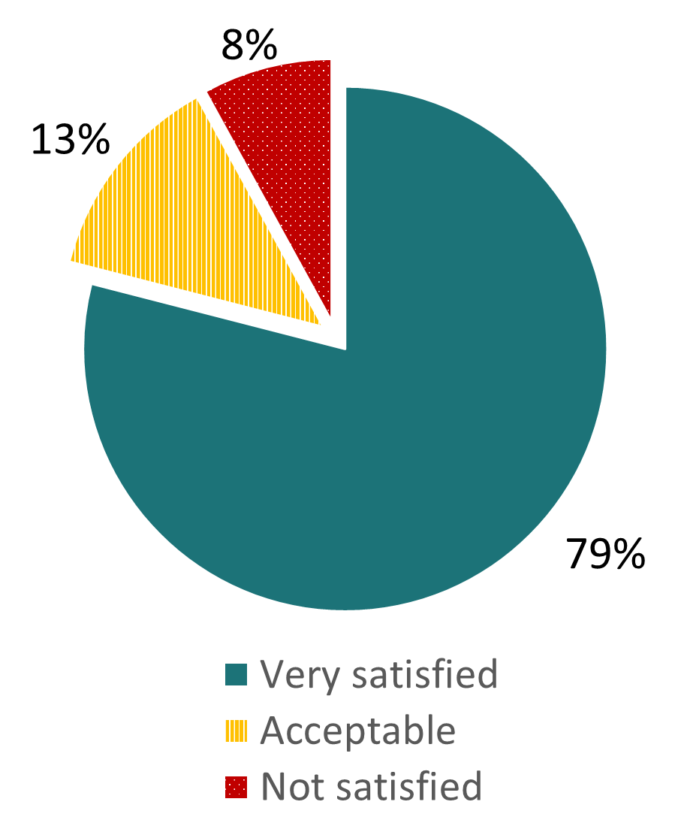


1) Background
2-4 elective AAA repairs a week in Oxford.
Lee et al. (2017) asked Oxford AAA patients:
“How satisfied are you with your care on the ward?”
Notes:
Every week in Oxford, about 2-4 patients undergo elective AAA repair operations, so we almost always have AAA patients on the vascular ward in some stage of their post-operative recovery.
One study by Lee et al. included a survey of AAA patients at our hospital asked ‘How satisfied they were with their care on the ward?’.38 Just over a fifth of AAA patients in our ward felt that their care could be improved (answered acceptable or not satisfied), but we didn’t know why they felt this way from this survey.

Slide 3


2) Aims
A) Understand the perceptions of AAA repair patients about their post-operative inpatient care
B) Explore differences in perceptions between open repair and endovascular repair groups
Notes:
Hence, this service evaluation had two objectives:
The primary objective was to understand the experiences of patients receiving an AAA repair towards their inpatient care during recovery at OUH. 35 The secondary objective was to understand whether there are differences in these perceptions between the open repair and endovascular groups.
(Inpatient care to focus the study as I couldn’t look at everything)

Slide 4



3) Methods
Mixed methods service evaluation:
Open-ended questionnaire
Quantitative questionnaire – PPE-15
In-depth interview
Notes:
This was a mixed methods service evaluation using qualitative and quantitative assessment methods:
An open-ended qualitative questionnaire asking patients to describe aspects of their care in their own words.
A subset of patients underwent a longer qualitative interview covering their experiences in more detail.
(These were piloted by two patients who had undergone an open and EVAR intervention.)
A validated quantitative survey called the PPE-15 was also used to allow patients to identify problems with aspects of the inpatient experience by selecting pre-defined answers.
(A quantitative survey called the patient picker experience 15 question tool (PPE-15) is a validated method for assessing inpatient care where patients rate their care from a range of predefined answers which can be categorised as a problem or no problem. This means I can calculate the percentage of patients identifying a problem with different aspects of the inpatient experience.)

Slide 5



3) Methods
Hospital stay
7-14 days post-discharge
6+ weeks post-discharge
Open-ended questionnaire
PPE-15 questionnaire
Demographic data
Consultant follow up appointment
In-depth interview
Notes:
If a patient agreed to take part, they were asked to complete the PPE-15 and the open-ended questionnaire, ideally 7-14 days post-discharge over the telephone. (Self-reported demographic data was also collected at this point.) Ideally, interviews took place after their consultant follow up appoint, 6 weeks or more after discharge. (Allowing patients to be selected throughout the study period based on particularly positive or negative events – opportunities for the most learning).
The qualitative data was analysed thematically, using Nvivo. (After transcription and anonymisation, multiple active readings). Themes were identified for the whole cohort and then compared between groups.
Tests for normality on the quantitative data were performed using the Shapiro-Wilk test. Differences in demographic data and responses to the PPE-15 questionnaire between the open and endovascular repair groups were analysed using a variety of tests (including unpaired t-test, chi-squared test, Fischer’s exact test or Mann-Whitney U test), as appropriate, depending on the distribution and sample size.
Extra bits:
Participants were eligible if they met the inclusion criteria:
aged 18 years or older
undergoing elective AAA repair (endovascular or open)
understands and speaks English
has capacity to consent
Patients meeting any of the exclusion criteria were not recruited:
younger than 18 years
undergoing emergency AAA repair
undergoing complex aneurysmal repair (fenestrated or thoracic aneurysm repair)
those without capacity to consent.
To achieve acceptable levels of risk of Type I and II errors, a p<0.05 value was selected as the threshold to determine whether there is a statistically significant difference between the groups, and 80% power was selected, respectively. The anticipated incidence of problems originates from the publication validating the PPE-15 questionnaire, where an average of 32.4% of UK inpatients identified a problem with their care, across all questionnaire items.⁴⁴ With little published research on inpatient care after AAA surgery, Professor Handa was consulted to determine what constitutes a meaningful clinical difference between the patient groups. He suggested that a difference of 30% may be considered meaningful as the surgeries have very different recovery pathways. 84 patients are required to detect a difference of ≥30% above the anticipated incidence, which is also provides sufficient power to detect a ≥25% difference below the anticipated incidence (78 patients required).⁵⁶ Recruitment of this many patients should also be possible within the timeframe.
Although needed 84 patients for statistical power which was not achieved.

Slide 6
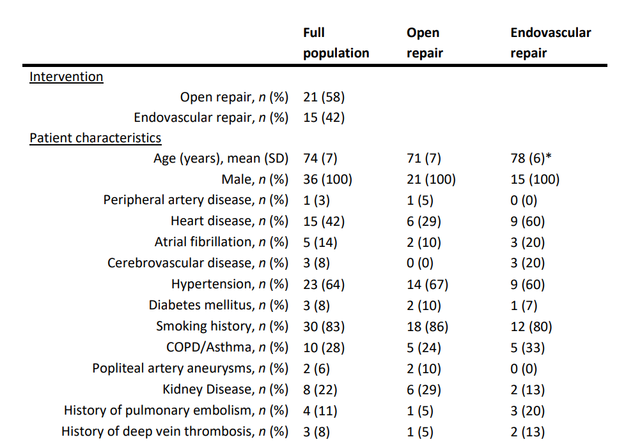
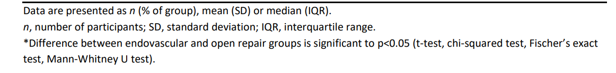
4) Results - demographics
36 patients completed the open-ended and PPE-15 questionnaires.
6 patients completed interviews (3 from each intervention group).
Notes:
38 patients were recruited in total, however 2 of these patients did not complete questionnaires/interviews so have been removed from the results, so 36 patients were included in total 15 endovascular patients and 21 open repair patients.
3 patients from each group completed an interview.
(Unfortunately, the two patients who did not complete the questionnaires were both originally from the endovascular group, which partially accounts for the uneven split, between the two groups).
All patients were male, with an average age of 74.
There were a range of medical histories, with smoking history and hypertension being most common (expected), and apart from the difference in age, no other statistical difference between the two groups was seen in terms of patient medical characteristics.

Slide 7
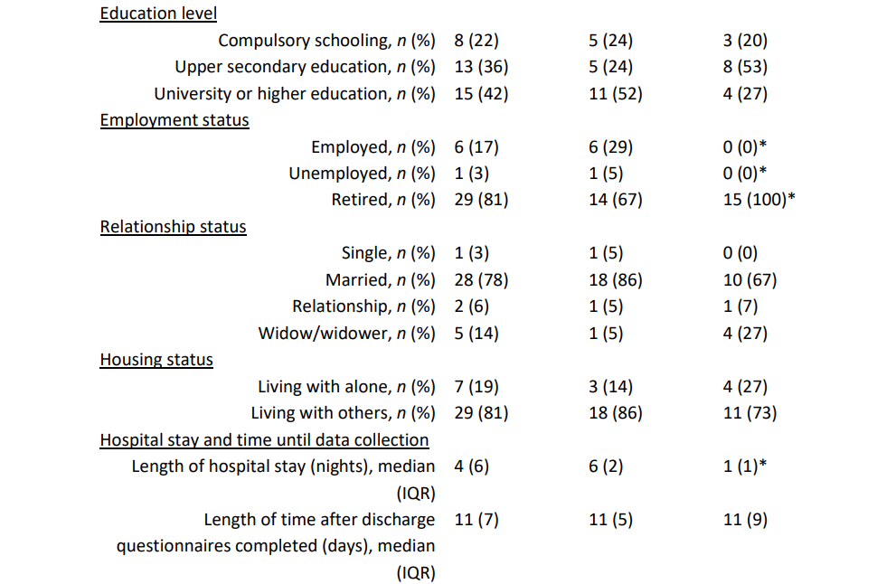
4) Results - demographics
Notes:
From other demographic data, only the employment status and length of the hospital stay between the two groups was statistically different. (likely due to slightly older age too).
(Length of hospital stay was significantly different between the two groups, (evar patients go home quickly unless there’s complications, whereas OR patients spend time in ICU and then on the ward before going home) but the length of time after discharge the questionnaires were completed was not.)

Slide 8
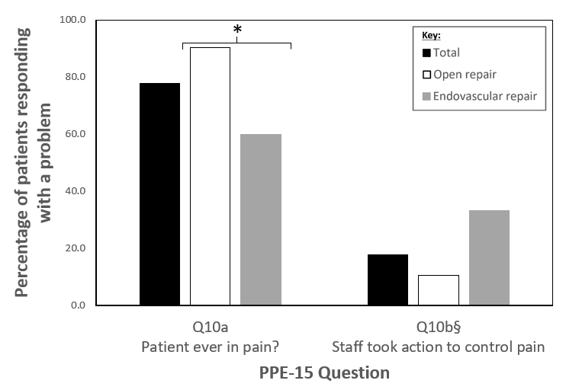
4) Results – PPE-15 responses
Notes:
There were 15 questions on the PPE-15 which were grouped by different dimensions of care so I’m going to briefly run over the questions where the highest proportion of patients reported problems:
Physical comfort domain:
78% of patients reported being in pain (Q10a), with a statistical difference between the open and endovascular repair group. Thankfully, far fewer patients felt that their pain was not being sufficiently managed (18%) (Q10b), and the statistical difference had been lost between the two groups.
(Pain difficult to avoid due to operation, questions include a range of answers for ‘problem’).

Slide 9

4) Results – PPE-15 responses
Not adequately informed about complications to watch for at home.
56%
Notes:
Patients also raised problems with the continuity and transition, with
56% of all patients reporting problems with receiving sufficient information about danger signals to observe at home (Q15).
(42% of patients had problems with information about medication side effects (Q14) and also with receiving conflicting information from different staff members.)

Slide 10


4) Results – themes
Being an active participant in their care
Feelings of gratitude
The hospital environment – noisy
Communication with staff – discharge conversations sometimes unclear
Confidence in staff
Patience with recovery
Feeling lucky
Fearing infection from other patients
Links to the outside world
4) Advocating for their needs
Both intervention groups
Open repair patients only
Notes:
From the qualitative data, five main themes were identified across both open and endovascular repair groups. These were:
Being an active participant in their care
Feelings of gratitude
The hospital environment
Communication with staff
Confidence in staff
Positive and negative things were said within each theme. However, key areas to improve from these themes were that the hospital environment was very noisy and busy (theme 3) and that discharge conversations were sometimes unclear (theme 4).
The open repair group also identified several unique sub-themes:
Open repair patients mentioned that they had to have patience with the recovery process as well.
All patients often expressed gratitude towards staff, however open repair patients also felt grateful to have survived the operation.
In terms of the hospital environment, open repair patients were concerned about infection from other patients whilst they were in hospital and spoke about links to the outside world, for example window views or being able to leave the ward easily.
Open repair patients also mentioned that they needed to have a role in advocating for their needs whilst staying on the ward e.g. preferences for pain relief and how to use the toilet.

Slide 11
5) Conclusions
Themes help us to understand how AAA patients feel about their care and how to improve.
Areas to improve include:
- Noise levels
- Information provision at discharge
Additional subthemes in the open repair group demonstrate they have additional priorities.
Notes:
The themes help us to understand how AAA patients feel about their care and how to improve.
Areas to improve include noise levels and information provision at discharge.
Additional subthemes from the open repair group demonstrate that they have additional priorities, likely due to the invasiveness of open repair and longer hospital stays.
Limits:
• Qualitative data collection did not occur face-to-face, which is the gold standard. (i.e. no non-verbal cues, interruptions)
• Learning effect of conducting qualitative interviews/questionnaires (e.g. leading questions)
• Unconscious bias in selecting interview participants. Extra reviewers will be good.
• PPE-15 has limited understanding of the vascular patient population as it is for all inpatients.

Slide 12






6) Next steps
To improve our AAA patient experience on the ward:
Installed a noise monitor at the nurses' station
Provide patients with ear plugs and headphones
Team lead physiotherapist is updating discharge information for AAA patients
Information day for AAA patients
Notes:
So to help improve the care we provide to our care for AAA patients, we have:
Installed a noise monitor on the ward to try and remind staff to minimize noise where possible, but aware that there is a level of noise needed for communication between staff, other patients etc.
Patients are given headphones, ear plugs etc. for when we can’t control the noise levels
Physiotherapist on the ward is updating the discharge information to help improve patient awareness of the next steps when going home
Our vascular service manager is also looking to develop an information day for AAA patients which had been previously successful for NAAASP patients in the region.

Slide 13
Thank you for listening

