Slide 1


Estimating & comparing the performance, clinical effectiveness, and cost-effectiveness of current diagnostic options for patients that present to primary care with suspected venous ulcers. 24th November 2022 Emma Flint

Slide 2
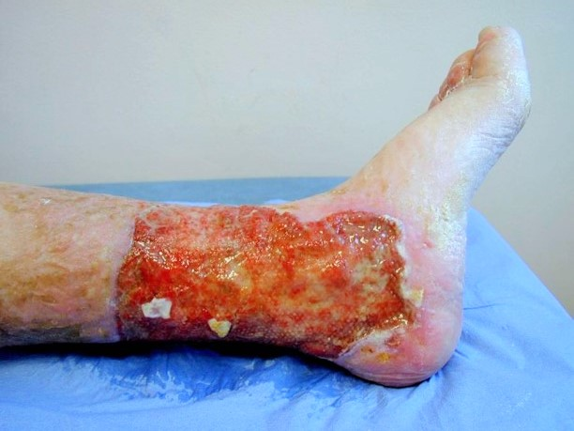
Venous Leg Ulcers
1 million patients in the UK are affected with a leg ulcer.
£3.1billion is the annual estimated cost associated with leg ulcers.
Pain, distress and a significant impact on quality of life.

Slide 3
Clinical Guidelines

Slide 4

NICE
Last recommendations revised in August 2021:
Assessment: Arrange investigations: ABPI, bloods and bacterial swabs.
Onward specialist vascular referral is suggested in certain scenarios.
https://cks.nice.org.uk/topics/leg-ulcer-venous/management/

Slide 5
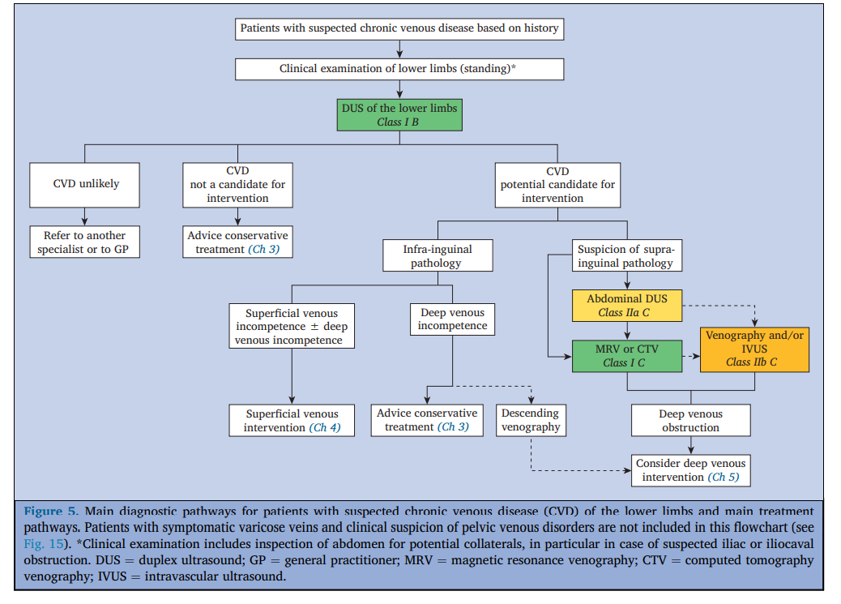
ESVS
Last recommendations revised in January 2022
https://www.ejves.com/action/showPdf?pii=S1078-5884%2821%2900979-5

Slide 6
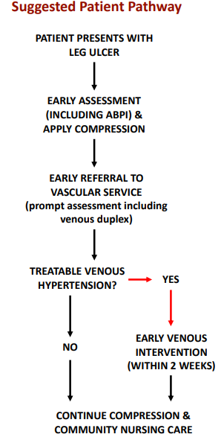
Venous forum
Last recommendations revised in April 2018
V10 Leg ulcer draft - Venous Forum MG (rsm.ac.uk)

Slide 7
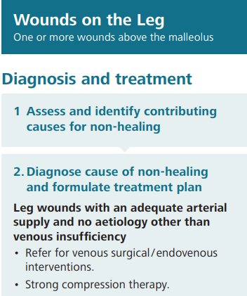
National wound care strategy
Last recommendations revised in Feb 2021:
https://www.nationalwoundcarestrategy.net/wp-content/uploads/2021/04/Lower-Limb-flowchart-25Feb21.pdf

Slide 8
Main aims and objectives

Slide 9
Main objective
The main objective of this project is to determine the role/position of diagnostic imaging in the patient journey for a patient with active or healed ulceration.

Slide 10
Aims
To determine:
The current practice in primary care for venous ulcer management.
The current practice for diagnosis and management of suspected venous leg ulcers in vascular scientist departments across the UK
The minimum diagnostics for this cohort of patients including what scans should be performed and can a set criterion be applied to this cohort of patients.
The cost effectiveness of implementing this in both primary and secondary care settings.

Slide 11
Proposed methodology

Slide 12
The current practice in primary care for venous ulcer management.
Establish what is current practice in primary care, using primary care networks to disseminate an electronic questionnaire to primary care centers to understand this.
Examples questions:
If a patient presents with suspected venous leg ulcers, what guidance do you follow with regards to diagnosing and managing venous leg ulcers?
Do you have access to staff that can perform ABPI in clinic?
Do you have staff that can perform any other form of diagnostic imaging on site?

Slide 13
The current practice for diagnosis and management of suspected venous leg ulcers in vascular scientist departments across the UK
Establish the current practice of vascular scientists across the UK for patients that present with a suspected venous leg ulcer via a Delph consensus.
Example initial questions:
Does your department run a specific leg ulcer clinic?
If so, what diagnostics do you perform during this clinic?
If a patient presents with a suspected venous ulcer, what diagnostic scans are performed on this patient?
What is a Delphi consensus?

Slide 14
The minimum diagnostics for this cohort of patients including what scans should be performed and can a set criterion be applied to this cohort of patients.
Review the current literature regarding typical pattern of reflux and anatomical location of ulcers
Is a spot check scan sufficient?
Could the diagnostic element of the pathway be performed in a primary care setting?

Slide 15
The cost effectiveness of implementing this in both primary and secondary care settings.
I intend to run two models of care depending on some of the outcomes from questionnaires discussed above. This will be discussed and designed in conjunction with David Epstein a health economist and modeler.
An idea of what these will be looking at:
Increasing the number of specialist ulcer clinics in community practice, with more advanced diagnostics, scientist to perform these diagnostics, and a set of nurse specialists
Optimizing and running specialist ulcer clinics in secondary care.
The methodology for this will follow that of previous work (Normahani et al. 2021; Epstein et al. 2018; Epstein et al. 2019).

Slide 16
Conclusion

Slide 17
Q&A

