Slide 1

A service evaluation investigating how patients feel about the care they receive after abdominal aortic aneurysm (AAA) repair
Anna Corby – Trainee Vascular Scientist
Oxford University Hospitals (OUH) NHS Foundation Trust
Notes:
Hello

Slide 2
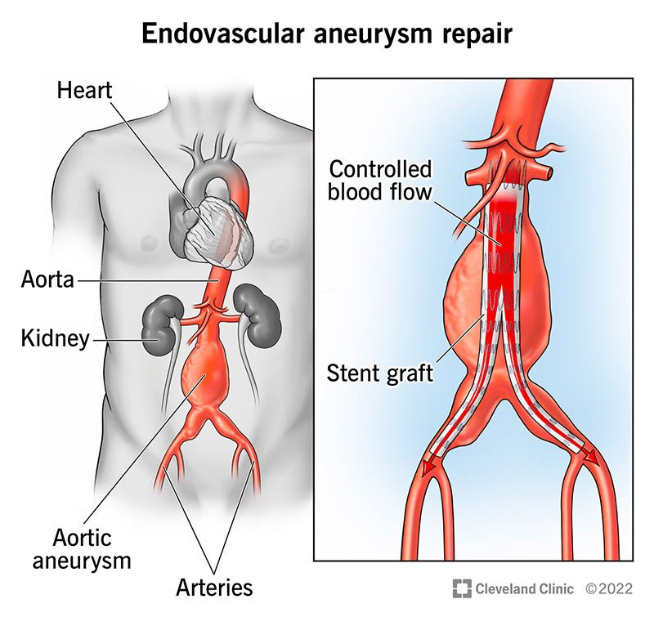
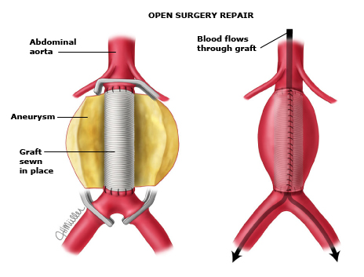
1) Background
Endovascular repair
Open repair
OUH: 2-4 AAA operations planned per week
Notes:
Every week in Oxford, about 2-4 patients undergo AAA repair operations, whether that’s endovascular or open AAA repair. This means that we almost always have AAA patients on the vascular ward during their post-operative recovery. I think AAA patients are an interesting group to study as these patients often have a long patient pathway before even reaching their intervention.
(would probably mean ~minimum of 104 pts/year)
________________
EVAR: https://my.clevelandclinic.org/health/treatments/22291-endovascular-aneurysm-repair
OR: https://www.uptodate.com/contents/image/print?imageKey=PI%2F57520

Slide 3
1) Background
AAA Patient experience
Impact of diagnosis
Living with the AAA
Impact of screening
Impact of open repair
Impact of endovascular repair
How do patients feel about their care around their operation?
?
Notes:
Within the body of work looking to understand the experience of being a AAA patient, there has been little research into understanding how patients feel about their care during the period around their operation.
Admittedly, this can be quite hard to publish as the results may be quite specific to each hospital and therefore not be generalisable.
https://www.ncbi.nlm.nih.gov/pmc/articles/PMC4687424/#bjs9838-bib-0001
https://www.vascularsociety.org.uk/_userfiles/pages/files/ASM%202022/VSASM%20Abstract%20Submission%20Guidelines%202022%20v2.pdf

Slide 4
1) Background
8%
13%
Lee et al. (2017) – ‘How satisfied were you with your care on the ward?’
79%
Notes:
Professor Lee et al.38 (2017) explored the experience of patients throughout the AAA clinical management pathway at OUH. They used a survey which included the question ‘If you had AAA surgery, how satisfied were you with your care on the ward?’.38 Whilst the majority of OUH patients were satisfied with their care, with 79% reportedly being ‘very satisfied’ with their care, this left 13% reporting their care as ‘acceptable’ and 8% would have been left ‘not satisfied’ (very satisfied/acceptable/not satisfied)).
So I would like to find out what patients think is good about their care and what patients think could be improved (i.e. what would have made them change their answer from acceptable to very satisfied?), and for those who are not satisfied – what could we avoid in the future or change about our care pathway?
Recheck literature > have checked ovid and google scholar for anything obvious, might need to use a finer toothed comb.

Slide 5
3) Importance
Compassionate and empathetic care is a key NHS value.
Patients with a positive patient experience have better health outcomes.
Improving the patient experience is a Vascular Research Collaborative priority.
Notes:
There are a number of reasons why I think understanding what patients feel about their care is really important.
Providing compassionate and empathetic care, is a key part of the NHS constitution. And we should check that patients feel that we are providing this to them. If we don’t check, how do we know when or how to improve?
Secondly, a positive patient experience is associated with better health outcomes (both patient-rated and objective measures), along with improved adherence to recommended medication and treatments, as well as reduced hospitalisation and adverse events.21, 22 **know these papers**
Finally, the Vascular Research Collaborative23 also recently (2021) identified the optimisation of vascular services to improve patient experience and outcomes as a top ten research priority amongst vascular healthcare professionals.23
So, hopefully this project will contribute to improvement of the OUH vascular service where it’s needed.

Slide 6


2) Aims
Primary objective: To understand the experiences and attitudes of patients about their inpatient care after AAA repair.
Secondary objective: To understand whether there are differences in patient perceptions between open and endovascular repair groups about their inpatient care.
Notes:
As a result, my project has two main aims.
First, I want to understand what the patient perspectives are of the care they receive after AAA surgery within an inpatient setting at Oxford University Hospitals NHS Foundation Trust.
[The Covid-19 pandemic may also have influenced the way care is given39-41 and perceived42 since Lee et al.’s research38 was published.]
And the second is to understand whether there are differences in the experiences of patients undergoing endovascular and open repair.

Slide 7





4) Methods
Intervention takes place
Pre-op assessment
Approached to consider participation
Patients’ AAA reaches 5.5cm
Consent discussion
Takes place before their surgery
Questionnaire stage
Quantitative and qualitative questionnaires completed
Interview stage:
Participants with notable experiences are selected for semi-structured interviews
1-2 weeks after discharge
6 week follow-up appointment
84 patients
10 patients
Notes:
If a patient’s AAA reaches 5.5cm, they will attend a pre-operative assessment clinic, and if they’re happy to take part, then 1-2 weeks after being discharged, I will ask all patients to complete two questionnaires over the telephone, one quantitative and one qualitative, and then a subset of patients are asked to take part in an interview when they come for their 6 week follow up appointment.

Slide 8
4) Methods
Primary objective: What do patients receiving an intervention for AAA repair feel about their care?
Themes from open-ended qualitative questionnaire
Themes from the semi-structured interviews
Outcome measure: bold
Notes:
For my project I will be using a mixed methods approach to achieve my aims. This means I will utilise both qualitative and quantitative data to answer my research questions.
For my primary aim, I wanted to understand what patients felt about their care in hospital after AAA repair.
I will conduct an open-ended questionnaire with all participants and complete semi-structured interviews with a subset, with 5 patients from each intervention group. The transcripts will then be thematically analysed to identify important features from the data.
The primary outcome measure is therefore what themes I identify from discussions with patients about their care.

Slide 9


Qualitative data
Open-ended questionnaire
Semi-structured interview
Describe elements of their care in their own words
  Confidence in staff
  Information provided
  Environment
  Guiding questions
  Range of possible follow up questions
  Flexibility to ask about anything else the participant mentions
Notes:
There are 8 questions in open-ended questionnaire asking patients to give short answers about a range of elements of their care, such as confidence in the staff, any worries they had and how they felt about the environment in hospital. It was tested by AAA patients and reviewed by a vascular surgeon. All participants will complete this. This is 84, as this is the same number needed for the quantitative questionnaire.
Patients giving notable answers in the questionnaires are then selected for interviews at their follow up appointments.
It covers 7 topics similar to the questionnaires and starts with some fixed guiding questions, with a list of possible follow up questions for each topic.
The prompts allow me to ask about areas I think may be important and the open-endedness allows patients to bring up anything else that I haven’t considered. A minimum of 5 participants from each intervention group will be asked to participate.

Slide 10
4) Methods
Secondary objective: What differences are there between patient groups?
a) Is there a statistically significant difference in answers to the quantitative questionnaire?
b) Is there a difference in the themes the groups discuss during the qualitative questionnaire and interviews?
Outcome measures: bold
Notes:
For my secondary aim, I wanted to understand if there are differences in how patients receiving endovascular and open AAA repair feel about their care.
There will be two secondary outcome measures.
First, there will be a quantitative aspect where patients will be given a quantitative questionnaire and I can compare the answers to this questionnaire using a statistical test. My outcome measure is whether there is a statistical difference between the two groups.
Secondly, I can compare the themes identified between the open and endovascular groups from the qualitative approaches to identify any similarities or differences.
Number of participants?
Data collection techniques

Slide 11
Patient picker experience 15 item questionnaire
1. When you had important questions to ask a doctor, did you get answers that you could understand?
Yes, always
Yes, sometimes
No
I had no need to ask
Notes:
The questionnaire I have chosen is the Patient Picker Experience short form questionnaire which has 15 questions about a range of elements of patient care. It has been validated by 1000s of patients, including for UK settings.
I have given an example of one of the questions and there are a range of answers the patients can select. They can be categorized as either there is no problem (blue) or there is a problem (orange).
This then allows me to compare the percentage of patients who identify a problem with their care for each item on the questionnaire between the two groups. I can then use the pearson chi-squared test to check for statistical significance as it is used to compare binary proportions (i.e. there is a problem vs. there isn’t).
84 patients are required in order to calculate whether there is a statistically significant difference, based on a power calculation.

Slide 12
4) Methods
Secondary objective: What differences are there between patient groups?
a) Is there a statistically significant difference in answers to the quantitative questionnaire?
b) Is there a difference in the themes the groups discuss during the qualitative questionnaire and interviews?
Notes:
Secondly, I can compare the themes identified between the open and endovascular groups from the qualitative approaches I have previously discussed.
Number of participants?
Data collection techniques

Slide 13
In summary
What do patients think about the care they receive in hospital after AAA surgery?
Are there differences in patient thoughts between those receiving open repair and endovascular repair?
What are we doing well in Oxford and how can we improve?

Slide 14
Thank you

