Slide 1
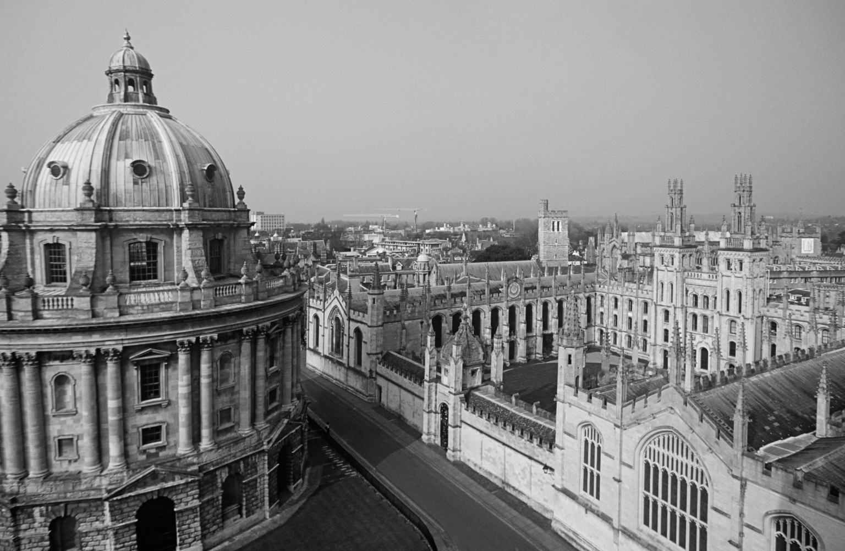



This is to certify that
Steve Saunders
Has attended the Thames Valley Vascular Network Venous Meeting on 18th March 2022
_______________________
Dr A Wigham
Consultant Interventional Radiologist
Oxford University Hospitals NHS Foundation Trust
_______________________
Miss E Wilton
Consultant Vascular Surgeon
Oxford University Hospitals NHS Foundation Trust
Kindly sponsored by Inari Medical

