Slide 1
Renal Artery Doppler
Josie Whitaker Sonographer

Slide 2
Duplex Criteria
PSV >180cm/s (>60% lumen diameter loss)
Acceleration time >70ms
RAR >3.5
Reduced renal length/ small kidney (<8cm)
RI >0.8 (Normal <0.7) considered a negative prognostic sign
Loss of early systolic peak

Slide 3
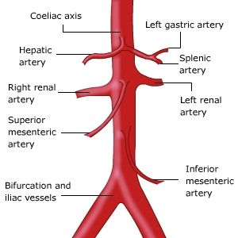
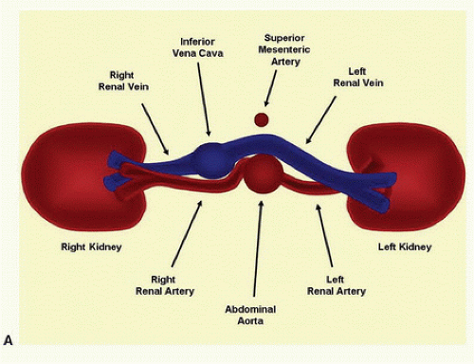
Anatomy
Aorta
Transverse

Slide 4
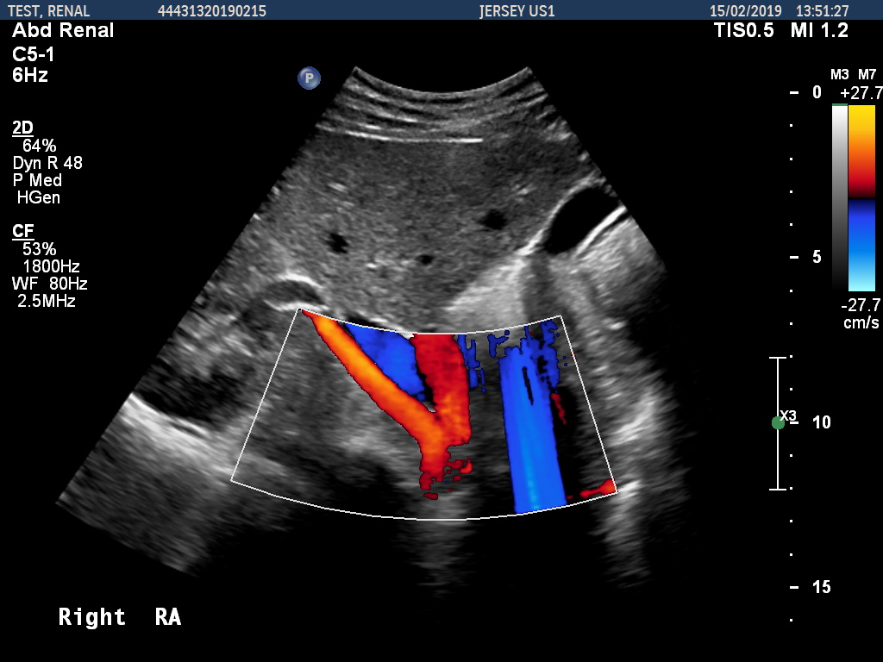
Hints and Tips
Start in TS of aorta to find renal artery origins (RT 10-11 o’clock position/ LT 3-5 o’clock position)
Atherosclerosis is generally located at the origin therefore if there is excessive bowel gas use distal intra-renal waveforms for secondary signs of RAS
FMD found in the mid RA

Slide 5
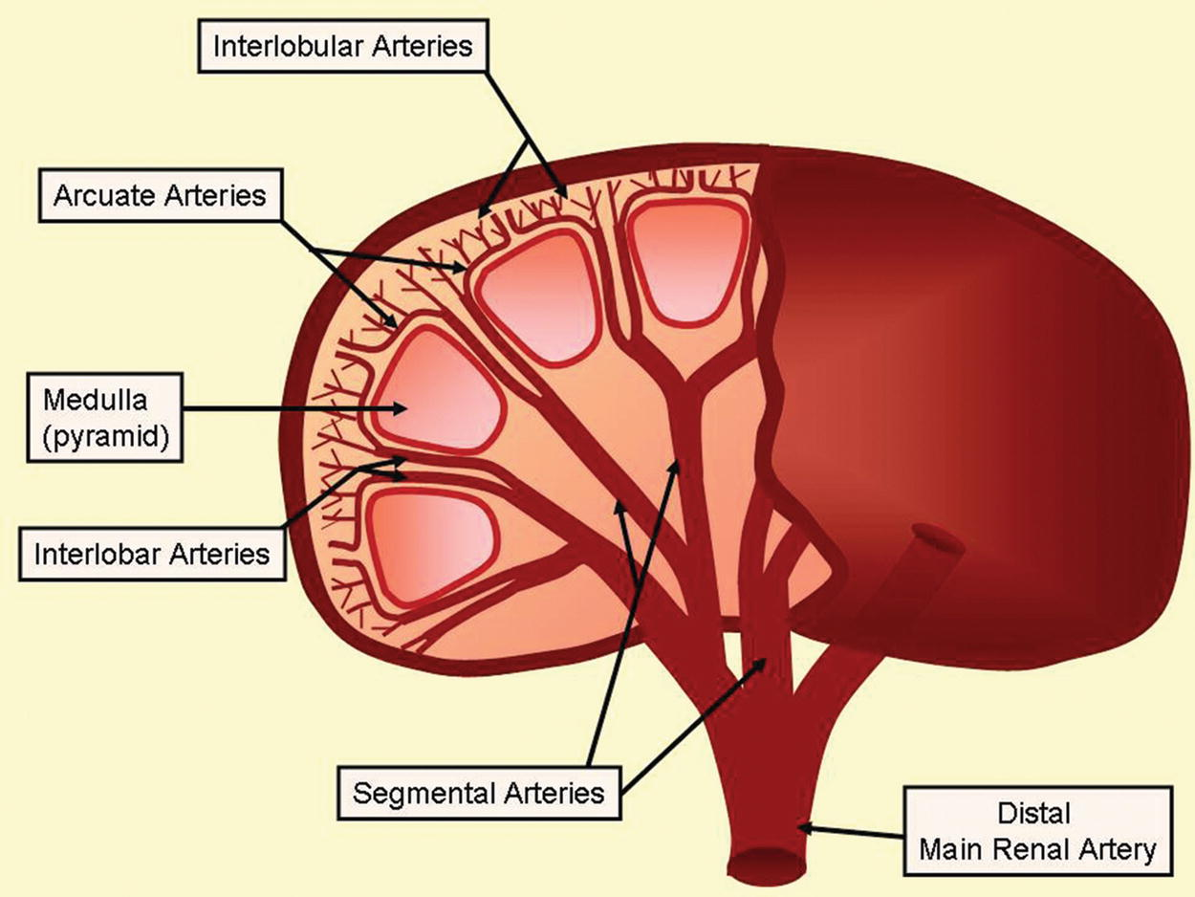
Renal Artery Anatomy

Slide 6
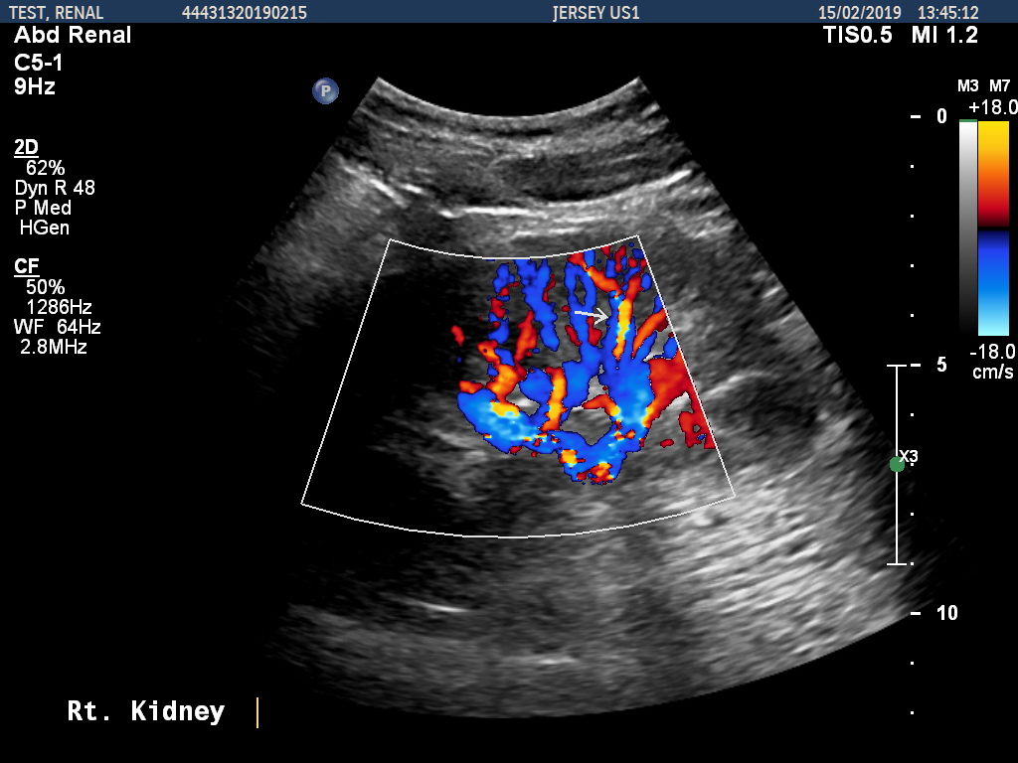
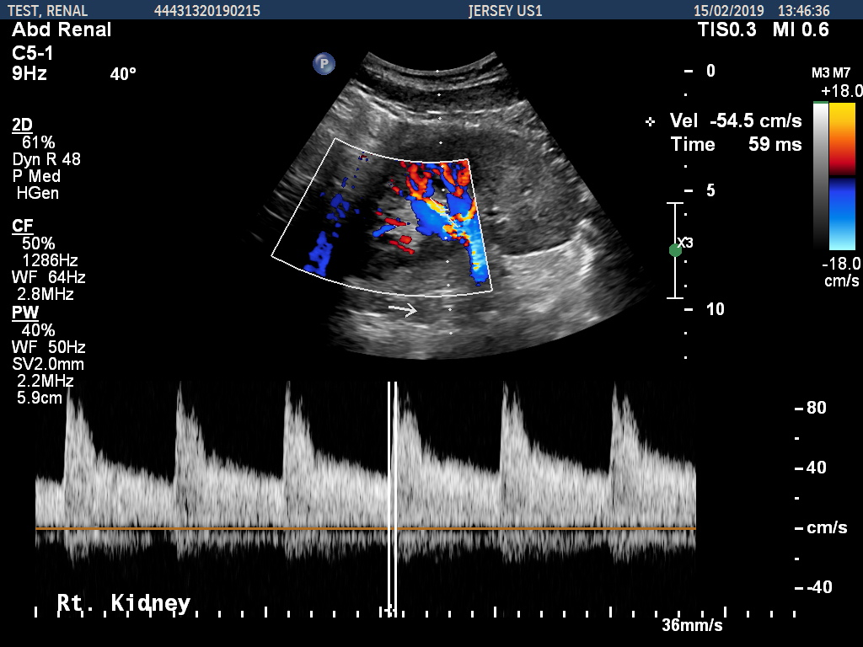
Measuring Acceleration Time
Where to measure AT
How to measure AT

Slide 7
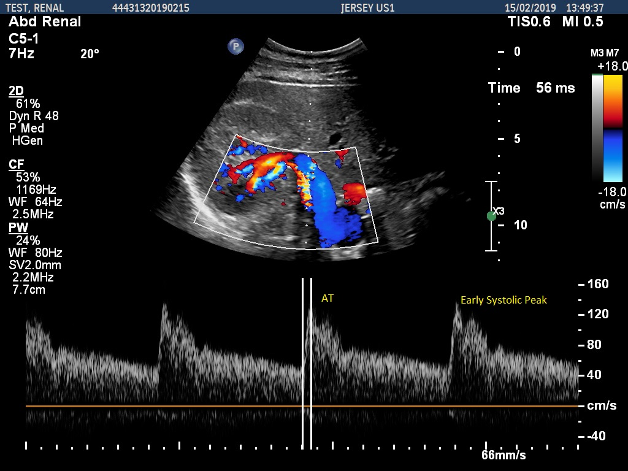
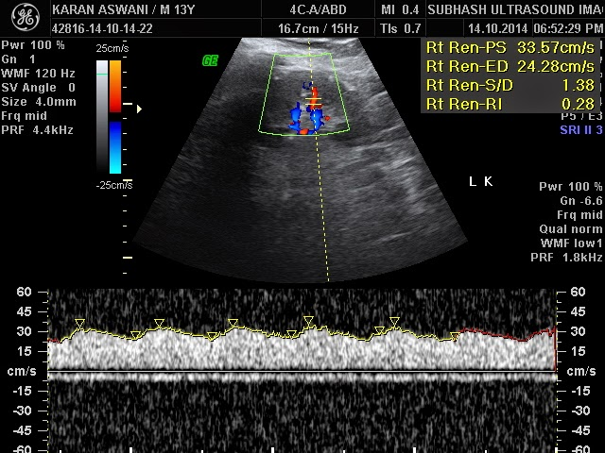
Intrarenal Artery Waveforms
Normal
Abnormal

Slide 8
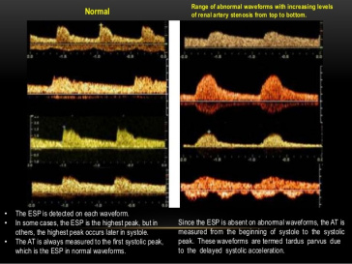
Resistive Index
Factors influencing Intrarenal RI, extent of stenosis, stiffness of vascular system, non-renal factors, location of RI measurement
Normal range = 0.6 -0.7
>0.8 predicts poor benefits from treatment????
Difference of >5% between the kidneys may be suggestive of RAS
Lower RI in the post-stenotic kidney.

Slide 9
Ultrasound Report
Normal
Abnormal
State if renal arteries visualised in their entirety
Normal ultrasound appearances of both kidneys
State renal lengths and RI
State no secondary signs of RAS if AT and renal length normal and no loss of ESP
State if stenosis directly visualised and max PSV and RAR if you have been able to visualise the stenosis.
If unable to visualise renal arteries and waveforms/AT suggestive of RAS state Abnormal intra-renal waveform with increased AT of 70 ms which is suggestive of RAS
Further imaging advised for confirmation.

