Slide 1


CST Southern group meeting Sub threshold aaa’s
Louise Fearnside
QA lEAD, Bristol, Bath and Weston AAA Screening Programme
Notes:
My name is Louise Fearnside and I’m currently the QA lead for the Bristol, Bath and Weston AAA screening programme and today I wanted to share something that we have recently implemented in our programme.

Slide 2

QA – NAAASP
Vascular Scientist
Notes:
I just wanted to share this with you all and wondered if you are in the same position. Sometimes I find it tricky to go to and from these two roles that I have, especially when there are differences in protocols and clinical management. This has become very apparent with subthreshold AAA’s during my quality assurance activity.

Slide 3

Sub- threshold AAA’s
NBT Department protocol
“At CVS discretion rescan 2.8-3.0cm aorta in 2 years. If unchanged discharge”
NAAASP
Recommendation; < 3cm discharge
Notes:
In our department, at our discretion, we perform a 2 year scan for aortas at 2.8 cm. Obviously with NAASP, generally a recommendation of discharge if less than 3 cm but we do then QA all those greater than 2.7 cm.
For those that look saccular or distinctly dilated subthreshold, I have been referring them on for a two year scan. I am finding this challenging and where to draw the line with this.
It has also produced another potential issue where these gentleman have been told everything’s fine and will therefore not be expecting a recall to the hospital in 2 years time. I have therefore asked the vascular nurse to call these gentleman up and let them know they will be seen again in 2 years time and the reasons why.
So what I want to do now is go through a few recent examples and get some feedback

Slide 4
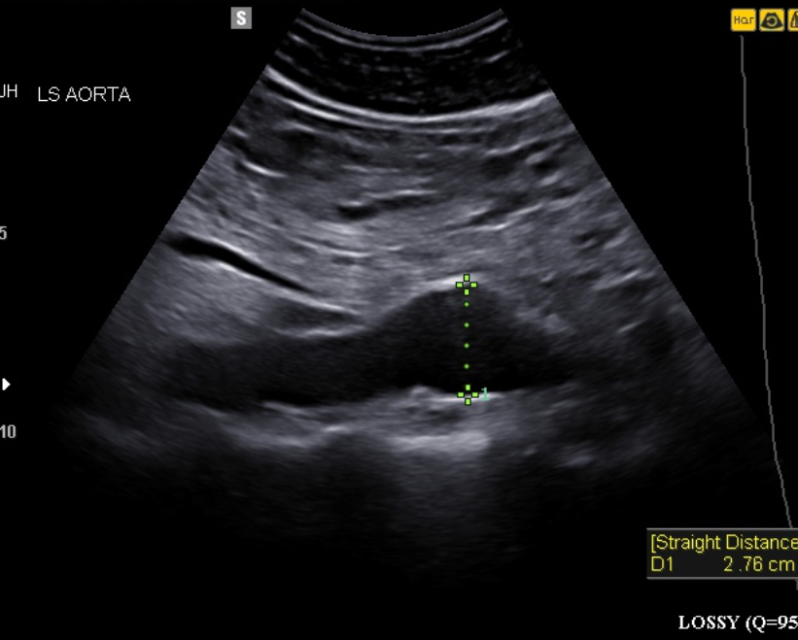
My QA Response:
Note screener comment of aneurysmal. Upon reviewing the images, the AA is not uniformly 2.8 cm with a distinct dilation of the anterior wall to 2.8 cm.
Aorta remains < 3 cm. In view of this, I recommend a screening discharge however a referral to VT for a scan in 2 year's time and a nurse telephone consultation with the gentleman to discuss the on going referral. Please can nurse make referral to VT for future scan. Thank you.
Notes:
So with this one, the anterior wall can clearly be seen to focally dilate.
In view of being < 3cm, I felt it appropriate to discharge from NAAASP and refer for a 2 year scan in the hospital.
I felt this would be easier administratively in order to obtain a potential one off 2 year scan.

Slide 5
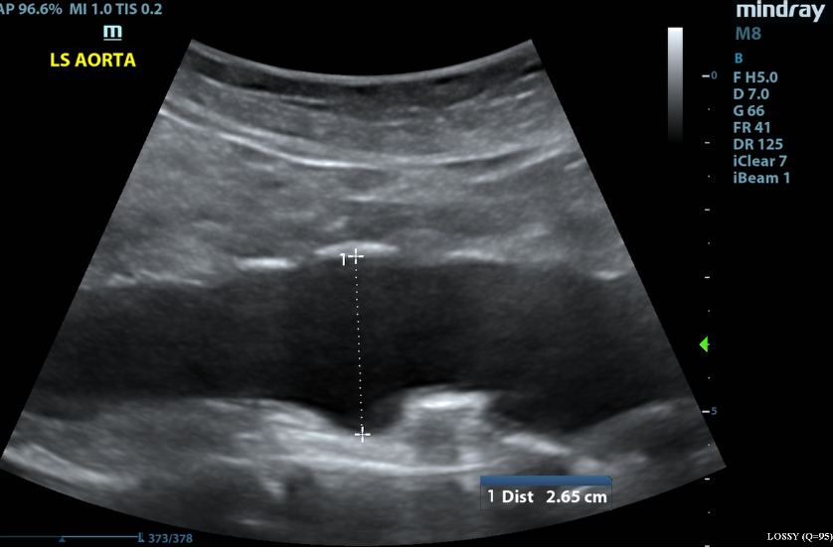
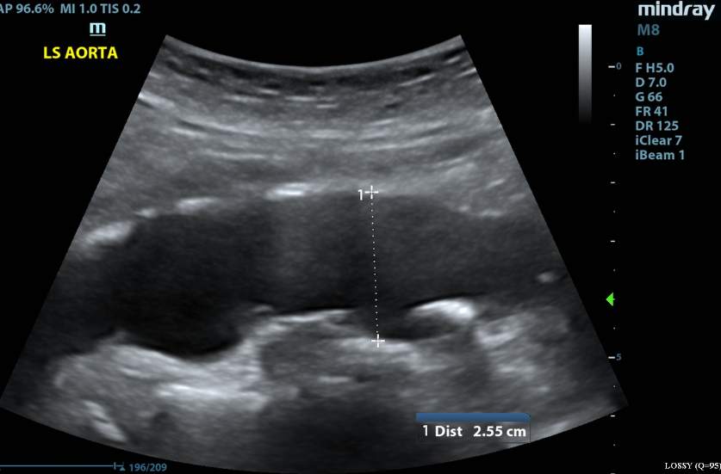
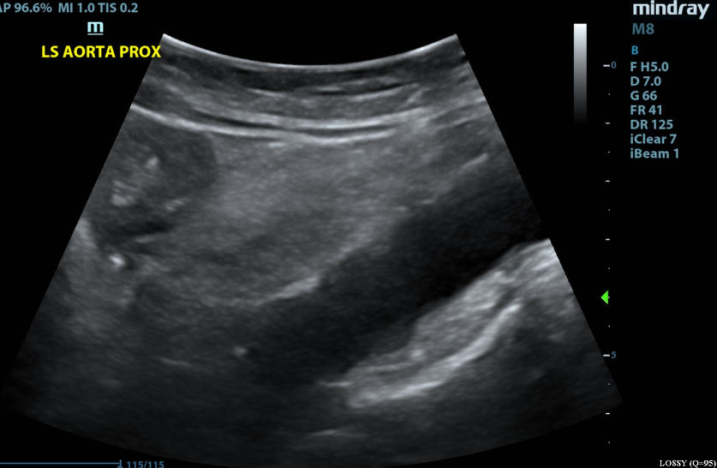
Ectatic appearing aorta with irregular posterior wall. Subthreshold at 2.7 cm however in view of appearance, suggest scan in 2 year's time at local hospital. Please can this gentleman have a nurse follow up call to discuss plan. Thanks.
Notes:
This is another one. A very irregular posterior wall. My concern is that the integrity of this aortas posterior wall has been compromised and is this the start of aneurysmal disease process?
Ectatic appearing aorta with irregular posterior wall. Subthreshold at 2.7 cm however in view of appearance, suggest scan in 2 year's time at local hospital. Please can this gentleman have a nurse follow up call to discuss plan. Thanks.

Slide 6
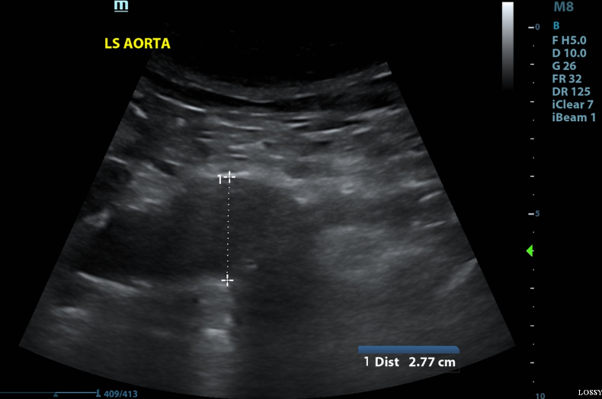
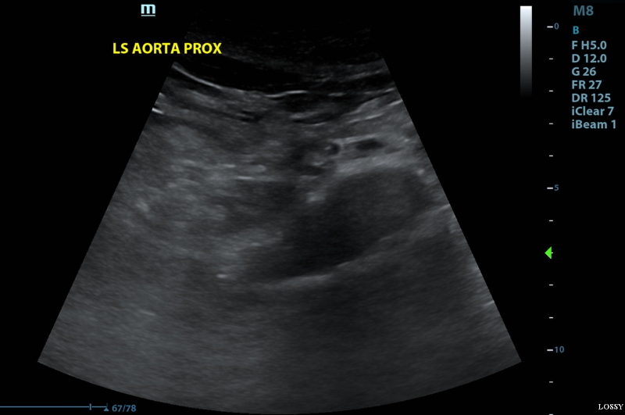
QA Response
Upon reviewing the images, the AA is not uniformly 2.8 cm with a distinct dilation distally compared to the proximal segment. Aorta remains < 3 cm. In view of this, I recommend a screening discharge however a referral to nearest hospital for a scan
Notes:
And another one,

Slide 7
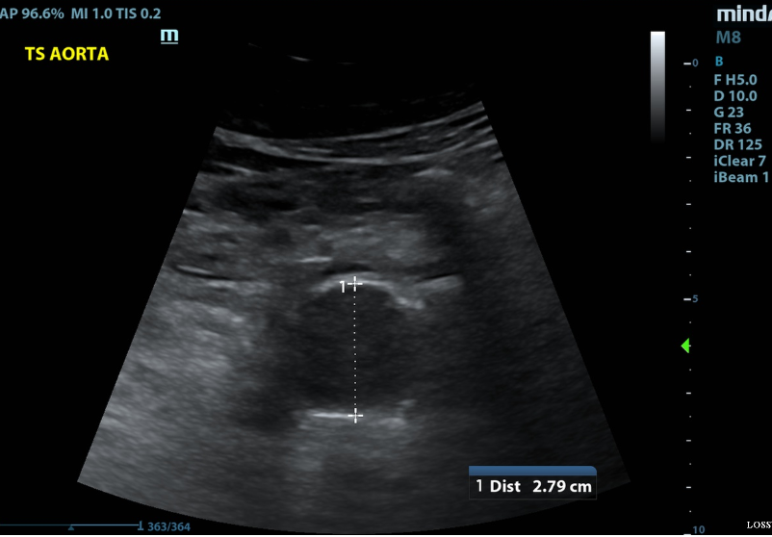
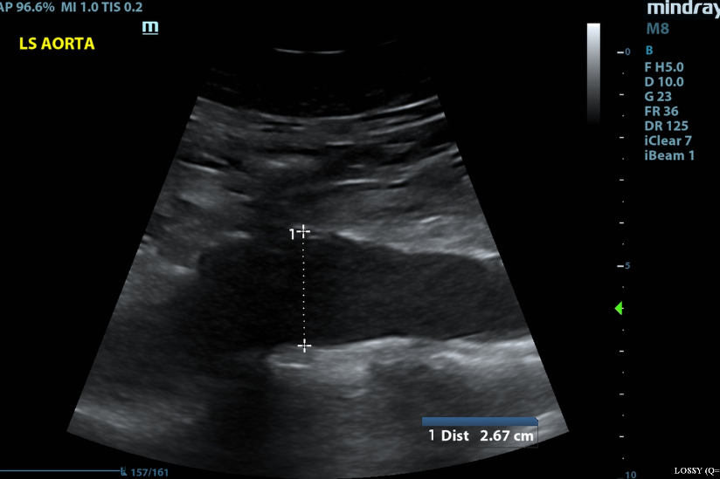
QA Response: Maximum diameter remains sub threshold and is not significantly larger than adjacent segments of visualised AA.
Notes:
This is an example of one which I didn’t refer on.
Maximum diameter remains sub threshold and is not significantly larger than adjacent segments of visualised AA.

Slide 8

Conclusion
Where to draw the line?
Thoughts?
Potential issues?
Notes:
Over the last year, since taking up the role of QA lead, I have got into a rhythm of referring these saccular/ irregular subthreshold AAA’ for 2 years scans.
I guess where I sometimes struggle with this is to where to draw the line? Can be subjective, which ones to rescan and which ones to not.
A potential issue with a 2 year re scan is distress to the individuals. This is why I have asked the vascular nurse to call these individuals, explaining the plan for 2 years time and giving them the chance to ask any questions.
So I just wanted to end on asking for peoples throughs on this, their experiences, and what they do with subthreshold AAA’s.

