Slide 1

Professional Conduct Update ‘Communication, body language and dealing with challenging situations”
Louise Fearnside, Clinical Vascular Scientist, North Bristol Trust.
Notes:
So the aim of this talk is to give an bit of an update on professional conduct, with a focus on communication, body language and then finish off with some real scenarios that occurred in the department which may be useful for us to reflect on

Slide 2

ICARE North Bristol Trust
i am responsible for
Communication that's effective
Attitude that's positive
Respect for patients, carers and colleagues
Environment that's conducive to care and recovery
Notes:
So really focusing on the icare philosophy which has been introduced to you before in a previous training session but to recap is:
I care moments on the trust webpage

Slide 3


Non-verbal Communication
Speaks volumes!
Undivided attention
Cleaning up/distracted
Look directly at the speaker
Show that you are listening
Open and inviting posture, positive body language (smiling, nodding), small verbal comments (ie yes, uh huh)
Allow the speaker of finish
Try not and rush the patient. Think about how you would like to be treated/ think back to a time when you feel rushed out of a consultation.
Notes:
I’m going to start by touching on non verbal communication which speaks volumes. It actually says alot. One aspect is to try and give the patient your undivided attention. I am guilty sometimes of cleaning up while I talk to patients to speed up the process, especially if I am running late but ideally I should really wait until the patient has left the room. I think sometimes it is a judgement call, if the patient appears concerned with the information you are giving them, you may need to give them extra time so that they do not feel like they are being ‘rushed out the room’

Slide 4
Verbal Communication
Communicate with no distraction – patient up and dressed/ tidying up
“Face to Face”
Make sure of their understanding. Ask them to repeat
Avoid lengthy discussions on areas outside your expertise
Notes:
I think these are fairly obvious but sometimes I think that we all need reminding, not to get into bad habits. I know that I am sometimes guilty of talking to them while doing other things like cleaning the probe.
Sometimes I find that I have said something to the patient and not been looking at them – quite often they don’t hear me and it is because they didn’t see my face and lips move. So must bear in mind to hold their gaze while talking.
Make sure they have understood what you have told them, if you are unsure you could ask them to repeat to you what you have told them.
It can sometimes be quite tricky but patients may ask you about things like the treatment options. It can be quite tempting to get into a discussion about this and then you find yourself down a road of explaining something that can then lead to confusion for the patient. Be mindful of this as you don’t want the patient to be mis informed or get the wrong end of the stick.

Slide 5
Dealing with challenging situations Scenario 1
AAA measurement smaller than previously measured (marginal size reduction)
Not biased by previous result/scanning blind to previous size – highly likely to occur
Patient – but how can it be smaller?
Notes:
I thought we would go through a couple of scenarios which can be challenging.
The first is when we measure the AAA smaller than previous measurements – that is marginal size reductions.
If we are unbiased by the previous result and/or are scanning blind say to the previous size, this is highly likely to occur occasionally.
The patient is likely to ask – but how can it be smaller?
What do you usually say?

Slide 6
Scenario 1 - cont
Make yourself aware of previous size
“There has been no significant change in the size of the aneurysm”
Patient prompts for measurement
Follow up with further reassurances,
Keep explanations easy to understand
“ we allow for small differences in size which occurs every time it is measured”
“We’re taking about very small differences, millimeters”
Avoid Inter/intra operator variability
“difference within acceptable limits”
Notes:
I think the first obvious thing is to make yourself aware of the previous size before informing the patient of the result. This will help you guide you in how to approach explanation.
I think it is always better to begin with a statement such as....instead of just reeling of a measurement. This gives the patient immediate reassurance.
Depending on the patient and the situation, it might be better to wait for a prompt for a size. Some patients are not concerned too much by the exact size and are happy with your reassurances alone, others will want to know the exact size. I would always give it to them if they ask for it but follow up with further reassurances and explanations about why it appears to be smaller today. Keep the explanations easy to understand. I would say, we allow for small differences in size which occurs every time it is measured and that can be when different colleagues scan it or indeed if i scanned it again. Try and not get bogged down in jargon such as inter/tntra operator variability which is the correct name for these types of variations but may confuse the patient further. You could say, we’re talking about very small differences, millimeters. I sometimes ask the patient to envisage 1 or 2 millimeters and how small that is. I also say, these differences are within acceptable limits, emphasising acceptable.

Slide 7
Scenario 2 – Large Discrepancy
Real life scenario in VT
Background:
Patient been going for AAA surveillance for past 10 years in general ultrasound. Under the care of the G.P and this was their first visit to the vascular testing department.
Result and sequence of events:
Normal calibre Aorta found
Second opinion sought – confirmed normal calibre
Patient informed
Referrer contacted, informed of result/need to follow up patient
Notes:
So moving onto another scenario which is when we get a large discrepancy. The is a real life scenario that occurred fairly recently in the department. Which is very familiar to some of you!

Slide 8
Scenario 2 – Learning Points
Patient has wrongly thought that they have had an aneurysm for 10 years
Enormity of information given – always seek second opinion
Do not inform patient until second opinion sought –
Ideally there and then, what if not possible?
No second opinion that day? – discussion with patient about result today, plan of action for second scan ASAP
Shocked
Confused
Angry
Upset
Nervous
Dismissive
Notes:
So you are actually all probably aware of what happened but I thought it would be useful to go through a few learning points. Useful for everyone to go through , us included, regardless of experience as this is something that doesn’t happen very often.
The patient has wrongly thought that they have had an aneurysm for 10 years. They will have a array of different emotions once being told that it is normal. They might feel several of these at once. Firstly, given the enormity what you are potentially going to tell the patient, I would always seek a second opinion, even if I am very confident about the result. Immediate reassurance for the patient. Do not inform the patient of the result until a second opinion is sought ( say need opinion, not coming up with a similar size)– there is still a chance that it is incorrect. If you are lone working - alternatives? Are you in Southmead hospital, could contact VT for second opinion. If outlier clinic and no second opinion available??

Slide 9
Scenario 2 – learning points cont
Informing patient of result:
Allow good time, don’t rush
Ensure they understand what you have told them - maybe ask them to repeat their understanding?
Apologise/Empathy
Avoid blame conversation about another department
Clear plan re next steps – be clear about your obligations
Notes:
When informing the patient of the result, allow good time and don’t rush – patient will need time to compute the result and allow time for any questions that they may have. Ensure that they understand what you have told them – they may want to bring in a family member aswell. If you are concerned that they haven’t understood, you could maybe ask them to repeat their understanding to you.
Apologise that they have been misinformed in the past, even through it’s not your fault, a general apology for the situation will go a long way and be appreciated. Show empathy for how they might be feeling.
Try and not get into a blame conversation about another department. The patient might initiate this conversation. Ultimately you do not have all the facts. Be clear that you can only comment on what has happened today in your own department.
Make a clear plan about the next steps, be clear about your obligations and what you expect should happen, taking a little bit of ownership of it

Slide 10
Learning points cont
Referrer (G.P) was informed that day.
Patient offered a future scan in dept (6m)
Feedback to department involved? Highlight issues /direct training etc? Duty of care.
Discuss with colleagues – debrief, aid learning
Notes:
So in this case, the referrer was informed that day and it was suggested that the patient should be seen by them to discuss the situation further. The patient was offered a future scan in the department for further confirmation and reassurance, I think that this is good practice.
I also think that it is a good idea to give feedback to the department involved – via your manager. It might highlight issues and direct future training. I have done this in the past when a popliteal artery was wrongly reported as occluded. I felt quite uncomfortable doing this but actually it was my duty of care to act and actually the information was well received and apparently was further evidence towards a training issue with a particular operator. It might also be helpful to discuss the scenario with colleagues, as a bit of a de brief for you and also it might help them too,.

Slide 11
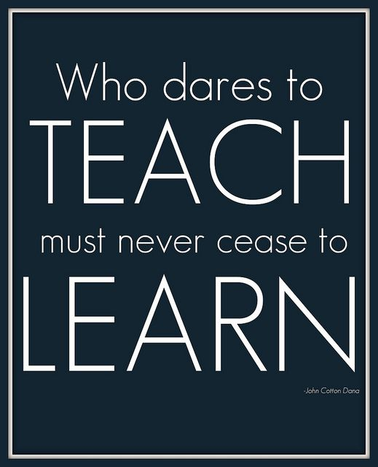
Notes:
I think the take home message is is that we never stop learning, and however experienced we are, we can always improve our practice. It is easy to let complacency set in. I think your revalidation is a really good idea and I think it is something that our profession could benefit from. Maybe it is something that will happen in the future...

