Slide 1
Carotid Dissection originating from an aortic dissection

Slide 2
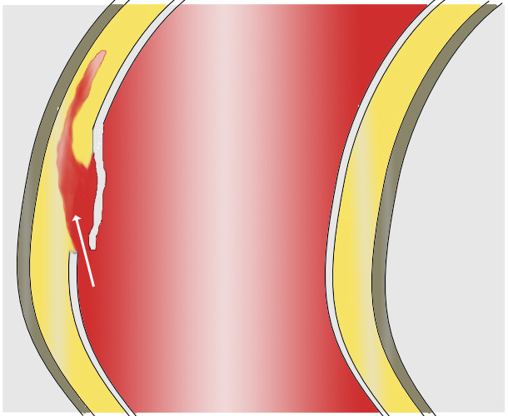
Aortic Dissection
Aortic dissection formed by a tear in the intima or a rupture of the vasa vasorum. The tear allows the blood under pressure to enter the aortic wall, which separates the intima from the adventitia and creates a false lumen.

Slide 3
incidence is approximately 3-4 per 100,000 per year.
Aortic dissection is the most common emergency affecting the aorta. Incidence is twice that of a ruptured AAA
The male:female ratio 2:1
It is most common between the ages of 50-70, being rare below the age of 40.
Aortic dissection is very rare in children but it has been reported in association with coarctation of the aorta

Slide 4
Risk factors
Hypertension (72-80%)
Connective tissue disorder eg Marfan’s syndrome (5-9%) Ehlers-Danlos syndrome
Atherosclerosis.
Bicuspid aortic valve (7-14%)
Traumatic - eg, shearing stresses in an RTA, after cardiac catheterisation/aortic balloon pump
18% have a history of open heart surgery, particularly aortic valve replacement.
Cocaine use, syphilis, Turners syndrome
.

Slide 5
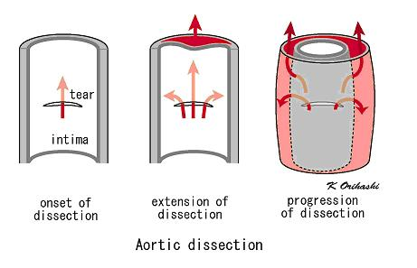
Vast majority start with an intimal tear in either the ascending aorta (65%), aortic arch (10%) or just distal to the ligamentum arteriosm in the descending thoracic aorta (20%)

Slide 6
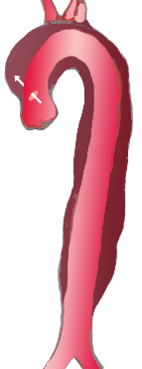

Classification
The Stanford classification in common use classifies the dissections into type A and type B:
Type A originates within the ascending aorta – needs surgical repair

Slide 7
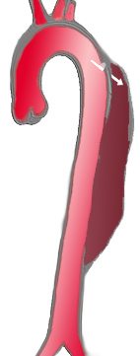
Aortic dissection Type B originates within the descending aorta. Treated medically

Slide 8
The initial tear is usually within 100mm of the aortic valve.
Can propagate towards the aortic root (retrograde)
Can propagate towards the Iliac vessels (antegrade)
Side branch involvement of the supraaortic vessels with dissection of the CCA or subclavian artery occurs in 15-41%
As blood flows down the false lumen the artery will rupture or it may cause secondary tears in the intima allowing blood to re enter the true lumen.

Slide 9
Patient 1
Type A aortic dissection in 2012 with a surgical repair (aortic root replacement) CT showed dissection flap extended into the proximal brachiocephalic and left subclavian artery.
Age 57
Male
Complaining of 3 episodes of blurred vision
Scan requested to show extent of flap into CCA.

Slide 10
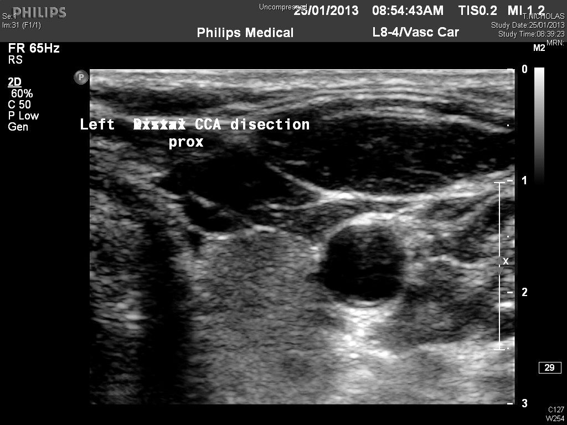

Slide 11
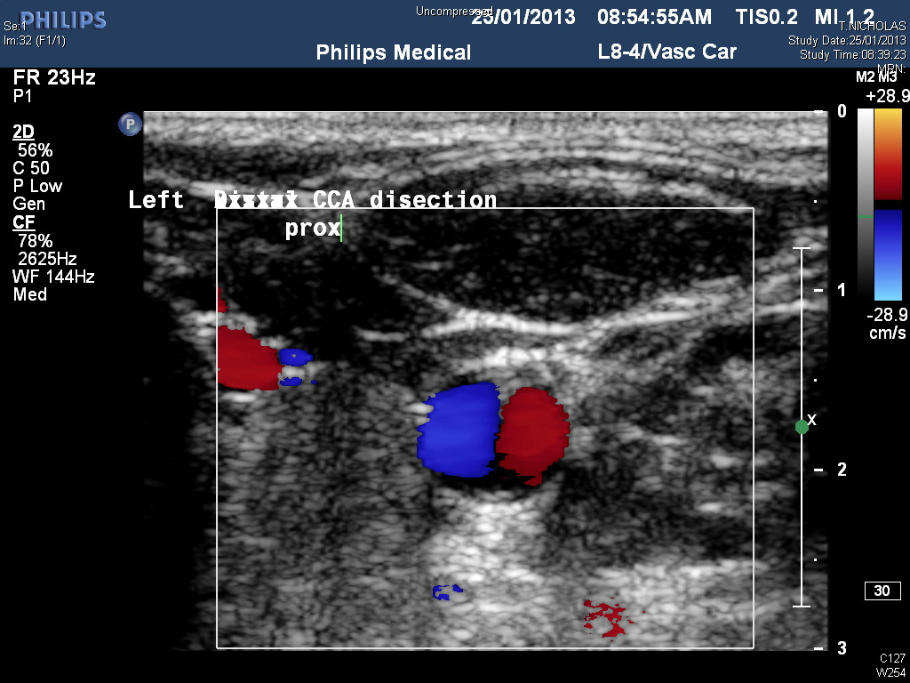

Slide 12
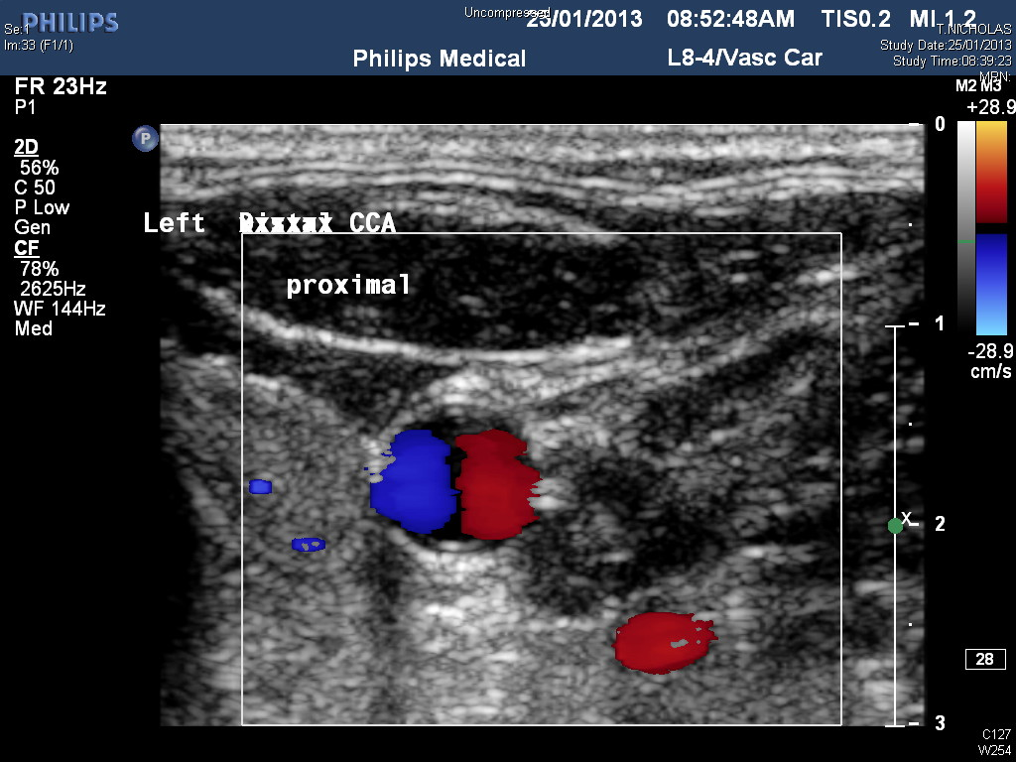

Slide 13
Dissection extends to the aortic bifurcation.
Left renal artery and IMA arise from the false lumen.
Cause of dissection unclear, patient to have genetic testing.

Slide 14
Patient 2
Type A aortic dissection with Aortic root replacement in 2003. Dissection within the ascending aorta and arch only and extends up brachiocephalic trunk and into right CCA.
Female
71yrs old
Referred for pre op carotid prior to AVR +/- aortic root replacement for moderate AR.

