Slide 1
Persistent Sciatic Artery A case study
Nicolette Kelly
Worcestershire Acute Hospitals NHS Trust

Slide 2
Embryology
Embryonic sciatic artery arises from umbilical artery
During development it passes along dorsal aspect of skeletal mesenchyme
EIA arises from umbilical artery proximal to sciatic artery and during development forms CFA and SFA
Sciatic artery connects with SFA distally
Sciatic artery then begins to involute and persists only as the inferior gluteal artery proximally

Slide 3
Epidemiology
Estimated incidence 0.03-0.06%
Patients are asymptomatic in majority of cases
Does not have a gender predilection
Catagorised as complete/incomplete

Slide 4
Complications
Aneurysm formation
Thromboembolism
Claudication / Critical limb ischaemia
Neuropathy

Slide 5
Case Study
66 year old male presented to OP clinic with unilateral claudication in left leg with some associated back pain
Reduced ABPI 0.66 on left (1 on the right)
Pulses palpable
US reported occluded distal SFA/proximal POPA bilaterally
US Aorto-iliac imaging - unremarkable
MRI lumbosacral spine - unremarkable
Treated with BMT

Slide 6
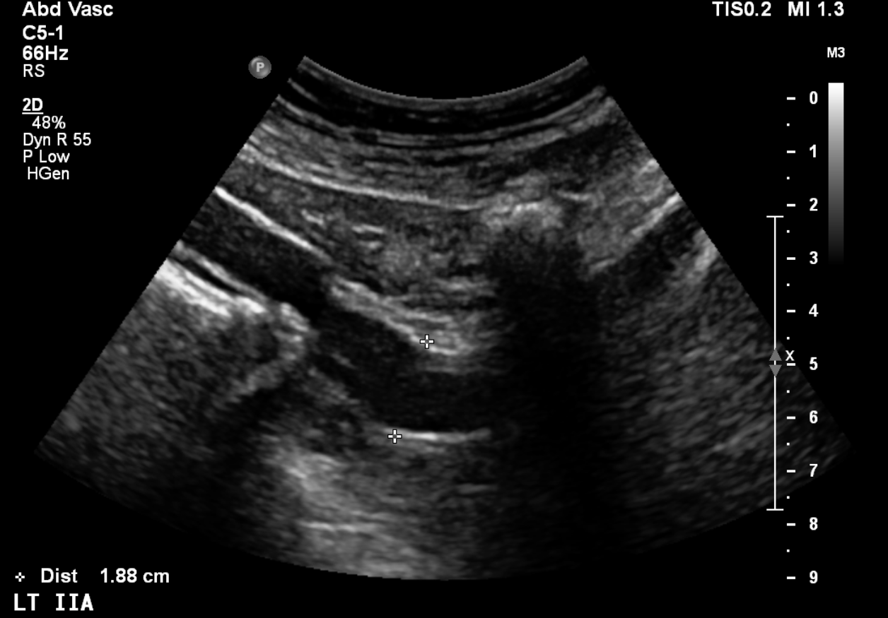
2.5 years later patient represents with left leg claudication and associated back pain
Duplex repeated with the following findings:
Ectatic left IIA

Slide 7
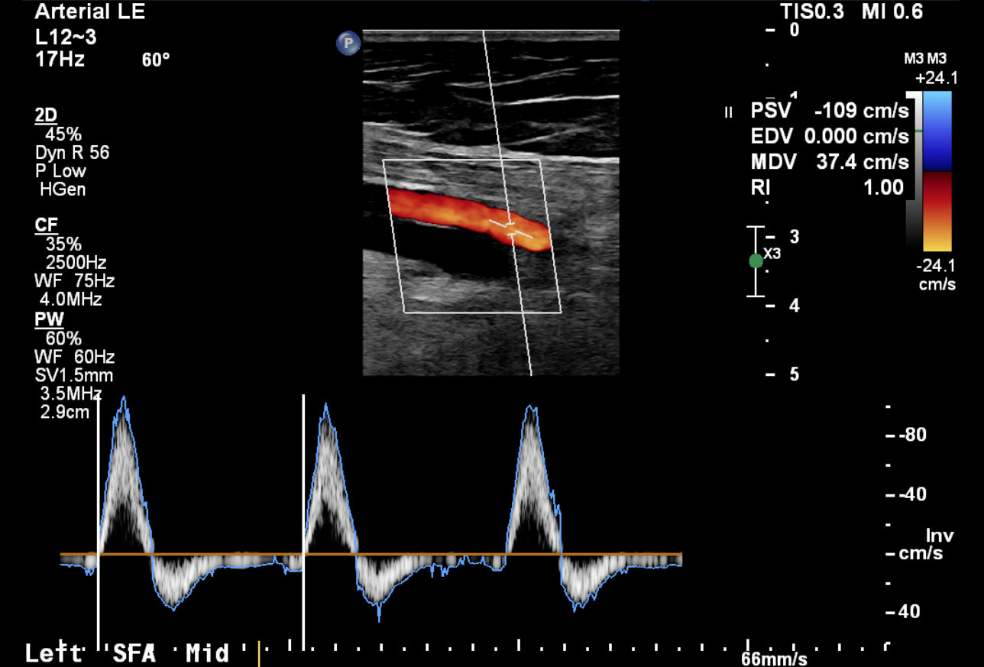
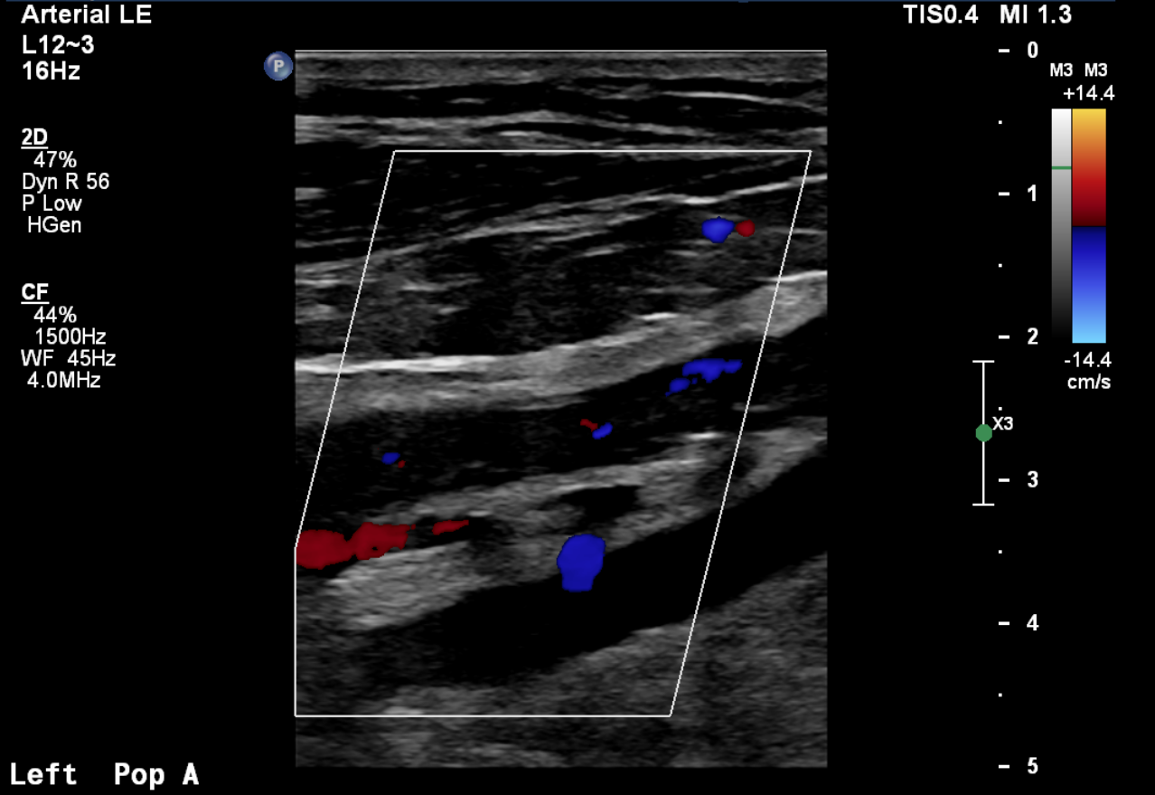
Biphasic Left SFA
Occluded POP A – *superficial to the POP V, with reformation of genicular artery via collaterals

Slide 8
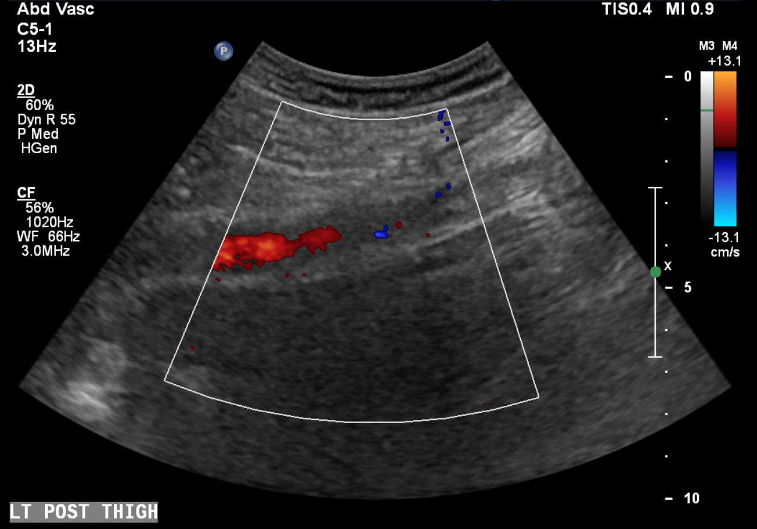
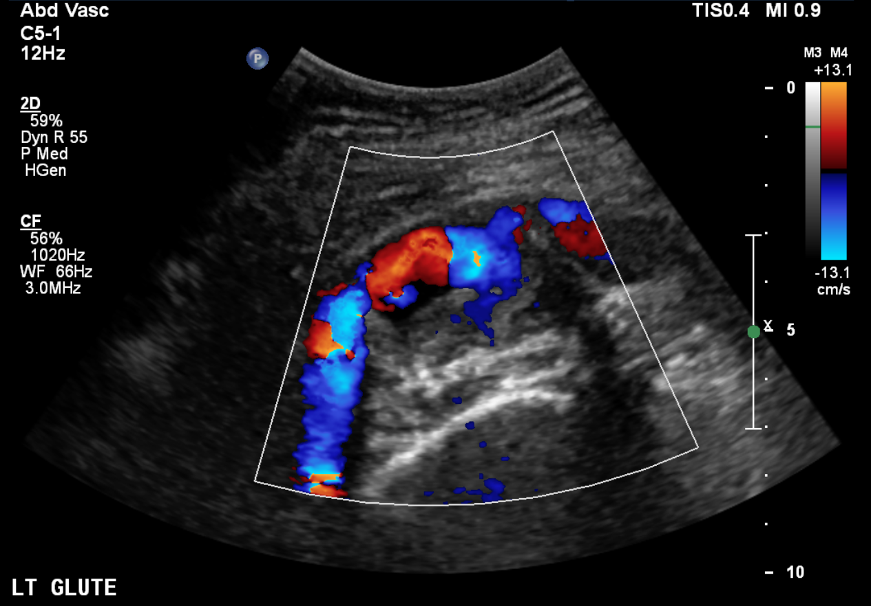
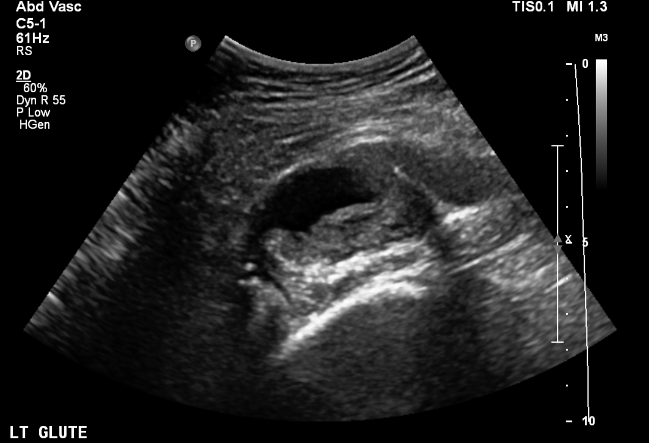
Occluded POP A extending into persistent Sciatic artery
4.5 cm aneurysm of the persistent sciatic artery with mural thrombus in the left gluteal region

Slide 9
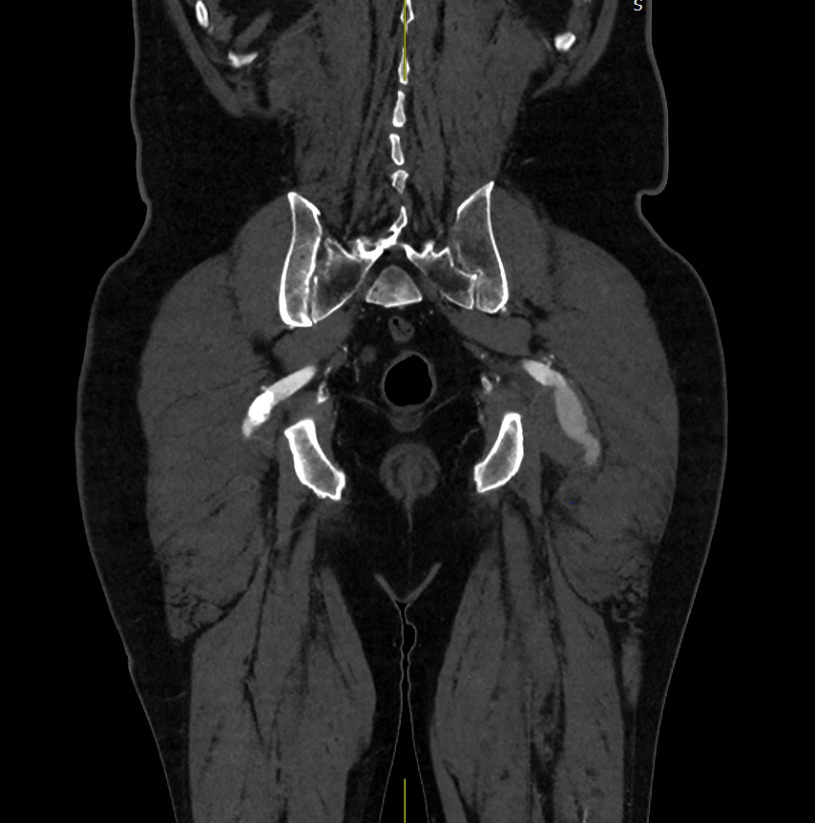
CT Angiogram confirms PSA

Slide 10
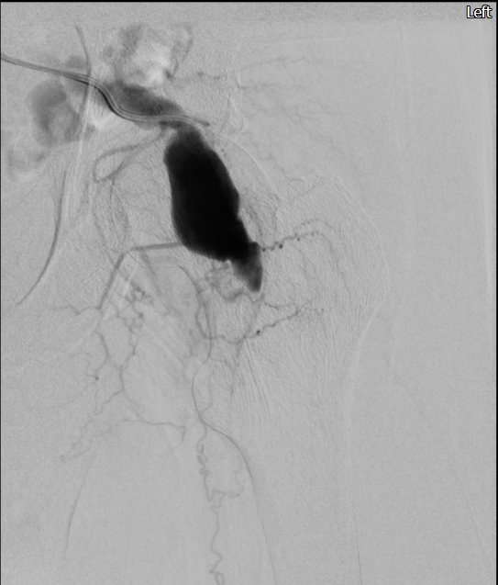
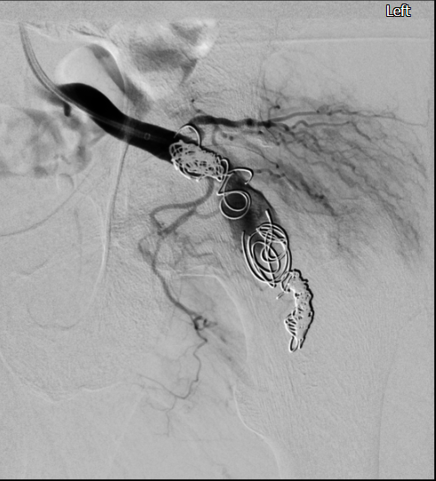
Interventional Radiology performed embolisation of persistent left Sciatic artery aneurysm

Slide 11
Conclusion - PSA
Can cause diagnostic difficulties as Duplex can give the impression of an occluded SFA.
As the major blood supply to the lower extremity in adults this rare vascular anomaly may be of surgical significance.
Failure to appreciate the PSA as the major inflow into the lower extremity may lead to inappropriate bypass of apparent occlusive disease of the SFA.
The persistent sciatic artery is also frequently aneurysmal, which may cause critical limb ischemia resulting from thrombosis or embolization of aneurysm thrombus.

