Slide 2
Session 20/11/2023
Introduction to Vascular Science

Slide 3

Today’s Agenda
09:30 –Vascular system and blood vessels
Abdominal Aortic Aneurysms
Ankle brachial pressure indicies
Toe brachial pressure indicies
10:15 –Quiz
break
10:45 – Laura’s Week
11:30 – End

Slide 4
Learning outcomes
Describe the role of the vascular system, the structure of blood vessels and problems that may occur with them
Introduce Vascular Ultrasound and Doppler techniques
Develop understanding of Abdominal Aortic Aneurysms (AAA) Ultrasound Scans, Ankle Brachial Pressure Index (ABPI) and Toe Brachial Pressure Index (TBPI)

Slide 5
The vascular system

Slide 6
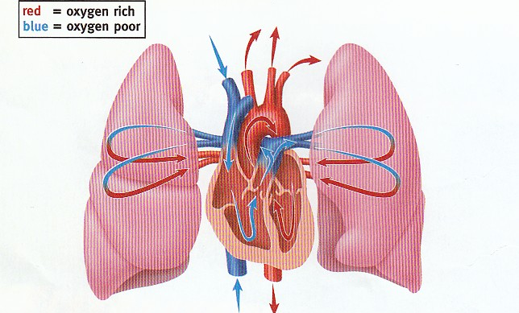
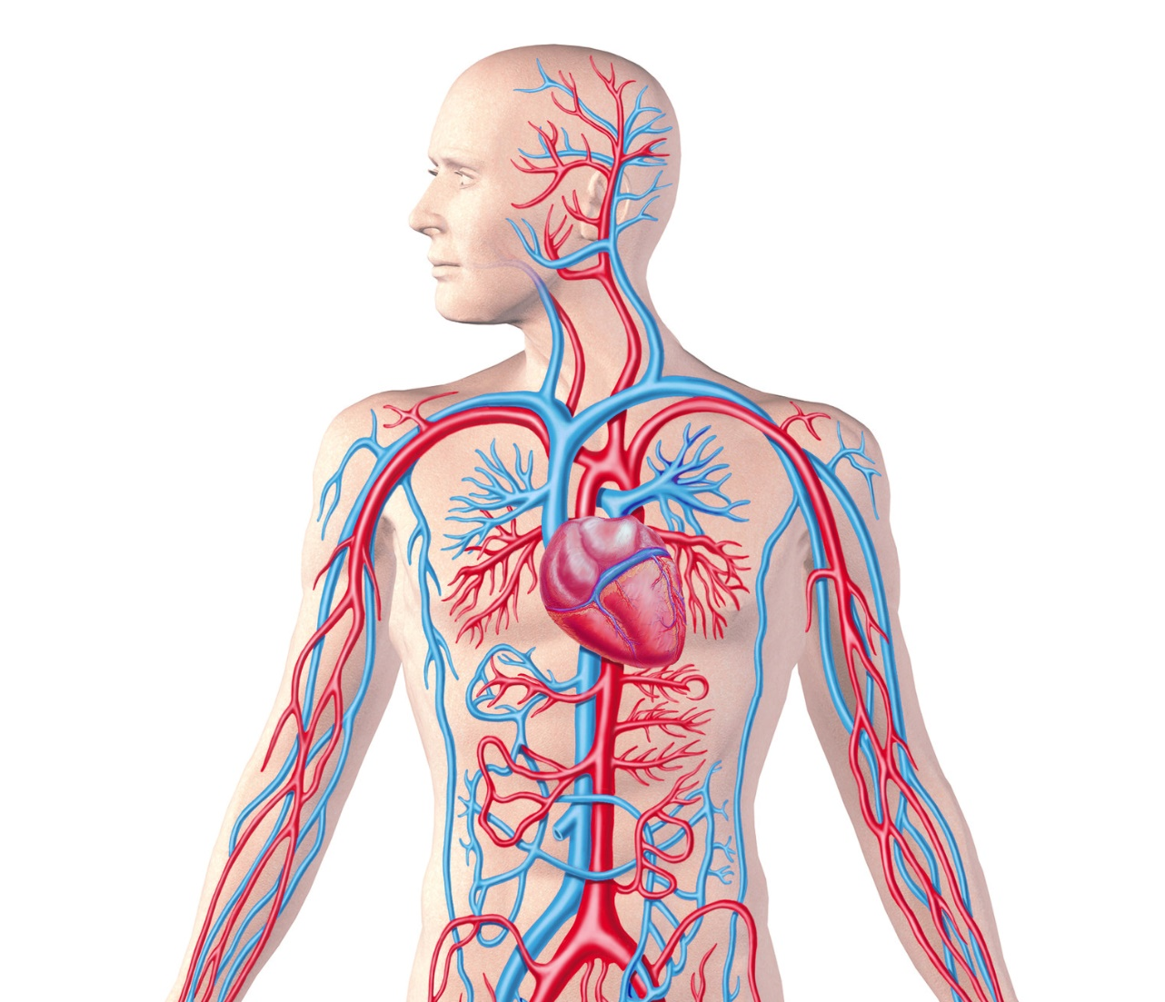
The (cardio)vascular system
Systemic circulation
Pulmonary circulation
Notes:
The cardiovascular systems job is to ensure vital oxygen and nutrients are delivered to organs, muscles and cells all around to body, to collect carbon dioxide to be disposed of and any other waste products. The cardiovascular system consists of the heart that beats oxygenated blood around the body and receives deoxygenated blood, through a closed system of blood vessels that have travelled throughout the body that’s called the systemic circulation. Also get the pulmonary circulatory system From the heart, the blood moves into the lungs to collect oxygen, then back to the heart to be pumped back round again
Cardio is in brackets as in vascular ultrasound we focus on blood vessels and blood flow everywhere but the heart

Slide 7
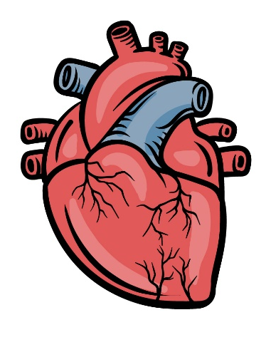
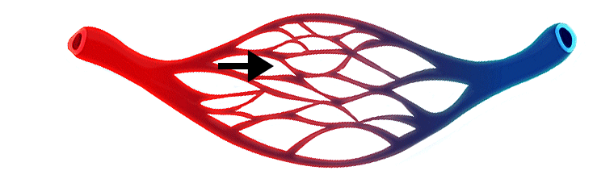
The vascular system
Consists of three types of blood vessel:
Arteries: transports oxygenated blood Away from the heart
Veins: transports deoxygenated blood towards the heart
Capillaries: connect arteries and veins
Notes:
Arteries...
and veins....
The deep veins and arteries are paired together, servicing the same region and are found all over our body. (with the exception of the superficial veins, which are signle and not paired with an arterial as there are no superficial arteries)
The veins and arteries are connected via
Capillaries, these are the smallest and thinnest of the blood vessels and are the site of oxygen and nutrient exchange within tissues
Arterioles and venules also play a part
You will notice that arteries are highlighted in RED and Veins are highlighted in BLUE: This is because this is how they are generally represented. Vascular ultrasound is used to assess to the arteries and veins

Slide 8
Blood vessels

Slide 9
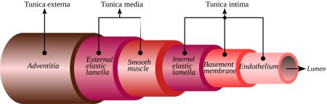
Blood vessel structure
Notes:
All blood vessels vary in size and composition according to their position within the body, however all consist of a tunica externa, which is the outermost connective tissue layer, the tunica media which is the middle smooth muscle layer and varies enormously between arteries and veins and the tunica intima, which is the innermost endothelial lining. The lumen is the tube in which the blood travels through.

Slide 10
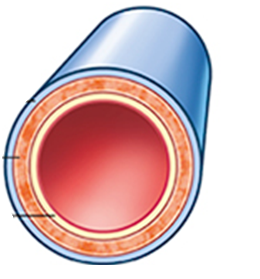
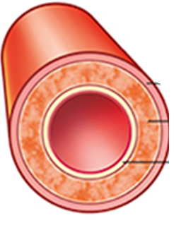
Blood vessel structure
Arteries
Narrow, rippled lumen
Thick tunica media
Veins
Wide, collapsible lumen
(valves)
Thin tunica media
Notes:
The structure of arteries varies from veins due to their differing function, the main differences are that arteries have a narrow and rippled lumen with a thick tunica media, made of smooth muscle cells, responsible for helping to maintain the cardiac pulse and getting that oxygenated blood to where it needs to promptly and efficiently
Veins have a wide and collapsible lumen which is very pliable and a series of one-way valves are found within some veins, and have a thin tunica media. Veins are not subjected to the cardiac pulse needs to be responsive to a variety of physiological mechanisms and this is facilitated by the thin tunica media

Slide 11
Blood vessel haemodynamics
Haemodynamics= how and why blood flows
Arteries
How= pulse
Why= heart
Veins
How= valves
Why= muscle pumps and breathing
Notes:
Haemodynamics refers to the study of blood flow- specifically how blood flows through your arteries and veins and the why in relation to the forces behind the flow or forces that affect the flow.
Within arteries, the blood flows in a constant, rhymical cardiac pulse and the force driving this is the beating of the heart. This is very different from the veins, where the cardiac pulse has diminished, Within the veins it is a series of one way valves that helps the blood flow back to the heart and it’s the muscular pumps for example our calf muscle and pressure changes when we breath that force the blood through the veins.
So if the how and the why are working effectively in both arterial and venous systems, blood will continue to flow, delivering oxygen and removing deoxygenated blood and other waste products and allows us to function normally!

Slide 12

Blood vessel problems
Arteries
Stenosis
Atherosclerosis
(peripheral arterial disease PAD)
Thrombus
(blood clots)
Occlusion
Notes:
When there is a problem with the blood vessels, there is often this causes a problem with blood flow which can lead to a wide range of disorders and affect all the organs within our bodies.
Lets explore a few examples, first of all in relation to the arteries.
Atherosclerosis which is a slow OR CHRONIC process, also known as PAD, where fatty deposits lining the tunica intima, causing the arteries to narrow (or stenosis) or block (occlude) and preventing or disrupt blood passing through, meaning anywhere beyond those areas will cause reduced blood supply and oxygen,
something that can occur a little more acutely (or spontaneously) blood clots or thrombus which can form and again preventing blood reaching the periphery
and causing claudication (EXPAND ON CLAUDICATION), pain at rest and/or ulcers which are non-healing wounds, particularly on feet and toes

Slide 13
Blood vessel problems
Arteries
Claudication
(pain when walking)
Ischaemia
Pain at rest
Ulcers
(non-healing wounds)
Atherosclerosis
(peripheral arterial disease)
Thrombus
(blood clots)
Notes:
and the sort of problems or symptoms that can occur are claudication (EXPAND ON CLAUDICATION),
Advanced or severe PAD causes chronic limb threatening ischaemia which presents as pain at rest and/or ulcers which are non-healing wounds, particularly on feet and toes

Slide 14
Blood vessel problems
Aneurysm
(widening)
Arteries
Thrombus or
embolus
Rupture
Notes:
Another problem that can occur with blood vessels are aneurysms or widening of the arteries , which is a dilatation of all walls of the artery at a particular, point, the problem with this is that as they get bigger, they are more likely to develop thrombus because of changes in the flow which can block the aneurysm or which can travel (or embolise) and block smaller vessels downstream,
or they can rupture- when blood leaks out of the vessel walls which can no longer withstand the size (like an overfilled balloon) this can be fatal.

Slide 15
Blood vessel problems
Veins
Deep vein thrombosis (DVT) Superficial vein thrombus (SVT)
(blood clots)
Pain and swelling
Pulmonary embolism
(clots in the lungs)
Notes:
With veins you can get deep or superficial vein thrombosis or blood clots which is an acute process and can cause limb pain, swelling as well as putting the patient at risk from developing PE which is potentially fatal

Slide 16
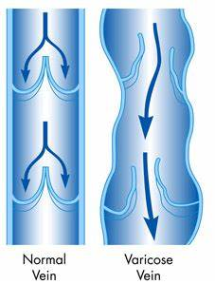
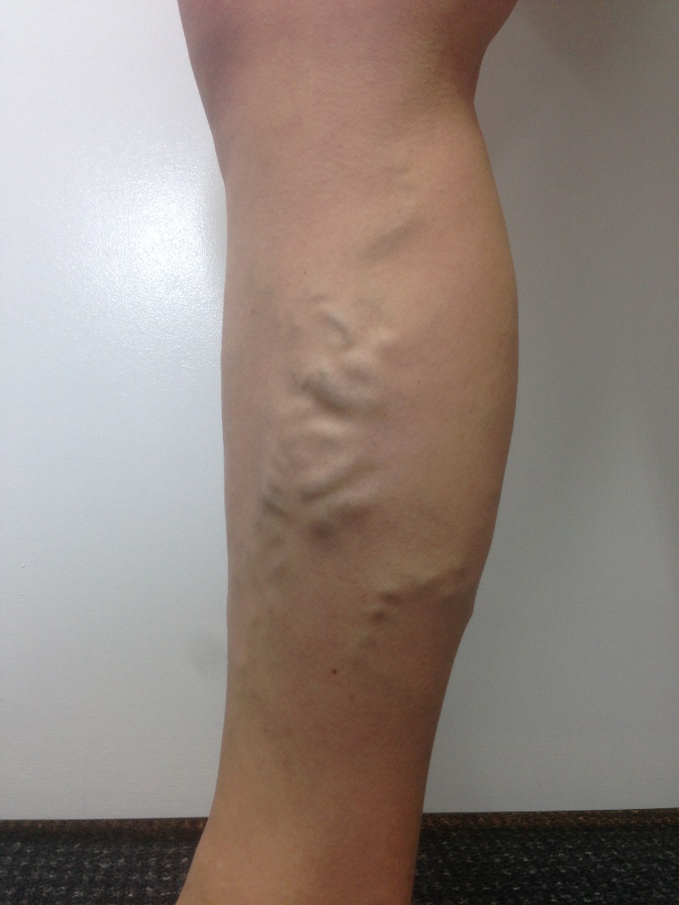
Blood vessel problems
Veins-superficial
Itching, aching
Ezcema, bleeding, ulcers
Varicose Veins
Notes:
The superficial veins can become varicose veins, which are where the valves stop working causing the veins to become larger and balloon up, looking like that bunch of grapes appearance CLICK and meaning blood doesn’t move through the veins effectively increasing the pressure in the veins, this can lead to a range of mild sx such as itching, aching and swelling, and more severe sx which can significantly impact the QoL of patients and include eczema, bleeding and ulcers. (lower leg)

Slide 17
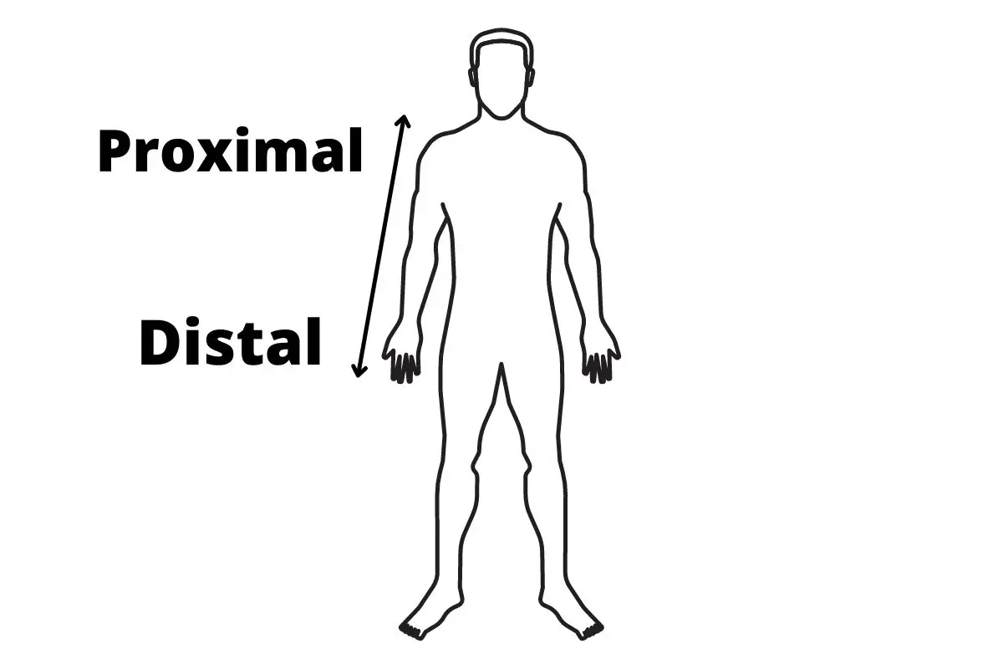
Anatomical positions
Notes:
Just a quick note on proximal and distal body positions as you may hear these terms proximal refers to any structure that is close to the centre of the body, or the heart, distal is away from. For example the knee is proximal to the foot and the foot is distal to the knee

Slide 18
Vascular Lab
Notes:
Just going to very quickly introduce the role of the vascular lab in diagnosing all those things we’ve just talked about/bbeen exploring/vascular. Vascular ultrasound is recognised as a speciality in itself and vascular surgeons and a wide range of other speciliaties within the hospital are dependent on the specialist skills of the vascular lab to investigate patients suffering with a range of simple to complex vascular disease.

Slide 19
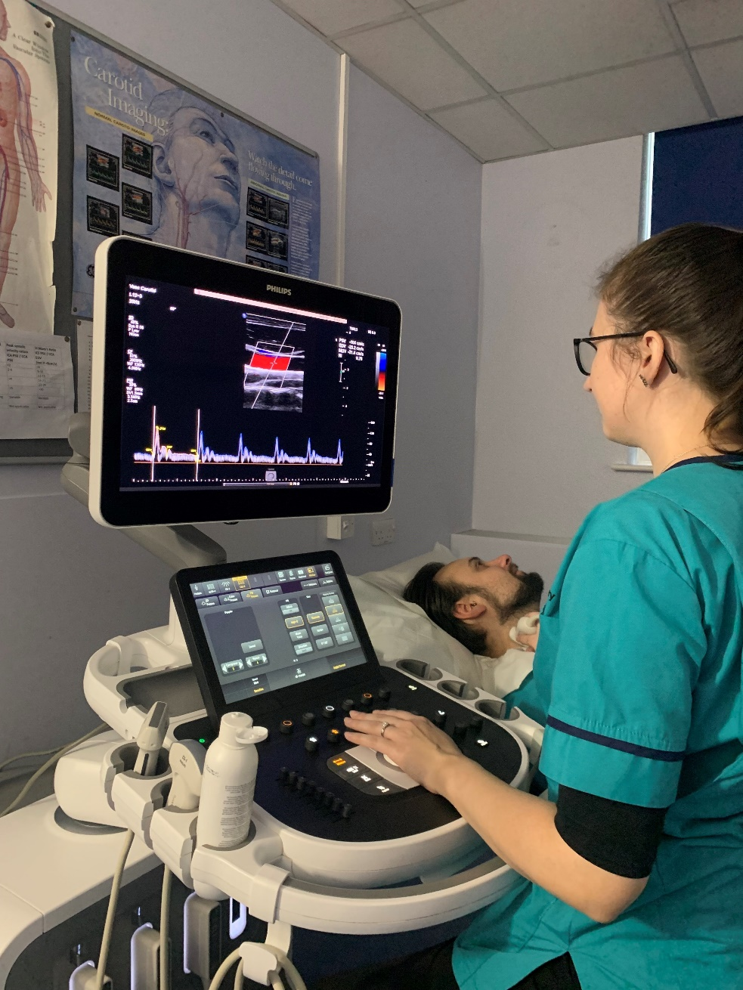
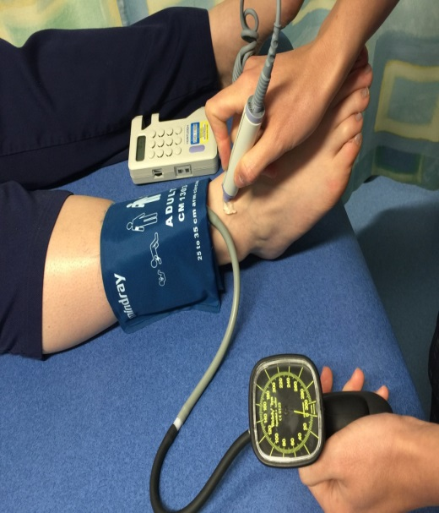
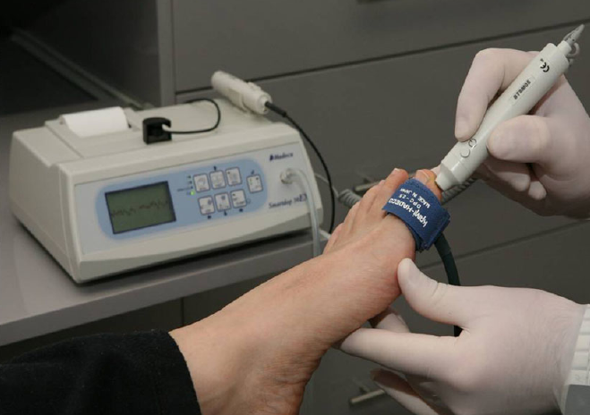
Vascular Lab
Ultrasound
B-mode
Colour Doppler
Pulse Wave Doppler
Hand held Doppler
Ankle Brachial Pressure Index (ABPI)
Toe Brachial Pressure Index (TBPI)
Notes:
Vascular examinations taking place within the vascular lab involve using non-invasive techniques to look at the blood vessels and blood flow to determine if they are normal or diseased. The techniques we use to do this are mainly ultrasound which involves using 3 modalities to form diagnoses: B-mode, colour Doppler and Pulse wave or Spectral Doppler
We also can use a hand held Doppler which utilises continuous wave Doppler, allows us to perform Ankle Brachial Pressure indices or Toe pressures

Slide 20
Vascular Ultrasound

