Slide 1
Paper review
Clinical meeting 03/07/2017
Ella Clements

Slide 2
Paper review
Microcirculation at Different Parts of the Foot in Healthy Subjects.
Stefan Rosfors - Department of Clinical Science and Education, Stockholm, Sweden.
HSOA Journal of Non Invasive Vascular Investigation, 2016.

Slide 3
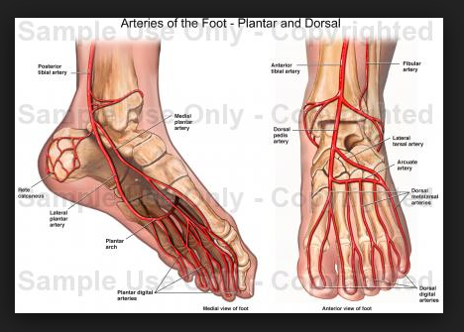
Introduction
The microcirculation of the foot receives attention regarding choice of target artery for re vascularisation to achieve best ulcer healing.
Microcirculation can be assessed with TcPO2 and Laser Doppler Flux (LDF), however little is known regarding how these two methods compare to each other and the effect of different positioning of electrodes.
Microcirculation of the foot can be described in terms of the angiosome model – refers to the block of tissue which is fed by certain end arteries.
3 from the PTA
2 from the PA
1 from the ATA
Notes:
Microcirculation of the foot can be described in terms of the angiosome model – refers to the block of tissue which is fed by certain end arteries.
3 from the PTA
2 from the PA
1 from the ATA

Slide 4
Aims
The aim of this study is to investigate the microcirculation of the foot in healthy subjects using two methods
- TcPO2
- Heat provoked Laser Doppler Flux (LDF)
Regional differences of parts of the foot supplied by different end arteries
Relationship between TcPO2 and LDF

Slide 5
Method
15 healthy subjections (6 male, 9 female)
Inclusion criteria
- aged between 18-40
- No current or previous smoking history
- No lower limb symptoms
- No lower ulcerations or other skin changes

Slide 6
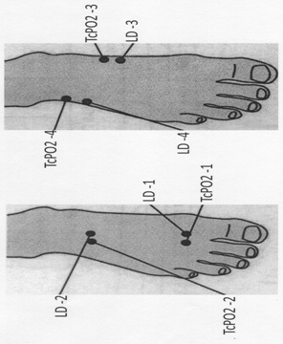
Methods
1. Dorsal distal: The distal part of dorsalis pedis angiosome, (supplied by the ATA)
2. Dorsal proximal: The proximal part of the dorsalis pedis angiosome (supplied by the ATA)
3. Medial: The medial plantar artery angiosome (supplied by the PTA)
4. Anterolateral: The anterior perforating branch angiosome (supplied by the peroneal artery

Slide 7
Methods
Test performed in two parts – measurements taken from positions 1 and 2 followed by positions 3 and 4.
Only one foot per person was studied (randomised to 7 right limbs and 8 left limbs).
TcPO2 was calibrated for 3 mins. TcPO2 was performed for 15 mins with the average of the last minute being recorded.
Afterwards the subjects breathed 100% oxygen for 10 mins through a closed mask with the highest TcPO2 levels being recorded.
LDF base line sample for 3 mins. LDF was performed for 16-18 mins with the average of the last minute being recorded.
LDF probes were left on during the 10 mins of 100% oxygen to determine any significant changes in LDF.

Slide 8
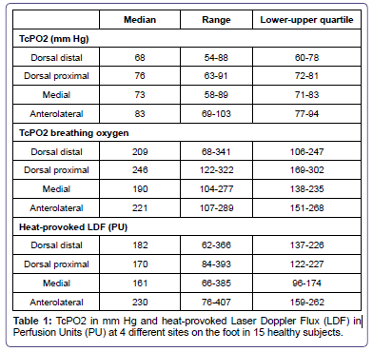
Results
Higher results in positions 2,3,4 comparted to position 1.
Oxygen breathing produced significantly higher TcPO2 results.
LDF baseline level was low (<20 PU) – increased more than 400% with heating. LD with heating produced a large range of results (62-393 PU).
LDF produced no significant difference in results from the different positions.
In general no correlation between TcPO2 and LDF was found. Only a relationship was found in position 3.
Notes:
PU – perfusion units.
Differences were tested for significance using Wilcoxon’s signed rank test.
Spearman’s rank order correlations were used to study relations between
TcPO2 and LD variables
(Statistical significance was assumed at P < 0.05).

Slide 9
Discussion
There was in general no significant relationship between TcPO2 values and LDF. This is not surprising since two different measuring principles are used…
- TcPO2 with measure of oxygen in skin capillaries
- LDF assessment of tissue reserve capacity.
Results show higher results at the proximal foot than at the distal foot. This was not related to angiosome.
In normal patients there are small but significant regional differences in microcirculation assessed with TcPO2.
Healthy subjects results showed 60-80mmHg increasing to 150-200mmHg with oxygen.

