Slide 1


Macclesfield DGH
Michael Crook and Dr Robin Sil
POCUS (vascular) 24TH January 2023

Slide 2
Introduction
The most important component of any DVT scan is compressibility of normal vein
Needs to be rapid
Hence three point compression in the lower leg
Comprises common femoral, proximal superficial femoral and popliteal veins.
Comparable diagnostic accuracy to vascular lab for detecting above knee DVT (full meta analysis Pomero F. et al 2013)

Slide 3
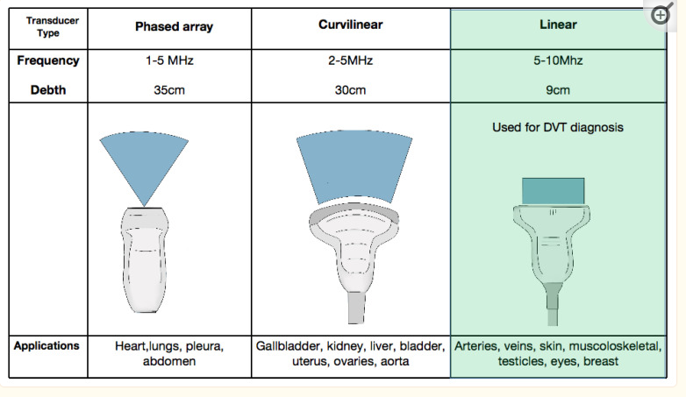
Select Appropriate Transducer
BMI dependent

Slide 4
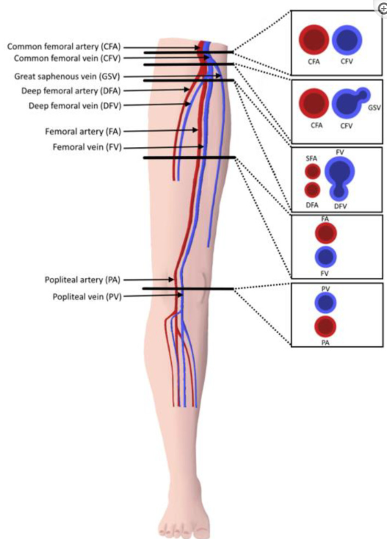
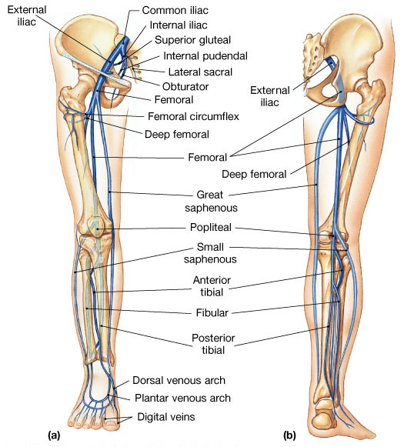
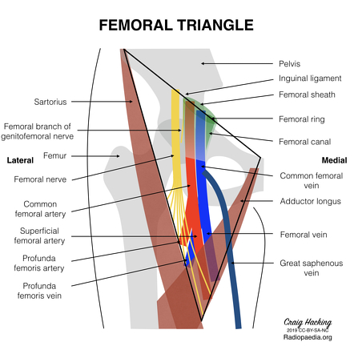
Venous Anatomy

Slide 5
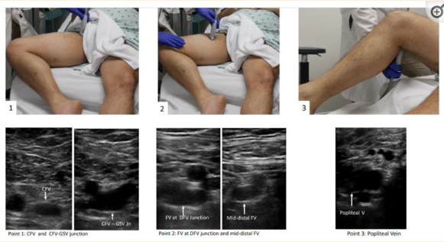
Patient position
Supine. Non-dynamic assessment

Slide 6

Three point technique
Position 1.
Mickey Mouse In the groin comprises SF junction and common femoral vein and artery.
Common femoral artery is lateral and relatively non compressible at the level of the inguinal ligament
Above this the external iliac vein dives steeply (compressibility is not possible)
No colour just compression

Slide 7
Technique contd
Position 2
Proximal thigh

Slide 8
Technique contd
Position 3 (knee bent)
Popliteal fossa
May need an assistant to stabilise knee flex position

Slide 9
Clinical Assessment
Is paramount and in every respect this applies to request for imaging/further imaging.
Ultrasound is a real time operator dependent examination and should be regarded as an extension of the clinical examination. Many clinicians personally undertake US in this way. Clinical radiologists are no different.
Is this right clinical question eg if the patient is on treatment and anticoagulation is within therapeutic ratio is this necessary.
Don’t check for recanalization in the leg as very little clinical requirement
Radiological findings are rarely specific and radiological advice often given on the basis of pretest clinical probability affects confidence particular negative result in high pre test context
It follows we require clinical examination findings to achieve this and help us choose the right imaging and protocol accordingly eg need to assess proximal veins for IVC filter. Following on from POCUS helps Department select appropriate further imaging

Slide 10
Well`s score
Clinical Characteristics | Points
Previous DVT or PE | 1.5
Heart rate >100 minute | 1.5
Surgery or immobilization < 4 weeks | 1.5
Hemoptysis | 1
Active malignancy | 1
Clinical signs of DVT | 3
Alternative diagnosis less likely than PE | 3
Table 1: The Well’s Clinical Prediction Rule includes the following:
The Wells score obtained relates to the probability of PE:
0-2 points indicates low probability (<3.6%)
3-6 points indicates moderate probability (<20.5%)
6 points or more indicates high probability (66.6%)

Slide 11
Pitfalls
High BMI
Mobility issues
Pregnancy
Post-operative
Infection (painful)
Calcified arteries leading to acoustic shadowing (Also helps distinguish)
Valve cusps
Don’t mistake superficial for deep vein (Different management)

Slide 12
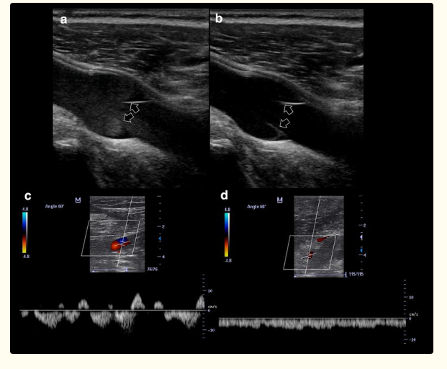
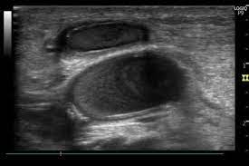
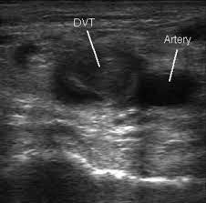
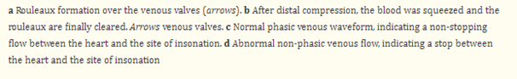
Pitfalls
Rouleaux
DVT

Slide 13
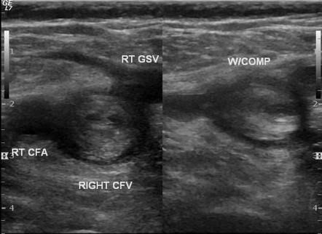
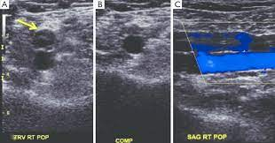
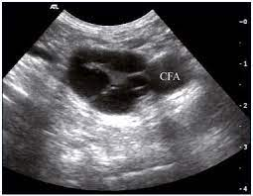
Established DVT
Acute DVT
Non occlusive DVT
Chronic scarring from
previous DVT

Slide 14
Summary
US is operator dependent
Proven diagnostic accuracy of POCUS
Will probably need full vascular assessment given local clinical desire to treat below knee DVT
In the case of thigh/full length swelling. Valsalva manoeuvre should be performed to determine if more proximal DVT is present.

Slide 15
References
Blanco P, Volpicelli G. Common pitfalls in point-of-care ultrasound: a practical guide for emergency and critical care physicians. Crit Ultrasound J. 2016 Dec;8(1):15. doi: 10.1186/s13089-016-0052-x. Epub 2016 Oct 26. PMID: 27783380; PMCID: PMC50819
Varrias D, Palaiodimos L, Balasubramanian P, Barrera CA, Nauka P, Melainis AA, Zamora C, Zavras P, Napolitano M, Gulani P, Ntaios G, Faillace RT, Galen B. The Use of Point-of-Care Ultrasound (POCUS) in the Diagnosis of Deep Vein Thrombosis. J Clin Med. 2021 Aug 30;10(17):3903. doi: 10.3390/jcm10173903. PMID: 34501350; PMCID: PMC8432124.

