Slide 1
12th November Bournemouth International Centre
Eleanor Walker

Slide 2
Student Proposals
Diagnostic accuracy study to assess VF measurements recorded using duplex and transonics in AVF patients
Duplex surveillance of infrapopliteal arteries following endovascular intervention (Guy’s and St Thomas’)
Evaluation of TBI PPG measurement as a method for assessing PAD improvement in diabetics with claudication following a 6 week supervised exercise programme (Royal Bournemouth)
Comparison between systolic RT at the ankle and Doppler US as gold standard. Can sys RT be an alternative quantifiable measure of PAD in the diabetic population?
Assessment of interoperator/machine variability and clinical trends in determining carotid stenosis grading across a vascular network (Bristol Royal Infirmary)
*Assessment of arterial blood flow at the thoracic outlet in an asymptomatic population using duplex and MRA (Nottingham UHT)
Negative DVT but high clinical suspision? Is there a need to rescan after a negative full leg compression US scan? (Mid Cheshire)
Are current triaging systems reflecting risk of signif. carotid stenosis? (Glouc.)

Slide 3
Diagnostic accuracy study to assess VF measurements
Royal Cornwall Hospital: Laura Haworth
Evaluate the level of agreement between volume flow measurements using transonics and duplex
Does duplex offer more accessible method?
Does volume flow vary pre and post-dialysis on duplex
Current practice is for duplex only if problem with dialysis
Method measure brachial artery VF, measurements taken on portable (Sonosite) + transonic (ref standard), blinded measurements
At risk >600, not at risk >600, pre and during dialsysis

Slide 4
Negative DVT but high clinical suspision? Is there a need to rescan?
NICE guidelines refer to scans not including calf veins and recommend rescan where high clinical suspicion after 1 week- but what if you scan the calf veins? No recommendation
Study to look at retrospective 18 months data and frequency –ve become positive
May lead to change in local recommendations

Slide 5
Assessment of arterial flow at the thoracic outlet in asymptomatic population using duplex and MRA
Winner best student proposal
-Prevalence TOS in asymptomatic population not known
Recruit 25 asymptomatic volunteers
1. Clinical assessment- Vasc. Cons and Radiologist
2. MRA positional
3. Duplex positional: + 2x PSV or no flow
Provoke false positives
Improve diagnostic process, best modality and manoeuvres for diagnosis

Slide 6
Guest speaker: David Beckett, Consultant Radiologist, Royal Bournemouth Hospital Pelvic Vein Imaging
Presentation pelvic pain and pelvic congestion syndrome. Whitely Clinic routinely uses transvaginal duplex with Valsalva to locate and identify venous reflux
Very experience dependent for identifying origin of reflux
Dilated veins by themselves mean nothing
Be aware of the Nutcracker syndrome- compression of the renal/ ovarian vein by SMA – treatment would not be beneficial

Slide 7
Pelvic congestion syndrome
Pelvic reflux predominantly originate form Right IIV 64.4% Left IIV 63.8%
Most frequent combination Bilateral IIV+Left OV 24.3%; Vulval veins 19.7%
Pelvic vein incompetence common ~20% women increasing only to 23% post child birth
Treatment coil embolisation- lots of images
Pitfalls wrong location treated, coiling into the iliac veins and renal veins- being too aggressive, May Turner compression- general dilation and collateralisation
Coils now retrievable

Slide 8
Debate: Stent and Graft surveillance- Is it worthwhile? For Iaonnis Vlachakis Against: Alex Watson
Lots of paper references listed in both debates Predominantly 1990s apart from A. Davis 2005 594 multicentre- worth looking up
Stent surveillance deemed worthwhile by both due to lack of evidence- continue surveillance and audit to know what is going on i.e. in stent stenosis and fracture.
PTFE graft surveillance both agreed not worthwhile from literature evidence: High failure rate with no predictive value: General consensus on the day pre discharge duplex and post 6 week scan for any surgical technique errors
Uncomplicated bypass grafts- no need to survey post 1 year

Slide 9
Lifetime Achievement Rewards
Crispian Oates
Mary Ellis
Ros Lea

Slide 10
Professional Issues and reports from Executive
Recommend reading through SVT programme or look up online
Membership 455
227 AVS
40 AVS trainees
31 STP
IQIPS 9 labs registered, 1 accredited; developing Level A standard ‘Aspirational’ template from Cardiology
Going to be a new website, greater links with VS

Slide 11
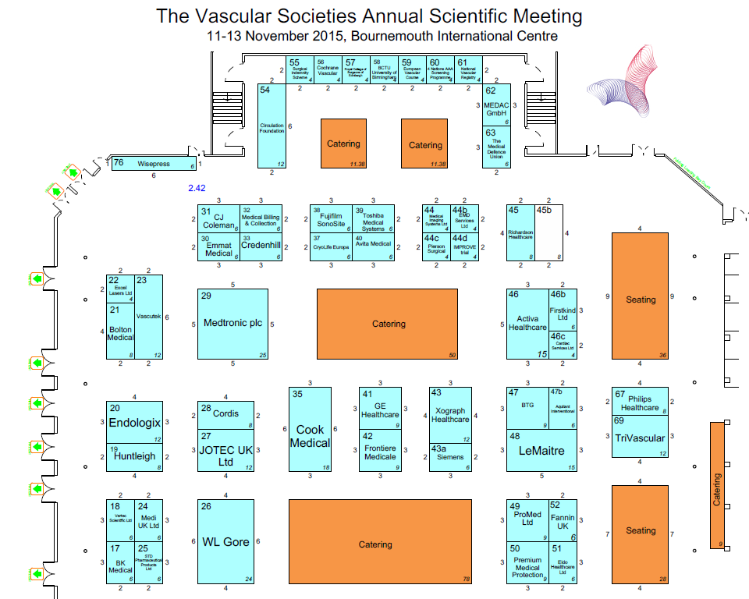
Lunch in the Exhibition Hall

Slide 12
Embracing the challenge of vascular science in the desert Nicola Segwick AVS
Cleveland clinic Abu Dhabi- new hospital
1st licensed AVS
Challenge getting professional recognition and developing service
Nicola Segwick highlighted cultural differences in the staff and patients
VVIPs

Slide 13
Proffered scientific papers
The current status of vein harvesting in coronary artery bypass grafting patients (Reshat Reshat, BRI); Resh presented this at our last clinical meeting, PowerPoint available on shared drive
Use of radiofrequency ultrasound to calculate central blood pressure in children (Louise Keehn, Kings College)- Very research orientated, using mean pressures to presume proximal central pressures using theory

Slide 14
2014 DVT Audit Lee Smith AVS South Manchester
To collate and analyse data from DVT scans performed across 10 Hospitals in the North West of England Jan to Dec 2014
Total 16217 new scans, results coded 1=+ve proximal, 2=+ve distal, 3=equivocal, 4=-ve
22% positive, 16% equivocal, 62% negative
Of the +ve 64% were proximal and 36% distal
Rescan data not acquired yet
Full legs scans performed
Data in keeping with literature
Calf scanning diagnosed >1300 DVTs which could progress to ~32 PE if left untreated
Keen to look at aging clot in the future, NEW-OLD- gray area in-between use elastography

Slide 15
And finally…
David King with the BlueDop
Tim Randall, Clinical Specialist Physiotherapist ‘Life on a Limb’
Tracey Gall ARDMS update AKA Vicky, Tanya and Tracey’s trip to the US
EPIC database
Improvements to the AVT Examination
Update Basil 2 and Basil 3 trials

