Slide 1
LOWER LIMB VENOUS ASSESSMENT
Fundamentals of Vascular Ultrasound
21st March 2024
Michael Davis AVS (University Hospital, Coventry)

Slide 2
OVERVIEW
Venous Anatomy and Physiology
Indications for Scanning Lower Limb Veins
DVT Scanning - positioning, protocol, interpretation, reporting
Venous Insufficiency Scanning - positioning, protocol, interpretation, reporting
Incidental Findings

Slide 3
ANATOMY AND PHYSIOLOGY

Slide 4
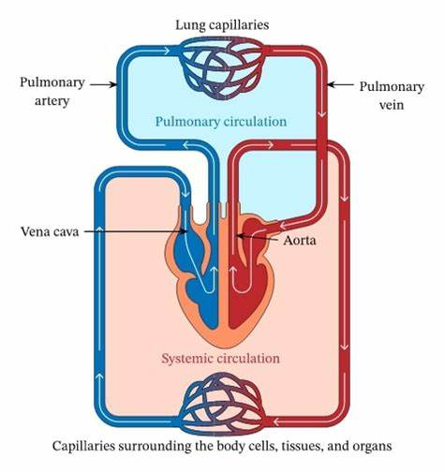
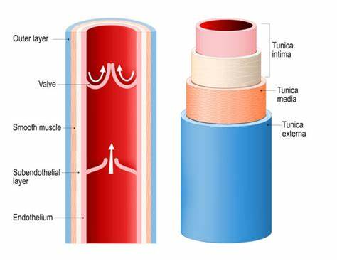
VEINS
Notes:
Transport Deox blood (right side heart) = organs and tissue – IVC/SVC – Rt Atrium – Rt Ventricle – Pul Art – Lungs
Veins – thin walled, three layers, bicuspid valves
Venous valves – prevent reflux/backflow

Slide 5
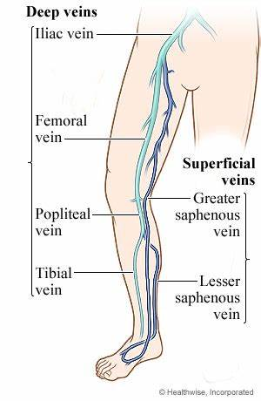
VEINS

Slide 6
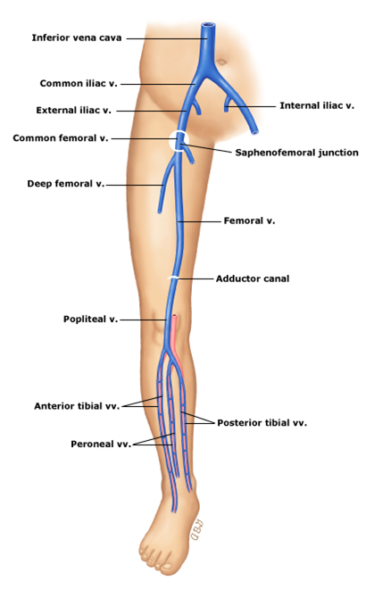
DEEP VEINS
Below fascia and within or between muscle compartments
Below knee – paired veins, lie parallel to named artery
‘Superficial’ Femoral Vein (SFV) - AKA Femoral Vein
Gastrocnemius (GV) and Soleal veins
Notes:
Gastroc veins – can be 2 or more
supplies med and lat heads of gastroc muscle
single junc with POP V
Soleal sinuses – receive blood from soleus muscle
drain into PTV and PERV

Slide 7
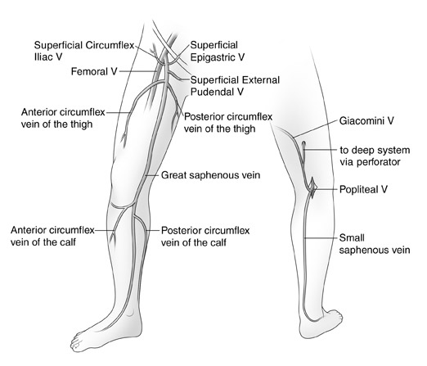

SUPERFICIAL VEINS
Lie between skin and deep fascia
Two main systems:
Long/Greater Saphenous Vein (LSV/GSV)
Short/Lesser Saphenous Vein (SSV)
Anterior Lateral Thigh Vein (ALTV)
Communication between Deep and Superficial systems:
Sapheno-Femoral Junction (SFJ)
Sapheno-Popliteal Junction (SPJ)
SFJ

Slide 8
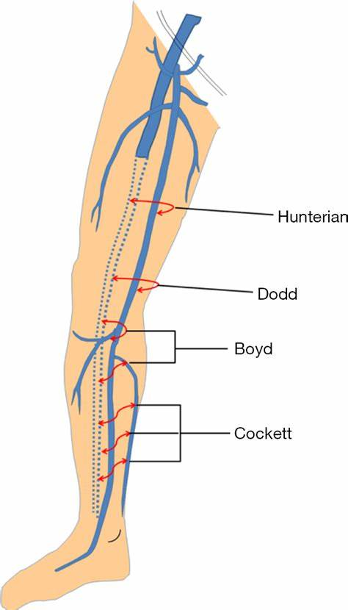
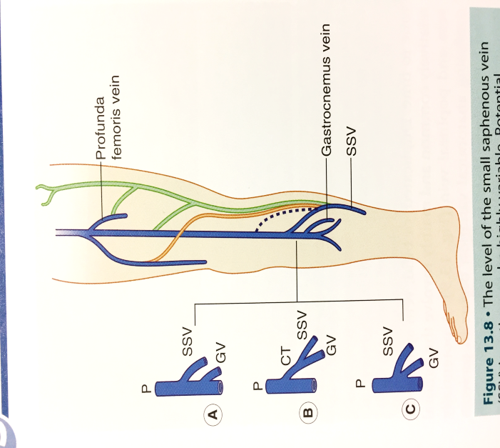
SUPERICIAL VEINS
SPJ position variable
Most commonly 0-4cm above knee
Common trunk or shared junction with GV
Drains to Proximal POP/SFV
Drains to LSV = Giacomini vein
Drains to SFV/PFV/Internal Iliac V (thigh extension vein)
Perforators – join superficial and deep veins
Notes:
SPJ - sometimes high junction with POPV (dashed line)
Green lines – thigh extension vein
Orange line – drains to LSV = Giacomini vein

Slide 9
INDICATIONS FOR VENOUS SCANNING

Slide 10
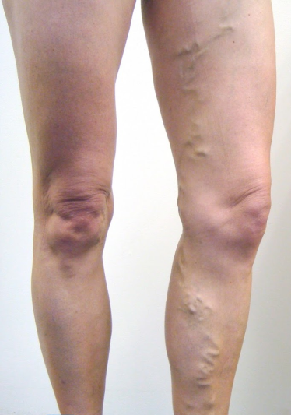
Deep vein thrombosis (DVT)
Pain, swelling, tenderness, reddening, heavy ache, and warm skin
Deep or Superficial Venous Insufficiency (DVI/SVI)
Varicose Veins
Primary, secondary, and recurrent
Primary 4-5 x more common than secondary
LSV involved 5-6 x more often than SSV

Slide 11
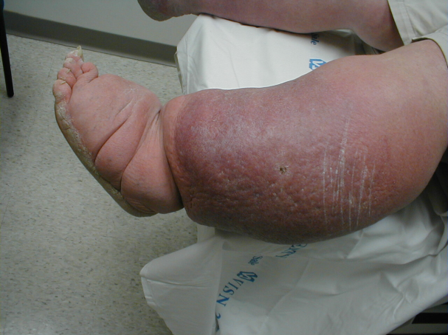
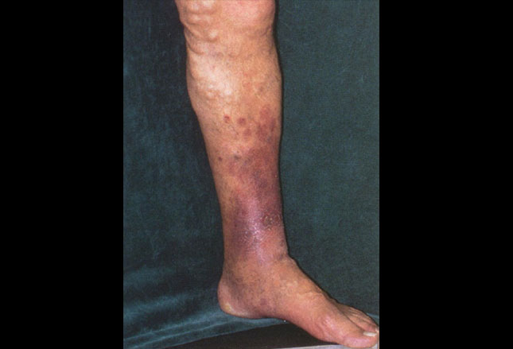
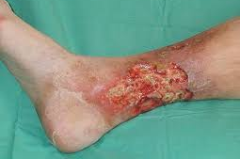
Oedema
Skin Changes
Lipodermatosclerosis
Varicose eczema
Ulceration
Notes:
Oedema – the trapping of tissue fluid in the interstitial spaces, No. reasons for this e.g. venous HTN due to DVT or CVI, cardiac or renal failure, extrinsic compression (pregnancy), systemic HTN.
Skin changes
LDS – noted particularly in medial aspect of lower calf,
- symptoms include pain, hardening of skin, change in skin colour, and swelling
Varicose eczema – classically associated with gaiter area of calf and may cause symptoms of itching or discomfort
Ulceration – 90% of ulcers are venous, situated in medial aspect of lower calf just above medial malleolus, usually associated with chronic skin changes (mentioned above)
Often painless, but can be extensive, involving large areas of tissue.

Slide 12
EQUIPMENT

Slide 13
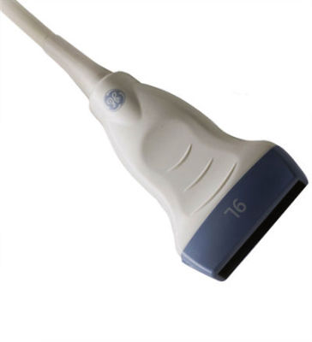
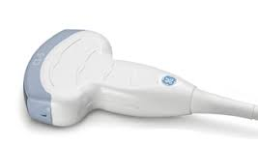
TRANSDUCERS
High frequency linear probe for majority of work (5 MHz)
Low frequency curvilinear probe for very large limbs or abdominal work (3-3.5MHz)

Slide 14
DVT SCANNING

Slide 15
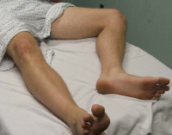
PATIENT POSITIONING
Pelvic and Thigh Veins
Lie patient supine, leg externally rotated, knee slightly flexed
Raise head and lower feet to aid venous distension

Slide 16
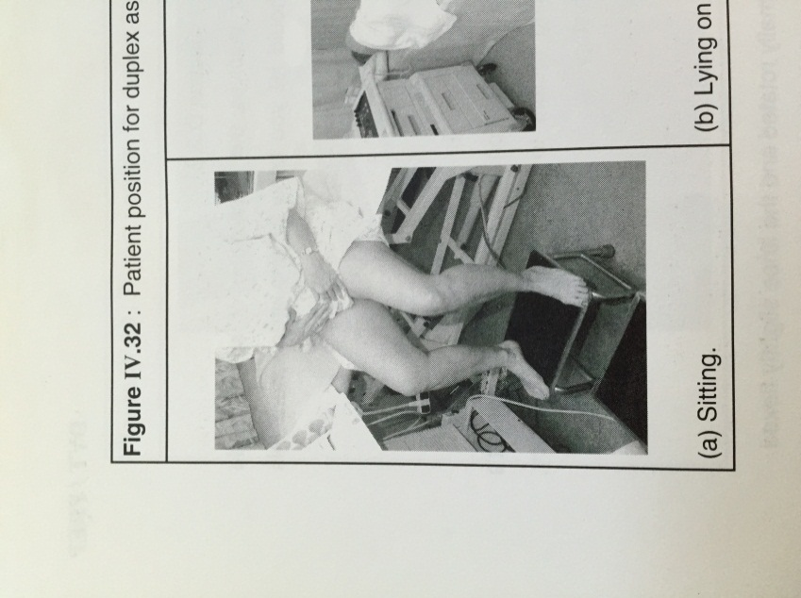
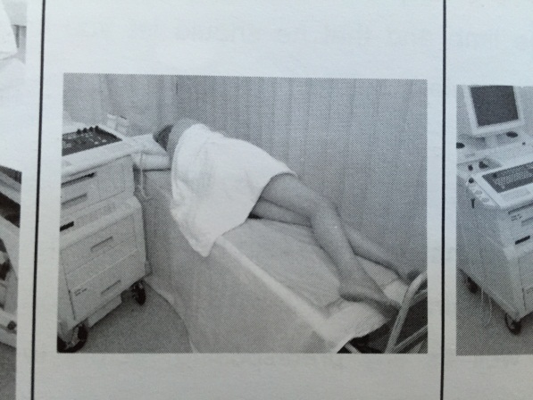
PATIENT POSITIONING
Popliteal Vein
Mobile patient – sit on edge of raised couch, ensure:
thigh is not compressed by couch
thigh sloped downward; knees lower than hips
calf hangs freely, muscles relaxed, and foot on stool
Immobile patient – lie on side with knees slightly flexed

Slide 17
PATIENT POSITIONING
Calf Veins
Mobile patient – as for popliteal
Immobile patient:
lie on side to assess Peroneal veins
lie supine for PTV’s and ATV’s

Slide 18

PROTOCOL
Explanation
Manual compression (moderate discomfort)
Starting at groin (intimate area)
Begin at groin in transverse, locate CFV, CFA, and SFJ in B-mode ‘Mickey Mouse view’
Apply gentle, slow, smooth pressure with transducer to examine compressibility
Into longitudinal projection use colour and spectral Doppler to assess flow (spontaneous and phasic with respiration).
CFA
SFJ
CFV

Slide 19
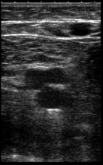
PROTOCOL
Move distally to SFV in transverse (B-mode) examine compressibility at proximal, mid, and distal thigh level
Examine around SFA for duplicate/triplicate SFV (duplicated in 20-30%)
Distal thigh can be difficult to compress, place hand directly under thigh and apply pressure from behind
A
V
V

Slide 20
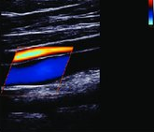
PROTOCOL
Reposition patient to assess popliteal, then repeat same process
Distal SFV (adductor canal) better visualised in this position
Above knee popliteal may require more pressure to demonstrate compressibility
When compression not possible (e.g. painful, poor imaging), use colour Doppler to demonstrate patency

Slide 21
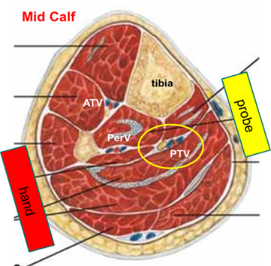
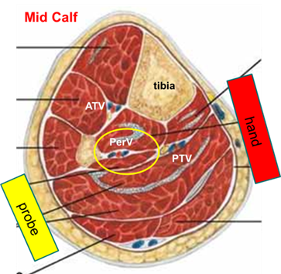
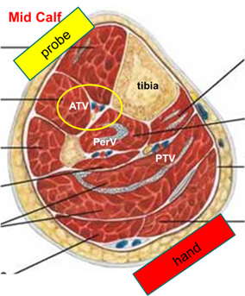
PROTOCOL
PTV and Peroneal veins compress from lateral and medial sides
ATV place probe anteriorly and brace knee with hand posteriorly

Slide 22
INTERPRETATION
Compressibility
Luminal diameter
Echogenicity
Colour and Spectral Doppler

Slide 23
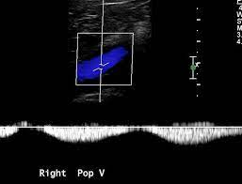
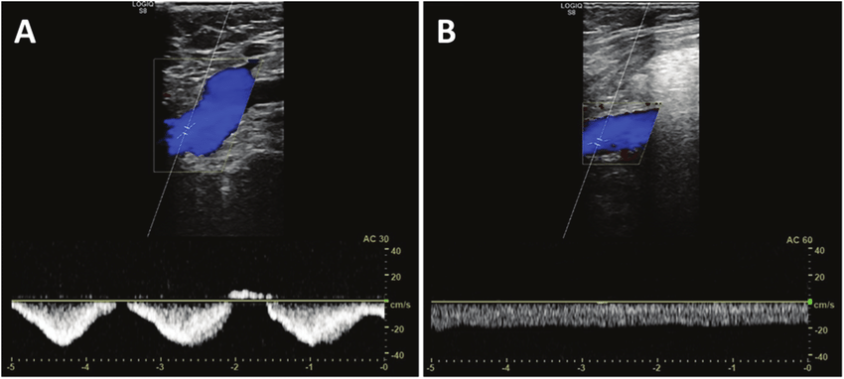
INTERPRETATION
Venous flow = Spontaneous and Phasic
Phasic flow (normal) Continuous flow (abnormal)
Notes:
Spontaneity – normal veins spontaneous phasic flow changes with respiration, without augmentation
- loss of spontaneity suggest DVT e.g. continuous flow in LSV = DVT in SFV
Phasicity - CFV, normally phasic with respiration, loss of this may indicate compromised venous outflow e.g. proximal iliac/IVC DVT

Slide 24
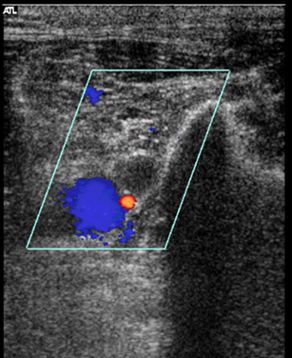
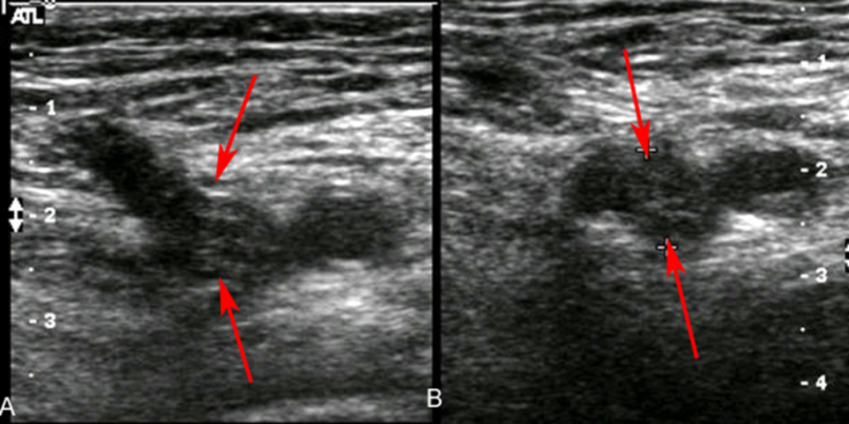
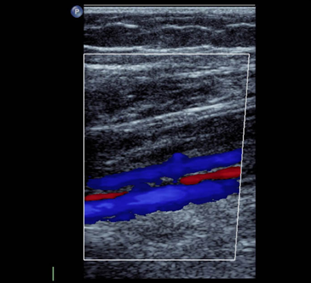
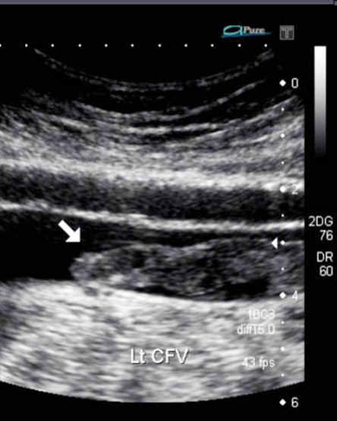
INTERPRETATION
CFV DVT
PTV and PERV DVT
Free floating ‘tongue’ of clot
Notes:
NOTE – establish proximal extent of clot (if possible)

Slide 25
INTERPRETATION
Acute thrombus
Anechoic or hypoechoic
Homogenous
Poorly attached or floating
Smooth borders
Spongy and deformable
Increase in vein diameter
Small collaterals
Chronic thrombus
Brightly echogenic
Heterogenous
Well attached
Irregular borders
More rigid
Small and contracted vein
Large collaterals

Slide 26

REPORTING
Written report, including:
Leg scanned
Technique used e.g. compression, colour Doppler, flow interpretation
Any sections could not image
If positive, the extent of the DVT and appearance (e.g. acute or chronic)

Slide 27
REPORTING
Example Normal Report:
RIGHT
Normal flow seen in the CFV suggesting no occlusive proximal obstruction. Femoral Vein - patent and compressible throughout. Popliteal Vein - patent and compressible throughout. Conclusion: No obvious current DVT seen.

Slide 28
REPORTING
Example Positive Report:
LEFT
Normal flow seen in the CFV suggesting no occlusive proximal obstruction.
CFV and Popliteal vein - patent and compressible throughout.
Femoral vein - Incompressible occluding thrombus seen throughout.
NOTE - thrombus is echolucent giving the impression of an acute thrombus with a free-floating tongue of clot seen proximally.
Conclusion: Left femoral vein DVT demonstrated.

Slide 29
VENOUS INSUFFICIENCY SCANNING

Slide 30
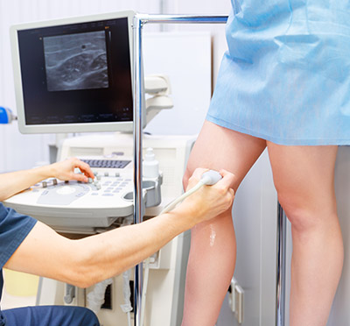
PATIENT POSITIONING
Different method’s, find what works for you!
Suggested Method (patient able to stand)
Stand patient on stool/small step facing you
Externally rotate leg while flexing the knee
Weight onto contralateral leg, minimal weight on flexed leg
Examining POP, patient faces away in same posture

Slide 31
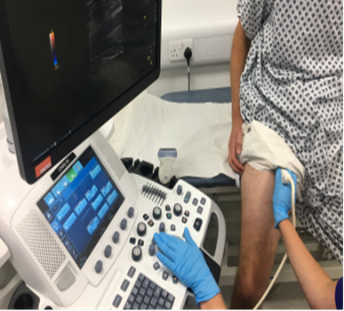
PATIENT POSITIONING
Alternative Method (patient unable to stand)
Thigh Veins:
Patient stood with back to raised couch, sit on very edge with feet flat on floor
Position leg in same posture as previous

Slide 32
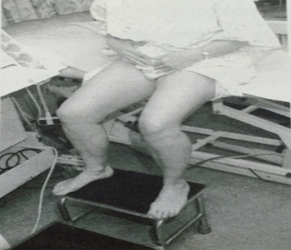
PATIENT POSITIONING
Below Knee Veins:
Sat on edge of raised couch, feet on stool (as per mobile DVT patient - POP and calf veins)
Externally rotate leg to examine medial calf region (LSV and deep calf veins)
Knee square on for examination of POP and SSV (ensure patient far enough forward to examine behind knee)

Slide 33

PROTOCOL
Before Starting
Look at request card
Primary or recurrent VV’s
?LSV, SSV, or other e.g. ATV
Previous DVT
Look and Speak to Patient
Obvious varicosities, skin changes, ulceration
Brief history (symptoms, previous treatment)
Problem as they see it
Explanation of Protocol
Starting at groin (intimate area)
Distal compression (calf/foot squeezes)
Occasional light headedness (males <40 yrs.)

Slide 34
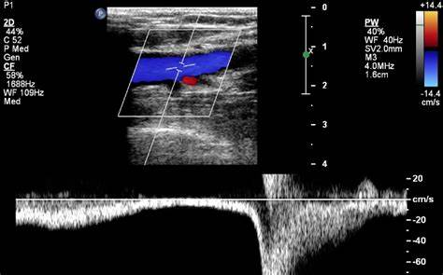
PROTOCOL
Assessment of:
Patency (colour and spectral Doppler)
Competency (distal compression)
Mapping of deep and superficial venous anatomy (inc. large varices/perforators)
Notes:
Longitudinal projection for checking patency and competency

Slide 35
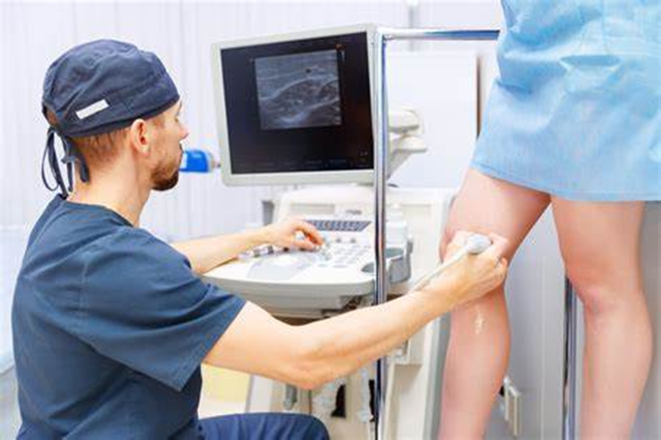
PROTOCOL
THIGH VEINS
CFV /SFJ – transverse B-mode ‘Mickey Mouse view’
SFV – proximal, mid, and distal thigh level
LSV – most commonly tracks along medial thigh
Check for ALTV
If LSV incompetence ?origin e.g. SFJ/pelvic branch/perforators
Notes:
Longitudinal projection for checking patency and competency

Slide 36
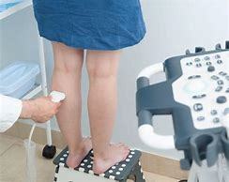
PROTOCOL
BELOW KNEE VEINS
LSV - medial calf, ensure overlap with above knee
Deep calf veins - mid calf level (spot check)
POP - behind knee, check above and below knee joint
SSV - start proximal posterior calf, trace proximally to look for SPJ (not always present), then trace distally
SPJ - level of and ?communication with Giacomini and GV

Slide 37
INTERPRETATION
COMPETENT/NORMAL
INCOMPETENT/REFLUX
Notes:
Competent/Normal – compress limb distal to TX, Cessation of flow during compression and phasic flow returns in normal direction upon release.
Incompetence/Reflux – retrograde flow (reflux) upon release

Slide 38
INTERPRETATION
Diagnostic criteria for reflux (as defined by SVT)
NORMAL
Valve closure <0.5secs
MILD
0.5secs to ≤1.0secs and max velocity ≥10 cm/s
Sustained low volume reflux (max velocity <10cm/s)
MODERATE/SEVERE
>1secs and max velocity ≥10cm/s
Notes:
As per SVT Vascular Lab Practise guide for Lower limb Venous Assessment

Slide 39
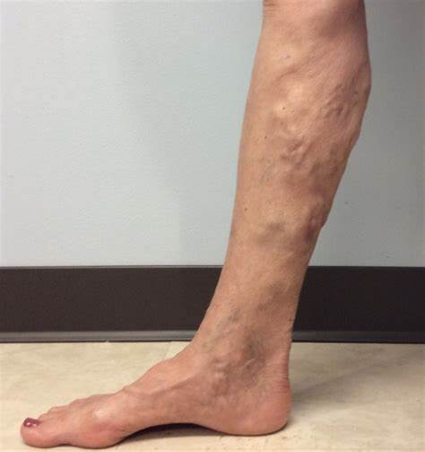
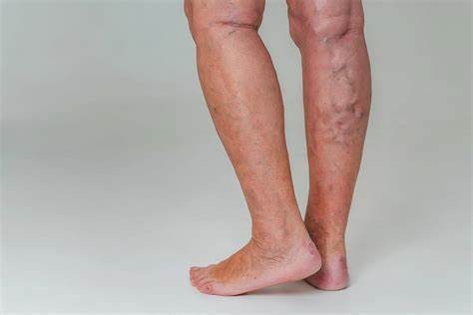
INTERPRETATION
Reflux – trace origin:
Thigh to perineum
Thigh to buttock
Abdomen
Giacomini origin
Segmental reflux
Recurrent variations
LSV - Collaterals at SFJ, pelvic branches, perforators
SSV - Perforator above-knee, Giacomini to SSV, common junction SSV and Gastrocnemius vein, branch from LSV

Slide 40

REPORTING
Ideally diagrammatic
Directed to answering clinical question
If written use bullet points, avoid extraneous detail
Note key points and highlight non-obvious points, e.g. incompetent perforators
Information to guide treatment:
Suitability for RFA/laser (diameter, depth, tortuosity)
Level of SPJ (may be marked before surgery)

Slide 41
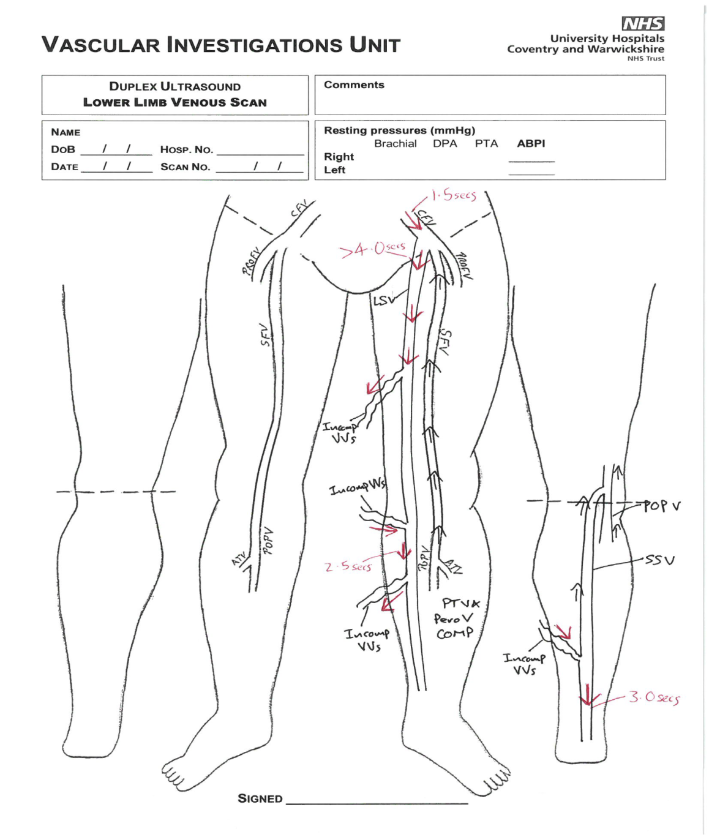
REPORTING

Slide 42
INCIDENTAL FINDINGS

Slide 43
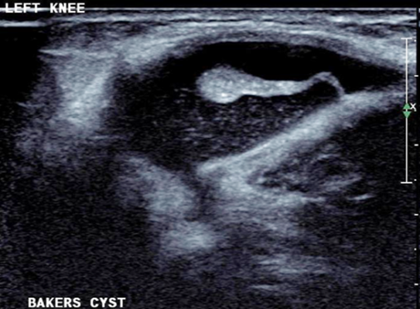
BAKERS CYST
Notes:
Bakers cyst – accumulation of synovial fluid from knee joint,
Large echolucent oval structures in POP fossa, lie some distance medial to vein and artery.

Slide 44
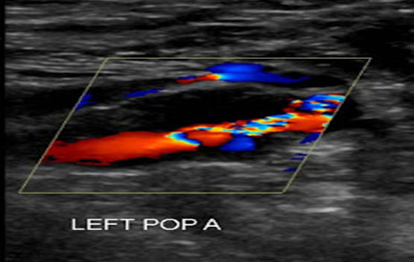
POPLITEAL ANEURYSM
Notes:
Popliteal aneurysm – large one can occasionally obstruct adjacent deep vein > DVT, should be able to define arterial walls.

Slide 45
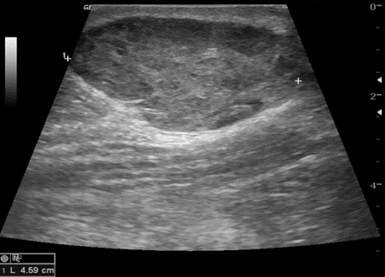
HAEMATOMA
Notes:
Haematoma – large echolucent areas with muscle, often associated with muscle fibre rupture from blunt trauma or vigorous exercise

Slide 46
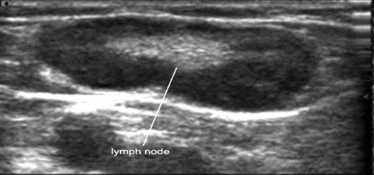
ENLARGED LYMPH NODE
Notes:
Enlarged lymph node – can occur due to infection or malignancy
Mainly echolucent, containing stronger echoes in centre of node
Can be mistaken for thrombosed vein
Most commonly seen around groin
Can become so large that they compress adjacent vein

Slide 47

ANY QUESTIONS?

